Slide 1

CSCI 1680: Computer Networks
Nick DeMarinis
https://brown-csci1680.github.io
For anonymous questions & feedback during lecture:
https://feedback.cs1680.systems/main
Based partly on lecture notes by Rodrigo Fonseca, David Mazières, Phil Levis, John Jannotti, Peterson & Davie

Slide 2


Slide 3
CSCI 1680: Computer Networks
Nick DeMarinis
https://brown-csci1680.github.io
For anonymous questions & feedback during lecture:
https://feedback.cs1680.systems/main
Based partly on lecture notes by Rodrigo Fonseca, David Mazières, Phil Levis, John Jannotti, Peterson & Davie

Slide 4
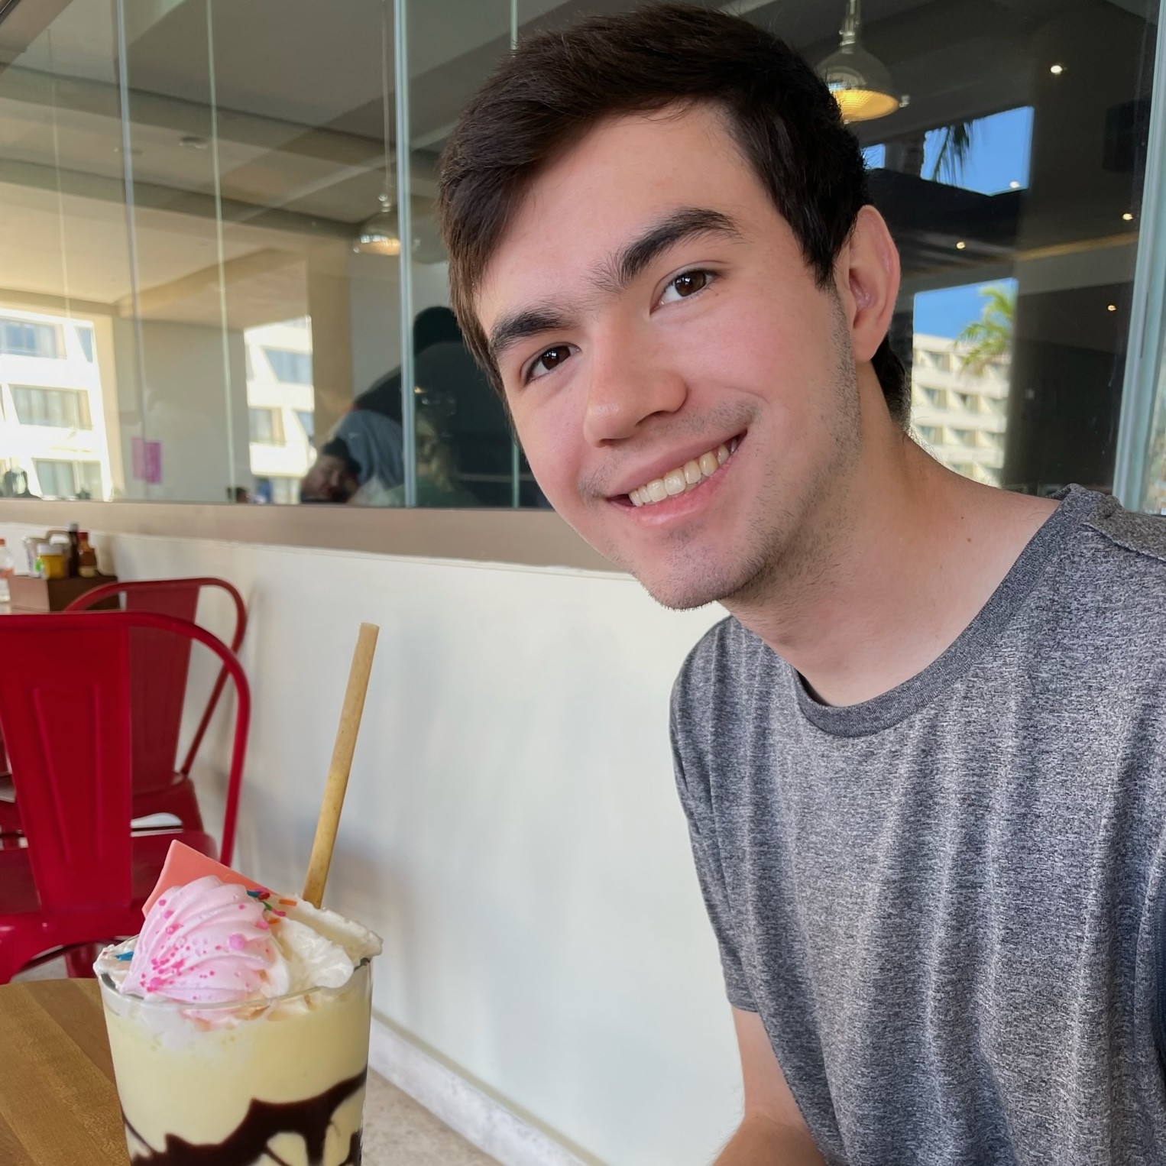
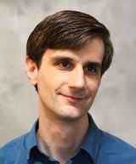

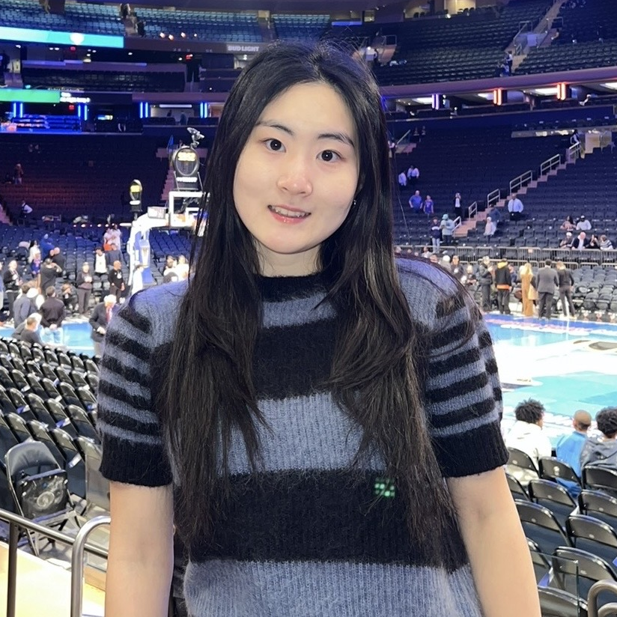
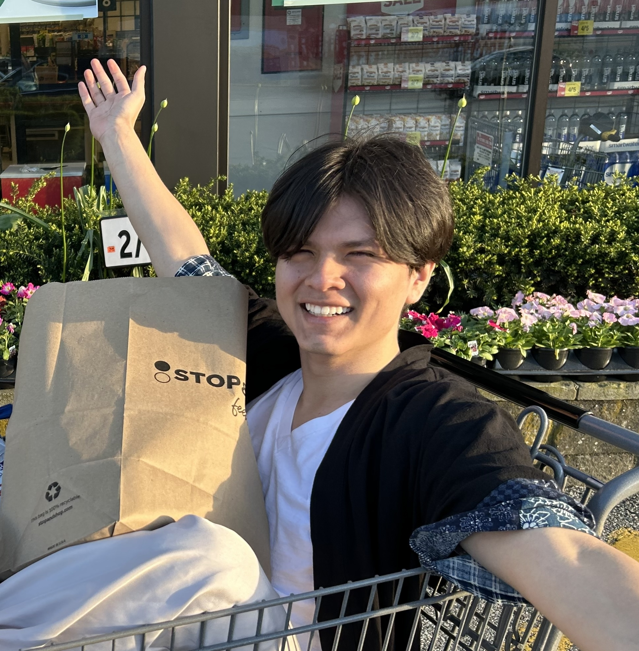

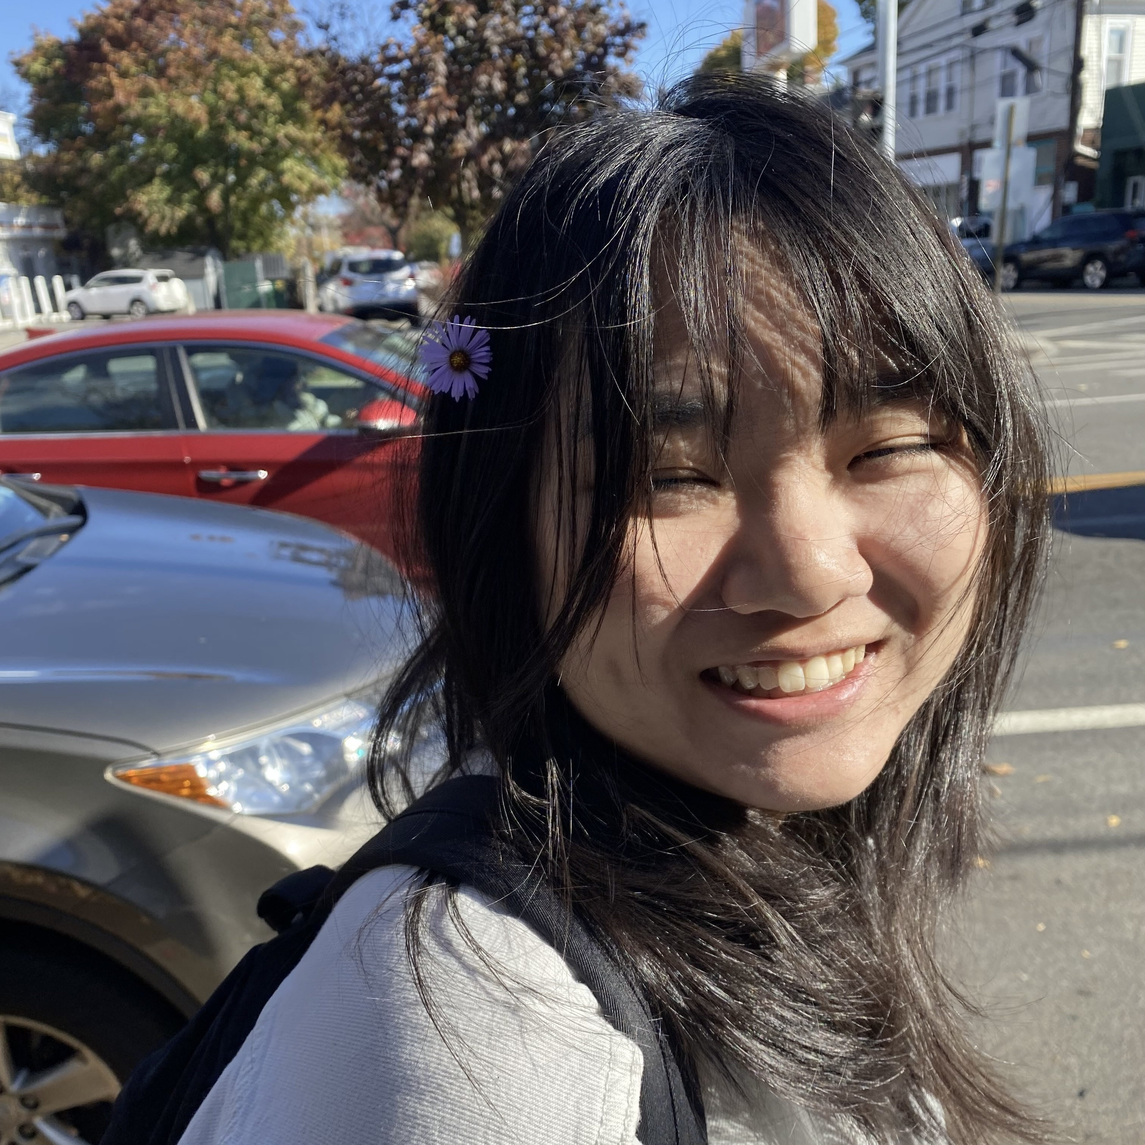

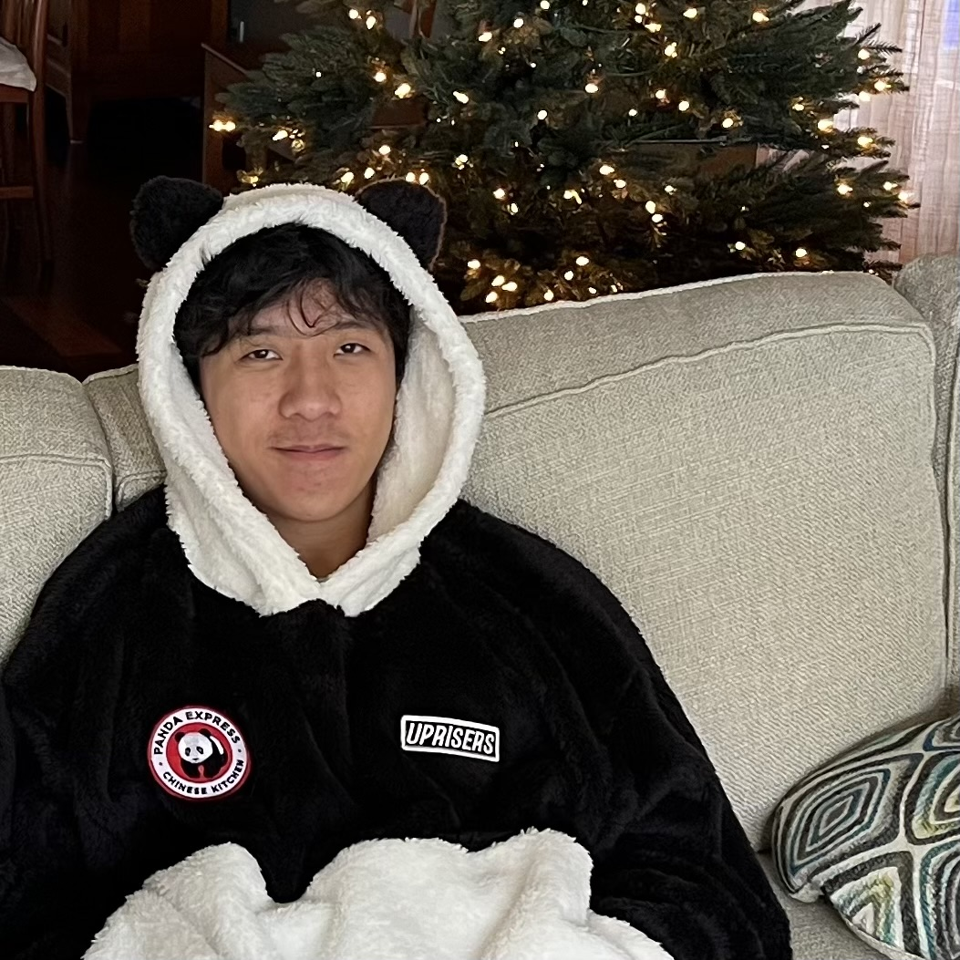
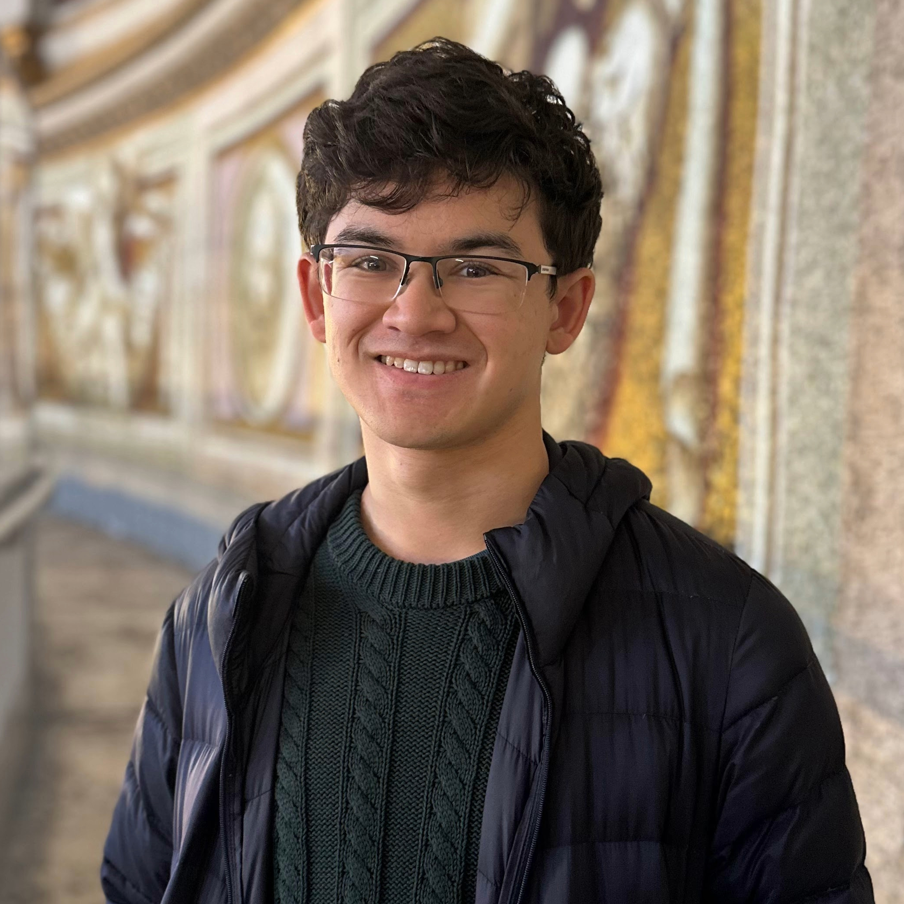

Cast
Michael
Kazuya
Julie
Nick
Roberto
Alex C.
Alex W.
Megan
Praccho
Matthias
Eddie

Slide 5






Why are we here?
You (the user)
Applications
Notes:
What’s in the cloud? How does it work?

Slide 6
Why are we here?
“The network”
“The Internet”
”The Cloud”
You (the user)
Applications
Notes:
What’s in the cloud? How does it work?

Slide 7
Why should you care?
Networks have mostly disappeared...
…by being everywhere!
Notes:
Important tradeoffs: ISP choice, how to build applications
“quality”: we’ll learn about latency, throughput, how these may differ across different users and systems and how this may affect your applications

Slide 8
Why should you care?
Networks have mostly disappeared...
…by being everywhere!
Almost all applications are cloud-based => new challenges in system and software design
How do we build robust networked applications?
How does the “quality” of network connectivity affect users?
What to do when networks fail?
Notes:
Important tradeoffs: ISP choice, how to build applications
“quality”: we’ll learn about latency, throughput, how these may differ across different users and systems and how this may affect your applications

Slide 9
Networks, in general
What is a network?
System of lines/channels that interconnect
E.g., railroad, highway, plumbing, postal, telephone, social, computer
Notes:
Specifically, what is a computer network?

Slide 10
Networks, in general
What is a network?
System of lines/channels that interconnect
E.g., railroad, highway, plumbing, postal, telephone, social, computer
A computer network…
Moves information
Nodes: general-purpose computers
Links: wires, fiber optics, EM spectrum…
Notes:
Specifically, what is a computer network?

Slide 11
Why are computer networks cooler?
Most nodes are general-purpose computers
Very easy to innovate and develop new uses of the network: you can program the nodes
Notes:
Why are computer networks cooler?
Can’t program most landline phones
Intelligence in the network (why?)
Just like a phone or a laptop, the network is programmable. You can’t say that for an endpoint like a phone

Slide 12
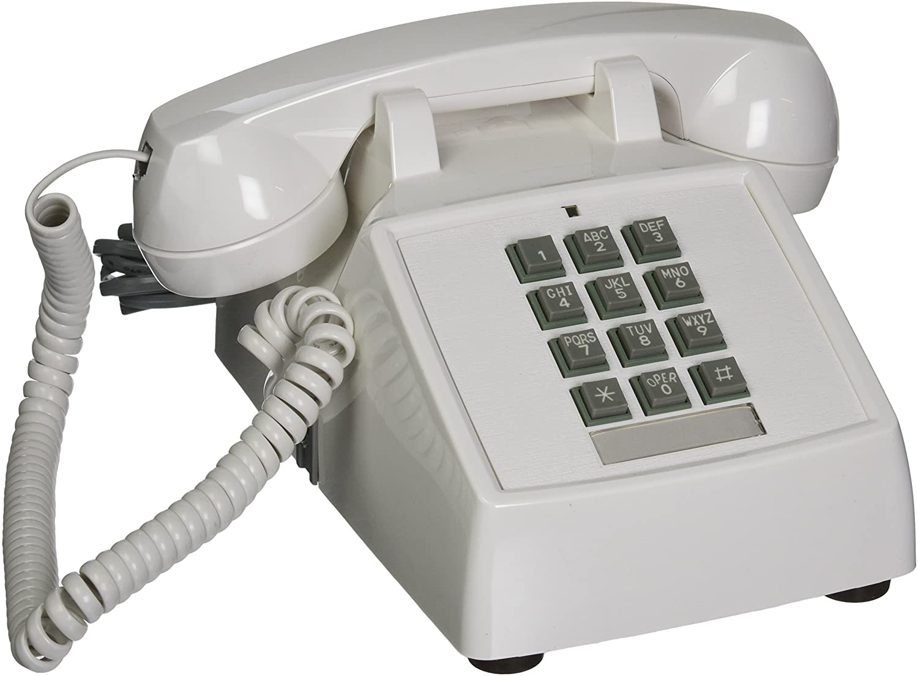
Why are computer networks cooler?
Most nodes are general-purpose computers
Very easy to innovate and develop new uses of the network: you can program the nodes
A landline phone
Notes:
Why are computer networks cooler?
Can’t program most landline phones
Intelligence in the network (why?)
Just like a phone or a laptop, the network is programmable. You can’t say that for an endpoint like a phone

Slide 13
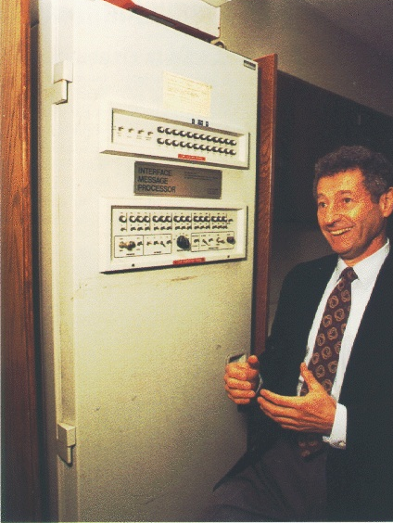
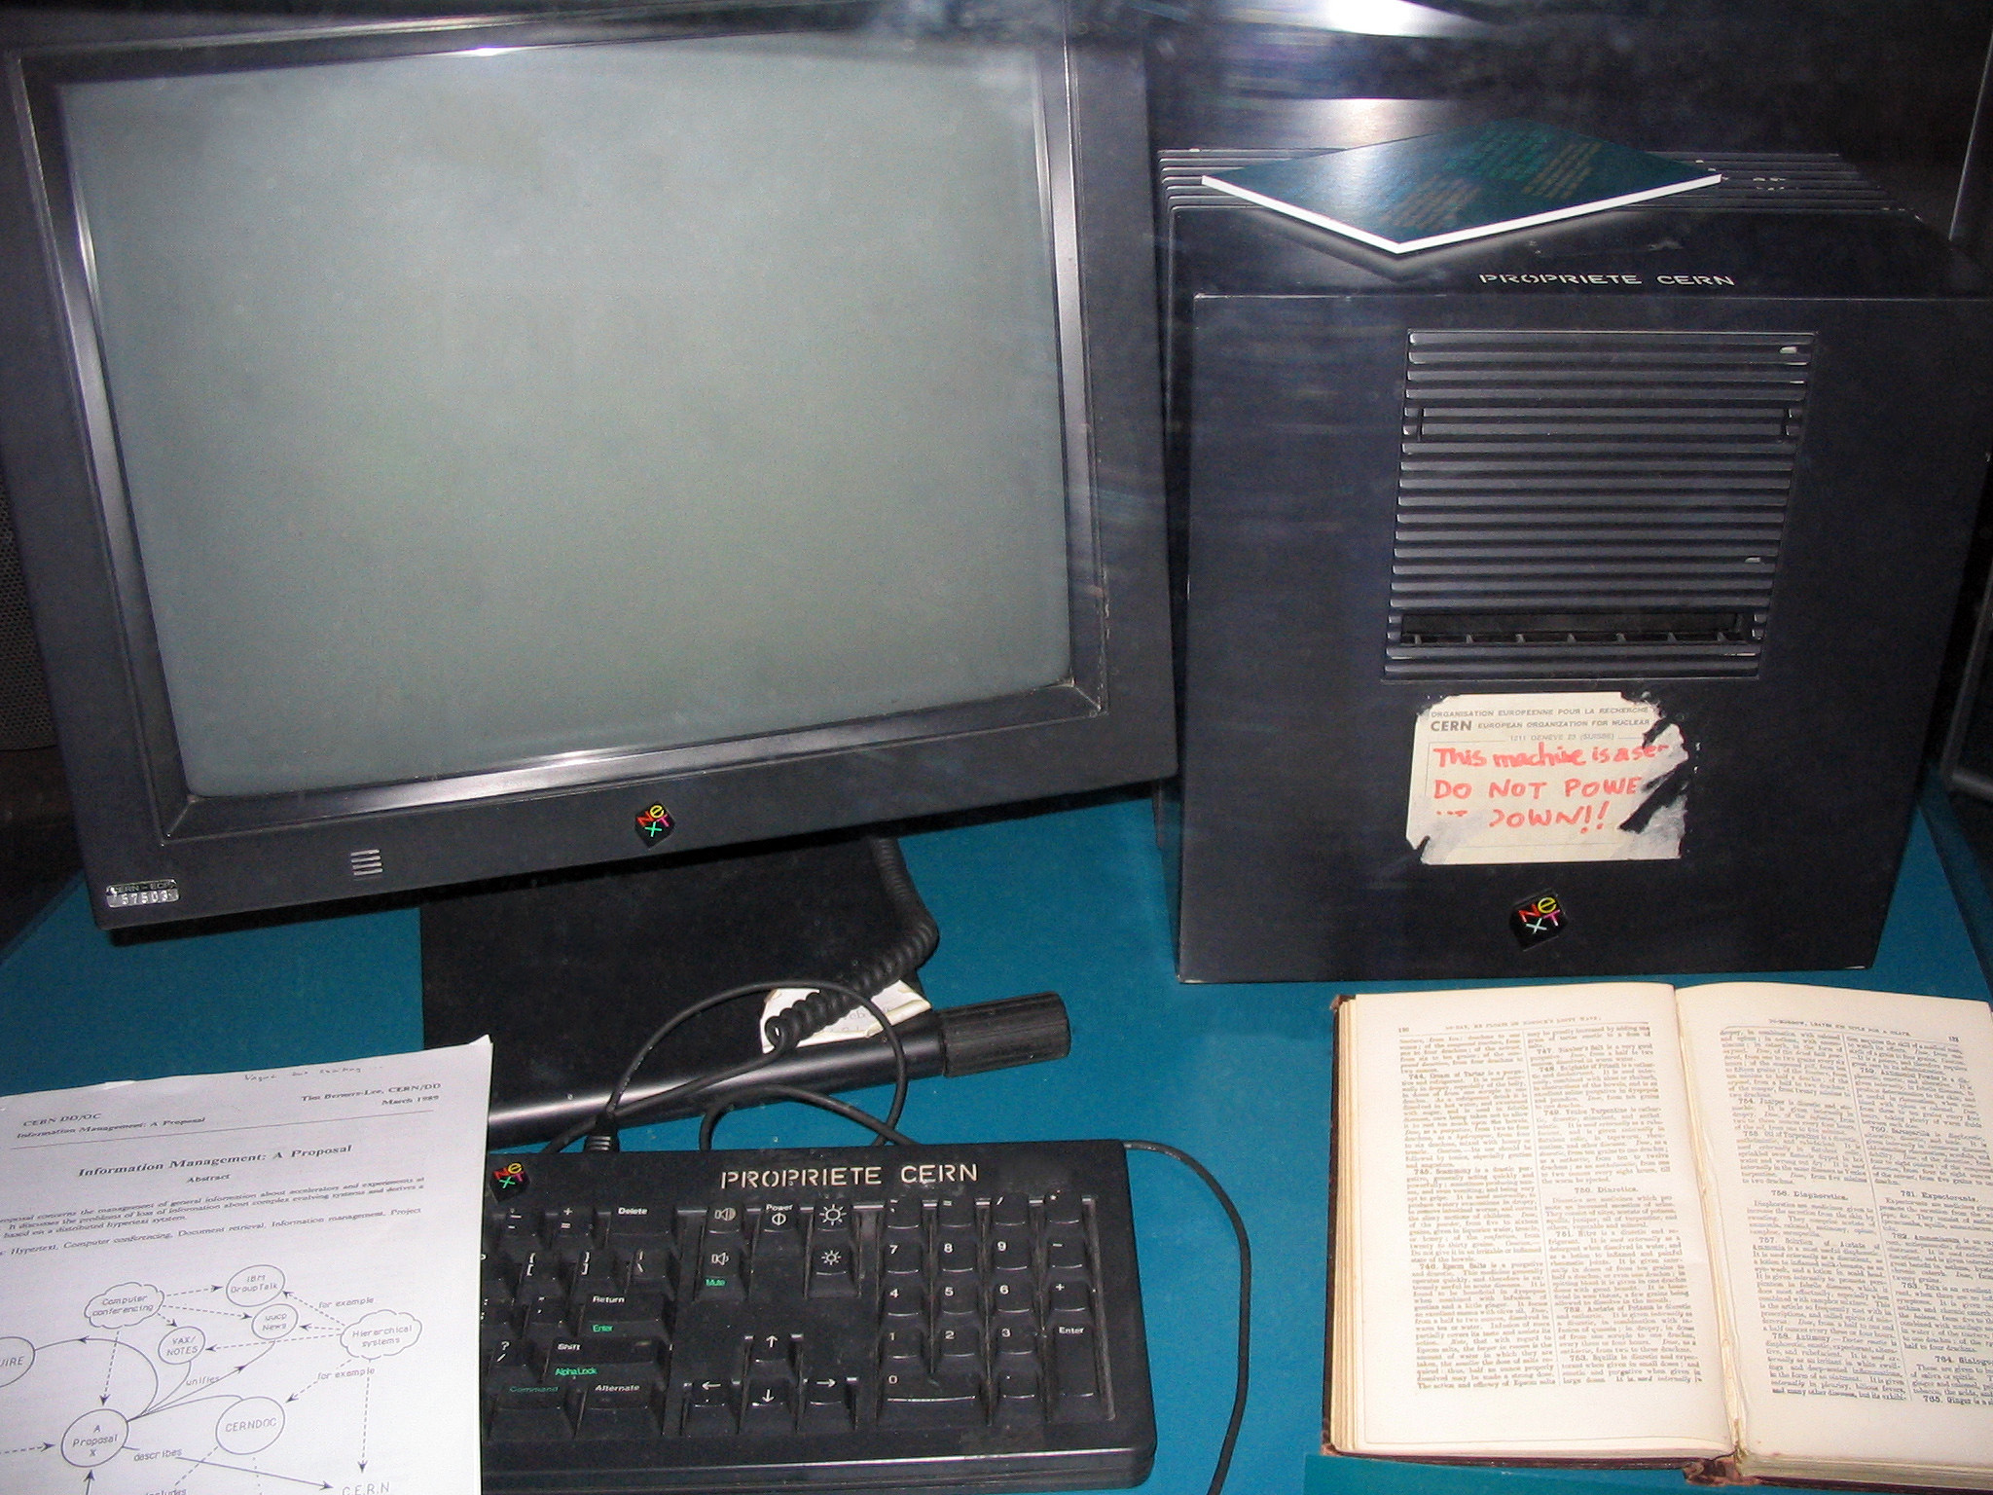
Why are computer networks cooler?
Most nodes are general-purpose computers
Very easy to innovate and develop new uses of the network: you can program the nodes
A landline phone
First “Internet” router
(~1969)
The first webserver (1993)
Notes:
Why are computer networks cooler?
Can’t program most landline phones
Intelligence in the network (why?)
Just like a phone or a laptop, the network is programmable. You can’t say that for an endpoint like a phone

Slide 14
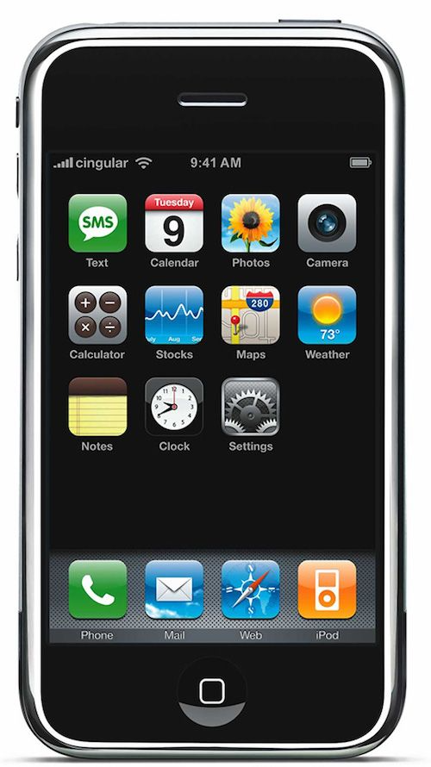
Why are computer networks cooler?
Most nodes are general-purpose computers
Very easy to innovate and develop new uses of the network: you can program the nodes
A landline phone
First “Internet” router
(~1969)
The first webserver (1993)
iPhone 1 (2007)
Notes:
Why are computer networks cooler?
Can’t program most landline phones
Intelligence in the network (why?)
Just like a phone or a laptop, the network is programmable. You can’t say that for an endpoint like a phone

Slide 15

Networking => Innovation
WhatsApp: 1B monthly active users in 7 years, now over 3B
1B users => 57 engineers
Uber, etc.: global dispatch service, enabled by smartphones
Online communities, memes, video platforms, …
Notes:
How long did it take for Whatsapp to reach 1B monthly active users?
It started with SMS, then audio
How long did it take for cellphones to add end-to-end encryption?
The iphone is about 15 years old now. Could you imagine that connectivity would disrupt the transportation industry?

Slide 16
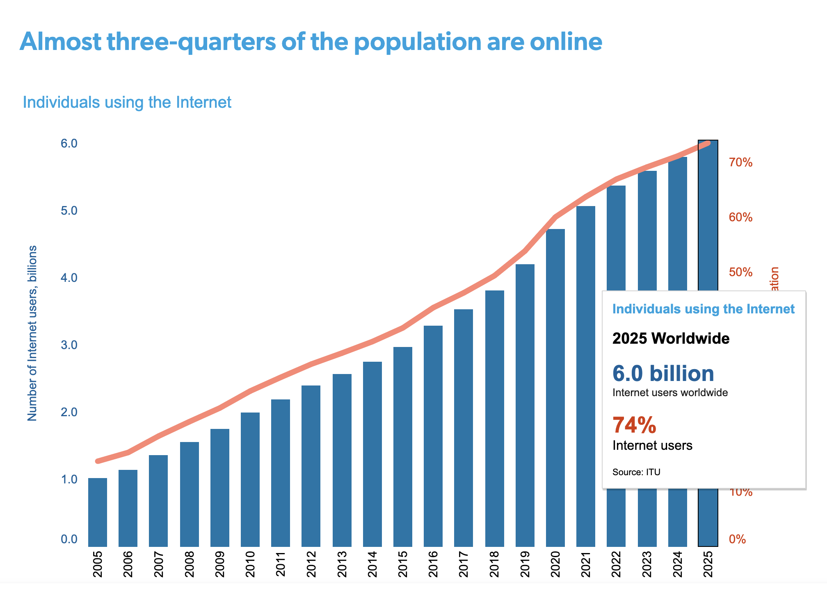
Challenge: Scale
Source: ITU Facts and Figures 2025

Slide 17
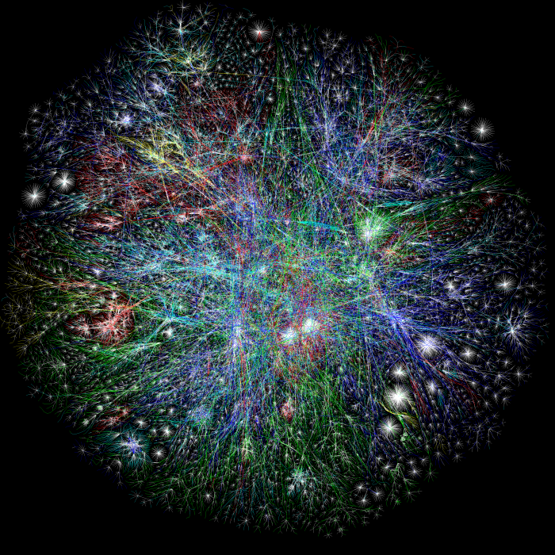
Challenge: Scale
Map of the Internet, circa 2003
(via Traceroute)
OPTE project

Slide 18
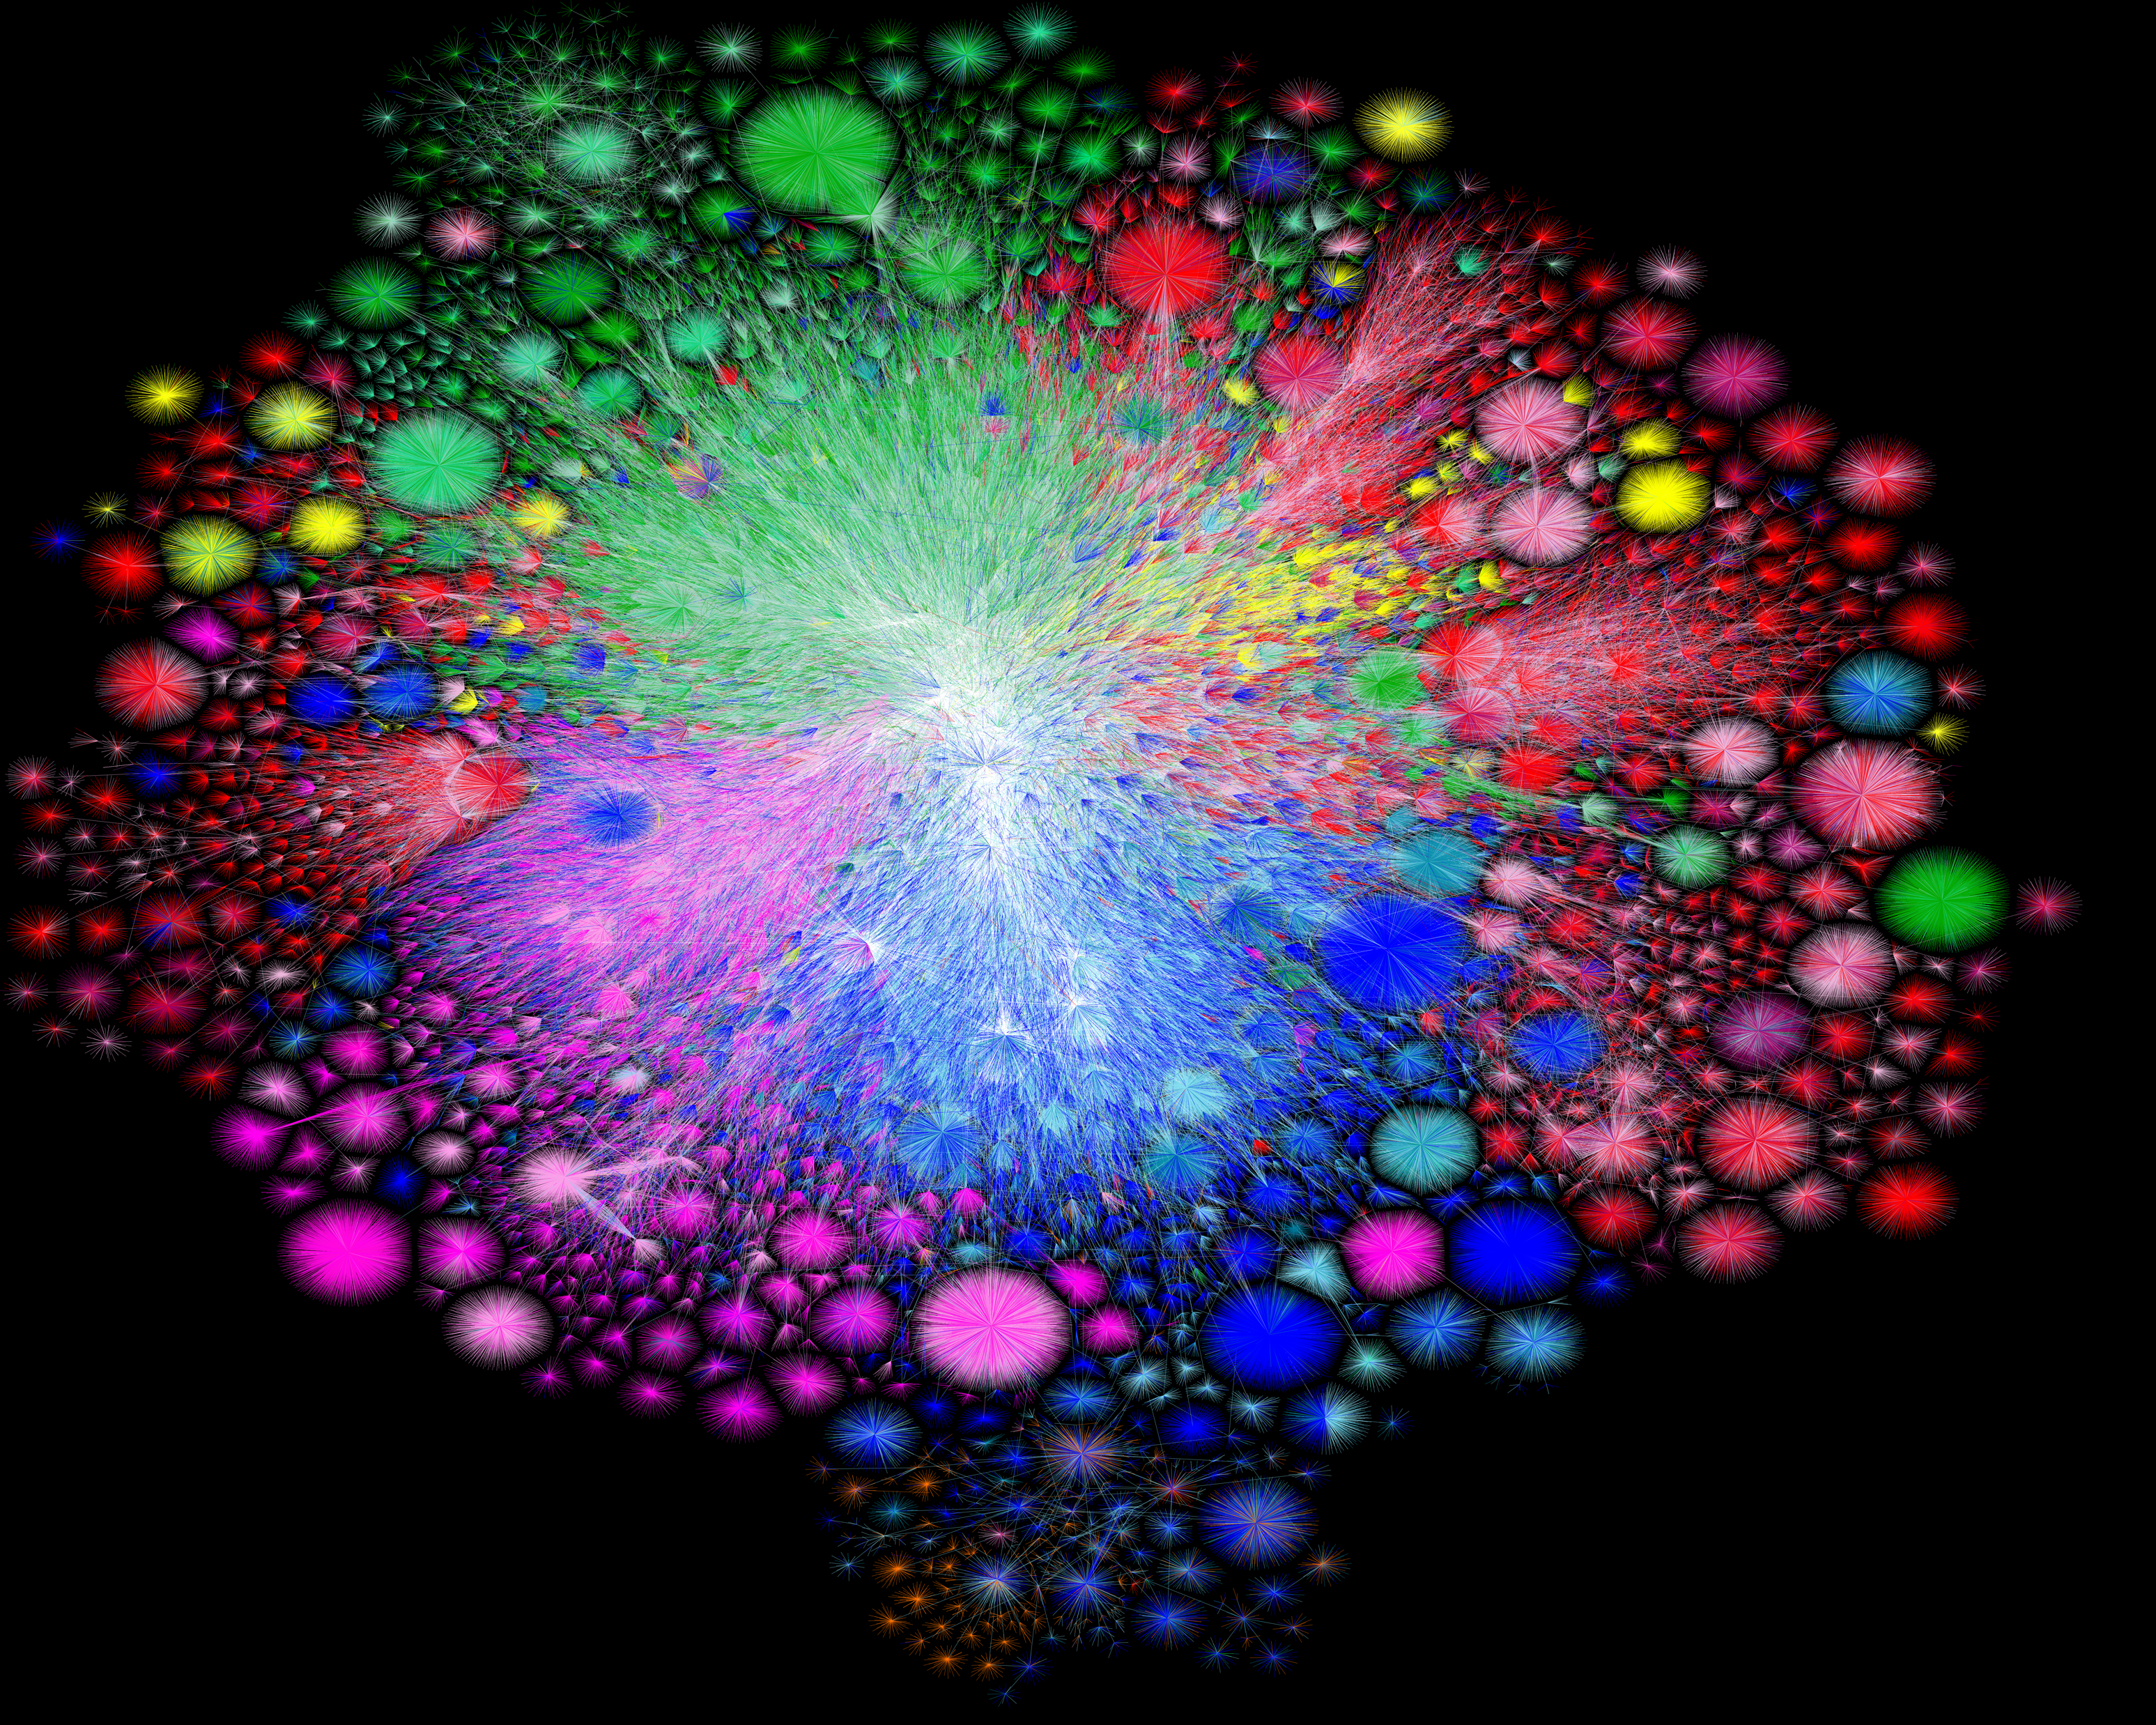
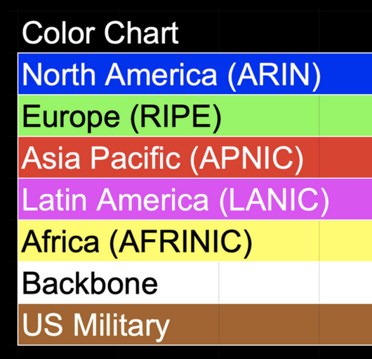
Challenge: Scale
Map of the Internet, 2021 (via BGP)
OPTE project
Notes:
Think about this: how do you, or how do you imagine other people as different ways you connect to the Internet?

Slide 19
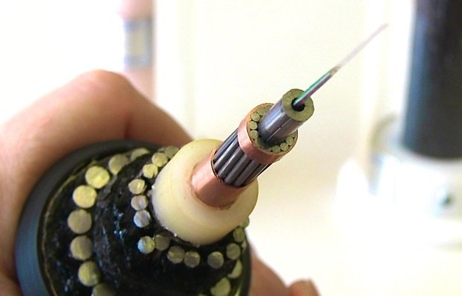
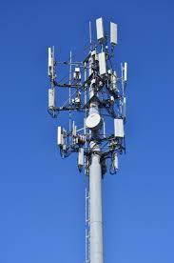
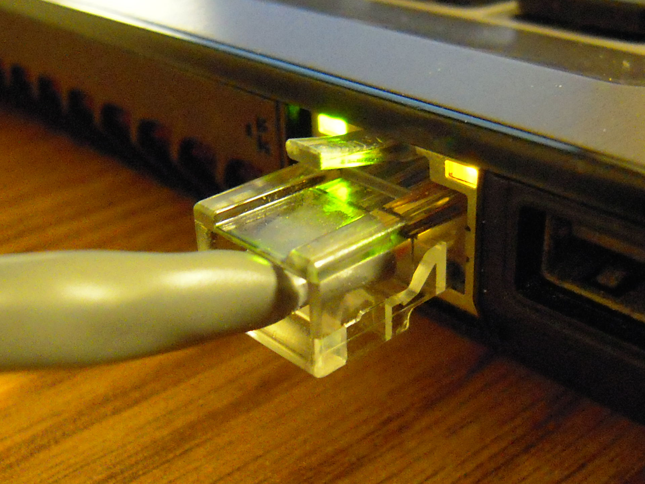
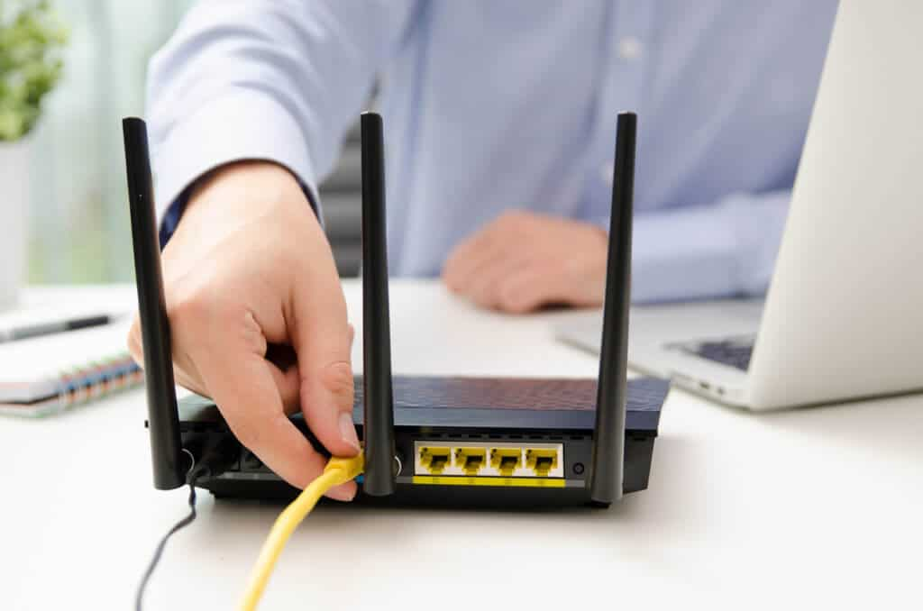
Challenge: Heterogeneity

Slide 20
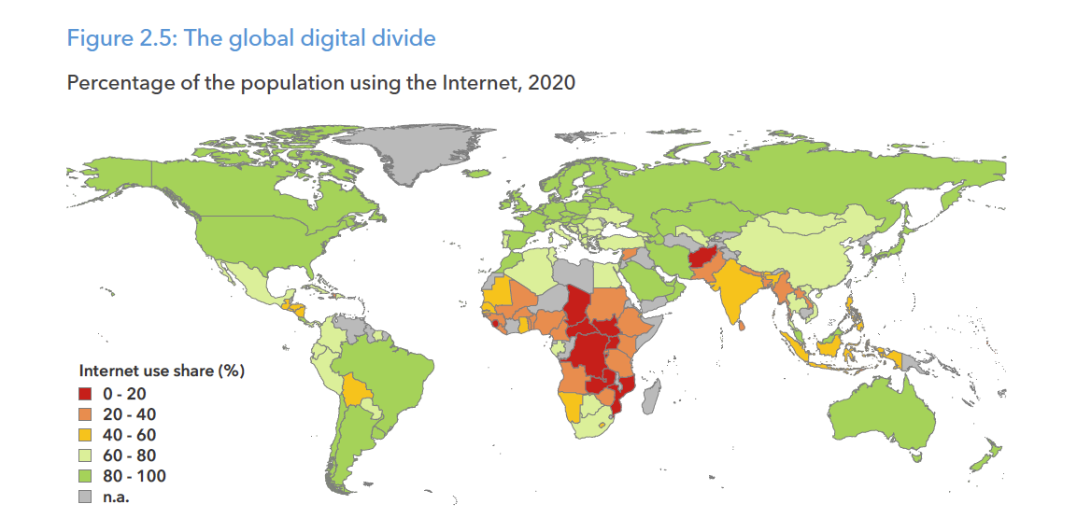
Challenges: Access
Notes:
If your goal is building a global application, how do you deal with this?

Slide 21
Challenge: Security
Mirai Botnet (2016)
Vulnerable DVRs, Home Routers, Cameras disrupted Dyn
DNS provider for Twitter, Netflix, Reddit, others
Largest denial-of-service (DDoS) attack at the time, over 1TBit/s
Notes:
How did we get here?
Moreover, we have seen a massive scale

Slide 22
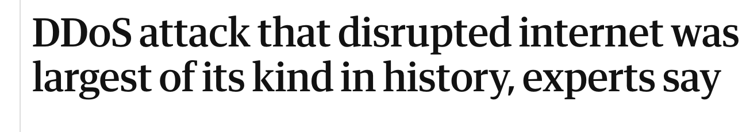


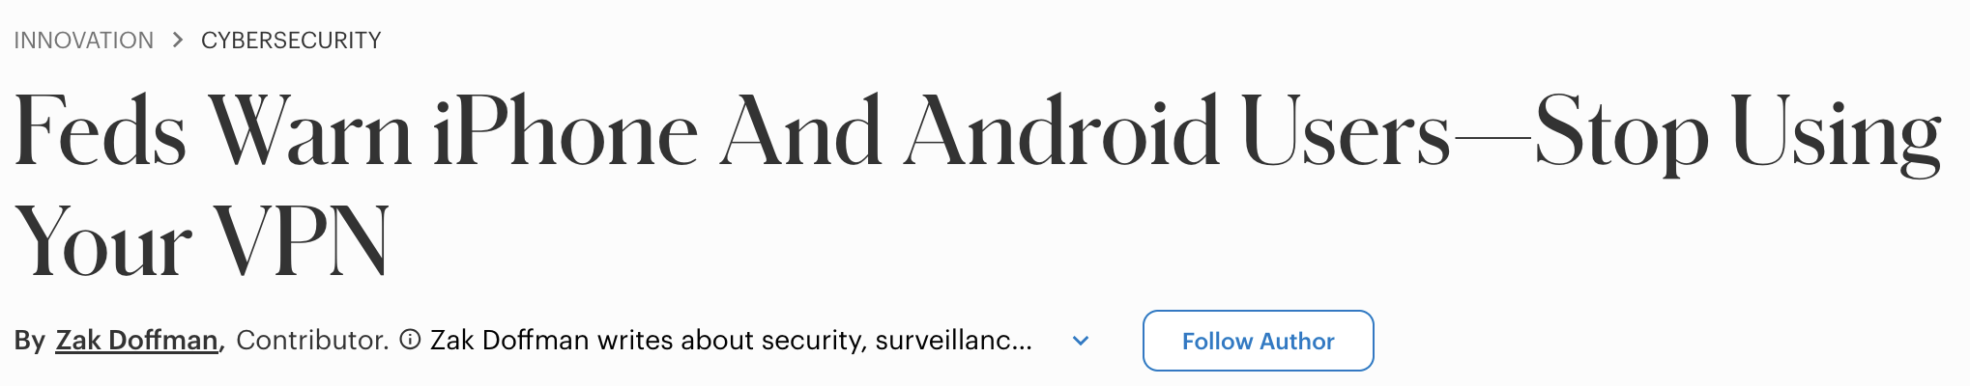

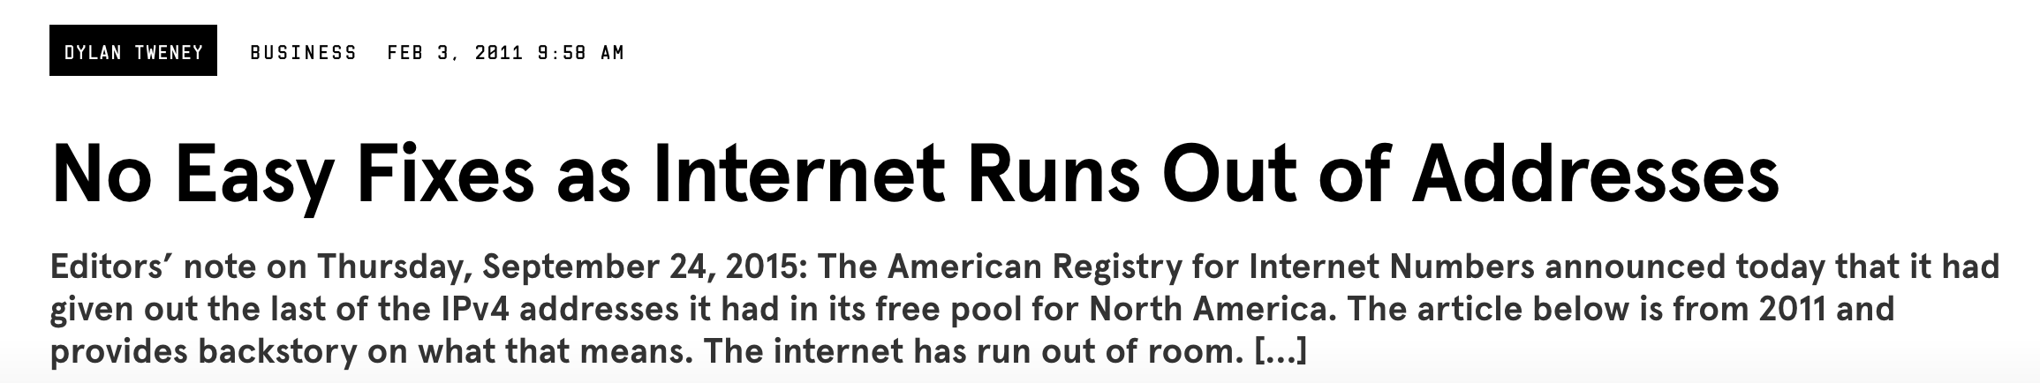


Challenges: Politics and Oversight
Notes:
No single administrative entity (mostly)

Slide 23
Why should you take this course?
Networks have a huge impact on computing on society
Continuously changing and evolving
Incredible complexity
Facts you learn will be out of date quickly
Instead: learn how to navigate the underlying principles and abstractions
Notes:
Also, because networks are so successful that they are disappearing from your sight!

Slide 24
Why should you take this course?
Networks have a huge impact on computing on society
Continuously changing and evolving
Incredible complexity
Facts you learn will be out of date quickly
Instead: learn how to navigate the underlying principles and abstractions
Networks are cool…
and you will learn to program them!
Notes:
Also, because networks are so successful that they are disappearing from your sight!

Slide 25
How will we do this?
Build networks from the ground up
How to link 2 things, then ~10 things
Then, how to link all the things (the Internet)
Transport: how to send messages between programs
Applications: how key protocols/apps make our modern Internet
Notes:
Help you learn how to deal with other stuff you might encounter

Slide 26
How will we do this?
Build networks from the ground up
How to link 2 things, then ~10 things
Then, how to link all the things (the Internet)
Transport: how to send messages between programs
Applications: how key protocols/apps make our modern Internet
A few cross-cutting issues:
=> Security, access, social impact, key abstractions…
Notes:
Help you learn how to deal with other stuff you might encounter

Slide 27
Logistics

Slide 28
How will we do this?
4 Programming Projects (65%)
~5 Written homeworks (35%)
No exams!
Notes:
Will confirm format soon!

Slide 29
Mechanics: Resources
Lecture slides/notes: authoritative content
Tools
Course website (notes, handouts, guides): https://brown-csci1680.github.io
Discussions: EdStem
You are responsible for checking Ed for announcements/updates

Slide 30
Mechanics: Resources
Lecture slides/notes: authoritative content
Tools
Course website (notes, handouts, guides): https://brown-csci1680.github.io
Discussions: EdStem
You are responsible for checking Ed for announcements/updates
Complete HW0 (on website) ASAP so we can add you to resources!

Slide 31
Prerequisites
Prereqs: CS330/CS1330, CS300/CS1310 (or equivalent)
You should have worked with systems programming and basic OS concepts before
Threads, processes, Kernel vs. Userspace
Bits and bytes, memory management, synchronization, …
Notes:
I have office hours today

Slide 32
Prerequisites
Prereqs: CS330/CS1330, CS300/CS1310 (or equivalent)
You should have worked with systems programming and basic OS concepts before
Threads, processes, Kernel vs. Userspace
Bits and bytes, memory management, synchronization, …
Graduate students: our systems courses are intensive, make sure your background is equivalent
If you aren’t sure if the course is right for you, please talk to us!
Notes:
I have office hours today

Slide 33
Lectures
T/Th 9-10:20am, Salomon DECI
Recorded and streamed live on zoom
Lots of live demos/coding, time for discussion, etc.

Slide 34
Lectures
T/Th 9-10:20am, Salomon DECI
Recorded and streamed live on zoom
Lots of live demos/coding, time for discussion, etc.
I will do my best to make 9am worth it!

Slide 35
Mechanics: Homeworks
Short problems based on lecture material
Some "on paper", some code, etc.
Experiment with some fundamental networking tools, tutorial-style

Slide 36
Mechanics: Homeworks
Short problems based on lecture material
Some "on paper", some code, etc.
Experiment with some fundamental networking tools, tutorial-style
How these work
Shouldn’t take a huge amount of time
4 or 5 homeworks total (TBA based on enrollment)
Hopefully fun!

Slide 37
Mechanics: Projects
Build fundamental Internet protocols and client/server apps from the ground up
4 Programming projects
Snowcast: streaming music server
IP: build your own networking library
TCP: extending your IP
Final (shorter, choose-your-own)
First project is individual, others in groups of 2
Notes:
Design is important
Software engineering and networking are tied together

Slide 38
Mechanics: Projects
Build fundamental Internet protocols and client/server apps from the ground up
4 Programming projects
Snowcast: streaming music server
IP: build your own networking library
TCP: extending your IP
Final (shorter, choose-your-own)
First project is individual, others in groups of 2
You get: lots of freedom to design your own system
Notes:
Design is important
Software engineering and networking are tied together

Slide 39
Languages
You can use any systems language
Go (recommended)
C
C++
Rust
You’ll be making a lot of threads, manipulating bits/bytes, …

Slide 40
Languages
You can use any systems language
Go (recommended)
C
C++
Rust
You’ll be making a lot of threads, manipulating bits/bytes, …
We recommend Go, even if it’s new to you.
We’ll do a bunch of live coding in Go in lectures 2-3

Slide 41
How projects work
This is where you will spend most of your time.
Learn how to design big systems… that happen to use the network
No stencil code! You get to design everything
We will provide lots of examples and meetings to help
Notes:
This is a secret software engineering class.

Slide 42

What this means
nick: no stencil code
everyone:
Notes:
It’s a different model of thinking, but we have a lot of resources to help you

Slide 43
The projects are a lot of work.
If you meet the prereqs, you have the skills.
But you need to be prepared for the time commitment.
Notes:
This is a secret software engineering class.

Slide 44
The projects are a lot of work.
If you meet the prereqs, you have the skills.
But you need to be prepared for the time commitment.
How to succeed? Start early, take advantage of the tools and resources we provide (there’s a lot!)
Notes:
This is a secret software engineering class.

Slide 45
How to compare this class to others

Slide 46
CS1680 + GenAI
Goal: you will write code to learn concepts, both in networking and system design
While we want you to learn how to use AI, you must use it in a way that supports your learning process, rather than replacing it

Slide 47
CS1680 + GenAI
Goal: you will write code to learn concepts, both in networking and system design
While we want you to learn how to use AI, you must use it in a way that supports your learning process, rather than replacing it
Each project will have its own AI policy. Some ground rules:
No autonomous agents
Don't use AI on written work (not worth it, pls don't waste our time)
You will be asked to tell us how you used AI
Ultimately, you are responsible for the work you submit

Slide 48
CS1680 + GenAI
Overall, you are responsible for everything you submit:
Larger projects are graded by code review
=> You'll need to explain and demonstrate your work for credit
You will need to maintain and debug your code, over 8+ weeks
=> It's in your interest to make sure you understand your work!

Slide 49
CS1680 + GenAI
Overall, you are responsible for everything you submit:
Larger projects are graded by code review
=> You'll need to explain and demonstrate your work for credit
You will need to maintain and debug your code, over 8+ weeks

Slide 50
How we support you on projects
Lots of posted code examples
Live demos during class
“Warmup” tutorials to get started with mechanics
Most of our time is spent here too

Slide 51
How we support you on projects
Lots of posted code examples
Live demos during class
“Warmup” tutorials to get started with mechanics
Gearups at least once per project
When scheduled: Thursdays 5-7pm in CIT165 (+ recorded)
Most of our time is spent here too

Slide 52
How we support you on projects
Lots of posted code examples
Live demos during class
“Warmup” tutorials to get started with mechanics
Gearups at least once per project
When scheduled: Thursdays 5-7pm in CIT165 (+recorded)
Milestone meetings with TA to check in about design
Grading by code review => discussion, partial credit
Most of our time is spent here too

Slide 53
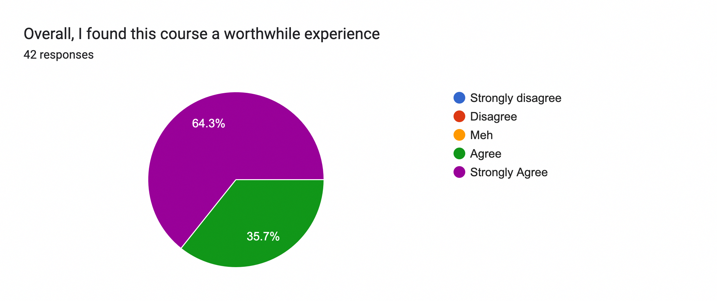
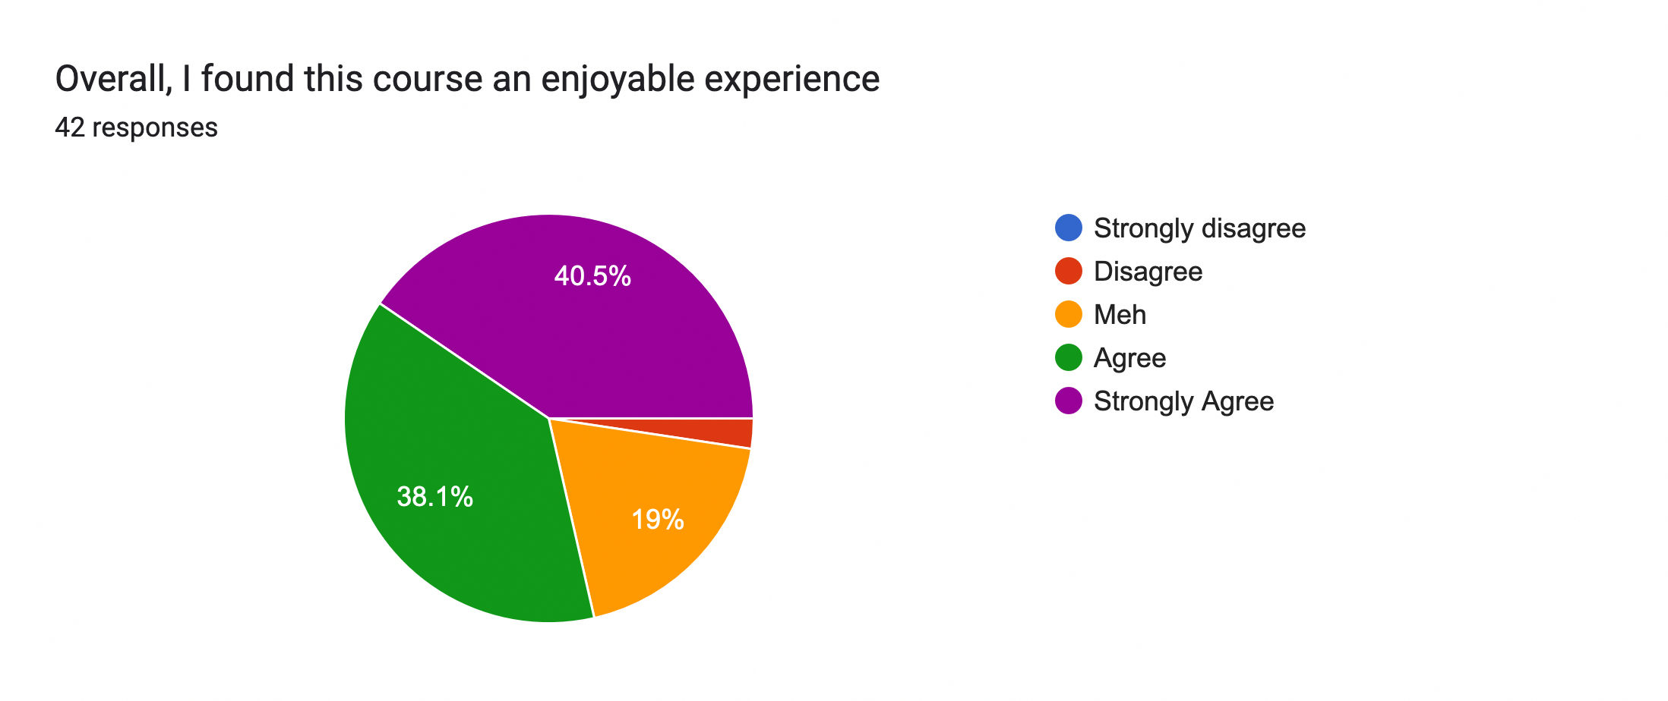
“If you spend an hour or two hours on IP and TCP every day it is *very* manageable”
“I am really glad that I took this course”
“it’s an amazing course and we had a wonderful staff to help us out”
“Just take it, worth it”
“Pace yourself, and don’t wait until the last minute”

Slide 54
Why should you listen to me?
My background
Received my PhD from Brown in 2021
My areas: software security, networking, network security
My third year as Lecturer, was a long-time TA before that
No one knows everything about networks, and I am no exception!
Notes:
I will mess up
I have experience with this course, but I’m still inheriting it

Slide 55
Brief history of this class
Fall 2019: ~35 students

Slide 56
Brief history of this class
Fall 2019: ~35 students
Spring 2022
Nick joins as instructor (capped at 40)
(+ demos, examples, tutorials, dev environment)
Fall 2022
Notes:
STILL LISTENING

Slide 57
Brief history of this class
Fall 2019: ~35 students
Spring 2022
Nick joins as instructor (capped at 40)
(+ demos, examples, tutorials, dev environment)
Fall 2022
Fall 2023
Scaling up (127 students!)
(+ Gearups)
Stability fixes, refinements
(+ New lecture content, HW tutorials)
Fall 2024
Notes:
STILL LISTENING

Slide 58
Brief history of this class
Fall 2019: ~35 students
Spring 2022
Nick joins as instructor (capped at 40)
(+ demos, examples, tutorials, dev environment)
Fall 2022
Fall 2023
Scaling up (127 students!)
(+ Gearups)
Stability fixes, refinements
(+ New lecture content, HW tutorials)
Fall 2024
You are here
(+ More lab-style HW, SRC, demos, and back to spring!)
Spring 2026
Notes:
STILL LISTENING

Slide 59
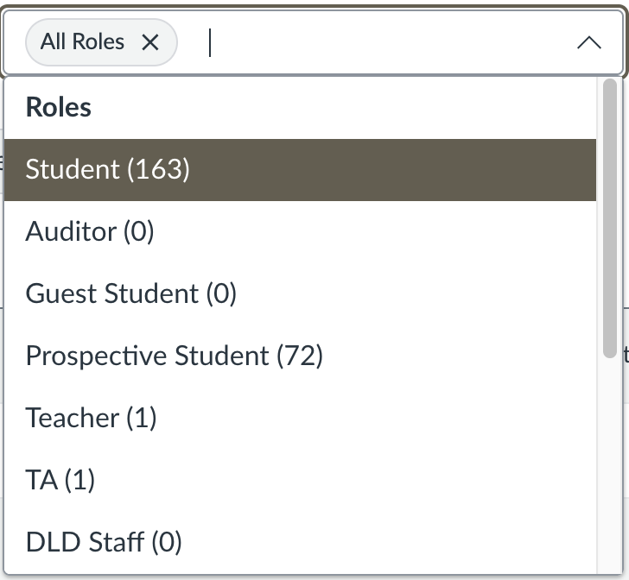
Our course is now more stable, but we’re still evolving and learning how to scale.
We may adjust course content/policies over time, paying equal attention to:
Making sure we provide support for everyone
Managing TA workloads
We value your feedback! (Ed, email, anonymous form, …)

Slide 60
Asking for help
Online help: EdStem
Office hours: collaborative (group, in-person)
Can help with…
Debugging
Project planning/design
Concepts
We’re here for you—don’t be afraid to ask!
I don’t bite—Instructor’s office hours are just like regular hours!

Slide 61
Asking for help
Collaboration: work with your peers!
Collaboration policy on course website
I encourage you to collaborate, so long as the code you write down is your own
Your health is most important
If you have concerns, feel free to talk to us

Slide 62
We’re listening!
Our course is now more stable, but we’re still evolving and learning how to scale.
We may adjust course content/policies/the schedule over time, paying equal attention to:
Making sure we provide support for everyone
Managing TA workloads
We value your feedback! (Ed, email, anonymous form, …)

Slide 63
Registration and Overrides

Slide 64
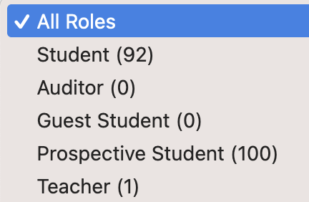
Registration/Overrides
Our enrollment is still fluctuating as overrides in other courses are being granted
We can support ~160 students. A lot of you will get seats.
On Monday (9/9), we’ll send an email on whether we can offer you a seat, based on latest data (+ more updates as seats open up)
We value your feedback! (Ed, email, anonymous form, …)

Slide 65
Registration/Overrides
Our enrollment is still fluctuating as overrides in other courses are being granted
We can support ~160 students. A lot of you will get seats.
On Monday (9/9), we’ll send an email on whether we can offer you a seat, based on latest data (+ more updates as seats open up)
To receive an override, you must complete our assignments during shopping period: HW0, Project 0 (Setup), and the milestone for Project 1 (Snowcast)
We value your feedback! (Ed, email, anonymous form, …)

Slide 66
What you should do now
Decide if you want to take this course
If you don’t, no hard feelings!
Please come chat with me if you’re unsure
If you have not done so already: fill out our registration request form
Start on assignments; look for email on Monday (to prioritize if you want to do the work)

Slide 67
What you should do now
Decide if you want to take this course
If you don’t, no hard feelings!
Please come chat with me if you’re unsure
If you have not done so already: fill out our registration request form
Start on assignments; look for email on Monday (to prioritize if you want to do the work)
More generally: watch this doc for updates on the process as a whole
I know this is frustrating. Thanks for your patience and understanding!

Slide 68
Cast
Michael
Kazuya
Julie
Nick
Roberto
Alex C.
Alex W.
Megan
Praccho
Matthias
Eddie

Slide 69
Stretch
(and I won’t look if you are shopping and want to flee)

Slide 70
Building Blocks
Nodes: Computers (hosts), dedicated routers, …
Links: Coax, twisted pair, fiber, radio, …

Slide 71
How to connect more nodes?
Notes:
Does this scale? Why doesn’t each of these models scale?

Slide 72
How to connect more nodes?
Multiple wires
Shared medium
Need a mechanism to share network resources
Notes:
Does this scale? Why doesn’t each of these models scale?

Slide 73
Multiplexing
Mechanisms for simultaneous communication on the same channel
(or at least nearly simultaneous)
Lots of different methods, depending on the medium and abstraction

Slide 74
How do you connect apps?
Your computer runs multiple applications
How to make them share the same resources?

Slide 75
Map of the Internet, 2021 (via BGP)
OPTE project
Notes:
To put something real to this, here’s a map of what that graph looks like. We call the Internet a network of networks: and each point is a network—a group of systems—that can talk to the others. And the network grants us the ability to pretty much communicate between any two points on this graph. And the goal of the network, how it’s designed, and the protocols that comprise it, is to figure out how to get a message there—regardless of where they are, whether they’re connected by a copper wire, or a wireless link, and regardless of what’s being sent.

Slide 76
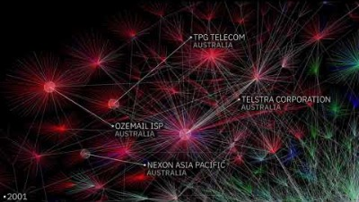
OPTE Internet map, 1997-2021: https://youtu.be/DdaElt6oP6w

Slide 77
How do we make sense of all this?
Very large number of computers
Incredible variety of technologies
Each with very different constraints
Lots of multiplexing
No single administrative entity
Evolving demands, protocols, applications
Each with very different requirements!
Notes:
How do we manage complexity in large software systems? Abstraction, Modularity

Slide 78
Layering
Separation of concerns
Break problem into separate parts
Solve each one independently
Abstract data from the layer above inside data from the layer below
“Encapsulation”
Different implementations at one “layer” use same interface
Allows independent evolution
Notes:
Abstractions
Example: deliver a letter
Interfaces

Slide 79
From Links to Networks
To scale to more nodes, use switching
Nodes can connect to multiple other nodes
Recursively, one node can connect to multiple networks
Notes:
Notice how we have some central elements connecting the hosts: switches
We want to create the illusion that the nodes are all connected to each other

Slide 80
Multiplexing
What to do when multiple flows must share a link?

Slide 81
Multiplexing strategies
Physical/Link layer (Copper wires, wireless): Signalling strategies
Network layer: IP addresses to identify one host
Transport layer: One host has many ports, used for different applications
Application layer: One program can have multiple “sockets”, which are an interface to one network “connection”

Slide 82
For next class
HW0: Survey (please fill out ASAP)
Project 0: dev environment setup (due next Thursday)
Project 1: out on Tuesday
Gearup: Thursday, Sept 14, 5-7pm in CIT368 (+ Zoom, recorded)

Slide 83
Why are we here?
Goal: learn concepts underlying networks, and their massive impact on computing and society
How do networks work? What can one do with them?
Gain a basic understanding of the Internet
Notes:
Massive technical and social impact

Slide 84
Why are we here?
Goal: learn concepts underlying networks, and their massive impact on computing and society
How do networks work? What can one do with them?
Gain a basic understanding of the Internet
Gain experience writing protocols
Tools to understand new protocols and applications
Notes:
Massive technical and social impact

Slide 85
Why are we here?
Goal: learn concepts underlying networks, and their massive impact on computing and society
How do networks work? What can one do with them?
Gain a basic understanding of the Internet
Gain experience writing protocols
Tools to understand new protocols and applications
Tackle technical and social challenges with building a global network
“From two communicating machines to the entire Internet”
Notes:
Massive technical and social impact

Slide 86
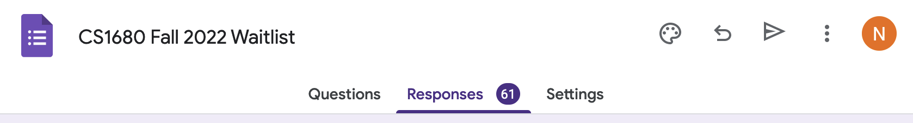
Some more honesty
Huge demand for the course this year!
We are working hard to scale the class—we appreciate your patience and understanding!
Notes:
Coming back from hiatus, building up new things

Slide 87
The Waitlist
If you are not enrolled, sign up for the waitlist
As enrollment changes, we will admit students from the waitlist, prioritizing those who cannot take the course again
First batch of admissions after class—look for an email
During shopping period, you are expected to participate in the course and submit assignments
Notes:
I’ll post on Ed afterward

Slide 88
Our staff
Instructor: Nick DeMarinis
HTAs: Rhea Goyal, Austin Miles, Richard Tang
UTAs: Nathan Andrews, Brandon Arocho, Alex Bao, Vignesh Pandiarajan, Madhav Ramesh, Kenta Yoshii
Notes:
Important tradeoffs: ISP choice, how to build applications
“quality”: we’ll learn about latency, throughput, how these may differ across different users and systems and how this may affect your applications

Slide 89
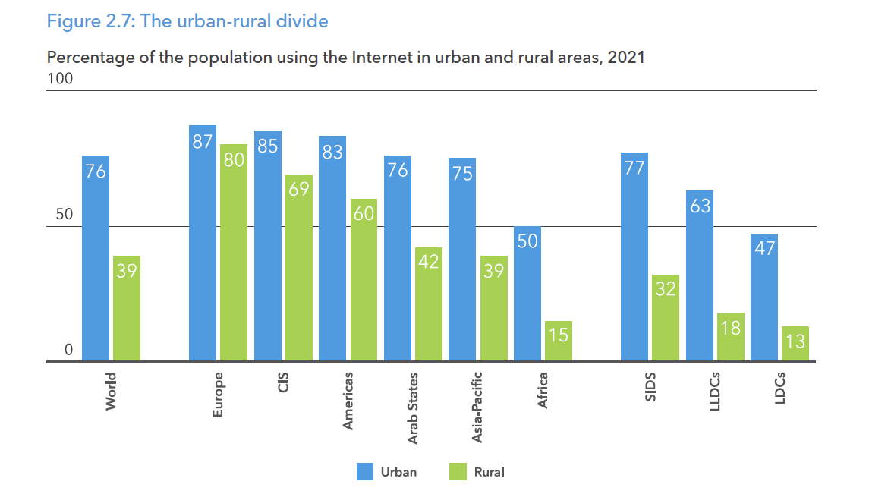
Challenges: Access

Slide 90
Recurring Themes
How to find who to talk to
Addresses and names, discovery, routing
Decide how to talk to them
Encodings, Protocols
Make sure communication is correct, only among intended parties, works for all
Mediation, Error correction, encryption, …
How to do this at scale
Planetary scale (or beyond)

