Slide 1
CS1680 Physical Layer, Link Layer I
Based partly on lecture notes by Rodrigo Fonseca, David Mazières, Phil Levis, John Jannotti

Slide 2
Administrivia
Snowcast: milestone due last night
I will be reviewing today; look for an announcement for feedback, reference doc
Snowcast full submission: due Tuesday, Jan 10

Slide 3
Administrivia
Snowcast: milestone due last night
I will be reviewing today; look for an announcement for feedback, reference doc, Gradescope
Snowcast full submission: due Tuesday, Jan 10
Last call for registration stuff
If you received an override, make sure you accept it. Check now!
If you want to be enrolled but are not, email me ASAP

Slide 4
Today
Two more things on sockets
Physical/Link layer: how to connect two things
=> Inherent properties of real networks

Slide 5
Layers, Services, Protocols
Application
Defined by application
Transport
Deliver packets to applications
(e.g., TCP, UDP)
Network
Move packets to any node in the network
Protocol: IP
Link
Move frames to other nodes across a link
Physical
Move bits to another node across a link

Slide 6
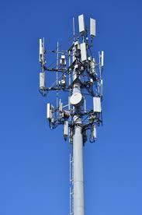
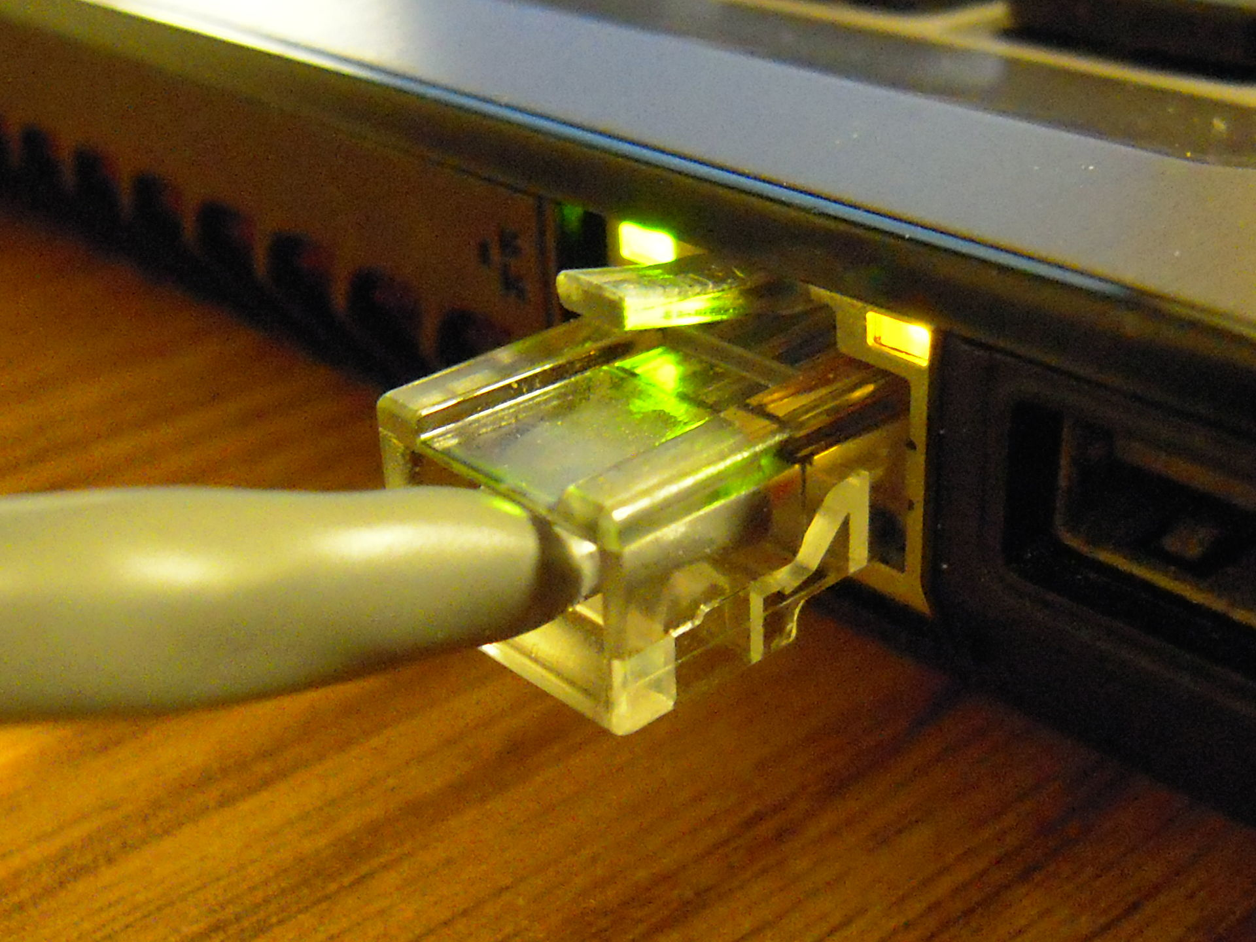
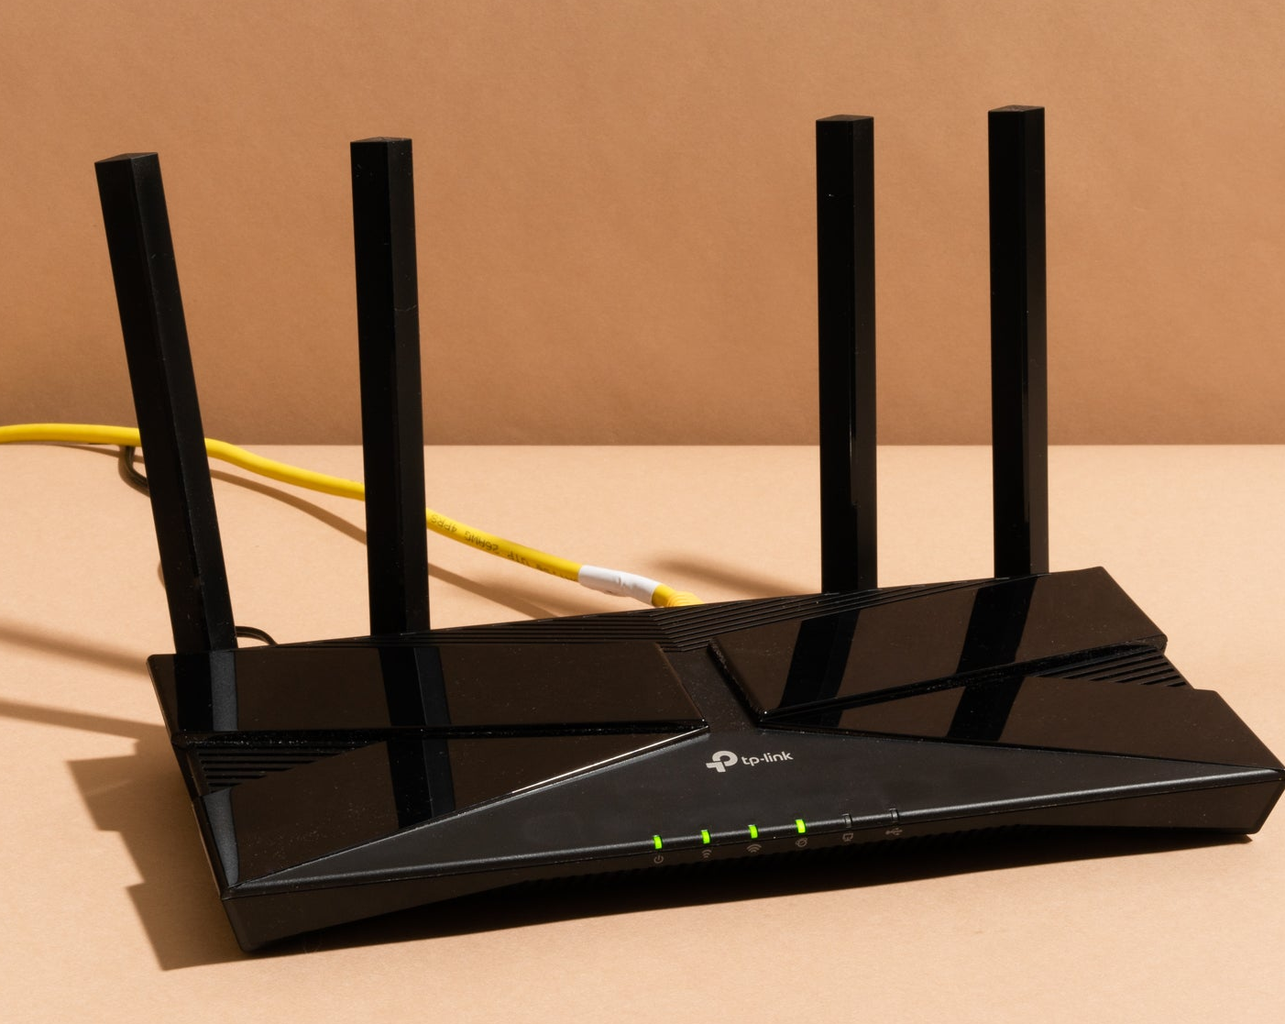
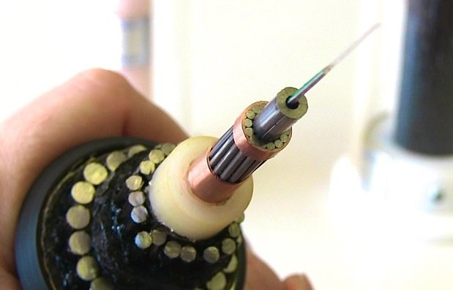
Physical Layer (Layer 1)
Specifies three things:
Physical medium
Signaling/modulation
Encoding
Notes:
Signaling/modulation: how we send a 1 or 0

Slide 7
Physical Layer (Layer 1)
Specifies three things:
Physical medium: cable, fiber, wireless frequency
Signaling/modulation: how to transmit/receive
Encoding: how to get meaningful data
Notes:
Signaling/modulation: how we send a 1 or 0

Slide 8
Why should we care?
This is the line between electrical engineering and computer science
Helpful to understand challenges involved => How design/limitations affect our systems
Notes:
It’s a really blurry line…

Slide 9
Why should we care?
This is the line between electrical engineering and computer science
Helpful to understand challenges involved => How design/limitations affect our systems
Also: Learn important principles we’ll use elsewhere
Notes:
It’s a really blurry line…

Slide 10
The main idea
A
B
Notes:
-Transmitter, receiver
Medium
Varies something

Slide 11
The main idea
A
B
Send/receive data over a medium (copper wire, fiber, radio frequency)
Sender encodes message using some format, sends “over the wire”
Receiver decodes (or recovers) message at the other end
How does this work?
Notes:
-Transmitter, receiver
Medium
Varies something

Slide 12
Why is this hard?
Sharing channel: interference from other devices
Noise
Physical distance (attenuation)
Energy usage
Security
…
Notes:
And the protocols we build to deal with these media are improving all the time

Slide 13
Why is this hard?
Sharing channel: interference from other devices
Noise
Physical distance (attenuation)
Energy usage
Security
…
=> Every medium has its own characteristics, and problems
Notes:
And the protocols we build to deal with these media are improving all the time

Slide 14
We don’t need to know the details.
However, there are some key takeways to help understand the challenges and implications

Slide 15
Key points

Slide 16
Key points
All media have fixed bandwidth => fixed “space” to transmit information
Sending data takes time! => latency
All media have (some) errors => how to deal with them?

Slide 17
Bandwidth

Slide 18
Bandwidth:
Creates a fixed “space” in which data can be transmitted
=>Wires: defined by physical properties
Wireless: frequency ranges are regulated

Slide 19
Bandwidth: frequencies that a channel propagates well (Most signals made up of different frequencies)
Creates a fixed “space” in which data can be transmitted
=>Wires: defined by physical properties
Wireless: frequency ranges are regulated

Slide 20
Bandwidth: frequencies that a channel propagates well (Most signals made up of different frequencies)
Creates a fixed “space” in which data can be transmitted
=>Wires: defined by physical properties
Wireless: frequency ranges are regulated
Upper bound on throughput: amount of data we can send per time (bits per second)

Slide 21
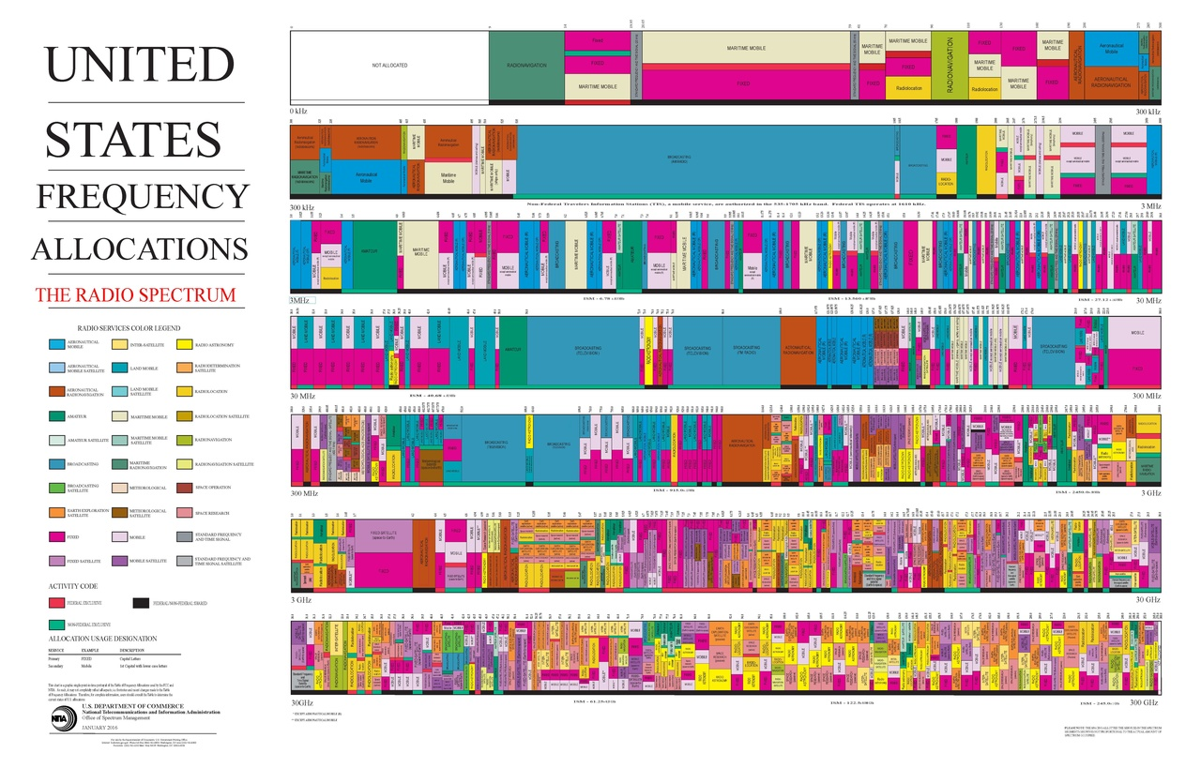
Notes:
https://en.wikipedia.org/wiki/File:United_States_Frequency_Allocations_Chart_2016_-_The_Radio_Spectrum.pdf

Slide 22
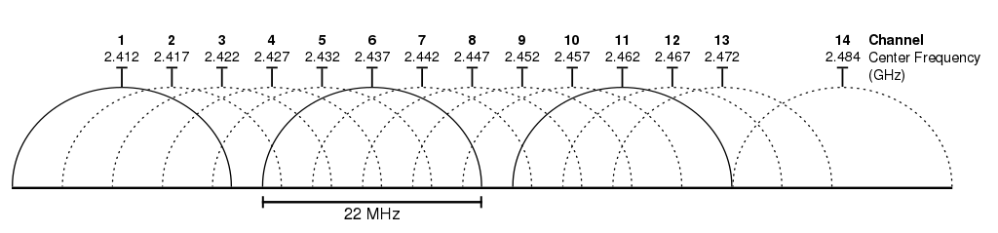
Early IEEE 802.11 (Wifi) channel bandwidth
Notes:
Note how the channels overlap

Slide 23
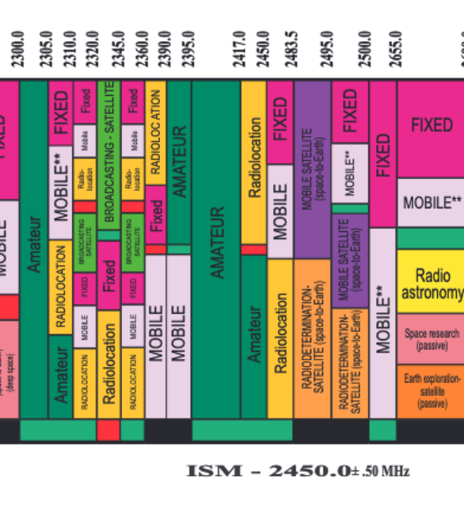
Early IEEE 802.11 (Wifi) channel bandwidth
Notes:
Note how the channels overlap. Why? Because only so much frequency space is unlicensed, it all fits into this “amateur” band here

Slide 24
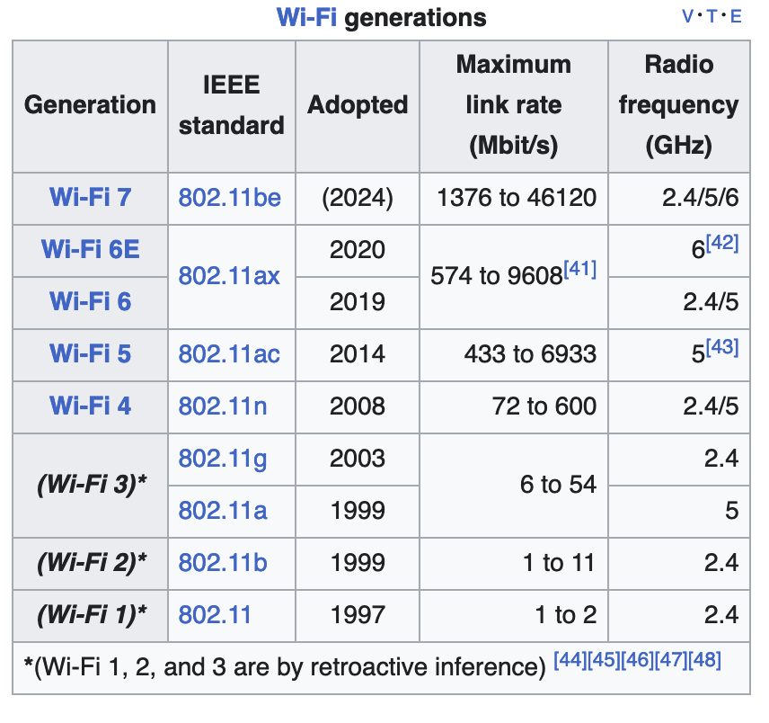

Slide 25
How to actually send data?
(Within a limited bandwidth)

Slide 26
How to actually send stuff?

Slide 27
How to actually send stuff?
Modulation: how to vary a signal in order to transmit information

Slide 28
Example: Start with a carrier frequency, modulate it to encode data
OOK: On-Off Keying
ASK: Amplitude Shift Keying

Slide 29
An (early) medium

Slide 30
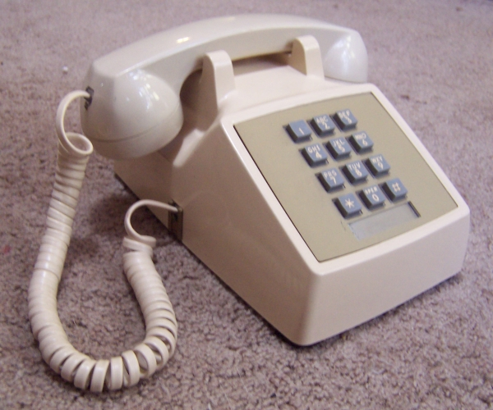
An (early) medium

Slide 31
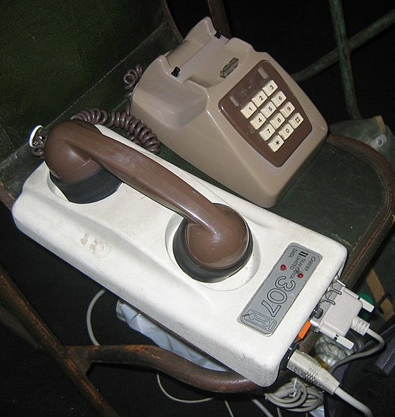
Example: Bell 103 modem (c. 1960s)
Uses frequency-shfit keying to encode data
Transmitting ("originating") side
-1 ("Mark"): 1270 Hz
-0 ("Space"): 1070 Hz
Receiving ("answering") side
- 1 ("Mark"): 2225 Hz
- 0 ("Space"): 2025 Hz

Slide 32
Example: Bell 103 modem (c. 1960s)
Uses frequency-shfit keying to encode data
Transmitting ("originating") side
-1 ("Mark"): 1270 Hz
-0 ("Space"): 1070 Hz
Receiving ("answering") side
- 1 ("Mark"): 2225 Hz
- 0 ("Space"): 2025 Hz
Throughput: 300 bits/second ("baud")
Transceiver: acoustic coupler

Slide 33
Lots of innovation since then! But still some fundamental limitations of the medium…

Slide 34
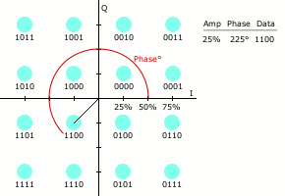
This can get more complex…
Lots of engineering you can do
Multiple carriers/frequencies
Adjust amplitude, phase
Clever ways to avoid errors
…
A good animation on Wikipedia

Slide 35
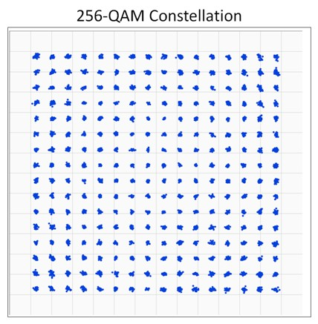
Example: Quadrature Amplitude Modulation (QAM)
Amplitude
Phase
Notes:
Quadrature encoding: two carries waves out of phase—modulate the amplitude and phase (hence two dimensions of the constellation)
Used for some forms of digital TV

Slide 36
Modulation schemes in action
https://www.youtube.com/watch?v=vvr9AMWEU-c

Slide 37
Sounds great, right?
The problem: noise limits the number of modulation levels (M)

Slide 38
Sounds great, right?
Problem: noise limits the number of modulation levels (M)
Shannon’s Law: C = B log₂(1 + S/N)
C: channel capacity (throughput) in bits/second
B : bandwidth in Hz
S, N: average signal, noise power

Slide 39
Sounds great, right?
Problem: noise limits the number of modulation levels (M)
Shannon’s Law: C = B log₂(1 + S/N)
C: channel capacity (throughput) in bits/second
B : bandwidth in Hz
S, N: average signal, noise power
Takeaway: fundamental limit on how much data we can fit into a fixed channel, based on noise
=> For any medium, designers create encodings to try and maximize throughput

Slide 40
Medium | Bandwidth | Throughput
Dialup (1960s) | 4 kHz | 300 bits/s
Dialup | 4 kHz | 56 Kbit/s
=> Does this mean wifi is the best?

Slide 41
Medium | Bandwidth | Throughput
Dialup (1960s) | 4 kHz | 300 bits/s
Dialup | 4 kHz | 56 Kbit/s
Early Wifi (802.11g) | 20 MHz | 54 Mbit/s
Modern Wifi (802.11ax) | 20-40 MHz | Up to 9 Gbps
Ethernet | 62.5 MHz (1Gbps version) | 1Gbit/s (common) Up to 100Gbps
3G cellular | Depends on carrier | 2 Mbit/s
5G cellular | Depends on carrier | > 1 GBps
=> Does this mean wifi is the best?

Slide 42
Latency

Slide 43
Sending data takes time!
Latency:

Slide 44
Sending data takes time!
Latency: time between sending data and when data arrives (somewhere)
Multiple components => many definitions, depending on what we’re measuring

Slide 45
How to think about latency
Notes:
How long does it take to send a frame across?

Slide 46
How to think about latency
Transmission Delay
Latency
Propagation Delay
Notes:
How long does it take to send a frame across?

Slide 47
How to think about latency

Slide 48
How to think about latency
Processing delay at the node: per message computation
Queuing delay: time spent waiting in buffers
Transmission delay: sending out the actual data
Size/Bandwidth
Propagation delay: time for bits to actually go out on the wire
Upper bound?
Depends on media, ultimate upper bound is speed of light

Slide 49
Ping

Slide 50
Round trip time (RTT): time between request and response

Slide 52
Round trip time (RTT): time between request and response
When we design protocols, can think about performance based on number of RTTs
Request
Response
Time
=> Not just about the physical layer!

Slide 53
Sending Frames Across
…
Throughput: bits / s
…
Notes:
How fast can we receive bytes?

Slide 54
Which matters most, bandwidth or delay?
How much data can we send during one RTT?
E.g., send request, receive file
Request
Response
Time
Notes:
Which one do we care about? It depends on what we’re doing

Slide 55
Which matters most, bandwidth or delay?
How much data can we send during one RTT?
E.g., send request, receive file
Request
Response
Time
Often: For small transfers, latency more important,
for bulk, throughput more important
Notes:
Which one do we care about? It depends on what we’re doing

Slide 56
Performance Metrics
Throughput: Number of bits received/unit of time
e.g. 100 Mbps
Goodput: Useful bits received per unit of time
Latency: How long for message to cross network
Jitter: Variation in latency

Slide 57
Dealing with errors

Slide 58
Error Detection
Basic idea: use a checksum
Compute small check value, like a hash of packet
Notes:
Examples: CRC, Internet,
This is different vs. cryptographic security

Slide 59
Error Detection
Basic idea: use a checksum
Compute small check value, like a hash of packet
Good checksum algorithms
Want several properties, e.g., detect any single-bit error
Details later
=> Not all protocols do this. Why?
Notes:
Examples: CRC, Internet,
This is different vs. cryptographic security

Slide 60
Encoding example: NRZ
How do we encode binary data onto signals?
One approach: 1 as high, 0 as low!
Called Non-return to Zero (NRZ)
0
0
1
0
1
0
1
1
0
NRZ
(non-return to zero)
Clock
Problem?
Notes:
Low is not necessarily 0V, (or rest), could be -1, for example; hence the name.
Assume we can change the value once per clock cycle.

Slide 61
Drawbacks of NRZ
No signal could be interpreted as 0 (or vice-versa)
Consecutive 1s or 0s are problematic
“Baseline wander problem”
How do you set the threshold?
Could compare to average, but average may drift
“Clock recovery problem”
For long runs of no change, could miscount periods
Different encodings try to correct for or work around these issues!

Slide 62
Alternative Encodings
Non-return to Zero Inverted (NRZI)
Encode 1 with transition from current signal
Encode 0 by staying at the same level
At least solve problem of consecutive 1s
0
0
1
0
1
0
1
1
0
NRZI
(non-return to zero
intverted)
Clock

Slide 63
One encoding scheme: 4B/5B
Can we have a more efficient encoding?
Every 4 bits encoded as 5 chips
Carefully select 16 5-bit chips we can transmit using NRZI
No more than one leading 0 and no more than two trailing 0s
Never get more than 3 consecutive 0s
Other codes used for other purposes
E.g., 11111: line idle; 00100: halt
Achieves 80% efficiency

Slide 64
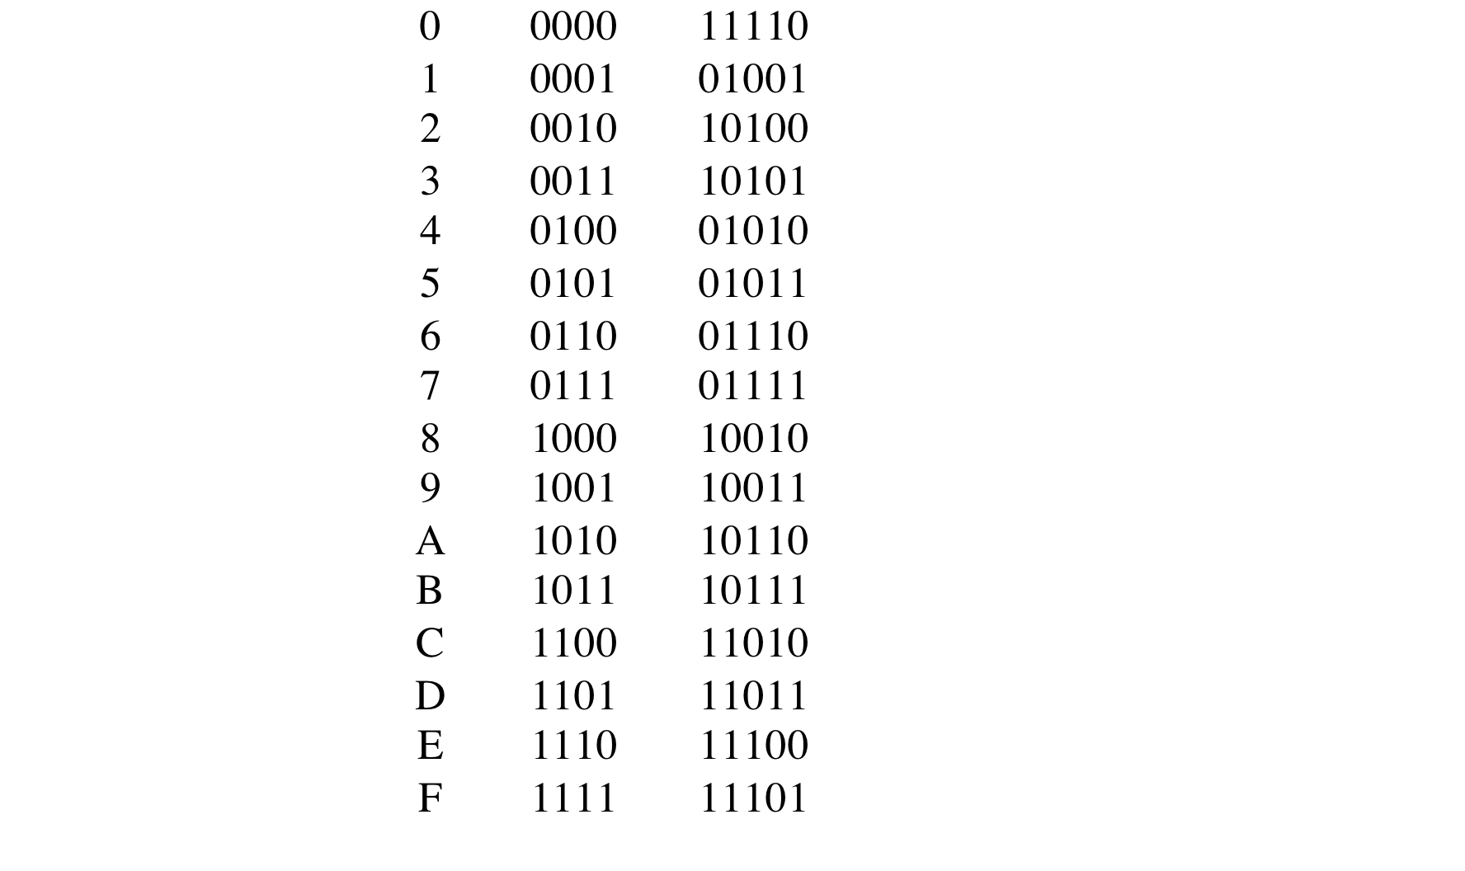
4B/5B Table

Slide 65
Encoding Goals
DC Balancing (same number of 0 and 1 chips)
Clock synchronization
Can recover some chip errors
Constrain analog signal patterns to make signal more robust
Ideally: operate near channel capacity with negligible errors
Shannon says it’s possible, doesn’t tell us how
Codes can get computationally expensive
In practice
More complex encoding: fewer bps, more robust
Less complex encoding: more bps, less robust

Slide 66
Last Example: 802.15.4
Standard for low-power, low-rate wireless PANs
Must tolerate high chip error rates
Uses a 4B/32B bit-to-chip encoding

Slide 67
Framing
Given a stream of bits, how can we represent boundaries?
Break sequence of bits into a frame
Typically done by network adaptor, or interface

Slide 68
Error Detection and Correction

Slide 69
Error Detection
Basic idea: use a checksum
Compute small check value, like a hash of packet
Good checksum algorithms
Want several properties, e.g., detect any single-bit error
Details later
Notes:
Examples: CRC, Internet,
This is different vs. cryptographic security

Slide 70
Error Detection
Idea: have some codes be invalid
Must add bits to catch errors in packet
Sometimes can also correct errors
If enough redundancy
Might have to retransmit
Used in multiple layers

Slide 71
Simplest Schemes
Example: send each bit 3 times
Valid codes: 000 111
Invalid codes : 001 010 011 100 101 110
Corrections : 0 0 1 0 1 1

Slide 72
Parity
Add a parity bit to the end of a word
Example with 2 bits:
Valid: 000 011 101 110
Invalid: 001 010 010 111
Can we correct?
Can detect odd number of bit errors
No correction
Notes:
Cannot correct because each invalid code is the same distance from 3 valid codes!

Slide 73
In general
Hamming distance: number of bits that are different between two codes
E.g.: HD (00001010, 01000110) = 3
If min HD between valid codewords is d:
Can detect d-1 bit error
Can correct ⌊(d-1)/2⌋ bit errors
What is d for parity and 3-voting?
Notes:
Parity: d=2
3-Voting: d=3

Slide 74
Checksums
Compute a “hash” over the message, send with message

Slide 75
Components of Latency
Processing
Per message, small, limits throughput
e.g. or 120μs/pkt
Queue
Highly variable, offered load vs outgoing b/w
Transmission
Size/Bandwidth
Propagation
Distance/Speed of Light

Slide 76
Reliable Delivery
Several sources of errors in transmission
Error detection can discard bad frames
Problem: if bad packets are lost, how can we ensure reliable delivery?
Exactly-once semantics = at least once + at most once
Notes:
Concepts are most important here—this is a theme we will see later

Slide 77
On reliable delivery
Many link layer protocols don’t account for reliable delivery!
Eg. Wifi does, Ethernet does not
Usually, reliable delivery guaranteed by other protocol layers if needed, such as TCP
Why might we NOT want reliable delivery at the link layer?

Slide 78
Maximizing Throughput
Can view network as a pipe
For full utilization want bytes in flight ≥ bandwidth × delay
But don’t want to overload the network (future lectures)
What if protocol doesn’t involve bulk transfer?
Get throughput through concurrency – service multiple clients simultaneously
Notes:
You can be sending data while you’re waiting for the other to respond—keep the pipe full

Slide 79
Summary: Reliable delivery
Want exactly once
At least once: acks + timeouts + retransmissions
At most once: sequence numbers
Want efficiency
Sliding window

Slide 80
Extra content

Slide 81
2-D Parity
Add 1 parity bit for each 7 bits
Add 1 parity bit for each bit position across the frame)
Can correct single-bit errors
Can detect 2- and 3-bit errors, most 4-bit errors
Find a 4-bit error that can’t be corrected
Notes:
Any corners of a square can’t be corrected

Slide 82
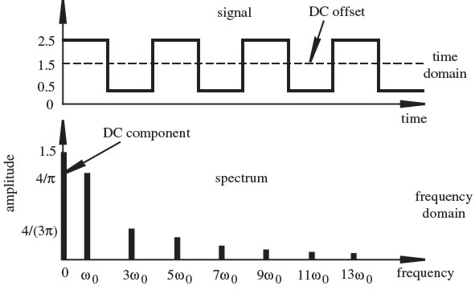
Components of a Square Wave
Graphs from Dr. David Alciatore, Colorado State University

Slide 83
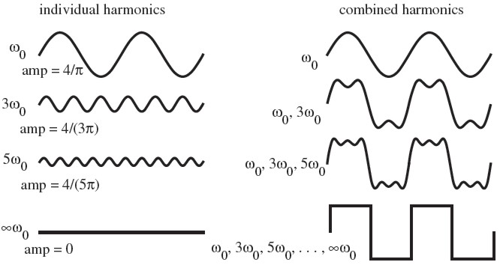
Approximation of a Square Wave
Graphs from Dr. David Alciatore, Colorado State University

Slide 84
Can we do better?
Suppose channel passes 1KHz to 2KHz
1 bit per sample: alternate between 1KHz and 2KHz
2 bits per sample: send one of 1, 1.33, 1.66, or 2KHz
Or send at different amplitudes: A/4, A/2, 3A/4, A
n bits: choose among 2^{n} frequencies!
What is the capacity if you can distinguish M levels?

Slide 85
Hartley’s Law
C = 2B log₂(M) bits/s
Great. By increasing M, we can have as large a capacity as we want!
Or can we?

Slide 86

The channel is noisy!

Slide 87
Putting it all together
Noise limits M!
2B log₂(M) ≤ B log₂(1 + S/N)
M ≤ √1+S/N
Example: Telephone Line has 3KHz BW, 30dB SNR
S/N = 10ˆ(30 dB/10) = 1000
C = 3KHz log₂(1 + 1000) ≈ 30Kbps
M < sqrt(1001) ≈ 31 levels
Signal-to-noise ratio (SNR)
is typically measured in Decibels (dB) dB = 10log₁₀(S/N)

Slide 88
Manchester Encoding
Map 0 → 01; 1 → 10
Transmission rate now 1 bit per two clock cycles
Solves clock recovery & baseline wander
… but halves transmission rate!
0
0
1
0
1
0
1
1
0
Manchester
Clock
Notes:
50% efficiency

Slide 89
Layering
Abstraction to the rescue!
Break problem into separate parts, solve part independently
Abstract data from the layer above inside data from the layer below
Encapsulate data from “higher layer” inside “lower layer”
=> Lower layer can handle data without caring what’s above it!
Notes:
Abstractions
Example: deliver a letter
Interfaces

Slide 90
The big complex picture
Application Protocol (L7)
Transport Protocol (L4)
Network Protocol (L3)
Link-Layer Protocol (L2)
“OSI reference model” or “7-layer model”
Notes:
Open Systems Interconnect, ISO
And there are different protocols at each stage

Slide 91





Applications (Layer 7)
The applicatons/programs/etc you use every day
Examples:
HTTP/HTTPS: Web traffic (browser, etc)
SSH: secure shell
FTP: file transfer
DNS (more on this later)
…
When you’re building programs,
you usually work here

