Slide 1
CSCI-1680
Building Links and (Local) Networks
Based partly on lecture notes by Rodrigo Fonseca, David Mazières, Phil Levis, John Jannotti

Slide 2
Administrivia
Snowcast due Tuesday (2/10) by 11:59pm EST
Look for announcement on Gradescope/testing soon
  See our FAQ post for testing resources & common issues!

Slide 3
Next week: we start IP
Tuesday, 2/10
  Start of IP lectures
  Form for selecting your team
  Pre-release IP handout available

Slide 4
Next week: we start IP
Tuesday, 2/10
  Start of IP lectures
  Form for selecting your team
  Pre-release IP handout available
Thursday, 2/12
  Team form due
  IP project official release
  Gearup 5-7pm, CIT 165

Slide 5
Today
Last time: how to send over a link
Today: how to build small network?
Link mechanics and sharing
Case study/fundamental terms: Ethernet (and Wifi)
How switching works

Slide 6
Fun systems facts: channels

Slide 7
Sending data takes time!
Latency:

Slide 8
Sending data takes time!
Latency: time between sending data and when data arrives (somewhere)
Multiple components => many definitions, depending on what we’re measuring

Slide 9
How to think about latency
Notes:
How long does it take to send a frame across?

Slide 10
How to think about latency
Transmission Delay
Latency
Propagation Delay
Notes:
How long does it take to send a frame across?

Slide 11
Latency: big picture

Slide 12
How to think about latency
Processing delay at the node: per message computation
Queuing delay: time spent waiting in buffers
Transmission delay: sending out the actual data
  Size/Bandwidth
Propagation delay: time for bits to actually go out on the wire
  Upper bound?
  Depends on media, ultimate upper bound is speed of light

Slide 13
Ping

Slide 14
Round trip time (RTT): time between request and response

Slide 15
Round trip time (RTT): time between request and response
When we design protocols,
can think about performance
based on number of RTTs
Request
Response
Time
=> Not just about the physical layer!

Slide 16
RTT vs. Throughput

Slide 17
Link layer

Slide 18
What does “link layer” mean?
Service: user-facing application.
Application-defined messages
Application
Service: multiplexing applications
Reliable byte stream to other node (TCP),
Unreliable datagram (UDP)
Transport
Network
Service: move packets to any other node in the network
Internet Protocol (IP)
Link
Service: move frames to other node across link.
May add reliability, medium access control
Physical
Service: move bits to other node across link

Slide 19
The main idea
A
B
Notes:
-Transmitter, receiver
Medium
Varies something

Slide 20
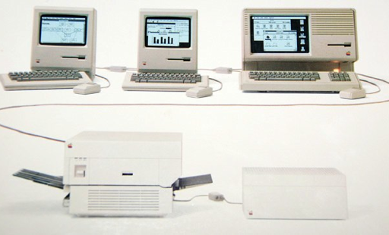
Setting the scene
An AppleTalk network (1980s)

Slide 21
Setting the scene
An AppleTalk network (1980s)
”Small” => Within a building, floor of office, etc
Related term: Local Area Network (LAN)

Slide 22
What does “link layer” mean?
…
A
???
B
C
D
Multiple hosts => shared channel
Need ways to allow “small” number of hosts to communicate

Slide 23
How to share the channel?

Slide 24
How to share the channel?
Medium Access Control (MAC)

Slide 25
Medium Access Control

Slide 26
Medium Access Control
Idea: No more than one device can be “talking” at one time
Need a protocol for “who can talk when?”
Another example of multiplexing
=> sharing the channel among multiple devices

Slide 27
High-level: MAC approaches
Partitioned Access: divide the channel into fixed slots
  Time Division Multiple Access (TDMA)
  Frequency Division Multiple Access (FDMA)
  …
Problems?
Hard to maximize channel utilization
(eg. what happens if only one person is talking?)

Slide 28
High-level: MAC approaches
Random Access: no fixed slots: “ask” to talk, or just talk and hope for the best
  Carrier Sense Multiple Access / Collision Detection (CSMA/CD)
  Carrier Sense Multiple Access / Collision Avoidance (CSMA/CA)
  RTS/CTS (Request to Send/Clear to Send)
  Token-based
  …
Problems?
Hard to maintain “fairness”
(eg. one host dominating channel)
Notes:
Senders

Slide 29
Why does this matter?
Different types of links solve these problems differently
  Ethernet (wired) vs. Wifi (wireless)
  Affects throughput, reliability, etc.
Understand why different links operate differently
=> How we build the Internet from them

Slide 30
How does a device use a link?
B

Slide 31
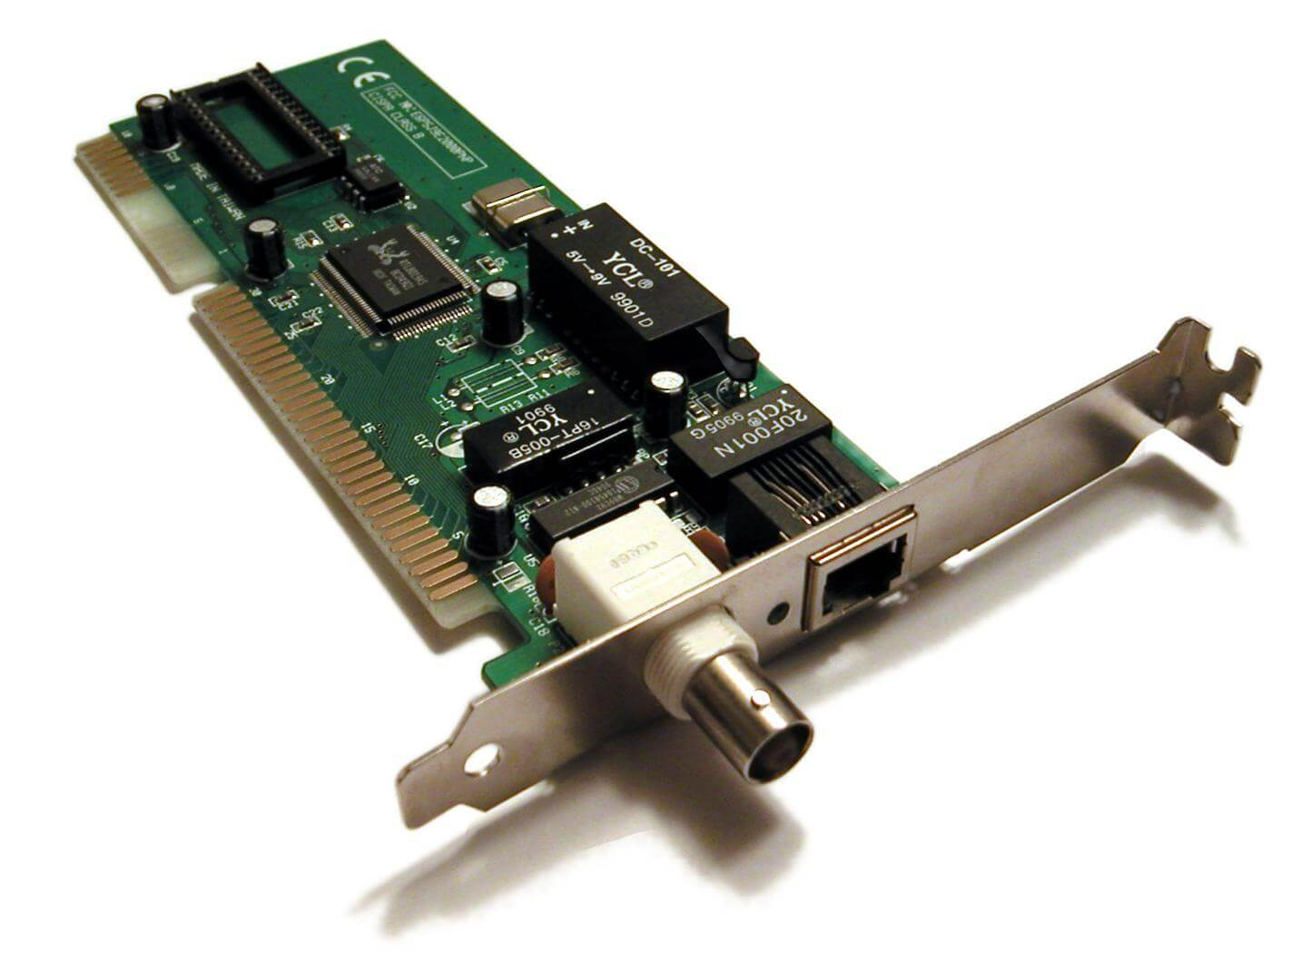
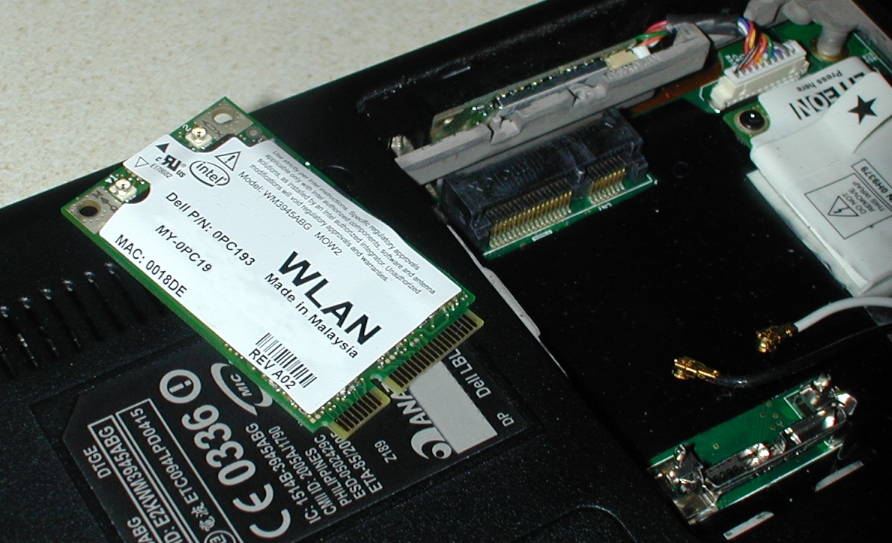

Slide 32
Interface: device that connects something to a network
OS abstraction for a network device
Physical hardware that does the “talking”
=> Network Interface Card (NIC)
Common interfaces
  Loopback: Virtual, only for local host
  Wifi, Ethernet, Bluetooth, …

Slide 33
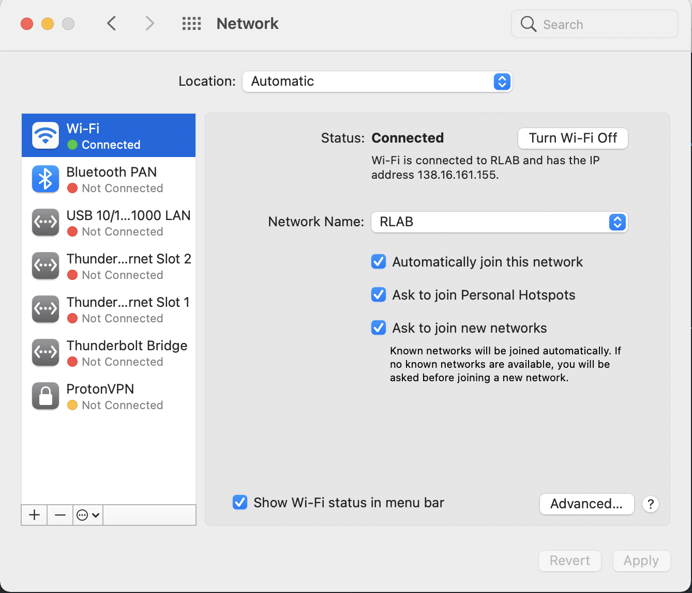

Slide 34
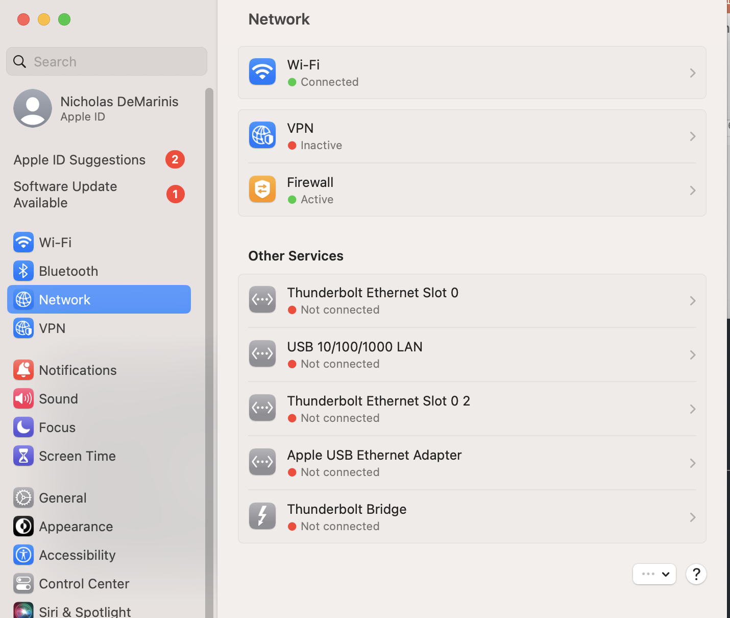

Slide 35
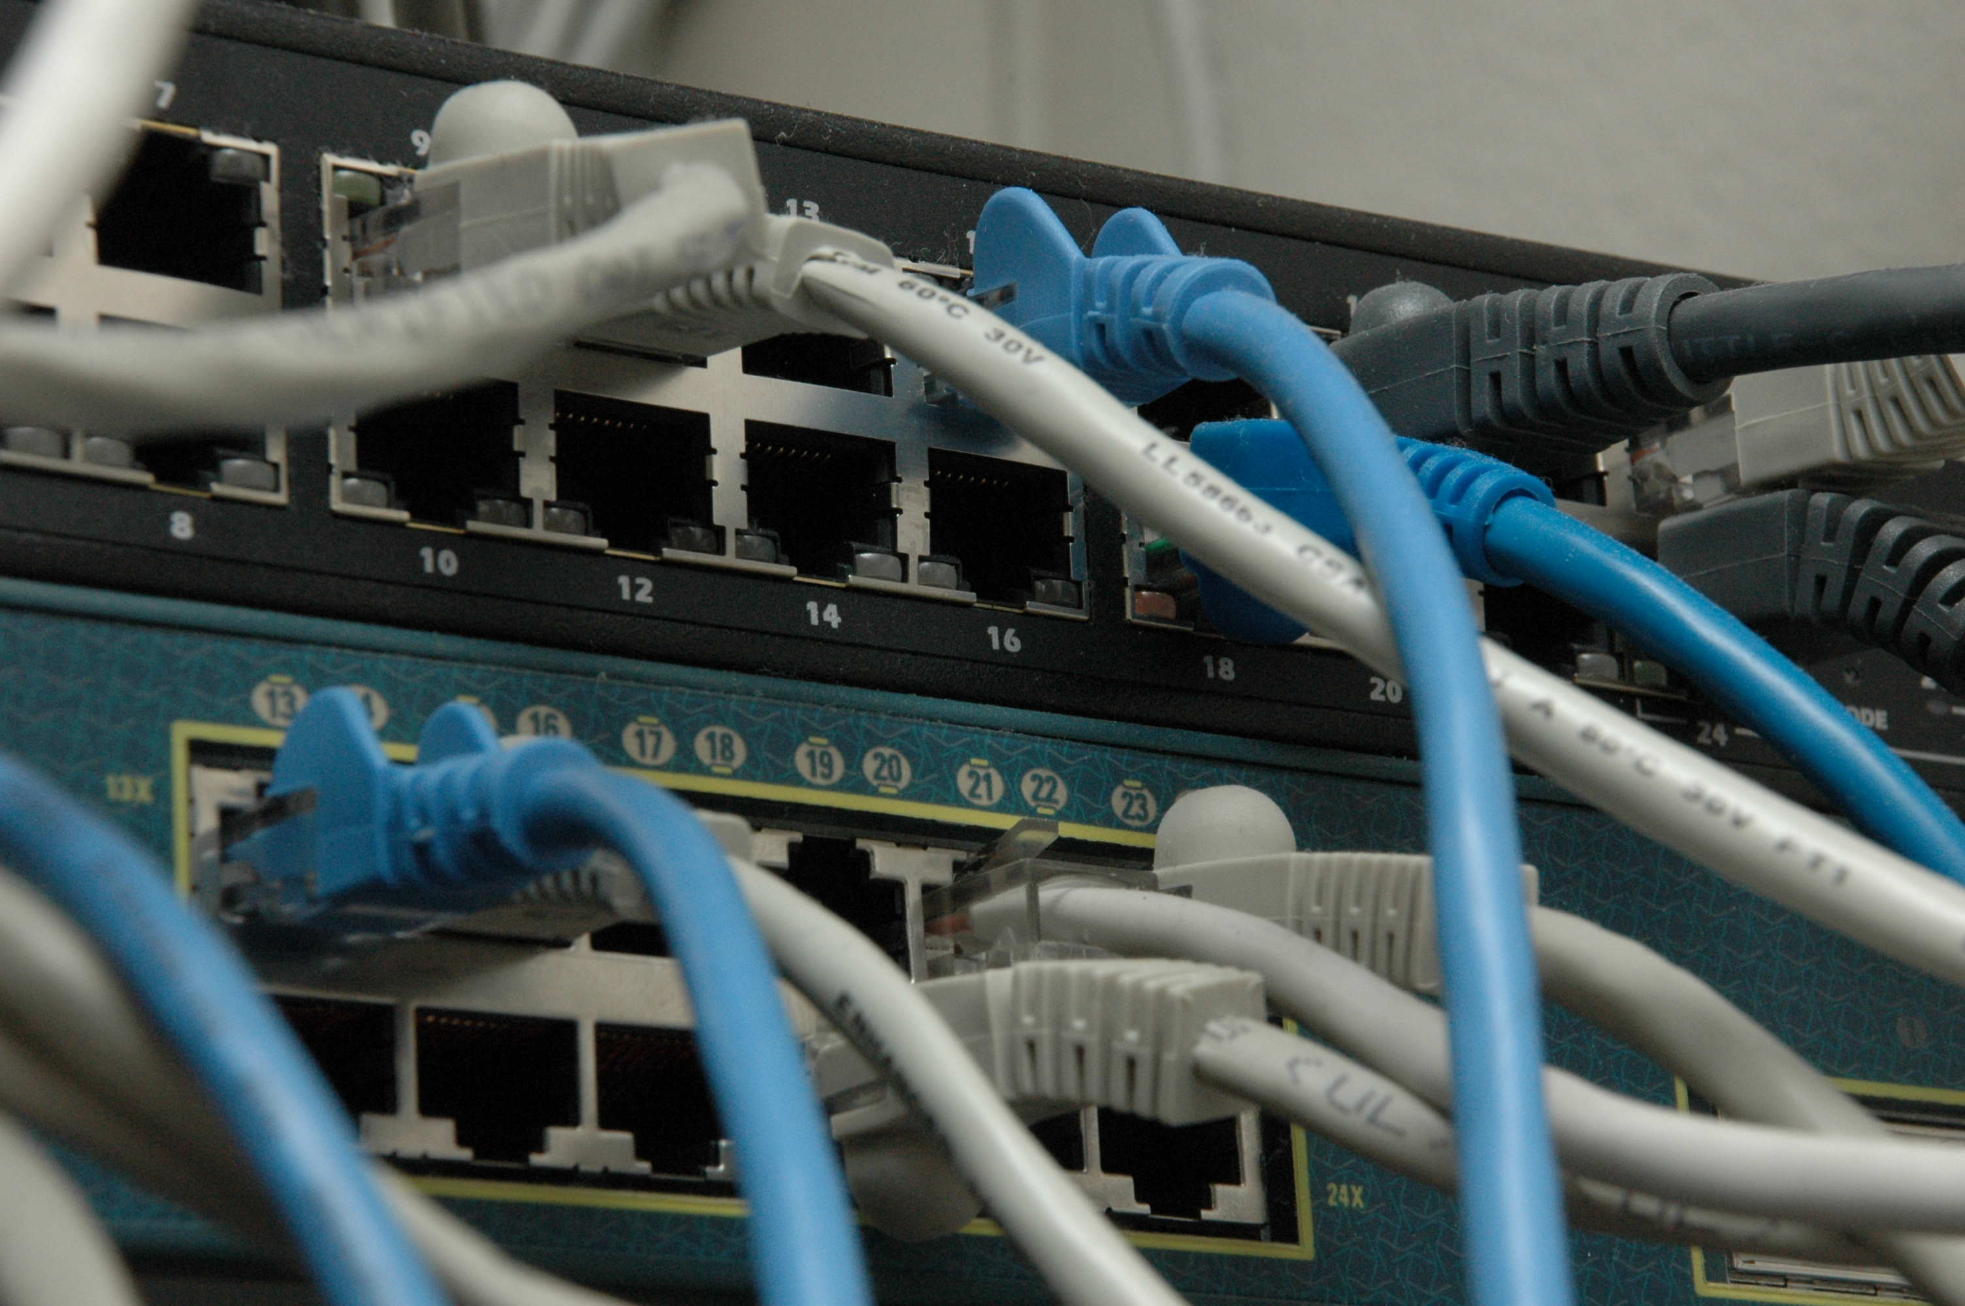
Example: Ethernet

Slide 36
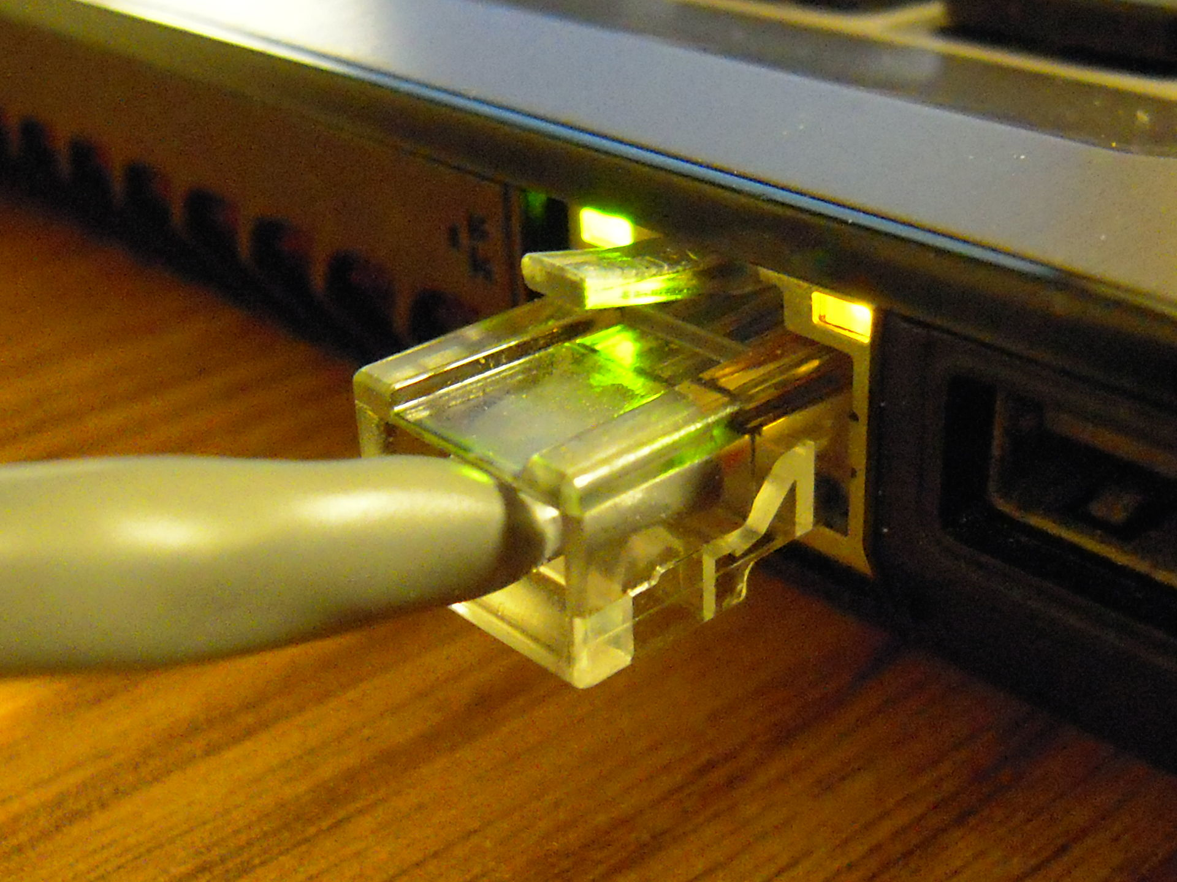
Ethernet
Dominant wired LAN technology, has evolved
significantly over time
Original version (1983): 10Mbps
Now (commonly): 1Gbps
Also: 10Gbps, 40Gbps, …
New developments in physical media, encodings, hardware => higher speeds over time

Slide 38
Ethernet: software viewpoint
Logically all hosts are connected to each other
All hosts have an “ethernet address” (”mac address”)
=> Globally-unique identifier
If you know a host’s ethernet address, you can send to it

Slide 39
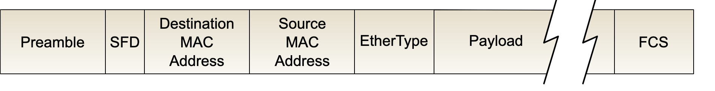
Ethernet: the header

Slide 40
Ethernet: the header
Source address: where packet is from
Destination address: where packet is going
  Devices ask: “Is this my packet?” ”Where should I send this packet?”
Other stuff
Preamble: when a packet starts
FCS: Frame Check sequence (checksum)

Slide 41
Ethernet Addresses (mac addresses)
Globally unique, 48-bit address per interface
00:1c:43:00:3d:09 (Samsung adapter)
=> Nowadays, we call them “mac addresses” or
“hardware addresses”

Slide 42
Ethernet Addresses (mac addresses)
Globally unique, 48-bit address per interface
00:1c:43:00:3d:09 (Samsung adapter)
First 24 bits: Registered to manufacturers
=> Other protocols have adopted this address format (eg. Wifi, Bluetooth, …)
=> Nowadays, we call them “mac addresses” or
“hardware addresses”

Slide 43
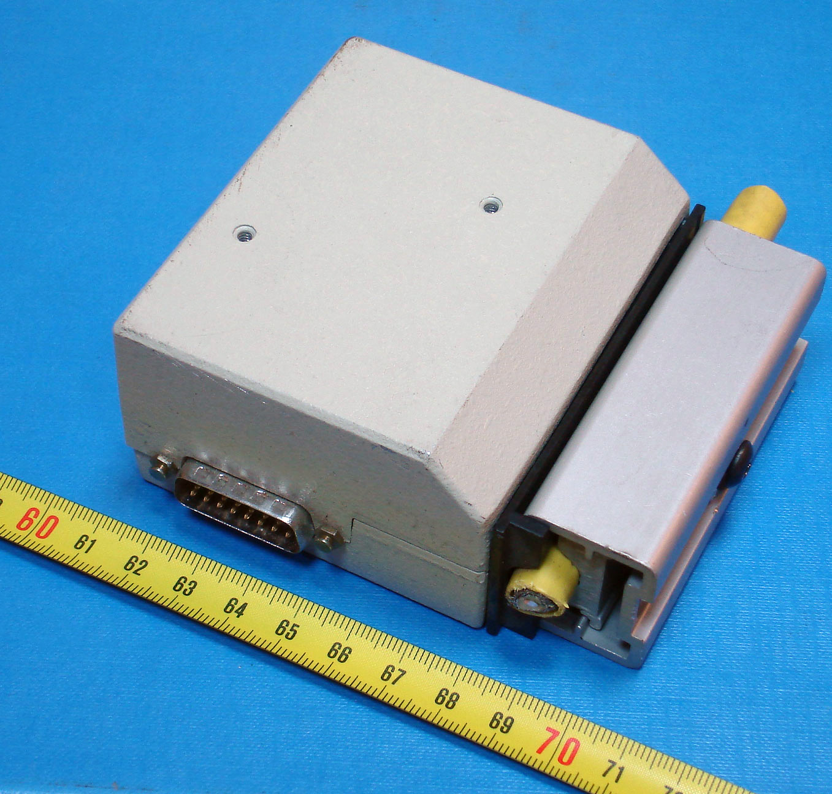
Ethernet’s evolution
Notes:
2^1-1, 2^2-1

Slide 44
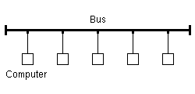
Ethernet’s evolution
Originally, a shared medium with all hosts
Basic idea: all hosts can see all frames, read a frame if it matches your hardware address
Implications?
Notes:
2^1-1, 2^2-1

Slide 45
Ethernet’s evolution
Originally, a shared medium with all hosts
Basic idea: all hosts can see all frames, read a frame if it matches your hardware address
Implications?
=>Can have collisons!
Notes:
2^1-1, 2^2-1

Slide 46
Classical Ethernet: Problems
Problem: all hosts in the same “collision domain”
Transmit algorithm
  If line is idle, transmit immediately
  Max message size: 1500 bytes
  If line is busy: wait until idle and transmit immediately

Slide 47
Classical Ethernet: Problems
Problem: all hosts in the same “collision domain”
Transmit algorithm
  If line is idle, transmit immediately
  Max message size: 1500 bytes
  If line is busy: wait until idle and transmit immediately
On Ethernet: generally possible to detect collisions (not always true!)

Slide 48
“Delay and try again later”
Sketch: In Ethernet
nth time: k × 51.2μs, for k = U{0..(2^{min(n,10)}-1)}
  1st time: 0 or 51.2μs
  2nd time: 0, 51.2, 102.4, or 153.6μs
Give up after several times (usually 16)

Slide 49
“Delay and try again later”
Sketch: In Ethernet
nth time: k × 51.2μs, for k = U{0..(2^{min(n,10)}-1)}
  1st time: 0 or 51.2μs
  2nd time: 0, 51.2, 102.4, or 153.6μs
Give up after several times (usually 16)
=> Exponential backoff: a useful, general technique

Slide 50
Does this scale?

Slide 51
Ethernet Recap
Service provided: send frames among stations with specific addresses
All nodes in the same “collision domain”

Slide 52
Avoiding collisions
Early method: bridging

Slide 53
Avoiding collisions
Add some hardware to the network that can separate collision domains
Original way (1990s): bridges

Slide 54
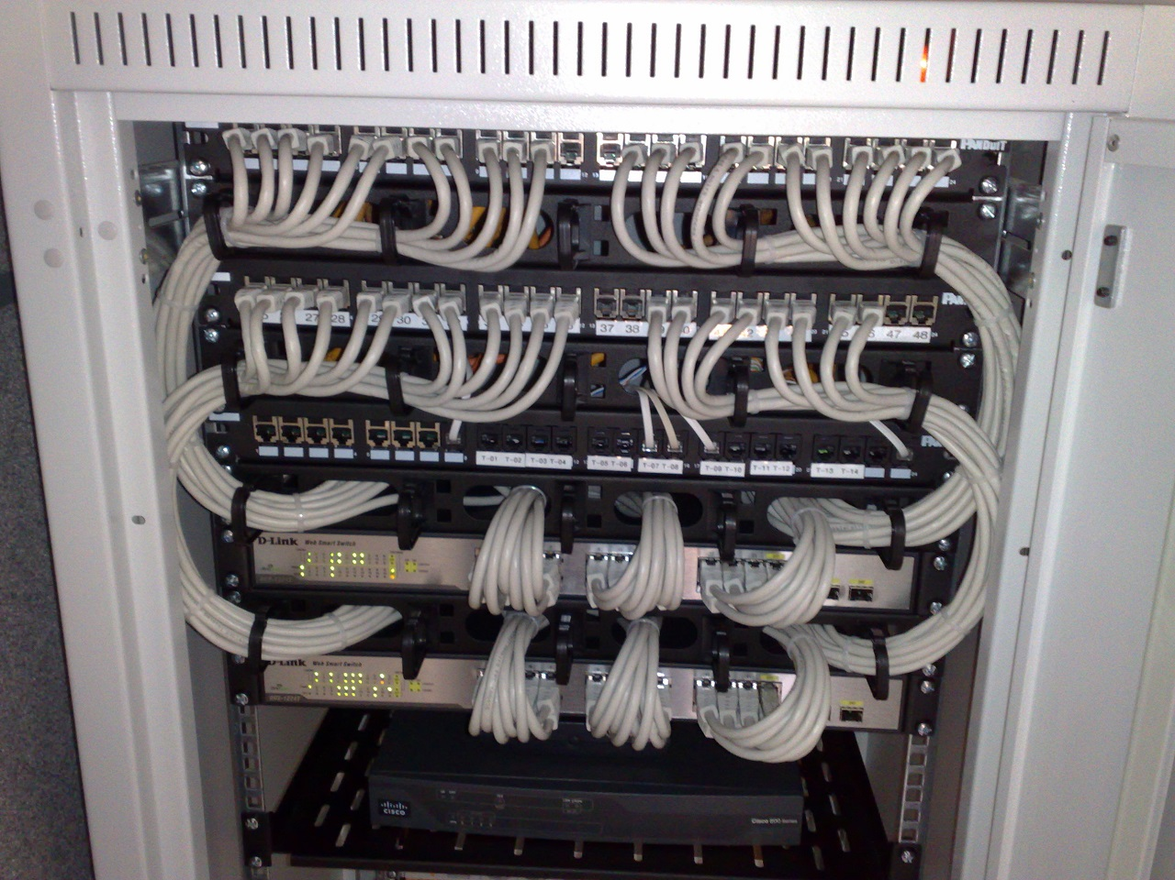
Modern way: switching
Switch: network device that forwards frames (packets) between ports
All hosts connect to a switch
Collision domain is host-switch
Switch buffers packets, forwards to destination when its port is idle
How to know which devices is on which port?

Slide 55
MAC learning, how it works

Slide 56
MAC Learning
Switches “learn” which host lives on which port by watching traffic
=>Keeps table of <destination addr => port>
If you don’t know, flood to all ports!

Slide 57
MAC Learning
Switches “learn” which host lives on which port by watching traffic
If you don’t know, flood to all ports!
MAC learning is just an optimization vs. old version
(but a pretty good one…)

Slide 58
MAC table example
R6#sh mac-address-table
EHWIC: 0
Destination Address Address Type VLAN Destination Port
------------------- ------------ ---- -----------------
5c45.27e0.8383 Dynamic 1 GigabitEthernet0/1/3
7641.7b63.584a Dynamic 20 GigabitEthernet0/1/3
5c45.27e0.8381 Dynamic 10 GigabitEthernet0/1/3
0000.5e00.0101 Dynamic 10 GigabitEthernet0/0/1
ca3f.aee3.e3e6 Dynamic 20 GigabitEthernet0/1/3
644b.f012.7f75. Dynamic 20 GigabitEthernet0/1/3
f018.9815.8eb8 Dynamic 20 GigabitEthernet0/1/3
ecb5.fa13.4677 Dynamic 20 GigabitEthernet0/0/2
a0a4.c5c2.4165 Dynamic 20 GigabitEthernet0/0/1
4c71.0c92.4f10 Dynamic 10 GigabitEthernet0/1/3
12d3.acae.bbc0 Dynamic 20 GigabitEthernet0/0/1
04d4.c448.9cf7 Dynamic 20 GigabitEthernet0/1/3
Notes:
Takes this information and synthesizes it down into its forwarding table baed on interfaces

Slide 59
What can go wrong?

Slide 60
Attack on a Learning Switch
Eve: wants to sniff all packets sent to Bob
Same segment: easy (shared medium)
Different segment on a learning bridge: hard
  Once bridge learns Bob’s port, stop broadcasting
How can Eve force the bridge to keep broadcasting?
  Flood the network with frames with spoofed src addr!

Slide 61
Bridges and Extended LANs
Single Ethernet collision domain has limitations
  Limits performance, distance, …
Next step: separate collision domains with bridges
  Operates on Ethernet addresses
  Forwards packets from one collision domain to others
Modern ethernet uses switches: all hosts directly connected to a bridge

Slide 62
Destinations for packets
Unicast: forward with filtering
Broadcast: always forward
Multicast: always forward or learn groups
Can try to limit how we direct packets to a destination

Slide 63
Learning Bridges/Switches
Idea: don’t forward a packet where it isn’t needed
  If you know recipient is not on that port
Learn hosts’ locations based on source addresses
  Build a table as you receive packets
  Table is a cache: if full, evict old entries. Why is this fine?
Table says when not to forward a packet
  Doesn’t need to be complete for correctness
Notes:
Never forward to INCOMING port…
What if hosts move? TIMEOUT
What if no space? Still works

Slide 64
Also: VLANs
Consider: Company network, A and B departments
  Broadcast traffic does not scale
  May not want traffic between the two departments
  What if employees move between offices?
b1
a1
b2
a2

Slide 65
VLANs
Solution: Virtual LANs
  Assign switch ports to a VLAN ID (color)
  Isolate traffic: only same color
  Some links may belong to multiple VLANs
=> Easy to change, no need to rewire
a2
a1
b2
b1

Slide 66
How does this all change with wifi?
A
B
C

Slide 67
How does this all change with wifi?
A
B
C
Can’t detect collisions anymore!
=> Carrier Sense Multiple Access / Collision Avoidance
=> Try to send: if you don’t hear back, assume collision (and maybe retry)

Slide 68
Extra material

Slide 69
Coming Up
Connecting multiple networks: IP and the Network Layer

