Slide 1
CSCI1680
Network Layer: IP & Forwarding
Based partly on lecture notes by Rodrigo Fonseca, David Mazières, Phil Levis, John Jannotti

Slide 2
Administivia
Snowcast: now due Thursday (2/12)
  Look for an announcement with updates to tester, tips for debugging
IP project: out Thursday
  Team form: out TODAY, due THURSDAY 2/12
  Gearup: THURSDAY 2/12 5-7pm CIT 165
HW1: out later today, due next Thurs
  Some practice for IP!

Slide 3
Today
Start of network layer
Network layer: Internet Protocol (IP) (v4)
Mechanics of IP forwarding
Intro to IP project

Slide 4
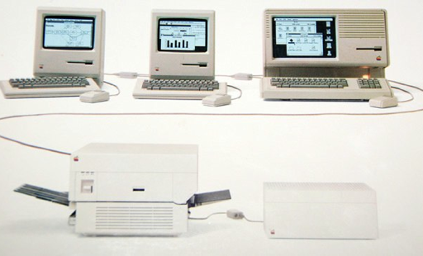
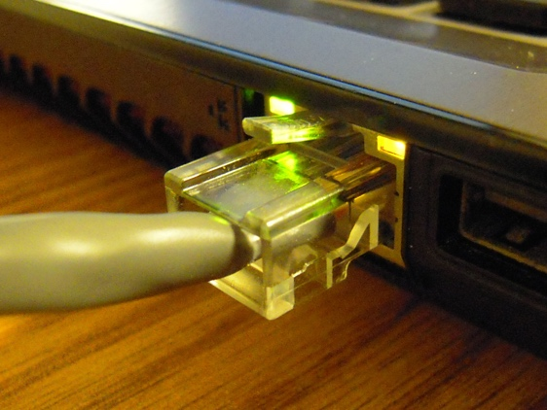
Recap: the link layer

Slide 5
Recap: the link layer
Goal: How to connect hosts on a ”small” network
Hosts connect to network via interfaces
Every interface has a link-layer address
  Ethernet/Wifi: MAC address (0c:45:22:c1:be:03)

Slide 6
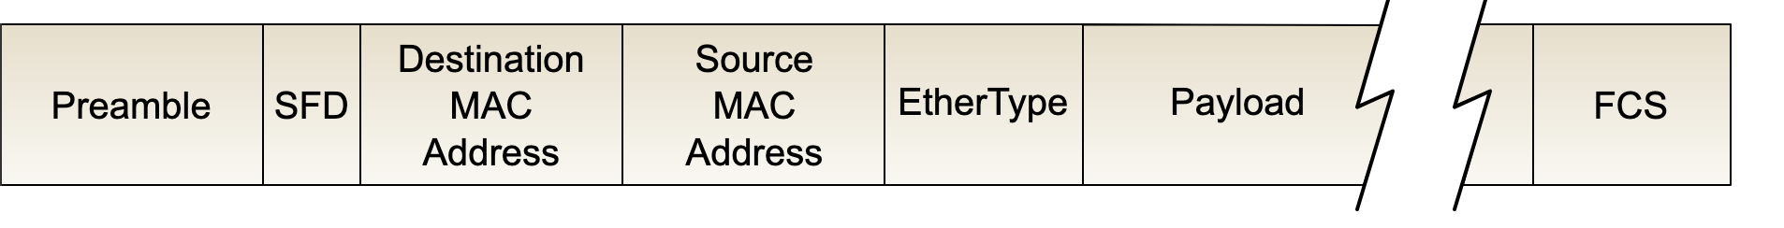
Ethernet Addresses (mac addresses)
00:1c:43:00:3d:09 (Samsung adapter)

Slide 7
Ethernet Addresses (mac addresses)
Globally unique, 48-bit address per interface
00:1c:43:00:3d:09 (Samsung adapter)
Globally unique, 48-bit address per interface
00:1c:43:00:3d:09 (Samsung adapter)
First 24 bits: Registered to manufacturers
=> Other protocols have adopted this address format (eg. Wifi, Bluetooth, …)
=> Nowadays, we call them “mac addresses” or
“hardware addresses”

Slide 8
Recap: the link layer
Goal: How to connect hosts on a ”small” network
Hosts connect to network via interfaces
Every interface has a link-layer address
  Ethernet/Wifi: MAC address (0c:45:22:c1:be:03)
Mental model for the link layer
Every host connected to every other host (at least logically)
Given a link-layer address, know how to reach host on your network
=> Devices: Switches, Wifi APs: forward packets between nodes on same network

Slide 9
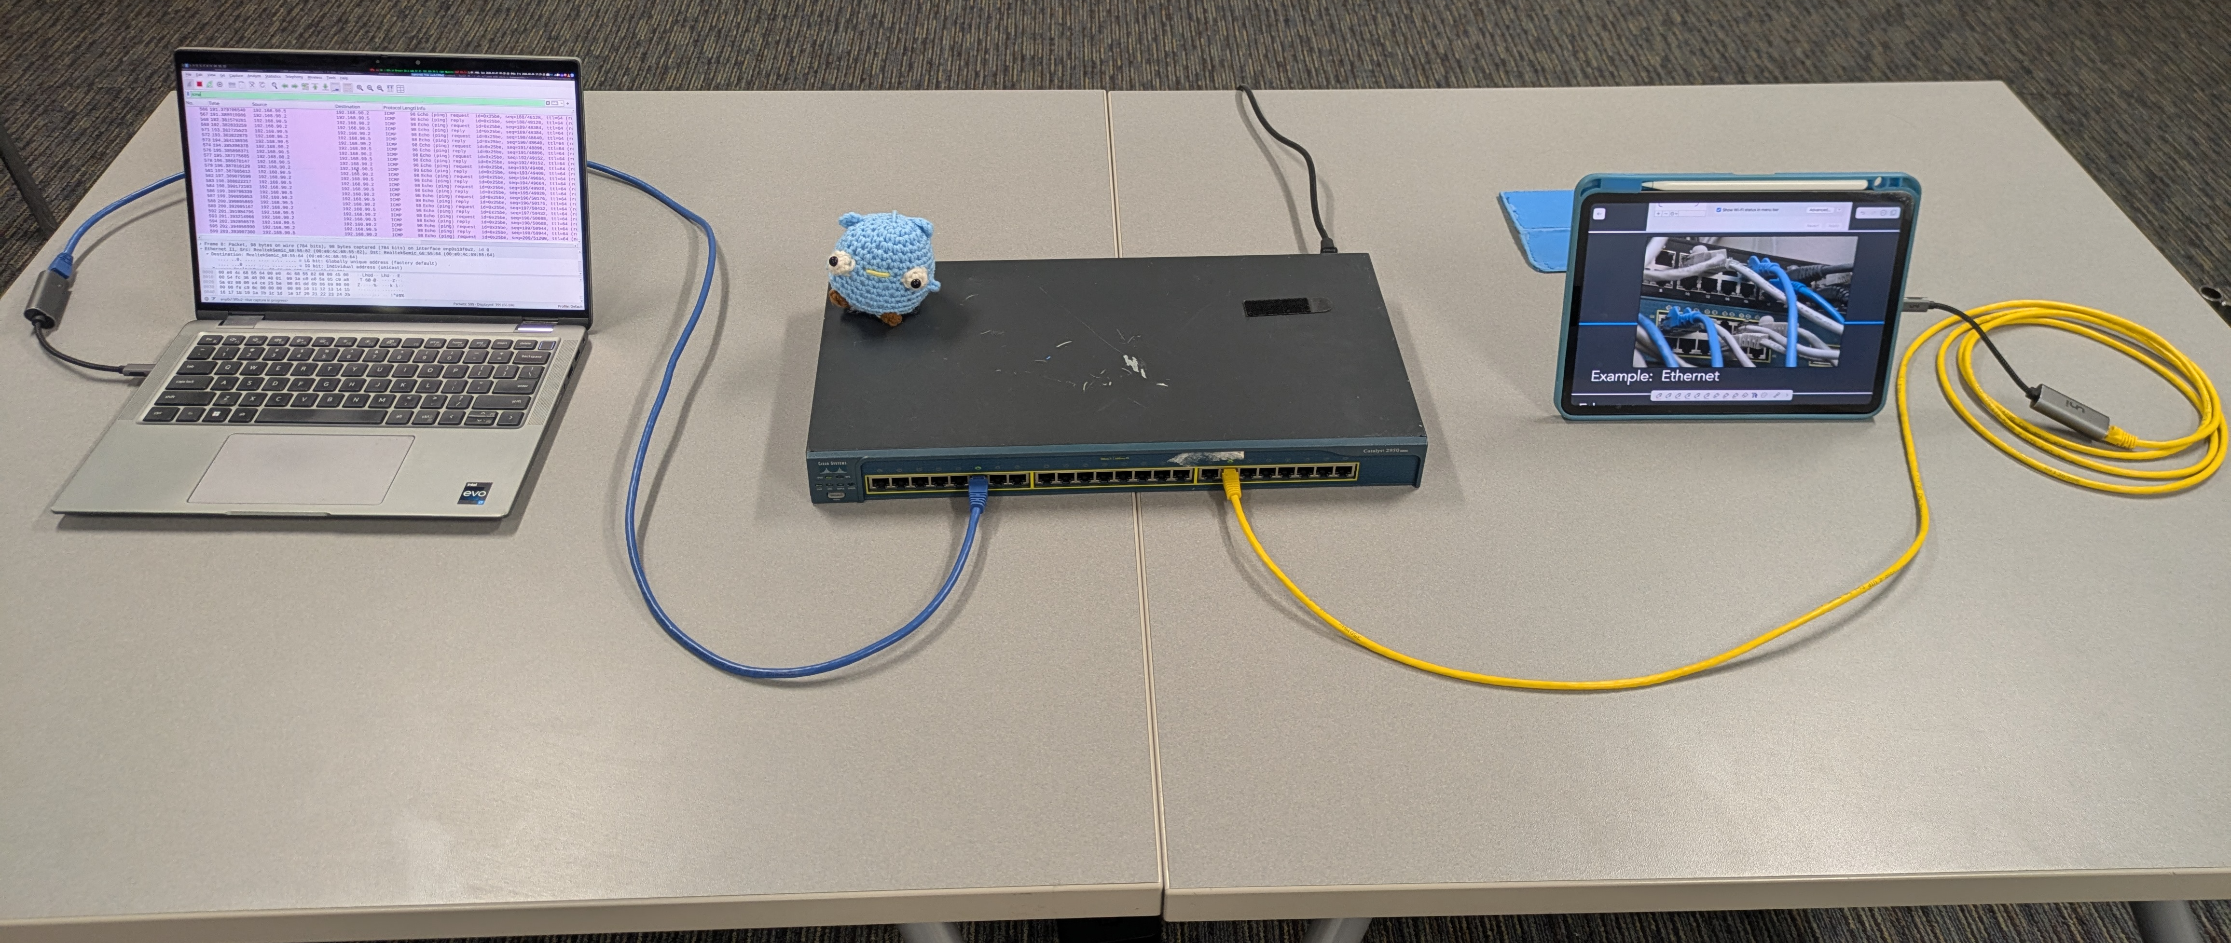
Switch: network device that forwards frames (packets) between ports

Slide 10
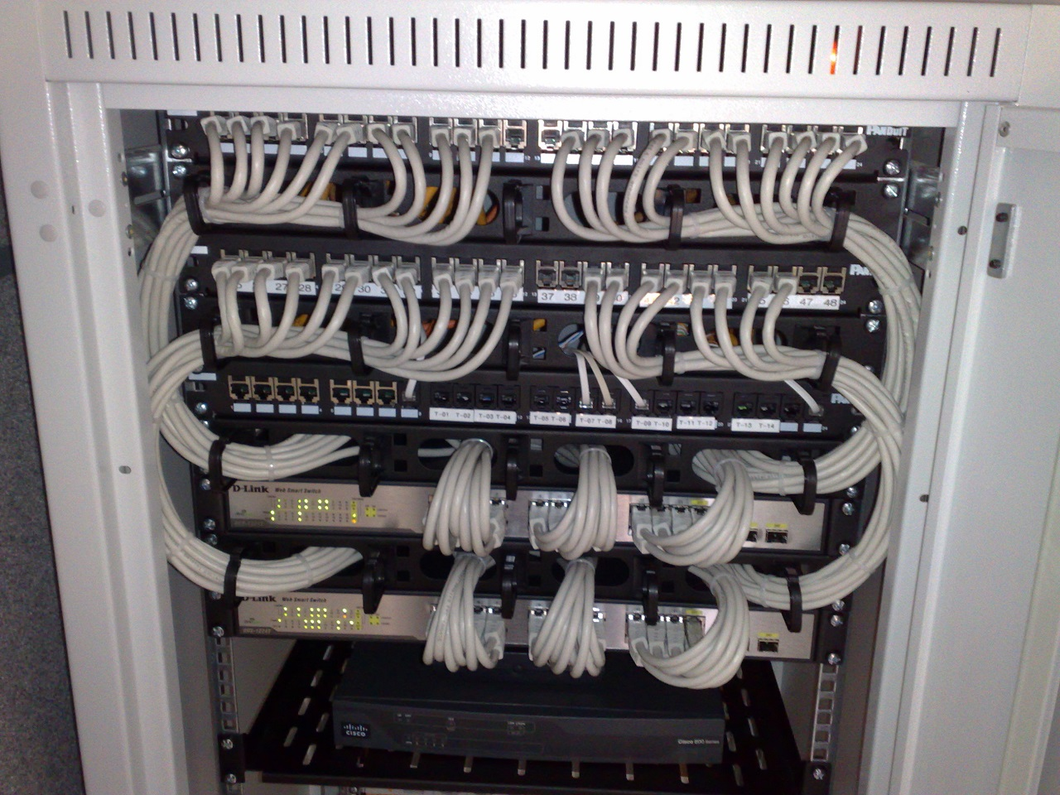
Switch: network device that forwards frames (packets) between ports

Slide 11
Example: Ethernet switch MAC table
R6#sh mac-address-table
EHWIC: 0
Destination Address Address Type VLAN Destination Port
------------------- ------------ ---- -----------------
5c45.27e0.8383 Dynamic 1 GigabitEthernet0/1/3
7641.7b63.584a Dynamic 20 GigabitEthernet0/1/3
5c45.27e0.8381 Dynamic 10 GigabitEthernet0/1/3
0000.5e00.0101 Dynamic 10 GigabitEthernet0/0/1
ca3f.aee3.e3e6 Dynamic 20 GigabitEthernet0/1/3
644b.f012.7f75 Dynamic 20 GigabitEthernet0/1/3
f018.9815.8eb8 Dynamic 20 GigabitEthernet0/1/3
ecb5.fa13.4677 Dynamic 20 GigabitEthernet0/0/2
a0a4.c5c2.4165 Dynamic 20 GigabitEthernet0/0/1
4c71.0c92.4f10 Dynamic 10 GigabitEthernet0/1/3
12d3.acae.bbc0 Dynamic 20 GigabitEthernet0/0/1
04d4.c448.9cf7 Dynamic 20 GigabitEthernet0/1/3
Notes:
Takes this information and synthesizes it down into its forwarding table baed on interfaces

Slide 12
Example: Ethernet switch MAC table
R6#sh mac-address-table
EHWIC: 0
Destination Address Address Type VLAN Destination Port
------------------- ------------ ---- -----------------
5c45.27e0.8383 Dynamic 1 GigabitEthernet0/1/3
7641.7b63.584a Dynamic 20 GigabitEthernet0/1/3
5c45.27e0.8381 Dynamic 10 GigabitEthernet0/1/3
0000.5e00.0101 Dynamic 10 GigabitEthernet0/0/1
ca3f.aee3.e3e6 Dynamic 20 GigabitEthernet0/1/3
644b.f012.7f75 Dynamic 20 GigabitEthernet0/1/3
f018.9815.8eb8 Dynamic 20 GigabitEthernet0/1/3
ecb5.fa13.4677 Dynamic 20 GigabitEthernet0/0/2
a0a4.c5c2.4165 Dynamic 20 GigabitEthernet0/0/1
4c71.0c92.4f10 Dynamic 10 GigabitEthernet0/1/3
12d3.acae.bbc0 Dynamic 20 GigabitEthernet0/0/1
04d4.c448.9cf7 Dynamic 20 GigabitEthernet0/1/3
Does it scale? 🤔
Notes:
Takes this information and synthesizes it down into its forwarding table baed on interfaces

Slide 13
Why doesn’t it scale?

Slide 14
Enter: IP
Service: user-facing application.
Application-defined messages
Application
Service: multiplexing applications
Reliable byte stream to other node (TCP),
Unreliable datagram (UDP)
Transport
Network
Service: move packets to any other node in the network
Internet Protocol (IP)
Link
Service: move frames to other node across link.
May add reliability, medium access control
Physical
Service: move bits to other node across link

Slide 15
Internet Protocol (IP) Goals
How to connect everyone?
Glue lower-level networks together
A network of networks!
Router: device that forwards packets between networks
Notes:
Goal: have any host be able to talk to any other host
Switches map mac addresses to ports
Routers map NETWORKS to ports/interfaces
Could we build a mac table for all hosts? No!

Slide 16
Internet Protocol (IP) Goals
How to connect everyone?
Glue lower-level networks together
A network of networks!
Router: device that forwards packets between networks
=> Doesn’t that sound like switching?
Notes:
Goal: have any host be able to talk to any other host
Switches map mac addresses to ports
Routers map NETWORKS to ports/interfaces
Could we build a mac table for all hosts? No!

Slide 17
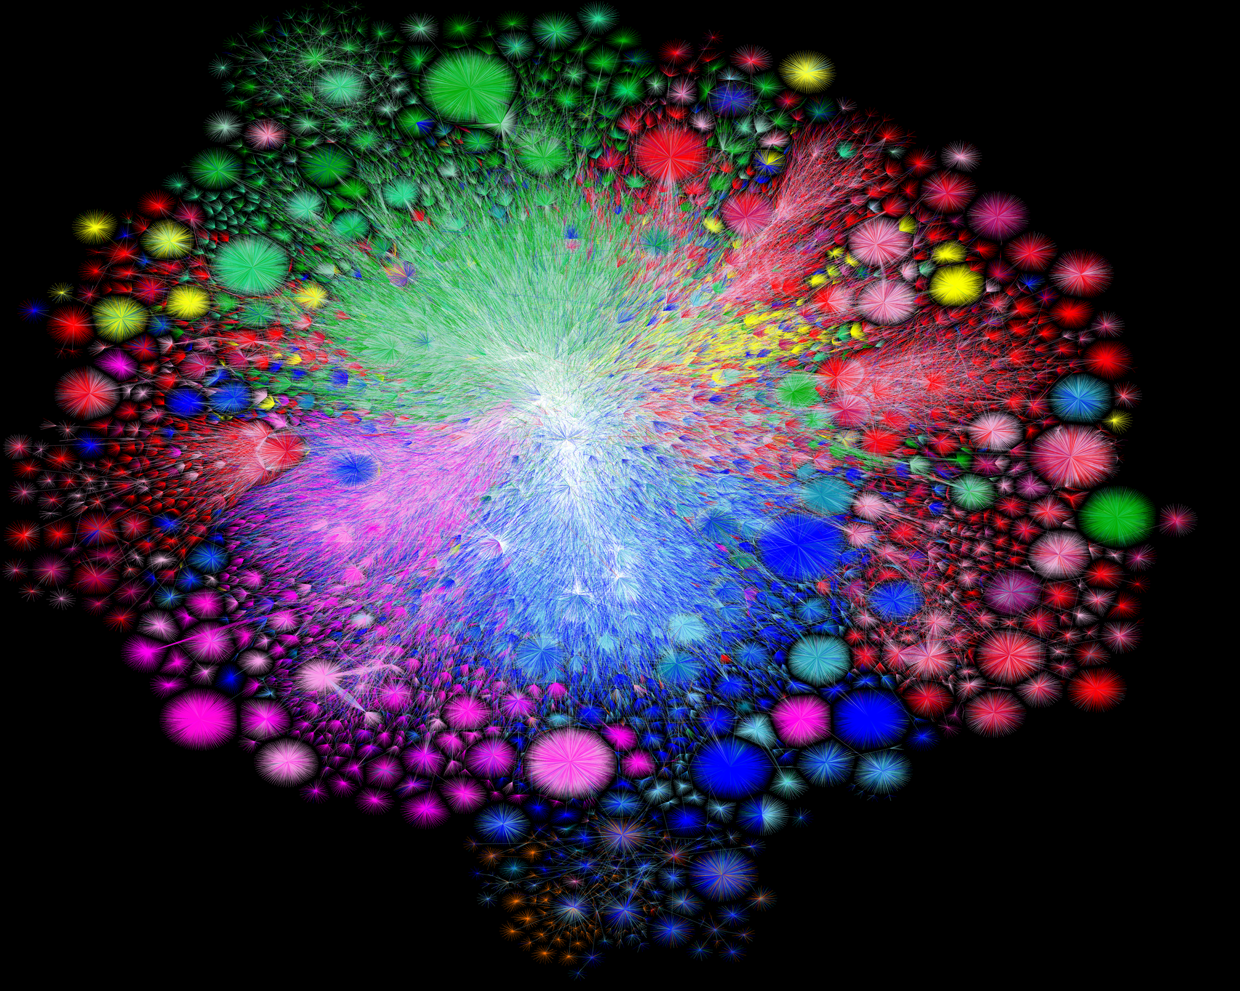
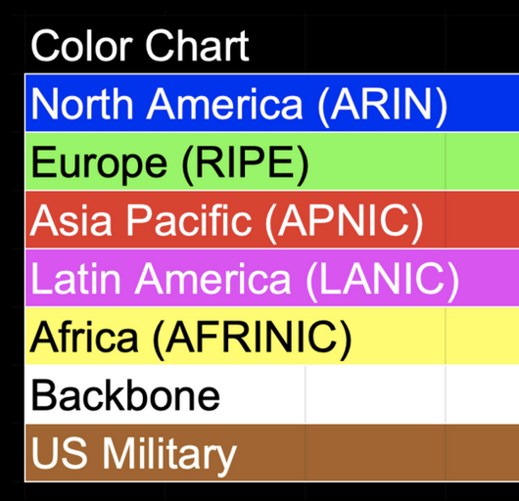
Map of the Internet, 2021 (via BGP)
OPTE project
Notes:
To put something real to this, here’s a map of what that graph looks like. We call the Internet a network of networks: and each point is a network—a group of systems—that can talk to the others. And the network grants us the ability to pretty much communicate between any two points on this graph. And the goal of the network, how it’s designed, and the protocols that comprise it, is to figure out how to get a message there—regardless of where they are, whether they’re connected by a copper wire, or a wireless link, and regardless of what’s being sent.

Slide 18
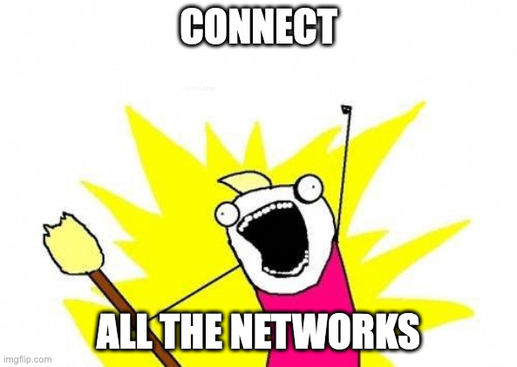

Slide 19
New Challenges
Networks are heterogeneous (eg. Wifi vs. Ethernet)
  Different frame formats
  Some are more reliable than others
  Different packet sizes/bandwidths
Scaling: link-layer strategies don’t work!
Notes:
Could you have a MAC table for all hosts on the Internet? No!

Slide 20
What came before the Internet?

Slide 21
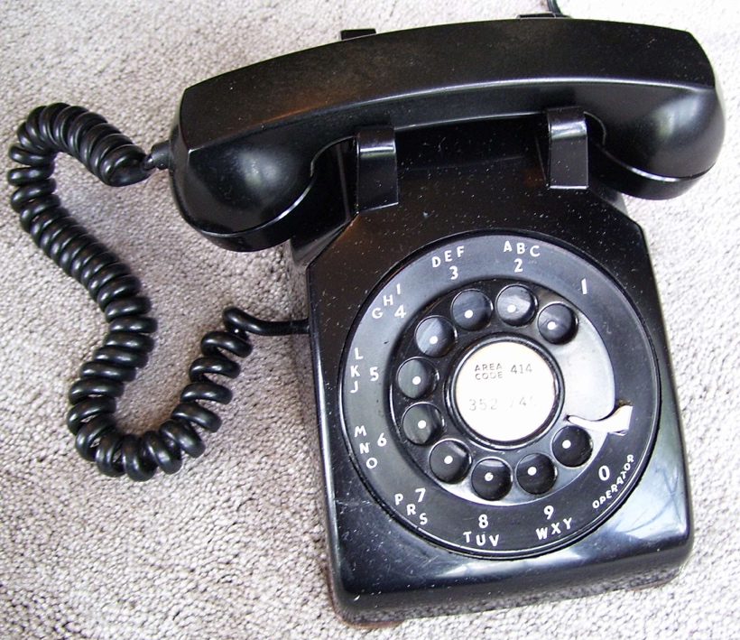
The (landline) telephone network
(Plain Old Telephone Service (POTS)
A Host

Slide 22
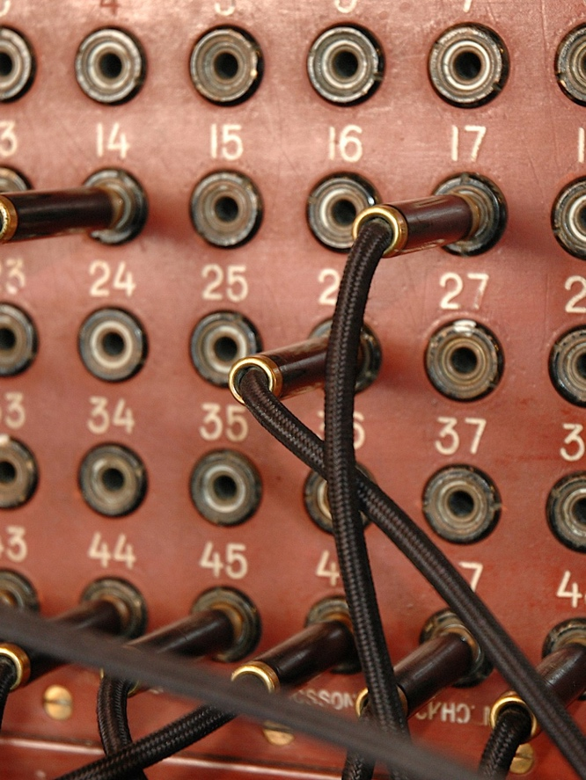
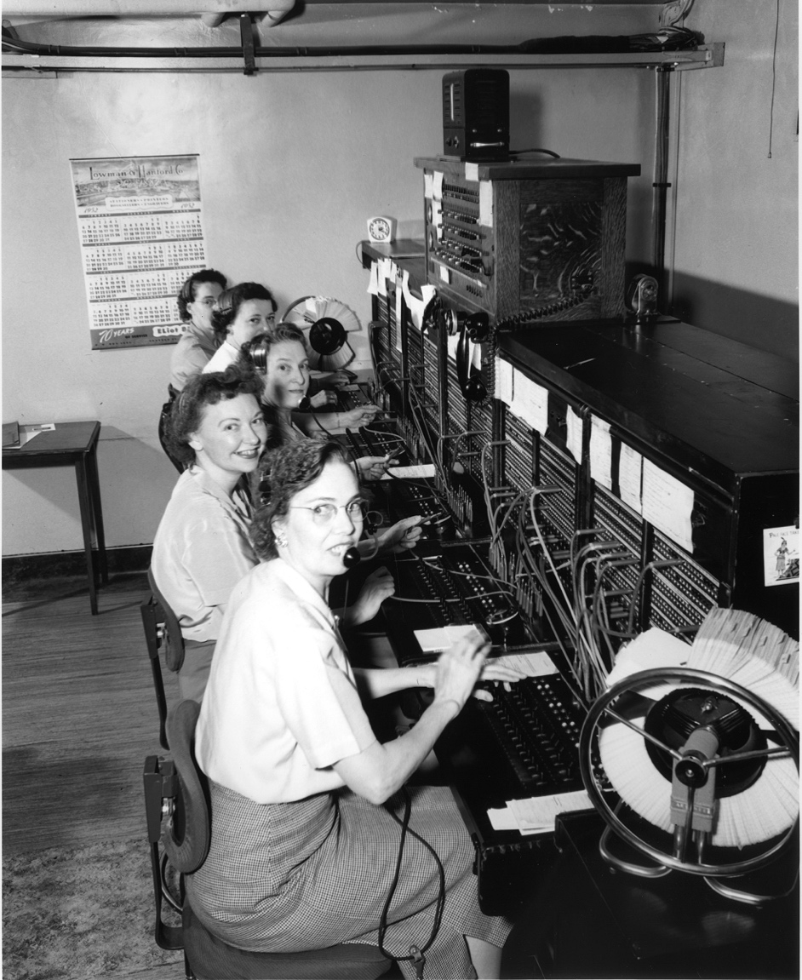
The (landline) telephone network
(Plain Old Telephone Service (POTS)
A Host

Slide 23
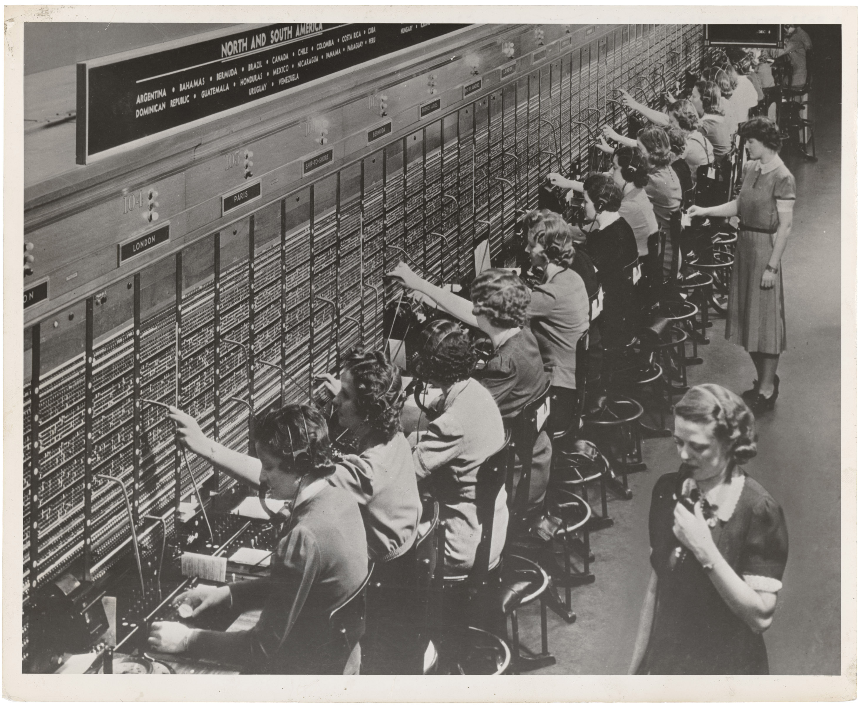
A large telephone exchange, 1943

Slide 24
Example: long distance telephone call
Dramatization from an episode of
radio program “Dragnet”, 1949

Slide 25
Early telephone systems
Circuit switching: set up whole path for call beforehand
Does it scale?

Slide 26
Early Internet goals

Slide 27
Early Internet goals
Build system that can connect different networks
=> Operate over long distances
=> Managed by different entities

Slide 28
Early Internet goals
Build system that can connect different networks
=> Operate over long distances
=> Managed by different entities
Need: devices and protocols to make this work

Slide 29
Design questions
How to deal with heterogeneous networks?
How to find hosts?
Should messages be reliable or unreliable?
What to do when a device joins/leaves?
…

Slide 30
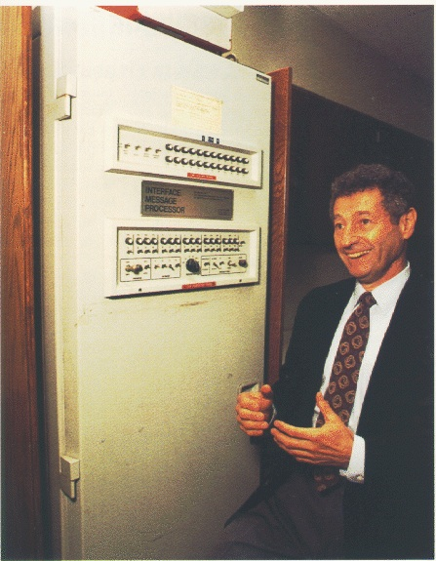
A Bit of History
Early Packet switched networks: Arpanet’s IMPs
  Late 1960’s => RFC 1 (1969)
  Reliable network with many features we know today
Notes:
Interface Message Processors

Slide 31
A Bit of History
Early Packet switched networks: Arpanet’s IMPs
  Late 1960’s => RFC 1, 1969!
  Reliable network with many features we know today
Initial version: Network Control Program (NCP)
  Assumed IMPs were reliable
Notes:
Interface Message Processors

Slide 32
A Bit of History
Early Packet switched networks: Arpanet’s IMPs
  Late 1960’s => RFC 1, 1969!
  Reliable network with many features we know today
Initial version: Network Control Program (NCP)
  Assumed IMPs were reliable
What about when network isn’t reliable?
Notes:
Interface Message Processors

Slide 35
How to make such a protocol?
How to deal with heterogeneous networks?
How to find hosts?
Should messages be reliable or unreliable?
What to do when a device joins/leaves?
…
Big concerns
Not every application needs all features
Can’t assume much functionality from (heterogeneous link layer)

Slide 36
1974: TCP/IP Introduced
Vint Cerf, Robert Kahn build protocol to replace NCP
Initial design: single protocol providing a reliable pipe
Notes:
Initially designed to support Could support any application, but then new requirements

Slide 37
1974: TCP/IP Introduced
Vint Cerf, Robert Kahn build protocol to replace NCP
Initial design: single protocol providing a reliable pipe
Eventually, separated into different protocols we know today
Notes:
Initially designed to support Could support any application, but then new requirements

Slide 38
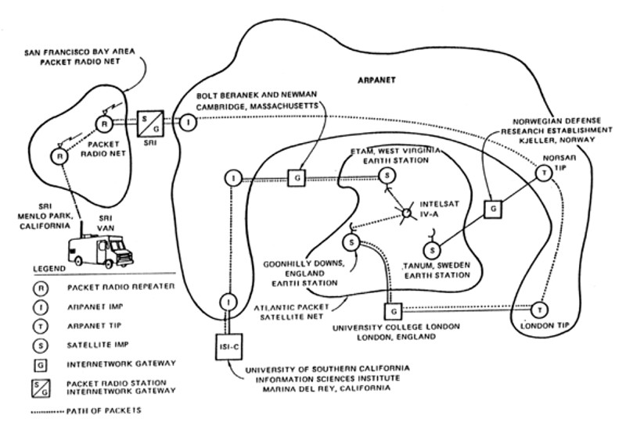

Slide 39
IP’s Decisions
Connectionless, packet-switched network
“Best-effort” service
How to reach hosts?

Slide 40
IP’s Decisions
Connectionless, packet-switched network
  => Routers are “simple” => no connection state
“Best-effort” service: other layers add reliability if you need it
  => Packets might be dropped, reordered, delayed, …
How to reach hosts?
Common message format: IP header
Every host identified by an IP address

Slide 41
An excellent read
David D. Clark, “The design Philosophy of the DARPA Internet Protocols”, 1988
Primary goal: multiplexed utilization of existing interconnected networks
Other goals:
  Communication continues despite loss of networks or gateways
  Support a variety of communication services
  Accommodate a variety of networks
  Permit distributed management of its resources
  Be cost effective
  Low effort for host attachment
  Resources must be accountable
Notes:
In order.
Missing: security

Slide 42
The Internet Protocol (IP): Runs on all hosts and routers
Notes:
Two main concepts:
We’re going to talk about addressing and forwarding today
And the thing is, every host will implement IP, so responsible for moving packets. The host has more, the router only needs to worry about IP. And that keeps the router simple—all of the hard stuff is pushed to the host.
Assumes you have other routing protocols…
- All of the hard stuff gets pushed to the host, called the end to end principle

Slide 43
The Internet Protocol (IP): Runs on all hosts and routers
Addressing: how we name nodes in an IP network
Provides forwarding: how routers move packets based on the destination address
(later) Routing: how routers build forwarding rules
Notes:
Two main concepts:
We’re going to talk about addressing and forwarding today
And the thing is, every host will implement IP, so responsible for moving packets. The host has more, the router only needs to worry about IP. And that keeps the router simple—all of the hard stuff is pushed to the host.
Assumes you have other routing protocols…
- All of the hard stuff gets pushed to the host, called the end to end principle

Slide 44
IP Addressing

Slide 45

What’s an IP address
Unique number to identify “all” hosts on the Internet
A number with structure => the number tells the network where the host is

Slide 46

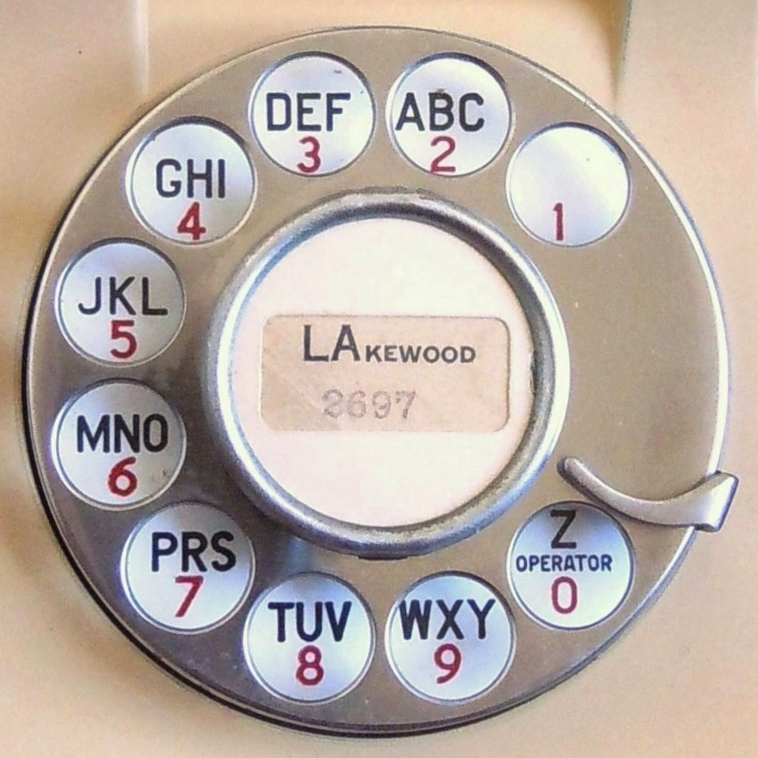
Example: phone numbers
+ 1 401 863 1000

Slide 47
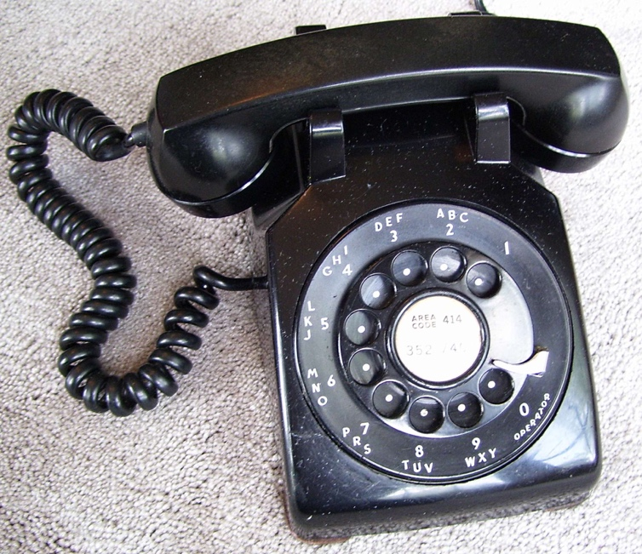
Analogy: back to phones
Telephone numbers have a structure to them
+ 1 401 863 1000
+1 212 555 4253
Part of the number tells where you are!
(or at least it did before cell phones)

Slide 48
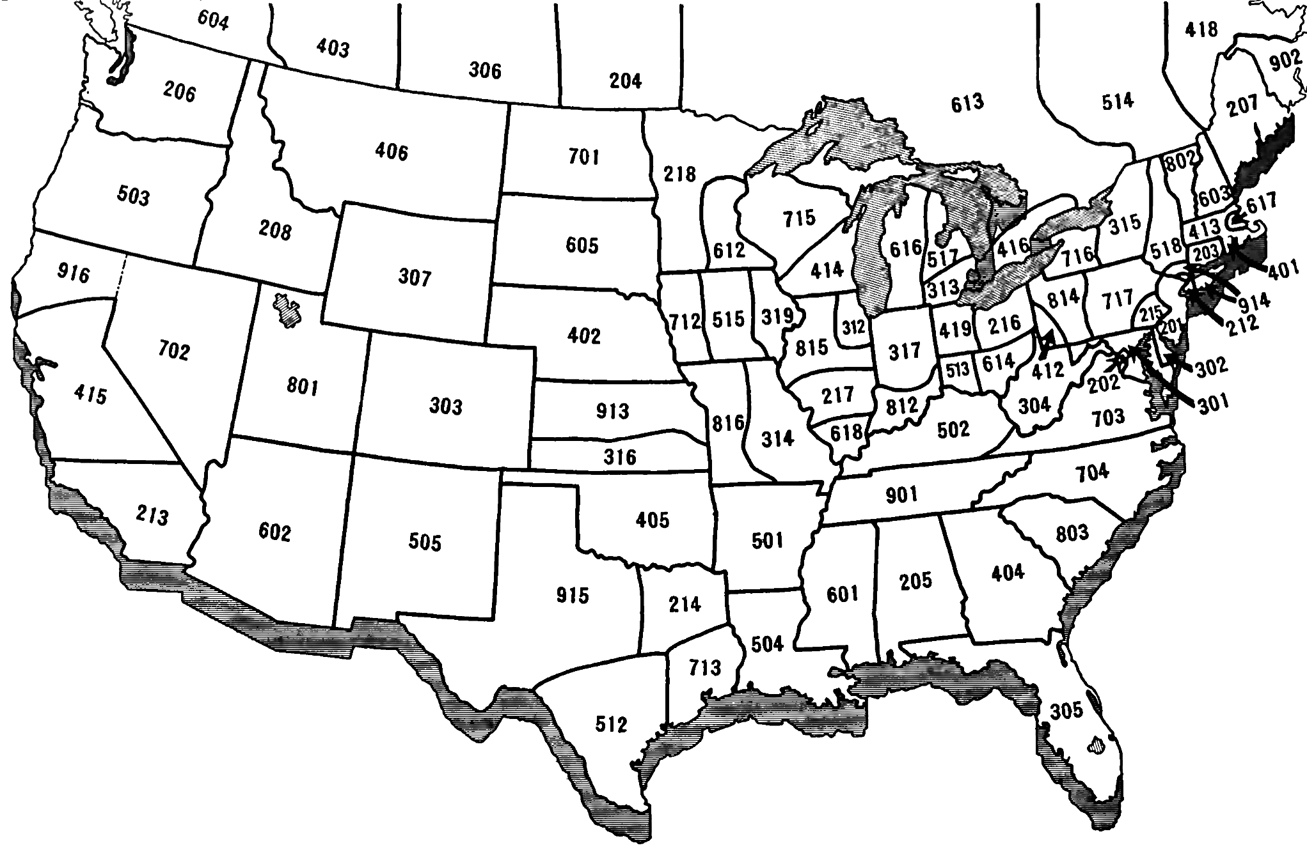

Slide 49
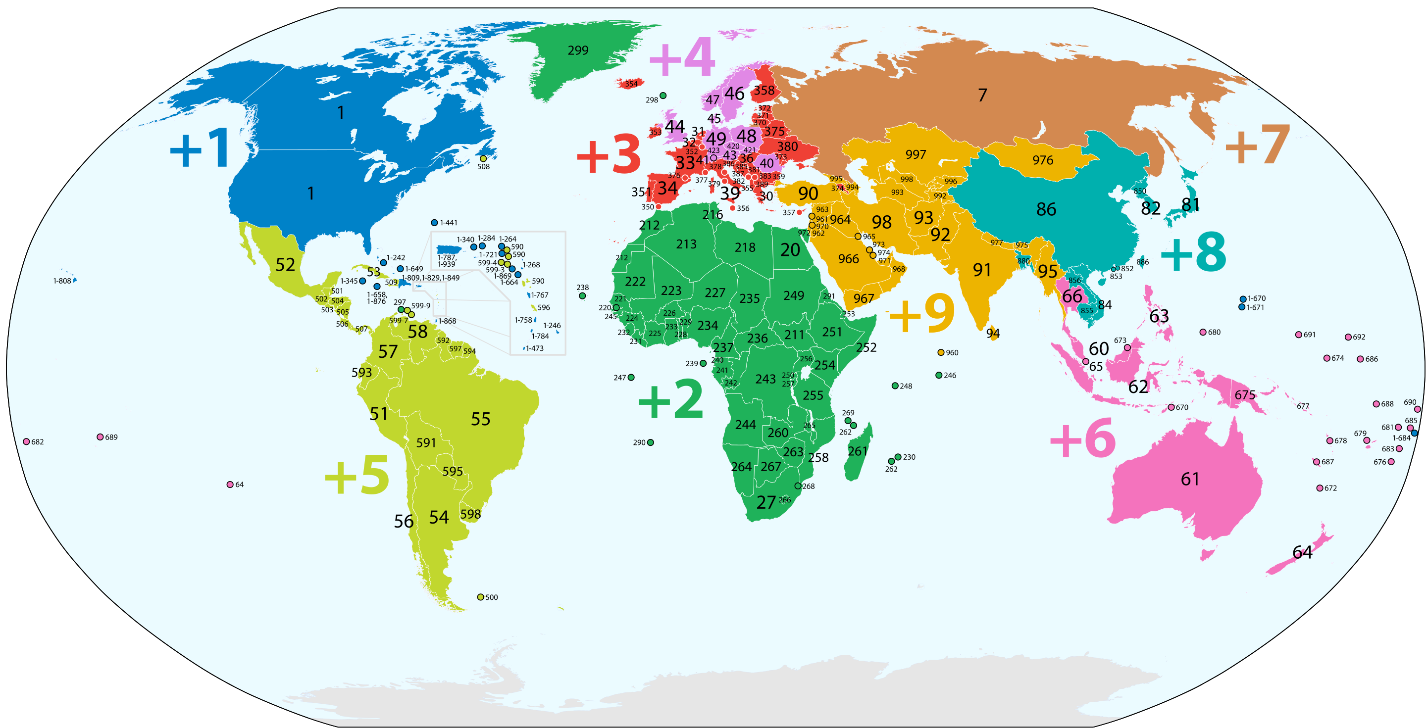
… and not all numbers are the same length!

Slide 50

IP Addressing
128.148.16.7
IP Version 4: Each address is a 32-bit number:
128.148.16.7
10000000 10010100 00010000 00000111
Notation
Write each byte (“octet”) as a decimal number
This is called “dotted decimal” or ”dotted quad” notation
Notes:
There are different versions of IP addresses. We’re going to talk about version 4 (or IPv4), which is the most widely used one. In this form, addresses are 32 bits.
(*)An example of an address is this form here, if we write it out in binary. But we generally don’t like to think in binary too much, so we usually write it in this form: we write each 8-bit group, called an octet, in decimal like this, with dots in between.
And we can see that for a 32-bit number we have 2^32 possible combinations of bits, which means that we can have ~4 billion total addresses. This is actually too small for the Internet as we know it, which is something we’ll talk about if we have time.
But first, what does the address mean, and how do we use it?
Look we have addresses—there are different versions, we’re going to talk about Ipv4, which is the most widely used one. Addresses are 32 bits.
But we don’t like to think about that, so we turn it into octos
So let’s look more at an individual IP address.
We encode something about the structure
This is called dotted-decimal notation, each number between the dots is called an “octet”
So each group, or octet is an 8 bit number
There’s a host part, and a network part, and the size of the host part and network part depend on the size of the network
How many total addresses do we have?

Slide 51
IP Addressing
128.148.16.7
IP Version 4: Each address is a 32-bit number:
128.148.16.7
10000000 10010100 00010000 00000111
32 bits => 2³² possible addresses… problem?
Notation
Write each byte (“octet”) as a decimal number
This is called “dotted decimal” or ”dotted quad” notation
Notes:
There are different versions of IP addresses. We’re going to talk about version 4 (or IPv4), which is the most widely used one. In this form, addresses are 32 bits.
(*)An example of an address is this form here, if we write it out in binary. But we generally don’t like to think in binary too much, so we usually write it in this form: we write each 8-bit group, called an octet, in decimal like this, with dots in between.
And we can see that for a 32-bit number we have 2^32 possible combinations of bits, which means that we can have ~4 billion total addresses. This is actually too small for the Internet as we know it, which is something we’ll talk about if we have time.
But first, what does the address mean, and how do we use it?
Look we have addresses—there are different versions, we’re going to talk about Ipv4, which is the most widely used one. Addresses are 32 bits.
But we don’t like to think about that, so we turn it into octos
So let’s look more at an individual IP address.
We encode something about the structure
This is called dotted-decimal notation, each number between the dots is called an “octet”
So each group, or octet is an 8 bit number
There’s a host part, and a network part, and the size of the host part and network part depend on the size of the network
How many total addresses do we have?

Slide 52
Conceptually: an IP address has two parts
128.148.16.7
10000000 10010100 00010000 00000111

Slide 53
Conceptually: an IP address has two parts
=> Network part: identifies this network to the Internet
=> Host part: identifies hosts on that network
128.148.16.7
10000000 10010100 00010000 00000111
Size of host part vs. network part can vary (more on this later)

Slide 54
IP Addressing
Brown owns the range:
128.148.xxx.xxx
10000000 10010100 xxxxxxxx xxxxxxxx
Network part
Identifies Brown (to the Internet)
Host part
Denotes individual hosts
within the Brown Network
Notes:
The idea is that those two questions: who a host is, and where it is on the network, are encoded inside the address. So every address has two parts: the network part, which denotes which network we are on: so to the outside internet, addresses starting with 1.2 identify Enet. The rest is the host part, which identifies individual hosts within Enet.
And the size of this host portion tells us how many addresses can be contained inside Enet: so there are 16 bits here which means that there are 2^16 addresses that start with 1.2, which means there are ~65K hosts that we can address with this allocation
Networks are allocated blocks of IP address space
If we pick this allocation, ExampleNet can assign any IP address that starts with 1.2.x.x to any of its hosts
So valid addresses would be
Everything on the internet is hierarchically organized into networks—so the network part is an ID for the network. The host part identifies the hosts within the network.

Slide 55

Assigning numbers
Networks are allocated ranges of IPs
by global authority (ICANN)
  Further subdivided by regions, ISPs, …
Some IPs have special uses (eg. 127.0.0.1)
128.148.16.7
eg. Brown owns 128.148.xxx.xxx, 138.16.xxx.xxx
*ICANN (Internet Corporation for Assigned Names and Numbers)
Notes:
An IP address provides two things:
ICANN (Internet Corporation for Assigned Names and Numbers)
For the purposes of this talk, I'm going to make up a network that I'll call ExampleNet, or Enet, let’s say that the allocation that ENet gets is 1.2.xxx.xxx
As long as a host is part of ExampleNet, then the network is 1.2. Then, the other part is what can change. All the hosts belong to the same network
I’m on the Brown network, and I’m host number #1247
So remember our two goals: who a host is, and how we need to get there. IP addresses help us with both of these
We encode something about the Internet structure into the address
Addresses are allocated to networks—we leverage some hierarchical structure
A network is a group of hosts, possibly a group of networks. Networks are connected together with routers, which connect multiple interfaces
Let’s zoom in on ExampleNet

Slide 56
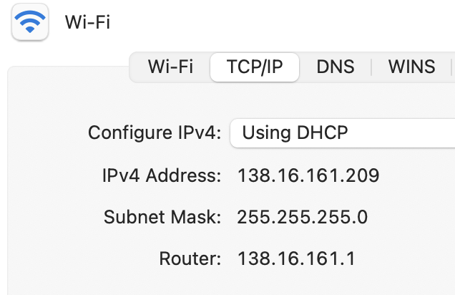
A typical configuration

Slide 57
What do we do with this number?
1.2.1.2
1.2.1.1
1.2.1.3
…
1.2.1.200

Slide 58
What do we do with this number?
Link layer: know how to communicate with devices on “your network”
Routers: know about multiple networks => Use address to decide how to forward packets between them
1.2.1.2
1.2.1.1
1.2.1.3
…
1.2.1.200

Slide 59
How IP forwarding works
Assume:
Communicating on same network is easy—this is the link-layer’s job!
Can map IP addresses to MAC addresses (more on this later)
How to reach an address outside this network?
1.2.1.2
1.2.1.1
1.2.1.3
…
Send packets to a router,
which forwards IP packets
to other networks
1.2.1.200
Notes:
ENet is free to assign addresses however it wants within its network, and in turn it can also make networks inside itself. So to look at this we’re going to start with a smaller network, this /24 here, which starts with 1.2.1.
For now we can say that as long as we’re in the same network, there are other devices like switches that transfer information from one host to another.
But what happens if we want to reach one host outside the network?
As long as we’re inside the network, we don’t need to make as much of a decision from the perspective of the Internet. It’s like shouting. I’m abstracting things here,

Slide 60
How do we move packets between networks?
Notes:
Now that we have the ability to name hosts, how do we move packets between them?
Another way to think about these things—and then the network part is some kind of grouping to refer to them as the same authority

Slide 61
To more networks (ie, Internet)
1.2.1.2
IF0
1.2.2.100
IF1
IF2
1.2.1.3
1.2.1.1
1.2.2.1
1.2.2.105
1.2.1.200
Subnet “A”: 1.2.1.0/24
Subnet “B”: 1.2.2.0/24
Notes:
Let’s first look at how we move packets between the two networks

Slide 62
What does it mean to be on the same network?

Slide 63
All systems with an IP address have a
configuration like this
138.16.161.209
Addr:
138.16.161.209
10001010 00010000 10100001 11010001
Mask:
255.255.255.0
&
11111111 11111111 11111111 00000000
10001010 00010000 10100001 00000000
24 bits
138.16.161.0
Can also write as 138.16.161.209/24
“Prefix notation” or “CIDR notation”

Slide 64
All systems with an IP address have a
configuration like this
138.16.161.209
Addr:
138.16.161.209
10001010 00010000 10100001 11010001
Mask:
255.255.255.0
11111111 11111111 11111111 00000000
=> Bitmask used to “filter out” which part is for hosts on the same network

Slide 65
All systems with an IP address have a
configuration like this
138.16.161.209
Addr:
138.16.161.209
10001010 00010000 10100001 11010001
Mask:
255.255.255.0
&
11111111 11111111 11111111 00000000
10001010 00010000 10100001 00000000
24 bits
138.16.161.0
Can also write as 138.16.161.209/24
“Prefix notation” or “CIDR notation”

Slide 66
138.16.161.0/24
10001010 00010000 10100001 xxxxxxxx
138.16.161.204
10001010 00010000 10100001 10100001
1.2.3.4
00000001 00000010 00000011 00000100
The mask can be any size 0-32
Not just checking the first three digits!

Slide 67
How do we move packets between networks?
Notes:
Now that we have the ability to name hosts, how do we move packets between them?
Another way to think about these things—and then the network part is some kind of grouping to refer to them as the same authority

Slide 68
A forwarding table (my laptop)
deemer@ceres ~ % ip route default via 10.3.128.1 dev wlp2s0
10.3.128.0/18 dev wlp2s0 proto dhcp scope link src 10.3.135.44 metric 3003
172.18.0.0/16 dev docker0 proto kernel scope link src 172.18.0.1
192.168.1.0/24 dev enp0s31f6 proto kernel scope link src 192.168.1.1

Slide 69
A routing table
R6#sh ip ro
Gateway of last resort is 108.34.215.1 to network 0.0.0.0
S* 0.0.0.0/0 [1/0] via 108.34.215.1
10.0.0.0/8 is variably subnetted, 7 subnets, 3 masks
C 10.1.0.0/24 is directly connected, wlan-ap0
L 10.1.0.2/32 is directly connected, wlan-ap0
O IA 10.1.44.1/32 [110/1001] via 10.20.30.33, 3w4d, Tunnel0
C 10.1.48.0/24 is directly connected, Loopback0
L 10.1.48.1/32 is directly connected, Loopback0
C 10.20.30.32/31 is directly connected, Tunnel0
L 10.20.30.32/32 is directly connected, Tunnel0
108.0.0.0/8 is variably subnetted, 2 subnets, 2 masks
C 108.34.215.0/24 is directly connected, GigabitEthernet0/0
L 108.34.215.208/32 is directly connected, GigabitEthernet0/0
172.16.0.0/16 is variably subnetted, 2 subnets, 2 masks
C 172.16.98.0/24 is directly connected, Vlan98
L 172.16.98.1/32 is directly connected, Vlan98
172.17.0.0/16 is variably subnetted, 6 subnets, 3 masks
O IA 172.17.44.0/24 [110/1001] via 10.20.30.33, 3w4d, Tunnel0
C 172.17.48.0/24 is directly connected, Vlan20
L 172.17.48.1/32 is directly connected, Vlan20
C 172.17.49.0/25 is directly connected, Vlan50
L 172.17.49.1/32 is directly connected, Vlan50
O IA 172.17.80.0/25 [110/1011] via 10.20.30.33, 4d12h, Tunnel0
Notes:
Takes this information and synthesizes it down into its forwarding table baed on interfaces

Slide 70
A routing table
R6#sh ip ro
Codes: L - local, C - connected, S - static, R - RIP, M - mobile, B - BGP
D - EIGRP, EX - EIGRP external, O - OSPF, IA - OSPF inter area
N1 - OSPF NSSA external type 1, N2 - OSPF NSSA external type 2
E1 - OSPF external type 1, E2 - OSPF external type 2
i - IS-IS, su - IS-IS summary, L1 - IS-IS level-1, L2 - IS-IS level-2
ia - IS-IS inter area, * - candidate default, U - per-user static route
o - ODR, P - periodic downloaded static route, H - NHRP, l - LISP
+ - replicated route, % - next hop override
Gateway of last resort is 108.34.215.1 to network 0.0.0.0
S* 0.0.0.0/0 [1/0] via 108.34.215.1
10.0.0.0/8 is variably subnetted, 7 subnets, 3 masks
C 10.1.0.0/24 is directly connected, wlan-ap0
L 10.1.0.2/32 is directly connected, wlan-ap0
O IA 10.1.44.1/32 [110/1001] via 10.20.30.33, 3w4d, Tunnel0
C 10.1.48.0/24 is directly connected, Loopback0
L 10.1.48.1/32 is directly connected, Loopback0
C 10.20.30.32/31 is directly connected, Tunnel0
L 10.20.30.32/32 is directly connected, Tunnel0
108.0.0.0/8 is variably subnetted, 2 subnets, 2 masks
C 108.34.215.0/24 is directly connected, GigabitEthernet0/0
L 108.34.215.208/32 is directly connected, GigabitEthernet0/0
172.16.0.0/16 is variably subnetted, 2 subnets, 2 masks
C 172.16.98.0/24 is directly connected, Vlan98
L 172.16.98.1/32 is directly connected, Vlan98
172.17.0.0/16 is variably subnetted, 6 subnets, 3 masks
O IA 172.17.44.0/24 [110/1001] via 10.20.30.33, 3w4d, Tunnel0
C 172.17.48.0/24 is directly connected, Vlan20
L 172.17.48.1/32 is directly connected, Vlan20
C 172.17.49.0/25 is directly connected, Vlan50
L 172.17.49.1/32 is directly connected, Vlan50
O IA 172.17.80.0/25 [110/1011] via 10.20.30.33, 4d12h, Tunnel0
Notes:
Takes this information and synthesizes it down into its forwarding table baed on interfaces

Slide 71
A large table
rviews@route-server.ip.att.net>show route table inet.0 active-path
inet.0: 866991 destinations, 13870153 routes (866991 active, 0 holddown, 0 hidden)
+ = Active Route, - = Last Active, * = Both
0.0.0.0/0 *[Static/5] 5w0d 19:43:09
> to 12.0.1.1 via em0.0
1.0.0.0/24 *[BGP/170] 1d 10:24:47, localpref 100, from 12.122.83.238
AS path: 7018 3356 13335 I, validation-state: valid
> to 12.0.1.1 via em0.0
1.0.4.0/22 *[BGP/170] 1d 10:24:47, localpref 100, from 12.122.83.238
AS path: 7018 3356 4826 38803 I, validation-state: valid
> to 12.0.1.1 via em0.0
1.0.4.0/24 *[BGP/170] 1d 10:24:47, localpref 100, from 12.122.83.238
AS path: 7018 3356 4826 38803 I, validation-state: valid
> to 12.0.1.1 via em0.0
1.0.5.0/24 *[BGP/170] 1d 10:24:47, localpref 100, from 12.122.83.238
AS path: 7018 3356 4826 38803 I, validation-state: valid
> to 12.0.1.1 via em0.0
1.0.6.0/24 *[BGP/170] 1d 10:24:47, localpref 100, from 12.122.83.238
AS path: 7018 3356 4826 38803 I, validation-state: valid
> to 12.0.1.1 via em0.0
1.0.7.0/24 *[BGP/170] 1d 10:24:47, localpref 100, from 12.122.83.238
AS path: 7018 3356 4826 38803 I, validation-state: valid
> to 12.0.1.1 via em0.0
1.0.64.0/18 *[BGP/170] 1d 10:24:47, localpref 100, from 12.122.83.238
AS path: 7018 2497 7670 18144 I, validation-state: unknown
> to 12.0.1.1 via em0.0
1.0.128.0/17 *[BGP/170] 1d 10:24:47, localpref 100, from 12.122.83.238
AS path: 7018 3356 38040 23969 I, validation-state: unknown
> to 12.0.1.1 via em0.0
1.0.128.0/18 *[BGP/170] 1d 10:24:47, localpref 100, from 12.122.83.238
AS path: 7018 3356 38040 23969 I, validation-state: unknown
> to 12.0.1.1 via em0.0
1.0.128.0/19 *[BGP/170] 1d 10:24:47, localpref 100, from 12.122.83.238
AS path: 7018 3356 38040 23969 I, validation-state: unknown
> to 12.0.1.1 via em0.0
1.0.128.0/24 *[BGP/170] 1d 10:24:47, localpref 100, from 12.122.83.238
AS path: 7018 6939 4651 23969 I, validation-state: unknown
> to 12.0.1.1 via em0.0
1.0.129.0/24 *[BGP/170] 1d 10:24:47, localpref 100, from 12.122.83.238
AS path: 7018 6939 4651 23969 I, validation-state: unknown
> to 12.0.1.1 via em0.0
Notes:
Takes this information and synthesizes it down into its forwarding table baed on interfaces

Slide 72
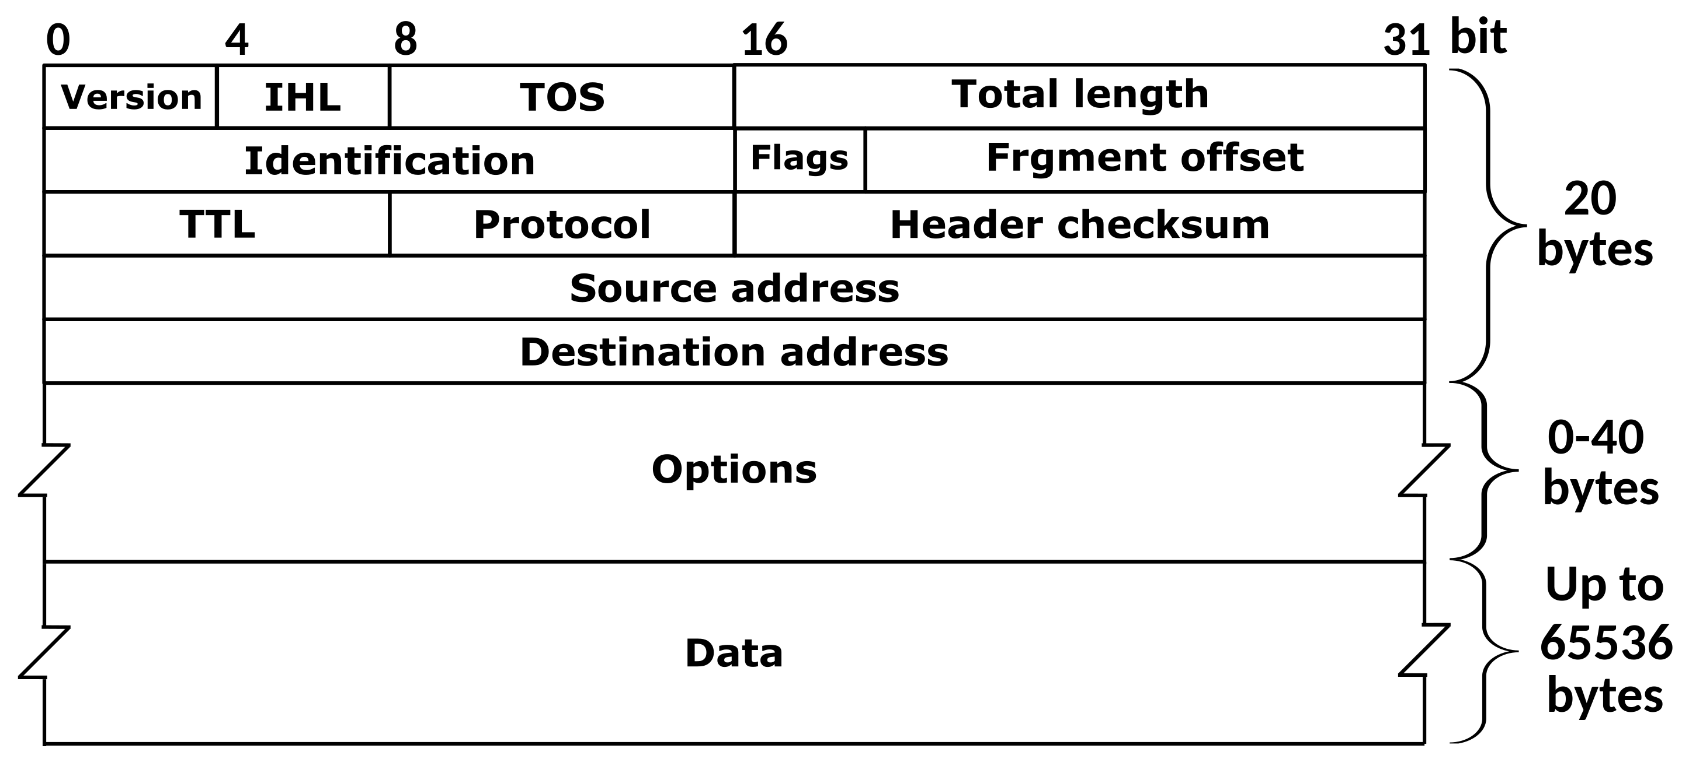
The IPv4 Header
Defined by RFC 791
RFC (Request for Comment): defines network standard
Notes:
The key parts are HERE

Slide 73
Traceroute example
[deemer@Warsprite ~]$ traceroute -q 1 google.com
traceroute to google.com (142.251.40.174), 30 hops max, 60 byte packets
1 router1-nac.linode.com (207.99.1.13) 0.621 ms
2 if-0-1-0-0-0.gw1.cjj1.us.linode.com (173.255.239.26) 0.499 ms
3 72.14.222.136 (72.14.222.136) 0.949 ms
4 72.14.222.136 (72.14.222.136) 0.919 ms
5 108.170.248.65 (108.170.248.65) 1.842 ms
6 lga25s81-in-f14.1e100.net (142.251.40.174) 1.812 ms

Slide 74
Traceroute example
[deemer@Warsprite ~]$ traceroute -q 1 amazon.co.uk
traceroute to amazon.co.uk (178.236.7.220), 30 hops max, 60 byte packets
1 router2-nac.linode.com (207.99.1.14) 0.577 ms
2 if-11-1-0-1-0.gw2.cjj1.us.linode.com (173.255.239.16) 0.461 ms
3 ix-et-2-0-2-0.tcore3.njy-newark.as6453.net (66.198.70.104) 1.025 ms
4 be3294.ccr41.jfk02.atlas.cogentco.com (154.54.47.217) 2.938 ms
5 be2317.ccr41.lon13.atlas.cogentco.com (154.54.30.186) 69.725 ms
6 be2350.rcr21.b023101-0.lon13.atlas.cogentco.com (130.117.51.138) 69.947 ms
7 a100-row.demarc.cogentco.com (149.11.173.122) 71.639 ms
8 150.222.15.28 (150.222.15.28) 78.217 ms
9 150.222.15.21 (150.222.15.21) 84.383 ms
10 *
11 150.222.15.4 (150.222.15.4) 74.529 ms
. . .
30 178.236.14.162 (178.236.14.162) 83.659 ms

Slide 75
A routing table
R6#sh ip ro
Codes: L - local, C - connected, S - static, R - RIP, M - mobile, B - BGP
D - EIGRP, EX - EIGRP external, O - OSPF, IA - OSPF inter area
N1 - OSPF NSSA external type 1, N2 - OSPF NSSA external type 2
E1 - OSPF external type 1, E2 - OSPF external type 2
i - IS-IS, su - IS-IS summary, L1 - IS-IS level-1, L2 - IS-IS level-2
ia - IS-IS inter area, * - candidate default, U - per-user static route
o - ODR, P - periodic downloaded static route, H - NHRP, l - LISP
+ - replicated route, % - next hop override
Gateway of last resort is 108.34.215.1 to network 0.0.0.0
S* 0.0.0.0/0 [1/0] via 108.34.215.1
10.0.0.0/8 is variably subnetted, 7 subnets, 3 masks
C 10.1.0.0/24 is directly connected, wlan-ap0
L 10.1.0.2/32 is directly connected, wlan-ap0
O IA 10.1.44.1/32 [110/1001] via 10.20.30.33, 3w4d, Tunnel0
C 10.1.48.0/24 is directly connected, Loopback0
L 10.1.48.1/32 is directly connected, Loopback0
C 10.20.30.32/31 is directly connected, Tunnel0
L 10.20.30.32/32 is directly connected, Tunnel0
108.0.0.0/8 is variably subnetted, 2 subnets, 2 masks
C 108.34.215.0/24 is directly connected, GigabitEthernet0/0
L 108.34.215.208/32 is directly connected, GigabitEthernet0/0
172.16.0.0/16 is variably subnetted, 2 subnets, 2 masks
C 172.16.98.0/24 is directly connected, Vlan98
L 172.16.98.1/32 is directly connected, Vlan98
172.17.0.0/16 is variably subnetted, 6 subnets, 3 masks
O IA 172.17.44.0/24 [110/1001] via 10.20.30.33, 3w4d, Tunnel0
C 172.17.48.0/24 is directly connected, Vlan20
L 172.17.48.1/32 is directly connected, Vlan20
C 172.17.49.0/25 is directly connected, Vlan50
L 172.17.49.1/32 is directly connected, Vlan50
O IA 172.17.80.0/25 [110/1011] via 10.20.30.33, 4d12h, Tunnel0
Notes:
Takes this information and synthesizes it down into its forwarding table baed on interfaces

Slide 76
A large table
rviews@route-server.ip.att.net>show route table inet.0 active-path
inet.0: 866991 destinations, 13870153 routes (866991 active, 0 holddown, 0 hidden)
+ = Active Route, - = Last Active, * = Both
0.0.0.0/0 *[Static/5] 5w0d 19:43:09
> to 12.0.1.1 via em0.0
1.0.0.0/24 *[BGP/170] 1d 10:24:47, localpref 100, from 12.122.83.238
AS path: 7018 3356 13335 I, validation-state: valid
> to 12.0.1.1 via em0.0
1.0.4.0/22 *[BGP/170] 1d 10:24:47, localpref 100, from 12.122.83.238
AS path: 7018 3356 4826 38803 I, validation-state: valid
> to 12.0.1.1 via em0.0
1.0.4.0/24 *[BGP/170] 1d 10:24:47, localpref 100, from 12.122.83.238
AS path: 7018 3356 4826 38803 I, validation-state: valid
> to 12.0.1.1 via em0.0
1.0.5.0/24 *[BGP/170] 1d 10:24:47, localpref 100, from 12.122.83.238
AS path: 7018 3356 4826 38803 I, validation-state: valid
> to 12.0.1.1 via em0.0
1.0.6.0/24 *[BGP/170] 1d 10:24:47, localpref 100, from 12.122.83.238
AS path: 7018 3356 4826 38803 I, validation-state: valid
> to 12.0.1.1 via em0.0
1.0.7.0/24 *[BGP/170] 1d 10:24:47, localpref 100, from 12.122.83.238
AS path: 7018 3356 4826 38803 I, validation-state: valid
> to 12.0.1.1 via em0.0
1.0.64.0/18 *[BGP/170] 1d 10:24:47, localpref 100, from 12.122.83.238
AS path: 7018 2497 7670 18144 I, validation-state: unknown
> to 12.0.1.1 via em0.0
1.0.128.0/17 *[BGP/170] 1d 10:24:47, localpref 100, from 12.122.83.238
AS path: 7018 3356 38040 23969 I, validation-state: unknown
> to 12.0.1.1 via em0.0
1.0.128.0/18 *[BGP/170] 1d 10:24:47, localpref 100, from 12.122.83.238
AS path: 7018 3356 38040 23969 I, validation-state: unknown
> to 12.0.1.1 via em0.0
1.0.128.0/19 *[BGP/170] 1d 10:24:47, localpref 100, from 12.122.83.238
AS path: 7018 3356 38040 23969 I, validation-state: unknown
> to 12.0.1.1 via em0.0
1.0.128.0/24 *[BGP/170] 1d 10:24:47, localpref 100, from 12.122.83.238
AS path: 7018 6939 4651 23969 I, validation-state: unknown
> to 12.0.1.1 via em0.0
1.0.129.0/24 *[BGP/170] 1d 10:24:47, localpref 100, from 12.122.83.238
AS path: 7018 6939 4651 23969 I, validation-state: unknown
> to 12.0.1.1 via em0.0
Notes:
Takes this information and synthesizes it down into its forwarding table baed on interfaces

Slide 77
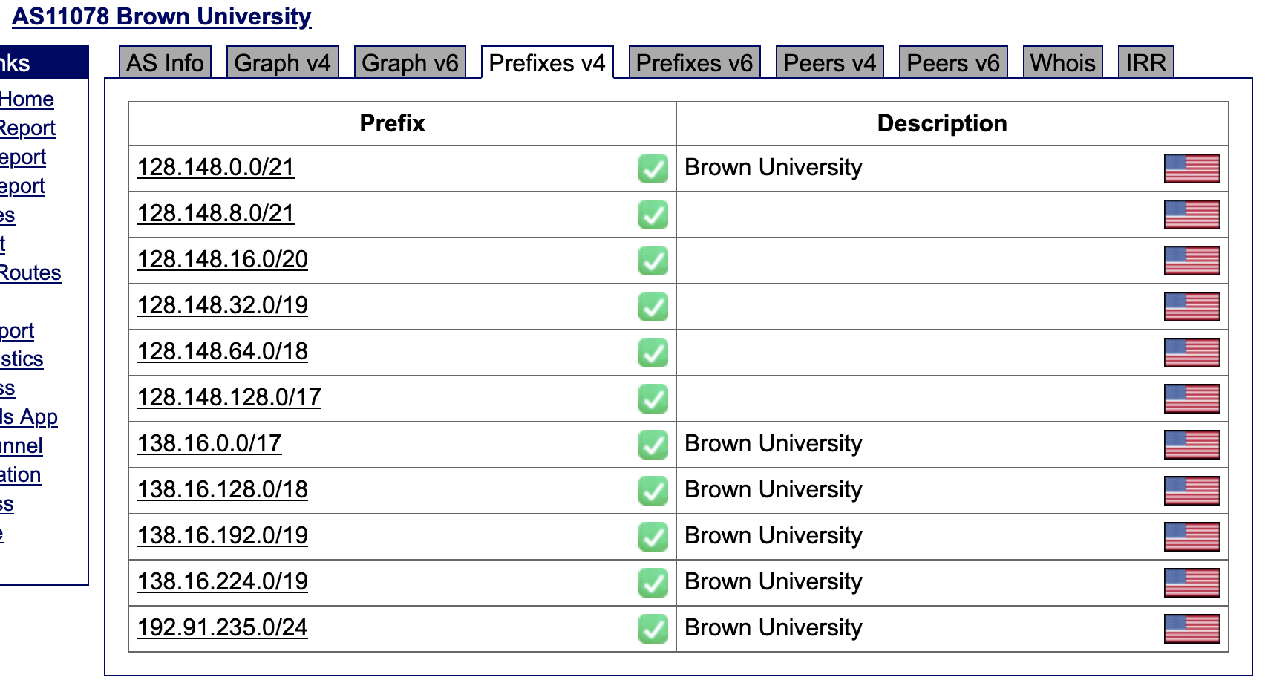
Notes:
These are the prefixes Brown advertises

