Slide 1
CSCI1680 Network Layer: IP & Forwarding II
Based partly on lecture notes by Rodrigo Fonseca, David Mazières, Phil Levis, John Jannotti

Slide 2
Administivia
IP Project: out later today
Partner form: due TONIGHT by 11:59pm
You will get an email confirming your team tomorrow
IP gearup: tonight 5-7pm, CIT165
IP Milestone: meet with me/a TA on/before next Friday (Feb 20) to discuss your design
(No working code yet, just some serious plans/sketches)

Slide 3
Administivia
IP Project: out later today
Partner form: due TONIGHT by 11:59pm
You will get an email confirming your team tomorrow morning
IP gearup: tonight 5-7pm, CIT 165
IP Milestone: meet with me/a TA on/before next Friday (Feb 20) to discuss your design
(No working code yet, just some serious plans/sketches)
HW1 (short): Due next Thursday

Slide 4
Today
Continuing network layer
IP forwarding mechanics
About the IP project

Slide 5
Where we left off
All hosts identified by an IP address
IP address: a number with structure
Network part
Host part
Routers look at network part to forward packets between networks

Slide 6


Warmup
Warmup: What are the two different networks?
What are the two different networks? How would you describe them?
To more networks (ie, Internet)
1.2.1.2
IF0
1.2.2.100
IF1
IF2
1.2.1.3
1.2.1.1
1.2.2.1
1.2.2.105
1.2.1.200
Notes:
Let’s first look at how we move packets between the two networks

Slide 7
To more networks (ie, Internet)
1.2.1.2
IF0
1.2.2.100
IF1
IF2
1.2.1.3
1.2.1.1
1.2.2.1
1.2.2.105
1.2.1.200
Subnet “A”: 1.2.1.xxx
Subnet “B”: 1.2.2.xxx
Notes:
Let’s first look at how we move packets between the two networks

Slide 8
Src: 5.6.7.8
Dst: 1.2.2.100
. . .
To more networks (ie, Internet)
1.2.1.2
IF0
1.2.2.100
IF1
IF2
1.2.1.3
1.2.1.1
1.2.2.1
1.2.2.105
1.2.1.200
Subnet “A”: 1.2.1.xxx
Subnet “B”: 1.2.2.xxx
Notes:
Let’s first look at how we move packets between the two networks

Slide 9
How do we specify an IP network (range of addresses)?
What does it mean for an address to be in a network?

Slide 10
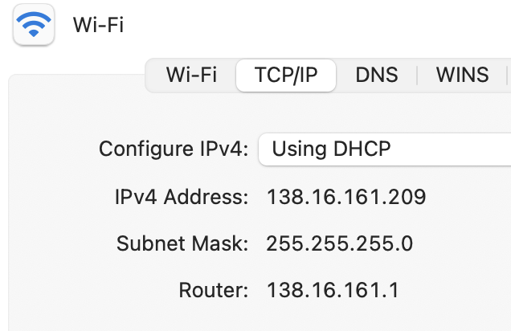

Slide 11
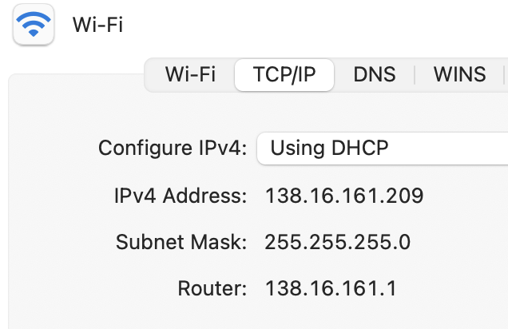
What network are we on?
138.16.161.209
Addr:
138.16.161.209
10001010 00010000 10100001 11010001
Mask:
255.255.255.0
11111111 11111111 11111111 00000000

Slide 12
What network are we on?
138.16.161.209
Addr:
138.16.161.209
10001010 00010000 10100001 11010001
Mask:
255.255.255.0
11111111 11111111 11111111 00000000
=> Bitmask used to “filter out” which part is for hosts on the same network

Slide 13
Identifying host and network
138.16.161.209
Addr:
138.16.161.209
10001010 00010000 10100001 11010001
Mask:
255.255.255.0
&
11111111 11111111 11111111 00000000
10001010 00010000 10100001 00000000
24 bits
138.16.161.0

Slide 14
All systems with an IP address have a
configuration like this
138.16.161.209
Addr:
138.16.161.209
10001010 00010000 10100001 11010001
Mask:
255.255.255.0
&
11111111 11111111 11111111 00000000
10001010 00010000 10100001 00000000
24 bits
138.16.161.0
Think: This host is on the network 138.16.161.0/24
=> “Prefix notation”, or “CIDR notation”

Slide 15
138.16.161.0/24
10001010 00010000 10100001 xxxxxxxx
138.16.161.204
10001010 00010000 10100001 10100001
1.2.3.4
00000001 00000010 00000011 00000100
The mask can be any size 0-32
Not just checking the first three digits!

Slide 16
How do we specify an IP network?
What does it mean for an address to be in a network?

Slide 17
How do we specify an IP network?
=> Range of addresses for a specific IP ”prefix” eg. 138.16.161.0/24
What does it mean for an address to be in a network?
=> Address must be within the range (based on the mask)

Slide 18
Common prefixes
1.2.0.0/16
00000001 00000010 xxxxxxxx xxxxxxxx
8.0.0.0/8
00001000 xxxxxxxx xxxxxxxx xxxxxxxx
123.10.1.0/24
01111011 00001010 00000001 xxxxxxxx
201.112.10.200/30
11001001 01110000 00001010 110010xx
Notes:
So here are some common prefixes—and we’ll see that the size of the prefix denotes the size of the network, the number of possible addresses
If we have a mask, we want to know how many hosts it has, and how big the network is
Once I reach that netwotk, it’s up to example net to figure out how to get to the hosts

Slide 19
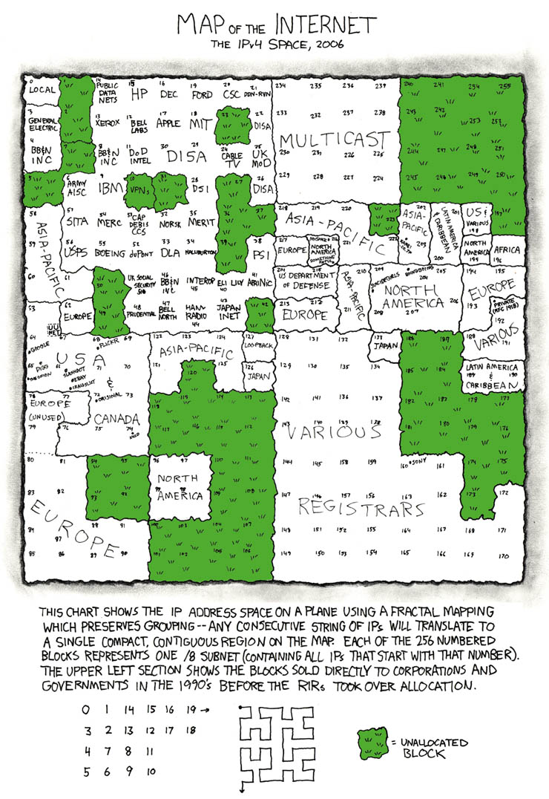
https://xkcd.com/195/
Notes:
Early /8 allocations

Slide 20
Example
How many addresses are in the network 1.1.0.0/20?
Is 1.1.16.1 in this prefix?
Notes:
Take a moment and try this
192.128.0.0-192.128.15.255, 4096 hosts

Slide 21
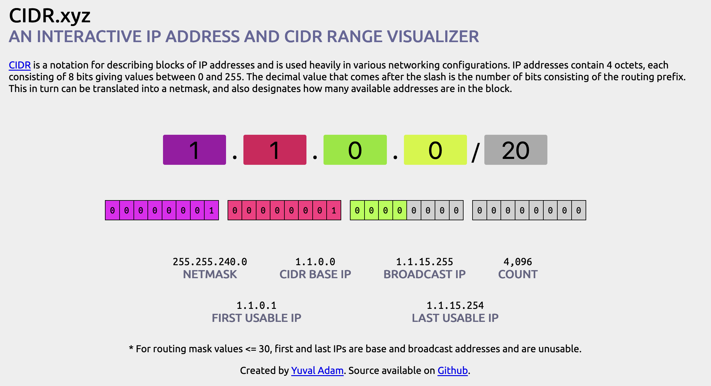
https://cidr.xyz
Tools exist, use them!

Slide 22
How do we move packets between networks?
Notes:
Now that we have the ability to name hosts, how do we move packets between them?
Another way to think about these things—and then the network part is some kind of grouping to refer to them as the same authority

Slide 23
Forwarding IP packets
Src: 1.2.1.3
Dst: 1.2.2.100
. . .
To more networks (ie, Internet)
1.2.1.2
IF0
1.2.2.100
IF1
IF2
1.2.1.3
1.2.1.1
1.2.2.1
1.2.2.105
1.2.1.200
Notes:
Let’s first look at how we move packets between the two networks

Slide 24
IP forwarding
Decide where to send packets based on forwarding table
Prefix | Interface/Next hop

Slide 25
IP forwarding
Decide where to send packets based on forwarding table
Prefix | Interface/Next hop
Key Type: An IP prefix (1.2.1.0/24)
Value type: Multiple forms
- Interface (IF0): “This is my neighbor (on local net), link-layer can figure it out”
- Next hop IP (eg. 1.1.1.1): send packet to this IP instead

Slide 26
IP forwarding
Decide where to send packets based on forwarding table
Prefix | Interface/Next hop
Key Type: An IP prefix (1.2.1.0/24)
Value type: Multiple forms
- Interface (IF0): “This is my neighbor (on local net), link-layer can figure it out”
=> ”Local delivery” - Next hop IP (eg. 1.1.1.1): send packet to this IP instead => Need to search for next hop in table!

Slide 27
Forwarding IP packets
Src: 1.2.1.3
Dst: 1.2.2.100
. . .
To more networks (ie, Internet)
1.2.1.2
IF0
1.2.2.100
IF1
IF2
1.2.1.3
1.2.1.1
1.2.2.1
Prefix | Interface/Next hop
1.2.2.105
1.2.1.200
Notes:
Could we have an entry for every host? Not over the whole internet. Instead, we rely on hierarchical structure of the network
We call this the forwarding table

Slide 28
Forwarding IP packets
Src: 1.2.1.3
Dst: 1.2.2.100
. . .
To more networks (ie, Internet)
1.2.1.2
IF0
1.2.2.100
IF1
IF2
1.2.1.3
1.2.1.1
1.2.2.1
Prefix | Interface
1.2.1.0/24 | IF1
1.2.2.0/24 | IF2
… | …
1.2.2.105
1.2.1.200
Notes:
Could we have an entry for every host? Not over the whole internet. Instead, we rely on hierarchical structure of the network
We call this the forwarding table
Keep in mind that if there are multiple matches

Slide 29
What about the rest?
How to reach networks that aren’t directly connected?
To more networks
(ie, Internet)
Prefix | Interface/Next hop
1.2.1.0/24 | IF1
1.2.2.0/24 | IF2
<everything else>
IF0
8.0.0.1
1.2.1.0/24
IF1
IF2
1.2.2.0/24
Notes:
Next hop
Could we have an entry for every host? Not over the whole internet. Instead, we rely on hierarchical structure of the network
We call this the forwarding table
Keep in mind that if there are multiple matches

Slide 30
“Default route”: where to send to reach anything not in the table
8.0.0.2
Prefix | IF/Next hop
1.2.1.0/24 | IF1
1.2.2.0/24 | IF2
8.0.0.0/30 | IF0
0.0.0.0/0 | 8.0.0.2
8.0.0.1
IF2
1.2.1.0/24
IF1
IF0
1.2.2.0/24
IF2
Notes:
Next hop
Could we have an entry for every host? Not over the whole internet. Instead, we rely on hierarchical structure of the network
We call this the forwarding table
Keep in mind that if there are multiple matches

Slide 31
“Default route”: where to send to reach anything not in the table
Gateway: device at the “edge” of a network (eg. Brown <-> Internet)
8.0.0.2
Prefix | IF/Next hop
1.2.1.0/24 | IF1
1.2.2.0/24 | IF2
8.0.0.0/30 | IF0
0.0.0.0/0 | 8.0.0.2
8.0.0.1
IF2
1.2.1.0/24
IF1
IF0
1.2.2.0/24
IF2
Notes:
Next hop
Could we have an entry for every host? Not over the whole internet. Instead, we rely on hierarchical structure of the network
We call this the forwarding table
Keep in mind that if there are multiple matches

Slide 32
“Default route”: where to send to reach anything not in the table
Gateway: device at the “edge” of a network (eg. Brown <-> Internet)
=> Use ”Next hop IP” in table
8.0.0.2
8.0.0.1
IF2
Prefix | IF/Next hop
1.2.1.0/24 | IF1
1.2.2.0/24 | IF2
8.0.0.0/30 | IF0
0.0.0.0/0 | 8.0.0.2
1.2.1.0/24
IF1
IF0
1.2.2.0/24
IF2
Notes:
Next hop
Could we have an entry for every host? Not over the whole internet. Instead, we rely on hierarchical structure of the network
We call this the forwarding table
Keep in mind that if there are multiple matches

Slide 34
“Default route”: where to send to reach anything not in the table
=> Use ”Next hop IP” in table
Gateway: device at the “edge” of a network (eg. Brown <-> Internet)
8.0.0.2
Prefix | IF/Next hop
1.2.1.0/24 | IF1
1.2.2.0/24 | IF2
8.0.0.0/30 | IF0
0.0.0.0/0 | 8.0.0.2
8.0.0.1
IF2
1.2.1.0/24
IF1
IF0
1.2.2.0/24
0.0.0.0 matches on everything! Problem?
Can have multiple matches in table => use the most specific (longest) prefix
(more on this later)
IF2
Notes:
Next hop
Could we have an entry for every host? Not over the whole internet. Instead, we rely on hierarchical structure of the network
We call this the forwarding table
Keep in mind that if there are multiple matches

Slide 35
What entries should go in the host's forwarding table?
To more networks
(ie, Internet)
1.2.1.2
Prefix | Interface/Next hop
IF1
1.2.1.3
1.2.1.1
1.2.1.200
Src: 1.2.1.3
Dst: 1.2.2.100
. . .
Notes:
Let’s first look at how we move packets between the two networks

Slide 36
Does it scale?
Prefix | IF/Next hop
1.2.1.0/24 | IF1
1.2.2.0/24 | IF2
8.0.0.0/30 | IF0
0.0.0.0/0 | 8.0.0.2

Slide 37
Does it scale?
Prefix | IF/Next hop
1.2.1.0/24 | IF1
1.2.2.0/24 | IF2
8.0.0.0/30 | IF0
0.0.0.0/0 | 8.0.0.2
Yes! At least enough to make the Internet as we know it….
Yes! (At least enough to make the Internet as we know it…) => Forward packets based on IP prefixes
=> Don’t need to keep track of every single host
=> Routers at the “edges” of the network don’t need to know about every route
=> Larger, highly-connected routers (“core routers”) do need very large tables, specialized hardware, optimization tricks…

Slide 38
Does it scale?
Prefix | IF/Next hop
1.2.1.0/24 | IF1
1.2.2.0/24 | IF2
8.0.0.0/30 | IF0
0.0.0.0/0 | 8.0.0.2
Yes! At least enough to make the Internet as we know it….
=> Forward packets based on IP prefixes
=> Don’t need to keep track of every single host
=> Routers at the “edges” of the network don’t need to know about every route
=> Larger, highly-connected routers (“core routers”) do need very large tables, specialized hardware, optimization tricks…

Slide 39
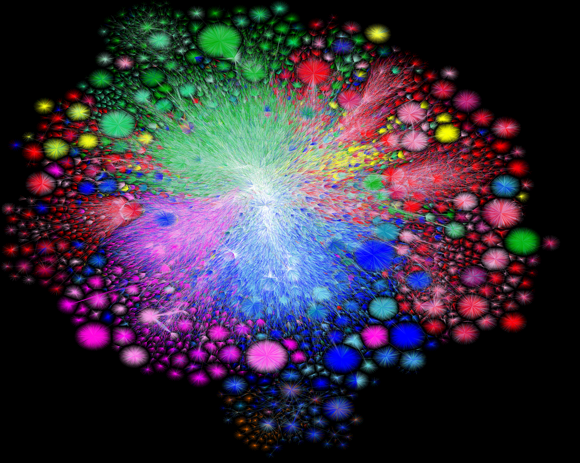
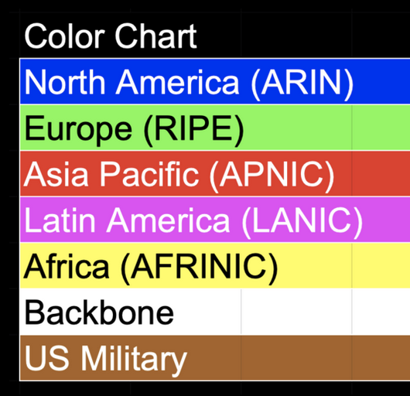
Map of the Internet, 2021 (via BGP)
OPTE project
Notes:
To put something real to this, here’s a map of what that graph looks like. We call the Internet a network of networks: and each point is a network—a group of systems—that can talk to the others. And the network grants us the ability to pretty much communicate between any two points on this graph. And the goal of the network, how it’s designed, and the protocols that comprise it, is to figure out how to get a message there—regardless of where they are, whether they’re connected by a copper wire, or a wireless link, and regardless of what’s being sent.

Slide 40
A forwarding table (my laptop)
deemer@ceres ~ % ip route
default via 10.3.128.1 dev wlp2s0
10.3.128.0/18 dev wlp2s0 proto dhcp scope link src 10.3.135.44 metric 3003
172.18.0.0/16 dev docker0 proto kernel scope link src 172.18.0.1
192.168.1.0/24 dev enp0s31f6 proto kernel scope link src 192.168.1.1

Slide 41
A routing table
R6#sh ip ro
Gateway of last resort is 108.34.215.1 to network 0.0.0.0
S* 0.0.0.0/0 [1/0] via 108.34.215.1
10.0.0.0/8 is variably subnetted, 7 subnets, 3 masks
C 10.1.0.0/24 is directly connected, wlan-ap0
L 10.1.0.2/32 is directly connected, wlan-ap0
O IA 10.1.44.1/32 [110/1001] via 10.20.30.33, 3w4d, Tunnel0
C 10.1.48.0/24 is directly connected, Loopback0
L 10.1.48.1/32 is directly connected, Loopback0
C 10.20.30.32/31 is directly connected, Tunnel0
L 10.20.30.32/32 is directly connected, Tunnel0
108.0.0.0/8 is variably subnetted, 2 subnets, 2 masks
C 108.34.215.0/24 is directly connected, GigabitEthernet0/0
L 108.34.215.208/32 is directly connected, GigabitEthernet0/0
172.16.0.0/16 is variably subnetted, 2 subnets, 2 masks
C 172.16.98.0/24 is directly connected, Vlan98
L 172.16.98.1/32 is directly connected, Vlan98
172.17.0.0/16 is variably subnetted, 6 subnets, 3 masks
O IA 172.17.44.0/24 [110/1001] via 10.20.30.33, 3w4d, Tunnel0
C 172.17.48.0/24 is directly connected, Vlan20
L 172.17.48.1/32 is directly connected, Vlan20
C 172.17.49.0/25 is directly connected, Vlan50
L 172.17.49.1/32 is directly connected, Vlan50
O IA 172.17.80.0/25 [110/1011] via 10.20.30.33, 4d12h, Tunnel0
Notes:
Takes this information and synthesizes it down into its forwarding table baed on interfaces

Slide 42
A routing table
R6#sh ip ro
Codes: L - local, C - connected, S - static, R - RIP, M - mobile, B - BGP
D - EIGRP, EX - EIGRP external, O - OSPF, IA - OSPF inter area
N1 - OSPF NSSA external type 1, N2 - OSPF NSSA external type 2
E1 - OSPF external type 1, E2 - OSPF external type 2
i - IS-IS, su - IS-IS summary, L1 - IS-IS level-1, L2 - IS-IS level-2
ia - IS-IS inter area, * - candidate default, U - per-user static route
o - ODR, P - periodic downloaded static route, H - NHRP, l - LISP
+ - replicated route, % - next hop override
Gateway of last resort is 108.34.215.1 to network 0.0.0.0
S* 0.0.0.0/0 [1/0] via 108.34.215.1
10.0.0.0/8 is variably subnetted, 7 subnets, 3 masks
C 10.1.0.0/24 is directly connected, wlan-ap0
L 10.1.0.2/32 is directly connected, wlan-ap0
O IA 10.1.44.1/32 [110/1001] via 10.20.30.33, 3w4d, Tunnel0
C 10.1.48.0/24 is directly connected, Loopback0
L 10.1.48.1/32 is directly connected, Loopback0
C 10.20.30.32/31 is directly connected, Tunnel0
L 10.20.30.32/32 is directly connected, Tunnel0
108.0.0.0/8 is variably subnetted, 2 subnets, 2 masks
C 108.34.215.0/24 is directly connected, GigabitEthernet0/0
L 108.34.215.208/32 is directly connected, GigabitEthernet0/0
172.16.0.0/16 is variably subnetted, 2 subnets, 2 masks
C 172.16.98.0/24 is directly connected, Vlan98
L 172.16.98.1/32 is directly connected, Vlan98
172.17.0.0/16 is variably subnetted, 6 subnets, 3 masks
O IA 172.17.44.0/24 [110/1001] via 10.20.30.33, 3w4d, Tunnel0
C 172.17.48.0/24 is directly connected, Vlan20
L 172.17.48.1/32 is directly connected, Vlan20
C 172.17.49.0/25 is directly connected, Vlan50
L 172.17.49.1/32 is directly connected, Vlan50
O IA 172.17.80.0/25 [110/1011] via 10.20.30.33, 4d12h, Tunnel0
Notes:
Takes this information and synthesizes it down into its forwarding table baed on interfaces

Slide 43
A large table
rviews@route-server.ip.att.net>show route table inet.0 active-path
inet.0: 866991 destinations, 13870153 routes (866991 active, 0 holddown, 0 hidden)
+ = Active Route, - = Last Active, * = Both
0.0.0.0/0 *[Static/5] 5w0d 19:43:09
> to 12.0.1.1 via em0.0
1.0.0.0/24 *[BGP/170] 1d 10:24:47, localpref 100, from 12.122.83.238
AS path: 7018 3356 13335 I, validation-state: valid
> to 12.0.1.1 via em0.0
1.0.4.0/22 *[BGP/170] 1d 10:24:47, localpref 100, from 12.122.83.238
AS path: 7018 3356 4826 38803 I, validation-state: valid
> to 12.0.1.1 via em0.0
1.0.4.0/24 *[BGP/170] 1d 10:24:47, localpref 100, from 12.122.83.238
AS path: 7018 3356 4826 38803 I, validation-state: valid
> to 12.0.1.1 via em0.0
1.0.5.0/24 *[BGP/170] 1d 10:24:47, localpref 100, from 12.122.83.238
AS path: 7018 3356 4826 38803 I, validation-state: valid
> to 12.0.1.1 via em0.0
1.0.6.0/24 *[BGP/170] 1d 10:24:47, localpref 100, from 12.122.83.238
AS path: 7018 3356 4826 38803 I, validation-state: valid
> to 12.0.1.1 via em0.0
1.0.7.0/24 *[BGP/170] 1d 10:24:47, localpref 100, from 12.122.83.238
AS path: 7018 3356 4826 38803 I, validation-state: valid
> to 12.0.1.1 via em0.0
1.0.64.0/18 *[BGP/170] 1d 10:24:47, localpref 100, from 12.122.83.238
AS path: 7018 2497 7670 18144 I, validation-state: unknown
> to 12.0.1.1 via em0.0
1.0.128.0/17 *[BGP/170] 1d 10:24:47, localpref 100, from 12.122.83.238
AS path: 7018 3356 38040 23969 I, validation-state: unknown
> to 12.0.1.1 via em0.0
1.0.128.0/18 *[BGP/170] 1d 10:24:47, localpref 100, from 12.122.83.238
AS path: 7018 3356 38040 23969 I, validation-state: unknown
> to 12.0.1.1 via em0.0
1.0.128.0/19 *[BGP/170] 1d 10:24:47, localpref 100, from 12.122.83.238
AS path: 7018 3356 38040 23969 I, validation-state: unknown
> to 12.0.1.1 via em0.0
1.0.128.0/24 *[BGP/170] 1d 10:24:47, localpref 100, from 12.122.83.238
AS path: 7018 6939 4651 23969 I, validation-state: unknown
> to 12.0.1.1 via em0.0
1.0.129.0/24 *[BGP/170] 1d 10:24:47, localpref 100, from 12.122.83.238
AS path: 7018 6939 4651 23969 I, validation-state: unknown
> to 12.0.1.1 via em0.0
Notes:
Takes this information and synthesizes it down into its forwarding table baed on interfaces

Slide 44
How does forwarding actually work?

Slide 45
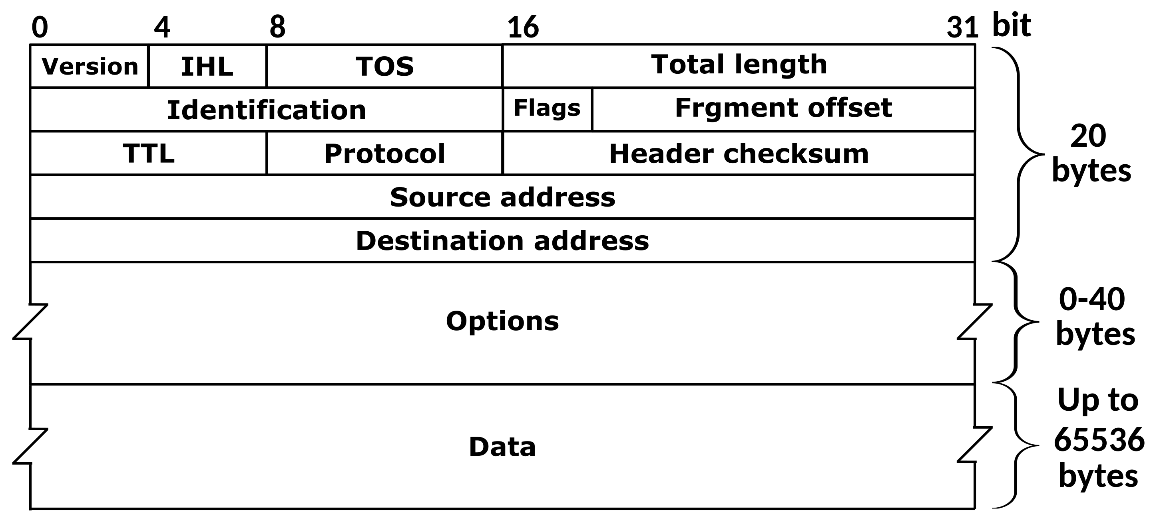
The IPv4 Header
Defined by RFC 791
RFC (Request for Comment): defines network standard
Notes:
The key parts are HERE

Slide 46
Most Important fields
Version: 4 for IPv4 packets, 6 for IPv6
Source address: where the packet came from
Destination address: where the packet is going
(continued…)

Slide 47
More important fields
TTL (time-to-live): decremented each hop
Can prevent forwarding loops (and do other stuff…)
Protocol identifier: describes what’s in the packet
6: TCP, 17: UDP, 1: ICMP, …
Defines the type of the payload
Checksum: used for error checking…

Slide 48
How a checksum works

Slide 49
Less important fields
Header length: in 32-bit units
>5 implies use of IP options
Almost all routers ignore IP options
Fragmentation
Network can fragment a packet if next link requires a small frame
Most routers don’t fragment (or reassemble fragments)
We won’t talk about…
Type of Service (TOS): basic traffic classification
Identifier: might have special meaning on some networks

Slide 50
Forwarding steps
What does a device do when it receives a packet?
Device: host, router, …
Notes:
Rest of OS <--> IP - ←NIC

Slide 51
A ”networking stack”

Slide 52
A ”networking stack”
Applications
Sockets, TCP, etc.
IP
Network layer
Interfaces
(Link layer)
if0
if1
. . .
We are here

Slide 53
A ”networking stack”
Applications
User space
Kernel space
Sockets, TCP, etc.
IP
Network layer
Interfaces
(Link layer)
if0
if1
. . .
We are here

Slide 54
A ”networking stack”
Applications
User space
Kernel space
Sockets, TCP, etc.
IP
Network layer
Interfaces
(Link layer)
if0
if1
. . .
We are here
On a router: packet might be for a different destination => send out another interface
If it’s for one for an IP assigned to this device, send to higher layer

Slide 55
Forwarding mechanics
When an IP packet arrives at a host/router:
Is it valid? Verify checksum over header
Is it for me? If dest IP == your address, send to OS
If not, where should it go?
Consult forwarding table => find next hop
Decrement TTL
Send packet to next hop

Slide 56
How to avoid loops?
TTL (Time to Live): Decrement by 1 at each hop, send back error at 0
traceroute: tool to send packets with increasing TTLs => can learn about network paths!

Slide 57
Traceroute
When TTL reaches 0, router may send back an error
ICMP TTL exceeded
If it does, we can identify a path used by a packet!
Notes:
TTL 0 => 1 HOP
TTL 1 => 2 hops
…

Slide 58
Traceroute example
[deemer@Warsprite ~]$ traceroute -q 1 google.com
traceroute to google.com (142.251.40.174), 30 hops max, 60 byte packets
1 router1-nac.linode.com (207.99.1.13) 0.621 ms
2 if-0-1-0-0-0.gw1.cjj1.us.linode.com (173.255.239.26) 0.499 ms
3 72.14.222.136 (72.14.222.136) 0.949 ms
4 72.14.222.136 (72.14.222.136) 0.919 ms
5 108.170.248.65 (108.170.248.65) 1.842 ms
6 lga25s81-in-f14.1e100.net (142.251.40.174) 1.812 ms

Slide 59
Traceroute example
[deemer@Warsprite ~]$ traceroute -q 1 amazon.co.uk
traceroute to amazon.co.uk (178.236.7.220), 30 hops max, 60 byte packets
1 router2-nac.linode.com (207.99.1.14) 0.577 ms
2 if-11-1-0-1-0.gw2.cjj1.us.linode.com (173.255.239.16) 0.461 ms
3 ix-et-2-0-2-0.tcore3.njy-newark.as6453.net (66.198.70.104) 1.025 ms
4 be3294.ccr41.jfk02.atlas.cogentco.com (154.54.47.217) 2.938 ms
5 be2317.ccr41.lon13.atlas.cogentco.com (154.54.30.186) 69.725 ms
6 be2350.rcr21.b023101-0.lon13.atlas.cogentco.com (130.117.51.138) 69.947 ms
7 a100-row.demarc.cogentco.com (149.11.173.122) 71.639 ms
8 150.222.15.28 (150.222.15.28) 78.217 ms
9 150.222.15.21 (150.222.15.21) 84.383 ms
10 *
11 150.222.15.4 (150.222.15.4) 74.529 ms
. . .
30 178.236.14.162 (178.236.14.162) 83.659 ms

Slide 60
Putting it all together

Slide 61
Demo: IP project

Slide 62
Coming up…
ARP: Mapping IPs to MAC addresses
How are addresses assigned?
NAT: When it gets complicated
Routing algorithms: how to build forwarding tables
Fill out the group preference survey for the IP project (announcement soon) by
tomorrow (Sep 30) by 11:59PM

Slide 63
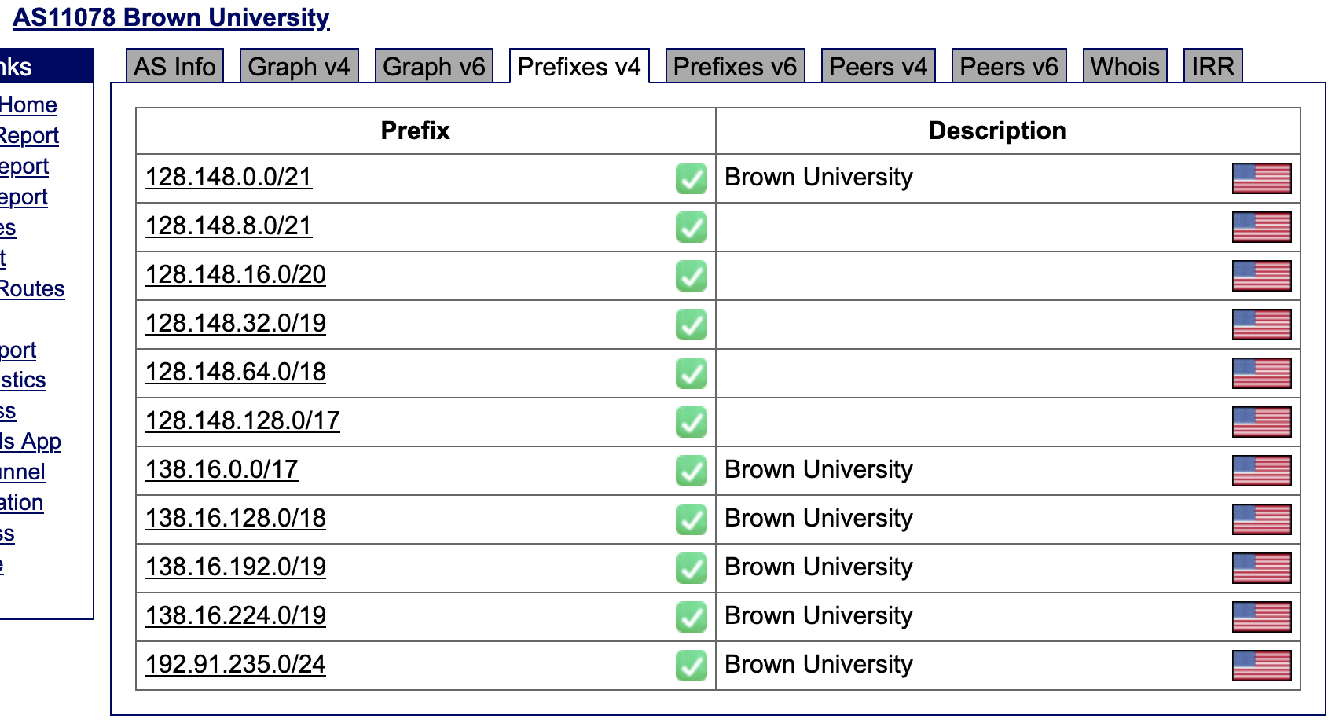
Notes:
These are the prefixes Brown advertises

Slide 64
Backup slides from last lecture

Slide 65
Common prefixes
1.2.0.0/16
00000001 00000010 xxxxxxxx xxxxxxxx
8.0.0.0/8
00001000 xxxxxxxx xxxxxxxx xxxxxxxx
123.10.1.0/24
01111011 00001010 00000001 xxxxxxxx
201.112.10.200/30
11001001 01110000 00001010 110010xx
Notes:
So here are some common prefixes—and we’ll see that the size of the prefix denotes the size of the network, the number of possible addresses
If we have a mask, we want to know how many hosts it has, and how big the network is
Once I reach that netwotk, it’s up to example net to figure out how to get to the hosts

Slide 66
How IP forwarding works
Assume:
Communicating on same network is easy—this is the link-layer’s job!
Can map IP addresses to MAC addresses (more on this later)
How to reach an address outside this network?
1.2.1.2
1.2.1.1
1.2.1.3
…
Send packets to a router,
which forwards IP packets
to other networks
1.2.1.200
Notes:
ENet is free to assign addresses however it wants within its network, and in turn it can also make networks inside itself. So to look at this we’re going to start with a smaller network, this /24 here, which starts with 1.2.1.
For now we can say that as long as we’re in the same network, there are other devices like switches that transfer information from one host to another.
But what happens if we want to reach one host outside the network?
As long as we’re inside the network, we don’t need to make as much of a decision from the perspective of the Internet. It’s like shouting. I’m abstracting things here,

Slide 67
Forwarding IP packets
Src: 1.2.1.3
Dst: 1.2.2.100
. . .
To more networks (ie, Internet)
1.2.1.2
IF0
1.2.2.100
IF1
IF2
1.2.1.3
1.2.1.1
1.2.2.1
1.2.2.105
1.2.1.200
Notes:
Let’s first look at how we move packets between the two networks

Slide 68
Forwarding IP packets
Src: 1.2.1.3
Dst: 1.2.2.100
. . .
To more networks (ie, Internet)
1.2.1.2
IF0
1.2.2.100
IF1
IF2
1.2.1.3
1.2.1.1
1.2.2.1
1.2.2.105
1.2.1.200
Notes:
Let’s first look at how we move packets between the two networks

Slide 69


Putting it all together…
Prefix | Interface
. . .
1.2.0.0/16 | 1.2.0.1 via IF42
142.0.0/8 | 5.0.0.5 via IF21
. . .
1.2.1.3
142.250.65.206
The more connected a router becomes, the more complex its forwarding table… and the more it may change!
Routing algorithms: routers exchange path information to their forwarding tables (more on this later)
Notes:
Note what we have in a larger graph: we have redundant links, there’s the possibility for loops, etc.

Slide 70
Goal: find the most specific
(ie, longest) prefix matching the
destination
IF0
Prefix | Interface
1.2.1.0/24 | IF1
1.2.2.0/24 | IF2
0.0.0.0/0 | IF0
Prefix | Interface
1.2.1.0/24 | IF1
1.2.2.0/24 | IF2
<everything else> | IF0
1.2.1.0/24
1.2.2.0/24
IF1
IF2
How to reach 1.2.2.100?
1.2.2.100 00000001.00000010.00000010.01100100
Output: IF2
?=
1.2.1.0/24 00000001.00000010.00000001.xxxxxxxx
1.2.2.0/24 00000001.00000010.00000010.xxxxxxxx
0.0.0.0/0 xxxxxxxx.xxxxxxxx.xxxxxxxx.xxxxxxxx
Longest Prefix Matching (LPM): can represent entire IP space in (small) table!
Src: 1.2.1.3
Dst: 1.2.2.100
. . .
Notes:
Forwarding table tells us about networks, not individual hosts
Prefix becomes a mask telling us how
Summarizing our forwarding options based on networks allows us to scale—we can represent the whole space in a relatively small table
And by picking the longest prefix, by picking the smallest or most specific network we know about that has that address, we’re getting closer to the destination—the hope being that this route either contains the destination, or has another router that knows what to do next

Slide 71
8.0.0.0/30
Some ISP
Dst: 128.148.105.207
. . .
Brown
128.148.0.0/16
Dst: 128.148.100.104
. . .
Customer 2
1.3.0.0/16
Prefix | Interface
128.148.0.0/16 | IF1
1.3.0.0/16 | IF2
5.6.128.0/20 | IF3
128.148.100.0/24 | IF4
0.0.0.0/0 | 8.0.0.2
Customer 3
5.6.128.0/20
Brown’
128.148.100.0/24
Notes:
But the table isn’t always nicely disjoint
It doesn’t need to be strictly hierardhical
Make sure you summarize

