Slide 1
CS 1680: Lecture 8
Based partly on lecture notes by Rodrigo Fonseca, David Mazières, Phil Levis, John Jannotti

Slide 2
Administrivia
Look for announcement to sign up for IP milestone meetings, preferably with your mentor TA; meetings on Fri/Mon/Tues
  You will be expected to talk about your design
  Don't need to have working code, but you should get started
IP gearup II: Look for an announcement
  Implementation and debugging tips

Slide 3
Today
Fill in missing pieces about how IP works in practice, start routing
Longest Prefix Match
IP<->Link layer (ARP)
Start of routing
After this: Routing

Slide 4

Default
Network A: 82.14.0.0/16
B: 1.3.0.0/16
D: 5.6.128.0/20
C: 1.3.25.0/24
Prefix | IF/Next hop
82.14.0.0/16 | (A)
1.3.0.0/16 | (B)
1.3.4.0/24 | (C)
5.6.128.0/20 | (D)
0.0.0.0/0 | (Default)
(X) is placeholder—could be an IP or an interface name

Slide 5
Default
Network A: 82.14.0.0/16
B: 1.3.0.0/16
D: 5.6.128.0/20
C: 1.3.25.0/24
Prefix | IF/Next hop
82.14.0.0/16 | (A)
1.3.0.0/16 | (B)
1.3.4.0/24 | (C)
5.6.128.0/20 | (D)
0.0.0.0/0 | (Default)
Warmup: based on the table, where would the router send packets destined for the following addresses:
5.6.128.100
1.3.1.1
8.8.8.8
1.3.4.8
(X) is placeholder—could be an IP or an interface name

Slide 6
What happens when prefixes overlap?
Prefix | IF/Next hop
1.3.0.0/16 | (B)
1.3.4.0/24 | (C)
1.3.4.5/32
0.0.0.0/0 | (Default)
An IP can match on more than one row
=> need to pick the most specific (longest) prefix
1.3.0.0/16
00000001 00000011 xxxxxxxx xxxxxxxx
1.3.4.0/24
00000001 00000011 00000100 xxxxxxxx

Slide 7
What happens when prefixes overlap?
Prefix | IF/Next hop
1.3.0.0/16 | (B)
1.3.4.0/24 | (C)
1.3.4.5/32
0.0.0.0/0 | (Default)
An IP can match on more than one row
=> need to pick the most specific (longest) prefix
1.3.0.0/16
00000001 00000011 xxxxxxxx xxxxxxxx
1.3.4.0/24
00000001 00000011 00000100 xxxxxxxx
More specific => best match!

Slide 8
What happens when prefixes overlap?
Prefix | IF/Next hop
1.3.0.0/16 | (B)
1.3.4.0/24 | (C)
1.3.4.5/32
0.0.0.0/0 | (Default)
An IP can match on more than one row
=> need to pick the most specific (longest) prefix
1.3.0.0/16
00000001 00000011 xxxxxxxx xxxxxxxx
1.3.4.0/24
00000001 00000011 00000100 xxxxxxxx
More specific => best match!
Other examples you’ll see…
0.0.0.0/0
xxxxxxxx xxxxxxxx xxxxxxxx xxxxxxxx
1.2.3.5/32
00000001 00000011 00000100 00000101

Slide 9
What happens when prefixes overlap?
Prefix | IF/Next hop
1.3.0.0/16 | (B)
1.3.4.0/24 | (C)
1.3.4.5/32
0.0.0.0/0 | (Default)
An IP can match on more than one row
=> need to pick the most specific (longest) prefix
1.3.0.0/16
00000001 00000011 xxxxxxxx xxxxxxxx
1.3.4.0/24
00000001 00000011 00000100 xxxxxxxx
More specific => best match!
Other examples you’ll see…
0.0.0.0/0
xxxxxxxx xxxxxxxx xxxxxxxx xxxxxxxx
=> Least specific!
(Used for default “catchall” routes)
1.2.3.5/32
00000001 00000011 00000100 00000101
=> Most specific!
(Refers to a single host,
often a local IP)

Slide 10
What happens when prefixes overlap?
Prefix | IF/Next hop
1.3.0.0/16 | (B)
1.3.4.0/24 | (C)
1.3.4.5/32
0.0.0.0/0 | (Default)
An IP can match on more than one row
=> need to pick the most specific (longest) prefix
1.3.0.0/16
00000001 00000011 xxxxxxxx xxxxxxxx
1.3.4.0/24
00000001 00000011 00000100 xxxxxxxx
More specific => best match!
Other examples you’ll see…
0.0.0.0/0
xxxxxxxx xxxxxxxx xxxxxxxx xxxxxxxx
=> Least specific!
(Used for default “catchall” routes)
1.2.3.5/32
00000001 00000011 00000100 00000101
=> Most specific!
(Refers to a single host,
often a local IP)
=>Longest prefix matching: can keep forwarding tables small by summarizing routes where possible, otherwise using specific prefixes

Slide 11

What happens at the link layer?
IF0
What does it mean to send to IF1?
IF1
IF2
1.2.1.3
1.2.2.100
1.2.1.1
1.2.2.1
Prefix | IF/Next hop
1.2.1.0/24 | IF1
1.2.2.0/24 | IF2
8.0.0.0/30 | IF0
Default | 8.0.0.2

Slide 12
What happens at the link layer?
IF0
What does it mean to send to IF1?
IF1
IF2
1.2.1.3
1.2.2.100
1.2.1.1
1.2.2.1
The story so far:
=>Can “easily” communicate with nodes on the same network,
but what about other networks?
=> Routers know about multiple networks, forward packets between them
Prefix | IF/Next hop
1.2.1.0/24 | IF1
1.2.2.0/24 | IF2
8.0.0.0/30 | IF0
Default | 8.0.0.2

Slide 13
“Local delivery”:
what does it mean to send to IF1?
IF0
Src: 1.2.4.100
Dst: 1.2.1.3
. . .
1.2.1.2
IF0
IF1
1.2.1.3
IF0
1.2.1.200
Subnet “A”: 1.2.1.0/24
Prefix | IF/Next hop
1.2.1.0/24 | IF1
… | …
Notes:
Let’s first look at how we move packets between the two networks

Slide 14
“Local delivery”:
what does it mean to send to IF1?
IF0
Src: 1.2.4.100
Dst: 1.2.1.3
. . .
1.2.1.2
IF0, IF1, etc are interface names
=> Identify a network physically connected to a certain device
=> Names are specific to that device (and get reused)
IF0
IF1
1.2.1.3
IF0
1.2.1.200
Subnet “A”: 1.2.1.0/24
Prefix | IF/Next hop
1.2.1.0/24 | IF1
… | …
Notes:
Let’s first look at how we move packets between the two networks

Slide 15
“Local delivery”:
what does it mean to send to IF1?
IF0
Src: 1.2.4.100
Dst: 1.2.1.3
. . .
1.2.1.2
So far: “easy” to communicate with nodes on the same network. But how?
To send a packet on a local network, we need:
Dest. IP (Network layer)
Dest. MAC address (Link layer)
Assume: link layer can figure out the rest once we fill in this info
IF0
IF1
1.2.1.3
1.2.1.1
IF0
 | Src | Dest
Link |  | ???
IP | 10.2.4.100 | 1.2.1.3
1.2.1.200
Subnet “A”: 1.2.1.0/24
Router's forwarding table
Prefix | IF/Next hop
1.2.1.0/24 | IF1
… | …
=> How do we get the MAC address?
Notes:
Let’s first look at how we move packets between the two networks

Slide 16
What about non-local delivery?
IF0
Src: 1.2.1.2
Dst: 5.6.7.8
. . .
H1
1.2.1.2
H1’s forwarding table
Prefix | IF/Next hop
1.2.1.0/24 | IF0
0.0.0.0/0 | 1.2.1.1
IF0
IF1
1.2.1.3
 | Src | Dest
Link
IP | 1.2.1.2 | 5.6.7.8
IF0
1.2.1.200
Subnet “A”: 1.2.1.0/24
IP address: where the packet is going globally (i.e., on the internet)
=> Final destination
MAC address: where the packet is going locally: on this network
=> "Next hop"
Notes:
Let’s first look at how we move packets between the two networks

Slide 17
What about non-local delivery?
IF0
Src: 1.2.1.2
Dst: 5.6.7.8
. . .
H1
1.2.1.2
H1’s forwarding table
Prefix | IF/Next hop
1.2.1.0/24 | IF0
0.0.0.0/0 | 1.2.1.1
IF0
IF1
1.2.1.3
 | Src | Dest
Link
IP | 1.2.1.2 | 5.6.7.8
IF0
1.2.1.200
Subnet “A”: 1.2.1.0/24
Notes:
Let’s first look at how we move packets between the two networks

Slide 18
“Glue” between L2 and L3
Need a way to connect get link layer info (mac address) from network-layer info (IP address)
“What MAC address has IP 1.2.3.4?”

Slide 19
“Glue” between L2 and L3
Need a way to connect get link layer info (mac address) from network-layer info (IP address)
“What MAC address has IP 1.2.3.4?”
Solution: ask the network!
=> Address Resolution Protocol (ARP)

Slide 20
ARP: Address resolution protocol
Given an IP address, ask network for the MAC address
  Request: “Who has 1.2.3.4?”
  Response: “aa:bb:cc:dd:ee:ff is at 1.2.3.4”

Slide 21
How ARP works

Slide 22
ARP: Address resolution protocol
Given an IP address, ask network for the MAC address
  Request: “Who has 1.2.3.4?”
  Response: “aa:bb:cc:dd:ee:ff is at 1.2.3.4”
Key data structure: ARP table: map of IP -> MAC address
All devices use ARP protocol to build their own table
Requests send to broadcast address: ff:ff:ff:ff:ff:ff

Slide 23
A
bb:bb:bb:bb:bb:bb
(1.2.1.3)
A
aa:aa:aa:aa:aa:aa
(1.2.1.1)

Slide 24
A
aa:aa:aa:aa:aa:aa
(1.2.1.1)
A
bb:bb:bb:bb:bb:bb
(1.2.1.3)
ARP Request
Src Dst
Eth …:aa:aa:aa ff:ff:ff:ff:ff:ff
Who has 1.2.1.3?
Broadcast address: sent to all hosts on the subnet!

Slide 25
A
aa:aa:aa:aa:aa:aa
(1.2.1.1)
A
bb:bb:bb:bb:bb:bb
(1.2.1.3)
ARP Request
Src Dst
Eth …:aa:aa:aa ff:ff:ff:ff:ff:ff
Who has 1.2.1.3?
Broadcast address: sent to all hosts on the subnet!
ARP Response
Src Dst
Eth …:bb:bb:bb …:aa:aa:aa
1.2.1.3 is at bb:bb:bb:bb:bb:bb

Slide 26
A
aa:aa:aa:aa:aa:aa
(1.2.1.1)
A
bb:bb:bb:bb:bb:bb
(1.2.1.3)
ARP Request
Src Dst
Eth …:aa:aa:aa ff:ff:ff:ff:ff:ff
Who has 1.2.1.3?
Broadcast address: sent to all hosts on the subnet!
ARP Response
Src Dst
Eth …:bb:bb:bb …:aa:aa:aa
1.2.1.3 is at bb:bb:bb:bb:bb:bb
=> Any host can respond. Problem?

Slide 27
Example
# arp -n
Address HWtype HWaddress Flags Mask Iface
172.17.44.1 ether 00:12:80:01:34:55 C eth0
172.17.44.25 ether 10:dd:b1:89:d5:f3 C eth0
172.17.44.6 ether b8:27:eb:55:c3:45 C eth0
172.17.44.5 ether 00:1b:21:22:e0:22 C eth0
Notes:
arp -an
netstat -rn

Slide 28
Putting it all together….

Slide 29
H1
1.2.1.2
MAC: aa:aa:aa
IF0
H2
IF1
IF2
1.2.1.3
MAC: bb:bb:bb
1.2.1.1
MAC: cc:cc:cc
1.2.2.100
MAC: ee:ee:ee
1.2.2.1
MAC: dd:dd:dd
Subnet “A”: 1.2.1.0/24
Subnet “B”: 1.2.2.0/24
Notes:
Let’s first look at how we move packets between the two networks

Slide 30
H1
1.2.1.2
MAC: aa:aa:aa
IF0
H2
IF1
IF2
1.2.1.3
MAC: bb:bb:bb
1.2.1.1
MAC: cc:cc:cc
1.2.2.100
MAC: ee:ee:ee
1.2.2.1
MAC: dd:dd:dd
Subnet “A”: 1.2.1.0/24
Subnet “B”: 1.2.2.0/24
Suppose H1 wants to send a packet to H2.
Q: What would the headers look like when
the packet leaves H1?
Q: Would it change after reaching R?
 | Src | Dest
Link
IP
Notes:
Let’s first look at how we move packets between the two networks

Slide 31
Suppose H1 wants to send a packet to H2.
Q: What would the headers look like leaving H1?
Q: Would it change after leaving the router?
 | Src | Dest
Link
IP
H1
1.2.1.2
MAC: aa:aa:aa
IF0
H2
IF1
IF2
1.2.1.3
MAC: bb:bb:bb
1.2.1.1
MAC: cc:cc:cc
1.2.2.100
MAC: ee:ee:ee
1.2.2.1
MAC: dd:dd:dd
Subnet “A”: 1.2.1.0/24
Subnet “B”: 1.2.2.0/24
H1’s forwarding table
Router’s forwarding table
Prefix | IF/Next hop
1.2.1.0/24 | IF0
0.0.0.0/0 | 1.2.1.1
Prefix | IF/Next hop
1.2.1.0/24 | IF1
1.2.2.0/24 | IF2
Notes:
Let’s first look at how we move packets between the two networks

Slide 32
End-to-end Principle
Keep the network layer simple
Application-specific features/requirements should by implemented by end hosts
  Reliability, security
  Application-specific functionality
Why?
Easier to implement, eg, reliability with end-to-end view
Easier for network layer to scale
Can implement new protocols without changing network

Slide 33
1.2.1.0/24
Practice: what is the destination MAC address when H1 is sending the following packets?
1.2.1.3
bb:bb:bb
H1
 | Src | Dest
Link | aa:aa:aa | ???
IP | 1.2.1.2 | 1.2.1.1
1)
1.2.1.2
aa:aa:aa
1.2.1.1
cc:cc:cc
 | Src | Dest
Link | aa:aa:aa | ???
IP | 1.2.1.2 | 1.2.1.3
H1’s forwarding table:
2)
Prefix | IF/Next hop
1.2.1.0/24 | IF1
0.0.0.0 | 1.2.1.1
 | Src | Dest
Link | aa:aa:aa | ???
IP | 1.2.1.2 | 8.8.8.8 (Google)
3)
Notes:
Let’s first look at how we move packets between the two networks

Slide 34
Recap: IP vs. Link-layer address
Link-layer header info (Ethernet/Wifi/etc)
- Destination MAC address is link-layer addr
for packet’s next hop
- Changes every hop
- Each hop could use a different link-layer
protocol!
 | Src | Dest
Link | aa:aa:aa | cc:cc:cc
IP | 1.2.1.2 | 8.8.8.8 (Google)
IP header info
- Destination IP is IP address of packet’s
final destination
- Routers look at destination IP to figure out where packet goes next (and which MAC address goes on packet next)

Slide 35
What we're still missing

Slide 36
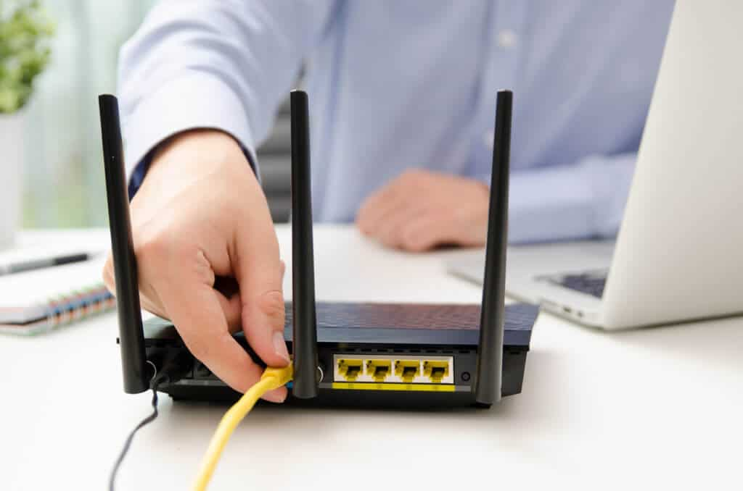
What does this thing do?

Slide 37
What we're still missing
… in order to make IP actually work in practice
=> How do you get an IP address? (DHCP)
=> What your home router does (NAT)
=> IPv6
We'll see the good, the bad, and the ugly...

Slide 38
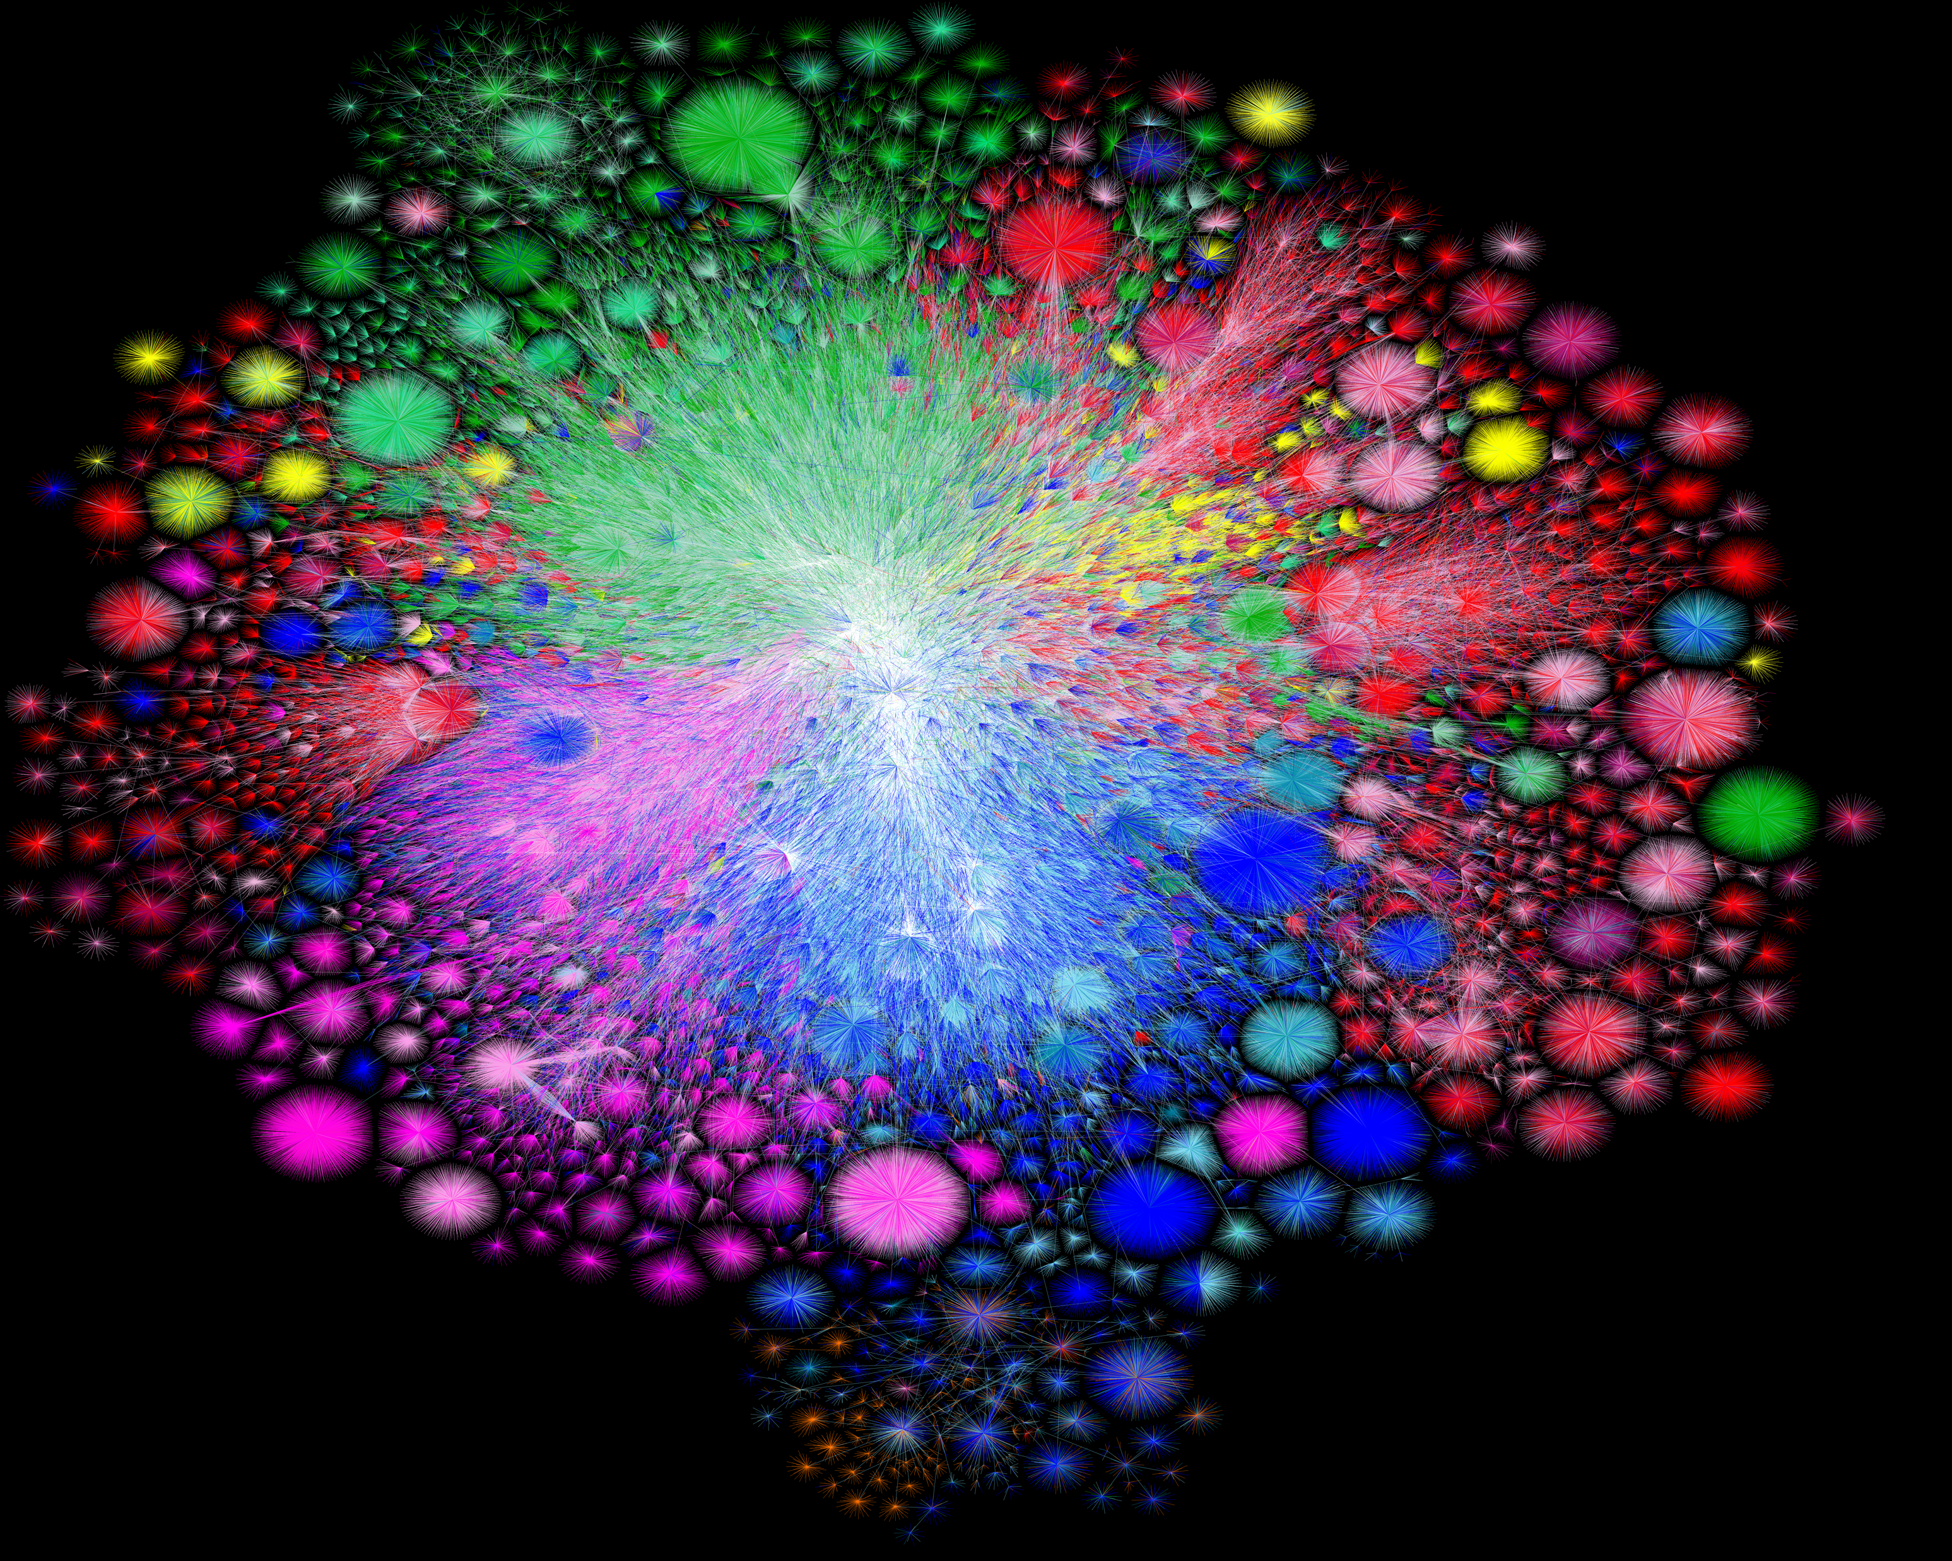
Map of the Internet, 2021 (via BGP)
OPTE project

Slide 39
Routing

Slide 40
Challenges in moving packets
Forwarding:
Routing:
Notes:
Forwarding uses forwarding table, routing builds forwarding table

Slide 41
Challenges in moving packets
Forwarding: given a packet, decide which interface to send the packet (based on IP destination)
Routing: network-wide process of determining a packet’s path through the network
  => How each router builds its forwarding table
Notes:
Forwarding uses forwarding table, routing builds forwarding table

Slide 42
Map of the Internet, 2021 (via BGP)
OPTE project
Routing is how we build this picture!

Slide 43
This is a hard problem
No single administrator
Topology always changing
=> Scale!!!!!

Slide 44
A forwarding table (my laptop)
deemer@ceres ~ % ip route
default via 10.3.128.1 dev wlp2s0
10.3.128.0/18 dev wlp2s0 proto dhcp scope link src 10.3.135.44 metric 3003
172.18.0.0/16 dev docker0 proto kernel scope link src 172.18.0.1
192.168.1.0/24 dev enp0s31f6 proto kernel scope link src 192.168.1.1

Slide 45
A large table
rviews@route-server.ip.att.net>show route table inet.0 active-path
inet.0: 866991 destinations, 13870153 routes (866991 active, 0 holddown, 0 hidden)
+ = Active Route, - = Last Active, * = Both
0.0.0.0/0 *[Static/5] 5w0d 19:43:09
> to 12.0.1.1 via em0.0
1.0.0.0/24 *[BGP/170] 1d 10:24:47, localpref 100, from 12.122.83.238
AS path: 7018 3356 13335 I, validation-state: valid
> to 12.0.1.1 via em0.0
1.0.4.0/22 *[BGP/170] 1d 10:24:47, localpref 100, from 12.122.83.238
AS path: 7018 3356 4826 38803 I, validation-state: valid
> to 12.0.1.1 via em0.0
1.0.4.0/24 *[BGP/170] 1d 10:24:47, localpref 100, from 12.122.83.238
AS path: 7018 3356 4826 38803 I, validation-state: valid
> to 12.0.1.1 via em0.0
1.0.5.0/24 *[BGP/170] 1d 10:24:47, localpref 100, from 12.122.83.238
AS path: 7018 3356 4826 38803 I, validation-state: valid
> to 12.0.1.1 via em0.0
1.0.6.0/24 *[BGP/170] 1d 10:24:47, localpref 100, from 12.122.83.238
AS path: 7018 3356 4826 38803 I, validation-state: valid
> to 12.0.1.1 via em0.0
1.0.7.0/24 *[BGP/170] 1d 10:24:47, localpref 100, from 12.122.83.238
AS path: 7018 3356 4826 38803 I, validation-state: valid
> to 12.0.1.1 via em0.0
1.0.64.0/18 *[BGP/170] 1d 10:24:47, localpref 100, from 12.122.83.238
AS path: 7018 2497 7670 18144 I, validation-state: unknown
> to 12.0.1.1 via em0.0
1.0.128.0/17 *[BGP/170] 1d 10:24:47, localpref 100, from 12.122.83.238
AS path: 7018 3356 38040 23969 I, validation-state: unknown
> to 12.0.1.1 via em0.0
1.0.128.0/18 *[BGP/170] 1d 10:24:47, localpref 100, from 12.122.83.238
AS path: 7018 3356 38040 23969 I, validation-state: unknown
> to 12.0.1.1 via em0.0
1.0.128.0/19 *[BGP/170] 1d 10:24:47, localpref 100, from 12.122.83.238
AS path: 7018 3356 38040 23969 I, validation-state: unknown
> to 12.0.1.1 via em0.0
1.0.128.0/24 *[BGP/170] 1d 10:24:47, localpref 100, from 12.122.83.238
AS path: 7018 6939 4651 23969 I, validation-state: unknown
> to 12.0.1.1 via em0.0
1.0.129.0/24 *[BGP/170] 1d 10:24:47, localpref 100, from 12.122.83.238
AS path: 7018 6939 4651 23969 I, validation-state: unknown
> to 12.0.1.1 via em0.0
Notes:
Takes this information and synthesizes it down into its forwarding table baed on interfaces

Slide 46
How do we connect everything?
Relies on hierarchical nature of IP addressing
Smaller routers don’t need to know everything, just another router that knows more
Core routers know everything

Slide 47
How do we connect everything?
Smaller routers don’t need to know everything, just another router that knows more
  Has default route
Core routers have no default, but may not have details…
=> Route packets to a certain network, which can figure it out from there

Slide 48
At scale, we think about routing to whole networks,
ie, some entity with some set of IP prefixes:
eg. Brown University @ 128.148.0.0/16, 138.16.0.0/16

Slide 49
Thinking about the scale
At this stage, we think about routing to whole networks,
ie, some entity with some set of IP prefixes:
eg. Brown University @ 128.148.0.0/16, 138.16.0.0/16
We call each entity an Autonomous System (AS):
a single administrative domain that lives on the Internet

Slide 50
Routing is organized in two levels:
Intra-domain (interior) routing: routing within an AS
Inter-domain (exterior) routing: routing between ASes

Slide 51
Routing is organized in two levels:
Intra-domain (interior) routing: routing within an AS
=> Full knowledge of the network inside the AS
=> One administrator, routing policy
=> Strive for optimal paths
Inter-domain (exterior) routing: routing between ASes
  => None of the above, decisions instead made by policy (later)
^ We are here today

Slide 52
Routing is the process of updating forwarding tables
  Routers exchange messages about networks they can reach

Slide 53
Routing is the process of updating forwarding tables
  Routers exchange messages about networks they can reach
Goal: find optimal route (or any route…) for
every other destination
This is a hard problem
  Decentralized
  Topology always changing
  Scale!

Slide 54
How do we connect everything?

Slide 55
Intra-Domain (Interior) Routing

Slide 56
Typically, view network as a graph
Nodes are routers
Assign some cost to each edge
  latency, b/w, queue length, …
Goal: find lowest-cost path between nodes
  Each node individually computes routes

Slide 57
Typically, view network as a graph
Nodes are routers
Assign some cost to each edge
  latency, b/w, queue length, …
Goal: find lowest-cost path between nodes
  Each node individually computes routes
Collect routes into a routing table, used to generate the forwarding table based on lowest-cost path

Slide 58
Generally: routing algorithms are decentralized

Slide 59
Generally: routing algorithms are decentralized
=>In general, no one entity telling routers what routes to use
=> Even for “interior” routing, where there is one admin, routers independently compute how to update their tables based on latest info from other routers

Slide 60
Two classes of intra-domain routing algorithms
Distance Vector (Bellman-Ford shortest path algorithm)
Link State (Djikstra/Prim shortest path algorithm)

Slide 61
Two classes of intra-domain routing algorithms
Distance Vector (Bellman-Ford shortest path algorithm)
  Idea: routers get updates from their neighbors
Link State (Djikstra/Prim shortest path algorithm)

Slide 62
Distance Vector Routing
Each node maintains a routing table
Exchange updates with neighbors
about node’s links:
=> List of <Destination, Cost> pairs
Notes:
Local routing algorithm

Slide 63
Distance Vector Routing
Each node maintains a routing table
Exchange updates with neighbors
about node’s links:
=> List of <Destination, Cost> pairs
When to send updates?
  Periodically (seconds to minutes)
  Whenever table changes (triggered update)
  Time out an entry if no updates within some time interval
Notes:
Local routing algorithm

Slide 64
Distance Vector Routing
Dest. | Cost | Next Hop
A | 3 | S
B | 4 | T
C | 5 | S
D | 6 | U
Each node maintains a routing table
Exchange updates with neighbors
about node’s links:
=> List of <Destination, Cost> pairs
When to send updates?
  Periodically (seconds to minutes)
  Whenever table changes (triggered update)
  Time out an entry if no updates within some time interval
Notes:
Local routing algorithm

Slide 65
Distance Vector Routing
Dest. | Cost | Next Hop
A | 3 | S
B | 4 | T
C | 5 | S
D | 6 | U
Each node maintains a routing table
Exchange updates with neighbors
about node’s links:
=> List of <Destination, Cost> pairs
When to send updates?
  Periodically (seconds to minutes)
  Whenever table changes (triggered update)
  Time out an entry if no updates within some time interval
Notes:
Local routing algorithm

Slide 66
How it works

Slide 67
Distance Vector: Update rules
Say router R receives an update <D, c_{D}> from neighbor N at cost C_{N}
=> Know: R can reach D via N with cost c = c_{D} + c_{N}
How to update table?
If D not in table, add <D, c, N> (New route!)
If table has entry <D, M, c_{old}>:
  if c < c_{old}: update table to <D, c, M>. (Lower cost!)
  if c > c_{old} and M == N: update table to <D, c, N> (Cost increased!)
  if c > c_{old} and M != N: ignore (N is better)
  if c == c_{old} and M ==N: no change (No new info)
(Just refresh timeout)

Slide 68
Calculating the best path
Bellman-Ford equation
Let:
  D_{a}(b) = the current best distance from a to b
  c(a,b) = the cost of a link from a to b
For some path x → y, where x has set of neighbors Z:
D_{x}(y) = min_{z}(c(x,z) + D_{z}(y)) ∀ z ∈ Z
In practice:
Routing messages contain D
D is any additive metric (number of hops, delay, …)

Slide 69
DV Example

Slide 70
DV Example
B’s routing table
Dest. | Cost | Next Hop
(B) | (0) | (B)
A | 1 | A
C | 1 | C
D | 2 | C
E | 2 | A
F | 2 | A
G | 3 | A

Slide 71
Warmup
Suppose router R has the following table:
What happens when it gets
this update from router S?
Dest. | Cost | Next Hop
A | 3 | S
B | 4 | T
C | 5 | S
D | 6 | U
Dest. | Cost
A | 2
B | 3
C | 5
D | 4
E | 2

Slide 72
Dealing with Failures
B
D
A
C
What happens when the D-A link fails?
=> “Count to Infinity” problem
Notes:
D-A fails
A sends update to B: (D, Inf)
C sends an update to B, so it now has (D, 2,C) (This is the race)
B sends update to A, which gets (D, B, 4)
Keep going until you reach infinity

Slide 73
How to avoid loops
Does IP TTL help?
Simple approach: consider a small cost n (e.g., 16) to be infinity
  After n rounds decide node is unavailable
  But rounds can be long, this takes time
Problem: distance vector based only on local information

Slide 74
One way: Split Horizon
When sending updates to node A, don’t include routes you learned from A
Prevents B and C from sending cost 2 to A

Slide 75
Split Horizon + Poison Reverse
Rather than not advertising routes learned from A, explicitly include cost of ∞.
Faster to break out of loops, but increases advertisement sizes

Slide 76
Distance-vector updates
B
Even with split horizon + poison reverse,
can still create loops with >2 nodes
What else can we do?
Triggered updates: send update as soon as link state changes
Hold down: delay using new routes for certain time, affects convergence time
D
A
C
Notes:
You need to do triggered updates in the assignment

Slide 77
Practice
B’s routing table
B
Dest. | Cost | Next Hop
A | 1 | A
C | 1 | C
D | 2 | A
D
A
C
Routers A,B,C,D use RIP. When B sends a periodic update to A, what does it send…
When using standard RIP?
When using split horizon + poison reverse?

Slide 78
Dealing with failures
B
D
A
C
What happens when the D-A link fails?
Notes:
D-A fails
A sends update to B: (D, Inf)
C sends an update to B, so it now has (D, 2,C) (This is the race)
B sends update to A, which gets (D, B, 4)
Keep going until you reach infinity

Slide 80
Extra content

Slide 81
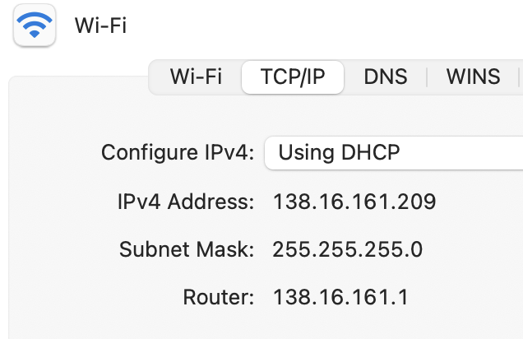
How do you get an IP address?

Slide 82
Getting an IP
Two ways to configure an IP for a host:
Static configuration: manually specify IP address, mask, gateway, …
Automatic: ask the network for an IP when you connect!

Slide 83
Getting an IP
Two ways to configure an IP for a host:
Static configuration: manually specify IP address, mask, gateway, …
=> More common with network devices that don’t change often
Automatic: ask the network for an IP when you connect!
    => Most common for end hosts
    => Dynamic Host Configuration Protocol (DHCP)

Slide 84
DHCP: The idea
Dynamic Host Configuration Protocol

Slide 85
DHCP: The idea
Dynamic Host Configuration Protocol
Every network has a “pool” of IPs it can assign to hosts
  Some subset of its prefix (eg. 192.168.1.0/24)
When a host connects, it asks a DHCP server for an address from the pool
DHCP server(s) act like allocators: give “leases” to IPs, provide other config info

Slide 86
Host A
DHCP server

Slide 87
Host A
DHCP server
Src: A's MAC address
Dst: ff:ff:ff:ff:ff:ff
DHCPDISCOVER
=> Again, host needs to use broadcast address. Why?
=> Problem?

Slide 88
Host A
DHCP server
Src: A's MAC address
Dst: ff:ff:ff:ff:ff:ff
DHCPDISCOVER
Src: <Server MAC address>
Dst: ff:ff:ff:ff:ff:ff
DHCPOFFER:
Your IP: 192.168.1.102
Mask: 255.255.255.0
Router: 192.168.1.1
...
(More steps after this)

Slide 89
Host A
DHCP server
Src: A's MAC address
Dst: ff:ff:ff:ff:ff:ff
DHCPDISCOVER
Src: <Server MAC address>
Dst: ff:ff:ff:ff:ff:ff
DHCPOFFER:
Your IP: 192.168.1.102
Mask: 255.255.255.0
Router: 192.168.1.1
...
(More steps after this)
=> Again, host needs to use broadcast address. Why?
=> Problem?

Slide 90
Obtaining Host IP Addresses - DHCP
Networks are free to assign addresses within block to hosts
Tedious and error-prone: e.g., laptop going from CIT to library to coffee shop
Solution: Dynamic Host Configuration Protocol
  Client: DHCP Discover to 255.255.255.255 (broadcast)
  Server(s): DHCP Offer to 255.255.255.255 (why broadcast?)
  Client: choose offer, DHCP Request (broadcast, why?)
  Server: DHCP ACK (again broadcast)
Result: address, gateway, netmask, DNS server

Slide 91
Problems with DHCP?
What happens if a random host decides to be a DHCP server?

Slide 92
Home routers
The good, the bad, and the ugly…

Slide 93
What’s in a home router?

Slide 94
Story time

Slide 95
Where it gets weird…
Notes:
Address sharing

Slide 96
Where it gets weird…
For many end hosts:
(IP assigned to your host) != (Your ”public” IP)
(IP seen by other systems on the Internet)
Notes:
Address sharing

Slide 97
Where it gets weird…
You get just one IP from your ISP…
=> Need to share IP among many devices on the same network!
Notes:
Address sharing

Slide 98
Where it gets weird…
You get just one IP from your ISP…
=> Need to share IP among many devices on the same network!
Solution: Create a “private” IP range used within local network
=> Routers need to do extra work to share public IP among many private IPs
=> Network Address Translation (NAT)
(A form of connection multiplexing)
Notes:
Address sharing

Slide 100
How NAT works
(The most common type)
192.168.1.100
S
IF1
IF0
192.168.1.101
192.168.1.1
5.6.7.8
Rest of Internet
1.2.1.102
“Inside” network
192.168.1.0/24
Goal: Share one IP among many hosts on a private network
Router translates (modifies) packets from ”inside” to use “outside” address

Slide 101
Private IPs (RFC1918)
IP ranges reserved for “private” networks:
Prefix | Use
127.0.0.0/8 | “Loopback” address—always for current host
10.0.0.0/8 | Reserved for private internal networks (RFC1918)
192.168.0.0/16 | IF2
172.16.0.0/12 | IF0

Slide 102
Private IPs (RFC1918)
IP ranges reserved for “private” networks:
Many networks will use these blocks internally
These IPs should never be routed over the Internet!
  What would happen if they were?
Prefix | Use
127.0.0.0/8 | “Loopback” address—always for current host
10.0.0.0/8 | Reserved for private internal networks (RFC1918)
192.168.0.0/16 | IF2
172.16.0.0/12 | IF0

Slide 103
How NAT works
(The most common type)
192.168.1.100
S
IF1
IF0
192.168.1.101
192.168.1.1
5.6.7.8
Rest of Internet
Your “public” IP
1.2.1.102
“Inside” network
192.168.1.0/24
Goal: Share one IP among many hosts on a private network
Router translates (modifies) packets from ”inside” to use “outside” address
=> Router needs to remember connection state
=> Router makes some (sketchy) assumptions about traffic

Slide 105
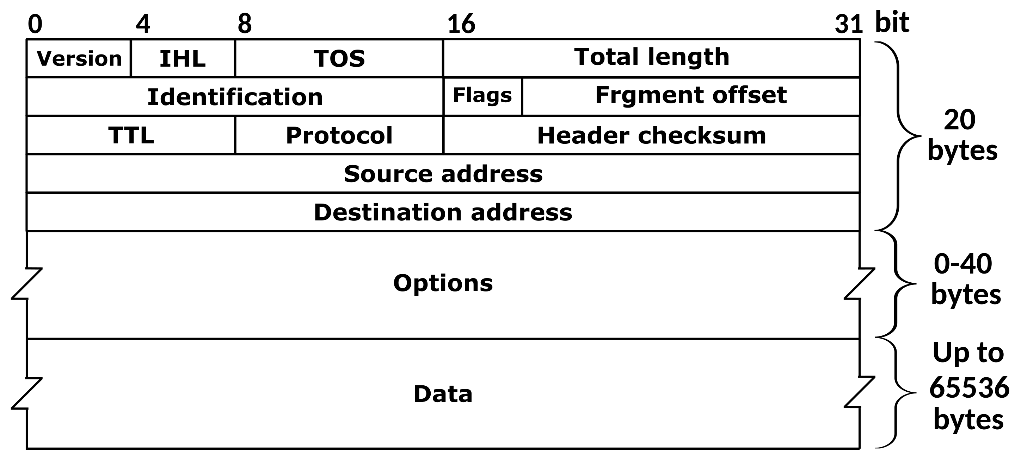
IP Header
Where are the port numbers?????

Slide 106
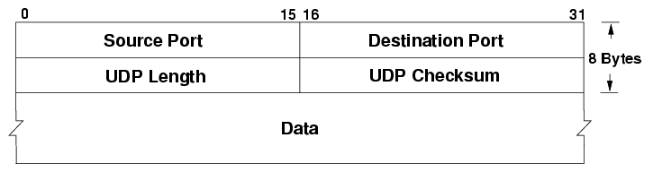
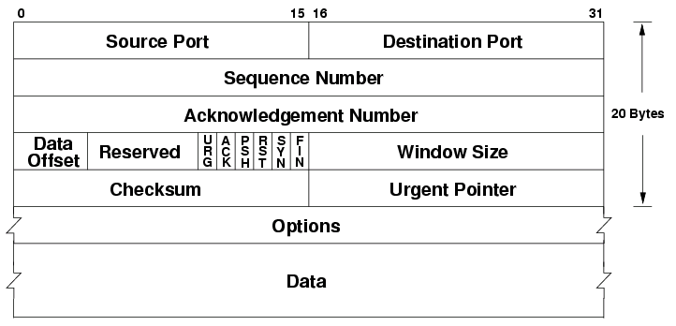
… ports are actually part of the transport layer header!
UDP
TCP
Problem???????

Slide 107
… ports are actually part of the transport layer header!
UDP
TCP
Problem?
Technically a violation of layering! Network layer shouldn’t care about port numbers, but here it matters
NAT needs to know semantics of TCP/UDP (how connections start/end…
...but wait there’s more…

Slide 108
NAT vs. Snowcast

Slide 109
A
192.168.1.100
S
B
IF1
R
IF0
192.168.1.101
192.168.1.1
5.6.7.8
Rest of Internet
C
1.2.1.102
“Inside” network
192.168.1.0/24
What happens when outside host S wants to connect to inside host A?

Slide 110
A
192.168.1.100
S
B
IF1
R
IF0
192.168.1.101
192.168.1.1
5.6.7.8
Rest of Internet
C
1.2.1.102
“Inside” network
192.168.1.0/24
What happens when outside host S wants to connect to inside host A?
Can’t do it (at least without special setup)!
By default, R only knows how to translate packets for connections originating from INSIDE the network
Breaks end to end connectivity!!!

Slide 111
A
192.168.1.100
S
B
IF1
R
IF0
192.168.1.101
192.168.1.1
5.6.7.8
Rest of Internet
C
1.2.1.102
“Inside” network
192.168.1.0/24
What happens when outside host S wants to connect to inside host A?
Can’t do it (at least without special setup)!
By default, R only knows how to translate packets for connections originating from INSIDE the network
Breaks end to end connectivity!!!

Slide 112
End to end connectivity, you say?

Slide 113
Why is this bad?
NAT is used in just about every consumer network
Generally: can’t connect directly to an end host unless it connects to you first

Slide 114
Why is this bad?
NAT is used in just about every consumer network
Generally: can’t connect directly to an end host unless it connects to you first
Need extra work for any protocols that need a direct connection between hosts
=> When do we need this?

Slide 115
Why is this bad?
NAT is used in just about every consumer network
Generally: can’t connect directly to an end host unless it connects to you first
Need extra work for any protocols that need a direct connection between hosts
Protocols that aren’t strictly client-server
Latency critical applications: voice/video calls, games

Slide 116
NAT Traversal
Various methods, depending on the type of NAT
Examples:
Manual method: port forwarding
ICE: Interactive Connectivity Establishment (RFC8445)
STUN: Session Traversal Utilities for NAT (RFC5389)
One idea: connect to external server via UDP, it tells you the address/port

Slide 117
IPv6

Slide 118
IP challenge: Address space exhaustion
IP version 4: ~4 billion IP addresses
  World population: ~8 billion
  Est. number of devices on Internet (2021): >10-30 billion
Since 1990s: various tricks
  Smarter allocations by registrars
  Address sharing: Network Address Translation (NAT)
  DHCP
  Reclaiming unused space
Long term solution: IP version 6

Slide 119
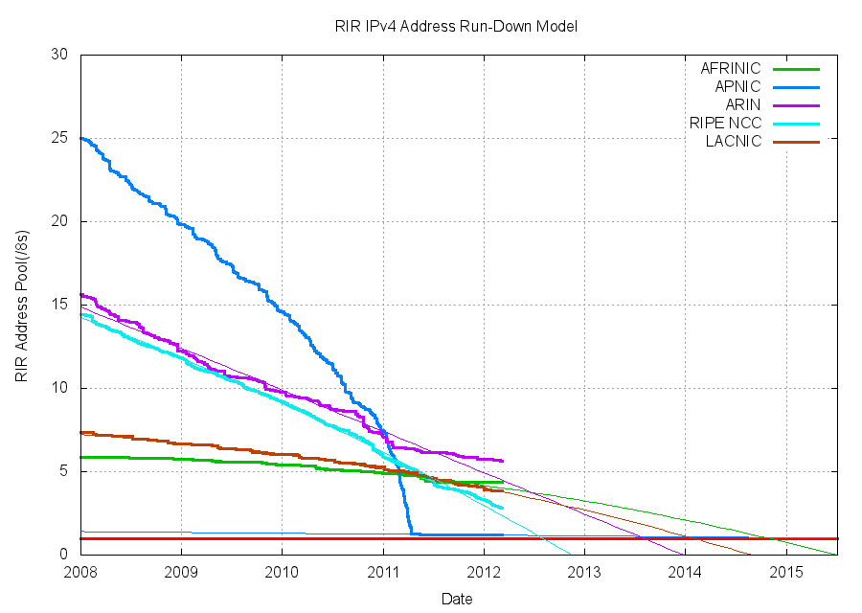
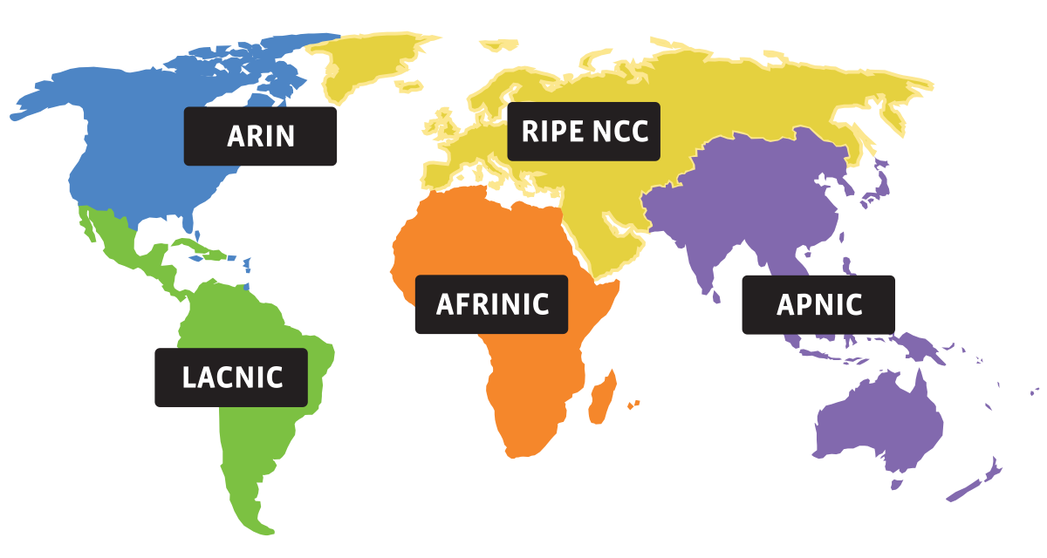
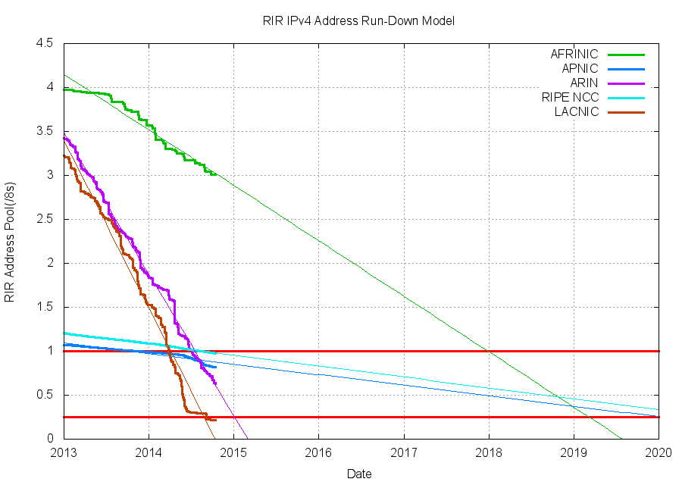
Source: potaroo.net/tools/ipv4
Notes:
Sorry the colors don’t line up

Slide 120
Source: potaroo.net/tools/ipv4

Slide 121
So what happened when we ran out of IPv4 addresses?
It’s not completely gone just yet, but close
Address block fragmentation
  Secondary market for IPv4
  E.g., in 2011 Microsoft bought >600K US IPv4 addresses for $7.5M
NATs galore
  Home NATs, carrier-grade NATs
Jun 2014

Slide 122
IPv6
Main motivation: IPv4 address exhaustion
Initial idea: larger address space
Need new packet format:
  REALLY expensive to upgrade all infrastructure!
  While at it, why don’t we fix a bunch of things in IPv4?
Work started in 1994, basic protocol published in 1998

Slide 123
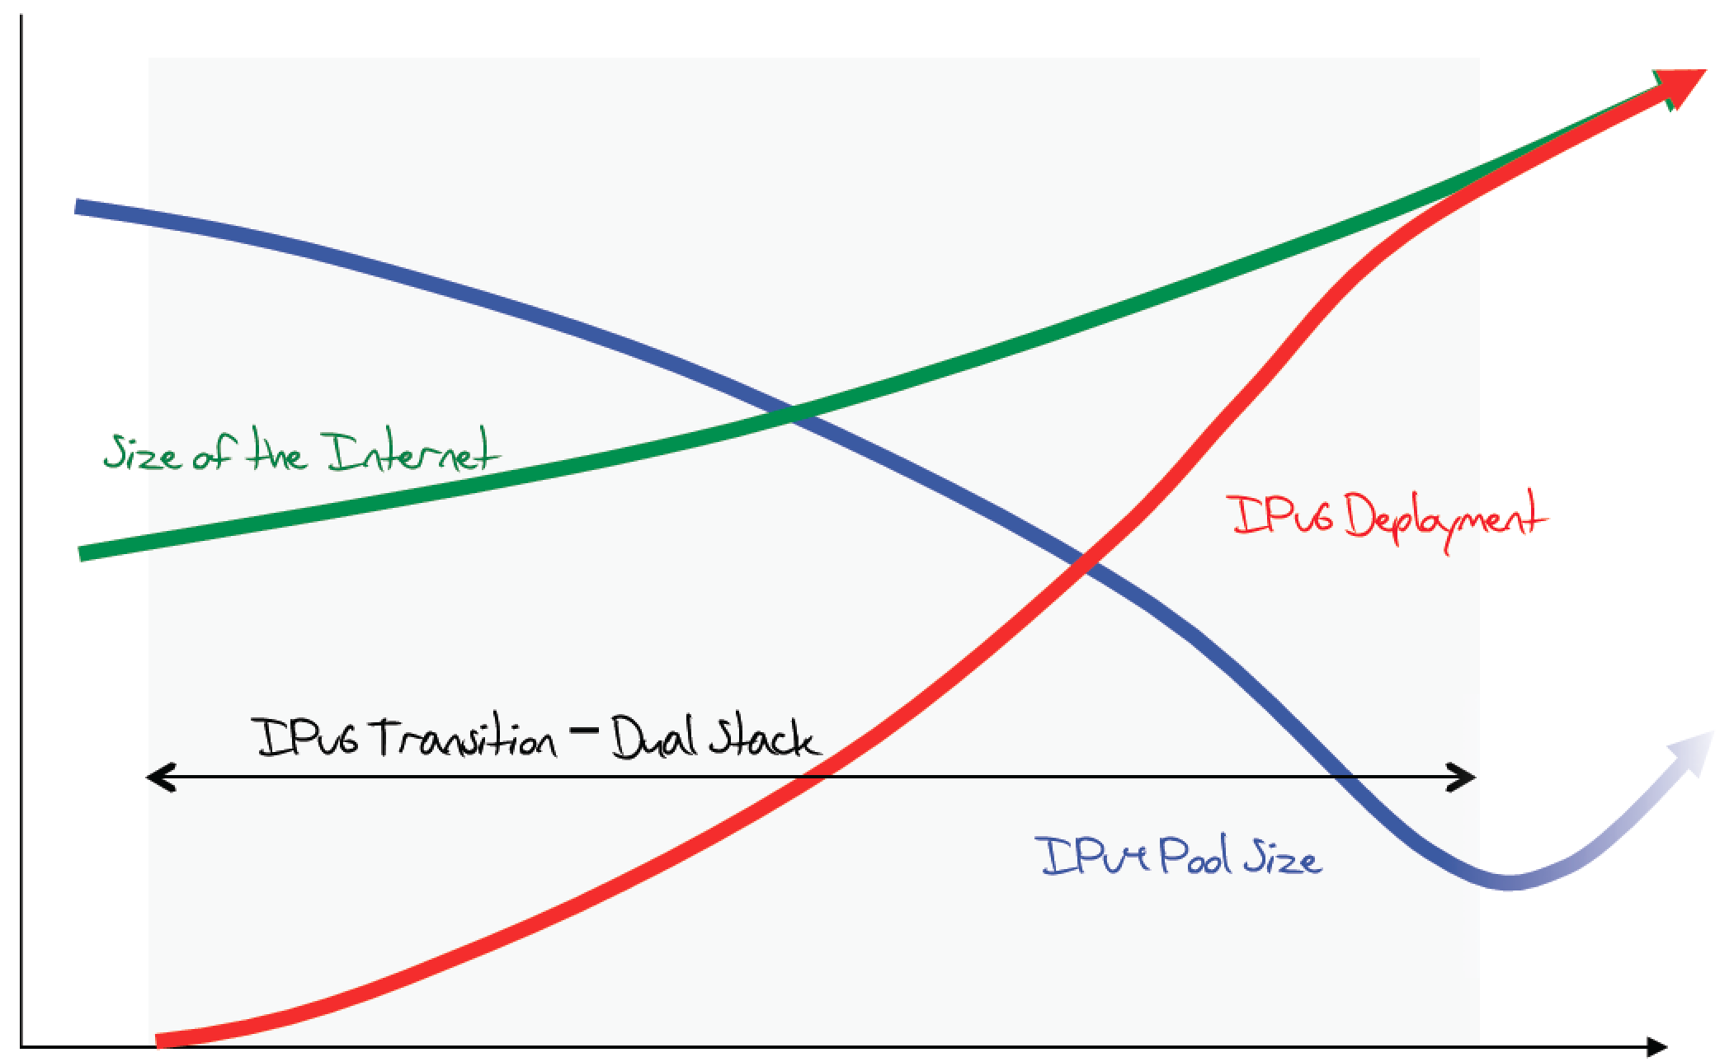
The original expected plan
From: http://www.potaroo.net/ispcol/2012-08/EndPt2.html

Slide 124
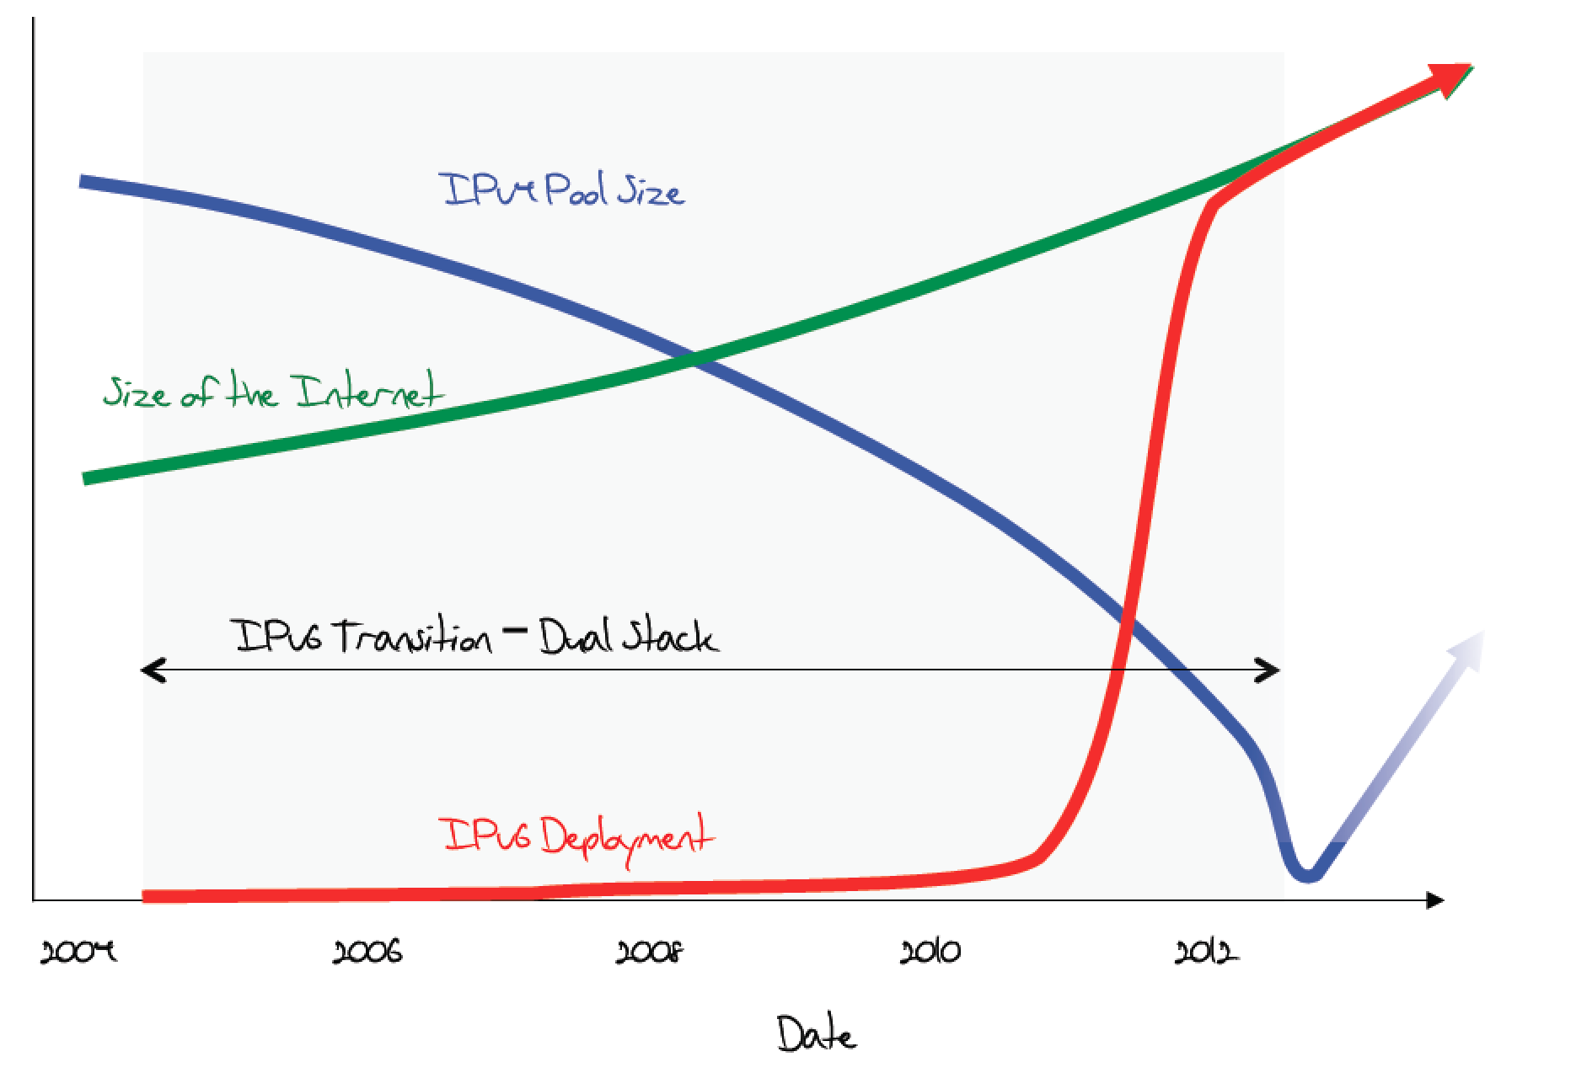
The plan in 2011

Slide 125
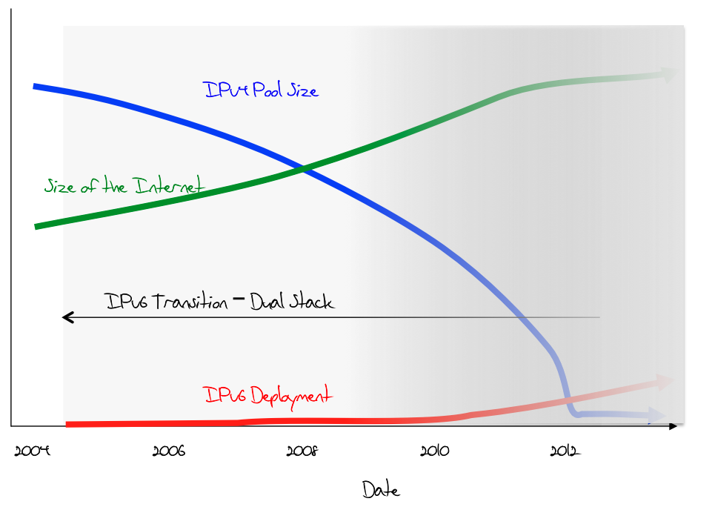
What was happening (late 2012)

Slide 126
June 6th, 2012

Slide 127
Transition is not painless
From http://www.internetsociety.org/deploy360/ipv6/ :
Why do each of these parties have to do something?

Slide 128
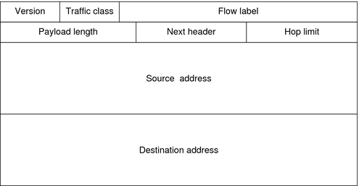
IP version 6
128-bit addresses!
Eg. 2600:3c03::f03c:91ff:fe6e:e3e1

Slide 129
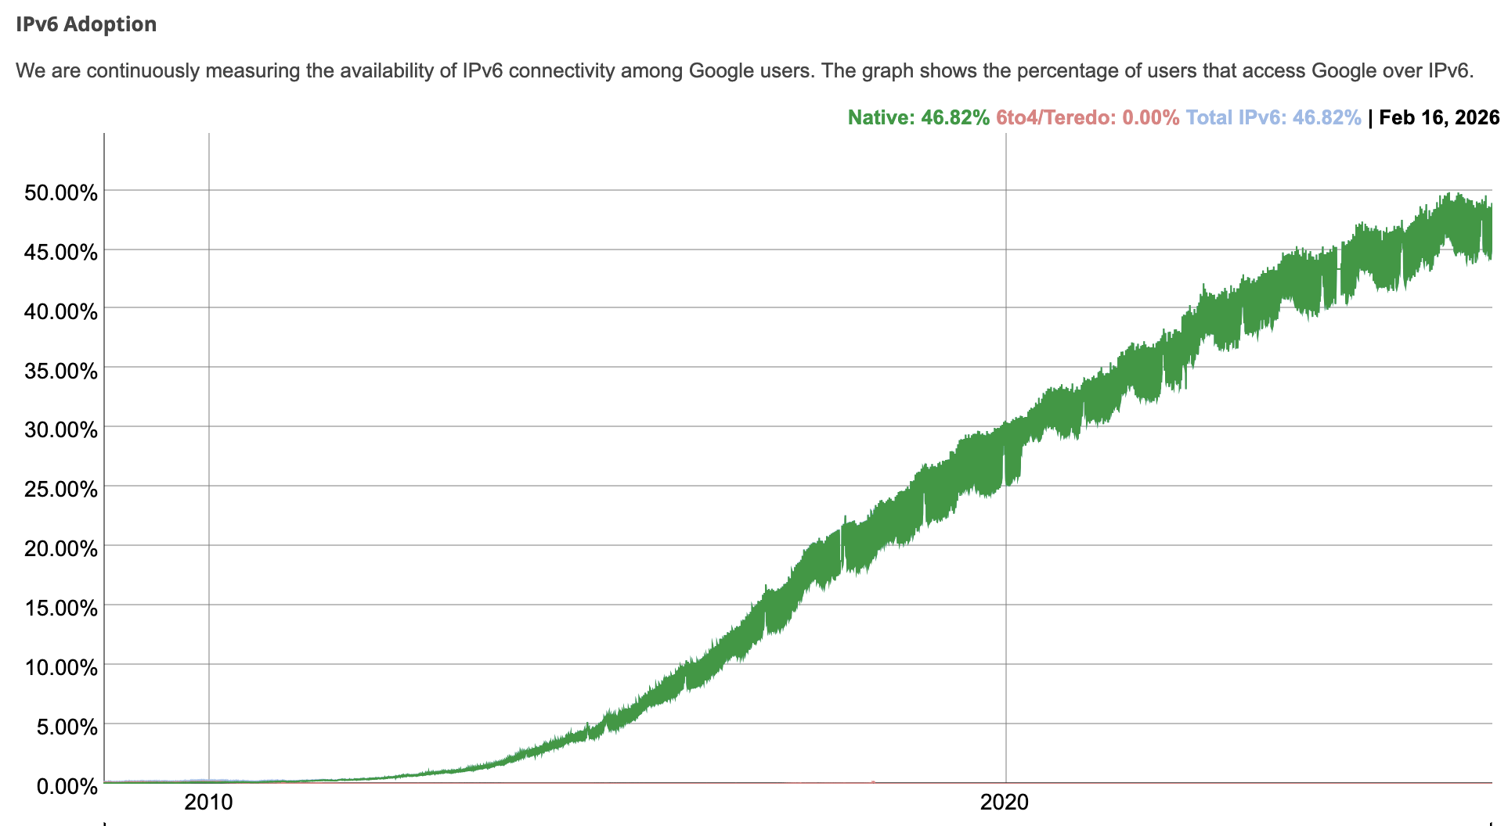
IPv6 Adoption
At Google:
Notes:
Just like routers provide access to the IPv4 space, all of the network elements in a path need to support IPv6—we basically need to build another graph, and allocate more addresses. This process has been happening gradually over the last 20 years, and now it’s starting to get better

Slide 130
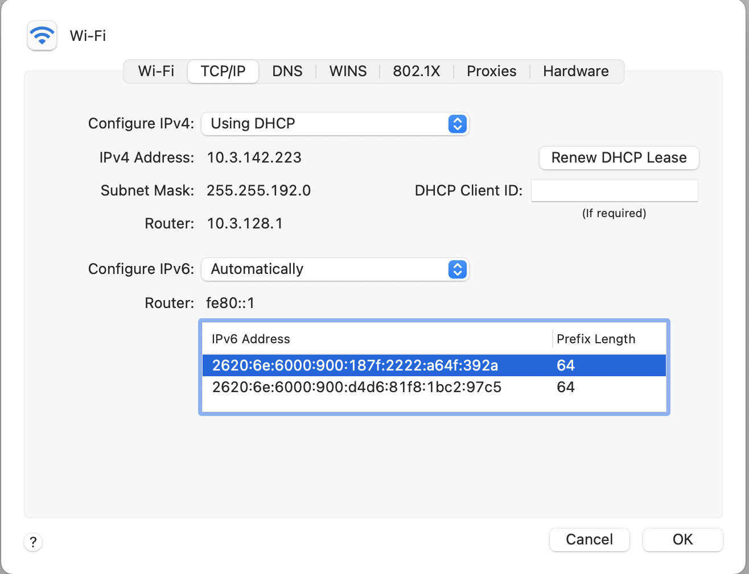
At Brown
Notes:
As of this semester I think, we now have IPv6!

Slide 131
IPv6 Header

Slide 132
Example Next Header Values
0: Hop by hop header
1: ICMPv4
4: IPv4
6:TCP
17: UDP
41: IPv6
43: Routing Header
44: Fragmentation Header
58: ICMPv6

Slide 133
Example
# arp -n
Address HWtype HWaddress Flags Mask Iface
172.17.44.1 ether 00:12:80:01:34:55 C eth0
172.17.44.25 ether 10:dd:b1:89:d5:f3 C eth0
172.17.44.6 ether b8:27:eb:55:c3:45 C eth0
172.17.44.5 ether 00:1b:21:22:e0:22 C eth0
# ip route
127.0.0.0/8 via 127.0.0.1 dev lo
172.17.44.0/24 dev enp7s0 proto kernel scope link src 172.17.44.22 metric 204
default via 172.17.44.1 dev eth0 src 172.17.44.22 metric 204
Notes:
arp -an
netstat -rn

Slide 134
Internet Control Message Protocol (ICMP)
Echo (ping)
Redirect
Destination unreachable (protocol, port, or host)
TTL exceeded
Checksum failed
Reassembly failed
Can’t fragment
Many ICMP messages include part of packet that triggered them
See http://www.iana.org/assignments/icmp-parameters

Slide 135
ICMP message format

Slide 136
Example: Time Exceeded
Code usually 0 (TTL exceeded in transit)
Discussion: traceroute

Slide 137
A
1.2.1.1
B
1.2.1.3
listen(80)
Src Dst
IP 1.2.3.4 5.6.7.8
Port 12345 80
Src Dst
IP 5.6.7.8 1.2.3.4
Port 80 12345

