Slide 1
CS 1680 Intra-domain Routing
Based partly on lecture notes by Rodrigo Fonseca, David Mazières, Phil Levis, John Jannotti

Slide 2
Administrivia
IP milestone meetings: Should meet with staff today
IP: Next steps
Gearup II: see recording/notes
See Implementation Start Guide, other resources
Do not leave this project until the last minute
HW1 due tonight

Slide 3


Warmup
1.2.1.0/24
What is the destination MAC address when H1 is sending the following packets?
1.2.1.3
bb:bb:bb
H1
 | Src | Dest
Link | aa:aa:aa | ???
IP | 1.2.1.2 | 1.2.1.1
1)
1.2.1.2
aa:aa:aa
1.2.1.1
cc:cc:cc
 | Src | Dest
Link | aa:aa:aa | ???
IP | 1.2.1.2 | 1.2.1.3
H1’s forwarding table:
2)
Prefix | IF/Next hop
1.2.1.0/24 | IF1
0.0.0.0 | 1.2.1.1
 | Src | Dest
Link | aa:aa:aa | ???
IP | 1.2.1.2 | 8.8.8.8 (Google)
3)
Notes:
Let’s first look at how we move packets between the two networks

Slide 4
Recap: IP vs. Link-layer address
Link-layer header info (Ethernet/Wifi/etc)
- Destination MAC address is link-layer addr
for packet’s next hop
- Changes every hop
- Each hop could use a different link-layer
protocol!
 | Src | Dest
Link | aa:aa:aa | cc:cc:cc
IP | 1.2.1.2 | 8.8.8.8 (Google)
IP header info
- Destination IP is IP address of packet’s final destination
- Routers look at destination IP to figure out where packet goes next (and which MAC address goes on packet next)

Slide 5
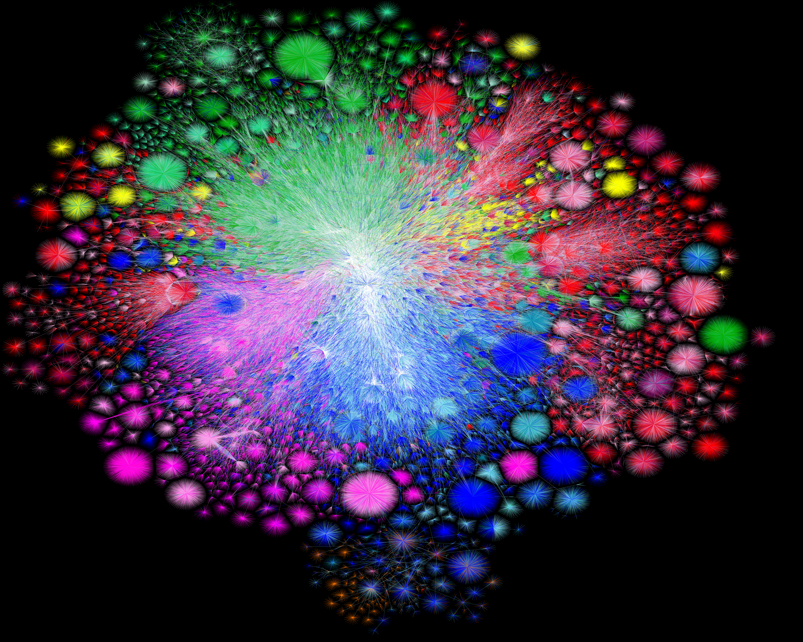
Map of the Internet, 2021 (via BGP)
OPTE project

Slide 6

What does this thing do?

Slide 7
What we're still missing
… in order to make IP actually work in practice
=> How do you get an IP address? (DHCP)
=> What your home router does (NAT)
=> IPv6
We'll see the good, the bad, and the ugly...

Slide 8
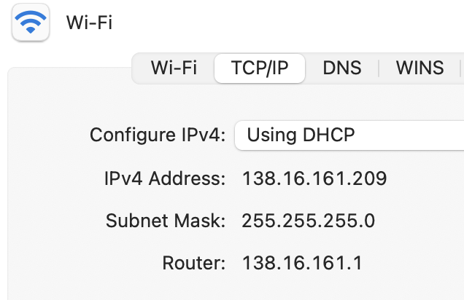
How do you get an IP address?

Slide 9
Getting an IP
Two ways to configure an IP for a host:
Static configuration: manually specify IP address, mask, gateway, …
Automatic: ask the network for an IP when you connect!

Slide 10
Getting an IP
Two ways to configure an IP for a host:
Static configuration: manually specify IP address, mask, gateway, …
=> More common with network devices that don’t change often
Automatic: ask the network for an IP when you connect!
=> Most common for end hosts
=> Dynamic Host Configuration Protocol (DHCP)

Slide 11
DHCP: The idea
Dynamic Host Configuration Protocol

Slide 12
DHCP: The idea
Dynamic Host Configuration Protocol
Every network has a “pool” of IPs it can assign to hosts
Some subset of its prefix (eg. 192.168.1.0/24)
When a host connects, it asks a DHCP server for an address from the pool
DHCP server(s) act like allocators: give “leases” to IPs, provide other config info

Slide 13
Host A
DHCP server

Slide 14
Host A
DHCP server
Src: A's MAC address
Dst: ff:ff:ff:ff:ff:ff
DHCPDISCOVER
=> Again, host needs to use broadcast address. Why?
=> Problem?

Slide 15
Host A
DHCP server
Src: A's MAC address
Dst: ff:ff:ff:ff:ff:ff
DHCPDISCOVER
Src: <Server MAC address>
Dst: ff:ff:ff:ff:ff:ff
DHCPOFFER:
Your IP: 192.168.1.102
Mask: 255.255.255.0
Router: 192.168.1.1
...
(More steps after this)

Slide 16
Host A
DHCP server
Src: A's MAC address
Dst: ff:ff:ff:ff:ff:ff
DHCPDISCOVER
Src: <Server MAC address>
Dst: ff:ff:ff:ff:ff:ff
DHCPOFFER:
Your IP: 192.168.1.102
Mask: 255.255.255.0
Router: 192.168.1.1
...
(More steps after this)
=> Again, host needs to use broadcast address. Why?
=> Problem?

Slide 17
Home routers
The good, the bad, and the ugly…

Slide 18
What’s in a home router?

Slide 19
Story time

Slide 20
Routing

Slide 21
Challenges in moving packets
Forwarding:
Routing:
Notes:
Forwarding uses forwarding table, routing builds forwarding table

Slide 22
Challenges in moving packets
Forwarding: given a packet, decide which interface to send the packet (based on IP destination)
Routing: network-wide process of determining a packet’s path through the network
=> How each router builds its forwarding table
Notes:
Forwarding uses forwarding table, routing builds forwarding table

Slide 23
Routing is the process of updating forwarding tables
Routers exchange messages about networks they can reach

Slide 24
Routing is the process of updating forwarding tables
Routers exchange messages about networks they can reach
Goal: find optimal route (or any route…) for every other destination
This is a hard problem
Decentralized
Topology always changing
Scale!

Slide 25
Map of the Internet, 2021 (via BGP)
OPTE project
Routing is how we build this picture!

Slide 26
How do we connect everything?
Relies on hierarchical nature of IP addressing
Smaller routers don’t need to know everything, just another router that knows more
Has default route
Core routers know everything => no default!

Slide 27
A forwarding table (my laptop)
deemer@ceres ~ % ip route
default via 10.3.128.1 dev wlp2s0
10.3.128.0/18 dev wlp2s0 proto dhcp scope link src 10.3.135.44 metric 3003
172.18.0.0/16 dev docker0 proto kernel scope link src 172.18.0.1
192.168.1.0/24 dev enp0s31f6 proto kernel scope link src 192.168.1.1

Slide 28
A large table
rviews@route-server.ip.att.net>show route table inet.0 active-path
inet.0: 866991 destinations, 13870153 routes (866991 active, 0 holddown, 0 hidden)
+ = Active Route, - = Last Active, * = Both
0.0.0.0/0 *[Static/5] 5w0d 19:43:09
> to 12.0.1.1 via em0.0
1.0.0.0/24 *[BGP/170] 1d 10:24:47, localpref 100, from 12.122.83.238
AS path: 7018 3356 13335 I, validation-state: valid
> to 12.0.1.1 via em0.0
1.0.4.0/22 *[BGP/170] 1d 10:24:47, localpref 100, from 12.122.83.238
AS path: 7018 3356 4826 38803 I, validation-state: valid
> to 12.0.1.1 via em0.0
1.0.4.0/24 *[BGP/170] 1d 10:24:47, localpref 100, from 12.122.83.238
AS path: 7018 3356 4826 38803 I, validation-state: valid
> to 12.0.1.1 via em0.0
1.0.5.0/24 *[BGP/170] 1d 10:24:47, localpref 100, from 12.122.83.238
AS path: 7018 3356 4826 38803 I, validation-state: valid
> to 12.0.1.1 via em0.0
1.0.6.0/24 *[BGP/170] 1d 10:24:47, localpref 100, from 12.122.83.238
AS path: 7018 3356 4826 38803 I, validation-state: valid
> to 12.0.1.1 via em0.0
1.0.7.0/24 *[BGP/170] 1d 10:24:47, localpref 100, from 12.122.83.238
AS path: 7018 3356 4826 38803 I, validation-state: valid
> to 12.0.1.1 via em0.0
1.0.64.0/18 *[BGP/170] 1d 10:24:47, localpref 100, from 12.122.83.238
AS path: 7018 2497 7670 18144 I, validation-state: unknown
> to 12.0.1.1 via em0.0
1.0.128.0/17 *[BGP/170] 1d 10:24:47, localpref 100, from 12.122.83.238
AS path: 7018 3356 38040 23969 I, validation-state: unknown
> to 12.0.1.1 via em0.0
1.0.128.0/18 *[BGP/170] 1d 10:24:47, localpref 100, from 12.122.83.238
AS path: 7018 3356 38040 23969 I, validation-state: unknown
> to 12.0.1.1 via em0.0
1.0.128.0/19 *[BGP/170] 1d 10:24:47, localpref 100, from 12.122.83.238
AS path: 7018 3356 38040 23969 I, validation-state: unknown
> to 12.0.1.1 via em0.0
1.0.128.0/24 *[BGP/170] 1d 10:24:47, localpref 100, from 12.122.83.238
AS path: 7018 6939 4651 23969 I, validation-state: unknown
> to 12.0.1.1 via em0.0
1.0.129.0/24 *[BGP/170] 1d 10:24:47, localpref 100, from 12.122.83.238
AS path: 7018 6939 4651 23969 I, validation-state: unknown
> to 12.0.1.1 via em0.0
Notes:
Takes this information and synthesizes it down into its forwarding table baed on interfaces

Slide 29
At this scale, we think about routing to whole networks, i.e., some entity with some set of IP prefixes:
e.g. Brown University @ 128.148.0.0/16, 138.16.0.0/16

Slide 30
At this scale, we think about routing to whole networks, i.e., some entity with some set of IP prefixes:
e.g. Brown University @ 128.148.0.0/16, 138.16.0.0/16
We call each entity an Autonomous System (AS):
a single administrative domain that lives on the Internet

Slide 31
Routing is organized in two levels:
Intra-domain (interior) routing: routing within an AS
Inter-domain (exterior) routing: routing between ASes

Slide 32
Routing is organized in two levels:
Intra-domain (interior) routing: routing within an AS
=> Full knowledge of the network inside the AS => One administrator, routing policy => Strive for optimal paths
Inter-domain (exterior) routing: routing between ASes
=> None of the above, decisions instead made by policy (later)
^ We are here today

Slide 33
Intra-Domain (Interior) Routing

Slide 34
Network == Graph
Assign cost to edges
=> latency, bandwidth, ….

Slide 35
Network == Graph
Assign cost to edges
=> latency, bandwidth, ….

Slide 36
Typically, view network as a graph
Nodes are routers
Assign some cost to each edge
latency, b/w, queue length, …
Goal: find lowest-cost path between nodes
Each node individually computes routes
Collect routes into a routing table, used to generate the forwarding table based on lowest-cost path

Slide 37
Generally: routing algorithms are decentralized

Slide 38
Generally: routing algorithms are decentralized
=>In general, no one entity telling routers what routes to use
=> Even for “interior” routing, where there is one admin, routers independently compute how to update their tables based on latest info from other routers

Slide 39
Two classes of intra-domain routing algorithms
Distance Vector (Bellman-Ford shortest path algorithm)
Link State (Djikstra/Prim shortest path algorithm)

Slide 40
Two classes of intra-domain routing algorithms
Distance Vector (Bellman-Ford shortest path algorithm)
Idea: routers get updates from their neighbors
Link State (Djikstra/Prim shortest path algorithm)

Slide 41
First type: Distance Vector Routing
Notes:
Local routing algorithm

Slide 42
Distance Vector Routing
Each node maintains a routing table
Exchange updates with neighbors about node’s links: => List of (Destination, Cost) pairs
Notes:
Local routing algorithm

Slide 43
Distance Vector Routing
Each node maintains a routing table
Exchange updates with neighbors about node’s links: => List of (Destination, Cost) pairs
When to send updates?
Periodically (seconds to minutes)
Whenever table changes (triggered update)
Time out an entry if no updates within some time interval
Notes:
Local routing algorithm

Slide 44
Distance Vector Routing
Dest. | Cost | Next Hop
A | 3 | S
B | 4 | T
C | 5 | S
D | 6 | U
Each node maintains a routing table
Exchange updates with neighbors about node’s links: => List of (Destination, Cost) pairs
When to send updates?
Periodically (seconds to minutes)
Whenever table changes (triggered update)
Time out an entry if no updates within some time interval
Notes:
Local routing algorithm

Slide 45
Distance Vector: Update rules
Say router R receives an update (D, c_{D}) from neighbor N at cost C_{N}
=> Know: R can reach D via N with cost c = c_{D} + c_{N}
How to update table?
If D not in table, add (D, c, N) (New route!)
If table has entry (D, M, c_{old}):
if c < c_{old}: update table to (D, c, M). (Lower cost!)
if c > c_{old} and M == N: update table to (D, c, N) (Cost increased!)
if c > c_{old} and M != N: ignore (N is better)
if c == c_{old} and M ==N: no change (No new info)
(Just refresh timeout)

Slide 46
DV Example

Slide 47
DV Example
B’s routing table
Dest. | Cost | Next Hop
(B) | (0) | (B)
A | 1 | A
C | 1 | C
D | 2 | C
E | 2 | A
F | 2 | A
G | 3 | A

Slide 48
Suppose router R has the following table:
What happens when it gets
this update from router S?
Dest. | Cost | Next Hop
A | 3 | S
B | 4 | T
C | 5 | S
D | 6 | U
Dest. | Cost
A | 2
B | 3
C | 5
D | 4
E | 2

Slide 49
What happens when the D-A link fails?
B
D
A
C
Notes:
D-A fails
A sends update to B: (D, Inf)
C sends an update to B, so it now has (D, 2,C) (This is the race)
B sends update to A, which gets (D, B, 4)
Keep going until you reach infinity

Slide 50
What happens when the D-A link fails?
B
D
A
C
=> “Count to Infinity” problem
Notes:
D-A fails
A sends update to B: (D, Inf)
C sends an update to B, so it now has (D, 2,C) (This is the race)
B sends update to A, which gets (D, B, 4)
Keep going until you reach infinity

Slide 51
What happens when the D-A link fails?
B
D
A
C
Updates occur in a loop with increasing cost until cost reaches infinity (16)!
=> Count to infinity => long time to converge when links fail
Notes:
D-A fails
A sends update to B: (D, Inf)
C sends an update to B, so it now has (D, 2,C) (This is the race)
B sends update to A, which gets (D, B, 4)
Keep going until you reach infinity

Slide 53
Can we avoid loops?
Does IP TTL help? Nope.
Simple approach: consider a small cost n (e.g., 16) to be infinity

Slide 54
Can we avoid loops?
Does IP TTL help? Nope.
Simple approach: consider a small cost n (e.g., 16) to be infinity
Fundamental problem: distance vector only based on local information!
=> Not enough info to resolve loops, race conditions, count-to-infinity,
but there are some tricks…

Slide 55
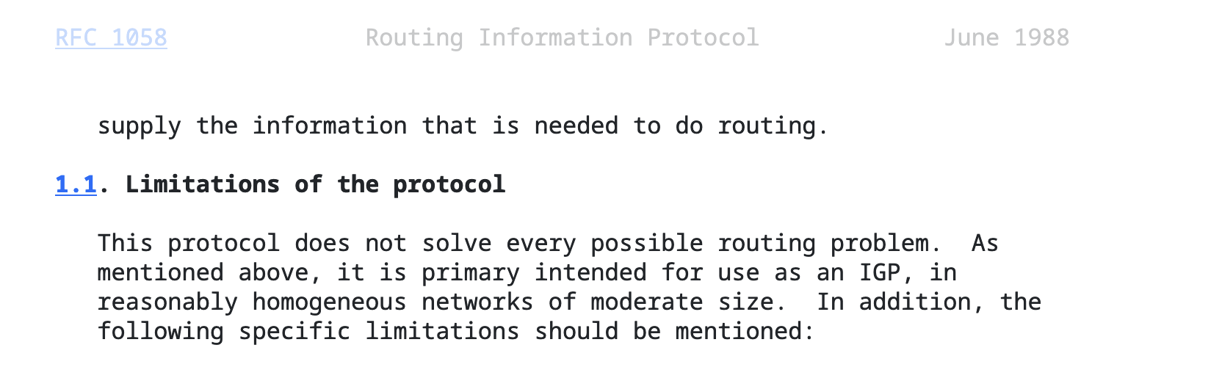
RFC1058 (1988): The original RIP standard*
*: Obsoleted by RFC2453 (don’t use RFC 1058 for the project,
Use RFC 2453 instead)

Slide 56
One strategy: Split Horizon
When sending updates to node A, don’t include routes you learned from A
Prevents B and C from sending cost 2 to A

Slide 57
Split Horizon + Poison reverse
Rather than not advertising routes learned from A, explicitly include cost of ∞.
Faster to break out of loops, but increases advertisement sizes

Slide 58
Split Horizon + Poison reverse
Rather than not advertising routes learned from A, explicitly include cost of ∞.
Faster to break out of loops, but increases advertisement sizes
=> Does it help?

Slide 59

Split Horizon + Poison reverse
Rather than not advertising routes learned from A, explicitly include cost of ∞.
Faster to break out of loops, but increases advertisement sizes
Does it help? Not completely.
=> A common convention, might reduce time to converge, but overall hard to see effect vs. split horizon

Slide 60
Even with split horizon + poison reverse,
can still create loops with >2 nodes!
B
D
A
C
Notes:
You need to do triggered updates in the assignment

Slide 61
Even with split horizon + poison reverse,
can still create loops with >2 nodes!
What else can we do?
B
D
A
C
Notes:
You need to do triggered updates in the assignment

Slide 62
Even with split horizon + poison reverse,
can still create loops with >2 nodes!
What else can we do?
Triggered updates: send update as soon as link state changes
Hold down: delay using new routes for certain time, affects convergence time
B
D
A
C
Notes:
You need to do triggered updates in the assignment

Slide 63
Practice
B’s routing table
B
Dest. | Cost | Next Hop
A | 1 | A
C | 1 | C
D | 2 | A
D
A
C
Routers A,B,C,D use RIP. When B sends a periodic update to A, what does it send…
When using standard RIP?
When using split horizon + poison reverse?

Slide 64
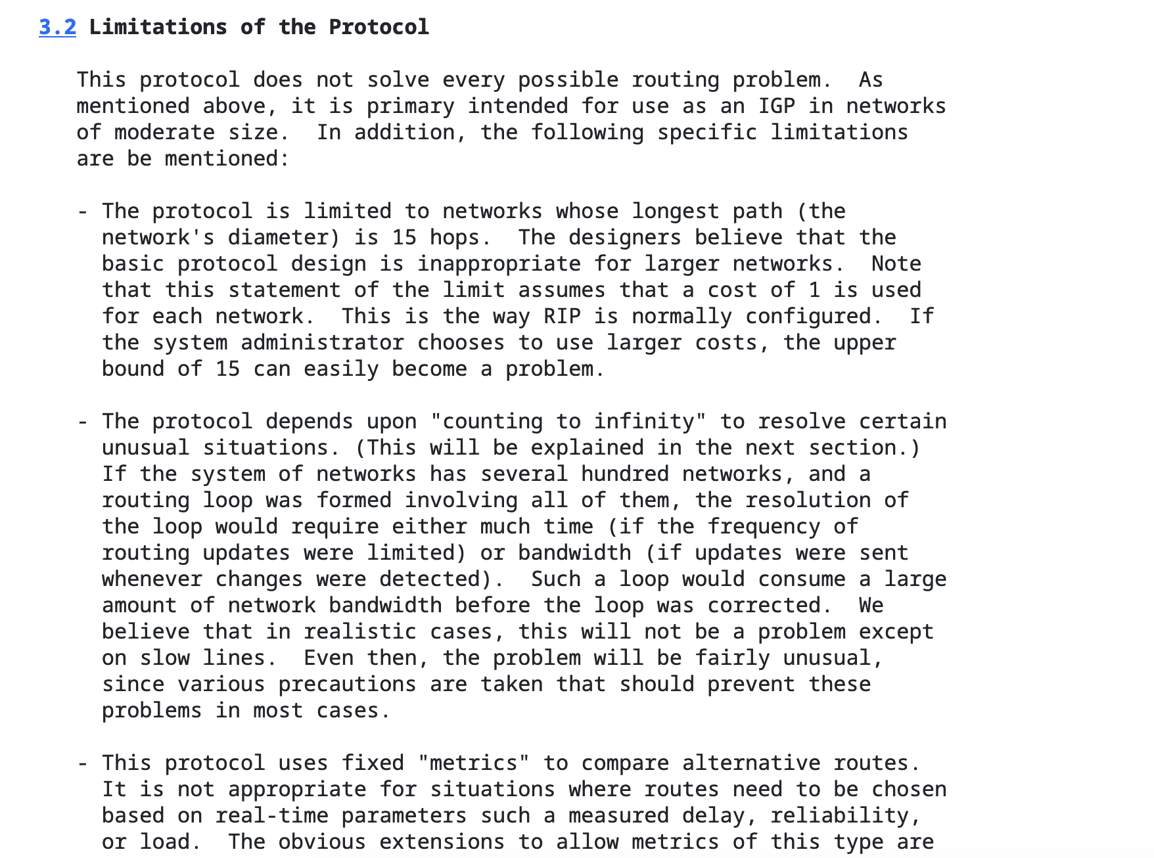
From RFC2453, RIP v2 (1998):

Slide 65
Link State Routing

Slide 66
Link State Routing: The Alternative
Example: OSPF
Strategy: each router sends information about its neighbors to all nodes

Slide 67
Link State Routing: The Alternative
Example: OSPF
Strategy: each router sends information about its neighbors to all nodes
Nodes build the full graph, not just neighbor info
Updates have more state info

Slide 68
Link State Routing: The Alternative
Strategy: each router sends information about its neighbors to all nodes
Nodes build the full graph, not just neighbor info
=> Can define “areas” to scale this in large networks
Updates have more state info
Node IDs, version info (sequence number, TTL), … => Can be used to detect loops, stale info
Focuses on building a consistent view of network state

Slide 69
Link State Routing: how it works
Each node computes shortest paths from itself
How? Dijkstra’s algorithm
Given: full graph of nodes
Find best next hop to each other node

Slide 70
Link State Routing: how it works
Each node computes shortest paths from itself
How? Dijkstra’s algorithm
Given: full graph of nodes
Find best next hop to each other node
Tradeoffs?

Slide 71
Tradeoffs: Link State (LS) vs. Distance Vector (DV)
LS sends more messages vs. DV
LS requires more computation vs. DV
Convergence time
DV: Varies (count-to-infinity)
LS: Reacts to updates better
Robustness
DV: Bad updates can affect whole network
LS: Bad updates affect a single node’s update
=> RIP isn’t used in production environments anymore…

Slide 72
Examples (and complexity)
Algorithm | Method | Pages in RFC
RIP v2 (RFC 2453) | Distance Vector | 38

Slide 73
Examples (and complexity)
Algorithm | Method | Pages in RFC
RIP v2 (RFC 2453) | Distance Vector | 38
OSPF (RFC 2328) | Link-State | 244
IS-IS (OSI) | Link-State | 210
OSPF: Open Shortest Path First
IS-IS: OSI standard similar to OSPF, doesn’t depend on IP

Slide 74
So why not just use OSPF everywhere?
Does it scale?

Slide 75
Not to this.
Map of the Internet, 2021 (via BGP)
OPTE project

Slide 76
Why not?
Can’t build a full routing graph with the whole Internet
More a policy problem than a technical problem

Slide 77
Why not?
Can’t build a full routing graph with the whole Internet
More a policy problem than a technical problem
No unified way to represent cost
No single administrator
Networks (ASes) have different policies on what “best” routes to choose
Need a different routing mechanism for exterior routing => BGP

Slide 78
With BGP: we talk about routing to Autonomous Systems (ASes)
= > Generally, large networks advertise some set of IP prefixes to the Internet
=> Each AS has its own policy for how it does routing

Slide 79
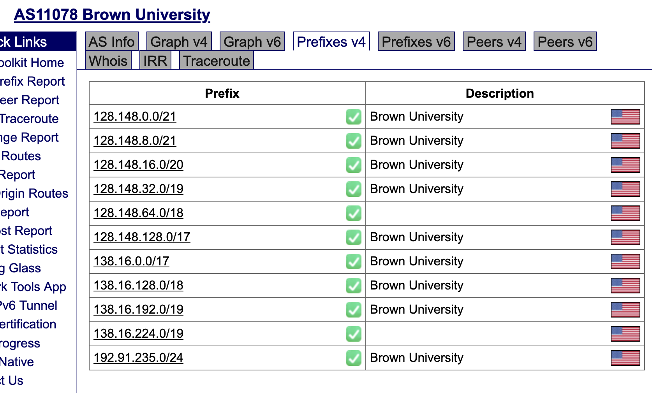
With BGP: we talk about routing to Autonomous Systems (ASes)
= > Generally, large networks advertise some set of IP prefixes to the Internet
=> Each AS has its own policy for how it does routing

Slide 80
BGP: A Path Vector Protocol
Distance vector + extra information
eg. “I can reach prefix 128.148.0.0/16 through ASes 44444 3356 14325 11078”

Slide 81
BGP: A Path Vector Protocol
Distance vector + extra information
For each route, router store the complete path (ASs)
No extra computation, just extra storage (and traffic)
BGP gets to decide what path to advertise to neighbors
eg. “I can reach prefix 128.148.0.0/16 through ASes 44444 3356 14325 11078”

Slide 82
Fun fact: loops are easy to avoid…
eg. “I can reach prefix 128.148.0.0/16 through ASes 44444 3356 14325 11078”
What would a loop look like?

Slide 83
BGP: A Path Vector Protocol
Distance vector + extra information
For each route, router store the complete path (ASs)
No extra computation, just extra storage (and traffic)
BGP gets to decide what path to advertise to neighbors
eg. “I can reach prefix 128.148.0.0/16 through ASes 44444 3356 14325 11078”
BGP routers look at path to decide how to “propagate” route, based on policy
Can easily avoid loops!

Slide 84
BGP Implications
No loops!
Not all ASs know all paths
Reachability not guaranteed
Decentralized combination of policies
Scaling
74K ASs
959K+ prefixes
ASs with one prefix: 25K
Most prefixes by one AS: 10008 (Uninet S.A. de C.V., MX)
Source: cidr-report 18Oct2022

Slide 85



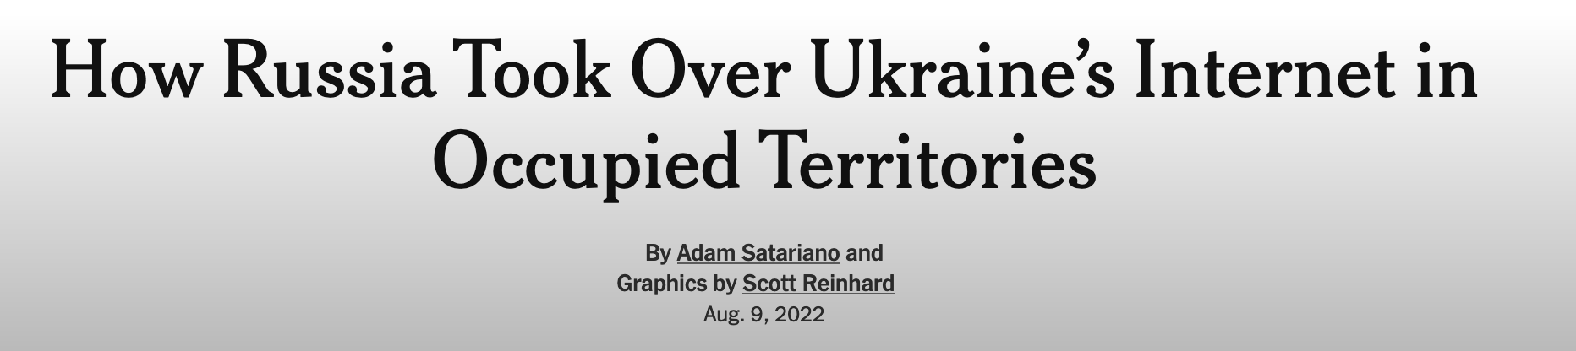
Why study BGP?
BGP is what makes the Internet run.
Lots of problems…

Slide 86

A Network Operations Center (NOC)

Slide 87
BGP Example

Slide 88
BGP Example

Slide 89
BGP Example

Slide 90
BGP Example

Slide 91
BGP Example

Slide 92
Demo: AS11078

Slide 93
Extra content

Slide 94
… or does it?

Slide 95
Where it gets weird…
For many end hosts:
(IP assigned to your host) != (Your ”public” IP)
(IP seen by other systems on the Internet)
Notes:
Address sharing

Slide 96
Where it gets weird…
You get just one IP from your ISP…
=> Need to share IP among many devices on the same network!
Notes:
Address sharing

Slide 97
Where it gets weird…
You get just one IP from your ISP…
=> Need to share IP among many devices on the same network!
Solution: Create a “private” IP range used within local network
=> Routers need to do extra work to share public IP among many private IPs
=> Network Address Translation (NAT) (A form of connection multiplexing)
Notes:
Address sharing

Slide 99
How NAT works
(The most common type)
192.168.1.100
S
IF1
IF0
192.168.1.101
192.168.1.1
5.6.7.8
Rest of Internet
1.2.1.102
“Inside” network
192.168.1.0/24
Goal: Share one IP among many hosts on a private network
Router translates (modifies) packets from ”inside” to use “outside” address

Slide 100
Private IPs (RFC1918)
IP ranges reserved for “private” networks:
Prefix | Use
127.0.0.0/8 | “Loopback” address—always for current host
10.0.0.0/8 | Reserved for private internal networks (RFC1918)
192.168.0.0/16 | IF2
172.16.0.0/12 | IF0

Slide 101
Private IPs (RFC1918)
IP ranges reserved for “private” networks:
Many networks will use these blocks internally
These IPs should never be routed over the Internet!
What would happen if they were?
Prefix | Use
127.0.0.0/8 | “Loopback” address—always for current host
10.0.0.0/8 | Reserved for private internal networks (RFC1918)
192.168.0.0/16 | IF2
172.16.0.0/12 | IF0

Slide 102
How NAT works
(The most common type)
192.168.1.100
S
IF1
IF0
192.168.1.101
192.168.1.1
5.6.7.8
Rest of Internet
Your “public” IP
1.2.1.102
“Inside” network
192.168.1.0/24
Goal: Share one IP among many hosts on a private network
Router translates (modifies) packets from ”inside” to use “outside” address
=> Router needs to remember connection state
=> Router makes some (sketchy) assumptions about traffic

Slide 104
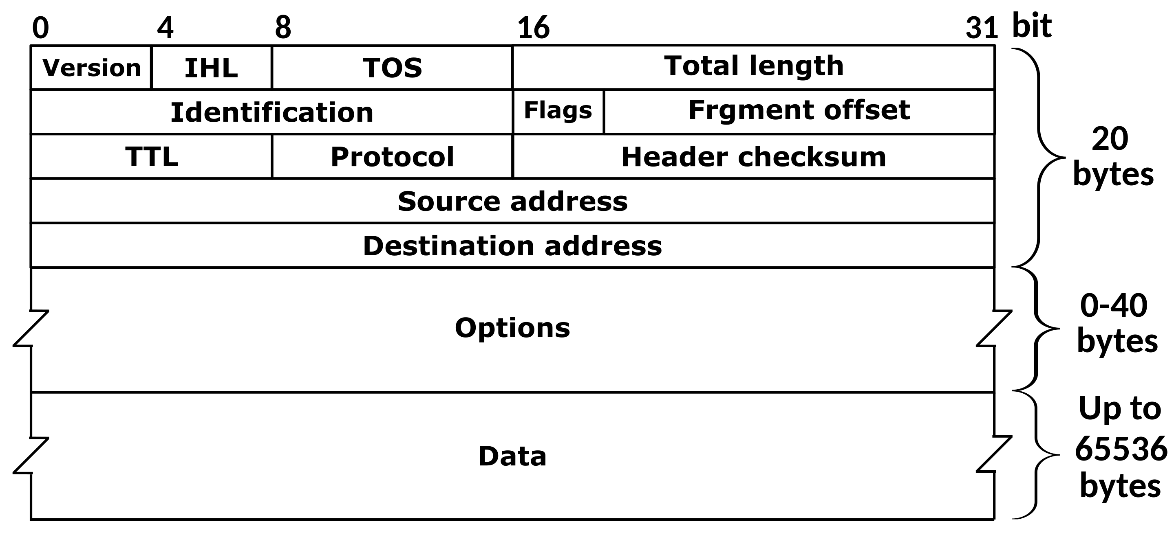
IP Header
Where are the port numbers?????

Slide 105
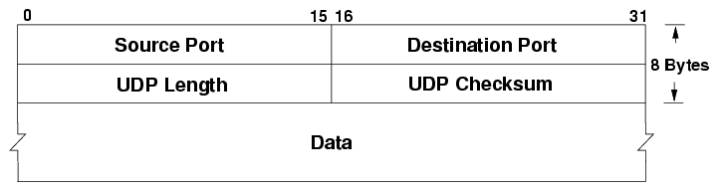
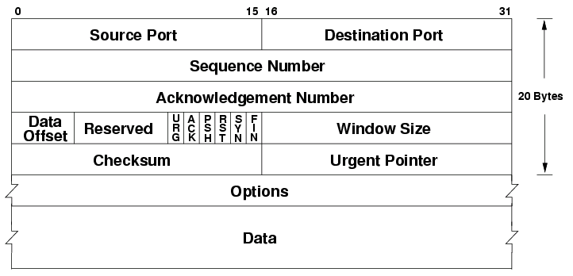
… ports are actually part of the transport layer header!
UDP
TCP
Problem???????

Slide 106
… ports are actually part of the transport layer header!
UDP
TCP
Problem?
Technically a violation of layering! Network layer shouldn’t care about port numbers, but here it matters
NAT needs to know semantics of TCP/UDP (how connections start/end…
...but wait there’s more…

Slide 107
NAT vs. Snowcast

Slide 108
A
192.168.1.100
S
B
IF1
R
IF0
192.168.1.101
192.168.1.1
5.6.7.8
Rest of Internet
C
1.2.1.102
“Inside” network
192.168.1.0/24
What happens when outside host S wants to connect to inside host A?

Slide 109
A
192.168.1.100
S
B
IF1
R
IF0
192.168.1.101
192.168.1.1
5.6.7.8
Rest of Internet
C
1.2.1.102
“Inside” network
192.168.1.0/24
What happens when outside host S wants to connect to inside host A?
Can’t do it (at least without special setup)!
By default, R only knows how to translate packets for connections originating from INSIDE the network
Breaks end to end connectivity!!!

Slide 110
A
192.168.1.100
S
B
IF1
R
IF0
192.168.1.101
192.168.1.1
5.6.7.8
Rest of Internet
C
1.2.1.102
“Inside” network
192.168.1.0/24
What happens when outside host S wants to connect to inside host A?
Can’t do it (at least without special setup)!
By default, R only knows how to translate packets for connections originating from INSIDE the network
Breaks end to end connectivity!!!

Slide 111
End to end connectivity, you say?

Slide 112
Why is this bad?
NAT is used in just about every consumer network
Generally: can’t connect directly to an end host unless it connects to you first

Slide 113
Why is this bad?
NAT is used in just about every consumer network
Generally: can’t connect directly to an end host unless it connects to you first
Need extra work for any protocols that need a direct connection between hosts
=> When do we need this?

Slide 114
Why is this bad?
NAT is used in just about every consumer network
Generally: can’t connect directly to an end host unless it connects to you first
Need extra work for any protocols that need a direct connection between hosts
Protocols that aren’t strictly client-server
Latency critical applications: voice/video calls, games

Slide 115
NAT Traversal
Various methods, depending on the type of NAT
Examples:
Manual method: port forwarding
ICE: Interactive Connectivity Establishment (RFC8445)
STUN: Session Traversal Utilities for NAT (RFC5389)
One idea: connect to external server via UDP, it tells you the address/port

