Slide 1
CSCI-1680
Layering and Encapsulation
Nick DeMarinis
Based partly on lecture notes by Rodrigo Fonseca, David Mazières, Phil Levis, John Jannotti

Slide 2
Administrivia
HW0: Due TODAY by 11:59pm
Container setup: due by Thursday
  If you have issues, please fill out the form
Snowcast out later today (look for Ed post)
  Gearup Thursday 9/12 5-7pm CIT368 (+Zoom, recorded)
Milestone due by Monday 9/16 by 11:59pm EDT
  Warmup and first steps + design doc for the rest
Notes:
If you got an email yesterday, I’ll approve your override code request when I get back to my desk

Slide 3
Topics for Today
Layering and Encapsulation
Intro to IP, TCP, UDP
Demo on sockets

Slide 4
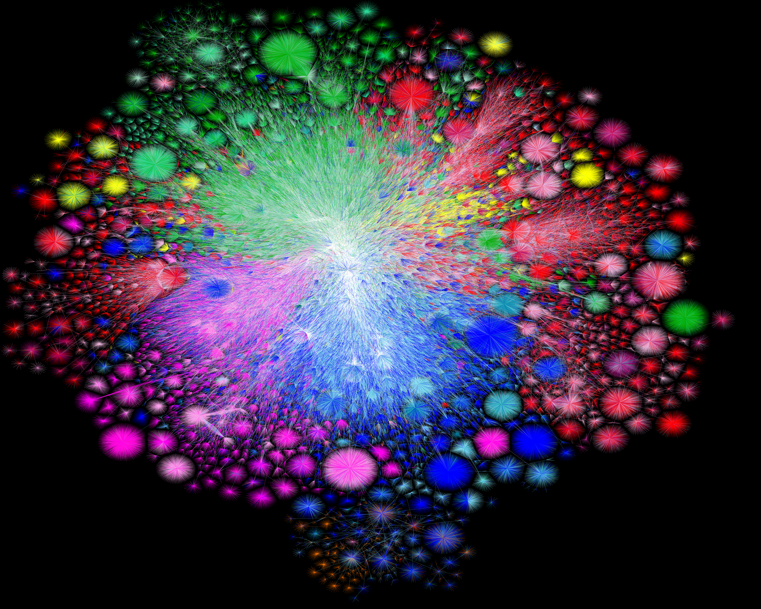
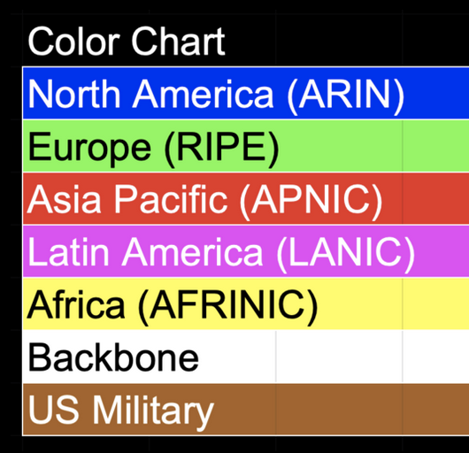
Map of the Internet, 2021 (via BGP)
OPTE project
Notes:
To put something real to this, here’s a map of what that graph looks like. We call the Internet a network of networks: and each point is a network—a group of systems—that can talk to the others. And the network grants us the ability to pretty much communicate between any two points on this graph. And the goal of the network, how it’s designed, and the protocols that comprise it, is to figure out how to get a message there—regardless of where they are, whether they’re connected by a copper wire, or a wireless link, and regardless of what’s being sent.

Slide 5
How do we make sense of all this?

Slide 6
How do we make sense of all this?
Very large number of computers
Diverse of technologies and constraints
Notes:
How do we manage complexity in large software systems? Abstraction, Modularity

Slide 7
How do we make sense of all this?
Very large number of computers
Diverse of technologies and constraints
Lots of multiplexing
No single administrative entity
Notes:
How do we manage complexity in large software systems? Abstraction, Modularity

Slide 8
How do we make sense of all this?
Very large number of computers
Diverse of technologies and constraints
Lots of multiplexing
No single administrative entity
Evolving demands, protocols, apps => different requirements!
Notes:
How do we manage complexity in large software systems? Abstraction, Modularity

Slide 9
Layering
Abstraction to the rescue!
Idea: Break problem into separate parts, solve part independently
Encapsulate data from “higher layer” inside “lower layer”
=> Lower layer can handle data without caring what’s above it!
Notes:
Abstractions
Example: deliver a letter
Interfaces

Slide 10
An analogy
How to deliver a package?
Notes:
Say you want to send a package to a friend at… UC Berkeley.

Slide 11
The big complex picture
Application Protocol (L7)
Transport Protocol (L4)
Network Protocol (L3)
Link-Layer Protocol (L2)
“OSI reference model” or “7-layer model”
Notes:
Open Systems Interconnect, ISO
And there are different protocols at each stage

Slide 12





Applications (Layer 7)
The applications/programs/etc you use every day
Examples:
HTTP/HTTPS: Web traffic (browser, etc)
SSH: secure shell
FTP: file transfer
DNS (more on this later)
…
When you’re building programs,
you usually work here

Slide 13
How to make apps use the network?
print(“Hello world”)
send(“Hello world”)

Slide 14
How to make apps use the network?
print(“Hello world”)
send(“Hello world”)
Want to send useful messages, not packets
Don’t have to care about how path packet takes to get from A->B, we just want it to get there

Slide 15
Apps rely on: transport layer (layer 4)

Slide 16
Apps rely on: transport layer (layer 4)
Provided by OS as socket interface
For app, creates a ”pipe” to send/recv data to/from another endpoint (think like a file descriptor)

Slide 17
Apps rely on: transport layer (layer 4)
Provided by OS as socket interface
For app, creates a ”pipe” to send/recv data to/from another endpoint (think like a file descriptor)
OS keeps track of sockets which sockets belong to which app => multiplexing

Slide 18
Key transport layer details
Multiplexing provided by port numbers
  16-bit number 0—65535
  Servers use well-known port numbers, clients typically choose one at random
Port | Service
22 | Secure Shell (SSH)
25 | SMTP (Email)
80 | HTTP (Web traffic)
443 | HTTPS (Secure Web traffic)
16800 | Snowcast

Slide 19
Key transport layer details
Multiplexing provided by port numbers
  16-bit number 0—65535
  Servers use well-known port numbers, clients typically choose one at random
Two main forms
  TCP: reliable transport
  UDP: unreliable transport
  (more details later)
Port | Service
22 | Secure Shell (SSH)
25 | SMTP (Email)
80 | HTTP (Web traffic)
443 | HTTPS (Secure Web traffic)
16800 | Snowcast
What service does the transport layer need?

Slide 20
Layer 3: Network layer
Provided by: Internet Protocol (IP)

Slide 21
Layer 3: Network layer
Provided by: Internet Protocol (IP)
Move packets between any two hosts anywhere on the Internet
Responsible for routing and forwarding between nodes

Slide 22
Layer 3: Network layer
Provided by: Internet Protocol (IP)
Move packets between any two hosts anywhere on the Internet
Responsible for routing and forwarding between nodes
Every host has a unique address:
www.cs.brown.edu => 128.148.32.110
Given address, the network knows how to get the packet there

Slide 24
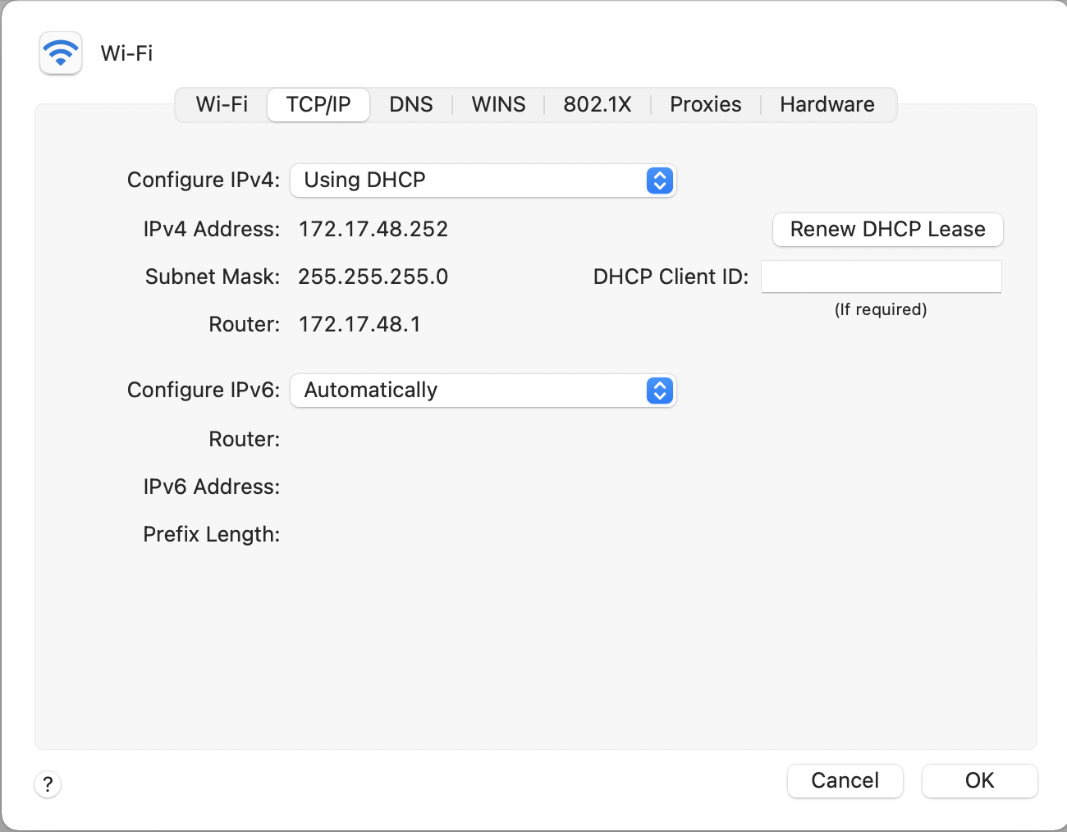

Slide 25
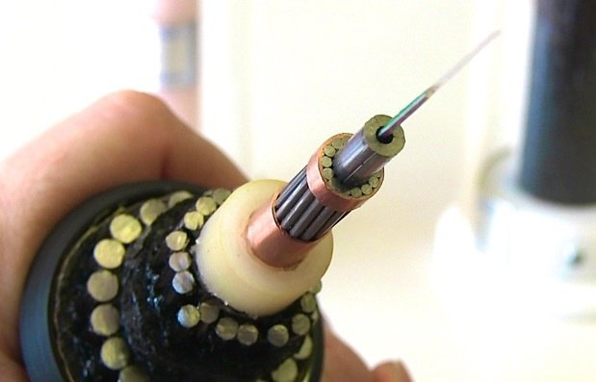
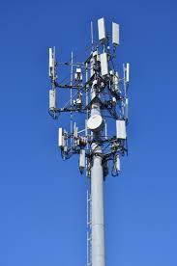
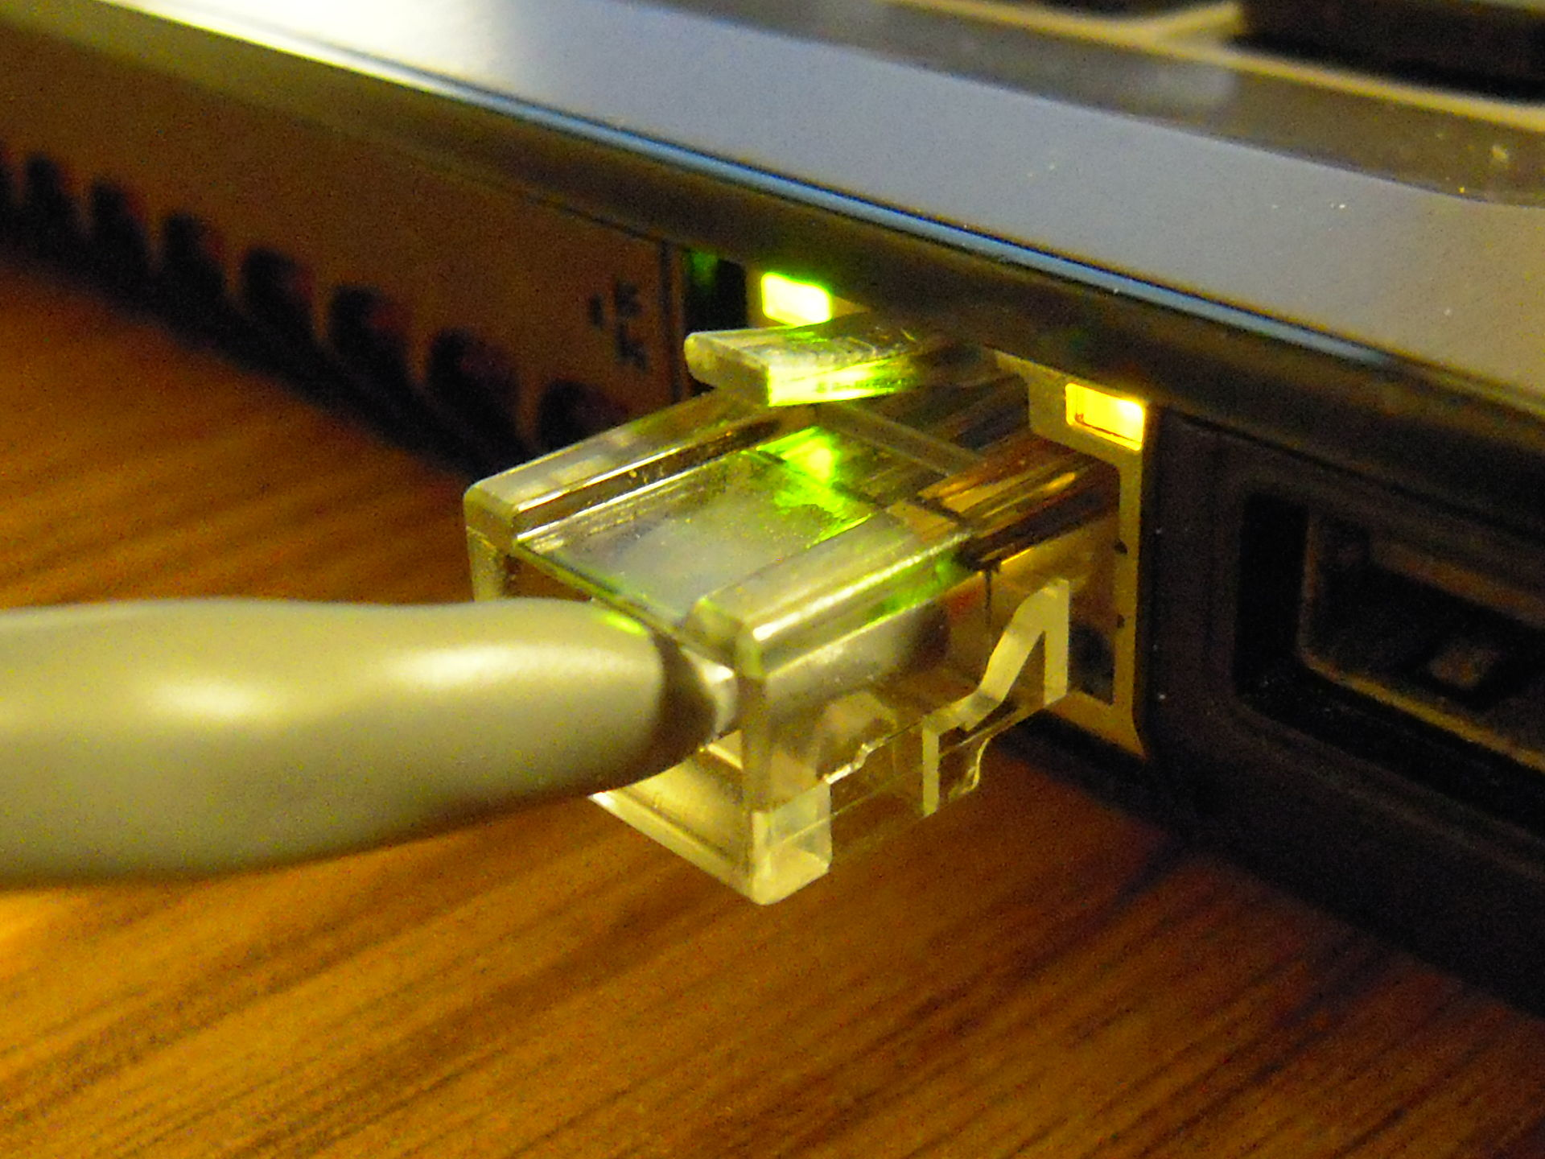
Lower layers
Link layer (L2): Individual links between nodes
Physical layer (L1): how to move bits over link
Examples
  Wifi
  Cellular Data
  Ethernet
  Fiber optic
  …

Slide 26
Lower layers
Link layer (L2): Individual links between nodes
=> Ethernet, wifi, cellular, …
Physical layer (L1): how to move bits over link
=> Engineering/physics problem
Examples
  Wifi
  Cellular Data
  Ethernet
  Fiber optic
  …
The OS sees links as interfaces
=> Each one probably has a driver that implements that particular protocol

Slide 27
IP as the “narrowing point”
Applications built using IP
IP connects many heterogeneous networks
Notes:
In the Internet, we say that this huge architecture of protocols has a “narrow waist” that lets everything else interoperate…
So there’s one protocol, but actually for real there’s two

Slide 28
IP as the “narrowing point”
Applications built using IP
IP connects many heterogeneous networks
“Hourglass” structure => one (actually two) core abstractions!
Notes:
In the Internet, we say that this huge architecture of protocols has a “narrow waist” that lets everything else interoperate…
So there’s one protocol, but actually for real there’s two

Slide 29
What you should take away from this
Layer N
Each layer is defined by some protocol
Notes:
When you implement one layer, you make certain assumptions about what you have from the layer below you

Slide 30
What you should take away from this
Layer N
Each layer is defined by some protocol
Layer N uses the services provided by N-1 to operate
Layer N-1
Notes:
When you implement one layer, you make certain assumptions about what you have from the layer below you

Slide 31
What you should take away from this
Layer N+1
Each layer provides a service for the layers “above” it
Layer N
Each layer is defined by some protocol
Layer N uses the services provided by N-1 to operate
Layer N-1
Notes:
When you implement one layer, you make certain assumptions about what you have from the layer below you

Slide 32
Why do we do this?
Helps us manage complexity
Different implementations at one “layer” use same interface
Allows independent evolution

Slide 33
To recap
3. Network
Service: move packets to any other node in the network
IPv4, IPv6 => (Unreliable)
Notes:
To explain this, I’m going to start in the middle
There are some cross-cutting challenges

Slide 34
To recap
3. Network
Service: move packets to any other node in the network
IPv4, IPv6 => (Unreliable)
2. Link
Service: move frames to other node via link
(eg. Ethernet, Wifi, …)
1. Physical
Service: move bits across link
(Electrical engineering problem)
Notes:
To explain this, I’m going to start in the middle
There are some cross-cutting challenges

Slide 35
To recap
Service: multiplexing applications
TCP: Reliable byte stream
UDP: Unreliable messages
5. Transport
3. Network
Service: move packets to any other node in the network
IPv4, IPv6 => (Unreliable)
2. Link
Service: move frames to other node via link
(eg. Ethernet, Wifi, …)
1. Physical
Service: move bits across link
(Electrical engineering problem)
Notes:
To explain this, I’m going to start in the middle
There are some cross-cutting challenges

Slide 36
To recap
7. Application
Service: user-facing application. (eg. HTTP, SSH, …)
Application-defined messages
Service: multiplexing applications
TCP: Reliable byte stream
UDP: Unreliable messages
5. Transport
3. Network
Service: move packets to any other node in the network
IPv4, IPv6 => (Unreliable)
2. Link
Service: move frames to other node across link.
(eg. Ethernet, Wifi, …)
1. Physical
Service: move bits to other node across link
(Electrical engineering problem)
Where do we handle, eg, security, reliability, fairness?
Notes:
To explain this, I’m going to start in the middle
There are some cross-cutting challenges

Slide 37
How/where to handle challenges?
Can decide on how to distribute certain problems
  What services at which layer?
  What to leave out?
  More on this later (“End-to-end principle”)
Notes:
By separating concerns, we can factor out the challenges into
Guiding principle: if you offer functionality in one layer, you force everyone above you to use it, even if they don’t need it. Where do you want to pay the cost?
Other problems: fairness, security, accountability/provenance etc…. We’ll see how the network is designed to handle these, (or isn’t)

Slide 38
How/where to handle challenges?
Can decide on how to distribute certain problems
  What services at which layer?
  What to leave out?
  More on this later (“End-to-end principle”)
Example: Why bother having (unreliable) UDP, when TCP provides a reliable way to send data?
Get to decide where (and if) to pay the “cost” of certain features
Notes:
By separating concerns, we can factor out the challenges into
Guiding principle: if you offer functionality in one layer, you force everyone above you to use it, even if they don’t need it. Where do you want to pay the cost?
Other problems: fairness, security, accountability/provenance etc…. We’ll see how the network is designed to handle these, (or isn’t)

Slide 39
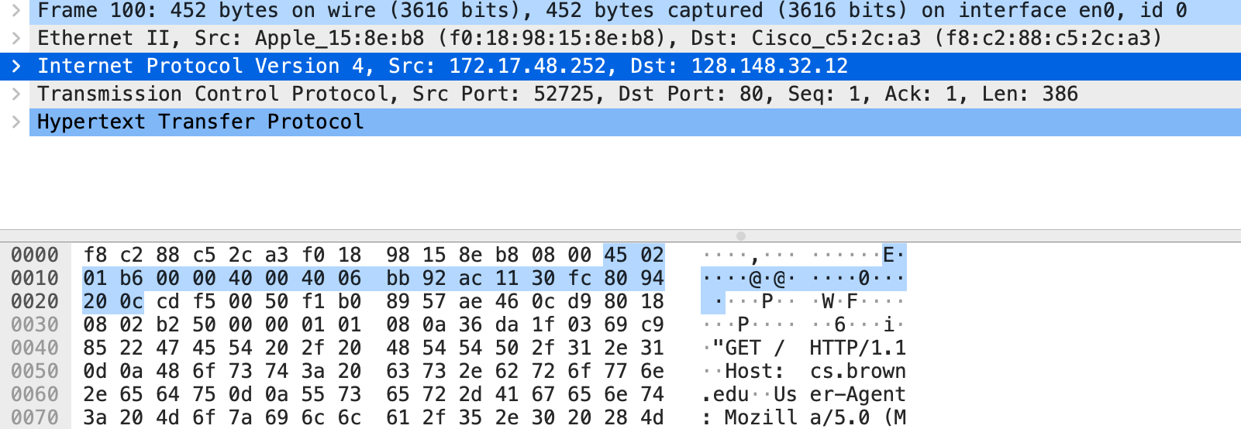
Anatomy of a packet

Slide 40
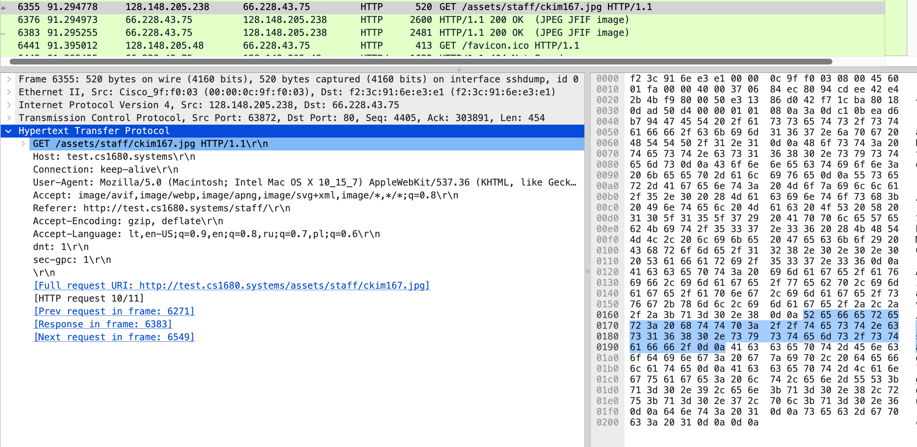

Slide 41
Link layer (L2)
Internet == Network of networks
Networks are made up of many different types of links!
Many types of links => different challenges, protocols, etc.
Examples
  Wifi
  Cellular Data
  Ethernet
  Fiber optic
  …

Slide 42
Link layer (L2)
Internet == Network of networks
Networks are made up of many different types of links!
Many types of links => different challenges, protocols, etc.
Examples
  Wifi
  Cellular Data
  Ethernet
  Fiber optic
  …
The OS sees links as interfaces
=> Each one probably has a driver that implements that particular protocol

Slide 43
Physical layer (Layer 1)
0
0
1
0
1
0
1
1
0
Data
(in one particular format)
Clock
How we move packets across one individual link
Deals with individual bits
More about electrical engineering/physics than computer science
We won’t spend much time on this

Slide 44
Example: communicating via UDP

Slide 46
Transport: UDP and TCP
UDP and TCP: most popular protocols atop IP
  Both use 16-bit port number & 32-bit IP address
  Applications bind a port & receive traffic on that port
UDP – User (unreliable) Datagram Protocol
  Send packets to a port (… and not much else)
  Sent packets may be dropped, reordered, even duplicated
TCP – Transmission Control Protocol
  Provides illusion of reliable ‘pipe’ or ‘stream’ between two processes anywhere on the network
  Handles congestion and flow control

Slide 47
Uses of TCP
Most applications use TCP
  Easier to program (reliability is convenient)
  Automatically avoids congestion (don’t need to worry about taking down the network
Servers typically listen on well-known ports:
  SSH: 22
  SMTP (email): 25
  HTTP (web): 80, 443

Slide 48
Uses of UDP
In general, when you have concerns other than a reliable “stream” of packets:
When latency is critical (late messages don’t matter)
When messages fit in a single packet
When you want to build your own (un)reliable protocol!
Examples
DNS (port 53)
Streaming multimedia/gaming (sometimes)
Notes:
TCP imposes some restrictions, because it’s handling how the message gets broken up and sent. You may not want this.

Slide 49
A note on layering
Strict layering not required
  TCP/UDP “cheat” to detect certain errors in IP-level information like address
  Overall, allows evolution, experimentation
Notes:
Package analogy: amazon

Slide 50
One more thing…
Layering defines interfaces well
  What if I get an Ethernet frame, and send it as the payload of an IP packet across the world?
Layering can be recursive
  Each layer agnostic to payload!
Many examples
  Tunnels: e.g., VXLAN is ETH over UDP (over IP over ETH again…)
  Our IP assignment: IP on top of UDP “links”

Slide 51
Example
* This is just an example, do not worry about the details, or the specific protocols!
From: Yu et al., A General, Easy to Program and Scalable Framework for Analyzing In-network Packet Traces, NSDI 2019

Slide 52
How do we use these protocols?

Slide 53
Using TCP/IP
How can applications use the network?
Sockets API.
  Originally from BSD, widely implemented (*BSD, Linux, Mac OS, Windows, …)
  Important to know and do once
  Higher-level APIs build on them
After basic setup, it’s a lot like working with files
Notes:
Unix philosophy!

Slide 54
Sockets: Communication Between Machines
Network sockets are file descriptors too
Datagram sockets (eg. UDP): unreliable message delivery
  Send atomic messages, which may be reordered or lost
Stream sockets (TCP): bi-directional pipes
  Stream of bytes written on one end, read on another
  Reads may not return full amount requested, must re-read

Slide 55
System calls for using TCP
Client Server
socket – make socket
bind – assign address, port
listen – listen for clients
socket – make socket
bind* – assign address
connect – connect to listening socket
accept – accept connection
This call to bind is optional, connect can choose address & port.

Slide 56
Socket Naming
TCP & UDP name communication endpoints
  IP address specifies host (128.148.32.110)
  16-bit port number demultiplexes within host
  Well-known services listen on standard ports (e.g. ssh – 22, http – 80, mail – 25)
  Clients connect from arbitrary ports to well known ports
A connection is named by 5 components
  Protocol, local IP, local port, remote IP, remote port

Slide 57
Dealing with Data
Many messages are binary data sent with precise formats
Data usually sent in Network byte order (Big Endian)
  Remember to always convert!
  In C, this is htons(), htonl(), ntohs(), ntohl()

