Slide 1
CSCI-1680
Building Links and (Local) Networks
Nick DeMarinis
Based partly on lecture notes by Rodrigo Fonseca, David Mazières, Phil Levis, John Jannotti

Slide 2
Administrivia
Snowcast due Tuesday (9/24) by 11:59pm EDT
Look for announcement on Gradescope/testing soon
  See our FAQ post for testing resources & common issues!

Slide 3
Next week: we start IP
Tuesday, 9/24
  Start of IP lectures
  Form for selecting your team
  Pre-release IP handout available

Slide 4
Next week: we start IP
Tuesday, 9/24
  Start of IP lectures
  Form for selecting your team
  Pre-release IP handout available
Thursday, 9/26
  Team form due
  IP project official release
  Gearup 5-7pm, CIT 368

Slide 5
Last time: RTT vs. Throughput

Slide 6
Today
Last time: how to send over a link
Today: how to build small network?
How to share a link
Case study/fundamental terms: Ethernet (and Wifi)
How switching works

Slide 7
What does “link layer” mean?
Service: user-facing application.
Application-defined messages
Application
Service: multiplexing applications
Reliable byte stream to other node (TCP),
Unreliable datagram (UDP)
Transport
Network
Service: move packets to any other node in the network
Internet Protocol (IP)
Link
Service: move frames to other node across link.
May add reliability, medium access control
Physical
Service: move bits to other node across link

Slide 8
The main idea
A
B
Notes:
-Transmitter, receiver
Medium
Varies something

Slide 9
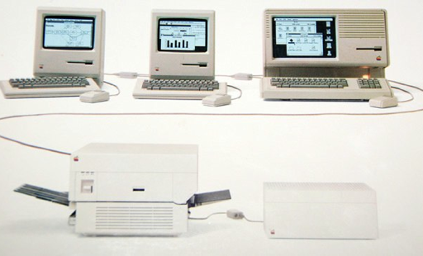
Setting the scene
An AppleTalk network (1980s)

Slide 10
Setting the scene
An AppleTalk network (1980s)
”Small” => Within a building, floor of office, etc
Related term: Local Area Network (LAN)

Slide 11
What does “link layer” mean?
…
A
???
B
C
D
Multiple hosts => shared channel
Need ways to allow “small” number of hosts to communicate

Slide 12
How to share the channel?

Slide 13
How to share the channel?
Medium Access Control (MAC)

Slide 14
Medium Access Control

Slide 15
Medium Access Control
Idea: No more than one device can be “talking” at one time
Need a protocol for “who can talk when?”
Another example of multiplexing
=> sharing the channel among multiple devices

Slide 16
High-level: MAC approaches
Partitioned Access: divide the channel into fixed slots
  Time Division Multiple Access (TDMA)
  Frequency Division Multiple Access (FDMA)
  …
Problems?
Hard to maximize channel utilization
(eg. what happens if only one person is talking?)

Slide 17
High-level: MAC approaches
Random Access: no fixed slots: “ask” to talk, or just talk and hope for the best
  Carrier Sense Multiple Access / Collision Detection (CSMA/CD)
  Carrier Sense Multiple Access / Collision Avoidance (CSMA/CA)
  RTS/CTS (Request to Send/Clear to Send)
  Token-based
  …
Problems?
Hard to maintain “fairness”
(eg. one host dominating channel)
Notes:
Senders

Slide 18
Why does this matter?
Different types of links solve these problems differently
  Ethernet (wired) vs. Wifi (wireless)
  Affects throughput, reliability, etc.
Understand why different links operate differently
=> How we build the Internet from them

Slide 19
How does a device use a link?
B

Slide 20
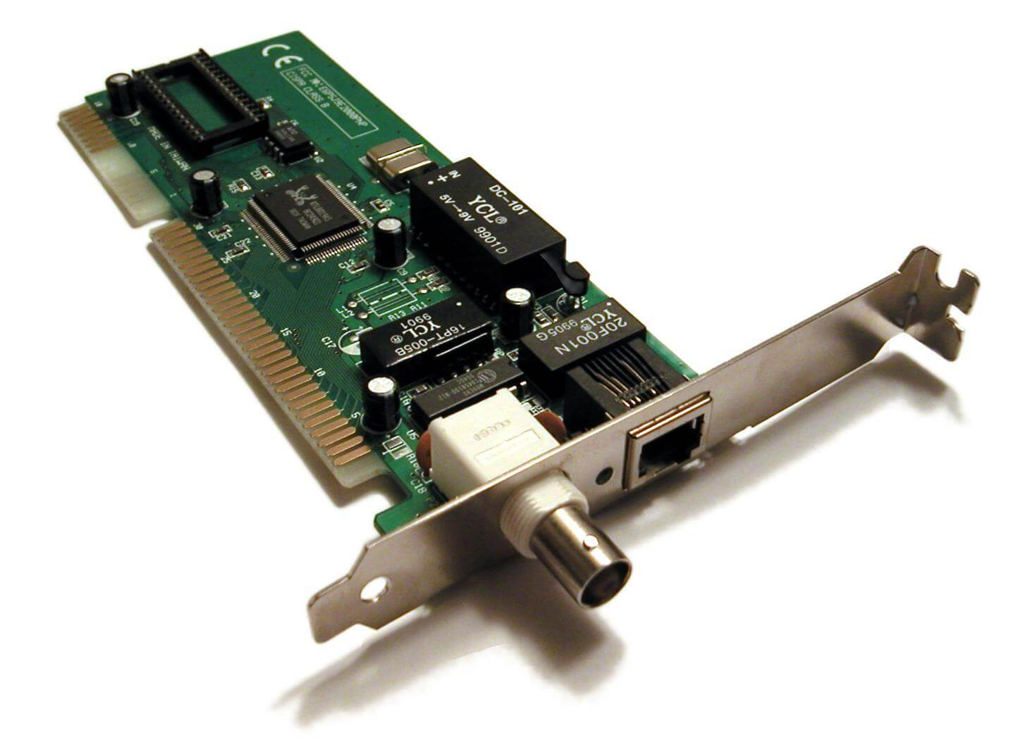
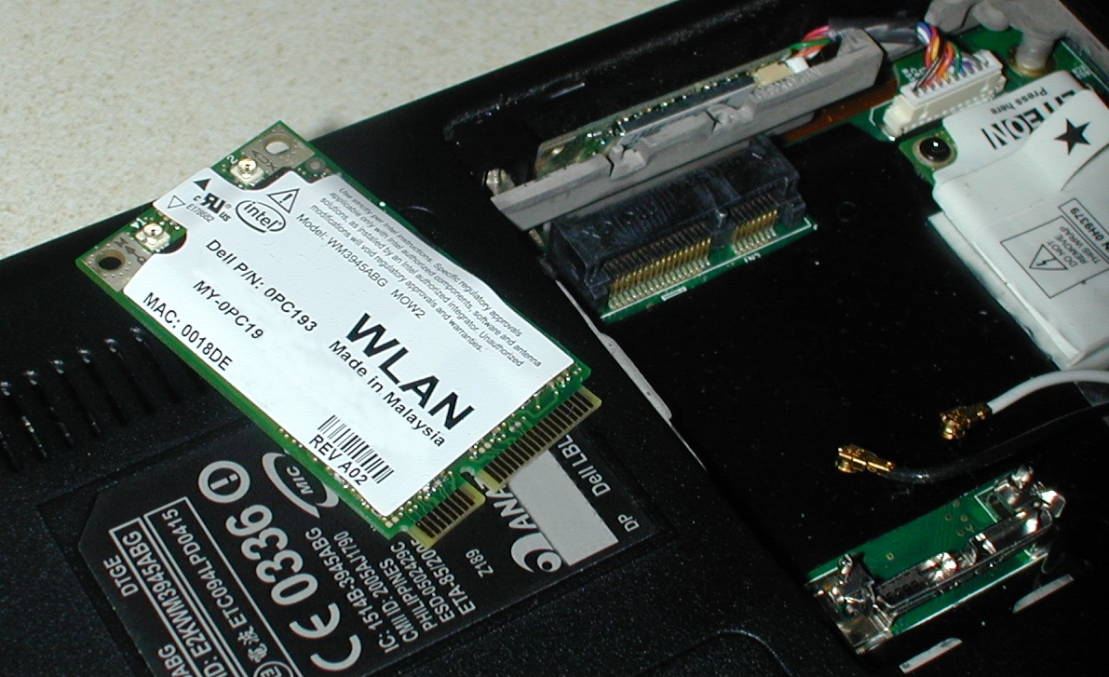

Slide 21
Interface: device that connects something to a network
OS abstraction for a network device
Physical hardware that does the “talking”
=> Network Interface Card (NIC)
Common interfaces
  Loopback: Virtual, only for local host
  Wifi, Ethernet, Bluetooth, …

Slide 22
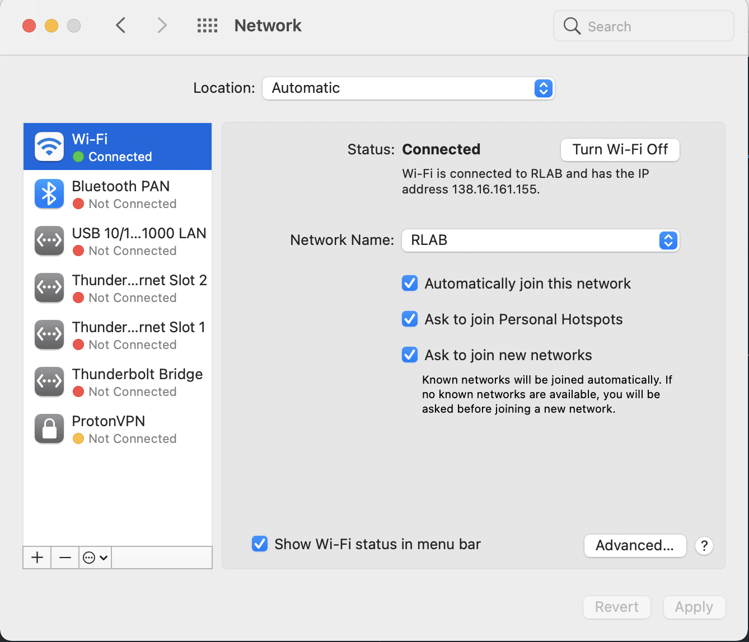

Slide 23
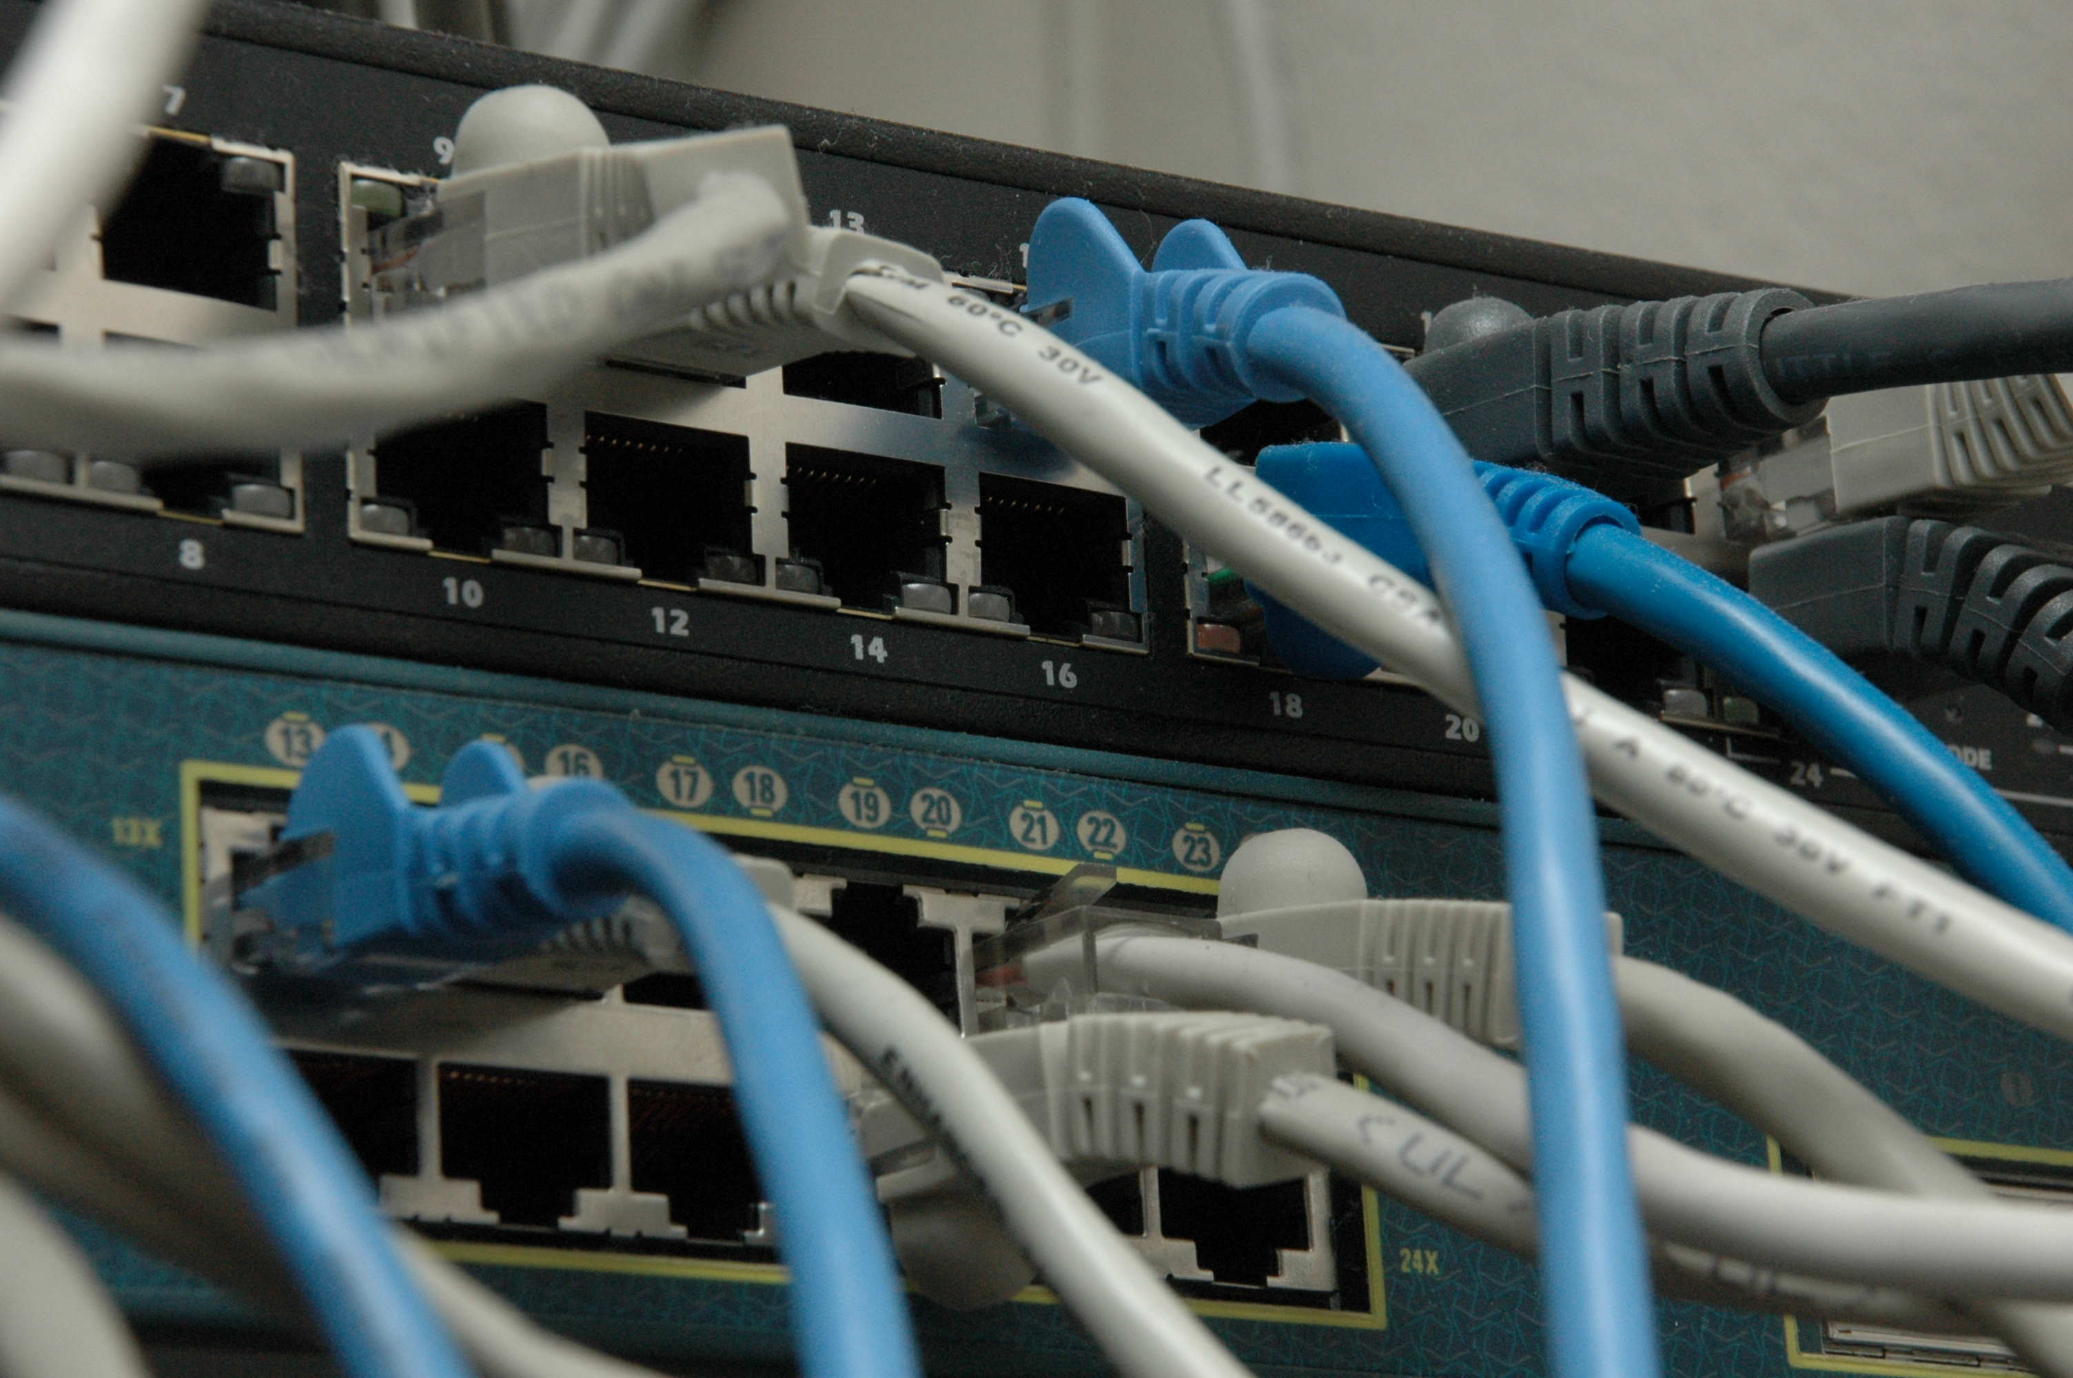
Example: Ethernet

Slide 24
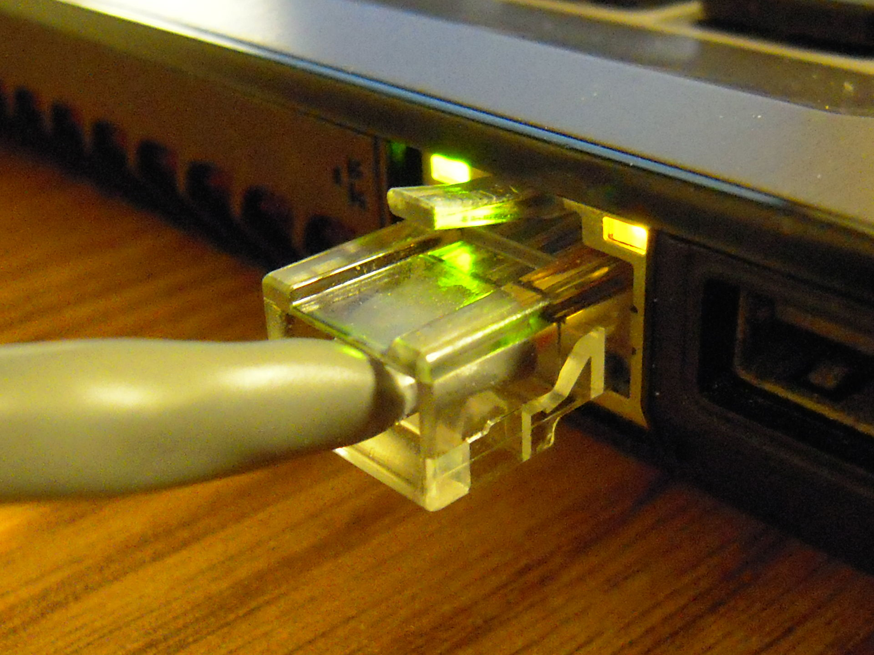
Ethernet
Dominant wired LAN technology, has evolved
significantly over time
Original version (1983): 10Mbps
Now (commonly): 1Gbps
Also: 10Gbps, 40Gbps, …
New developments in physical media, encodings, hardware => higher speeds over time

Slide 25
Ethernet: software viewpoint

Slide 26
Ethernet: software viewpoint
Logically all hosts are connected to each other
All hosts have an “ethernet address” (”mac address”)
=> Globally-unique identifier
If you know a host’s ethernet address, you can send to it

Slide 27
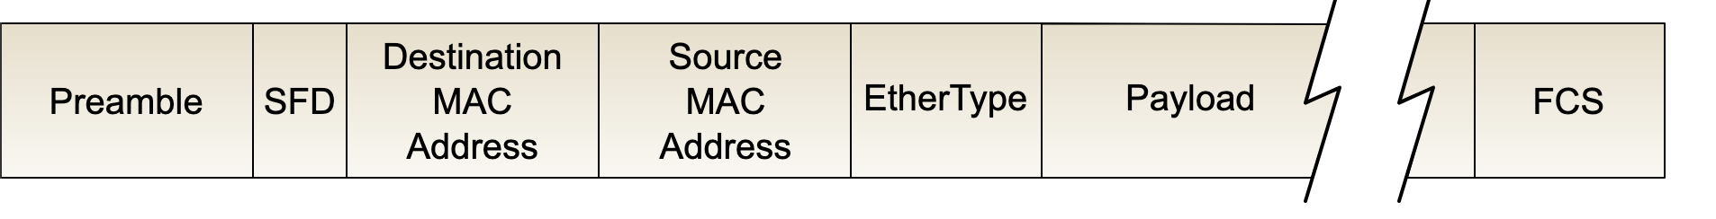
Ethernet: the header

Slide 28
Ethernet: the header
Source address: where packet is from
Destination address: where packet is going
  Devices ask: “Is this my packet?” ”Where should I send this packet?”
Other stuff
Preamble: when a packet starts
FCS: Frame Check sequence (checksum)

Slide 29
Ethernet Addresses (mac addresses)
Globally unique, 48-bit address per interface
00:1c:43:00:3d:09 (Samsung adapter)
=> Nowadays, we call them “mac addresses” or
“hardware addresses”

Slide 30
Ethernet Addresses (mac addresses)
Globally unique, 48-bit address per interface
00:1c:43:00:3d:09 (Samsung adapter)
First 24 bits: Registered to manufacturers
=> Other protocols have adopted this address format (eg. Wifi, Bluetooth, …)
=> Nowadays, we call them “mac addresses” or
“hardware addresses”

Slide 31
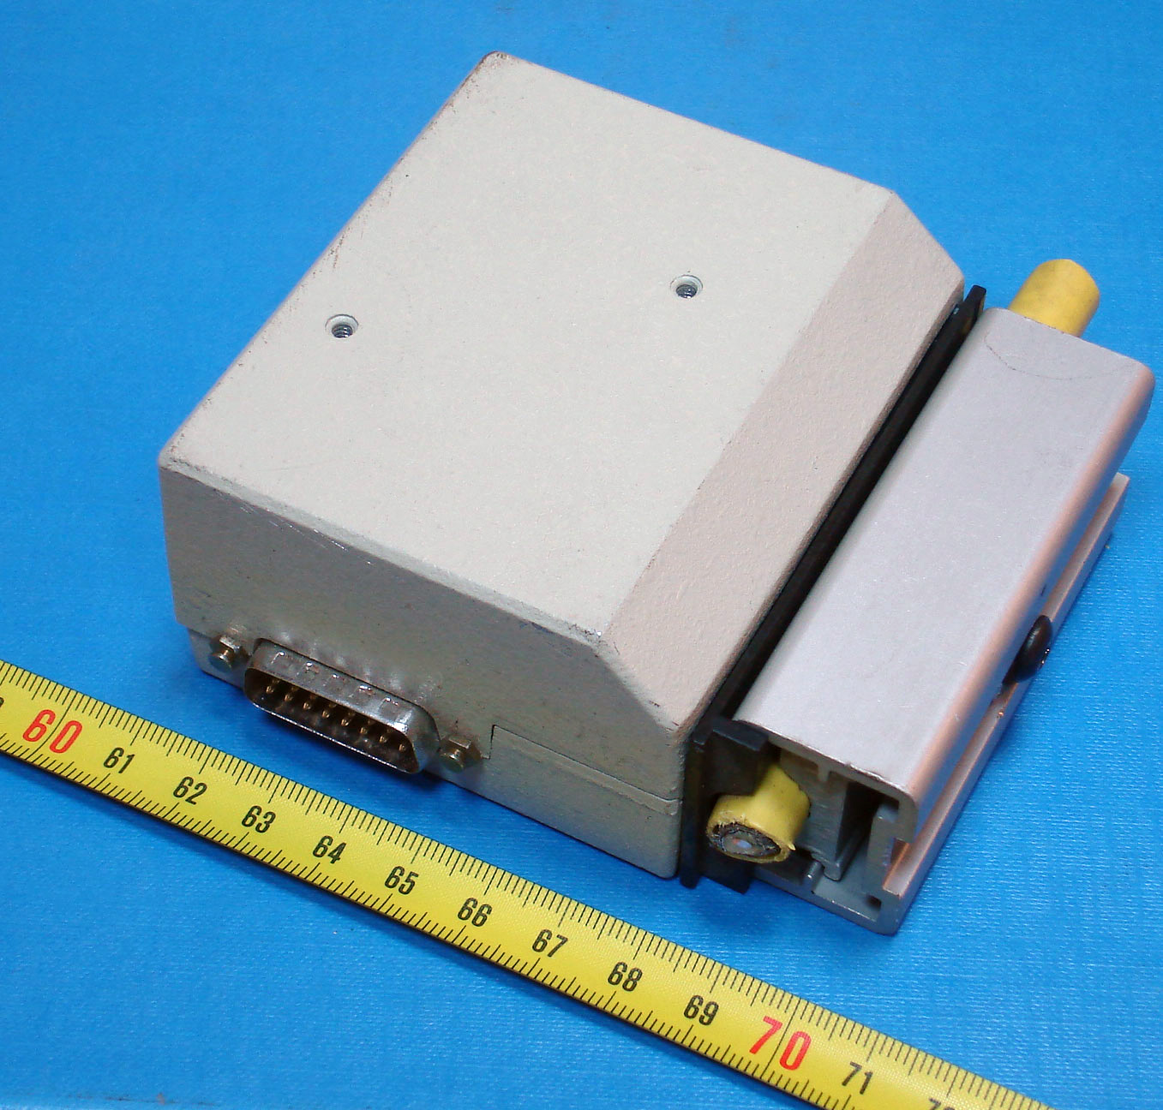
Ethernet’s evolution
Notes:
2^1-1, 2^2-1

Slide 32
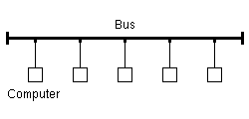
Ethernet’s evolution
Originally, a shared medium with all hosts
Basic idea: all hosts can see all frames, read a frame if it matches your hardware address
Implications?
=>Can have collisons!
Notes:
2^1-1, 2^2-1

Slide 33
Classical Ethernet: Problems
Problem: all hosts in the same “collision domain”
Transmit algorithm
  If line is idle, transmit immediately
  Max message size: 1500 bytes
  If line is busy: wait until idle and transmit immediately

Slide 34
Classical Ethernet: Problems
Problem: all hosts in the same “collision domain”
Transmit algorithm
  If line is idle, transmit immediately
  Max message size: 1500 bytes
  If line is busy: wait until idle and transmit immediately
On Ethernet: generally possible to detect collisions (not always true!)

Slide 35
“Delay and try again later”
Sketch: In Ethernet
nth time: k × 51.2μs, for k = U{0..(2^{min(n,10)}-1)}
  1st time: 0 or 51.2μs
  2nd time: 0, 51.2, 102.4, or 153.6μs
Give up after several times (usually 16)

Slide 36
“Delay and try again later”
Sketch: In Ethernet
nth time: k × 51.2μs, for k = U{0..(2^{min(n,10)}-1)}
  1st time: 0 or 51.2μs
  2nd time: 0, 51.2, 102.4, or 153.6μs
Give up after several times (usually 16)
=> Exponential backoff: a useful, general technique

Slide 37
Does this scale?

Slide 38
Ethernet Recap
Service provided: send frames among stations with specific addresses
All nodes in the same “collision domain”

Slide 39
Avoiding collisions
Early method: bridging

Slide 40
Avoiding collisions
Add some hardware to the network that can separate collision domains
Original way (1990s): bridges

Slide 41
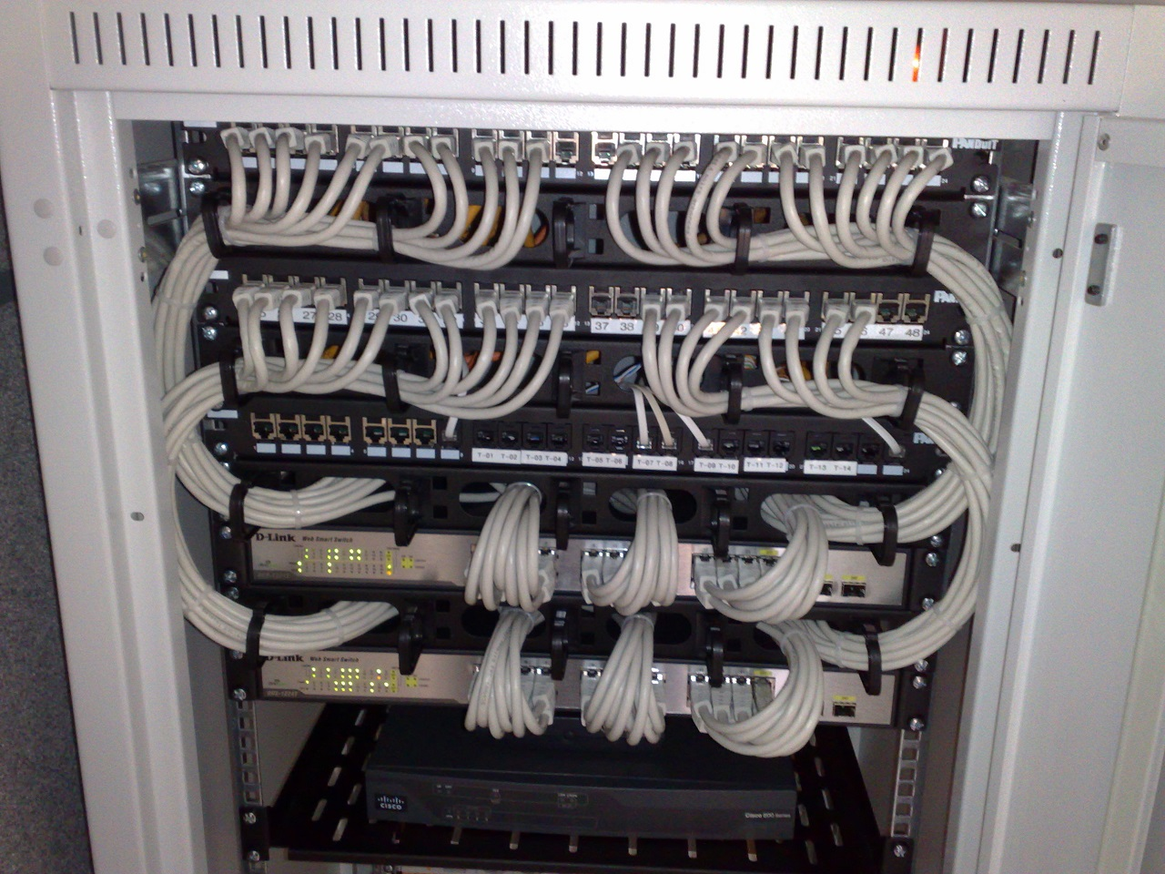
Modern way: switching
Switch: network device that forwards frames (packets) between ports
All hosts connect to a switch
Collision domain is host-switch
Switch buffers packets, forwards to destination when its port is idle
How to know which devices is on which port?

Slide 42
MAC learning, how it works

Slide 43
MAC Learning
Switches “learn” which host lives on which port by watching traffic
=>Keeps table of <destination addr => port>
If you don’t know, flood to all ports!

Slide 44
MAC Learning
Switches “learn” which host lives on which port by watching traffic
If you don’t know, flood to all ports!
MAC learning is just an optimization vs. old version
(but a pretty good one…)

Slide 45
MAC table example
R6#sh mac-address-table
EHWIC: 0
Destination Address Address Type VLAN Destination Port
------------------- ------------ ---- -----------------
5c45.27e0.8383 Dynamic 1 GigabitEthernet0/1/3
7641.7b63.584a Dynamic 20 GigabitEthernet0/1/3
5c45.27e0.8381 Dynamic 10 GigabitEthernet0/1/3
0000.5e00.0101 Dynamic 10 GigabitEthernet0/0/1
ca3f.aee3.e3e6 Dynamic 20 GigabitEthernet0/1/3
644b.f012.7f75. Dynamic 20 GigabitEthernet0/1/3
f018.9815.8eb8 Dynamic 20 GigabitEthernet0/1/3
ecb5.fa13.4677 Dynamic 20 GigabitEthernet0/0/2
a0a4.c5c2.4165 Dynamic 20 GigabitEthernet0/0/1
4c71.0c92.4f10 Dynamic 10 GigabitEthernet0/1/3
12d3.acae.bbc0 Dynamic 20 GigabitEthernet0/0/1
04d4.c448.9cf7 Dynamic 20 GigabitEthernet0/1/3
Notes:
Takes this information and synthesizes it down into its forwarding table baed on interfaces

Slide 46
What can go wrong?

Slide 47
Attack on a Learning Switch
Eve: wants to sniff all packets sent to Bob
Same segment: easy (shared medium)
Different segment on a learning bridge: hard
  Once bridge learns Bob’s port, stop broadcasting
How can Eve force the bridge to keep broadcasting?
  Flood the network with frames with spoofed src addr!

Slide 48
Bridges and Extended LANs
Single Ethernet collision domain has limitations
  Limits performance, distance, …
Next step: separate collision domains with bridges
  Operates on Ethernet addresses
  Forwards packets from one collision domain to others
Modern ethernet uses switches: all hosts directly connected to a bridge

Slide 49
Destinations for packets
Unicast: forward with filtering
Broadcast: always forward
Multicast: always forward or learn groups
Can try to limit how we direct packets to a destination

Slide 50
Learning Bridges/Switches
Idea: don’t forward a packet where it isn’t needed
  If you know recipient is not on that port
Learn hosts’ locations based on source addresses
  Build a table as you receive packets
  Table is a cache: if full, evict old entries. Why is this fine?
Table says when not to forward a packet
  Doesn’t need to be complete for correctness
Notes:
Never forward to INCOMING port…
What if hosts move? TIMEOUT
What if no space? Still works

Slide 51
Also: VLANs
Consider: Company network, A and B departments
  Broadcast traffic does not scale
  May not want traffic between the two departments
  What if employees move between offices?
b1
a1
b2
a2

Slide 52
VLANs
Solution: Virtual LANs
  Assign switch ports to a VLAN ID (color)
  Isolate traffic: only same color
  Some links may belong to multiple VLANs
=> Easy to change, no need to rewire
a2
a1
b2
b1

Slide 53
How does this all change with wifi?
A
B
C

Slide 54
How does this all change with wifi?
A
B
C
Can’t detect collisions anymore!
=> Carrier Sense Multiple Access / Collision Avoidance
=> Try to send: if you don’t hear back, assume collision (and maybe retry)

Slide 55
Extra material

Slide 56
Coming Up
Connecting multiple networks: IP and the Network Layer

Slide 57
Handling Collisions
Collision detection (10Base2 Ethernet)
  Monitors line voltage level
  Uses Manchester encoding. Why does that help?
    Constant average voltage unless multiple transmitters
If collision
  Jam for 32 bits, then stop transmitting frame
Notes:
51.2 us round-trip time

Slide 58
Collision Detection
Without minimum frame length, might not detect collision

Slide 59
Handling Collisions
Collision detection (10Base2 Ethernet)
  Monitors line voltage level
  Uses Manchester encoding. Why does that help?
    Constant average voltage unless multiple transmitters
If collision
  Jam for 32 bits, then stop transmitting frame
Collision detection constrains protocol
  Must ensure transmission time ≥ 2x propagation delay
  Imposes min. packet size (64 bytes or 512 bits)
  Imposes maximum network diameter (2500m)
Notes:
51.2 us round-trip time

Slide 60
Token Ring
Idea: frames flow around ring
Capture special “token” bit pattern to transmit
Variation used today in Metropolitan Area Networks, with fiber

Slide 61
Interface Cards
Problem: if host dies, can break the network
Hardware typically has relays

Slide 62
Token Ring Frames
Frame format (Differential Manchester)
Sender grabs token, sends message(s)
Recipient checks address
Sender removes frame from ring after lap
Maximum holding time: avoid capture
Monitor node reestablishes lost token

Slide 63
Bridging

Slide 64
Dealing with Loops
Problem: people may create loops in LAN!
  Accidentally, or to provide redundancy
  Don’t want to forward packets indefinitely

Slide 65
Enter Radia Perlman
“…we have designed an algorithm that allows the extended network to consist of an arbitrary topology. (…)
The algorithm (…) computes a subset of the topology that connects all LANs yet is loop-free (a spanning tree).”
Perlman, Radia (1985). "An Algorithm for Distributed Computation of a Spanning Tree in an Extended LAN". ACM SIGCOMM Computer Communication Review. 15 (4): 44–53. doi:10.1145/318951.319004

Slide 66
Spanning Tree
Need to disable ports, so that no loops in network
Like creating a spanning tree in a graph
  View switches and networks as nodes, ports as edges

Slide 67
Distributed Spanning Tree Algorithm
Every bridge has a unique ID (Ethernet address)
Goal:
  Bridge with the smallest ID is the root
  Each segment has one designated bridge, responsible for forwarding its packets towards the root
    Bridge closest to root is designated bridge
    If there is a tie, bridge with lowest ID wins

Slide 68
Spanning Tree Protocol
Send message when you think you are the root
Otherwise, forward messages from best known root
  Add one to distance before forwarding
  Don’t forward over discarding ports (see next slide)
Spanning Tree messages contain:
  ID of bridge sending the message
  ID sender believes to be the root
  Distance (in hops) from sender to root
Bridges remember best config msg on each port
In the end, only root is generating messages

Slide 69
Spanning Tree Protocol (cont.)
Forwarding and Broadcasting
Port states*:
  Root port: a port the bridge uses to reach the root
  Designated port: the lowest-cost port attached to a single segment
  If a port is not a root port or a designated port, it is a discarding port.
* In a later protocol RSTP, there can be ports configured as backups and alternates.

Slide 70
Root Port
Designated Port
Discarding Port

Slide 71
Algorhyme
I think that I shall never see
a graph more lovely that a tree.
A tree whose crucial property
is loop-free connectivity.
A tree that must be sure to span
so packet can reach every LAN.
First the root must be selected.
By ID, it is elected.
Least cost paths from root are traced.
In the tree, these paths are placed.
A mesh is made by folks like me,
then bridges find a spanning tree.
Radia Perlman

Slide 72
Limitations of Bridges
Scaling
  Spanning tree algorithm doesn’t scale
  Broadcast does not scale
  No way to route around congested links, even if path exists
May violate assumptions
  Could confuse some applications that assume single segment
    Much more likely to drop packets
    Makes latency between nodes non-uniform
  Beware of transparency

Slide 73
Switching
Switches must be able to, given a packet, determine the outgoing port
3 ways to do this:
  Virtual Circuit Switching
  Datagram Switching
  Source Routing

Slide 74
Virtual Circuit Switching
Explicit set-up and tear down phases
  Establishes Virtual Circuit Identifier on each link
  Each switch stores VC table
Subsequent packets follow same path
  Switches map [in-port, in-VCI] : [out-port, out-VCI]
Also called connection-oriented model

Slide 75
Virtual Circuit Model
Requires one RTT before sending first packet
Connection request contain full destination address, subsequent packets only small VCI
Setup phase allows reservation of resources, such as bandwidth or buffer-space
  Any problems here?
If a link or switch fails, must re-establish whole circuit
Example: ATM, MPLS
Notes:
What is the domain of each VCI?
And the address?

Slide 76
Datagram Switching
Each packet carries destination address
Switches maintain address-based tables
  Maps [destination address]:[out-port]
Also called connectionless model
Switch 2
Addr | Port
A | 3
B | 0
C | 3
D | 3
E | 2
F | 1
G | 0
H | 0

Slide 77
Datagram Switching
No delay for connection setup
Source can’t know if network can deliver a packet
Possible to route around failures
Higher overhead per-packet
Potentially larger tables at switches
Notes:
Why larger tables?

Slide 78
Source Routing
Packets carry entire route: ports
Switches need no tables!
  But end hosts must obtain the path information
Variable packet header
Notes:
May be loose or strict.
Brittle if there are changes host doesn’t know about.

Slide 79
Generic Switch Architecture
Goal: deliver packets from input to output ports
Three potential performance concerns:
  Throughput in bytes/second
  Throughput in packets/second
  Latency
Notes:
Different if packets are variable size

Slide 80
Shared Memory Switch
1st Generation – like a regular PC
  NIC DMAs packet to memory over I/O bus
  CPU examines header, sends to destination NIC
  I/O bus is serious bottleneck
  For small packets, CPU may be limited too
  Typically < 0.5 Gbps

Slide 81
Shared Bus Switch
2st Generation
  NIC has own processor, cache of forwarding table
  Shared bus, doesn’t have to go to main memory
  Typically limited to bus bandwidth
    (Cisco 5600 has a 32Gbps bus)

Slide 82
Point to Point Switch
3rd Generation: overcomes single-bus bottleneck
Example: Cross-bar switch
  Any input-output permutation
  Multiple inputs to same output requires trickery
  Cisco 12000 series: 60Gbps
Notes:
Layer 3 routers are similar
Current switching speeds: 6.5Tbps

Slide 83
Cut through vs. Store and Forward
Two approaches to forwarding a packet
  Receive a full packet, then send to output port
  Start retransmitting as soon as you know output port, before full packet
Cut-through routing can greatly decrease latency
Disadvantage
  Can waste transmission (classic optimistic approach)
    CRC may be bad
    If Ethernet collision, may have to send runt packet on output link

Slide 84
Buffering
2
Port 1
1
2
Port 2
Buffering of packets can happen at input ports, fabric, and/or output ports
Queuing discipline is very important
Consider FIFO + input port buffering
  Only one packet per output port at any time
  If multiple packets arrive for port 2, they may block packets to other ports that are free
  Head-of-line blocking: can limit throughput to ~ 58% under some reasonable conditions*
* For independent, uniform traffic, with same-size frames
Notes:
Also allows QoS, Fairness, Prioritization
For independent and uniform traffic

Slide 85
Head-of-Line Blocking
2
Port 1
1
2
Port 2
Solution: Virtual Output Queueing
  Each input port has n FIFO queues, one for each output
  Switch using matching in a bipartite graph
  Shown to achieve 100% throughput*
*MCKEOWN et al.: ACHIEVING 100% THROUGHPUT IN AN INPUT-QUEUED SWITCH, 1999

Slide 86
Current Developments
Switches are becoming programmable
  Match-action paradigm
  Custom protocols, encapsulation, metering, monitoring
Current speeds reach 12.8Tbps (32x400Gbps or 256x50Gbps) on a single programmable switching chip

Slide 87
Warmup
IEEE 802.15.4 is a low-power wireless standard.
- What kind of bit rate can it achieve at a 2MHz bandwidth using QPSK (M = 4)?
- Is this achievable with a signal-to-noise ratio of 20dB?
Hartley’s Law: C = 2B log₂(M) bits/s
Shannon’s Channel Capacity: C = B log₂(1 + S/N)
  C: channel capacity in bits/second
  B : bandwidth in Hz
  S, N: average signal, noise power
  M: Number of modulation levels
  Decibels, measure of relative power: dB = 10log₁₀(S/N)

