Slide 1
CS 1680
IP Forwarding realities
Nick DeMarinis
Based partly on lecture notes by Rodrigo Fonseca, David Mazières, Phil Levis, John Jannotti

Slide 2
Administrivia
Look for announcement to sign up for IP milestone meetings, preferably with your mentor TA, on or before Friday (Oct 4)
  You don’t need to show an implementation, but you are expected to talk about your design
IP gearup II: Thursday 6-8pm in CIT368
  Implementation and debugging tips

Slide 3
Administrivia
Look for announcement to sign up for IP milestone meetings, preferably with your mentor TA, on or before Friday (Oct 4)
  You don’t need to show an implementation, but you are expected to talk about your design
IP gearup II: Thursday 6-8pm in CIT368
  Implementation and debugging tips
HW1: Due Thursday (HW2 out Thursday)

Slide 4
Today
Odds and ends that make IP forwarding actually work
Longest Prefix Match
IP<->Link layer (ARP, DHCP)
Network Address Translation (NAT)
After this: Routing

Slide 5

Default
Network A: 82.14.0.0/16
B: 1.3.0.0/16
D: 5.6.128.0/20
C: 1.3.25.0/24
Prefix | IF/Next hop
82.14.0.0/16 | (A)
1.3.0.0/16 | (B)
1.3.4.0/24 | (C)
5.6.128.0/20 | (D)
0.0.0.0/0 | (Default)
Warmup: based on the table, where would the router send packets destined for the following addresses:
5.6.128.100
1.3.1.1
8.8.8.8
1.3.4.8
(X) is placeholder—could be an IP or an interface name

Slide 6
What happens when prefixes overlap?
Prefix | IF/Next hop
1.3.0.0/16 | (B)
1.3.4.0/24 | (C)
1.3.4.5/32
0.0.0.0/0 | (Default)
An IP can match on more than one row
=> need to pick the most specific (longest) prefix
1.3.0.0/16
00000001 00000011 xxxxxxxx xxxxxxxx
1.3.4.0/24
00000001 00000011 00000100 xxxxxxxx

Slide 7
What happens when prefixes overlap?
Prefix | IF/Next hop
1.3.0.0/16 | (B)
1.3.4.0/24 | (C)
1.3.4.5/32
0.0.0.0/0 | (Default)
An IP can match on more than one row
=> need to pick the most specific (longest) prefix
1.3.0.0/16
00000001 00000011 xxxxxxxx xxxxxxxx
1.3.4.0/24
00000001 00000011 00000100 xxxxxxxx
More specific => best match!

Slide 8
What happens when prefixes overlap?
Prefix | IF/Next hop
1.3.0.0/16 | (B)
1.3.4.0/24 | (C)
1.3.4.5/32
0.0.0.0/0 | (Default)
An IP can match on more than one row
=> need to pick the most specific (longest) prefix
1.3.0.0/16
00000001 00000011 xxxxxxxx xxxxxxxx
1.3.4.0/24
00000001 00000011 00000100 xxxxxxxx
More specific => best match!
Other examples you’ll see…
0.0.0.0/0
xxxxxxxx xxxxxxxx xxxxxxxx xxxxxxxx
1.2.3.5/32
00000001 00000011 00000100 00000101

Slide 9
What happens when prefixes overlap?
Prefix | IF/Next hop
1.3.0.0/16 | (B)
1.3.4.0/24 | (C)
1.3.4.5/32
0.0.0.0/0 | (Default)
An IP can match on more than one row
=> need to pick the most specific (longest) prefix
1.3.0.0/16
00000001 00000011 xxxxxxxx xxxxxxxx
1.3.4.0/24
00000001 00000011 00000100 xxxxxxxx
More specific => best match!
Other examples you’ll see…
0.0.0.0/0
xxxxxxxx xxxxxxxx xxxxxxxx xxxxxxxx
=> Least specific!
(Used for default “catchall” routes)
1.2.3.5/32
00000001 00000011 00000100 00000101
=> Most specific!
(Refers to a single host,
often a local IP)

Slide 10
What happens when prefixes overlap?
Prefix | IF/Next hop
1.3.0.0/16 | (B)
1.3.4.0/24 | (C)
1.3.4.5/32
0.0.0.0/0 | (Default)
An IP can match on more than one row
=> need to pick the most specific (longest) prefix
1.3.0.0/16
00000001 00000011 xxxxxxxx xxxxxxxx
1.3.4.0/24
00000001 00000011 00000100 xxxxxxxx
More specific => best match!
Other examples you’ll see…
0.0.0.0/0
xxxxxxxx xxxxxxxx xxxxxxxx xxxxxxxx
=> Least specific!
(Used for default “catchall” routes)
1.2.3.5/32
00000001 00000011 00000100 00000101
=> Most specific!
(Refers to a single host,
often a local IP)
=>Longest prefix matching: can keep forwarding tables small by summarizing routes where possible, otherwise using specific prefixes

Slide 11

What happens at the link layer?
IF0
What does it mean to send to IF1?
IF1
IF2
1.2.1.3
1.2.2.100
1.2.1.1
1.2.2.1
Prefix | IF/Next hop
1.2.1.0/24 | IF1
1.2.2.0/24 | IF2
8.0.0.0/30 | IF0
Default | 8.0.0.2

Slide 12
What happens at the link layer?
IF0
What does it mean to send to IF1?
IF1
IF2
1.2.1.3
1.2.2.100
1.2.1.1
1.2.2.1
The story so far:
=>Can “easily” communicate with nodes on the same network,
but what about other networks?
=> Routers know about multiple networks, forward packets between them
Prefix | IF/Next hop
1.2.1.0/24 | IF1
1.2.2.0/24 | IF2
8.0.0.0/30 | IF0
Default | 8.0.0.2

Slide 13
“Local delivery”:
what does it mean to send to IF1?
Src: 1.2.4.100
Dst: 1.2.1.3
. . .
1.2.1.2
IF1
1.2.1.3
1.2.1.1
1.2.1.200
Subnet “A”: 1.2.1.0/24
Prefix | IF/Next hop
1.2.1.0/24 | IF1
… | …
Notes:
Let’s first look at how we move packets between the two networks

Slide 14
“Local delivery”:
what does it mean to send to IF1?
Src: 1.2.4.100
Dst: 1.2.1.3
. . .
1.2.1.2
So far: “easy” to communicate with nodes on the same network. But how?
To send a packet on a local network, we need:
Dest. IP (Network layer)
Dest. MAC address (Link layer)
Assume: link layer can figure out the rest once we fill in this info
IF1
1.2.1.3
1.2.1.1
 | Src | Dest
Link |  | ???
IP | 10.2.4.100 | 1.2.1.3
1.2.1.200
Subnet “A”: 1.2.1.0/24
Prefix | IF/Next hop
1.2.1.0/24 | IF1
… | …
=> How do we get the MAC address?
Notes:
Let’s first look at how we move packets between the two networks

Slide 15
“Glue” between L2 and L3
Need a way to connect get link layer info (mac address) from network-layer info (IP address)
“What MAC address has IP 1.2.3.4?”

Slide 16
“Glue” between L2 and L3
Need a way to connect get link layer info (mac address) from network-layer info (IP address)
“What MAC address has IP 1.2.3.4?”
Solution: ask the network!
=> Address Resolution Protocol (ARP)

Slide 17
ARP: Address resolution protocol
Given an IP address, ask network for the MAC address
  Request: “Who has 1.2.3.4?”
  Response: “aa:bb:cc:dd:ee:ff is at 1.2.3.4”

Slide 18
How ARP works

Slide 19
ARP: Address resolution protocol
Given an IP address, ask network for the MAC address
  Request: “Who has 1.2.3.4?”
  Response: “aa:bb:cc:dd:ee:ff is at 1.2.3.4”
Key data structure: ARP table: map of IP -> MAC address
All devices use ARP protocol to build their own table
Requests send to broadcast address: ff:ff:ff:ff:ff:ff

Slide 20
A
bb:bb:bb:bb:bb:bb
(1.2.1.3)
A
aa:aa:aa:aa:aa:aa
(1.2.1.1)

Slide 21
A
aa:aa:aa:aa:aa:aa
(1.2.1.1)
A
bb:bb:bb:bb:bb:bb
(1.2.1.3)
ARP Request
Src Dst
Eth …:aa:aa:aa ff:ff:ff:ff:ff:ff
Who has 1.2.1.3?
Broadcast address: sent to all hosts on the subnet!
ARP Response
Src Dst
Eth …:bb:bb:bb …:aa:aa:aa
1.2.1.3 is at bb:bb:bb:bb:bb:bb

Slide 22
A
aa:aa:aa:aa:aa:aa
(1.2.1.1)
A
bb:bb:bb:bb:bb:bb
(1.2.1.3)
ARP Request
Src Dst
Eth …:aa:aa:aa ff:ff:ff:ff:ff:ff
Who has 1.2.1.3?
Broadcast address: sent to all hosts on the subnet!
ARP Response
Src Dst
Eth …:bb:bb:bb …:aa:aa:aa
1.2.1.3 is at bb:bb:bb:bb:bb:bb
=> Any host can respond. Problem?

Slide 23
Example
# arp -n
Address HWtype HWaddress Flags Mask Iface
172.17.44.1 ether 00:12:80:01:34:55 C eth0
172.17.44.25 ether 10:dd:b1:89:d5:f3 C eth0
172.17.44.6 ether b8:27:eb:55:c3:45 C eth0
172.17.44.5 ether 00:1b:21:22:e0:22 C eth0
Notes:
arp -an
netstat -rn

Slide 24
Putting it all together….

Slide 25
H1
1.2.1.2
MAC: aa:aa:aa
IF0
H2
IF1
IF2
1.2.1.3
MAC: bb:bb:bb
1.2.1.1
MAC: cc:cc:cc
1.2.2.100
MAC: ee:ee:ee
1.2.2.1
MAC: dd:dd:dd
Subnet “A”: 1.2.1.0/24
Subnet “B”: 1.2.2.0/24
Notes:
Let’s first look at how we move packets between the two networks

Slide 26
H1
1.2.1.2
MAC: aa:aa:aa
IF0
H2
IF1
IF2
1.2.1.3
MAC: bb:bb:bb
1.2.1.1
MAC: cc:cc:cc
1.2.2.100
MAC: ee:ee:ee
1.2.2.1
MAC: dd:dd:dd
Subnet “A”: 1.2.1.0/24
Subnet “B”: 1.2.2.0/24
Suppose H1 wants to send a packet to H2.
Q: What would the headers look like when
the packet leaves H1?
Q: Would it change after reaching R?
 | Src | Dest
Link
IP
Notes:
Let’s first look at how we move packets between the two networks

Slide 27
H1
1.2.1.2
MAC: aa:aa:aa
IF0
H2
IF1
IF2
1.2.1.3
MAC: bb:bb:bb
1.2.1.1
MAC: cc:cc:cc
1.2.2.100
MAC: ee:ee:ee
1.2.2.1
MAC: dd:dd:dd
Subnet “A”: 1.2.1.0/24
Subnet “B”: 1.2.2.0/24
H1’s forwarding table
Router’s forwarding table
Prefix | IF/Next hop
1.2.1.0/24 | IF0
0.0.0.0/0 | 1.2.1.1
Prefix | IF/Next hop
1.2.1.0/24 | IF1
1.2.2.0/24 | IF2
Notes:
Let’s first look at how we move packets between the two networks

Slide 28
End-to-end Principle
Keep the network layer simple
Application-specific features/requirements should by implemented by end hosts
  Reliability, security
  Application-specific functionality
Why?
Easier to implement, eg, reliability with end-to-end view
Easier for network layer to scale
Can implement new protocols without changing network

Slide 29
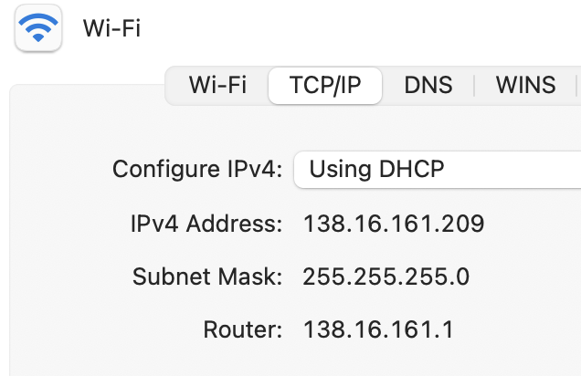
How do you get an IP address?

Slide 30
Getting an IP
Two ways to configure an IP for a host:
Static configuration: manually specify IP address, mask, gateway, …
Automatic: ask the network for an IP when you connect!

Slide 31
Getting an IP
Two ways to configure an IP for a host:
Static configuration: manually specify IP address, mask, gateway, …
=> More common with network devices that don’t change often
Automatic: ask the network for an IP when you connect!
    => Most common for end hosts
    => Dynamic Host Configuration Protocol (DHCP)

Slide 32
DHCP: The idea
Dynamic Host Configuration Protocol

Slide 33
DHCP: The idea
Dynamic Host Configuration Protocol
Every network has a “pool” of IPs it can assign to hosts
  Some subset of its prefix (eg. 192.168.1.0/24)
When a host connects, it asks a DHCP server for an address from the pool
DHCP server(s) act like allocators: give “leases” to IPs, provide other config info

Slide 34
Host A
DHCP server

Slide 35
Host A
DHCP server
Src: A's MAC address
Dst: ff:ff:ff:ff:ff:ff
DHCPDISCOVER
=> Again, host needs to use broadcast address. Why?
=> Problem?

Slide 36
Host A
DHCP server
Src: A's MAC address
Dst: ff:ff:ff:ff:ff:ff
DHCPDISCOVER
Src: <Server MAC address>
Dst: ff:ff:ff:ff:ff:ff
DHCPOFFER:
Your IP: 192.168.1.102
Mask: 255.255.255.0
Router: 192.168.1.1
...
(More steps after this)

Slide 37
Host A
DHCP server
Src: A's MAC address
Dst: ff:ff:ff:ff:ff:ff
DHCPDISCOVER
Src: <Server MAC address>
Dst: ff:ff:ff:ff:ff:ff
DHCPOFFER:
Your IP: 192.168.1.102
Mask: 255.255.255.0
Router: 192.168.1.1
...
(More steps after this)
=> Again, host needs to use broadcast address. Why?
=> Problem?

Slide 38
Obtaining Host IP Addresses - DHCP
Networks are free to assign addresses within block to hosts
Tedious and error-prone: e.g., laptop going from CIT to library to coffee shop
Solution: Dynamic Host Configuration Protocol
  Client: DHCP Discover to 255.255.255.255 (broadcast)
  Server(s): DHCP Offer to 255.255.255.255 (why broadcast?)
  Client: choose offer, DHCP Request (broadcast, why?)
  Server: DHCP ACK (again broadcast)
Result: address, gateway, netmask, DNS server

Slide 39
Problems with DHCP?
What happens if a random host decides to be a DHCP server?

Slide 40
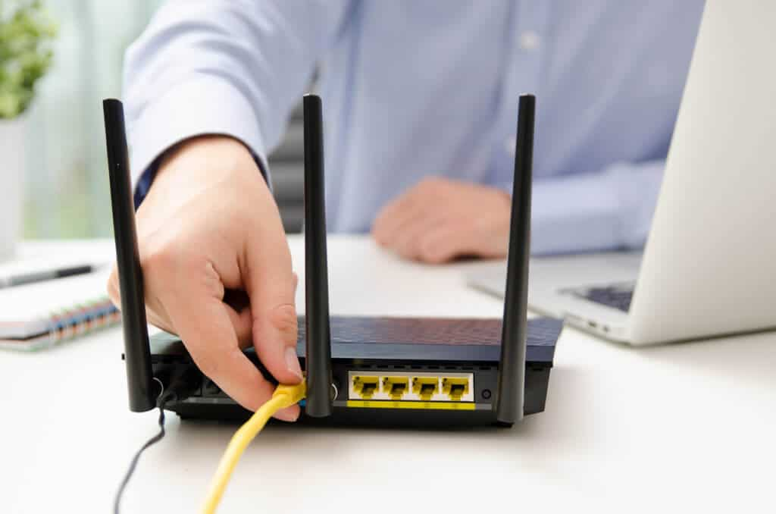
Home routers
The good, the bad, and the ugly…

Slide 41
What’s in a home router?

Slide 42
Story time

Slide 43
Where it gets weird…
Notes:
Address sharing

Slide 44
Where it gets weird…
You get just one IP from your ISP…
=> Need to share IP among many devices on the same network!
Notes:
Address sharing

Slide 45
Where it gets weird…
You get just one IP from your ISP…
=> Need to share IP among many devices on the same network!
Solution: Create a “private” IP range used within local network
=> Routers need to do extra work to share public IP among many private IPs
=> Network Address Translation (NAT)
(A form of connection multiplexing)
Notes:
Address sharing

Slide 47
How NAT works
(The most common type)
192.168.1.100
S
IF1
IF0
192.168.1.101
192.168.1.1
5.6.7.8
Rest of Internet
1.2.1.102
“Inside” network
192.168.1.0/24
Goal: Share one IP among many hosts on a private network
Router translates (modifies) packets from ”inside” to use “outside” address

Slide 48
How NAT works
(The most common type)
192.168.1.100
S
IF1
IF0
192.168.1.101
192.168.1.1
5.6.7.8
Rest of Internet
1.2.1.102
“Inside” network
192.168.1.0/24
Goal: Share one IP among many hosts on a private network
Router translates (modifies) packets from ”inside” to use “outside” address
=> Router needs to remember connection state
=> Router makes some (sketchy) assumptions about traffic

Slide 50
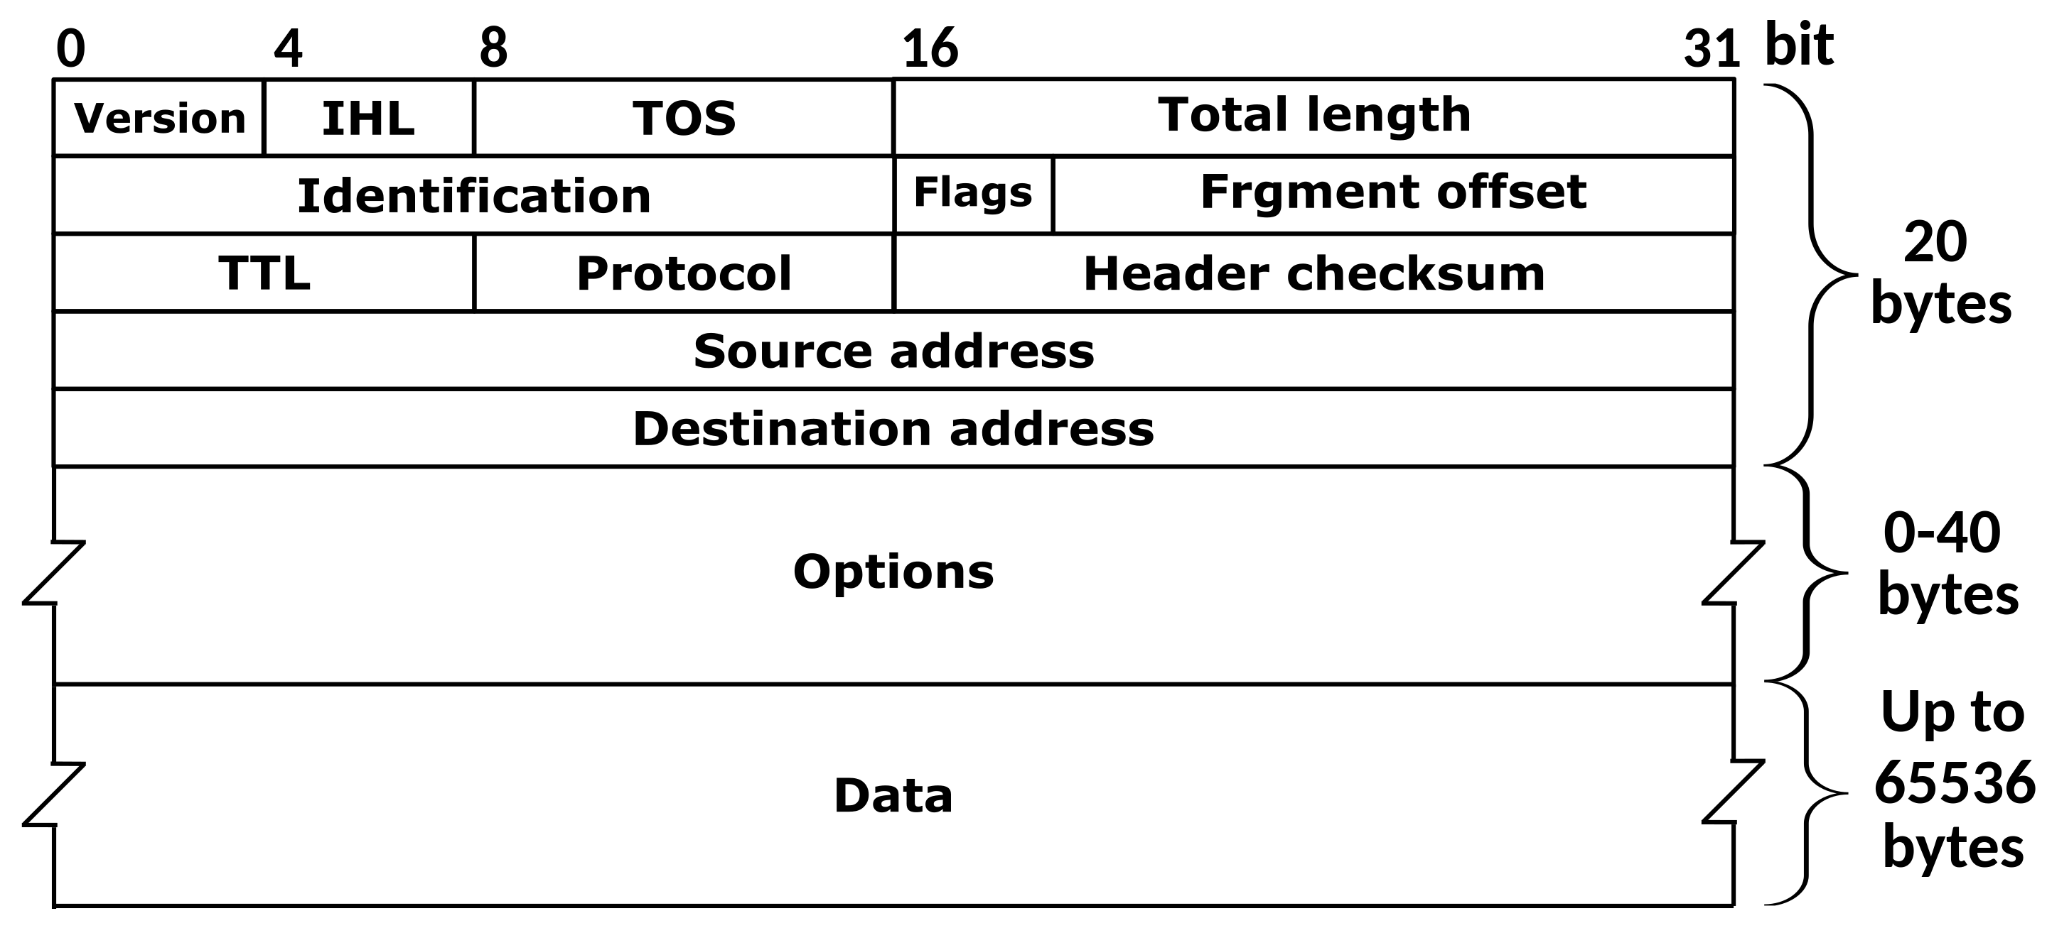
IP Header
Where are the port numbers?????

Slide 51
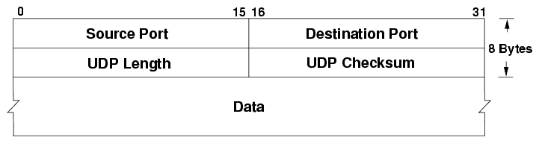
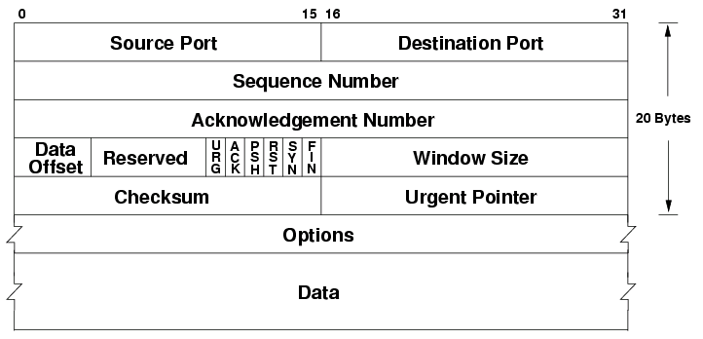
… ports are actually part of the transport layer header!
UDP
TCP
Problem?
Technically a violation of layering! Network layer shouldn’t care about port numbers, but here it matters
NAT needs to know semantics of TCP/UDP (how connections start/end…
...but wait there’s more…

Slide 52
A
192.168.1.100
S
B
IF1
R
IF0
192.168.1.101
192.168.1.1
5.6.7.8
Rest of Internet
C
1.2.1.102
“Inside” network
192.168.1.0/24
What happens when outside host S wants to connect to inside host A?

Slide 53
A
192.168.1.100
S
B
IF1
R
IF0
192.168.1.101
192.168.1.1
5.6.7.8
Rest of Internet
C
1.2.1.102
“Inside” network
192.168.1.0/24
What happens when outside host S wants to connect to inside host A?
Can’t do it (at least without special setup)!
By default, R only knows how to translate packets for connections originating from INSIDE the network
Breaks end to end connectivity!!!

Slide 54
Private IPs (RFC1918)
IP ranges reserved for “private” networks:
Prefix | Use
127.0.0.0/8 | “Loopback” address—always for current host
10.0.0.0/8 | Reserved for private internal networks (RFC1918)
192.168.0.0/16 | IF2
172.16.0.0/12 | IF0

Slide 55
Private IPs (RFC1918)
IP ranges reserved for “private” networks:
Many networks will use these blocks internally
These IPs should never be routed over the Internet!
  What would happen if they were?
Prefix | Use
127.0.0.0/8 | “Loopback” address—always for current host
10.0.0.0/8 | Reserved for private internal networks (RFC1918)
192.168.0.0/16 | IF2
172.16.0.0/12 | IF0

Slide 56
A
192.168.1.100
S
B
IF1
R
IF0
192.168.1.101
192.168.1.1
5.6.7.8
Rest of Internet
C
1.2.1.102
“Inside” network
192.168.1.0/24
What happens when outside host S wants to connect to inside host A?
Can’t do it (at least without special setup)!
By default, R only knows how to translate packets for connections originating from INSIDE the network
Breaks end to end connectivity!!!

Slide 57
End to end connectivity, you say?

Slide 58
Why is this bad?
NAT is used in just about every consumer network
Generally: can’t connect directly to an end host unless it connects to you first

Slide 59
Why is this bad?
NAT is used in just about every consumer network
Generally: can’t connect directly to an end host unless it connects to you first
Need extra work for any protocols that need a direct connection between hosts
=> When do we need this?

Slide 60
Why is this bad?
NAT is used in just about every consumer network
Generally: can’t connect directly to an end host unless it connects to you first
Need extra work for any protocols that need a direct connection between hosts
Protocols that aren’t strictly client-server
Latency critical applications: voice/video calls, games

Slide 61
NAT Traversal
Various methods, depending on the type of NAT
Examples:
Manual method: port forwarding
ICE: Interactive Connectivity Establishment (RFC8445)
STUN: Session Traversal Utilities for NAT (RFC5389)
One idea: connect to external server via UDP, it tells you the address/port

Slide 62
NAT Example

Slide 63
IPv6

Slide 64
IP challenge: Address space exhaustion
IP version 4: ~4 billion IP addresses
  World population: ~8 billion
  Est. number of devices on Internet (2021): >10-30 billion
Since 1990s: various tricks
  Smarter allocations by registrars
  Address sharing: Network Address Translation (NAT)
  DHCP
  Reclaiming unused space
Long term solution: IP version 6

Slide 65
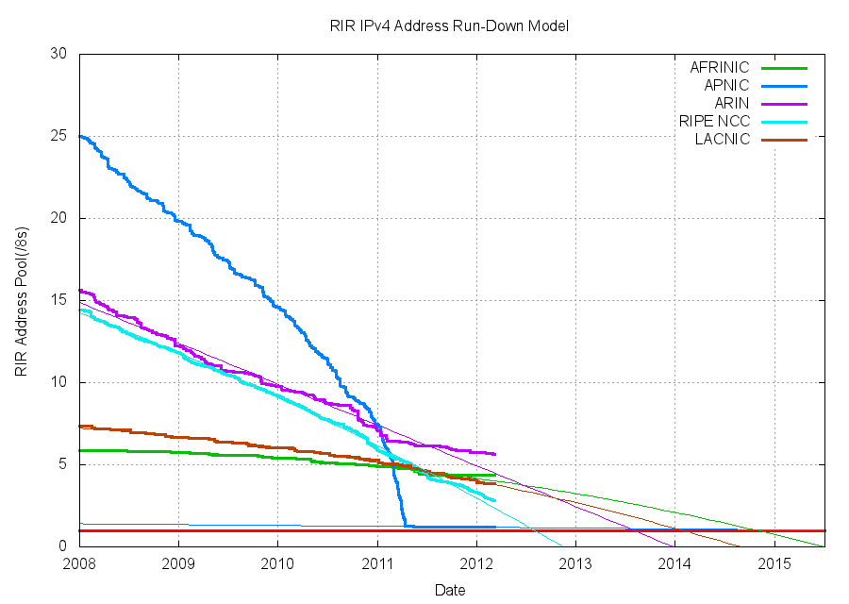
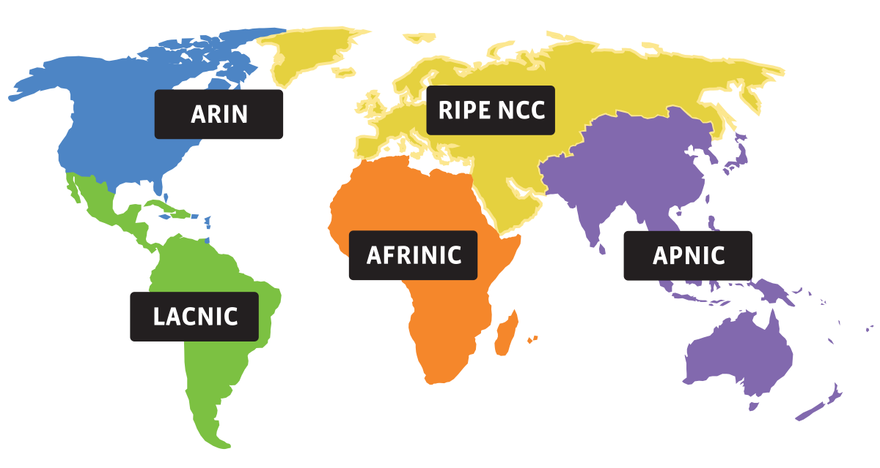
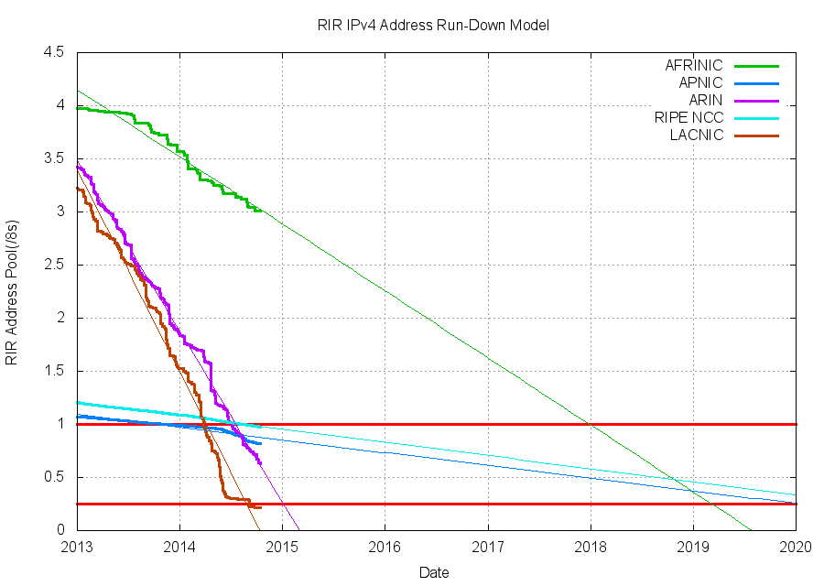
Source: potaroo.net/tools/ipv4
Notes:
Sorry the colors don’t line up

Slide 66
Source: potaroo.net/tools/ipv4

Slide 67
So what happened when we ran out of IPv4 addresses?
It’s not completely gone just yet, but close
Address block fragmentation
  Secondary market for IPv4
  E.g., in 2011 Microsoft bought >600K US IPv4 addresses for $7.5M
NATs galore
  Home NATs, carrier-grade NATs
Jun 2014

Slide 68
IPv6
Main motivation: IPv4 address exhaustion
Initial idea: larger address space
Need new packet format:
  REALLY expensive to upgrade all infrastructure!
  While at it, why don’t we fix a bunch of things in IPv4?
Work started in 1994, basic protocol published in 1998

Slide 69
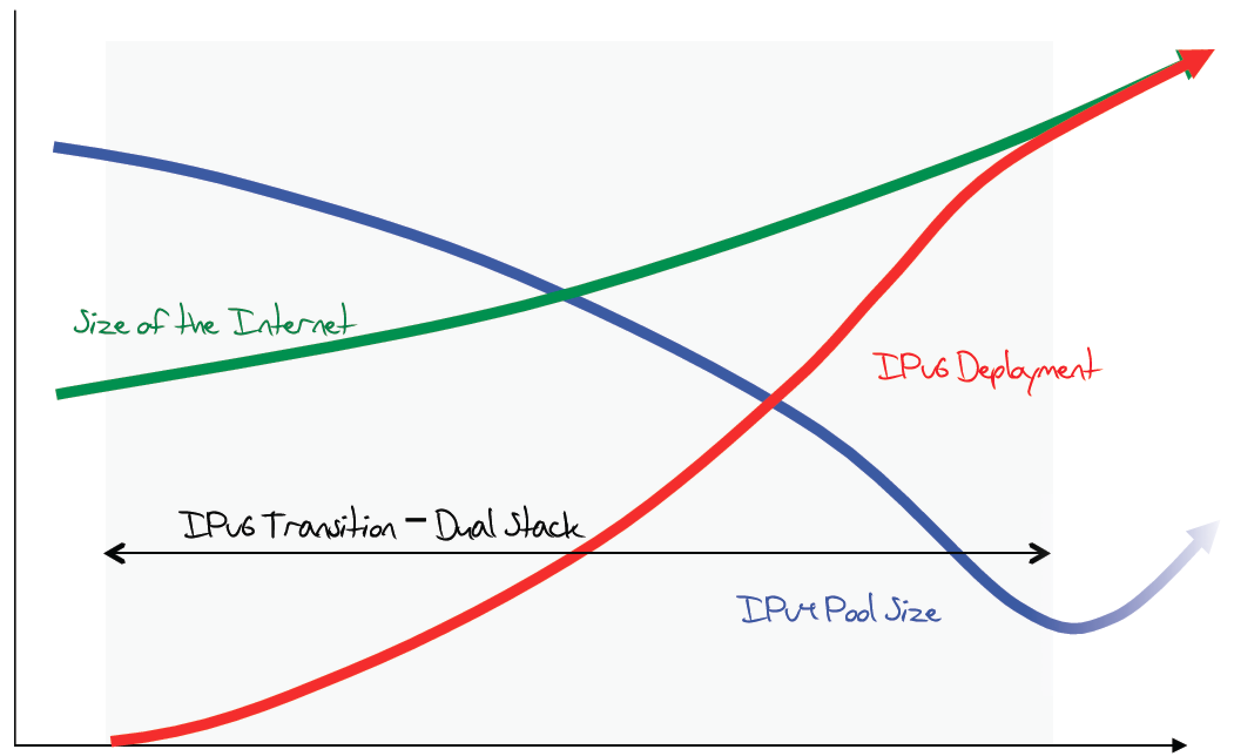
The original expected plan
From: http://www.potaroo.net/ispcol/2012-08/EndPt2.html

Slide 70
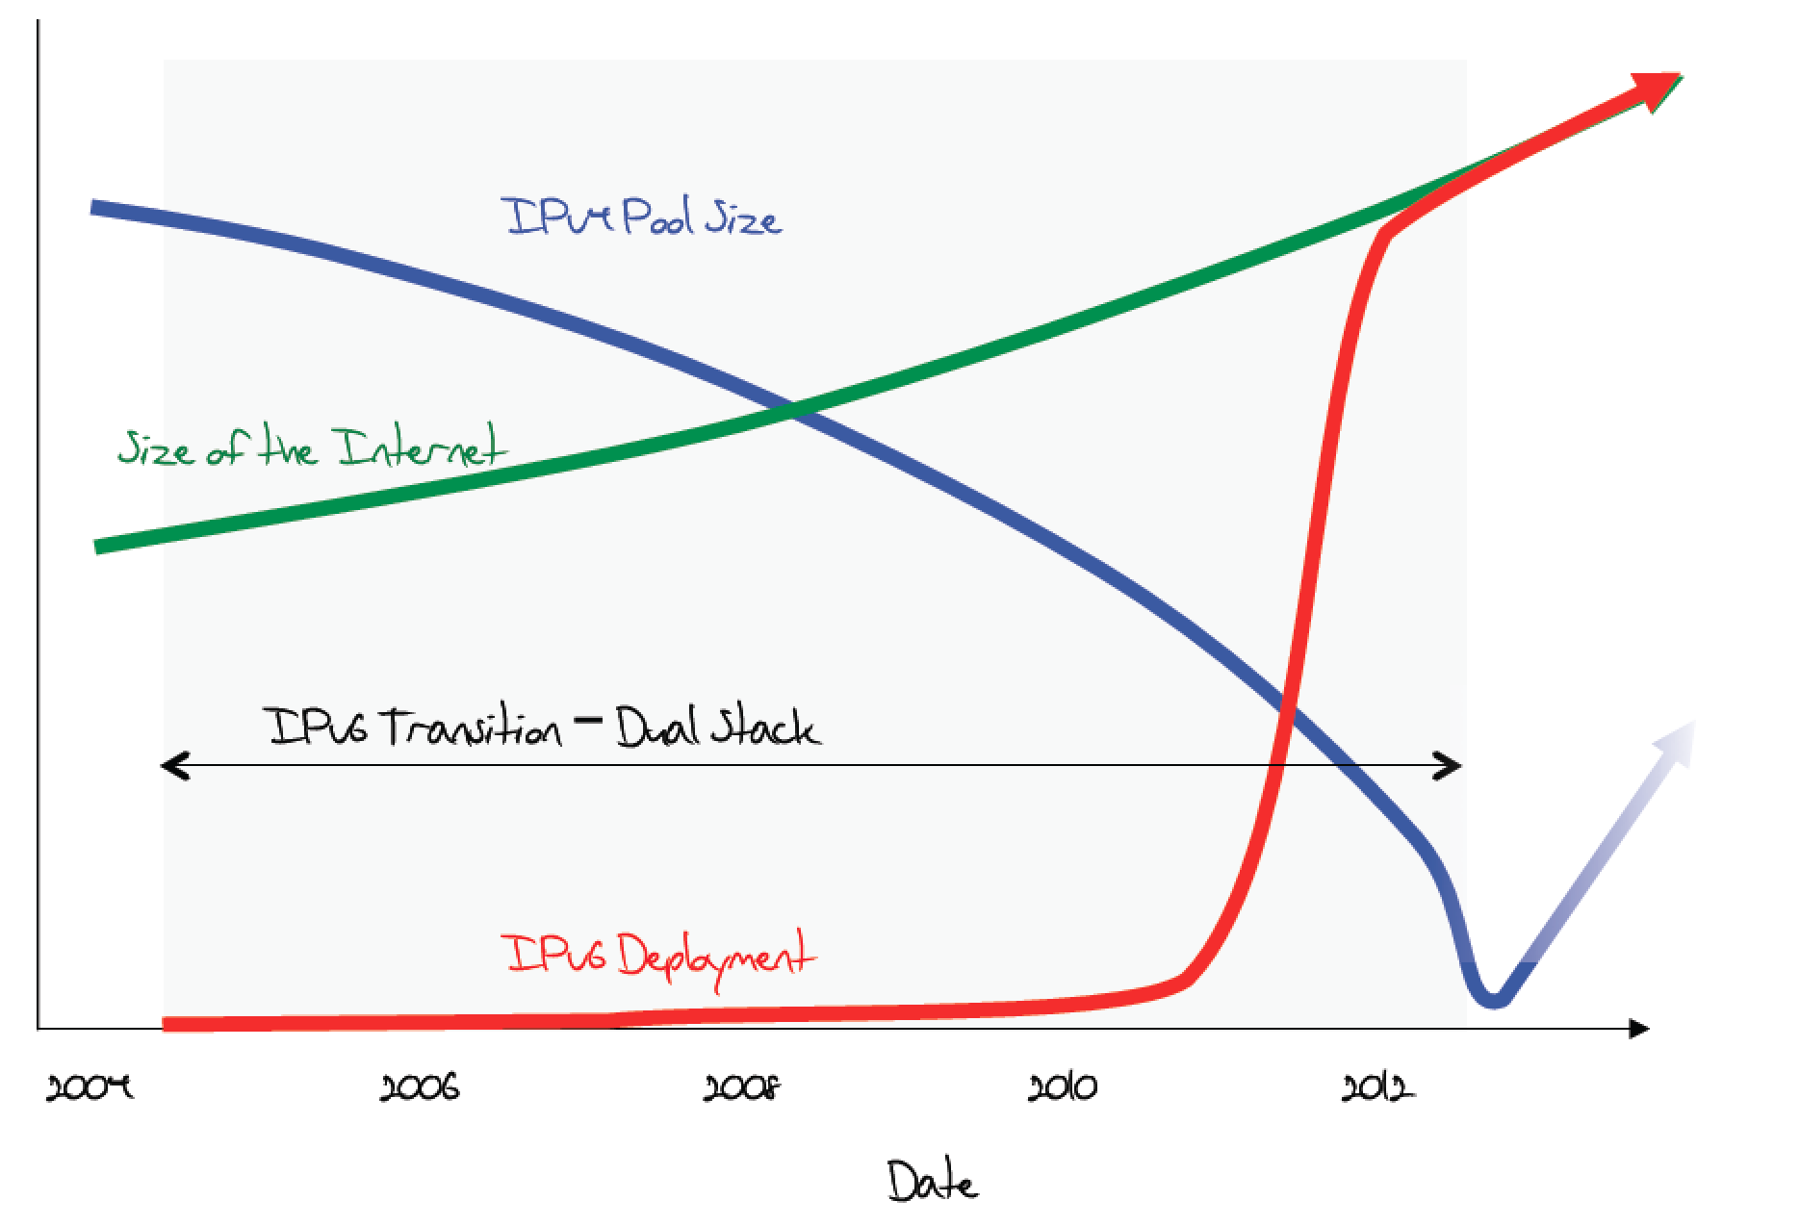
The plan in 2011

Slide 71
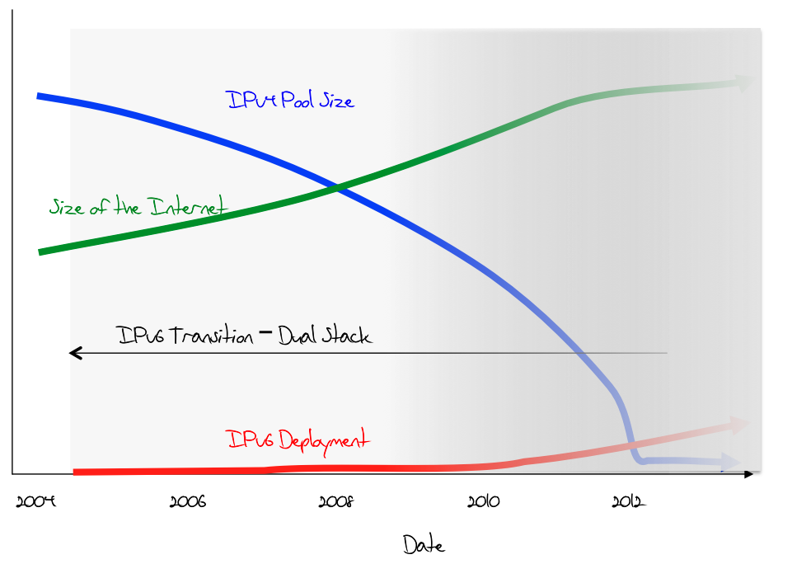
What was happening (late 2012)

Slide 72
June 6th, 2012

Slide 73
Transition is not painless
From http://www.internetsociety.org/deploy360/ipv6/ :
Why do each of these parties have to do something?

Slide 74
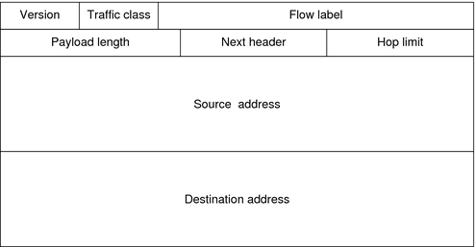
IP version 6
128-bit addresses!
Eg. 2600:3c03::f03c:91ff:fe6e:e3e1

Slide 75
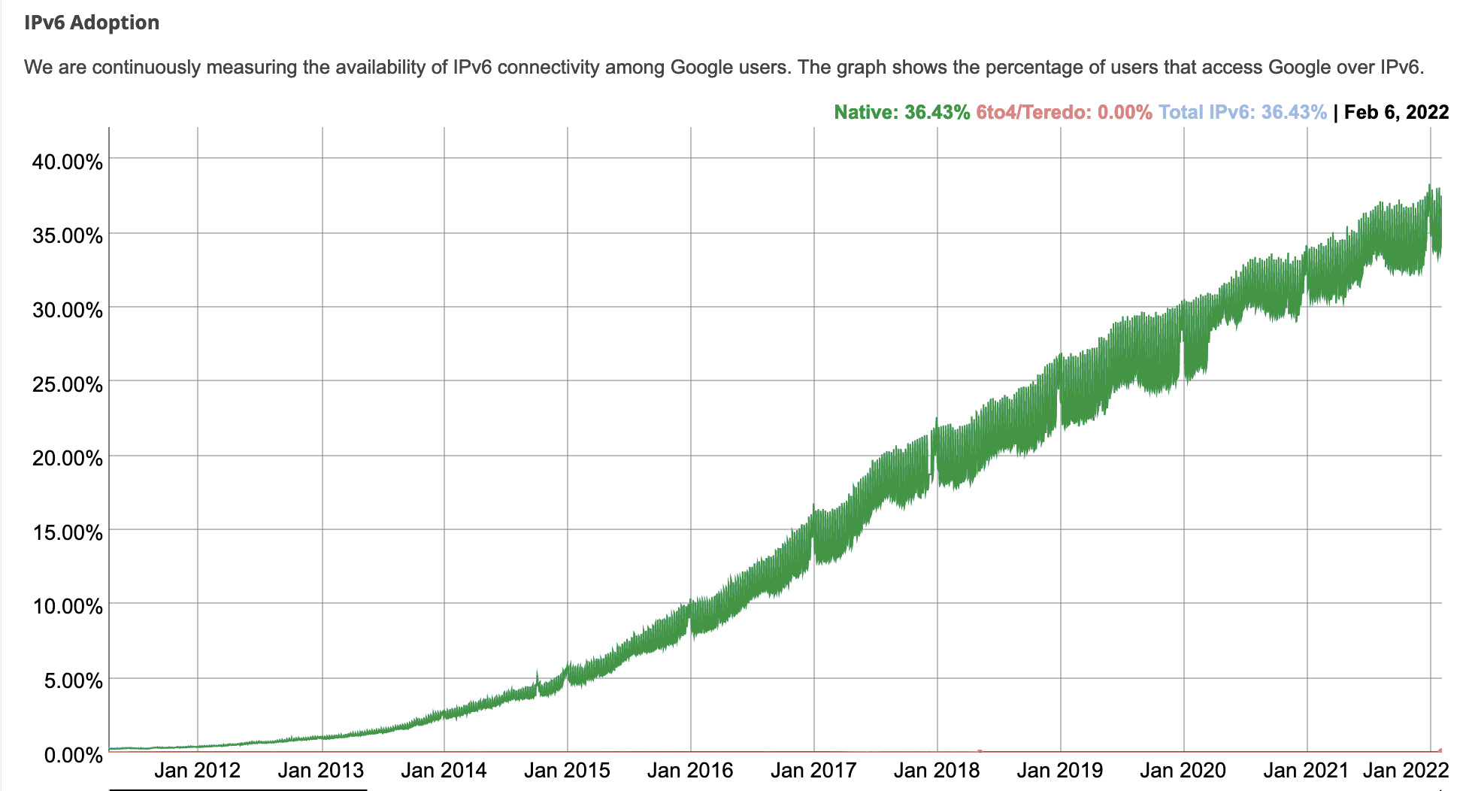
IPv6 Adoption
At Google:
Notes:
Just like routers provide access to the IPv4 space, all of the network elements in a path need to support IPv6—we basically need to build another graph, and allocate more addresses. This process has been happening gradually over the last 20 years, and now it’s starting to get better

Slide 76
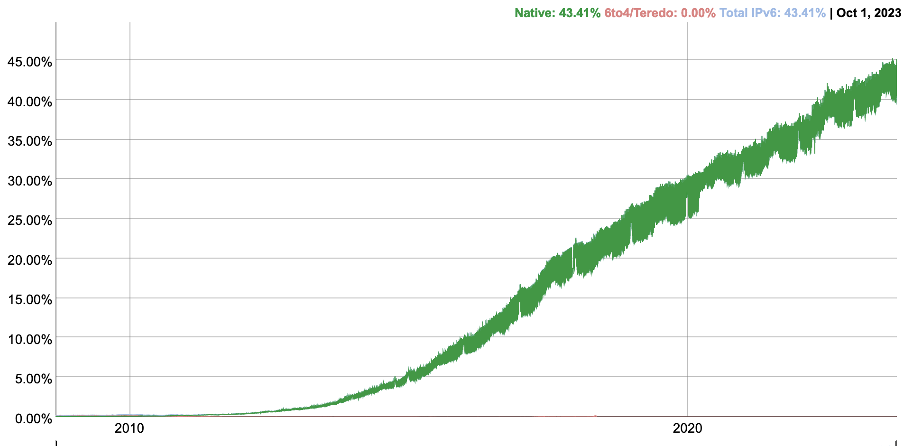
IPv6 Adoption
At Google:
Notes:
Just like routers provide access to the IPv4 space, all of the network elements in a path need to support IPv6—we basically need to build another graph, and allocate more addresses. This process has been happening gradually over the last 20 years, and now it’s starting to get better

Slide 77
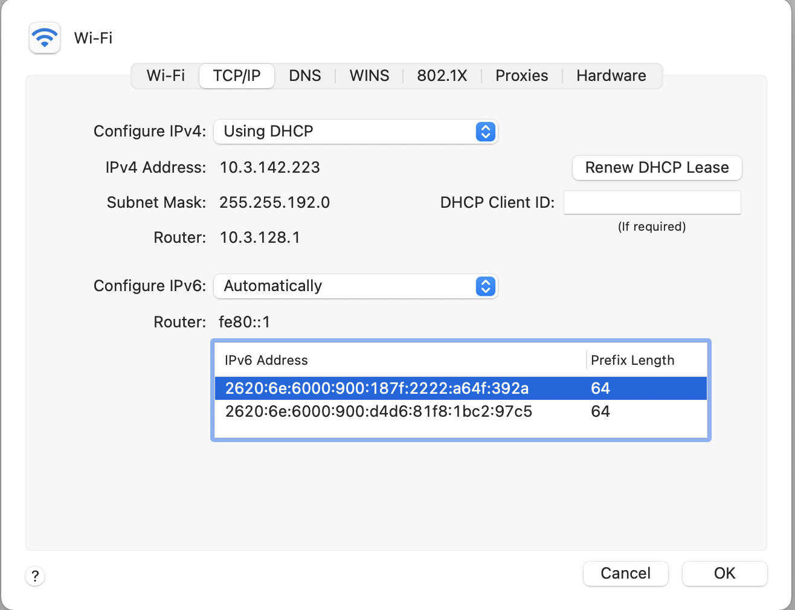
At Brown
Notes:
As of this semester I think, we now have IPv6!

Slide 78
IPv6 Key Features
128-bit addresses
Simplifies basic packet format through extension headers
  40-byte base header (fixed)
  Make less common fields optional
Security and Authentication

Slide 79
IPv6 Address Representation
Groups of 16 bits in hex notation
47cd:1244:3422:0000:0000:fef4:43ea:0001
Two rules:
  Leading 0’s in each 16-bit group can be omitted
  47cd:1244:3422:0:0:fef4:43ea:1
  One contiguous group of 0’s can be compacted
  47cd:1244:3422::fef4:43ea:1

Slide 80
IPv6 Addresses
Break 128 bits into 64-bit network and 64-bit interface
  Makes autoconfiguration easy: interface part can be derived from Ethernet address, for example
Types of addresses
  All 0’s: unspecified
  000…1: loopback
  ff/8: multicast
  fe8/10: link local unicast
  fec/10: site local unicast
  All else: global unicast

Slide 81
IPv6 Header

Slide 82
IPv6 Header Fields
Version: 4 bits, 6
Class: 8 bits, like TOS in IPv4
Flow: 20 bits, identifies a flow
Length: 16 bits, datagram length
Next Header, 8 bits: …
Hop Limit: 8 bits, like TTL in IPv4
Addresses: 128 bits
What’s missing?
  No options, no fragmentation flags, no checksum

Slide 83
Design Philosophy
Simplify handling
  New option mechanism (fixed size header)
  No more header length field
Do less work at the network (why?)
  No fragmentation
  No checksum
General flow label
  No semantics specified
  Allows for more flexibility
Still no accountability
With some content from Scott Shenker
Notes:
End-to-end principle

Slide 84
Interoperability
RFC 4038
  Every IPv4 address has an associated IPv6 address (mapped)
  Networking stack translates appropriately depending on other end
  Simply prefix 32-bit IPv4 address with 80 bits of 0 and 16 bits of 1:
  E.g., ::FFFF:128.148.32.2
Two IPv6 endpoints must have IPv6 stacks
Transit network:
  v6 – v6 – v6 : ✔
  v4 – v4 – v4 : ✔
  v4 – v6 – v4 : ✔
  v6 – v4 – v6 : ✗!!

Slide 85
Example Next Header Values
0: Hop by hop header
1: ICMPv4
4: IPv4
6:TCP
17: UDP
41: IPv6
43: Routing Header
44: Fragmentation Header
58: ICMPv6

Slide 86
Current State
IPv6 Deployment picking up
Most end hosts have dual stacks today (Windows, Mac OSX, Linux, *BSD, Solaris)
Requires all parties to work!
  Servers, Clients, DNS, ISPs, all routers
IPv4 and IPv6 will coexist for a long time

Slide 87
Coming Up
Routing: how do we fill the routing tables?
  Intra-domain routing: Tuesday, 10/4
  Inter-domain routing: Thursday, 10/6

Slide 88
Example
# arp -n
Address HWtype HWaddress Flags Mask Iface
172.17.44.1 ether 00:12:80:01:34:55 C eth0
172.17.44.25 ether 10:dd:b1:89:d5:f3 C eth0
172.17.44.6 ether b8:27:eb:55:c3:45 C eth0
172.17.44.5 ether 00:1b:21:22:e0:22 C eth0
# ip route
127.0.0.0/8 via 127.0.0.1 dev lo
172.17.44.0/24 dev enp7s0 proto kernel scope link src 172.17.44.22 metric 204
default via 172.17.44.1 dev eth0 src 172.17.44.22 metric 204
Notes:
arp -an
netstat -rn

Slide 89
Internet Control Message Protocol (ICMP)
Echo (ping)
Redirect
Destination unreachable (protocol, port, or host)
TTL exceeded
Checksum failed
Reassembly failed
Can’t fragment
Many ICMP messages include part of packet that triggered them
See http://www.iana.org/assignments/icmp-parameters

Slide 90
ICMP message format

Slide 91
Example: Time Exceeded
Code usually 0 (TTL exceeded in transit)
Discussion: traceroute

Slide 92
A
1.2.1.1
B
1.2.1.3
listen(80)
Src Dst
IP 1.2.3.4 5.6.7.8
Port 12345 80
Src Dst
IP 5.6.7.8 1.2.3.4
Port 80 12345

Slide 93
Fragmentation & Reassembly
Each network has maximum transmission unit (MTU)
Strategy
  Fragment when necessary (MTU < size of datagram)
  Source tries to avoid fragmentation (why?)
  Re-fragmentation is possible
  Fragments are self-contained datagrams
  Delay reassembly until destination host
  No recovery of lost fragments
Notes:
Fragmentation: loss of one fragment implies all fragments discarded
Delay of entire packet is worst case delay over all fragments

Slide 94
Fragmentation Example
Ethernet MTU is 1,500 bytes
PPP MTU is 576 bytes
  R2 must fragment IP packets to forward them
Notes:
Never reassemble: you never know if you’ll have all of the packets

Slide 95
Fragmentation Example
IP addresses plus ident field identify fragments of same packet
MF (more fragments bit) is 1 in all but last fragment
Fragment offset multiple of 8 bytes
  Multiply offset by 8 for fragment position original packet
Notes:
No fragmentation
Fragmentation into three packets

