Slide 1
CSCI-1680
Transport Layer Warmup (ish)
Nick DeMarinis
Based partly on lecture notes by Rodrigo Fonseca, Jennifer Rexford, Rob Sherwood, David Mazières, Phil Levis, John Jannotti

Slide 2
Administrivia: This week
IP: Due Thursday
  Signups for grading meetings after that
  Look for a feedback form

Slide 3
Administrivia: This week
IP: Due Thursday
  Signups for grading meetings after that
  Look for a feedback form
  Code cleanup, README, etc after deadline is okay

Slide 4
Administrivia: This week
IP: Due Thursday
  Signups for grading meetings after that
  Code cleanup, README, etc after deadline is okay
  Look for a feedback form
HW2: Out today, due in >1wk
TCP: Out on Friday
  New team form this week (you MAY keep the same team)

Slide 5
Warmup
Advertised by… | Export to…
Customer | Everyone
Peer | Customers only
Provider | Customers only
Given the following AS relationships,
Which ASes will A know about?
X
Y
Z
A
B
C
D
Customer (“A is customer of X”)
Peer

Slide 6
Warmup II
What happens if C suddenly starts advertising A’s prefix?
X
Y
A
B
C

Slide 7
Recap: Prefix hijacking
By default, BGP doesn’t verify that advertised routes match their owners
  Update: “I can reach prefix 128.148.0.0/16
  hrough ASes 44444 3356 14325 11078”

Slide 8
Recap: Prefix hijacking
By default, BGP doesn’t verify that advertised routes match their owners
  Update: “I can reach prefix 128.148.0.0/16
  hrough ASes 44444 3356 14325 11078”
BGP router should ask:
“Should AS11078 be originating 138.16.161.0/24?”

Slide 9
Recap: Prefix hijacking
By default, BGP doesn’t verify that advertised routes match their owners
  Update: “I can reach prefix 128.148.0.0/16
  hrough ASes 44444 3356 14325 11078”
BGP router should ask:
“Should AS11078 be originating 138.16.161.0/24?”
=> Not part of BGP by default. Standards have evolved to help, but adoption is limited.

Slide 10
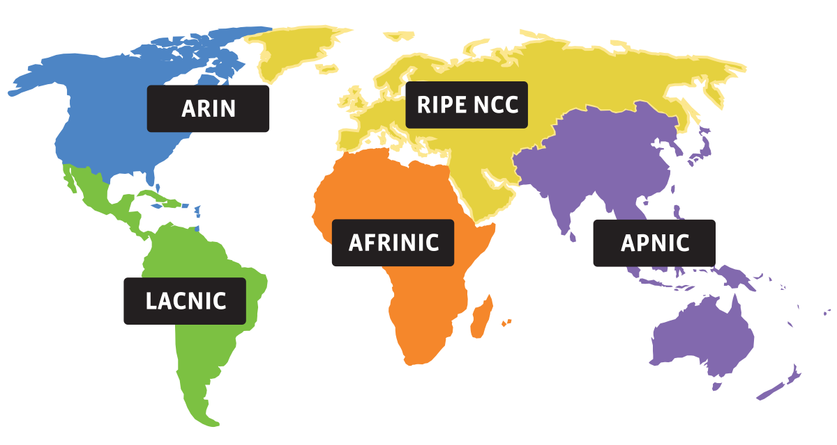
A modern way: RPKI
Leverages hierarchy of how IPs are allocated:
Every AS adds a signature of its route info in database, signed by authority that allocates addresses
  => ROA (Route Origin Authorization)
Other ASes can verify ROA signature using cryptography, making it hard to forge

Slide 11
A modern way: RPKI
Leverages hierarchy of how IPs are allocated:
Every AS adds a signature of its route info in database, signed by authority that allocates addresses
  => ROA (Route Origin Authorization)
Other ASes can verify ROA signature using cryptography, making it hard to forge
Can avoid
  Prefix hijacking
  Addition, removal, or reordering of intermediate ASes

Slide 12
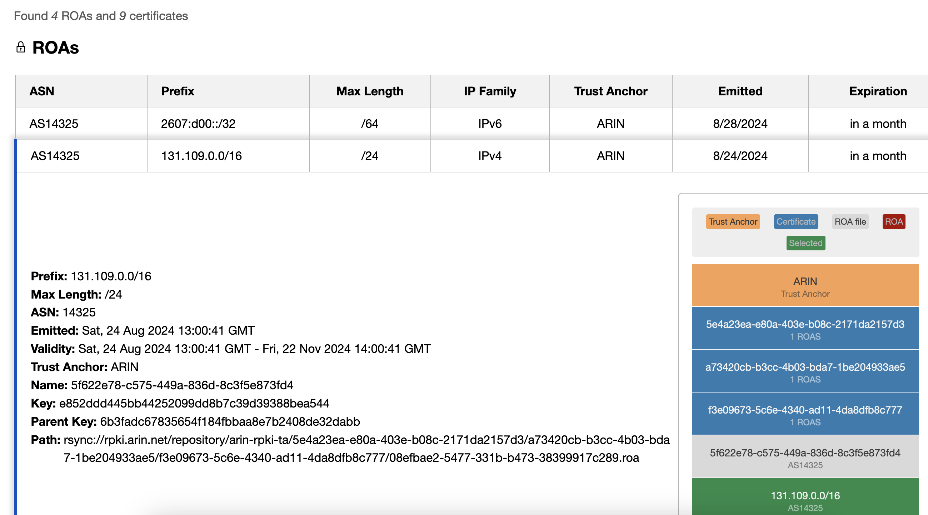
ROAs for OSHEAN (Brown’s provider)

Slide 13
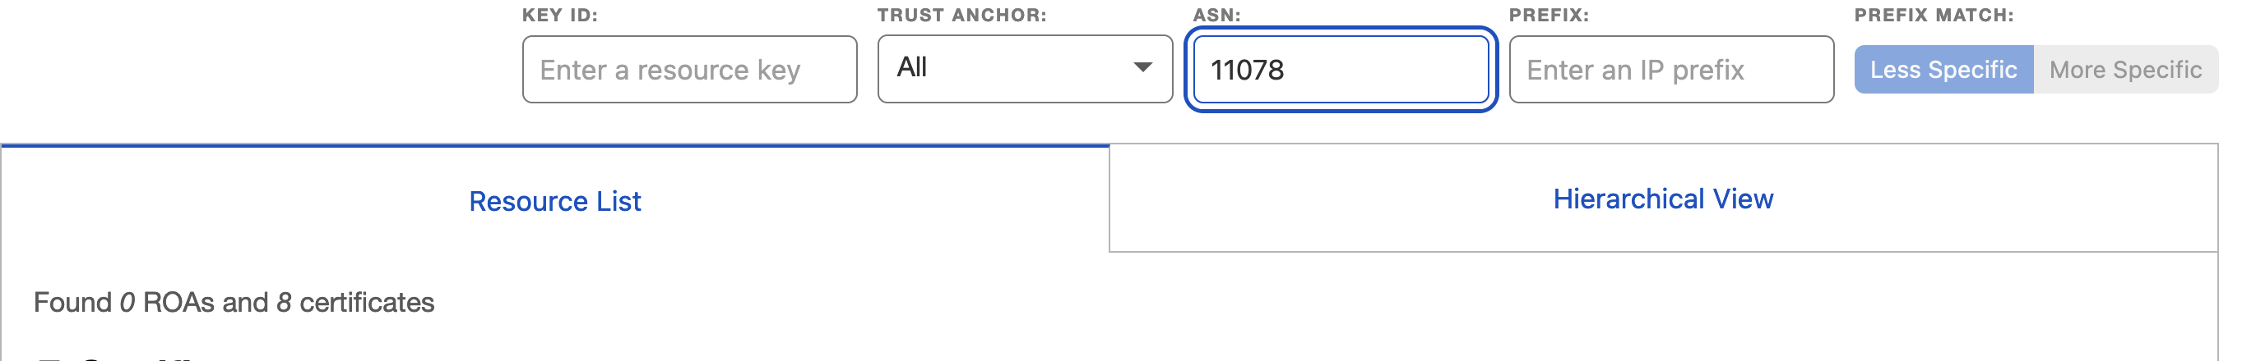
ROAs for Brown
😭

Slide 14
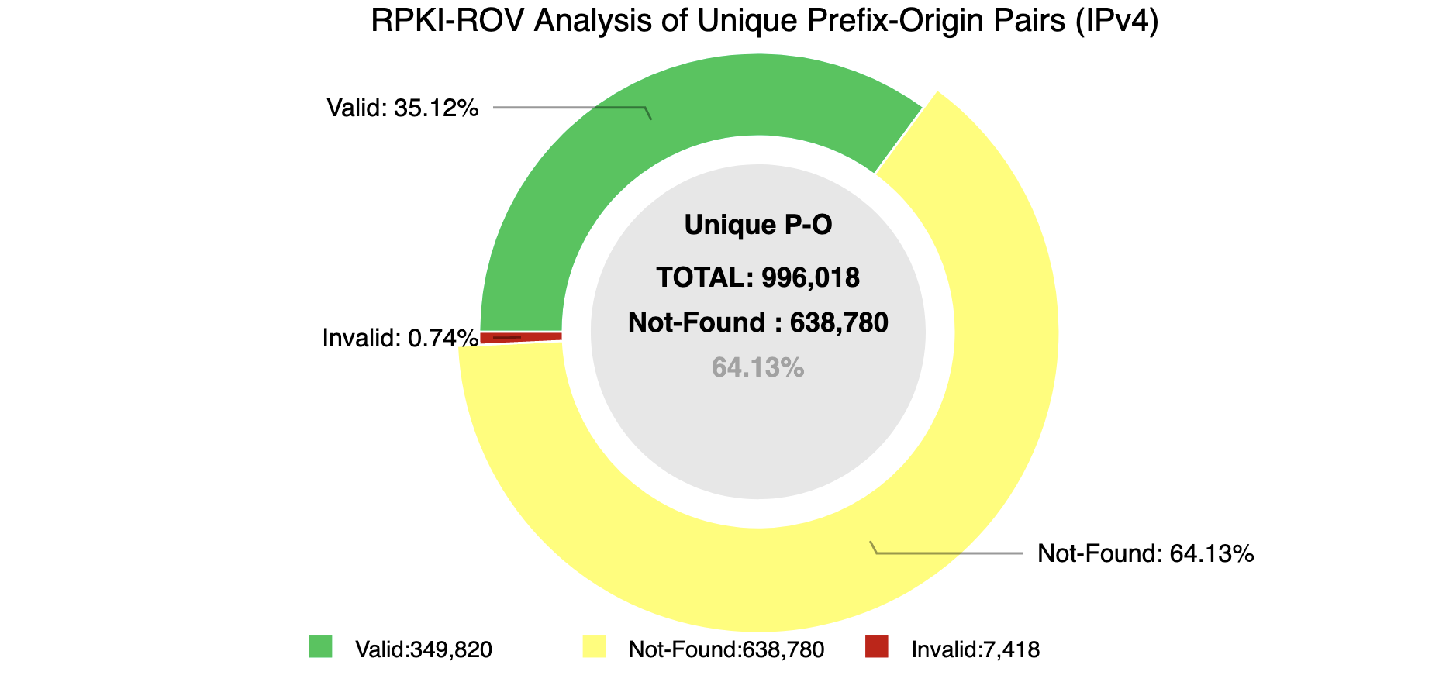
RPKI deployment (2022)

Slide 15
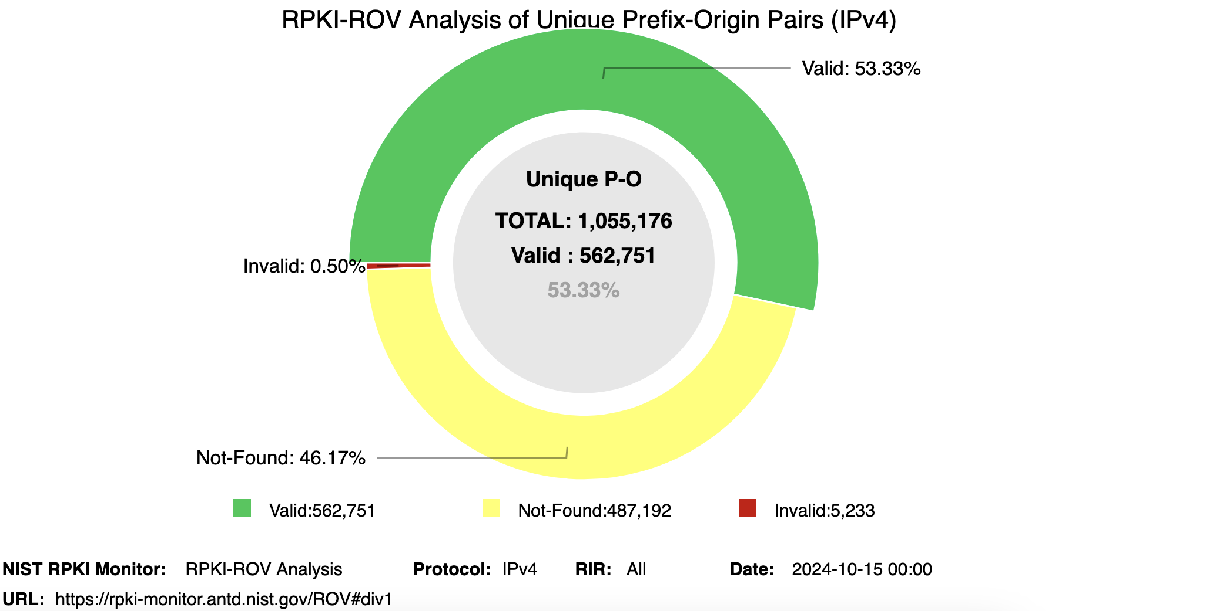
RPKI deployment (2024)

Slide 16
This week
Start of transport layer
Intro to TCP

Slide 17
One more fun BGP thing…

Slide 18
Anycast
Advertise the same prefix (IP) from multiple places
  => Multiple devices have the same IP!!
Used to make certain IPs highly available
  Public DNS: 8.8.8.8 (Google), 1.1.1.1 (Cloudflare)

Slide 19
Anycast
Advertise the same prefix (IP) from multiple places
  => Multiple devices have the same IP!!
Used to make certain IPs highly available
  Public DNS: 8.8.8.8 (Google), 1.1.1.1 (Cloudflare)
Problems?

Slide 20
Anycast
Advertise the same prefix (IP) from multiple places
  => Multiple devices have the same IP!!
Used to make certain IPs highly available
  Public DNS: 8.8.8.8 (Google), 1.1.1.1 (Cloudflare)
=> If you send multiple packets to 8.8.8.8, no guarantee you’re talking to the same server!
=> Protocol must be able to account for this
(DNS does, more on this later)

Slide 21
Intro to TCP: Ports and Sockets

Slide 22
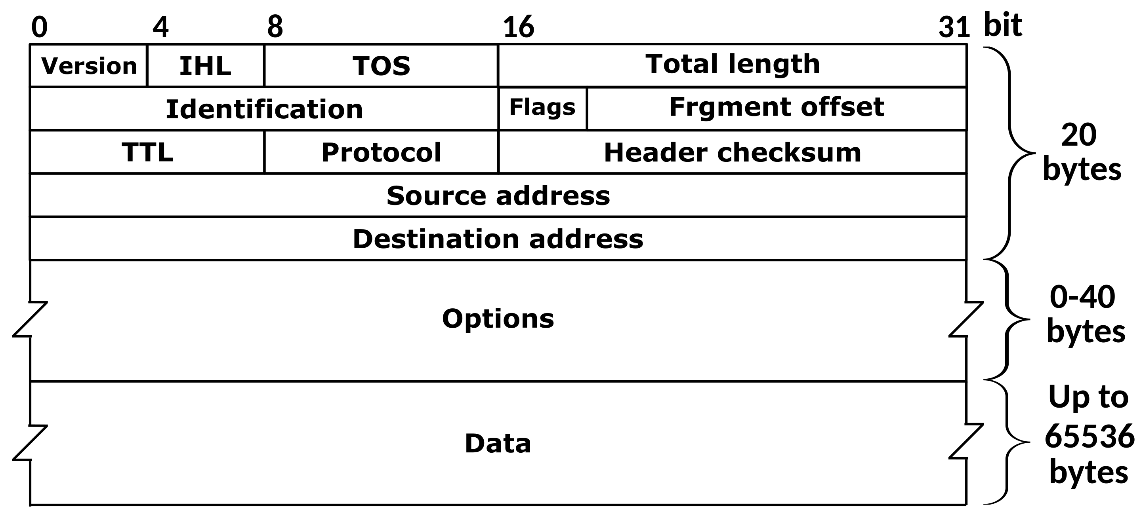
The story so far
Network layer (L3): move packets between hosts
(anywhere on Internet)

Slide 23
Layers, Services, Protocols
Service: user-facing application.
Application-defined messages
Application
Transport
How to support multiple applications?
Network
Moving data between hosts (nodes)
Link
Move data across individual links
Physical
Service: move bits to other node across link

Slide 24
The transport layer: a service provided for applications, usually part of the OS
Examples: TCP, UDP

Slide 25
The transport layer: a service provided for applications, usually part of the OS
Examples: TCP, UDP
Major challenges
Multiplexing: multiple connections at same IP
Messaging: packets ?= messages
TCP is one transport-layer protocol
=> Provides a reliable, connection-oriented, byte stream

Slide 26
TCP: a reliable, connection-oriented, byte stream
Today’s focus: connections

Slide 27
TCP: a reliable, connection-oriented, byte stream
Today’s focus: connections
More generally: how does the OS support multiple applications using the network?
=> Not just about TCP!

Slide 28
How to support multiple applications?
Multiplexing multiple connections at the same IP using port numbers
=> Provided by OS as sockets
=> In general, used by all transport-layer protocols

Slide 29
What’s a port number?
16-bit unsigned integer, 0-65535
Ports define a communication endpoint, usually a process/service on the host

Slide 30
What’s a port number?
16-bit unsigned integer, 0-65535
Ports define a communication endpoint, usually a process/service on the host
OS keeps track of which ports map to which applications
Port numbering
port < 1024: “Well known port numbers”
port > 20000: “ephemeral ports”, for general app use

Slide 31
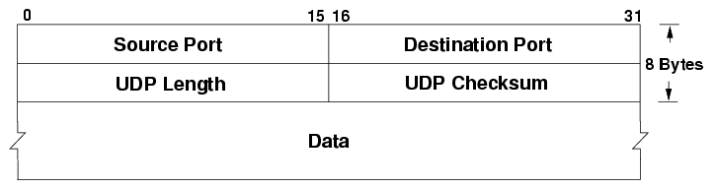
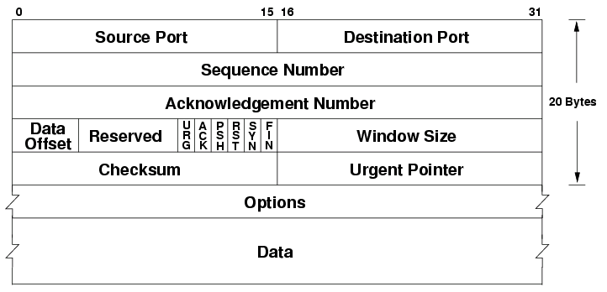
Ports are part of the transport layer
UDP
TCP
Port numbers are the first two fields of these headers! (Not part of IP!)

Slide 32
Some common ports
Port | Service
20, 21 | File Transfer Protocol (FTP)
22 | Secure Shell (SSH)
23 | Telnet (pre-SSH remote login)
25 | SMTP (Email)
53 | Domain Name System (DNS)
67, 68 | DHCP
80 | HTTP (Web traffic)
443 | HTTPS (Secure HTTP over TLS)

Slide 33
Ports and connections in TCP
Think back to Snowcast:
func main() {
listenConn, err := net.Listen(“tcp”, “127.0.0.1:5000”)
for {
clientConn, err := listenConn.Accept()
go handleClient(clientConn)
}
}

Slide 34
Ports and connections in TCP
To implement TCP, we need:
Wait for new connections
Individual connections between server and client
  => Separate data streams for multiple clients at a time!

Slide 35
How ports/sockets work
Two modes for using ports/sockets
Listen ( or “passive”) mode
Normal (or “active”) mode
*: Nick made this term up so it has a name

Slide 36
How ports/sockets work
Two modes for using ports/sockets
Listen ( or “passive”) mode: apps “bind” to a port to accept new connections
Normal (or “active”) mode: a specific connection to another socket (probably on a different system)
*: Nick made this term up so it has a name

Slide 37
How ports work
The kernel maps ports to sockets, which are used in applications like file descriptors to access the network
Two modes for using ports/sockets:
Listen mode: apps “bind” to a port to accept new connections
=> Used to receive/wait for new connections
“Normal” mode*: make a connection to another socket
=> Used to make outgoing connections
*: Nick made this term up so it has a name

Slide 38
A
1.2.3.4
B
5.6.7.8
listen(80)

Slide 39
A
1.2.3.4
B
5.6.7.8
listen(80)
connect(1.2.3.4, 80)
Src Dst
IP 1.2.3.4 5.6.7.8
Port 12345 80

Slide 40
A
1.2.3.4
B
5.6.7.8
listen(80)
connect(1.2.3.4, 80)
Src Dst
IP 1.2.3.4 5.6.7.8
Port 12345 80
A must know B is listening on port 80
=> "well known numbers"!
When connecting, A's OS picks random source port (eg. 12345), for its side of connection

Slide 41
A
1.2.3.4
B
5.6.7.8
listen(80)
connect(1.2.3.4, 80)
Src Dst
IP 1.2.3.4 5.6.7.8
Port 12345 80
Src Dst
IP 5.6.7.8 1.2.3.4
Port 80 12345
B responds to A using this port

Slide 42
Demo: netstat

Slide 43
How sockets work
Socket: OS abstraction for a network connection
(like a file descriptor)
Kernel receives all packets => needs to map each packet to a socket to deliver to app

Slide 44
How sockets work
Socket: OS abstraction for a network connection
(like a file descriptor)
Kernel receives all packets => needs to map each packet to a socket to deliver to app
Socket table: list of all open sockets
Each socket has some kernel state too (buffers, etc.)
You will build this!!!

Slide 45
How to map packets to sockets?
Kernel table looks something like this:
Proto | Local (yours) | Local | Remote (theirs) |  | Socket
 | IP | Port | IP | Port
 |  |  |  |  | (some struct)
 |  |  |  |  | …

Slide 46
How to map packets to sockets?
Kernel table looks something like this:
Proto | Local (yours) | Local | Remote (theirs) |  | Socket
 | IP | Port | IP | Port
tcp/udp | 10.0.0.1 | 12345 | 1.2.3.4 | 80 | (some struct)
 | 10.0.0.1 | 55444 | 5.6.7.8 | 443 | (some struct)
... | ... | ... | … | … | …
Key: 5-tuple of (local IP, local port, remote IP, remote port, protocol)
Value: kernel state for socket
(state, buffers, …)

Slide 47
What if A does: listen(22)
Proto | Local (yours) | Local | Remote (theirs) |  | Socket
 | IP | Port | IP | Port
tcp | 1.2.3.4 | 12345 | 5.6.7.8 | 80 | (normal struct)
tcp | * | 22 | * | * | (listen struct)
... | ... | ... | … | … | …
Key: 5-tuple of (local IP, local port, remote IP, remote port, protocol)
Value: kernel state for socket
(state, buffers, …)
=> For listen sockets, some fields may be blank

Slide 48
Netstat
deemer@vesta ~/Development % netstat -an
Active Internet connections (including servers)
Proto Recv-Q Send-Q Local Address Foreign Address (state)
tcp4 0 0 10.3.146.161.51094 104.16.248.249.443 ESTABLISHED
tcp4 0 0 10.3.146.161.51076 172.66.43.67.443 ESTABLISHED
tcp6 0 0 2620:6e:6000:900.51074 2606:4700:3108::.443 ESTABLISHED
tcp4 0 0 10.3.146.161.51065 35.82.230.35.443 ESTABLISHED
tcp4 0 0 10.3.146.161.51055 162.159.136.234.443 ESTABLISHED
tcp4 0 0 10.3.146.161.51038 17.57.147.5.5223 ESTABLISHED
tcp6 0 0 *.51036 *.* LISTEN
tcp4 0 0 *.51036 *.* LISTEN
tcp4 0 0 127.0.0.1.14500 *.* LISTEN
Notes:
If you get a packet from X:Y---it goes to this socket

Slide 49
An interface to applications
Ports define an interface to applications
If you can connect to the port, you can (usually) use it!
Problems?

Slide 50
Port scanning
What can we learn if we just start connecting to well-known ports?
Applications have common port numbers
Network protocols use well-defined patterns
deemer@vesta ~/Development % nc <IP addr> 22
SSH-2.0-OpenSSH_9.1

Slide 51
Port scanning
What can we learn if we just start connecting to well-known ports?
Applications have common port numbers
Network protocols use well-defined patterns
deemer@vesta ~/Development % nc <IP addr> 22
SSH-2.0-OpenSSH_9.1
Can discover things about the network
Can learn about open (vulnerable) systems

Slide 52
Port scanning
What can we learn if we just start connecting to well-known ports?
Applications have common port numbers
Network protocols use well-defined patterns
deemer@vesta ~/Development % nc <IP addr> 22
SSH-2.0-OpenSSH_9.1
Can discover things about the network
Can learn about open (vulnerable) systems
Port scanners: try to connect to lots of ports, determine available services, find vulnerable services...

Slide 53
Large-scale port scanning
Can reveal lots of open/insecure systems!
Examples:
  shodan.io
  VNC roulette
  Open webcam viewers…
  …

Slide 54
Disclaimer
Network scanning is easy to detect
Unless you are the owner of the network, it’s seen as malicious activity
If you scan the whole Internet, the whole Internet will get mad at you (unless done very politely)
Do NOT try this on the Brown network. I warned you.

Slide 55
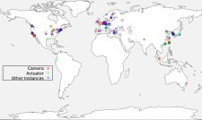
Internet scanning I have done
Scanned IPv4 space for ROS (Robot Operating System)
Found ~200 “things” using ROS (some robots, some other stuff)

Slide 56
The transport layer MAY provide…
Reliable data delivery
Creating a data stream
Managing throughput/sharing bandwidth
  “Congestion control”
These are provided by TCP, which is our main focus. However:
Not required for all transport layer (UDP has none of these)
Other protocols do this too (eg. QUIC)

Slide 57
From Lec 2: OSI Model
Application Protocol
Transport Protocol
Network Protocol
Link-Layer Protocol
Notes:
Open Systems Interconnect, ISO
We no longer care about paths

