Slide 1
CSCI-1680
Transport Layer I
Nick DeMarinis
Based partly on lecture notes by Rodrigo Fonseca, David Mazières, Phil Levis, John Jannotti

Slide 2
Administrivia
IP: due tonight!
  Look for email today/tomorrow about grading meetings
  + required post-project survey

Slide 3
Administrivia
IP: due tonight!
  Look for email today/tomorrow about grading meetings
  + required post-project survey
“Between the time you’ve handed in and the demo meeting, you can continue to making small changes and bug fixes and
push them to your git repo/Gradescope”
  OK: Fixing bugs, code cleanup, README
  Not OK: Implementing RIP, adding new features

Slide 4
Administrivia
HW2 is out (finally!): Due Monday, Oct 28
HW3 will be super short
TCP: Handout out tomorrow, stencil/repo setup over weekend
  Gearup on Thursday, Oct 24 6-8pm in CIT 368

Slide 5
Warmup
You capture the following packets on your router. How many unique connections are present?
Pkt# | Source | Local | Destination
 | IP | Port | IP | Port
P1 | 10.0.0.1 | 12345 | 1.2.3.4 | 80
P2 | 10.0.0.2 | 55444 | 5.6.7.8 | 443
P3 | 1.2.3.4 | 80 | 10.0.0.1 | 12345
P4 | 10.0.0.1 | 43233 | 1.2.3.4 | 80

Slide 6
Today
Light overview of the transport layer and TCP
  Why we need TCP
  What components are involved
  What you will do in the project

Slide 7
Transport layer: the story so far
  Provides support for different applications via ports
  OS provides interface to applications via sockets
For now: transport layer is part of OS, service provided to apps

Slide 8
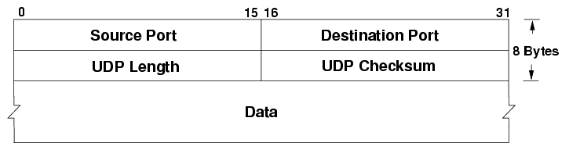
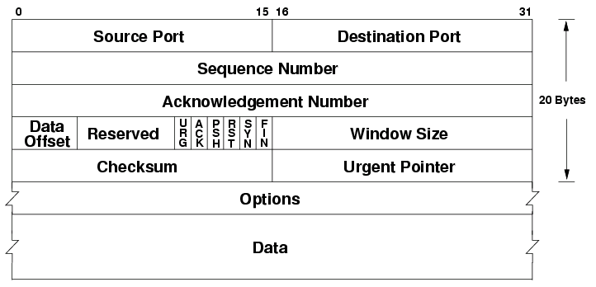
The headers
UDP
TCP
Port numbers are part of these headers
=> OS uses these to map to sockets

Slide 9
Motivation: sending a big file
A problem, in pseudocode:
$ cp ~/dir/all-my-files.zip ~/some-other-dir
$ scp ~/dir/all-my-files.zip 1.2.3.4:/some-other-dir
What are some challenges with implementing the network part?

Slide 10
Motivation: sending a big file
A problem, in pseudocode:
func sender() {
fd, _ := os.Open("all-my-files.zip")
conn, _ := net.Dial("1.2.3.4:80")
buf := ReadTheWholeFile(fd)
conn.Write(buf)
}
func receiver() {
conn, err := net.Listen(“:80”)
buf := make([]byte, . . .)
conn.Read(buf)
fd = os.Open(”copy-of-files.zip”)
fd.Write(buf)
}
What are some challenges with implementing the network part?

Slide 11
Motivation: sending a big file
A problem, in pseudocode:
func sender() {
fd, _ := os.Open("all-my-files.zip")
conn, _ := net.Dial("1.2.3.4:80")
buf := ReadTheWholeFile(fd)
conn.Write(buf)
}
func receiver() {
conn, err := net.Listen(“:80”)
buf := make([]byte, . . .)
conn.Read(buf)
fd = os.Open(”copy-of-files.zip”)
fd.Write(buf)
}
How do we get data from A->B, reliably?

Slide 12
What features do we need?

Slide 13
UDP: User Datagram Protocol
Send a message between ports… and nothing else

Slide 14
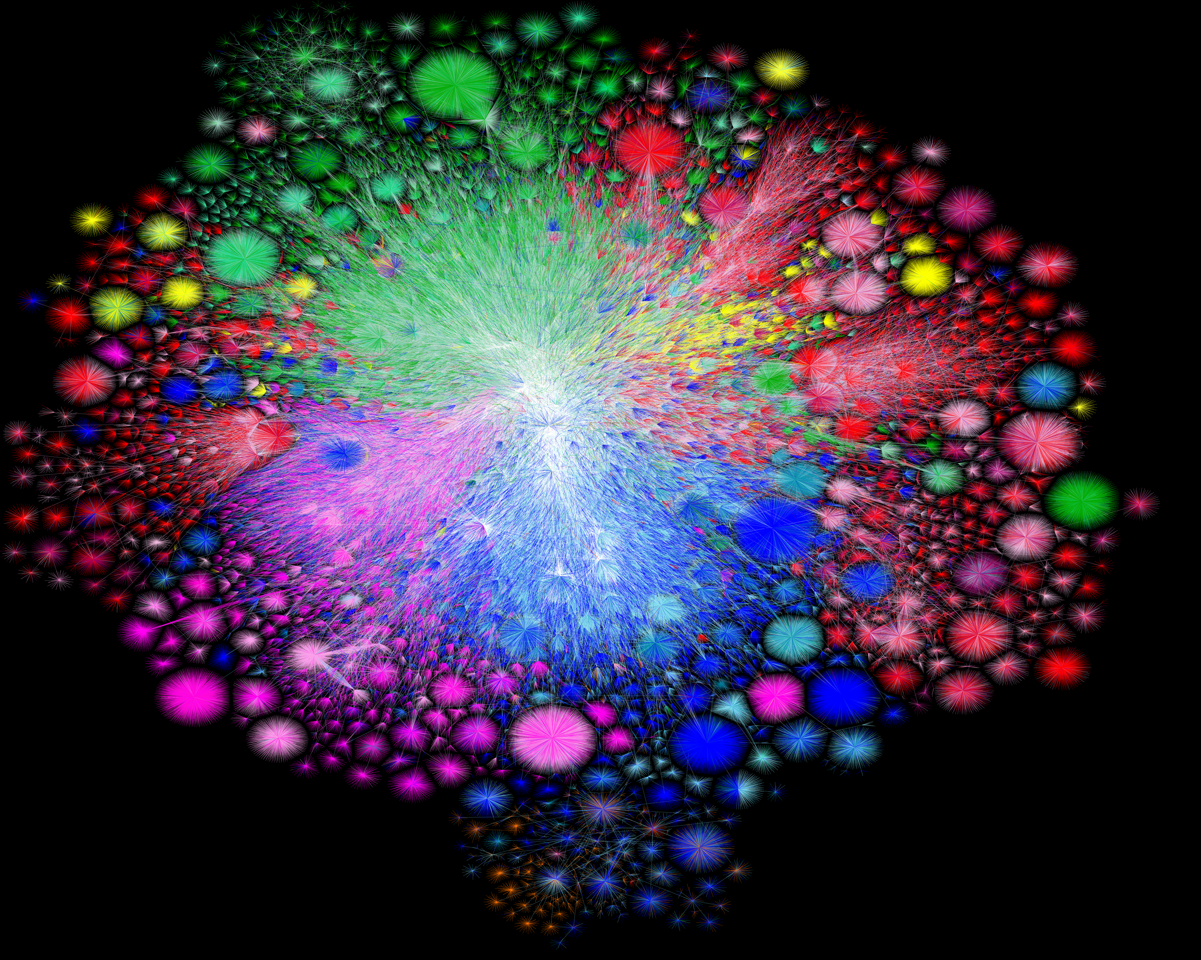
UDP: What could possibly go wrong?
Map of the Internet, 2021 (via BGP)
OPTE project

Slide 15
Problem: Reliability
Packets could…
Dropped packets
Duplicate packets
Packets arrive out of order
Multiple hops and paths => Lots of opportunities for failure!
=> TCP has mechanisms to deal with this

Slide 16
Also: performance challenges
Hosts have different (and unknown!) resources
Network has unknown resources
  => Varying RTT, link bandwidth

Slide 17
Also: performance challenges
Hosts have different (and unknown!) resources
=> Flow control: how much data can we send to receiver?
Network has unknown resources
  => Varying RTT, link bandwidth
  => Congestion control: must not overload network

Slide 18
Also: performance challenges
Hosts have different (and unknown!) resources
=> Flow control: how much data can we send to receiver?
Network has unknown resources
  => Varying RTT, link bandwidth
  => Congestion control: must not overload network
Two performance goals:
1. Must not overwhelm receiver, or network (critical!!)
2. Maximize throughput => best performance

Slide 19
Transport Layer Reliability
Extra difficulties
  Multiple hops
  Multiple potential paths
What does this mean?
  Multiple opportunities for failure
  Hosts have different resources
  Varying RTTs
Notes:
Both across connections and during a connection
Why do they vary? What do they influence?
RTT influences the potential window size (delay X bandwidth), the values for timeouts.

Slide 20
Extra Difficulties (cont.)
Out of order packets
  Not only because of drops/retransmissions
  Can get very old packets (up to 120s), must not get confused
Unknown resources at other end
  Must be able to discover receiver buffer: flow control
Unknown resources in the network
  Should not overload the network
  But should use as much as safely possible to maximize throughput
Notes:
We call this congestion control

Slide 21
So how does it work?

Slide 22
TCP: the big picture

Slide 23
TCP – Transmission Control Protocol
Service model: “reliable, connection oriented, full duplex ordered byte stream”
Flow control: If one end stops reading, writes at other eventually stop/fail
Congestion control: Keeps sender from overloading the network

Slide 24
TCP: Key features
RFC 793 (1981) (+ many others now)
Creates concept of connections between two endpoints
=> Each connection has its own state
Notes:
Don’t always need reliability!

Slide 25
TCP: Key features
Initially: RFC 793 (1981) (+ many others now)
Creates concept of connections between two endpoints
=> Each connection has its own state
End-to-end protocol
Notes:
Don’t always need reliability!

Slide 26
From Lec 2: OSI Model
Application Protocol
Transport Protocol
Network Protocol
Link-Layer Protocol
Notes:
Open Systems Interconnect, ISO
We no longer care about paths

Slide 27
From Lec 2: OSI Model
Application Protocol
Transport Protocol
Network Protocol
Link-Layer Protocol
New abstraction: builds on network layer
=> Just care about endpoint, not individual routers on path
=> All mechanisms run on endpoints (not routers) => Why?
Notes:
Open Systems Interconnect, ISO
We no longer care about paths

Slide 28
Why not provide X on the network layer?
X = Reliability, security, message ordering…
Might be too costly
  Extra features aren’t free: don’t burden protocols that don’t need them!
  Cost could be extra latency, extra computation, …
Features might be conflicting
  Timeliness vs. in-order delivery
Might not be enough
  Example: reliability
Notes:
Insufficient: need an end-to-end picture to get reliable delivery

Slide 29
End-to-end argument
Functions placed at lower levels of a system may be redundant or of little value
  They may need to be performed at a higher layer anyway
But they may be justified for performance reasons
  Or just because they provide most of what is needed
  Example: retransmissions
=> Takeaway: Important to weigh the costs and benefits at each layer!
Notes:
Example: Bit-torrent file transfer
Example performance enhancement
o-----o-----o----o 0.1 chance of drop
End-to-end ack: (0.9^4)^2 = 0.43 (~2.3X)
2 Retransmissions per hop:
Failure: fails three retransmissions = ((1-(0.1)^3)^4)^8 = 0.99

Slide 30
TCP Header

Slide 31
Important Header Fields
Ports: multiplexing
Sequence number
  Where segment is in the stream (in bytes)
Acknowledgment Number
  Next expected sequence number
Window
  How much data you’re willing to receive
Flags…

Slide 32
Important Header Fields: Flags
SYN:
ACK:
FIN:
RST: reset connection (used for errors)
PSH: push data to the application immediately
URG: whether there is urgent data

Slide 33
Important Header Fields: Flags
SYN: establishes connection (“synchronize”)
ACK: this segment ACKs some data (all packets except first)
FIN: close connection (gracefully)
RST: reset connection (used for errors)
PSH: push data to the application immediately
URG: whether there is urgent data

Slide 34
Less important header fields
Checksum: Very weak, like IP
  Has weird semantics (”pseudo header”), more on this later…
Data Offset: used to indicate TCP options (mostly unused)
Urgent Pointer

Slide 35

TCP Standards: The Many RFCs

Slide 36
TCP Standards: The Many RFCs
RFC793 (Original)

Slide 37
TCP Standards: The Many RFCs
RFC793 (Original)
RFC1122 (Some corrections)

Slide 38
TCP Standards: The Many RFCs
RFC793 (Original)
RFC1122 (Some corrections)
RFC5681 (Congestion control)

Slide 39
TCP Standards: The Many RFCs
RFC793 (Original)
RFC1122 (Some corrections)
RFC5681 (Congestion control)
RFC7414 (Roadmap to TCP RFCs)

Slide 40
TCP Standards: The Many RFCs
RFC793 (Original)
RFC1122 (Some corrections)
RFC5681 (Congestion control)
RFC7414 (Roadmap to TCP RFCs)
Various Errata . . .

Slide 41
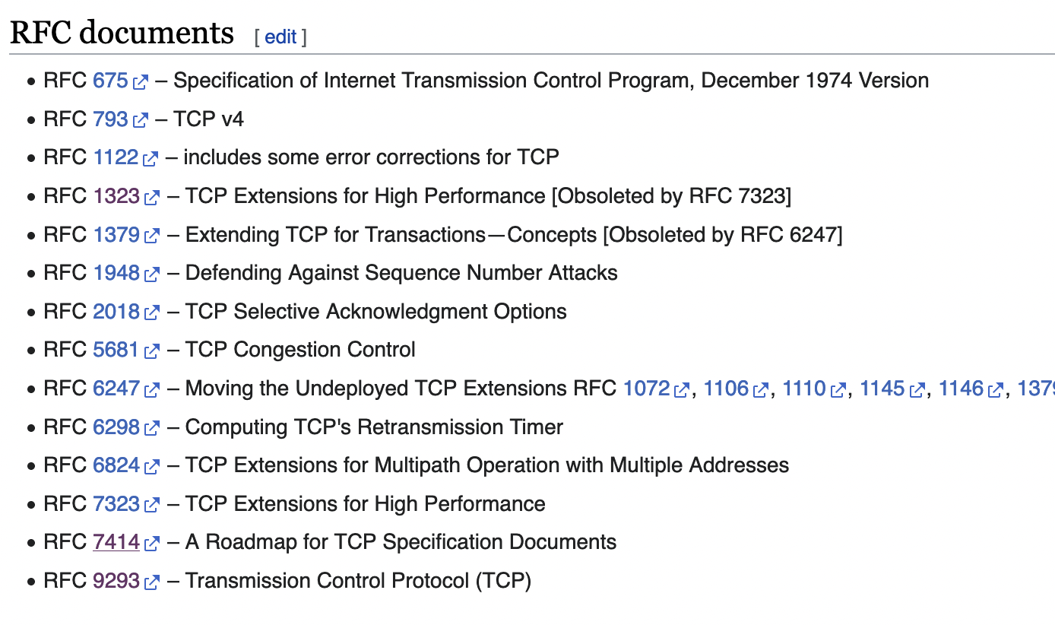
TCP Standards: The Many RFCs

Slide 42

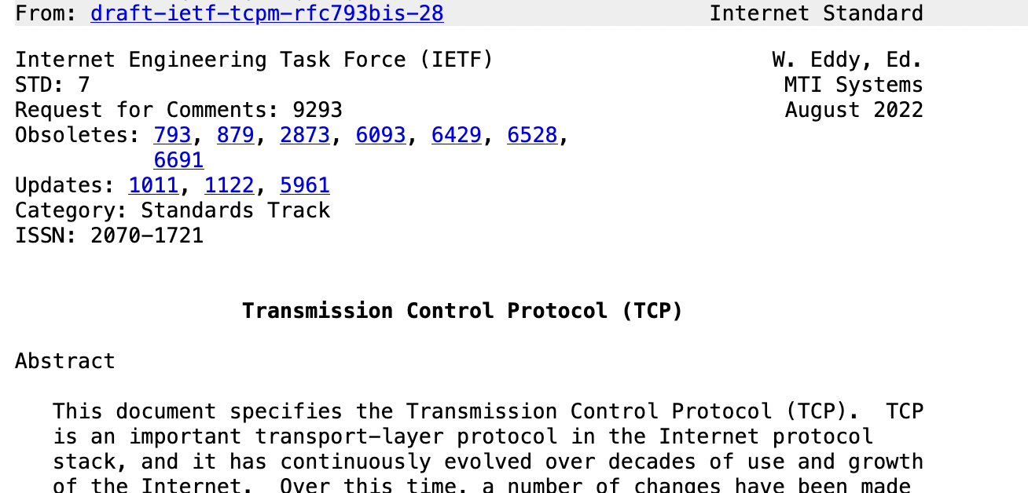
RFC9293
The One RFC

Slide 43
Establishing a Connection
Goals
Contact the other side (or error)
Both sides agree on initial sequence numbers

Slide 44
Establishing a Connection
connect()
listen(),
accept()
accept()
returns
Three-way handshake
  Two sides agree on respective initial sequence nums
If no one is listening on port: OS may send RST
If server is overloaded: ignore SYN
If no SYN-ACK: retry, timeout

Slide 45
Summary of TCP States
Connection Establishment
Passive close:
Can still send!
Active close:
Can still receive

Slide 46
TCP State Diagram

Slide 47
Sequence numbers
How to pick the initial sequence number?
Protocols based on relative sequence numbers based on starting value
Why not start at 0?
RFC9293, Sec 3.4.1: Procedure for picking ISN, based on timer and cryptographic hash
  => For project, just pick a random integer :)

Slide 48
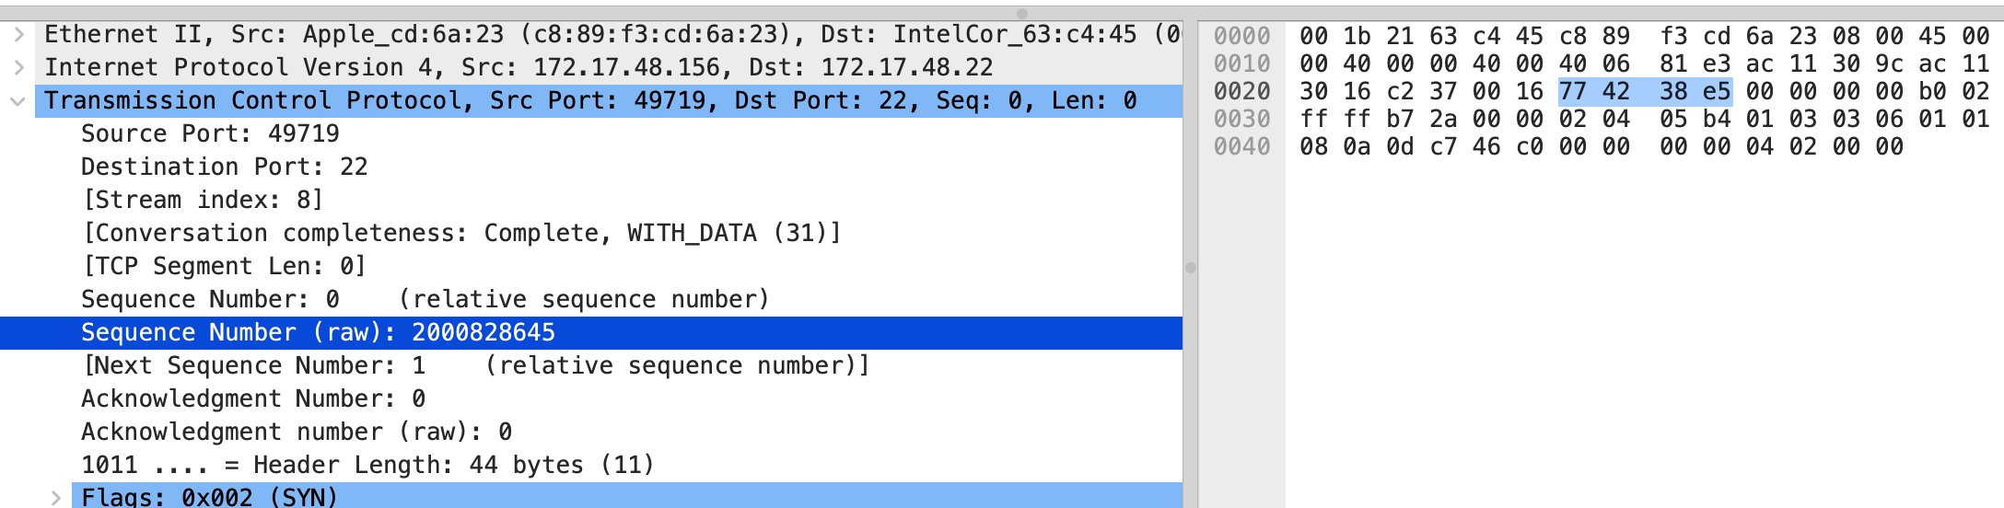
Relative Sequence Numbering

Slide 49
How do we tell two connections apart?
=> Port numbers
  5-tuple (proto., source IP, source port, dest IP, dest port) => 1 Connection
  Kernel maintains socket table: maps (5-tuple) => Socket
If a 5-tuple is reused => new ISN, so sequence numbers likely out of range from past connection

Slide 50
Netstat
deemer@vesta ~/Development % netstat -an
Active Internet connections (including servers)
Proto Recv-Q Send-Q Local Address Foreign Address (state)
tcp4 0 0 10.3.146.161.51094 104.16.248.249.443 ESTABLISHED
tcp4 0 0 10.3.146.161.51076 172.66.43.67.443 ESTABLISHED
tcp6 0 0 2620:6e:6000:900.51074 2606:4700:3108::.443 ESTABLISHED
tcp4 0 0 10.3.146.161.51065 35.82.230.35.443 ESTABLISHED
tcp4 0 0 10.3.146.161.51055 162.159.136.234.443 ESTABLISHED
tcp4 0 0 10.3.146.161.51038 17.57.147.5.5223 ESTABLISHED
tcp6 0 0 *.51036 *.* LISTEN
tcp4 0 0 *.51036 *.* LISTEN
tcp4 0 0 127.0.0.1.14500 *.* LISTEN
Notes:
If you get a packet from X:Y---it goes to this socket

Slide 51
Keeping state: the TCB
State for a TCP connection kept in Transmission Control Buffer (TCB)
Keeps initial sequence numbers, connection state, send/recv buffers, status of unACK’d segments, …
When to allocate?
  Server: listening on a connection*
  Client: Initiating a connection (sending a SYN)
  Server: accepting a new connection (receiving SYN)
Notes:
Listening sockets won’t use all of the TCB state

Slide 52
Recall: the socket table
deemer@vesta ~ % netstat -anl
Active Internet connections (including servers)
Proto Recv-Q Send-Q Local Address Foreign Address (state)
tcp4 0 0 172.17.48.121.56915 192.168.1.58.7000 SYN_SENT
tcp4 0 0 172.17.48.121.56908 142.250.80.35.443 ESTABLISHED
tcp4 0 0 172.17.48.121.56887 13.225.231.50.80 ESTABLISHED
. . .
tcp4 0 0 *.22 *.* LISTEN
Each connection has an associated TCB in the kernel
For each packet, kernel maps the 5-tuple
(tcp/udp, local IP, local port, remote IP, remote port) => socket
Depending on socket type, socket contains TCB
Notes:
You will implement this

Slide 53
deemer@vesta ~ % netstat -anl
Active Internet connections (including servers)
Proto Recv-Q Send-Q Local Address Foreign Address (state)
tcp4 0 0 172.17.48.121.56915 192.168.1.58.7000 SYN_SENT
tcp4 0 0 172.17.48.121.56908 142.250.80.35.443 ESTABLISHED
tcp4 0 0 172.17.48.121.56887 13.225.231.50.80 ESTABLISHED
. . .
tcp4 0 0 *.22 *.* LISTEN
Two “types” of sockets:
“Normal” sockets
Listen sockets

Slide 54
Proto Recv-Q Send-Q Local Address Foreign Address (state)
tcp4 0 0 172.17.48.121.56887 13.225.231.50.80 ESTABLISHED
. . .
tcp4 0 0 *.22 *.* LISTEN
“Normal” sockets
  Connection between two specific endpoints
  Can send/recv data
Listen sockets
  Created by receiver to accept new connections
  When a client connects, client info gets queued by kernel
  When server process calls accept(), a new (”normal”) socket is created between the server and that client

Slide 55
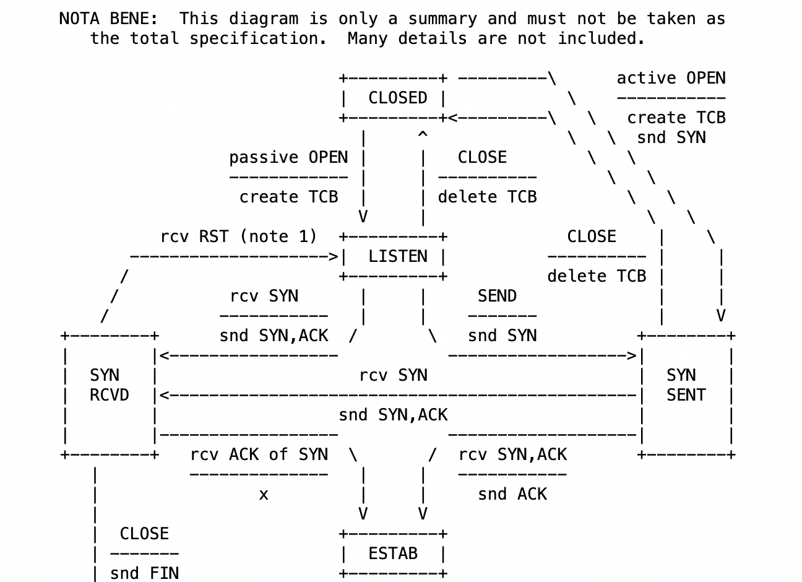
RFC 9293, Sec 3.3.2

Slide 56
SYN flooding
What happens if you send a someone huge number of SYN packets?

Slide 57
A hacky solution: SYN cookies
Don’t allocate TCB on first SYN
Encode some state inside the initial sequence number that goes back to the client (in the SYN+ACK)
What gets encoded?
  Coarse timestamp
  Hash of connection IP/port
  Other stuff (implementation dependent)
Better ideas?

Slide 58
Next class
Sending data over TCP

Slide 59
Connection Termination
FIN bit says no more data to send
  Caused by close or shutdown
  Both sides must send FIN to close a connection
Typical close
Close
FIN_WAIT_1
FIN
ACK
CLOSE_WAIT
FIN_WAIT_2
…
Close
FIN
LAST_ACK
TIME_WAIT
2MSL
ACK
CLOSED
CLOSED

Slide 60
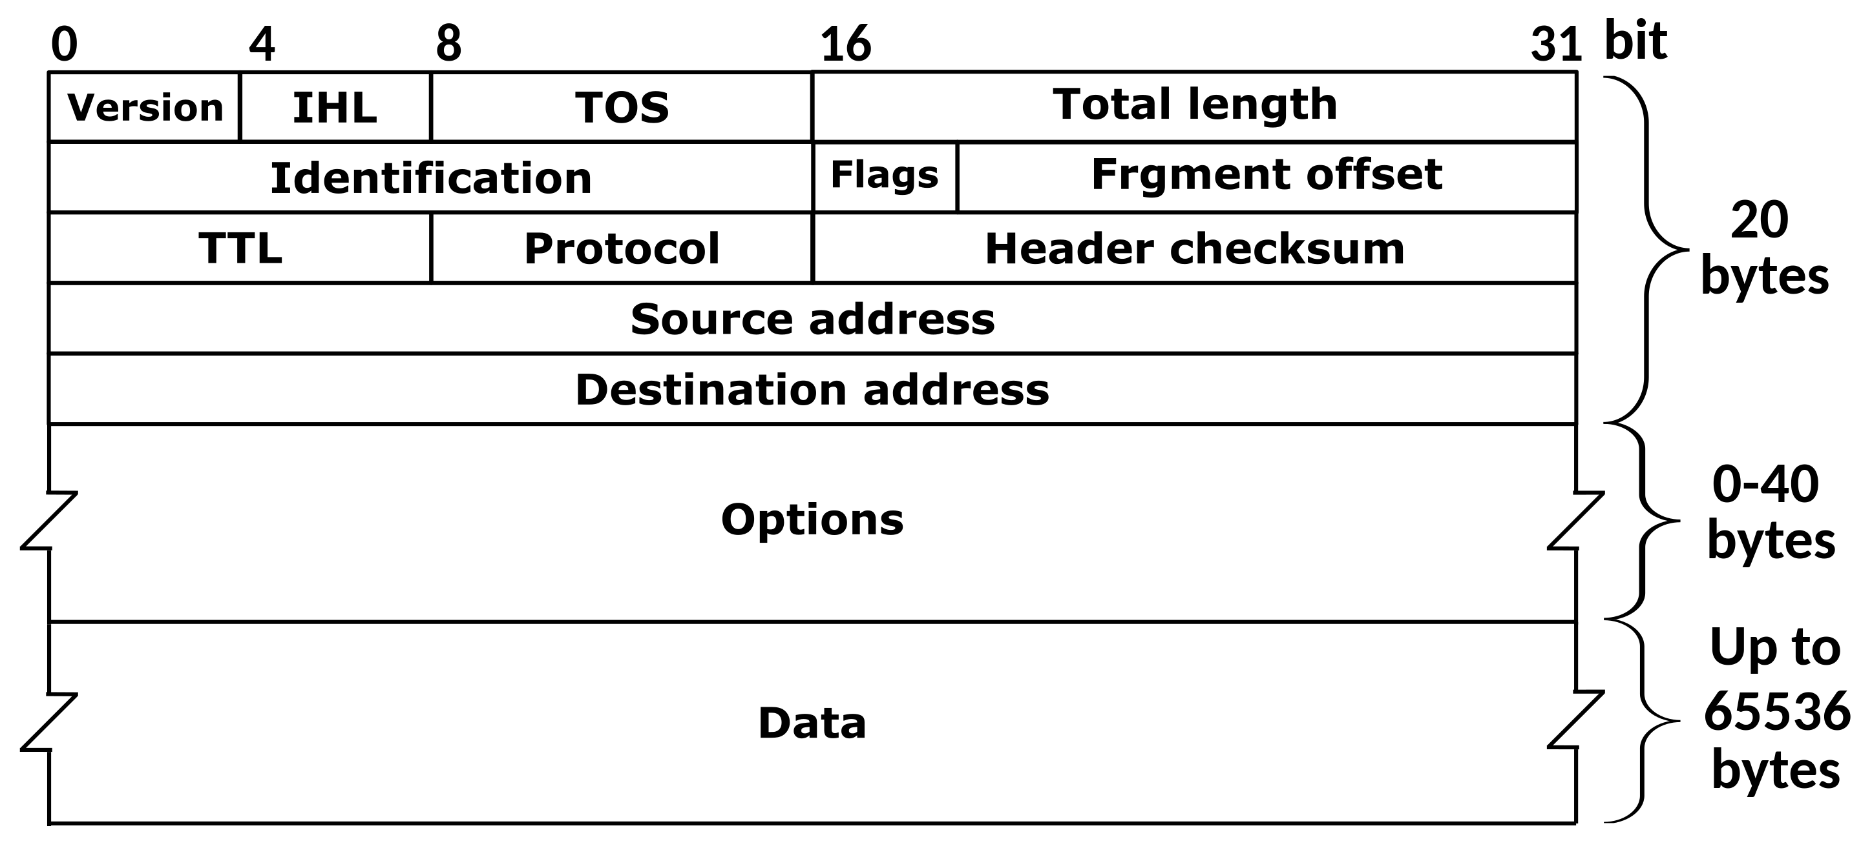
The IPv4 Header
Defined by RFC 791
RFC (Request for Comment): defines network standard
Notes:
The key parts are HERE

