Slide 1
CSCI-1680
Transport Layer II
Data over TCP: Flow Control
Nick DeMarinis
Based partly on lecture notes by Rodrigo Fonseca, David Mazières, Phil Levis, John Jannotti

Slide 2
Administrivia
IP project grading: happening now! Sign up for a meeting if you haven’t already
TCP assignment: out now—start early!
  Gearup I: Thursday 10/4 6-8pm
  Milestone 1: schedule meeting on/before Friday, November 1

Slide 3
Administrivia
IP project grading: happening now! Sign up for a meeting if you haven’t already
TCP assignment: out now—start early!
  Gearup I: Thursday 10/4 6-8pm
  Milestone 1: schedule meeting on/before Friday, November 1
HW2: Out now, due next Monday
  Last problem is good prep for Milestone 1

Slide 4
TCP: The story so far
Last lecture
Sockets
TCP: connection setup
Today
Basic flow control: How to send data

Slide 5
Warmup: TCP Handshake
Client
“Active” side
Server
“Passive” side
Flags: SYN, SEQ: ___, ACK: ___
1. What are the SEQ and ACK numbers?
(eg. From some starting values X, Y)
2. When is the first data transmitted?
(eg. Send(“hello”))
Flags: SYN+ACK, SEQ: ___, ACK: ___
Flags: ACK, SEQ: ___, ACK: ___

Slide 6
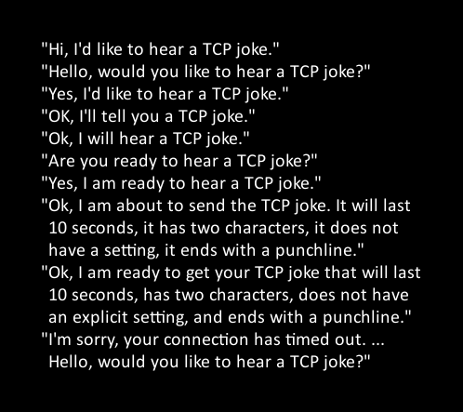

Slide 7
Client
“Active” side
Server
“Passive” side
Flags: SYN, SEQ: ___, ACK: ___
Flags: SYN+ACK, SEQ: ___, ACK: ___
Flags: ACK, SEQ: ___, ACK: ___

Slide 8
How to pick the initial sequence number?
Protocols based on relative seq. numbers based on starting value
Why not start at 0?

Slide 9
How to pick the initial sequence number?
Protocols based on relative seq. numbers based on starting value
Why not start at 0?
=> Someone might guess the value!

Slide 10
How to pick the initial sequence number?
Protocols based on relative seq. numbers based on starting value
Why not start at 0?
=> Someone might guess the value!
=> RFC9293, Sec 3.4.1: Procedure for picking ISN, based on timer and cryptographic hash
  => For project, just pick a random integer :)

Slide 11
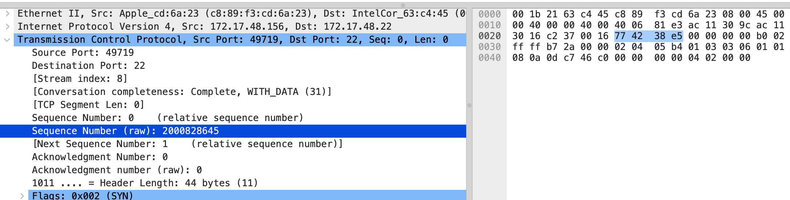
Relative Sequence Numbering

Slide 12
TCP – Transmission Control Protocol
TCP: a “reliable, connection-oriented,
full duplex ordered byte stream”

Slide 13
TCP state machine

Slide 14
TCP state machine
Every connection has a state
=> Each state has different behavior
=> Certain packet events cause transitions between state

Slide 15
TCP state machine
Every connection has a state
=> Each state has different behavior
=> Certain packet events cause transitions between states
State machines: a common way to model systems!

Slide 16
The TCP State Diagram

Slide 17
We are now here

Slide 18
For each connection, what data do we need to keep track of so far?
(i.e. what per-connection “state” is required?
in the general sense, not just state machine’s state)

Slide 19
Per-connection state kept in Transmission Control Buffer (TCB)
Notes:
Listening sockets won’t use all of the TCB state

Slide 20
Per-connection state kept in Transmission Control Buffer (TCB)
e.g., Initial sequence numbers, connection state, send/recv buffers, status of unACK’d segments, …
Each endpoint (client, server) will have state for each connection
Think: parts of socket struct
When to allocate?
Notes:
Listening sockets won’t use all of the TCB state

Slide 21
Client
“Active” side
Server
“Passive” side
Flags: SYN, SEQ: ___, ACK: ___
Flags: SYN+ACK, SEQ: ___, ACK: ___
Flags: ACK, SEQ: ___, ACK: ___

Slide 22
Client
“Active” side
Server
“Passive” side
Flags: SYN, SEQ: ___, ACK: ___
Flags: SYN+ACK, SEQ: ___, ACK: ___
Flags: ACK, SEQ: ___, ACK: ___
listenConn, err := net.Listen(“tcp”, “:5000”)
for {
clientConn, err := listenConn.Accept()
//go handleClient(clientConn)
}
clientConn := net.Dial(“1.2.3.4:5000”)
. . .

Slide 23
State for a TCP connection kept in Transmission Control Buffer (TCB)
Keeps initial sequence numbers, connection state, send/recv buffers, status of unACK’d segments, …
When to allocate?
When to deallocate?
Notes:
Listening sockets won’t use all of the TCB state

Slide 24
Per-connection state kept in Transmission Control Buffer (TCB)
e.g., Initial sequence numbers, connection state, send/recv buffers, status of unACK’d segments, …
Each endpoint (client, server) will have state for each connection
Think: parts of socket struct
When to allocate?
  Server: listening on a connection*
  Client: Initiating a connection (sending a SYN)
  Server: accepting a new connection (receiving SYN)
Notes:
Listening sockets won’t use all of the TCB state

Slide 25
State for a TCP connection kept in Transmission Control Buffer (TCB)
Keeps initial sequence numbers, connection state, send/recv buffers, status of unACK’d segments, …
When to allocate?
  Server: listening on a connection*
  Client: Initiating a connection (sending a SYN)
  Server: accepting a new connection (receiving SYN)
When to deallocate?
Only after connection termination is fully completed (CLOSED state) => If no state, can’t meaningfully respond to packet!
Notes:
Listening sockets won’t use all of the TCB state

Slide 26
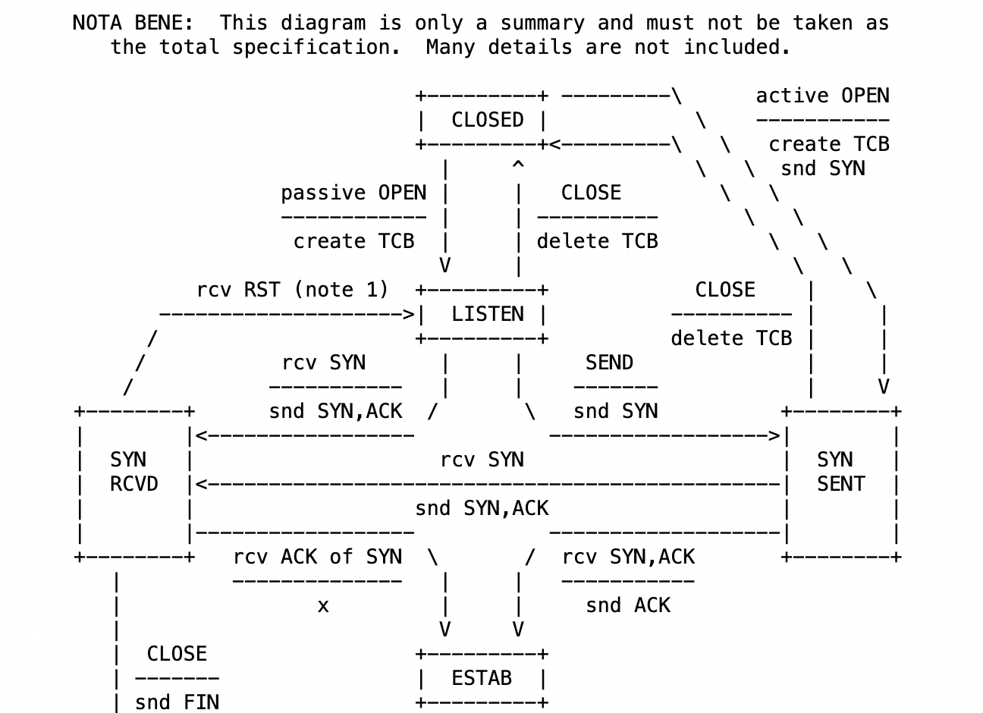
RFC 9293, Sec 3.3.2

Slide 27
Recall: the socket table
Proto | Local (yours) | Local | Remote (theirs) |  | Socket
 | IP | Port | IP | Port
tcp | 1.2.3.4 | 22 | 5.6.7.8 | 12453
tcp | 1.2.3.4 | 22 | 100.3.15.7 | 66452
tcp | * | 22 | * | *

Slide 28
Recall: the socket table
Proto | Local (yours) | Local | Remote (theirs) |  | Socket
 | IP | Port | IP | Port
tcp | 1.2.3.4 | 22 | 5.6.7.8 | 12453
tcp | 1.2.3.4 | 22 | 100.3.15.7 | 66452
tcp | * | 22 | * | *
OS maps IP/port info => info about each socket
In general:
Tuple (local IP, local port, remote IP, remote port) => socket struct, including TCB

Slide 29
Recall: the socket table
Proto | Local (yours) | Local | Remote (theirs) |  | Socket
 | IP | Port | IP | Port
tcp | 1.2.3.4 | 22 | 5.6.7.8 | 12453
tcp | 1.2.3.4 | 22 | 100.3.15.7 | 66452
tcp | * | 22 | * | *
OS maps IP/port info => info about each socket
In general:
Tuple (local IP, local port, remote IP, remote port) => socket struct, including TCB
But what about the sockets with “*”???

Slide 30
Proto | Local (yours) | Local | Remote (theirs) |  | Socket info
 | IP | Port | IP | Port
tcp | 1.2.3.4 | 22 | 5.6.7.8 | 12453 | ESTABLISHED, …
tcp | * | 22 | * | * | LISTEN, …
Two “types” of sockets:
“Normal” sockets
Listen sockets

Slide 31
Proto | Local (yours) | Local | Remote (theirs) |  | Socket info
 | IP | Port | IP | Port
tcp | 1.2.3.4 | 22 | 5.6.7.8 | 12453 | ESTABLISHED, …
tcp | * | 22 | * | * | LISTEN, …
“Normal” sockets
  Connection between two specific endpoints
  Can send/recv data
Listen sockets
  Created by receiver to accept new connections
  When a client connects, client info gets queued by kernel
  When server process calls accept(), a new (”normal”) socket is created between the server and that client

Slide 32
Sending data

Slide 33
Sending data: the basic idea
Start: app calls Send(), loads send buffer
TCP stack divides data into packets called segments

Slide 34
Sending data: the basic idea
Start: app calls Send(), loads send buffer
TCP stack divides data into packets called segments
Key challenges
When to send data?
How much data to send?

Slide 35
Sending data
Flow control: don’t send more data than the receiver can handle
TCP stack divides data into packets called segments
Questions
When to send data?
How much data to send?
  Data is sent in MSS-sized segments
    MSS = Maximum Segment Size (TCP packet that can fit in an IP packet)
    Chosen to avoid fragmentation

Slide 36
Sending data: the basic idea
Start: app calls Send(), loads send buffer
TCP stack divides data into packets called segments
Key challenges
When to send data?
How much data to send?
Flow control (now): don’t send more data than the receiver can handle
Congestion control (much later) don’t send more data than the network can handle

Slide 37
Terminology: MSS
MSS: Maximum segment size
Largest segment a TCP can send
Can be configurable
Nowadays: sender and receiver negotiate using TCP options
(out of scope for this class)
=> For project: just a fixed value

Slide 38
Simplest TCP sender: stop and wait

Slide 39
Simplest method: Stop and Wait
Consider sending one packet at a time
  S: Send packet, wait
  R: Receive packet, send ACK
  S: Receive ACK, send next packet
  OR
  No ACK within some time (RTO), timeout and retransmit

Slide 40
What can go wrong?

Slide 41
Sequence number example

Slide 42
Problems?

Slide 43
Can we do better?

Slide 44
Better Flow Control: Sliding window
Part of TCP specification (even before 1988)
Send multiple packets at once, based on a window
Receiver uses window header field to tell sender how much space it has

Slide 45
TCP and buffering
Recall: TCP stack responsibilities
Sender: breaking application data into segments
Receiver: receiving segments, reassembling them in order
Need to buffer data

Slide 46
Sliding window: in abstract terms
Window of size w
Can send at most w packets before waiting for an ACK
Goal
  Network “pipe” always filled with data
  ACKs come back at rate data is delivered => “self-clocking”

Slide 47
Sender example

Slide 48
Receiver example

Slide 49
Flow Control: Sender
Invariants
LastByteSent – LastByteAcked <= AdvertisedWindow
EffectiveWindow = AdvertisedWindow – (BytesInFlight)
LastByteWritten – LastByteAcked <= MaxSendBuffer
Useful Sliding Window Terminology:
RFC 9293, Sec 3.3.1

Slide 50
Flow control: receiver
Useful Sliding Window Terminology:
RFC 9293, Sec 3.3.1
Can accept data if space in window
Available window =
BufferSize– ((NextByteExpected-1) - LastByteRead
On receiving segment for byte S
  if s is outside window, ignore packet
  if s == NextByteExpected:
    Deliver to application (Update LastByteReceived)
    If next segment was early arrival, deliver it too
  If s > NextByteExpected, but within window
    Queue as early arrival
Send ACK for highest contiguous byte received, available window

Slide 51
Flow Control
Advertised window can fall to 0
  How?
  Sender eventually stops sending, blocks application
Resolution: zero window probing: sender sends 1-byte segments until window comes back > 0

Slide 53
Some Visualizations
Normal conditions: https://www.youtube.com/watch?v=zY3Sxvj8kZA
With packet loss: https://www.youtube.com/watch?v=lk27yiITOvU

Slide 54
How do ACKs work?
ACK contains next expected sequence number
If one segment is missed but new ones received, send duplicate ACK
Retransmit when:
  Receive timeout (RTO) expires
  Possibly other conditions, for certain TCP variants (eg. 3 dup ACKs)
How to set RTO?

Slide 55
When to time out?
RFC793, Sec 3.7
Should expect an ACK within one Round Trip Time (RTT)
Problem: RTT can be highly variable
Strategy: expected RTT based on ACKs received
  Use exponentially weighted moving average (EWMA)
  RFC793 version (“smoothed RTT”):
  SRTT = (⍺ * SRTT) + (1 - ⍺)* RTT_{Measured}
  RTO = max(RTO_{Min}, min(β * SRTT, RTO_{Max}))
  ⍺ = “Smoothing factor”: .8-.9
  β = “Delay variance factor”: 1.3—2.0
Notes:
Congestion control is all about modeling the network

Slide 56
This is only the beginning…
Problem 1: what if segment is a retransmission?
  Solution: don’t update RTT if segment was retransmitted
Problem 2: RTT can have high variance
  Initial implementation doesn’t account for this
  Congestion control: modeling network load

Slide 57
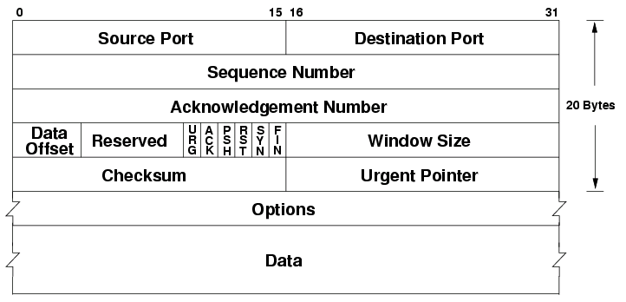
TCP Header

Slide 58
Important Header Fields
Ports: multiplexing
Sequence number
  Where segment is in the stream (in bytes)
Acknowledgment Number
  Next expected sequence number
Window
  How much data you’re willing to receive
Flags…

Slide 59
Important Header Fields: Flags
SYN: establishes connection (“synchronize”)
ACK: this segment ACKs some data (all packets except first)
FIN: close connection (gracefully)
RST: reset connection (used for errors)
PSH: push data to the application immediately
URG: whether there is urgent data

Slide 60
Less important header fields
Checksum: Very weak, like IP
  Has weird semantics (”pseudo header”), more on this later…
Data Offset: used to indicate TCP options (mostly unused)
Urgent Pointer

Slide 61
Establishing a Connection
connect()
listen(),
accept()
accept()
returns
Three-way handshake
  Two sides agree on respective initial sequence nums
If no one is listening on port: OS may send RST
If server is overloaded: ignore SYN
If no SYN-ACK: retry, timeout

Slide 62
Summary of TCP States
Connection Establishment
Passive close:
Can still send!
Active close:
Can still receive

Slide 63
Observation: new connections use memory!
A
A
SYN
Server
malloc()

Slide 64
Observation: new connections use memory!
A
A
SYN
Server
malloc()
What happens if you send a someone lots of SYN packets?

Slide 65
Observation: new connections use memory!
A
A
SYN
Server
malloc()
What happens if you send a someone lots of SYN packets?
SYN flood => type of Denial of Service (DOS) attack

Slide 66
A
A
SYN
Server
SYN
SYN
SYN
SYN
SYN
malloc()
SYN
malloc()
malloc()
malloc()
malloc()
malloc()
malloc()
malloc()
...
SYN flood => type of Denial of Service (DOS) attack
=> Especially bad when attack traffic comes from multiple sources (more on this later)

Slide 67
A hacky solution: SYN cookies
Don’t allocate TCB on first SYN
Encode some state inside the initial sequence number that goes back to the client (in the SYN+ACK)
What gets encoded?
  Coarse timestamp
  Hash of connection IP/port
  Other stuff (implementation dependent)
Better ideas?

Slide 68
A hacky solution: SYN cookies
Don’t allocate TCB on first SYN
Encode some state inside the initial sequence number that goes back to the client (in the SYN+ACK)
What gets encoded?
  Coarse timestamp
  Hash of connection IP/port
  Other stuff (implementation dependent)
Better ideas?
Nowadays: filtering in kernel (or in network) on number of new connections per time (esp. on servers)
= > More on this later!

Slide 69
deemer@vesta ~ % netstat -anl
Active Internet connections (including servers)
Proto Recv-Q Send-Q Local Address Foreign Address (state)
tcp4 0 0 172.17.48.121.56915 192.168.1.58.7000 SYN_SENT
tcp4 0 0 172.17.48.121.56908 142.250.80.35.443 ESTABLISHED
tcp4 0 0 172.17.48.121.56887 13.225.231.50.80 ESTABLISHED
. . .
tcp4 0 0 *.22 *.* LISTEN
Two “types” of sockets:
“Normal” sockets
Listen sockets

Slide 70
Proto Recv-Q Send-Q Local Address Foreign Address (state)
tcp4 0 0 172.17.48.121.56887 13.225.231.50.80 ESTABLISHED
. . .
tcp4 0 0 *.22 *.* LISTEN
“Normal” sockets
  Connection between two specific endpoints
  Can send/recv data
Listen sockets
  Created by receiver to accept new connections
  When a client connects, client info gets queued by kernel
  When server process calls accept(), a new (”normal”) socket is created between the server and that client

Slide 71
Recall: the socket table
deemer@vesta ~ % netstat -anl
Active Internet connections (including servers)
Proto Recv-Q Send-Q Local Address Foreign Address (state)
tcp4 0 0 172.17.48.121:56915 192.168.1.58:7000 SYN_SENT
tcp4 0 0 172.17.48.121:56908 142.250.80.35:443 ESTABLISHED
tcp4 0 0 172.17.48.121:56887 13.225.231.50:80 ESTABLISHED
. . .
tcp4 0 0 *.22 *.* LISTEN
Each connection has an associated TCB in the kernel
Depending on socket type, socket contains TCB
Notes:
You will implement this

Slide 72
Recall: the socket table
deemer@vesta ~ % netstat -anl
Active Internet connections (including servers)
Proto Recv-Q Send-Q Local Address Foreign Address (state)
tcp4 0 0 172.17.48.121.56915 192.168.1.58.7000 SYN_SENT
tcp4 0 0 172.17.48.121.56908 142.250.80.35.443 ESTABLISHED
tcp4 0 0 172.17.48.121.56887 13.225.231.50.80 ESTABLISHED
. . .
tcp4 0 0 *.22 *.* LISTEN
Each connection has an associated TCB in the kernel
Depending on socket type, socket contains TCB
For each packet, kernel maps the 5-tuple
(tcp/udp, local IP, local port, remote IP, remote port) => socket
Notes:
You will implement this

Slide 73
5-tuple (proto., source IP, source port, dest IP, dest port) => 1 Conn
  Kernel maintains socket table: maps (5-tuple) => Socket
If a 5-tuple is reused => new ISN, so sequence numbers likely out of range from past connection
deemer@vesta ~ % netstat -anl
Active Internet connections (including servers)
Proto Recv-Q Send-Q Local Address Foreign Address (state)
tcp4 0 0 *.22 *.* LISTEN

Slide 74
5-tuple (proto., source IP, source port, dest IP, dest port) => 1 Conn
  Kernel maintains socket table: maps (5-tuple) => Socket
If a 5-tuple is reused => new ISN, so sequence numbers likely out of range from past connection
deemer@vesta ~ % netstat -anl
Active Internet connections (including servers)
Proto Recv-Q Send-Q Local Address Foreign Address (state)
tcp4 0 0 172.17.48.121:22 192.168.1.58:34452 SYN_SENT
tcp4 0 0 *.22 *.* LISTEN

Slide 75
5-tuple (proto., source IP, source port, dest IP, dest port) => 1 Conn
  Kernel maintains socket table: maps (5-tuple) => Socket
If a 5-tuple is reused => new ISN, so sequence numbers likely out of range from past connection
deemer@vesta ~ % netstat -anl
Active Internet connections (including servers)
Proto Recv-Q Send-Q Local Address Foreign Address (state)
tcp4 0 0 172.17.48.121:22 192.168.1.58:34452 SYN_SENT
tcp4 0 0 172.17.48.121:22 142.250.80.35:11435 ESTABLISHED
tcp4 0 0 172.17.48.121:22 13.225.231.50:12345 ESTABLISHED
. . .
tcp4 0 0 *.22 *.* LISTEN

