Slide 1
CSCI-1680
TCP: Where we go from here
Nick DeMarinis
Based partly on lecture notes by Rodrigo Fonseca, David Mazières, Phil Levis, John Jannotti

Slide 2
Administrivia
TCP 1 milestone meetings this week => signups soon
HW3 (short!): out today, due next Wed
TCP Gearup II: Thursday (10/31) 6-8pm, CIT368
  Sliding window, how to test/debug

Slide 3
Administrivia
TCP 1 milestone meetings this week => signups soon
HW3 (short!): out today, due next Wed
TCP Gearup II: Thursday (11/2) 6-8pm, CIT368
  Sliding window, how to test/debug
Grading is in progress… we are prioritizing your milestone meetings so you get real-time feedback

Slide 4
Warmup
A wants to send “abcdef”
Max segment size (MSS) = 1
Receiver’s window = 4
How many packets are sent
before the first ACK?

Slide 5
Warmup: Sliding Window
A
Max segment size (MSS) = 1
Receiver’s window = 4
A sends ”abcdef”
SYN, Seq:1
B
SYN+ACK, Seq:0, Ack:1, Win:4
How many packets are sent before the first ACK?
(and what’s in them?)
ACK, Seq:1, Ack:1, Win:4
conn.Write(“abcdef”)
…

Slide 6
Topics for today
Connection termination
Some sending mechanics
Motivation for congestion control

Slide 7
Connection termination
A 4-step process
When you have no more data to send, send a FIN
Both sides close connection separately!

Slide 9
TCP State Diagram

Slide 10
Connection termination
A 4-step process
When you have no more data to send, send a FIN
Both sides close connection separately!
How to know when last ACK received?
Initiating side must wait for 2*MSL before deleting TCB
  => MSL = Longest time a segment might be delayed
  (configurable, ~1min)
Why do we need to wait this long?

Slide 11
Congestion control

Slide 12
The story so far
Flow control: ensures reliable, in-order delivery
Goal: Send as much data as possible, without overwhelming receiver

Slide 13
The story so far
Flow control: ensures reliable, in-order delivery
Goal: Send as much data as possible, without overwhelming receiver
=> Advertised window: included with each ACK, receiver can control how much data is sent

Slide 14
The story so far
Flow control: ensures reliable, in-order delivery
Goal: Send as much data as possible, without overwhelming receiver
=> Advertised window: included with each ACK, receiver can control how much data is sent
Are we done? What can go wrong?

Slide 15
What could go wrong?

Slide 16
What else do we need?
Flow control provides correctness: reliable, in order delivery
Need more for performance
  What if the network is the bottleneck?

Slide 17
What happens when the network is overloaded?

Slide 18
Congestion in the network

Slide 19
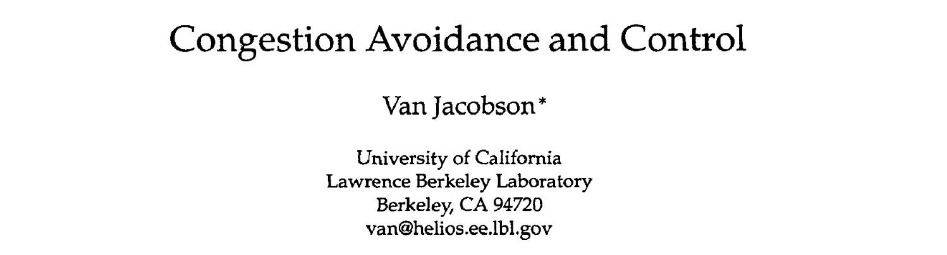
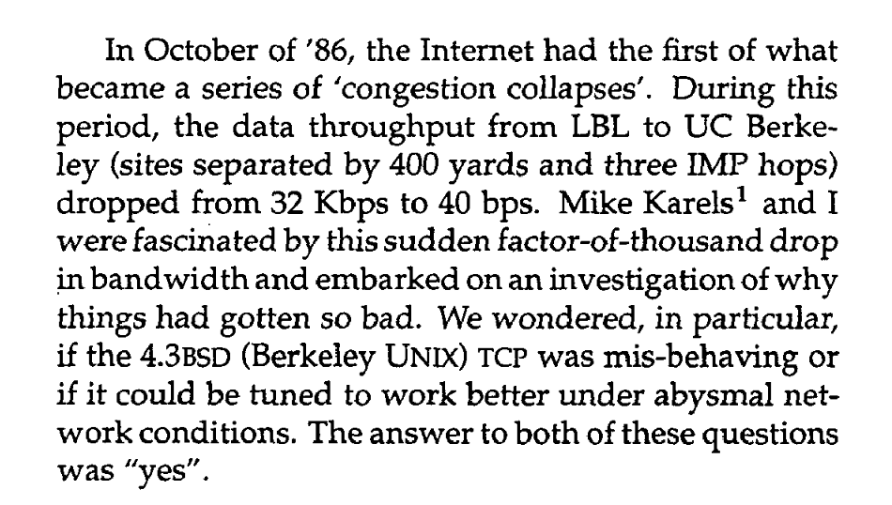
”Congestion Avoidance and Control” Van Jacobson, 1988

Slide 20
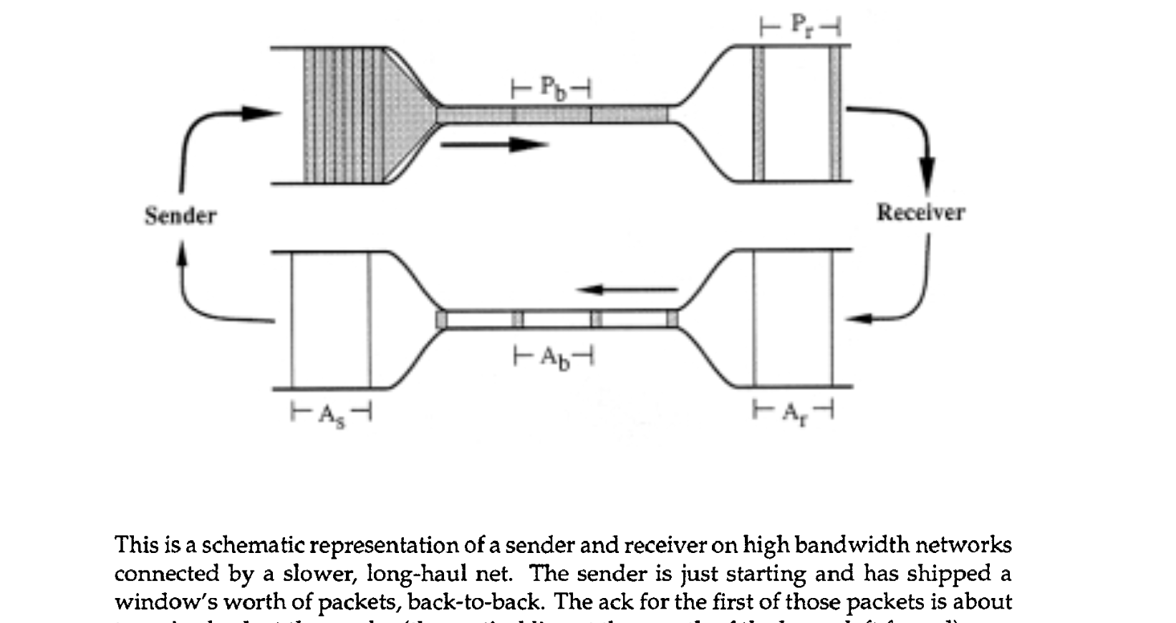
”Congestion Avoidance and Control” Van Jacobson, 1988

Slide 21
Congestion control
We must not send more data than the network can handle
What happens if we do?

Slide 22
A Short History of TCP
1974: 3-way handshake
1978: IP and TCP split
1983: January 1st, ARPAnet switches to TCP/IP
1984: Nagle predicts congestion collapses
1986: Internet begins to suffer congestion collapses
  LBL to Berkeley drops from 32Kbps to 40bps
1987/8: Van Jacobson fixes TCP, publishes seminal paper*: (TCP Tahoe)
1990: Fast transmit and fast recovery added
(TCP Reno)
* Van Jacobson and Michael Karels. Congestion avoidance and control. SIGCOMM ’88

Slide 23
Congestion Collapse
Nagle, rfc896, 1984
Mid 1980’s: Problem with the protocol implementations, not the protocol!
What was happening?
If close to capacity, and, e.g., a large flow arrives suddenly…
  RTT estimates become too short
  Lots of retransmissions → increase in queue size
  Eventually many drops happen (full queues)
  Fraction of useful packets (not copies) decreases
Notes:
Load on the network → buffers at routers fill up → round trip time increases

Slide 24
The problem
https://witestlab.poly.edu/respond/sites/genitutorial/files/tcp-aimd.ogv

Slide 25
In any modern TCP….
Flow control: making sure we don’t
overwhelm the receiver
Congestion control: making sure we don’t
overwhelm the network

Slide 26
TCP Congestion Control
3 Key Challenges
  Determining the available capacity in the first place
  Adjusting to changes in the available capacity
  Sharing capacity between flows
Idea
  Each source determines network capacity for itself
  Rate is determined by window size
  Uses implicit feedback (drops, delay)
  ACKs pace transmission (self-clocking)

Slide 27
Congestion control has a long history
Active research area for ~40 years
I am nowhere close to being an expert
My hope is to get you to understand the problems involved

Slide 28
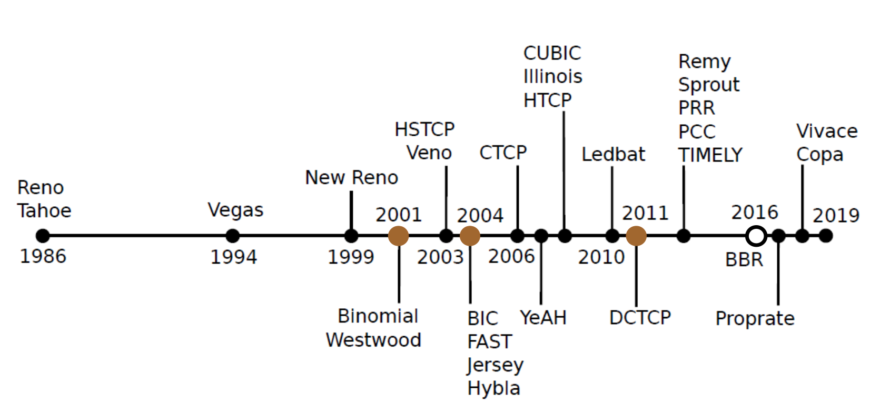

Slide 29


Slide 31
Thinking about congestion
“BBR congestion control”

Slide 32
“BBR congestion control”
Bandwidth-delay product (BDP): maximum amount of data that can be in-transit on a network link at any given time
            (Link capacity (bits/sec)) * (RTT (sec))
            = (bytes)

Slide 33
“BBR congestion control”
Bandwidth-delay product (BDP): maximum amount of data that can be in-transit on a network link at any given time
            (Link capacity (bits/sec)) * (RTT (sec))
            = (bytes)
            Eg. 1Gbps link * 1ms RTT = 125KiB BDP

Slide 34
“BBR congestion control”
Bandwidth-delay product (BDP): maximum amount of data that can be in-transit on a network link at any given time
            (Link capacity (bits/sec)) * (RTT (sec))
            = (bytes)
            Eg. 1Gbps link * 1ms RTT = 125KiB BDP
=> After exceeding BDP, network is queueing packets. After queues are full, packets getting dropped due to congestion.

Slide 35
Congestion control algorithms operate somewhere in this region
“BBR congestion control”
Bandwidth-delay product (BDP): maximum amount of data that can be in-transit on a network link at any given time
            (Link capacity (bits/sec)) * (RTT (sec))
            = (bytes)
            Eg. 1Gbps link * 1ms RTT = 125KiB BDP
=> After exceeding BDP, network is queueing packets. After queues are full, packets getting dropped due to congestion.

Slide 36
Why is this hard?
Sender doesn’t know the network capacity
  The network can’t (generally) tell us this
… and the network may change
New connections start up
Connections end
Link characteristics may change...

Slide 37
Why is this hard?
Sender doesn’t know the network capacity
  The network can’t (generally) tell us this
… and the network may change
New connections start up
Connections end
Link characteristics may change...
=> Need to measure or model what is going on in the network as we are sending, adapt accordingly

Slide 38
The basic principle
Congestion Control (CC)
algorithm

Slide 39
The basic principle
Signals from the network
(ACKs, other TCP packet info, more...)
Congestion Control (CC)
algorithm
Congestion window: cwnd

Slide 40
The basic principle
Signals from the network
(ACKs, other TCP packet info, more...)
Congestion Control (CC)
algorithm
Congestion window: cwnd
Sender can send: min(advertised window, cwnd)
(Advertised window: flow control window from receiver)

Slide 41
The basic principle
Signals from the network
(ACKs, other TCP packet info, more...)
Congestion Control (CC)
algorithm
Congestion window: cwnd
Sender can send: min(advertised window, cwnd)
(Advertised window: flow control window from receiver)
Different CC algorithms use different signals, different techniques for adapting cwnd, but most fit this format

Slide 42
Lots of CC variants designed with different strategies and goals
Network Signals
Packet loss (“loss-based”)
Delay/RTT (“delay-based”)
”Marks” added on packets by routers
Goals
Maximize throughput
Recover from packet loss or high RTT
Short-long “flows”
Datacenter-specific (low-latency)
This is a big research area!

Slide 44
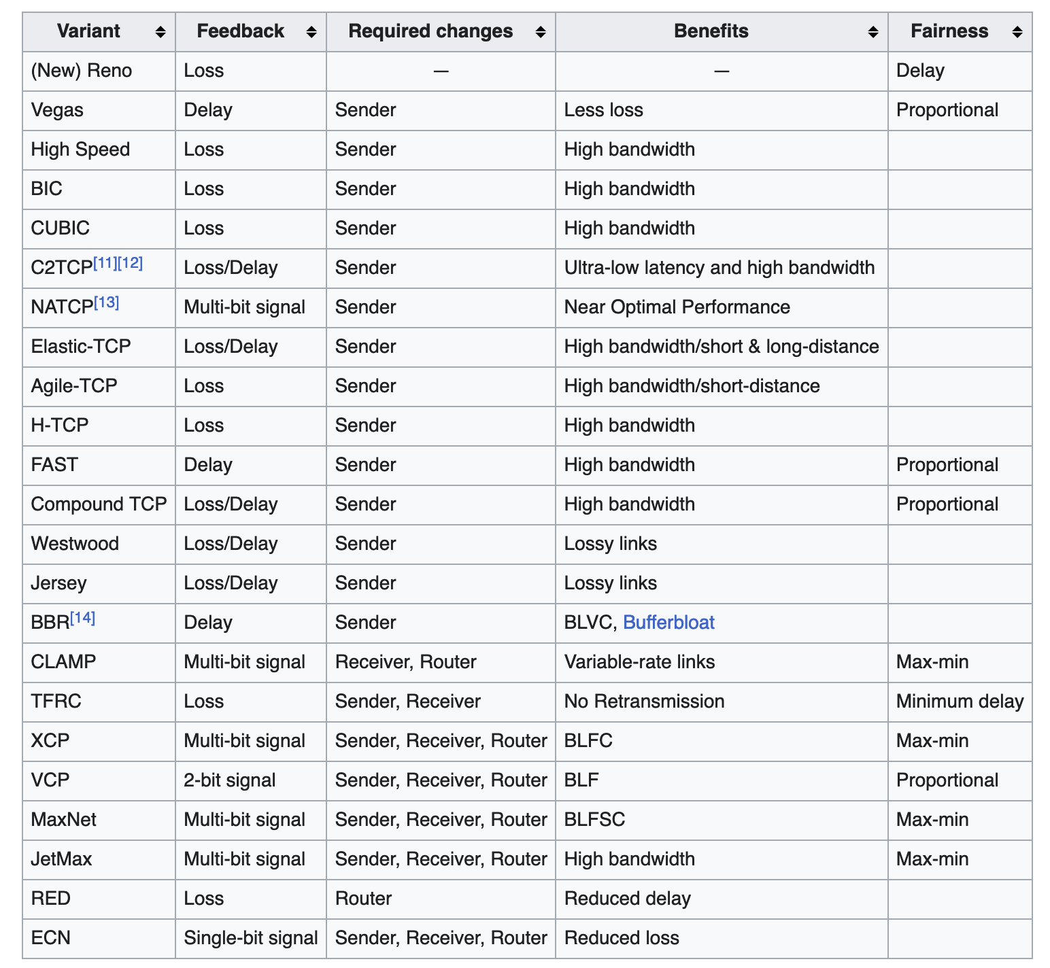
Wikipedia’s list

Slide 45
Classical Congestion Control
Loss-based: assume packet loss => congestion
Notes:
TCP Tahoe is a great paper

Slide 46
Classical Congestion Control
Loss-based: assume packet loss => congestion
TCP Tahoe (1988)
  Slow start, congestion avoidance, fast retransmit
Notes:
TCP Tahoe is a great paper

Slide 47
Classical Congestion Control
Loss-based: assume packet loss => congestion
TCP Tahoe (1988)
  Slow start, congestion avoidance, fast retransmit
TCP Reno (1990)
  TCP Tahoe + Fast recovery
Many variations developed from this… (see optional readings)
Notes:
TCP Tahoe is a great paper

Slide 48
Modes of operation
Slow start (SS)
  Determine initial window, recover after loss
Congestion avoidance (CA)
  Steady state, slowly probe for changes in capacity

Slide 49
Congestion Avoidance
After finishing a window, recompute cwnd:
If no losses, cwnd = cwnd + MSS
  (Often written as cwnd += 1)
If packets were lost: cwnd = cwnd/2

Slide 50
Congestion Avoidance
After finishing a window, recompute cwnd:
If no losses, cwnd = cwnd + MSS
  (Often written as cwnd += 1)
If packets were lost: cwnd = cwnd/2
This is called additive increase, multiplicative decrease (AIMD)
- Slowly increase capacity
- Dramatically scale back on loss

Slide 51
AIMD Example
Notes:
“Sawtooth”

Slide 52
Slow Start
Turns out AIMD is really slow to start up. So do something faster at connection start…
Notes:
Initial cwnd for slow start depends on implementation

Slide 53
Slow Start
Turns out AIMD is really slow to start up. So do something faster at connection start…
After finishing a window
cwnd = cwnd * 2
Continue doing this until you experience a loss
Notes:
Initial cwnd for slow start depends on implementation

Slide 54
Slow Start
Turns out AIMD is really slow to start up. So do something faster at connection start…
After finishing a window
cwnd = cwnd * 2
Continue doing this until you experience a loss
After first loss, keep slow-start threshold (ssthresh):
  If window < ssthresh: slow-start
  If window > ssthresh: congestion avoidance
After first loss: ssthresh = cwnd / 2
Notes:
Initial cwnd for slow start depends on implementation

Slide 56
How to Detect Loss
Timeout
Any other way?
  Gap in sequence numbers at receiver
  Receiver uses cumulative ACKs: drops => duplicate ACKs
3 Duplicate ACKs considered loss
Which one is worse?
Notes:
Timeout is calculated as EstRTT + 4x StdErr, so it is much longer than the actual RTT of a duplicate ack

Slide 57
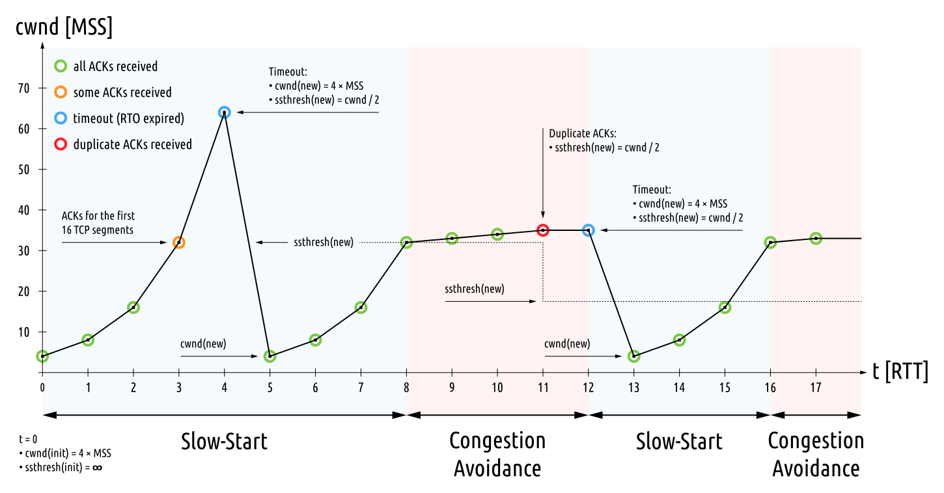

Slide 58
Putting it all together
cwnd
Timeout
Timeout
AIMD
AIMD
ssthresh
Slow
Start
Slow
Start
Slow
Start
Time

Slide 59
Slow start every time?!
Losses have large effect on throughput
Fast Recovery (TCP Reno)
  Same as TCP Tahoe on Timeout: w = 1, slow start
  On triple duplicate ACKs: w = w/2
  Retransmit missing segment (fast retransmit)
  Stay in Congestion Avoidance mode
Why 3 dup-acks instead of just 1?
Notes:
What does a duplicate ack mean?
Probably that we missed a segment!
Why 3?
3 because just 1 or two are more likely to be caused by reordering
What is the difference between a timeout and a few dup-acks?
* You are still getting packets, can still use ack-clocking. Timeout is worse because you lose that

Slide 60
This is just the beginning…
Lots of congestion control schemes, with different strategies/goals:
Tahoe (1988)
Reno (1990)
Vegas (1994): Detect based on RTT
New Reno: Better recovery multiple losses
Cubic (2006): Linux default, window size scales by cubic function
BBR (2016): Used by Google, measures bandwidth/RTT

Slide 61
BBR: what’s different
“BBR congestion control”

Slide 62
BBR
Problem: can’t measure both RTT_{prop} and Bottleneck BW at the same time
BBR:
  Slow start
  Measure throughput when RTT starts to increase
  Measure RTT when throughput is still increasing
  Pace packets at the BDP
  Probe by sending faster for 1RTT, then slower to compensate

Slide 63
BBR
From: https://labs.ripe.net/Members/gih/bbr-tcp

Slide 64
Another way: ECN
What if we didn’t have to drop packets?
Routers/switches set bits in packet to indicate congestion
When sender sees congestion bit, scales back cwnd
Must be supported by both sender and receiver
=>Avoids retransmissions optionally dropped packets

Slide 65
Special purpose example: DCTCP (2010)
Designed for datacenter usage only
Want to avoid queuing as much as possible
Routers/switches mark packets with ECN bit in header
When this happens, senders scale back dramatically

Slide 66
What happens in practice now?

Slide 67
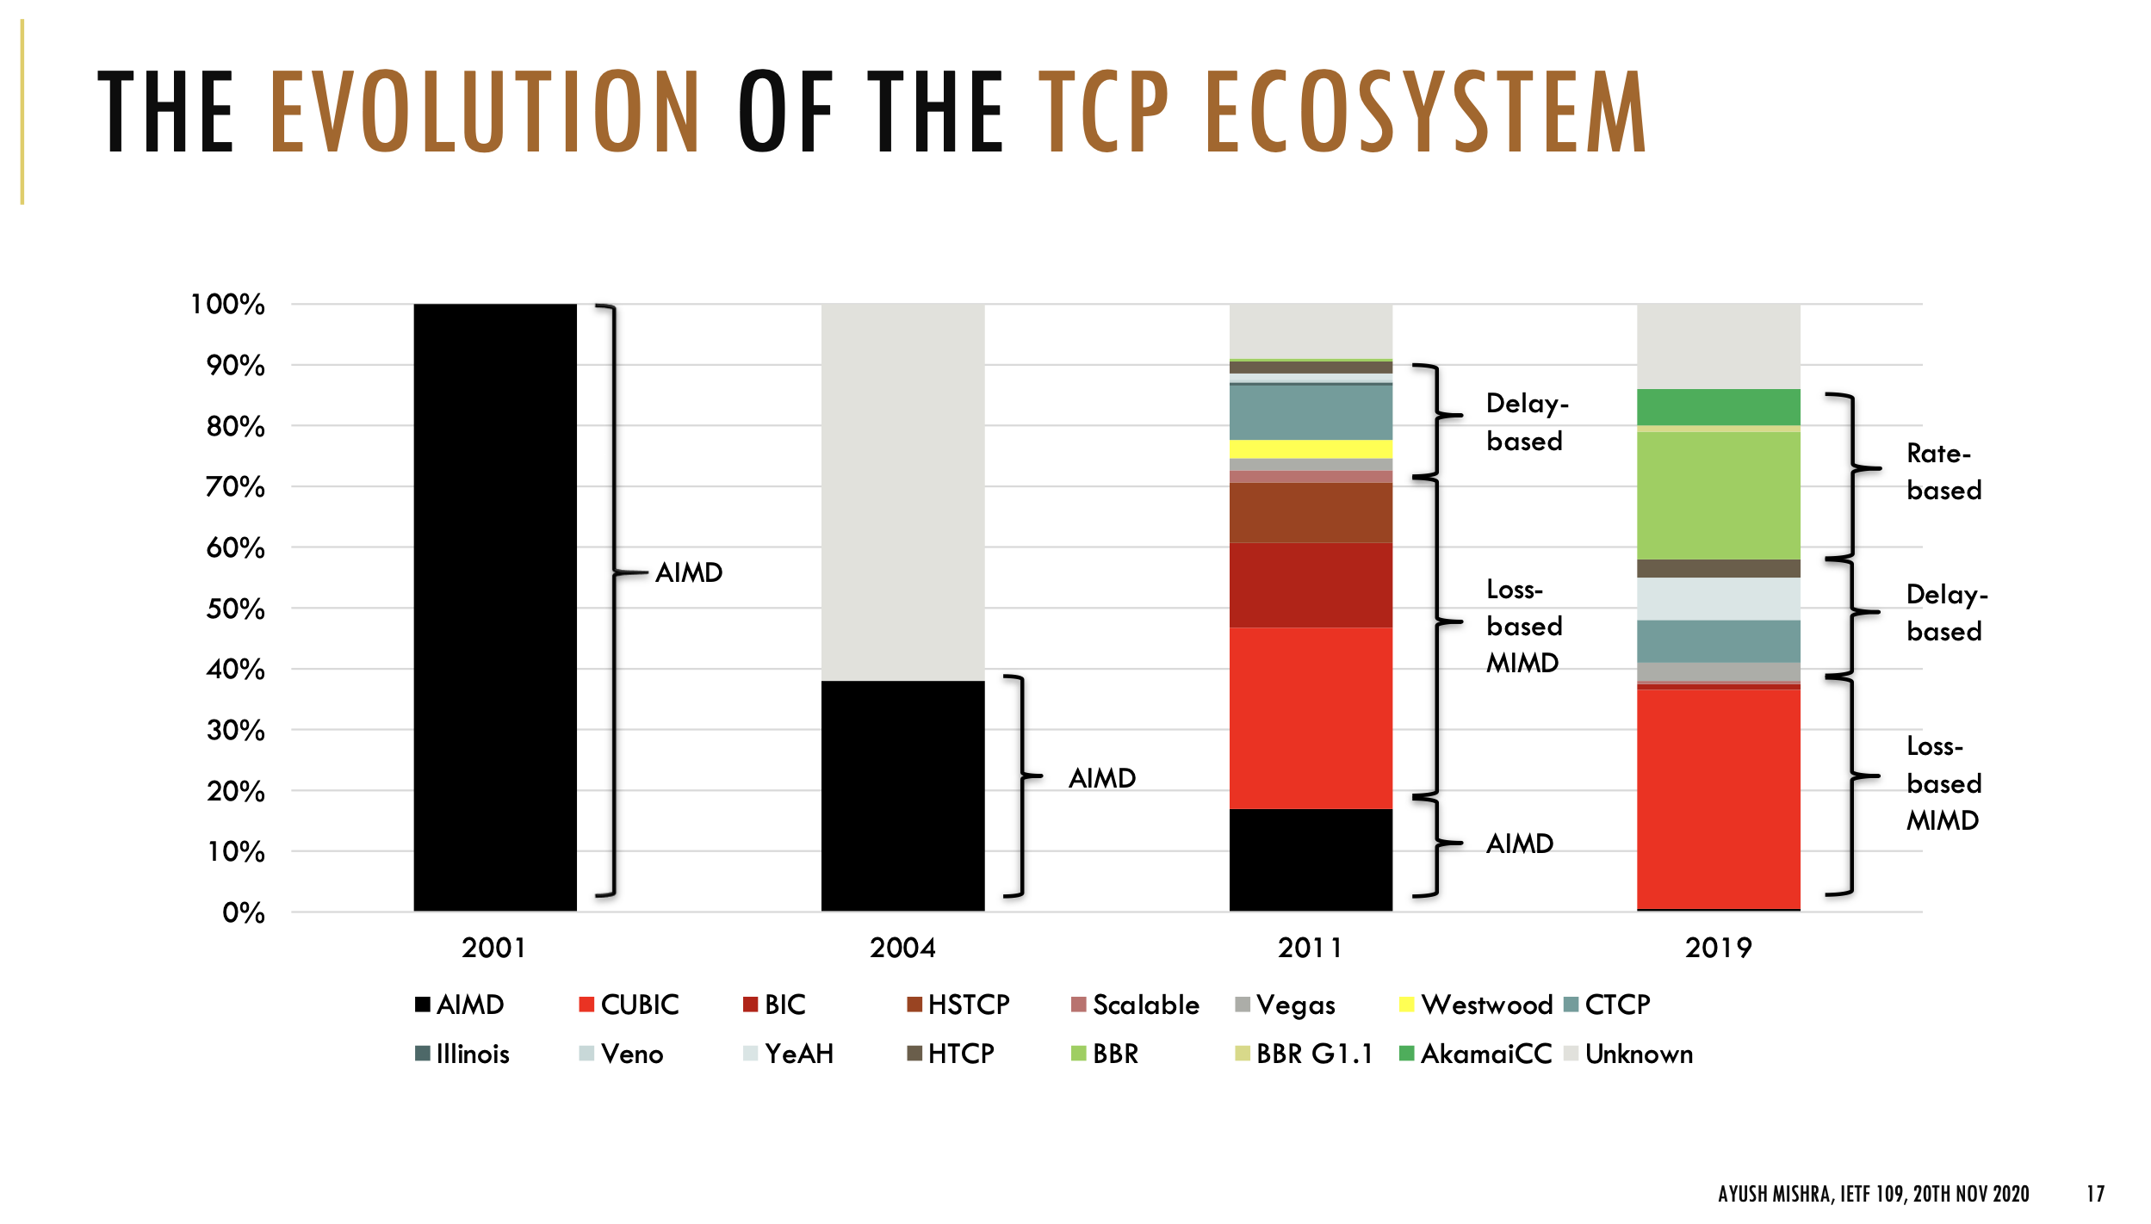
"The Great Internet TCP congestion control census" (2019)

Slide 68
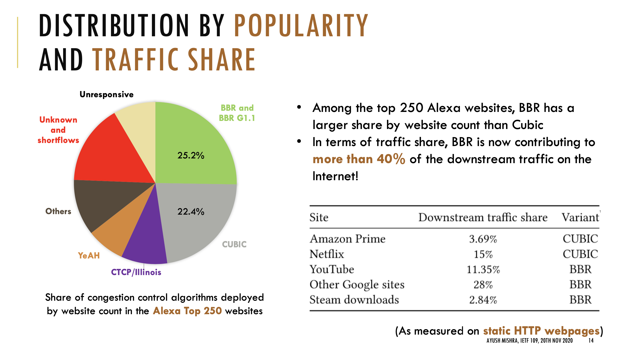
"The Great Internet TCP congestion control census" (2019)

Slide 69
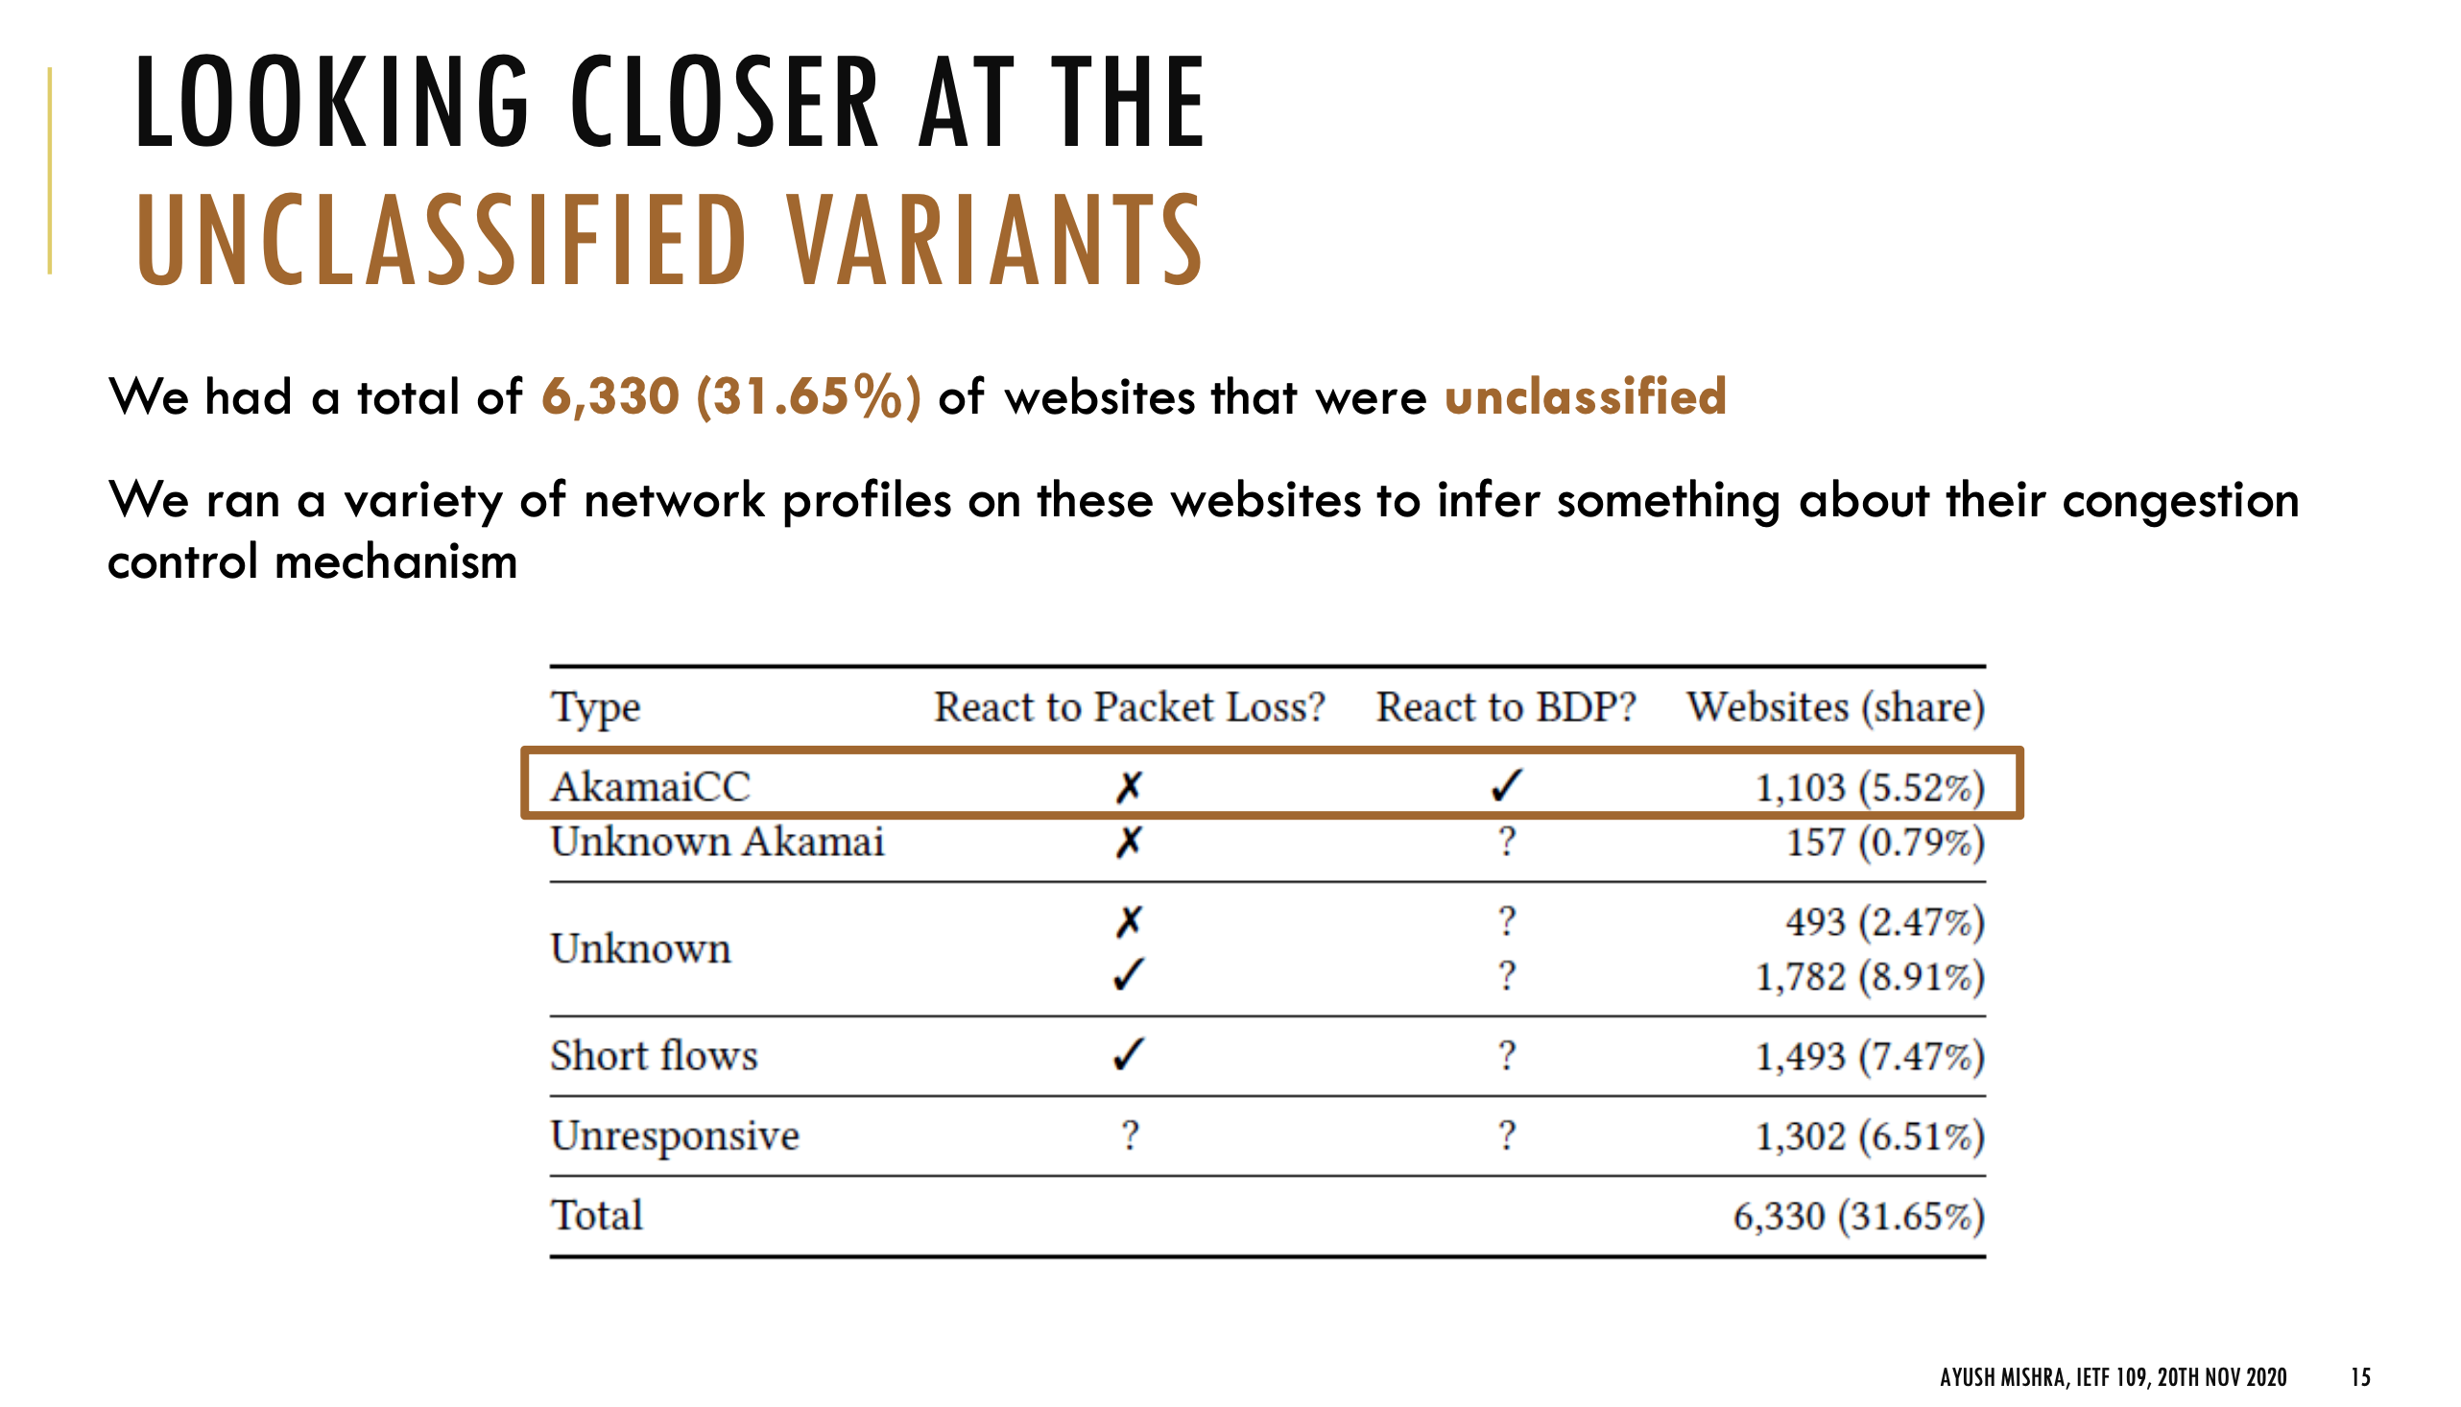
"The Great Internet TCP congestion control census" (2019)

Slide 70
Extra notes only after this point

Slide 71

Timeline of (some!) congestion control implementations
“The great Internet congestion control census” (2019)

Slide 72
How do we know when the network is overloaded?

Slide 73
Just a few TCP implementations
What’s the difference?
General usage
Reno (1980s)
Tahoe
Vegas
New Vegas
Westwood
Cubic
BBR (2016)
…
Notes:
How do they differ?
- How they model the network
How they respond to ACKs
Compute RTT
Most build on each other

Slide 74
Dealing with Congestion
Maintain two windows:
  Advertised Window (from receiver)
  Congestion window (cwnd)
Sending rate = min(Advertised Window, cwnd)
Ideally, want to have sending rate: ~= Window/RTT

Slide 75
The main idea
Goals
Determine initial network capacity
Adjust sending rate as capacity changes
How? Maintain two windows:
  Advertised Window (from receiver)
  Congestion window (cwnd)
Sending rate = min(Advertised Window, cwnd)
Ideally, want to have sending rate: ~= Window/RTT

Slide 76
Dealing with Congestion
To start:
Assume losses are due to congestion
After a loss, reduce congestion window
  How much to reduce?
Idea: conservation of packets at equilibrium
  Want to keep roughly the same number of packets in network
  Analogy with water in fixed-size pipe
  Put new packet into network when one exits

Slide 77
Classical Congestion Control
Loss-based: assume packet loss => congestion
TCP Tahoe (1988)
  Slow start, congestion avoidance, fast retransmit
TCP Reno (1990)
  TCP Tahoe + Fast recovery
Many variations developed from this… (see optional readings)
Notes:
TCP Tahoe is a great paper

Slide 78
Modes of operation
Slow start (SS)
  Determine initial window, recover after loss
Congestion avoidance (CA)
  Steady state, slowly probe for changes in capacity

Slide 79
Congestion Avoidance
After finishing a window, recompute cwnd:
If no losses, cwnd = cwnd + MSS
  (Often written as cwnd += 1)
If packets were lost: cwnd = cwnd/2
This is known as additive increase, multiplicative decrease (AIMD)
Slowly increase capacity
Dramatically scale back on loss

Slide 80
AIMD Example
Notes:
“Sawtooth”

Slide 81
Slow Start
After finishing a window
cwnd = cwnd * 2
Continue doing this until you experience a loss
After first loss, keep slow-start threshold (ssthresh):
  If window < ssthresh: slow-start
  If window > ssthresh: congestion avoidance
After first loss: ssthresh = cwnd / 2
Notes:
Initial cwnd for slow start depends on implementation

Slide 83
How to Detect Loss
Timeout
Any other way?
  Gap in sequence numbers at receiver
  Receiver uses cumulative ACKs: drops => duplicate ACKs
“Fast recovery”: 3 Duplicate ACKs considered loss
Which one is worse?
Notes:
Timeout is calculated as EstRTT + 4x StdErr, so it is much longer than the actual RTT of a duplicate ack

Slide 85
Slow start every time?!
Losses have large effect on throughput
Fast Recovery (TCP Reno)
  Same as TCP Tahoe on Timeout: w = 1, slow start
  On triple duplicate ACKs: w = w/2
  Retransmit missing segment (fast retransmit)
  Stay in Congestion Avoidance mode
Why 3 dup-acks instead of just 1?
Notes:
What does a duplicate ack mean?
Probably that we missed a segment!
Why 3?
3 because just 1 or two are more likely to be caused by reordering
What is the difference between a timeout and a few dup-acks?
* You are still getting packets, can still use ack-clocking. Timeout is worse because you lose that

Slide 86
This is just the beginning…
Lots of congestion control schemes, with different strategies/goals:
Tahoe (1988)
Reno (1990)
Vegas (1994): Detect based on RTT
New Reno: Better recovery multiple losses
Cubic (2006): Linux default, window size scales by cubic function
BBR (2016): Used by Google, measures bandwidth/RTT
…

Slide 87
BBR
Problem: can’t measure both RTT_{prop} and Bottleneck BW at the same time
BBR:
  Slow start
  Measure throughput when RTT starts to increase
  Measure RTT when throughput is still increasing
  Pace packets at the BDP
  Probe by sending faster for 1RTT, then slower to compensate

Slide 88
BBR
From: https://labs.ripe.net/Members/gih/bbr-tcp

Slide 89
Help from the network
What if routers could tell TCP that congestion is happening?
  Congestion causes queues to grow: rate mismatch
TCP responds to drops
Idea: Random Early Drop (RED)
  Rather than wait for queue to become full, drop packet with some probability that increases with queue length
  TCP will react by reducing cwnd
  Could also mark instead of dropping: ECN

Slide 90
Help from the network
What if routers could tell TCP that congestion is happening?
  Congestion causes queues to grow: rate mismatch
Know: TCP responds to drops
Idea: Random Early Drop (RED)
  Rather than wait for queue to become full, drop packet with some probability that increases with queue length
  TCP will react by reducing cwn

Slide 91
RED Advantages
Probability of dropping a packet of a particular flow is roughly proportional to the share of the bandwidth that flow is currently getting
Higher network utilization with low delays
Average queue length small, but can absorb bursts
But can we do better?

Slide 92
ECN
What if we didn’t have to drop packets?
Routers/switches set bits in packet to indicate congestion

Slide 93
ECN
What if we didn’t have to drop packets?
Routers/switches set bits in packet to indicate congestion
When sender sees congestion bit, scales back cwnd
Must be supported by both sender and receiver
=>Avoids retransmissions optionally dropped packets

Slide 94
Special purpose example: DCTCP

Slide 96
Another view of Congestion Control
Round Trip Time
Bytes in Flight
Throughput
Bytes in Flight
Tput =
InFlight/RTT_{prop}
Diagrams based on Cardwell et al., BBR: Congestion Based Congestion Control,”
Communications of the ACM, Vol. 60 No. 2, Pages 58-66.

Slide 97
Another view of Congestion Control
Round Trip Time
RTT_{prop}
Bytes in Flight
BDP
Bottleneck BW
Throughput
Slope = 1/RTT_{prop}
Bytes in Flight

Slide 98
Another view of Congestion Control
Slope = 1/BW
Round Trip Time
RTT_{prop}
Bytes in Flight
Bottleneck BW
Throughput
Slope = 1/RTT_{prop}
BDP
Bytes in Flight
BDP+Bottleneck
Queue

Slide 99
Another view of Congestion Control
Ideal
Operating Point
Slope = 1/BW
Round Trip Time
RTT_{prop}
Loss-based CC
Bytes in Flight
Bottleneck BW
Throughput
Slope = 1/RTT_{prop}
BDP
Bytes in Flight
BDP+Bottleneck
Queue
Notes:
Why is the slope the BW? One way to view this is to look at the onset of drops: at this point the queue is full with Q packets, and the extra RTT is the time it takes to send Q extra packets at the bottleneck BW. Slope is then ”time to send Q packets” / Q packets, which is the 1/BW.

Slide 100
BBR
Problem: can’t measure both RTT_{prop} and Bottleneck BW at the same time
BBR:
  Slow start
  Measure throughput when RTT starts to increase
  Measure RTT when throughput is still increasing
  Pace packets at the BDP
  Probe by sending faster for 1RTT, then slower to compensate

Slide 101
BBR
From: https://labs.ripe.net/Members/gih/bbr-tcp

Slide 102
TCP State Diagram

Slide 103
TCP Header
0 1 2 3
0 1 2 3 4 5 6 7 8 9 0 1 2 3 4 5 6 7 8 9 0 1 2 3 4 5 6 7 8 9 0 1
+-+-+-+-+-+-+-+-+-+-+-+-+-+-+-+-+-+-+-+-+-+-+-+-+-+-+-+-+-+-+-+-+
| Source Port | Destination Port |
+-+-+-+-+-+-+-+-+-+-+-+-+-+-+-+-+-+-+-+-+-+-+-+-+-+-+-+-+-+-+-+-+
| Sequence Number |
+-+-+-+-+-+-+-+-+-+-+-+-+-+-+-+-+-+-+-+-+-+-+-+-+-+-+-+-+-+-+-+-+
| Acknowledgment Number |
+-+-+-+-+-+-+-+-+-+-+-+-+-+-+-+-+-+-+-+-+-+-+-+-+-+-+-+-+-+-+-+-+
| Data | |U|A|P|R|S|F| |
| Offset| Reserved |R|C|S|S|Y|I| Window |
| | |G|K|H|T|N|N| |
+-+-+-+-+-+-+-+-+-+-+-+-+-+-+-+-+-+-+-+-+-+-+-+-+-+-+-+-+-+-+-+-+
| Checksum | Urgent Pointer |
+-+-+-+-+-+-+-+-+-+-+-+-+-+-+-+-+-+-+-+-+-+-+-+-+-+-+-+-+-+-+-+-+
| Options | Padding |
+-+-+-+-+-+-+-+-+-+-+-+-+-+-+-+-+-+-+-+-+-+-+-+-+-+-+-+-+-+-+-+-+
| data |
+-+-+-+-+-+-+-+-+-+-+-+-+-+-+-+-+-+-+-+-+-+-+-+-+-+-+-+-+-+-+-+-+

Slide 104
Other mechanics for sending packets
(used in modern TCPs, not required for project)

Slide 105
Example: telnet/SSH
Terminal input <=> TCP connection

Slide 106
Example: telnet/SSH
Terminal input <=> TCP connection
Problems
=> Tiny packets means high overhead!
=> But also don’t want to add latency
=> How to decide when to send? Multiple strategies.

Slide 107
One way: add some more logic to the sender
Nagle’s algorithm
Goal: reduce the overhead of small packets
  if (there is data to send) and (window >= MSS)
  Send a MSS segment
  else
  if there is unAcked data in flight
  buffer the new data until ACK arrives
  else
  send all the new data now
Notes:
Problem: too many small packets

Slide 108
One way: add some more logic to the sender
Nagle’s algorithm
Goal: reduce the overhead of small packets
  if (there is data to send) and (window >= MSS)
  Send a MSS segment
  else
  if there is unAcked data in flight
  buffer the new data until ACK arrives
  else
  send all the new data now
Recommended in some cases, but waiting to send not always a great idea
=> Configurable on socket creation
Notes:
Problem: too many small packets

Slide 109
Another way: change how the receiver advertises the window
What if receiving app only reads 1 byte at a time?

Slide 110
Another way: change how the receiver advertises the window
What if receiving app only reads 1 byte at a time?
Silly Window Syndrome (SWS) Avoidance: when window is zero, wait until 1MSS of receive buffer space is available before advertising nonzero window

Slide 111
Another way: change the receiver
What if receiving app only reads 1 byte at a time?
Silly Window Syndrome (SWS) Avoidance: when window is zero, wait until 1MSS of receive buffer space is available before advertising nonzero window
Yet another way: receiver could delay sending ACK for short time (400ms),
in case it has data to send
=> All data segments are ACKs, so why send packet again?

Slide 112
Delayed Acknowledgments
Goal: Piggy-back ACKs on data
  Delay ACK for 200ms in case application sends data
  If more data received, immediately ACK second segment
  Note: never delay duplicate ACKs (if missing a segment)
Warning: can interact badly with Nagle for some applications
  Nagle waits for ACK until send => Temporary deadlock
  App can disable Nagle with TCP_NODELAY
  App should also avoid many small writes
Notes:
Why does it

Slide 113
Extra congestion control content

Slide 114
Putting it all together
cwnd
Timeout
Timeout
AIMD
AIMD
ssthresh
Slow
Start
Slow
Start
Slow
Start
Time

Slide 115
Fast Recovery and Fast Retransmit
cwnd
AI/MD
Slow Start
Fast retransmit
Time

Slide 116
TCP Friendliness
Can other protocols co-exist with TCP?
  E.g., if you want to write a video streaming app using UDP, how to do congestion control?
1 UDP Flow at 10MBps
31 TCP Flows
Sharing a 10MBps link

Slide 117
TCP Friendliness
Can other protocols co-exist with TCP?
  E.g., if you want to write a video streaming app using UDP, how to do congestion control?
Equation-based Congestion Control
  Instead of implementing TCP’s CC, estimate the rate at which TCP would send. Function of what?
  RTT, MSS, Loss
Measure RTT, Loss, send at that rate!

Slide 118
TCP Throughput
Assume a TCP congestion of window W (segments), round-trip time of RTT, segment size MSS
  Sending Rate S = W x MSS / RTT (1)
Drop: W = W/2
  grows by MSS for W/2 RTTs, until another drop at W ≈ W
Average window then 0.75xS
  From (1), S = 0.75 W MSS / RTT (2)
Loss rate is 1 in number of packets between losses:
  Loss = 1 / ( 1 + (W/2 + W/2+1 + W/2 + 2 + … + W)
  = 1 / (3/8 W²) (3)

Slide 119
TCP Throughput (cont)
  Loss = 8/(3W²) (4)
  Substituting (4) in (2), S = 0.75 W MSS / RTT ,
  Throughput ≈
Equation-based rate control can be TCP friendly and have better properties, e.g., small jitter, fast ramp-up…

Slide 120
What Happens When Link is Lossy?
Throughput ≈ 1 / sqrt(Loss)
p = 0
p = 1%
p = 10%

Slide 121
What can we do about it?
Two types of losses: congestion and corruption
One option: mask corruption losses from TCP
  Retransmissions at the link layer
  E.g. Snoop TCP: intercept duplicate acknowledgments, retransmit locally, filter them from the sender
Another option:
  Tell the sender about the cause for the drop
  Requires modification to the TCP endpoints

Slide 122
Congestion Avoidance
TCP creates congestion to then back off
  Queues at bottleneck link are often full: increased delay
  Sawtooth pattern: jitter
Alternative strategy
  Predict when congestion is about to happen
  Reduce rate early
Other approaches
  Delay Based: TCP Vegas (not covered)
  Better model of congestion: BBR
  Router-centric: RED, ECN, DECBit, DCTCP

Slide 123
Another view of Congestion Control
Round Trip Time
Bytes in Flight
Throughput
Bytes in Flight
Tput =
InFlight/
RTT_{prop}
Diagrams based on Cardwell et al., BBR: Congestion Based Congestion Control,”
Communications of the ACM, Vol. 60 No. 2, Pages 58-66.

Slide 124
Another view of Congestion Control
Round Trip Time
RTT_{prop}
Bytes in Flight
BDP
Bottleneck BW
Throughput
Slope = 1/RTT_{prop}
Bytes in Flight

Slide 125
Another view of Congestion Control
Slope = 1/BW
Round Trip Time
RTT_{prop}
Bytes in Flight
Bottleneck BW
Throughput
Slope = 1/RTT_{prop}
BDP
Bytes in Flight
BDP+Bottleneck
Queue

Slide 126
Another view of Congestion Control
Ideal
Operating Point
Slope = 1/BW
Round Trip Time
RTT_{prop}
Loss-based CC
Bytes in Flight
Bottleneck BW
Throughput
Slope = 1/RTT_{prop}
BDP
Bytes in Flight
BDP+Bottleneck
Queue
Notes:
Why is the slope the BW? One way to view this is to look at the onset of drops: at this point the queue is full with Q packets, and the extra RTT is the time it takes to send Q extra packets at the bottleneck BW. Slope is then ”time to send Q packets” / Q packets, which is the 1/BW.

Slide 127
BBR
Problem: can’t measure both RTT_{prop} and Bottleneck BW at the same time
BBR:
  Slow start
  Measure throughput when RTT starts to increase
  Measure RTT when throughput is still increasing
  Pace packets at the BDP
  Probe by sending faster for 1RTT, then slower to compensate

Slide 128
BBR
From: https://labs.ripe.net/Members/gih/bbr-tcp

Slide 129
TCP Vegas
Idea: source watches for sign that router’s queue is building up (e.g., sending rate flattens)

Slide 130
TCP Vegas
Compare Actual Rate (A) with Expected Rate (E)
  If E-A > β, decrease cwnd linearly : A isn’t responding
  If E-A < α, increase cwnd linearly : Room for A to grow

Slide 131
Vegas
Shorter router queues
Lower jitter
Problem:
  Doesn’t compete well with Reno. Why?
  Reacts earlier, Reno is more aggressive, ends up with higher bandwidth…

Slide 132
Help from the network
What if routers could tell TCP that congestion is happening?
  Congestion causes queues to grow: rate mismatch
TCP responds to drops
Idea: Random Early Drop (RED)
  Rather than wait for queue to become full, drop packet with some probability that increases with queue length
  TCP will react by reducing cwnd
  Could also mark instead of dropping: ECN

Slide 133
RED Details
Compute average queue length (EWMA)
  Don’t want to react to very quick fluctuations

Slide 134
RED Drop Probability
Define two thresholds: MinThresh, MaxThresh
Drop probability:
Improvements to spread drops (see book)

Slide 135
RED Advantages
Probability of dropping a packet of a particular flow is roughly proportional to the share of the bandwidth that flow is currently getting
Higher network utilization with low delays
Average queue length small, but can absorb bursts
ECN
  Similar to RED, but router sets bit in the packet
  Must be supported by both ends
  Avoids retransmissions optionally dropped packets

Slide 136
What happens if not everyone cooperates?
TCP works extremely well when its assumptions are valid
  All flows correctly implement congestion control
  Losses are due to congestion

Slide 137
Cheating TCP
Possible ways to cheat
  Increasing cwnd faster
  Large initial cwnd
  Opening many connections
  Ack Division Attack

Slide 138
Larger Initial Window
x
A
B
y
D
E
x starts SS with cwnd = 4
y starts SS with cwnd = 1
Figure from Walrand, Berkeley EECS 122, 2003

Slide 139
Open Many Connections
Web Browser: has to download k objects for a page
  Open many connections or download sequentially?
Assume:
  A opens 10 connections to B
  B opens 1 connection to E
TCP is fair among connections
  A gets 10 times more bandwidth than B
x
A
B
y
D
E
Figure from Walrand, Berkeley EECS 122, 2003

Slide 140
Exploiting Implicit Assumptions
Savage, et al., CCR 1999:
  “TCP Congestion Control with a Misbehaving Receiver”
Exploits ambiguity in meaning of ACK
  ACKs can specify any byte range for error control
  Congestion control assumes ACKs cover entire sent segments
What if you send multiple ACKs per segment?

Slide 141
ACK Division Attack
Receiver: “upon receiving a segment with N bytes, divide the bytes in M groups and acknowledge each group separately”
Sender will grow window M times faster
Could cause growth to 4GB in 4 RTTs!
  M = N = 1460

Slide 142
TCP Daytona!

Slide 143
Defense
Appropriate Byte Counting
  [RFC3465 (2003), RFC 5681 (2009)]
  In slow start, cwnd += min (N, MSS)
  where N is the number of newly acknowledged bytes in the received ACK

Slide 144
More help from the network
Problem: still vulnerable to malicious flows!
  RED will drop packets from large flows preferentially, but they don’t have to respond appropriately
Idea: Multiple Queues (one per flow)
  Serve queues in Round-Robin
  Nagle (1987)
  Good: protects against misbehaving flows
  Disadvantage?
  Flows with larger packets get higher bandwidth

Slide 145
Solution
Bit-by-bit round robing
Can we do this?
  No, packets cannot be preempted!
We can only approximate it…

Slide 146
Fair Queueing
Define a fluid flow system as one where flows are served bit-by-bit
Simulate ff, and serve packets in the order in which they would finish in the ff system
Each flow will receive exactly its fair share

Slide 147
Example
Flow 1
(arrival traffic)
1
2
3
4
5
6
time
Flow 2
(arrival traffic)
1
2
3
4
5
time
Service
in fluid flow
system
1
2
1
2
3
4
5
6
3
4
5
time
Packet
system
1
2
1
3
2
3
4
4
5
5
6
time

Slide 148
Implementing FQ
Suppose clock ticks with each bit transmitted
  (RR, among all active flows)
P_{i} is the length of the packet
S_{i} is packet i’s start of transmission time
F_{i} is packet i’s end of transmission time
F_{i} = S_{i} + P_{i}
When does router start transmitting packet i?
  If arrived before F_{i-1}, S_{i} = F_{i-1}
  If no current packet for this flow, start when packet arrives (call this A_{i}): S_{i} = A_{i}
Thus, F_{i} = max(F_{i-1},A_{i}) + P_{i}

Slide 149
Fair Queueing
Across all flows
  Calculate F_{i} for each packet that arrives on each flow
  Next packet to transmit is that with the lowest F_{i}
  Clock rate depends on the number of flows
Advantages
  Achieves max-min fairness, independent of sources
  Work conserving
Disadvantages
  Requires non-trivial support from routers
  Requires reliable identification of flows
  Not perfect: can’t preempt packets
Notes:
Example of max-min fairness: 10: 8, 6, 2 => 10/3 = 3.33; 2 gets 2; 8 remaining: 8/2 = 4, others get 8, 6.

Slide 150
Fair Queueing Example
10Mbps link, 1 10Mbps UDP, 31 TCPs

Slide 151
Big Picture
Fair Queuing doesn’t eliminate congestion: just manages it
You need both, ideally:
  End-host congestion control to adapt
  Router congestion control to provide isolation

Slide 152
Congestion control: motivation

Slide 153
The story so far
Flow control: reliable, in-order delivery
Goal: send as much data as receiver can handle
  Receiver’s advertised window: sent with every ACK
Sliding window: increase throughput by having multiple packets in flight

Slide 154
Summary: flow control
Flow control provides correctness: reliable, in order delivery
Need more for performance
  What if the network is the bottleneck?
Sending too fast will cause queue overflows, heavy packet loss
Need more for performance: congestion control

Slide 155
A Short History of TCP
1974: 3-way handshake
1978: IP and TCP split
1983: January 1st, ARPAnet switches to TCP/IP
1984: Nagle predicts congestion collapses
1986: Internet begins to suffer congestion collapses
  LBL to Berkeley drops from 32Kbps to 40bps
1987/8: Van Jacobson fixes TCP, publishes seminal paper*: (TCP Tahoe)
1990: Fast transmit and fast recovery added
(TCP Reno)
* Van Jacobson and Michael Karels. Congestion avoidance and control. SIGCOMM ’88

Slide 156
Congestion Collapse
Nagle, rfc896, 1984
Mid 1980’s: Problem with the protocol implementations, not the protocol!
What was happening?
If close to capacity, and, e.g., a large flow arrives suddenly…
  RTT estimates become too short
  Lots of retransmissions → increase in queue size
  Eventually many drops happen (full queues)
  Fraction of useful packets (not copies) decreases
Notes:
Load on the network → buffers at routers fill up → round trip time increases

Slide 157
The problem
https://witestlab.poly.edu/respond/sites/genitutorial/files/tcp-aimd.ogv

Slide 158
TCP Congestion Control
3 Key Challenges
  Determining the available capacity in the first place
  Adjusting to changes in the available capacity
  Sharing capacity between flows
Idea
  Each source determines network capacity for itself
  Rate is determined by window size
  Uses implicit feedback (drops, delay)
  ACKs pace transmission (self-clocking)

Slide 159
Congestion control has a long history
Active research area for ~40 years
I am nowhere close to being an expert
My hope is to get you to understand the problems involved

Slide 160
Just a few TCP implementations
What’s the difference?
General usage
Reno (1980s)
Tahoe
Vegas
New Vegas
Westwood
Cubic
BBR (2016)
…
Notes:
How do they differ?
- How they model the network
How they respond to ACKs
Compute RTT
Most build on each other

Slide 161
Dealing with Congestion
Maintain two windows:
  Advertised Window (from receiver)
  Congestion window (cwnd)
Sending rate = min(Advertised Window, cwnd)
Ideally, want to have sending rate: ~= Window/RTT

Slide 162
Dealing with Congestion
Assume losses are due to congestion
After a loss, reduce congestion window
  How much to reduce?
Idea: conservation of packets at equilibrium
  Want to keep roughly the same number of packets in network
  Analogy with water in fixed-size pipe
  Put new packet into network when one exits

Slide 163
Next time
TCP Tahoe/Reno
Overview of other CC schemes

