Slide 1
CSCI-1680
DNS
Nick DeMarinis
Based partly on lecture notes by Rodrigo Fonseca, Scott Shenker and John Jannotti

Slide 2
Administrivia
TCP milestone I: this week, sign up for a meeting if you haven’t
TCP Gearup II: TONIGHT, 10/31 6-8pm in CIT 368
  Prep for milestone II
HW3 (short!): Due next Thurs

Slide 3
Administrivia
TCP milestone I: this week, sign up for a meeting if you haven’t
  If you’re stuck: bring what you have, it does not need to be perfect
  DO NOT just hack stuff together to make it look good in Wireshark
TCP Gearup II: TONIGHT, 10/31 6-8pm in CIT 368
  Prep for milestone II
HW3 (short!): Due next Thurs

Slide 4
Warmup
Which of the following contribute to congestion?
Packets queueing up at switches
High CPU usage on the receiver
Many TCP connections sending on the same link
Many UDP connections sending on the same link
An unreliable Wifi link

Slide 5
Thinking about congestion
“BBR congestion control”

Slide 6
“BBR congestion control”
Bandwidth-delay product (BDP): maximum amount of data that can be in-transit on a network link at any given time
            (Link capacity (bits/sec)) * (RTT (sec))
            = (bytes)

Slide 7
“BBR congestion control”
Bandwidth-delay product (BDP): maximum amount of data that can be in-transit on a network link at any given time
            (Link capacity (bits/sec)) * (RTT (sec))
            = (bytes)
            Eg. 1Gbps link * 1ms RTT = 125KiB BDP

Slide 8
Congestion control algorithms operate somewhere in this region
“BBR congestion control”
Bandwidth-delay product (BDP): maximum amount of data that can be in-transit on a network link at any given time
            (Link capacity (bits/sec)) * (RTT (sec))
            = (bytes)
            Eg. 1Gbps link * 1ms RTT = 125KiB BDP
=> After exceeding BDP, network is queueing packets. After queues are full, packets getting dropped due to congestion.

Slide 9
The basic principle
Congestion Control (CC)
algorithm

Slide 10
The basic principle
Signals from the network
(ACKs, other TCP packet info, more...)
Congestion Control (CC)
algorithm
Congestion window: cwnd

Slide 11
The basic principle
Signals from the network
(ACKs, other TCP packet info, more...)
Congestion Control (CC)
algorithm
Congestion window: cwnd
Sender can send: min(advertised window, cwnd)
(Advertised window: flow control window from receiver)

Slide 12
The basic principle
Signals from the network
(ACKs, other TCP packet info, more...)
Congestion Control (CC)
algorithm
Congestion window: cwnd
Sender can send: min(advertised window, cwnd)
(Advertised window: flow control window from receiver)
Different CC algorithms use different signals, different techniques for adapting cwnd, but most fit this format

Slide 13
Lots of CC variants designed with different strategies and goals
Network Signals
Packet loss (“loss-based”)
Delay/RTT (“delay-based”)
”Marks” added on packets by routers
Goals
Maximize throughput
Recover from packet loss or high RTT
Short-long “flows”
Datacenter-specific (low-latency)
This is a big research area!

Slide 14
This is just the beginning…
Lots of congestion control schemes, with different strategies/goals:
Tahoe (1988)
Reno (1990)
Vegas (1994): Detect based on RTT
New Reno: Better recovery multiple losses
Cubic (2006): Linux default, window size scales by cubic function
BBR (2016): Used by Google, measures bandwidth/RTT

Slide 15
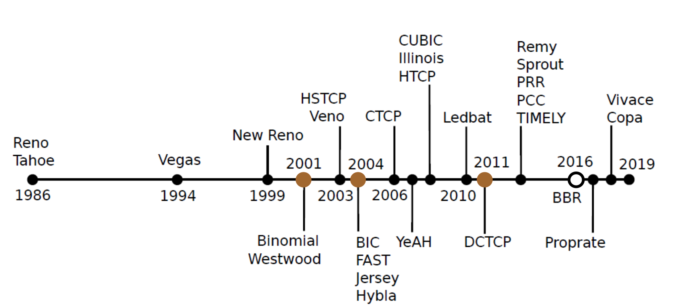

Slide 16
DNS

Slide 17
Connecting to a server: the story so far
POV: You want to connect to some website
You
Some site
5.6.7.8

Slide 18
Connecting to a server: the story so far
POV: You want to connect to some website
You
Some site
5.6.7.8
connect(5.6.7.8, 80)

Slide 19
Connecting to a server: the story so far
POV: You want to connect to some website
You
Some site
5.6.7.8
connect(5.6.7.8, 80)
Is this how users interact with the network? No!

Slide 20
Why not? Why is this bad?
You
Some site
5.6.7.8
connect(5.6.7.8, 80)

Slide 21
Why not? Why is this bad?
You
Some site
5.6.7.8
connect(5.6.7.8, 80)
Need to know IP addresses!
  Users won’t know
  Hosts don’t know—can’t remember every single one!
Some host ?= its IP address? No!
  A large website may be run by many servers
  Devices may move between networks

Slide 22
What we have so far
IP addresses
Used by routers to forward packets
Fixed length, binary numbers
Assigned based on where host is on the network
Usually refers to one host

Slide 23
What we have so far
IP addresses
Used by routers to forward packets
Fixed length, binary numbers
Assigned based on where host is on the network
Usually refers to one host
Examples
5.6.7.8
212.58.224.138
2620:6e:6000:900:c1d:c9f7:8a1c:2f48

Slide 24
What we have
IP addresses
Used by routers to forward packets
Fixed length, binary numbers
Assigned based on where host is on the network
Usually refers to one host
Examples
5.6.7.8
212.58.224.138
2620:6e:6000:900:c1d:c9f7:8a1c:2f48
Efficient forwarding: ✅
Human readable: ❌
Scalable for distributed services: ❌

Slide 25
What we have
IP addresses
Used by routers to forward packets
Fixed length, binary numbers
Assigned based on where host is on the network
Usually refers to one host
Examples
5.6.7.8
212.58.224.138
2620:6e:6000:900:c1d:c9f7:8a1c:2f48
Efficient forwarding: ✅
Human readable: ❌
Scalable for distributed services: ❌
=> Need a new abstraction for “stuff” we are trying to access

Slide 26
What we want: a new abstraction for names
Server for website.com
5.6.7.8
You
connect(“website.com”, 80)
connect(5.6.7.8, 80)

Slide 27
What we want: a new abstraction for names
Server for website.com
5.6.7.8
You
connect(“website.com”, 80)
connect(5.6.7.8, 80)
Want: names
- Human-readable
- Variable length
- Don’t need to care about where destination is/what server it is
=> Can refer to a service, not just a host

Slide 28
What does this mean?
cs.brown.edu => 128.148.32.110
Notes:
www.cnn.com maps to at least 6 ip addresses
Enables
Load balancing
Latency reduction
Tailoring request based on requester’s location/device/identity

Slide 29
What does this mean?
cs.brown.edu => 128.148.32.110
Why?
Names are easier to remember
Addresses can change underneath
Useful Multiplexing/sharing
Notes:
www.cnn.com maps to at least 6 ip addresses
Enables
Load balancing
Latency reduction
Tailoring request based on requester’s location/device/identity

Slide 30
What does this mean?
cs.brown.edu => 128.148.32.110
Why?
Names are easier to remember
Addresses can change underneath
  e.g, renumbering when changing providers
Useful Multiplexing/sharing
  One name -> multiple addresses
  Multiple names -> one address
Notes:
www.cnn.com maps to at least 6 ip addresses
Enables
Load balancing
Latency reduction
Tailoring request based on requester’s location/device/identity

Slide 31
Remember ARP?
IP address => Link-layer address

Slide 32
Remember ARP?
IP address => Link-layer address
Now: DNS
Names useful to users/applications => IP addresses

Slide 33
Remember ARP?
IP address => Link-layer address
Now: DNS
Names useful to users/applications => IP addresses
Another change in layers => which enables so much more….

Slide 34
The original way: one file: hosts.txt
Flat namespace
Central administrator kept master copy (for the Internet)
To add a host, emailed admin
Downloaded file regularly
Notes:
Completely impractical today
File would be huge (gigabytes)
Traffic implosion (lookups and updates)
Some names change mappings every few days (dynamic IP)
Single point of failure
Impractical politics (security, ownership, etc…)

Slide 35
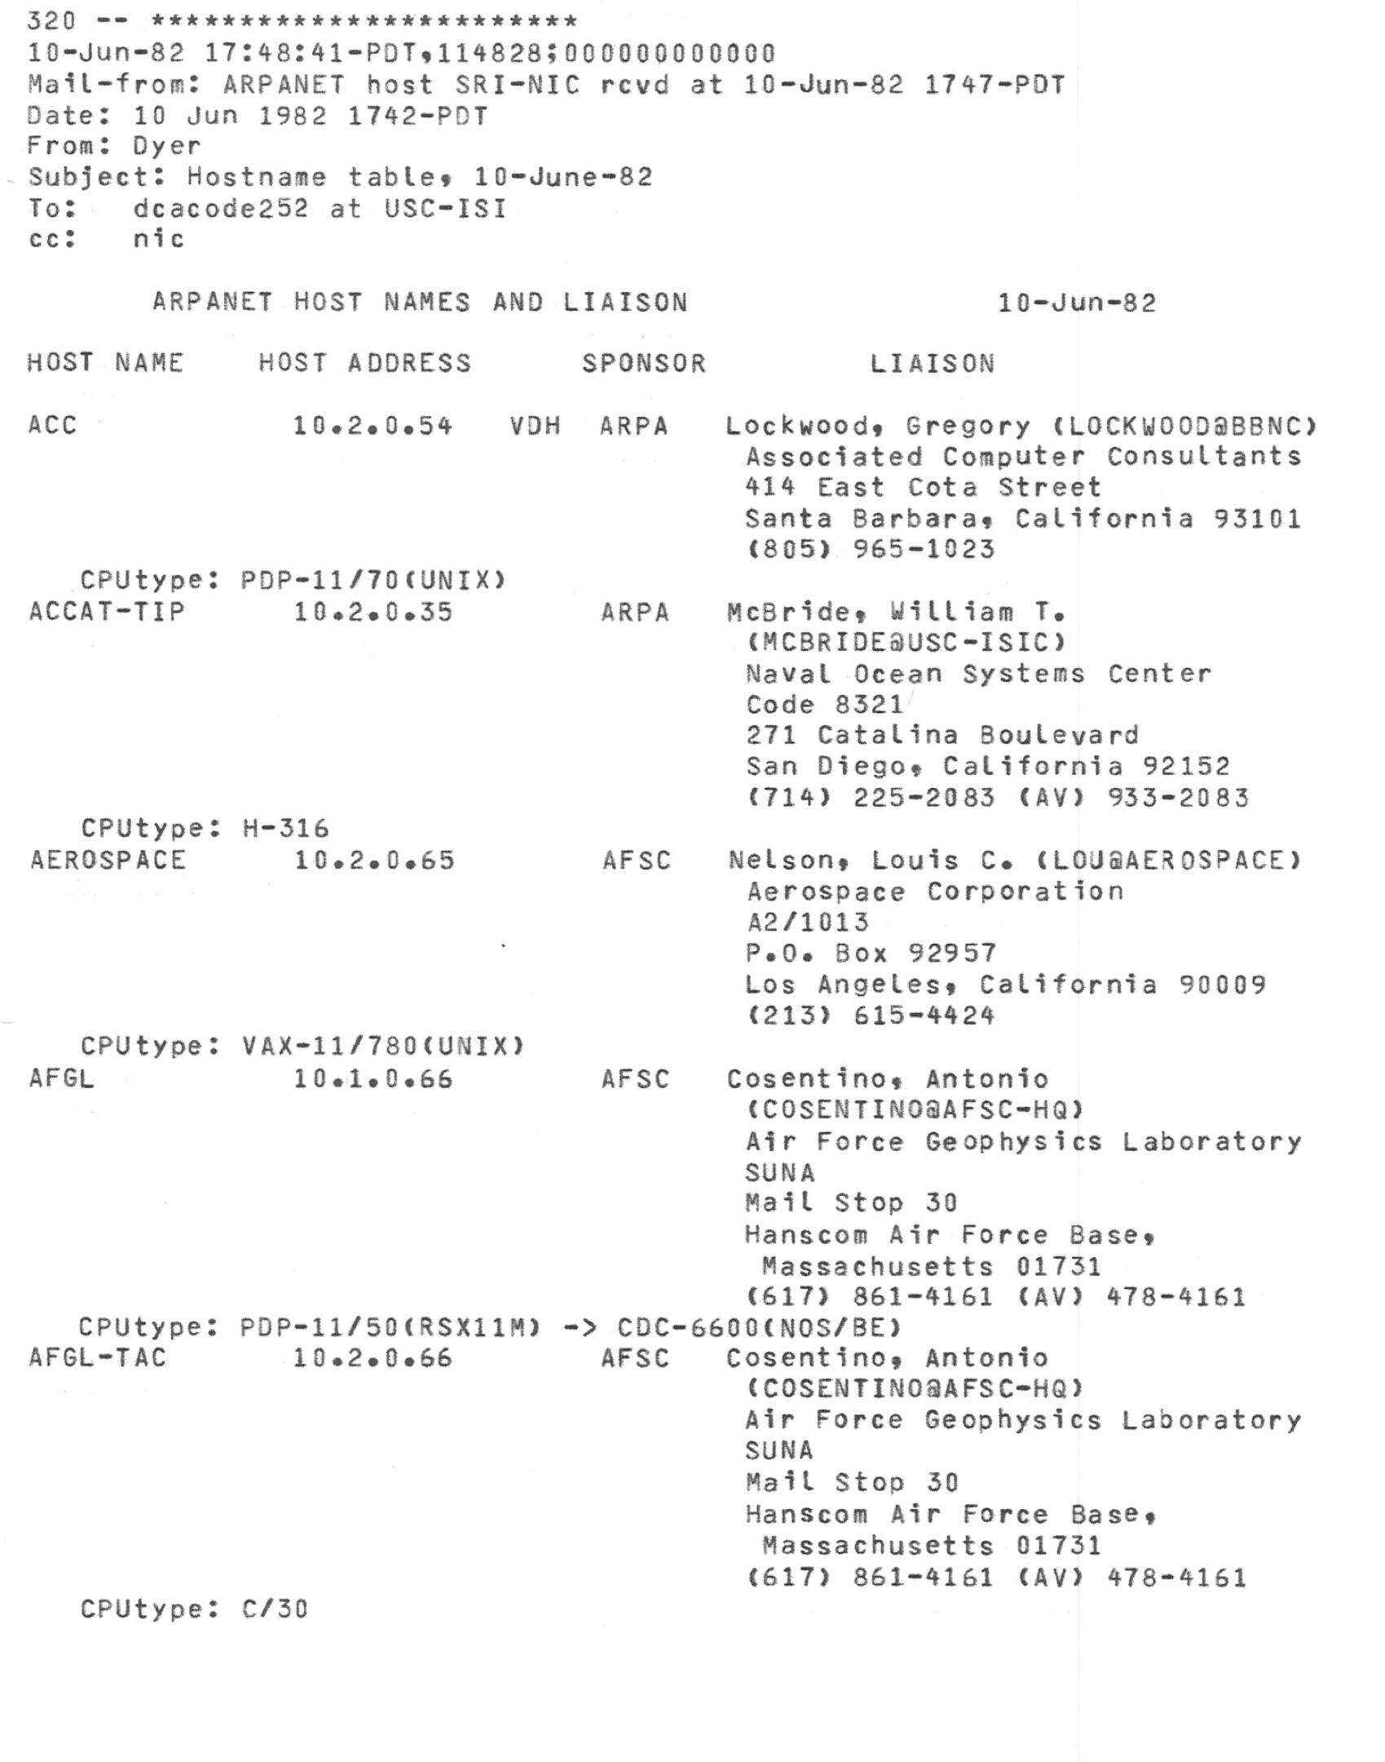

Slide 36
The original way: one file: hosts.txt
Flat namespace
Central administrator kept master copy (for the Internet)
To add a host, emailed admin
Downloaded file regularly
Does it scale?
Notes:
Completely impractical today
File would be huge (gigabytes)
Traffic implosion (lookups and updates)
Some names change mappings every few days (dynamic IP)
Single point of failure
Impractical politics (security, ownership, etc…)

Slide 37
The original way: one file: hosts.txt
Flat namespace
Central administrator kept master copy (for the Internet)
To add a host, emailed admin
Downloaded file regularly
Does it scale?
Lol no.
Notes:
Completely impractical today
File would be huge (gigabytes)
Traffic implosion (lookups and updates)
Some names change mappings every few days (dynamic IP)
Single point of failure
Impractical politics (security, ownership, etc…)

Slide 38
Domain Name System (DNS)
Originally proposed by RFC882, RFC883 (1983)
Distributed protocol to translate hostnames -> IP addresses
  Human-readable names
  Delegated control
  Load-balancing/content delivery
  So much more…

Slide 39
Domain Name System (DNS)
Originally proposed by RFC882, RFC883 (1983)
Distributed protocol to translate hostnames -> IP addresses
  Human-readable names
  Delegated control
  Load-balancing/content delivery
  So much more…
=> Distributed key-value store, before it was cool…

Slide 40
Goals for DNS
Scalability
Distributed Control
Fault Tolerance

Slide 41
Goals for DNS
Scalability
  Must handle a huge number of records
    With some software synthesizing names on the fly
  Must sustain update and lookup load
Distributed Control
  Let people control their own names
Fault Tolerance
  Minimize lookup failures in face of other network problems

Slide 42
The good news
Compared to other distributed systems, some properties that make these goals easier to achieve…
  Read-mostly database
    Lookups MUCH more frequent than updates
  Loose consistency
    When adding a machine, not end of the world if it takes minutes or hours to propagate
Can use lots and lots of caching
  Once you’ve lookup up a hostname, remember
  Don’t have to look again in the near future

Slide 43
The good news
Compared to other distributed systems, some properties that make these goals easier to achieve…

Slide 44
The good news
Compared to other distributed systems, some properties that make these goals easier to achieve…
  Read-mostly database
    Lookups MUCH more frequent than updates
  Loose consistency
    When adding a machine, not end of the world if it takes minutes or hours to propagate

Slide 45
How it works
Hierarchical namespace broken into zones
cslab1a.cs.brown.edu

Slide 47
How it works
Hierarchical namespace broken into zones
  root (.), edu., brown.edu., cs.brown.edu.,
  Zones separately administered => delegation
  Parent zone tells you how to find servers for subdomains
Each zone served from multiple replicated servers
Lots and lots of caching

Slide 48
Types of DNS servers

Slide 49
“Types” of DNS servers
Top Level Domain (TLD) servers
  Generic domains (e.g., com, org, edu)
  Country domains (e.g., uk, br, tv, in, ly)
  Special domains (e.g., arpa)
  Corporate domains (...)
Authoritative DNS servers
  Provides public records for hosts at an organization
  Can be maintained locally or by a service provider
Recursive resolvers
  Big public servers, or local to a network
  Lots of caching

Slide 50
How a resolver works

Slide 51
Resolver operation
Apps make recursive queries to local DNS server (1)
  Ask server to get answer for you
Server makes iterative queries to remote servers (2,4,6)
  Ask servers who to ask next
  Cache results aggressively

Slide 52
$ dig cs.brown.edu @10.1.1.10
; <<>> DiG 9.10.6 <<>> cs.brown.edu @10.1.1.10
;; global options: +cmd
;; Got answer:
;; ->>HEADER<<- opcode: QUERY, status: NOERROR, id: 8536
;; flags: qr aa rd ra; QUERY: 1, ANSWER: 1, AUTHORITY: 0, ADDITIONAL: 1
;; OPT PSEUDOSECTION:
; EDNS: version: 0, flags:; udp: 1220
;; QUESTION SECTION:
;cs.brown.edu. IN A
;; ANSWER SECTION:
cs.brown.edu. 1800 IN A 128.148.32.12
;; Query time: 69 msec
;; SERVER: 10.1.1.10#53(10.1.1.10)
;; WHEN: Tue Apr 19 09:03:39 EDT 2022
;; MSG SIZE rcvd: 57
Notes:
Responses called Resource Records (RRs)

Slide 53
$ dig cs.brown.edu @e.root-servers.net
; <<>> DiG 9.10.6 <<>> cs.brown.edu @e.root-servers.net
[ . . .]
;; QUESTION SECTION:
;cs.brown.edu. IN A
;; AUTHORITY SECTION:
edu. 172800 IN NS b.edu-servers.net.
edu. 172800 IN NS i.edu-servers.net.
edu. 172800 IN NS g.edu-servers.net.
[ . . .]
;; ADDITIONAL SECTION:
[ . . .]
i.edu-servers.net. 172800 IN A 192.43.172.30
g.edu-servers.net. 172800 IN A 192.42.93.30
b.edu-servers.net. 172800 IN A 192.33.14.30
;; Query time: 123 msec
;; SERVER: 2001:500:a8::e#53(2001:500:a8::e)
;; WHEN: Thu Oct 31 08:29:45 EDT 2024
;; MSG SIZE rcvd: 839

Slide 54
$dig cs.brown.edu @192.33.14.30. [192.33.14.30 was IP returned for b.edu-servers.net]
; <<>> DiG 9.10.6 <<>> cs.brown.edu @192.33.14.30
[ . . . ]
;; QUESTION SECTION:
;cs.brown.edu. IN A
;; AUTHORITY SECTION:
brown.edu. 172800 IN NS ns1.ucsb.edu.
brown.edu. 172800 IN NS bru-ns1.brown.edu.
brown.edu. 172800 IN NS bru-ns2.brown.edu.
brown.edu. 172800 IN NS bru-ns3.brown.edu.
;; ADDITIONAL SECTION:
ns1.ucsb.edu. 172800 IN A 128.111.1.1
ns1.ucsb.edu. 172800 IN AAAA 2607:f378::1
bru-ns1.brown.edu. 172800 IN A 128.148.248.11
bru-ns2.brown.edu. 172800 IN A 128.148.248.12
bru-ns3.brown.edu. 172800 IN A 128.148.2.13

Slide 55
$ dig cs.brown.edu @128.111.1.1 [128.111.1.1 was IP returned for ns1.ucsb.edu]
; <<>> DiG 9.10.6 <<>> cs.brown.edu @128.111.1.1
[ . . . ]
;; QUESTION SECTION:
;cs.brown.edu. IN A
;; ANSWER SECTION:
cs.brown.edu. 1800 IN A 128.148.32.12
;; Query time: 77 msec
;; SERVER: 128.111.1.1#53(128.111.1.1)
;; WHEN: Thu Oct 31 08:35:11 EDT 2024
;; MSG SIZE rcvd: 57

Slide 56
dig: DNS query/debugging tool

Slide 57
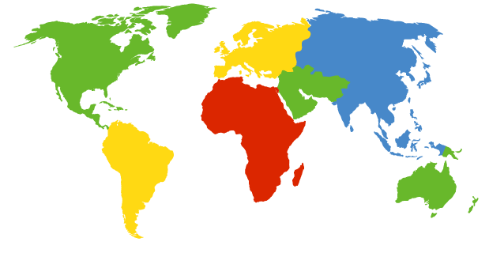
Where is the root server?
Located in New York
How do we make the root scale?
Verisign, New York, NY

Slide 58
DNS Root Servers
13 Root Servers (www.root-servers.org)
  Labeled A through M (e.g, A.ROOT-SERVERS.NET)
Does this scale?
A Verisign, New York, NY
C Cogent, Herndon, VA
D U Maryland College Park, MD
G US DoD Columbus, OH
H ARL Aberdeen, MD
J Verisign
K RIPE London
I Netnod, Stockholm
E NASA Mt View, CA
F Internet Software
Consortium
Palo Alto, CA
M WIDE Tokyo
B USC-ISI Marina del Rey, CA
L ICANN Los Angeles, CA

Slide 59
DNS Root Servers
13 Root Servers (www.root-servers.org)
  Labeled A through M (e.g, A.ROOT-SERVERS.NET)
Remember anycast?
A Verisign, New York, NY (also Frankfurt, HK, London, LA)
C Cogent, Herndon, VA (also Los Angeles, NY, Chicago, Frankfurt and 3+)
D U Maryland College Park, MD (also in 106 other locations)
G US DoD Columbus, OH (+5)
H ARL Aberdeen, MD (also San Diego)
J Verisign (118 locations)
K RIPE London (plus 41 other locations)
I Netnod, Stockholm
(plus 49 other locations)
E NASA Mt View, CA (+70)
F Internet Software
Consortium,
Palo Alto, CA
(and 57 other locations)
M WIDE Tokyo
plus Seoul, Paris,
San Francisco, Osaka
B USC-ISI Marina del Rey, CA
L ICANN Los Angeles, CA
(plus 157 other locations)

Slide 60
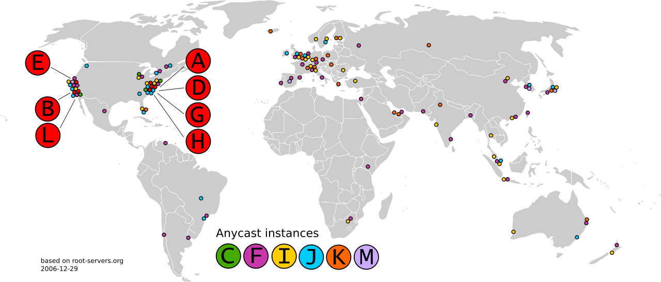

Slide 61
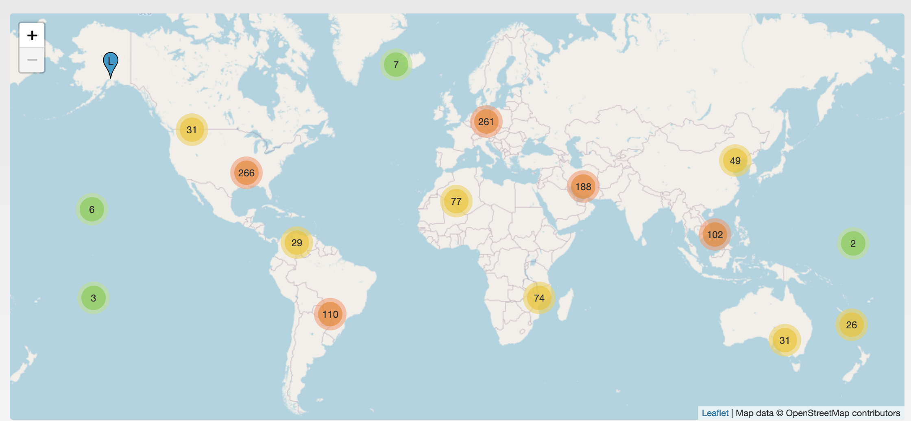
DNS Root Servers: Today
From: www.root-servers.org

Slide 62
How it scales: caching
Resolvers cache responses to avoid doing recursive/iterative queries
Many messages => extra computation, extra latency
$ dig cs.brown.edu @10.1.1.10
;; ANSWER SECTION:
cs.brown.edu. 1800 IN A 128.148.32.12

Slide 63
How it scales: caching
Resolvers cache responses to avoid extra recursive/iterative queries
Many messages => extra computation, extra latency
How long to cache?
=> Every record has a TTL (in seconds), delete when it expires
$ dig cs.brown.edu @10.1.1.10
;; ANSWER SECTION:
cs.brown.edu. 1800 IN A 128.148.32.12

Slide 64
Today
You
DNS resolver
example.com
5.6.7.8
connect(example.com,
80)
A example.com?
5.6.7.8
How does this work in practice? What can go wrong?

Slide 65
How it scales: caching
DNS Resolvers cache responses to avoid doing recursive/iterative queries
Many messages => extra computation, extra latency
How long to cache?
=> Every record has a TTL (in seconds), delete when it expires
$ dig cs.brown.edu @10.1.1.10
;; ANSWER SECTION:
cs.brown.edu. 1800 IN A 128.148.32.12

Slide 66
Related: redundant services via DNS
Can return multiple answers for one record
=> If a client can’t connect to first result, can try next one
$ dig nytimes.com
;; ANSWER SECTION:
nytimes.com. 111 IN A 151.101.65.164
nytimes.com. 111 IN A 151.101.1.164
nytimes.com. 111 IN A 151.101.129.164
nytimes.com. 111 IN A 151.101.193.164
;; Query time: 40 msec
;; SERVER: 10.1.1.10#53(10.1.1.10)
;; WHEN: Thu Nov 09 08:42:41 EST 2023
;; MSG SIZE rcvd: 104
DNS server usually shuffles answers on each response—why?
Notes:
Responses called Resource Records (RRs)

Slide 67
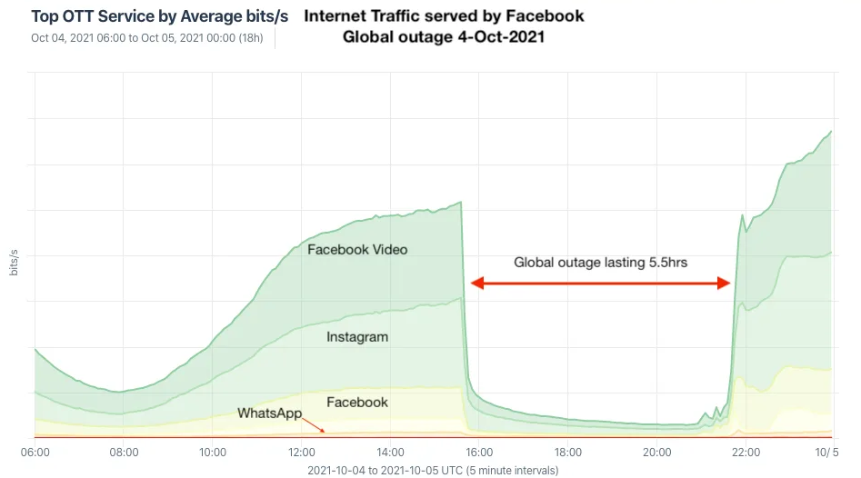
Facebook DNS outage (2021)
BGP configuration bug: Facebook withdraws all routes for its DNS servers to the Internet
=> Facebook DNS unreachable—not even Facebook could access their systems!
Traffic graph
Many writeups here

Slide 68
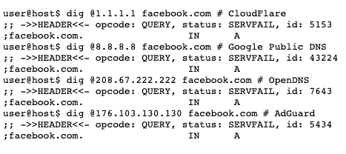
Source

Slide 69
DNS record types
RR Type | Purpose | Example
A | IPv4 Address | 128.148.56.2
AAAA | IPv6 Address | 2001:470:8956:20::1
CNAME | Specifies an alias (“Canonical name”) | systems.cs.brown.edu. 86400 IN CNAME systems-v3.cs.brown.edu. systems-v3.cs.brown.edu. 86400 IN A 128.148.36.51
NS | DNS servers for a domain | cs.brown.edu. 86400 IN NS br1.brown.edu
MX | Mail servers | MX <priority> <ip> eg. MX 10 1.2.3.4
SOA | Start of authority | Information about who owns a zone
PTR | Reverse IP lookup | 7.34.148.128.in-addr.arpa. 86400 IN PTR quanto.cs.brown.edu.
SRV | How to reach specific services (eg. host, port) | _minecraft._tcp.example.net 3600 SRV <priority> <weight> <port> <server IP>
More: https://en.wikipedia.org/wiki/List_of_DNS_record_types

Slide 70
DNS record types
RR Type | Purpose | Example
A | IPv4 Address | 128.148.56.2
AAAA | IPv6 Address | 2001:470:8956:20::1
CNAME | Specifies an alias (“Canonical name”) | systems.cs.brown.edu. 86400 IN CNAME systems-v3.cs.brown.edu. systems-v3.cs.brown.edu. 86400 IN A 128.148.36.51
NS | DNS servers for a domain | cs.brown.edu. 86400 IN NS br1.brown.edu
MX | Mail servers | MX <priority> <ip> eg. MX 10 1.2.3.4
SOA | Start of authority | Information about who owns a zone
PTR | Reverse IP lookup | 7.34.148.128.in-addr.arpa. 86400 IN PTR quanto.cs.brown.edu.
SRV | How to reach specific services (eg. host, port) | _minecraft._tcp.example.net 3600 SRV <priority> <weight> <port> <server IP>
More: https://en.wikipedia.org/wiki/List_of_DNS_record_types

Slide 71
Reverse DNS
What if we want to map IP address => domain name?
Notes:
dig -tPTR 12.32.148.128.in-addr.arpa

Slide 72
Reverse DNS
What if we want to map IP address => domain name?
Leverages hierarchy in IP addresses, but in reverse
=> How? reverse the numbers: 12.32.148.128, then look that up
Notes:
dig -tPTR 12.32.148.128.in-addr.arpa

Slide 73
DNS Caching
Recursive queries are expensive
Caching greatly reduces overhead
  Top level servers very rarely change
  Popular sites visited often
  Local DNS server caches information from many users
How long do you store a cached response?
  Original server tells you: TTL entry
  Server deletes entry after TTL expires

Slide 74
Reverse DNS
How do we get the other direction, IP address to name?
Addresses have a natural hierarchy:
  128.148.32.12
Idea: reverse the numbers: 12.32.148.128 …
  and look that up in DNS
Under what TLD?
  Convention: in-addr.arpa
  Lookup 12.32.148.128.in-addr.arpa
  in6.arpa for IPv6
Notes:
dig -tPTR 12.32.148.128.in-addr.arpa

Slide 75
DNS Protocol
TCP/UDP port 53
Most traffic uses UDP
  Lightweight protocol has 512 byte message limit
  Retry using TCP if UDP fails (e.g., reply truncated)
Bit in query determines if query is recursive

Slide 76
DNS Example
$ dig cs.brown.edu @10.1.1.10
; <<>> DiG 9.10.6 <<>> cs.brown.edu @10.1.1.10
;; global options: +cmd
;; Got answer:
;; ->>HEADER<<- opcode: QUERY, status: NOERROR, id: 8536
;; flags: qr aa rd ra; QUERY: 1, ANSWER: 1, AUTHORITY: 0, ADDITIONAL: 1
;; OPT PSEUDOSECTION:
; EDNS: version: 0, flags:; udp: 1220
;; QUESTION SECTION:
;cs.brown.edu. IN A
;; ANSWER SECTION:
cs.brown.edu. 1800 IN A 128.148.32.12
;; Query time: 69 msec
;; SERVER: 10.1.1.10#53(10.1.1.10)
;; WHEN: Tue Apr 19 09:03:39 EDT 2022
;; MSG SIZE rcvd: 57
Notes:
Responses called Resource Records (RRs)

Slide 77
DNS Example
When server doesn’t know all info…
% dig +norec cs.brown.edu @j.root-servers.net
; <<>> DiG 9.10.6 <<>> +norec cs.brown.edu @j.root-servers.net
;; global options: +cmd
;; Got answer:
;; ->>HEADER<<- opcode: QUERY, status: NOERROR, id: 61618
;; flags: qr; QUERY: 1, ANSWER: 0, AUTHORITY: 13, ADDITIONAL: 27
;; OPT PSEUDOSECTION:
; EDNS: version: 0, flags:; udp: 1232
;; QUESTION SECTION:
;cs.brown.edu. IN A
;; AUTHORITY SECTION:
edu. 172800 IN NS a.edu-servers.net.
edu. 172800 IN NS b.edu-servers.net.
edu. 172800 IN NS l.edu-servers.net.
edu. 172800 IN NS m.edu-servers.net.
;; ADDITIONAL SECTION:
a.edu-servers.net. 172800 IN A 192.5.6.30
b.edu-servers.net. 172800 IN A 192.33.14.30
c.edu-servers.net. 172800 IN A 192.26.92.30
d.edu-servers.net. 172800 IN A 192.31.80.30
e.edu-servers.net. 172800 IN A 192.12.94.30
Notes:
Responses called Resource Records (RRs)

Slide 78
Example
dig . ns
dig +norec www.cs.brown.edu @a.root-servers.net
dig +norec www.cs.brown.edu @a.edu-servers.net
dig +norec www.cs.brown.edu @bru-ns1.brown.edu
www.cs.brown.edu. 86400 IN A 128.148.32.110

Slide 79
Resource Records
All DNS info represented as resource records (RR)
name [ttl] [class] type rdata
  name: domain name
  TTL: time to live in seconds
  class: for extensibility, normally IN (1) “Internet”
  type: type of the record
  rdata: resource data dependent on the type
Example RRs
  www.cs.brown.edu. 86400 IN A 128.148.32.110
  cs.brown.edu. 86400 IN NS dns.cs.brown.edu.
  cs.brown.edu. 86400 IN NS ns1.ucsb.edu.

Slide 80
DNS record types
RR Type | Purpose | Example
A | IPv4 Address | 128.148.56.2
AAAA | IPv6 Address | 2001:470:8956:20::1
CNAME | Specifies an alias (“Canonical name”) | systems.cs.brown.edu. 86400 IN CNAME systems-v3.cs.brown.edu. systems-v3.cs.brown.edu. 86400 IN A 128.148.36.51
MX | Mail servers | MX <priority> <ip> eg. MX 10 1.2.3.4
SOA | Start of authority | Information about who owns a zone
PTR | Reverse IP lookup | 7.34.148.128.in-addr.arpa. 86400 IN PTR quanto.cs.brown.edu.
SRV | How to reach specific services (eg. host, port) | _minecraft._tcp.example.net 3600 SRV <priority> <weight> <port> <server IP>
More: https://en.wikipedia.org/wiki/List_of_DNS_record_types

Slide 81
Inserting a Record in DNS
Your new startup helpme.com

Slide 82
Some important details
How do local servers find root servers?
  DNS lookup on a.root-servers.net ?
  Servers configured with root cache file
  Contains root name servers and their addresses
  . 3600000 IN NS A.ROOT-SERVERS.NET.
  A.ROOT-SERVERS.NET. 3600000 A 198.41.0.4
  ...
How do you get addresses of other name servers?
  To obtain the address of www.cs.brown.edu, ask a.edu-servers.net, says a.root-servers.net
  How do you find a.edu-servers.net?
  Glue records: A records in parent zone

Slide 83
Other uses of DNS
Local multicast DNS
  Used for service discovery
  Made popular by Apple
  This is how you learn of different Apple TVs in the building
Load balancing
CDNs (more on this later)

Slide 84
Reliability
Answers may contain several alternate servers
Try alternate servers on timeout
  Exponential backoff when retrying same server
Use same identifier for all queries
  Don’t care which server responds, take first answer

Slide 85
Inserting a Record in DNS
Your new startup helpme.com
Get a block of addresses from ISP
  Say 212.44.9.0/24
Register helpme.com at namecheap.com (for ex.)
  Provide name and address of your authoritative name server (primary and secondary)
  Registrar inserts RR pair into the .com TLD server:
    helpme.com NS dns1.helpme.com
    dns1.helpme.com A 212.44.9.120
Configure your authoritative server (dns1.helpme.com)
  Type A record for www.helpme.com
  Type MX record for helpme.com

Slide 86
Inserting a Record in DNS, cont
Need to provide reverse PTR bindings
  E.g., 212.44.9.120 -> dns1.helpme.com
Configure your dns server to serve the 9.44.212.in-addr.arpa zone
  Need to add a record of this NS into the parent zone (44.212.in-addr.arpa)
Insert the bindings into the 9.44.212.in-addr.arpa zone

Slide 87
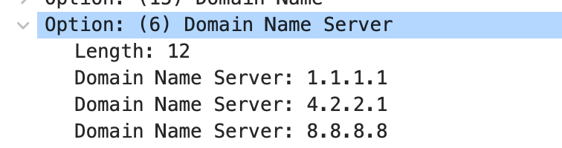
DNS Security
You go to starbucks, how does your browser find www.google.com?
  Ask local name server, obtained from DHCP
Can you trust this DNS server?

Slide 88
Great Firewall of CIT
If attacker is on the path (say, it is the ISP, or a malicious version of TStaff), what could they do?
  Can sniff all DNS queries
  Send fake responses back first
  Could do this selectively, to direct facebook.com to cs.brown.edu, for example…

Slide 89
Great Firewall of CIT
If attacker is on the path (say, it is the ISP, or a malicious version of TStaff), what could they do?

Slide 90
https://blog.thousandeyes.com/monitoring-dns-in-china/

Slide 91
Public DNS
Public DNS resolvers provided by cloud companies and ISPs
8.8.8.8 (Google)
1.1.1.1 (Cloudflare)
… and others
Why do this?

Slide 92
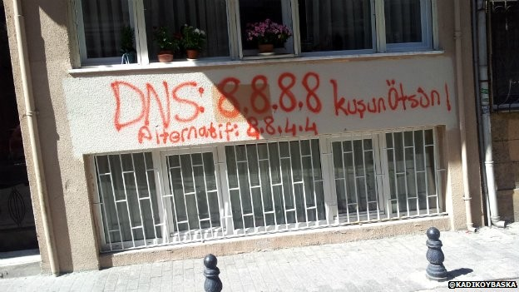

Slide 93
“Helpful” ISPs
Many ISPs hijack NXDOMAIN responses to “help” by offering search and advertisement related to the domain
E.g., www.bicycleisntadomain.com doesn’t (currently) exist
  Could return a page with search and ads on bicycles (or domain registrations?)

Slide 94
What can be done?
Some defenses against DNS spoofing/hijacking

Slide 95
What can be done?
Some defenses against DNS spoofing/hijacking
DNSSEC: protocol to sign/verify hierarchy of DNS lookups
  Expensive to deploy, hierarchy must support at all levels
  APNIC DNSSEC monitor: https://stats.labs.apnic.net/dnssec
  https://www.internetsociety.org/resources/deploy360/2012/nist-ipv6-and-dnssec-statistics-6/
Tunneling DNS: client uses DNS via more secure protocol
  DNS over HTTPS
  DNS over TLS

Slide 96
More on DNS

Slide 97
Structure of a DNS Message
Same format for queries and replies
  Query has 0 RRs in Answer/Authority/Additional
  Reply includes question, plus has RRs
Authority allows for delegation
Additional for glue, other RRs client might need

Slide 98
Header format
Id: match response to query; QR: 0 query/1 response
RCODE: error code.
AA: authoritative answer, TC: truncated,
RD: recursion desired, RA: recursion available

Slide 99
Other RR Types
CNAME (canonical name): specifies an alias
www.google.com. 446199 IN CNAME www.l.google.com.
www.l.google.com. 300 IN A 72.14.204.147
MX record: specifies servers to handle mail for a domain (the part after the @ in email addr)
  Different for historical reasons
SOA (start of authority)
  Information about a DNS zone and the server responsible for the zone
PTR (reverse lookup)
7.34.148.128.in-addr.arpa. 86400 IN PTR quanto.cs.brown.edu.

Slide 100
More on CC

Slide 101
Traditional, Loss-based CC
Notes:
“Sawtooth”

Slide 102
Traditional, Loss-based CC
=> Additive Increase, Multiplicative Decrease (AIMD)
Notes:
“Sawtooth”

Slide 103
In practice: AIMD + Slow Start (SS)

Slide 104
BBR: what’s different
“BBR congestion control”

Slide 105
BBR
From: https://labs.ripe.net/Members/gih/bbr-tcp

Slide 106
Another way: ECN
What if routers/switches could help?
Routers/switches set bit in packet when experiencing congestion
When sender sees congestion bit, scales back cwnd
In theory, no dropped packets!

Slide 107
Another way: ECN
What if routers/switches could help?
Routers/switches set bit in packet when experiencing congestion
When sender sees congestion bit, scales back cwnd
In theory, no dropped packets!

Slide 108
Special purpose example: DCTCP (2010)
Designed for datacenter usage only
Want to avoid queuing as much as possible
Routers/switches mark packets with ECN bit in header
When this happens, senders scale back dramatically

Slide 109

Timeline of (some!) congestion control implementations
“The great Internet congestion control census” (2019)

Slide 110
Negative Caching
Remember things that don’t work
  Misspellings like www.cnn.comm, ww.cnn.com
  Is the cost of these two queries the same?
These can take a long time to fail the first time
  Good to cache negative results so it will fail faster next time
But negative caching is optional, and not widely implemented

