Slide 1
CSCI-1680
DNS
Nick DeMarinis
Based partly on lecture notes by Rodrigo Fonseca, Scott Shenker and John Jannotti

Slide 2
Administrivia
TCP milestone II: meetings Mon/Tues next week, signups soon
HW3, due today (11/7); HW4: out tomorrow, very short
TCP Gearup III: will be next Tuesday (11/14) 4-5pm

Slide 3
The story so far
POV: You want to connect to some website
You
example.com
5.6.7.8
connect(example.com,
80)

Slide 4
The story so far
POV: You want to connect to some website
You
DNS resolver
example.com
5.6.7.8
connect(example.com,
80)
A example.com?
5.6.7.8

Slide 5
The story so far
POV: You want to connect to some website
You
DNS resolver
example.com
5.6.7.8
connect(example.com,
80)
A example.com?
…
5.6.7.8

Slide 6
The story so far
POV: You want to connect to some website
You
DNS resolver
example.com DNS server
example.com
5.6.7.8
connect(example.com,
80)
A example.com?
…
5.6.7.8
5.6.7.8

Slide 7
The story so far
POV: You want to connect to some website
You
DNS resolver
example.com DNS server
example.com
5.6.7.8
connect(example.com,
80)
A example.com?
…
5.6.7.8
5.6.7.8

Slide 8
The story so far
POV: You want to connect to some website
You
DNS resolver
example.com DNS server
example.com
5.6.7.8
connect(example.com,
80)

Slide 9
Warmup
Q: If the example.com’s DNS server goes down,
can another DNS server still resolve example.com?
You
DNS resolver
example.com DNS server
example.com
5.6.7.8
connect(example.com,
80)
A example.com?
…
5.6.7.8
5.6.7.8

Slide 11
Recursive vs. iterative queries

Slide 12
How it scales: caching
Resolvers cache responses to avoid doing recursive/iterative queries
Many messages => extra computation, extra latency
$ dig cs.brown.edu @10.1.1.10
;; ANSWER SECTION:
cs.brown.edu. 1800 IN A 128.148.32.12

Slide 13
How it scales: caching
DNS Resolvers cache responses to avoid doing recursive/iterative queries
Many messages => extra computation, extra latency
How long to cache?
=> Every record has a TTL (in seconds), delete when it expires
$ dig cs.brown.edu @10.1.1.10
;; ANSWER SECTION:
cs.brown.edu. 1800 IN A 128.148.32.12

Slide 14
Recursive vs. iterative queries
Iterative query: resolver starts with root, queries each successive level of the doomain
Recursive query: query another resolver, which does the iterative query on your behalf, returns result to you

Slide 15
$ dig cs.brown.edu @10.1.1.10
; <<>> DiG 9.10.6 <<>> cs.brown.edu @10.1.1.10
;; global options: +cmd
;; Got answer:
;; ->>HEADER<<- opcode: QUERY, status: NOERROR, id: 8536
;; flags: qr aa rd ra; QUERY: 1, ANSWER: 1, AUTHORITY: 0, ADDITIONAL: 1
;; OPT PSEUDOSECTION:
; EDNS: version: 0, flags:; udp: 1220
;; QUESTION SECTION:
;cs.brown.edu. IN A
;; ANSWER SECTION:
cs.brown.edu. 1800 IN A 128.148.32.12
;; Query time: 69 msec
;; SERVER: 10.1.1.10#53(10.1.1.10)
;; WHEN: Tue Apr 19 09:03:39 EDT 2022
;; MSG SIZE rcvd: 57
Notes:
Responses called Resource Records (RRs)

Slide 16
Today
You
DNS resolver
example.com
5.6.7.8
connect(example.com,
80)
Some realities: How does this work in practice?
What can go wrong?
A example.com?
5.6.7.8

Slide 17
dig: DNS lookup tool

Slide 18
In practice: DNS record types
RR Type | Purpose | Example
A | IPv4 Address | 128.148.56.2
AAAA | IPv6 Address | 2001:470:8956:20::1
CNAME | Specifies an alias (“Canonical name”) | systems.cs.brown.edu. 86400 IN CNAME systems-v3.cs.brown.edu. systems-v3.cs.brown.edu. 86400 IN A 128.148.36.51
NS | DNS servers for a domain | cs.brown.edu. 86400 IN NS br1.brown.edu
MX | Mail servers | MX <priority> <ip> eg. MX 10 1.2.3.4
SOA | Start of authority | Information about who owns a zone
PTR | Reverse IP lookup | 7.34.148.128.in-addr.arpa. 86400 IN PTR quanto.cs.brown.edu.
SRV | How to reach specific services (eg. host, port) | _minecraft._tcp.example.net 3600 SRV <priority> <weight> <port> <server IP>
More: https://en.wikipedia.org/wiki/List_of_DNS_record_types

Slide 19
DNS record types
RR Type | Purpose | Example
A | IPv4 Address | 128.148.56.2
AAAA | IPv6 Address | 2001:470:8956:20::1
CNAME | Specifies an alias (“Canonical name”) | systems.cs.brown.edu. 86400 IN CNAME systems-v3.cs.brown.edu. systems-v3.cs.brown.edu. 86400 IN A 128.148.36.51
NS | DNS servers for a domain | cs.brown.edu. 86400 IN NS br1.brown.edu
MX | Mail servers | MX <priority> <ip> (eg. MX 10 1.2.3.4)
SOA | Start of authority | Information about who owns a zone
PTR | Reverse IP lookup | 7.34.148.128.in-addr.arpa. 86400 IN PTR quanto.cs.brown.edu.
SRV | How to reach specific services (eg. host, port) | _minecraft._tcp.example.net 3600 SRV <priority> <weight> <port> <server IP>
TXT | Arbitrary string | . . .
More: https://en.wikipedia.org/wiki/List_of_DNS_record_types

Slide 20
% dig brown.edu TXT @1.1.1.1
;; ANSWER SECTION:
brown.edu. 3600 IN TXT "google-site-verification=9NxSC7hDW1F0dOB7Hp5sj1b4Zh3YuOLsWALzm0W5e3M"
brown.edu. 3600 IN TXT "docusign=084c221f-92f9-4237-beb8-c25279422ee0"
brown.edu. 3600 IN TXT "atlassian-domain-verification=Hs1rCYbV9DaUuZH78ks2h7V68IDvaPFkmvb6vrxSU/3HXmysLgY5FKVuj1PY0sWT"
brown.edu. 3600 IN TXT "cisco-ci-domain-verification=122c4cac85430ffd529f4c1f7dbc9a90b3d511cd9486b79c39bf04929a3d24aa"
brown.edu. 3600 IN TXT "airtable-verification=5535dab3fd5abf3d31fb73a24ce236a4"
brown.edu. 3600 IN TXT "miro-verification=72ea693488717c97da4e2a48c89fdfee7e673b54"
brown.edu. 3600 IN TXT "v=spf1 ip4:128.148.0.0/16 ip4:209.235.66.235/32 ip4:74.122.104.0/22"
" ip4:35.163.186.146 ip4:208.117.49.214 ip4:198.2.128.0/18 ip4:148.105.8.0/21
ip4:198.105.13.0/24" " ip4:206.107.42.249 ip4:206.107.42.254 ip4:206.107.42.9
ip4:35.169.11.239 ip4:198.187.196.100 include:_spf.google.com include:sendgrid.net include:_spf.qualtrics.com include:aspmx.pardot.com ~all"
brown.edu. 3600 IN TXT "github-verification=ekYLSgdWns5XA28K32JpNpD53dWpQEHQAmg5y7BY"
[ . . . ]
Notes:
Responses called Resource Records (RRs)

Slide 21
What happens when you register a new domain?

Slide 22
Registering a new domain
Your new startup helpme.com
Get a block of addresses from ISP
  Say 212.44.9.0/24
Register helpme.com at namecheap.com (for ex.)
  Provide name and address of your authoritative name server (primary and secondary)
  Registrar inserts RR pair into the .com TLD server:
    helpme.com NS dns1.helpme.com
    dns1.helpme.com A 212.44.9.120
Configure your authoritative server (dns1.helpme.com)
  Type A record for www.helpme.com
  Type MX record for helpme.com

Slide 23
Registering a new domain
Your new startup helpme.com
Get a block of addresses from ISP
  Say 212.44.9.0/24
Register helpme.com at namecheap.com (for ex.)
  Provide name and address of your authoritative name server (primary and secondary)
  Registrar inserts RR pair into the .com TLD server:
    helpme.com NS dns1.helpme.com
    dns1.helpme.com A 212.44.9.120
Configure your authoritative server (dns1.helpme.com)
  Type A record for www.helpme.com
  Type MX record for helpme.com

Slide 24
Inserting a Record in DNS, cont
Need to provide reverse PTR bindings
  E.g., 212.44.9.120 -> dns1.helpme.com
Configure your dns server to serve the 9.44.212.in-addr.arpa zone
  Need to add a record of this NS into the parent zone (44.212.in-addr.arpa)
Insert the bindings into the 9.44.212.in-addr.arpa zone

Slide 25
DNS Resolution
What can go wrong?

Slide 26
You
DNS resolver
example.com
5.6.7.8
connect(example.com,
80)
A example.com?
5.6.7.8

Slide 27
DNS Protocol
TCP/UDP port 53
Most traffic uses UDP
  Lightweight protocol has 512 byte message limit
  Can run over TCP (more on this later)
A few options to request recursive queries, …

Slide 28
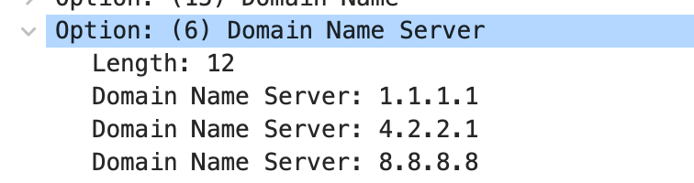
Who is your resolver?
You go to starbucks, how does your browser find www.google.com?
Typical, classic way: use DNS server from DHCP
Can you trust this DNS server?

Slide 29
What if the resolver doesn’t want you accessing a site?
You
Local DNS
example.com
5.6.7.8

Slide 30
Great Firewall of CIT
If attacker is on the path (say, it is the ISP, or a malicious version of TStaff), what could they do?

Slide 31
What if the resolver doesn’t want you accessing a site?
You
Local DNS
Public DNS
example.com
5.6.7.8

Slide 32
You
Local DNS
Public DNS
example.com
5.6.7.8

Slide 33
DNS filtering/etc.: applications

Slide 34
Great Firewall of CIT
If attacker is on the path (say, it is the ISP, or a malicious version of TStaff), what could they do?
  Can sniff all DNS queries
  Send fake responses back first
  Could do this selectively, to direct facebook.com to cs.brown.edu, for example…

Slide 35
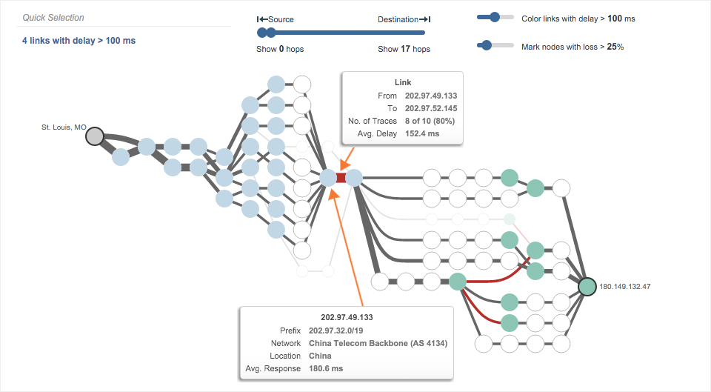
https://www.thousandeyes.com/blog/internet-censorship-around-the-world

Slide 36
https://blog.thousandeyes.com/monitoring-dns-in-china/

Slide 37
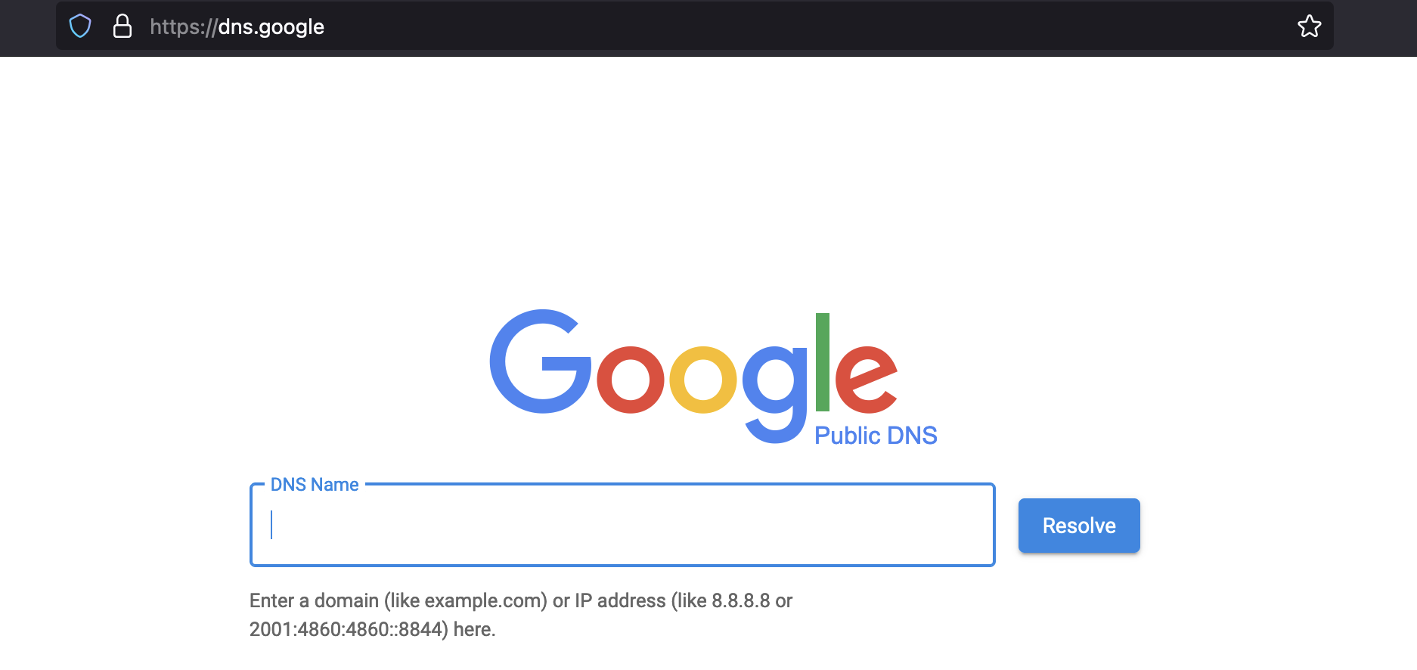
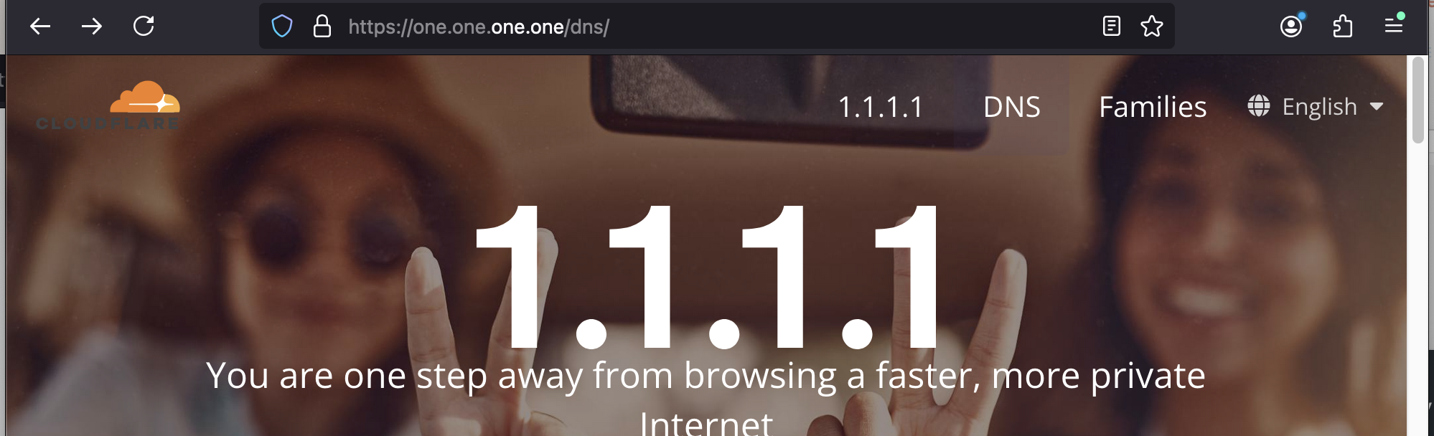
Public DNS: resolvers provided by cloud companies and ISPs

Slide 38
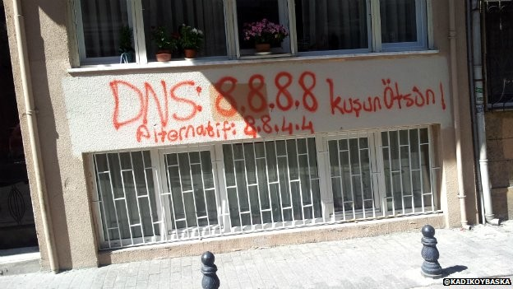
Changing DNS servers in response to blocking of Twitter in Turkey (2014)
Writeup, with more links: https://www.thousandeyes.com/blog/internet-censorship-around-the-world

Slide 39
What else can a less-than-honest resolver do?
You
Local DNS
Public DNS
example.com
5.6.7.8

Slide 40
“Helpful” ISPs
Many ISPs hijack NXDOMAIN responses to “help” by offering search and advertisement related to the domain
E.g., www.bicycleisntadomain.com doesn’t (currently) exist
  Could return a page with search and ads on bicycles (or domain registrations?)

Slide 41
What can be done?

Slide 42
What can be done?
Some defenses:
=> DNS over HTTPS (DoH): Similar protocol, but occurs over secure channel (same as HTTPS websites)
=> DNSSEC: protocol to sign/verify hierarchy of DNS lookups
  Expensive to deploy, hierarchy must support at all levels

Slide 43
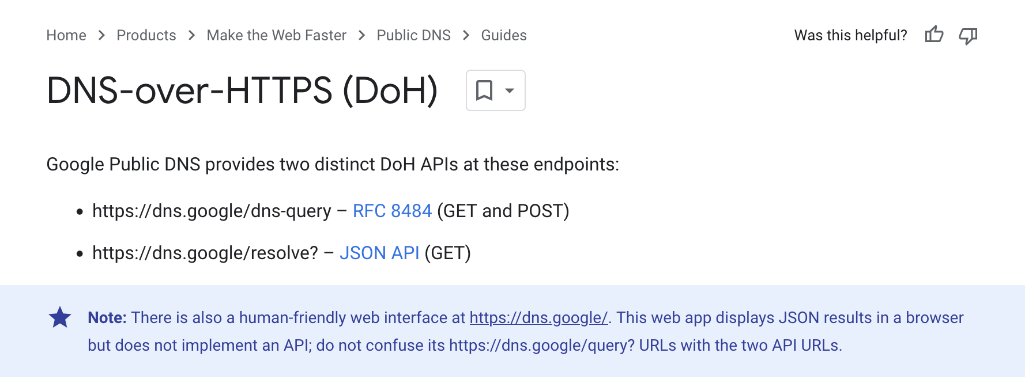


Slide 44
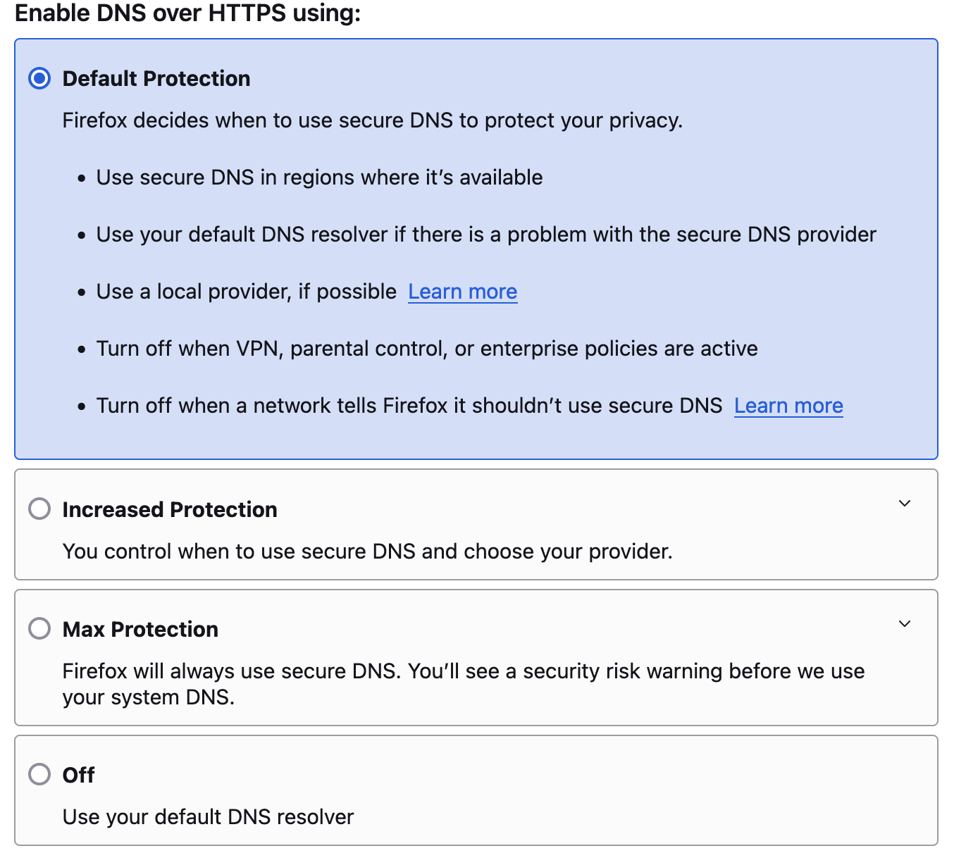

Slide 45
DNS over HTTPs
You
DoH DNS server
example.com
5.6.7.8

Slide 46
DNS over HTTPs
You
DoH DNS server
example.com
5.6.7.8
Problems?

Slide 47
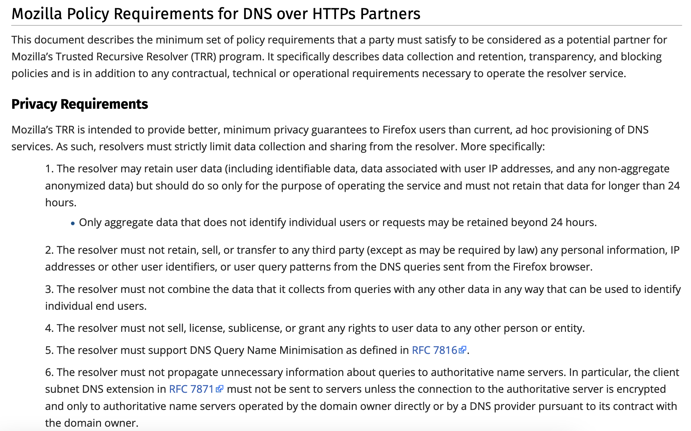
Mozilla privacy requirements for a Trusted DoH Resolver

Slide 48
Is a less-than-honest resolver always bad?

Slide 49
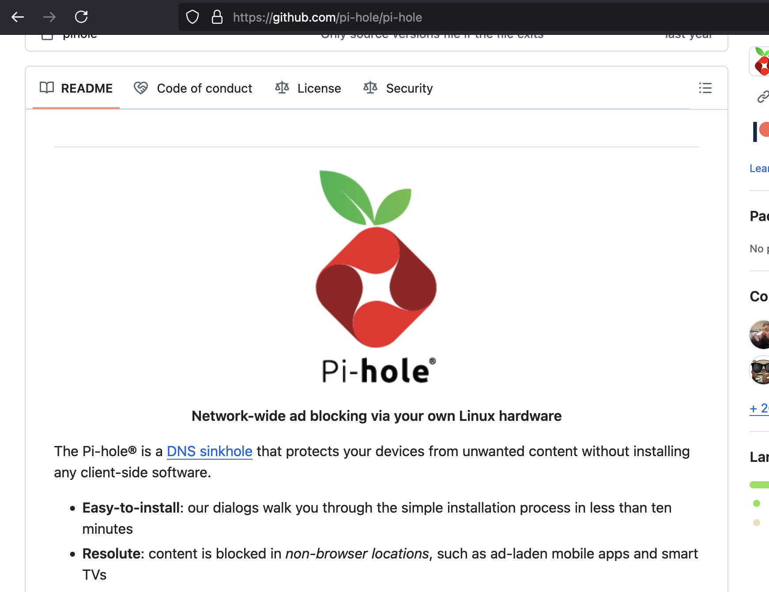
DNS filtering for (weak) ad blocking

Slide 50
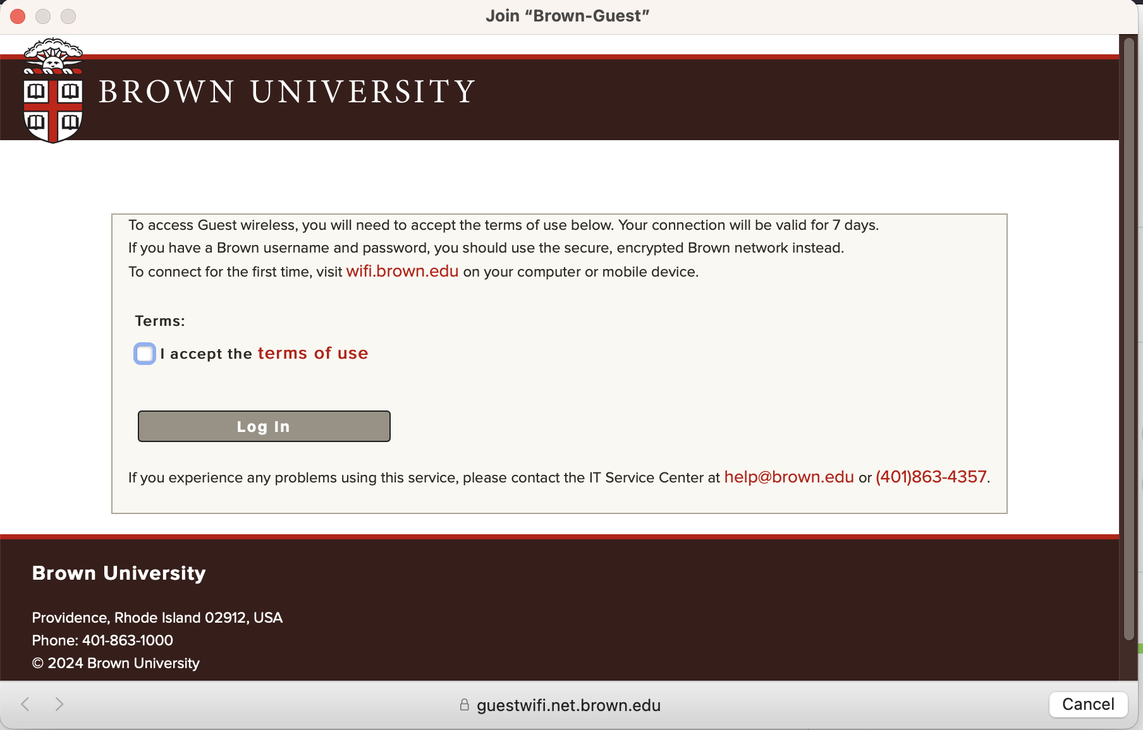
Captive portals

Slide 51
More on DNS

Slide 52
Reverse DNS
What if we want to map IP address => domain name?
Notes:
dig -tPTR 12.32.148.128.in-addr.arpa

Slide 53
Reverse DNS
What if we want to map IP address => domain name?
Leverages hierarchy in IP addresses, but in reverse
=> How? reverse the numbers: 12.32.148.128, then look that up
Notes:
dig -tPTR 12.32.148.128.in-addr.arpa

Slide 54
Structure of a DNS Message
Same format for queries and replies
  Query has 0 RRs in Answer/Authority/Additional
  Reply includes question, plus has RRs
Authority allows for delegation
Additional for glue, other RRs client might need

Slide 55
Header format
Id: match response to query; QR: 0 query/1 response
RCODE: error code.
AA: authoritative answer, TC: truncated,
RD: recursion desired, RA: recursion available

Slide 56
Other RR Types
CNAME (canonical name): specifies an alias
www.google.com. 446199 IN CNAME www.l.google.com.
www.l.google.com. 300 IN A 72.14.204.147
MX record: specifies servers to handle mail for a domain (the part after the @ in email addr)
  Different for historical reasons
SOA (start of authority)
  Information about a DNS zone and the server responsible for the zone
PTR (reverse lookup)
7.34.148.128.in-addr.arpa. 86400 IN PTR quanto.cs.brown.edu.

Slide 57
Example
dig . ns
dig +norec www.cs.brown.edu @a.root-servers.net
dig +norec www.cs.brown.edu @a.edu-servers.net
dig +norec www.cs.brown.edu @bru-ns1.brown.edu
www.cs.brown.edu. 86400 IN A 128.148.32.110

Slide 58
Resource Records
All DNS info represented as resource records (RR)
name [ttl] [class] type rdata
  name: domain name
  TTL: time to live in seconds
  class: for extensibility, normally IN (1) “Internet”
  type: type of the record
  rdata: resource data dependent on the type
Example RRs
  www.cs.brown.edu. 86400 IN A 128.148.32.110
  cs.brown.edu. 86400 IN NS dns.cs.brown.edu.
  cs.brown.edu. 86400 IN NS ns1.ucsb.edu.

Slide 59
DNS Example
$ dig cs.brown.edu @10.1.1.10
; <<>> DiG 9.10.6 <<>> cs.brown.edu @10.1.1.10
;; global options: +cmd
;; Got answer:
;; ->>HEADER<<- opcode: QUERY, status: NOERROR, id: 8536
;; flags: qr aa rd ra; QUERY: 1, ANSWER: 1, AUTHORITY: 0, ADDITIONAL: 1
;; OPT PSEUDOSECTION:
; EDNS: version: 0, flags:; udp: 1220
;; QUESTION SECTION:
;cs.brown.edu. IN A
;; ANSWER SECTION:
cs.brown.edu. 1800 IN A 128.148.32.12
;; Query time: 69 msec
;; SERVER: 10.1.1.10#53(10.1.1.10)
;; WHEN: Tue Apr 19 09:03:39 EDT 2022
;; MSG SIZE rcvd: 57
Notes:
Responses called Resource Records (RRs)

Slide 60
DNS Example
When server doesn’t know all info…
% dig +norec cs.brown.edu @j.root-servers.net
; <<>> DiG 9.10.6 <<>> +norec cs.brown.edu @j.root-servers.net
;; global options: +cmd
;; Got answer:
;; ->>HEADER<<- opcode: QUERY, status: NOERROR, id: 61618
;; flags: qr; QUERY: 1, ANSWER: 0, AUTHORITY: 13, ADDITIONAL: 27
;; OPT PSEUDOSECTION:
; EDNS: version: 0, flags:; udp: 1232
;; QUESTION SECTION:
;cs.brown.edu. IN A
;; AUTHORITY SECTION:
edu. 172800 IN NS a.edu-servers.net.
edu. 172800 IN NS b.edu-servers.net.
edu. 172800 IN NS l.edu-servers.net.
edu. 172800 IN NS m.edu-servers.net.
;; ADDITIONAL SECTION:
a.edu-servers.net. 172800 IN A 192.5.6.30
b.edu-servers.net. 172800 IN A 192.33.14.30
c.edu-servers.net. 172800 IN A 192.26.92.30
d.edu-servers.net. 172800 IN A 192.31.80.30
e.edu-servers.net. 172800 IN A 192.12.94.30
Notes:
Responses called Resource Records (RRs)

Slide 61
What we have
IP addresses
Used by routers to forward packets
Fixed length, binary numbers
Assigned based on where host is on the network
Usually refers to one host
Examples
5.6.7.8
212.58.224.138
2620:6e:6000:900:c1d:c9f7:8a1c:2f48
Efficient forwarding: ✅
Human readable: ❌
Scalable for distributed services: ❌

Slide 62
What we have
IP addresses
Used by routers to forward packets
Fixed length, binary numbers
Assigned based on where host is on the network
Usually refers to one host
Examples
5.6.7.8
212.58.224.138
2620:6e:6000:900:c1d:c9f7:8a1c:2f48
Efficient forwarding: ✅
Human readable: ❌
Scalable for distributed services: ❌
=> Need a new abstraction for “stuff” we are trying to access

Slide 63
What we want: a new abstraction for names
Server for website.com
5.6.7.8
You
connect(“website.com”, 80)
connect(5.6.7.8, 80)

Slide 64
What we want: a new abstraction for names
Server for website.com
5.6.7.8
You
connect(“website.com”, 80)
connect(5.6.7.8, 80)
Want: names
- Human-readable
- Variable length
- Don’t need to care about where destination is/what server it is
=> Can refer to a service, not just a host

Slide 65
Some important details
How do local servers find root servers?
  DNS lookup on a.root-servers.net ?
  Servers configured with root cache file
  Contains root name servers and their addresses
  . 3600000 IN NS A.ROOT-SERVERS.NET.
  A.ROOT-SERVERS.NET. 3600000 A 198.41.0.4
  ...
How do you get addresses of other name servers?
  To obtain the address of www.cs.brown.edu, ask a.edu-servers.net, says a.root-servers.net
  How do you find a.edu-servers.net?
  Glue records: A records in parent zone

Slide 66
Other uses of DNS
Local multicast DNS
  Used for service discovery
  Made popular by Apple
  This is how you learn of different Apple TVs in the building
Load balancing
CDNs (more on this later)

Slide 67
Reliability
Answers may contain several alternate servers
Try alternate servers on timeout
  Exponential backoff when retrying same server
Use same identifier for all queries
  Don’t care which server responds, take first answer

Slide 68
Negative Caching
Remember things that don’t work
  Misspellings like www.cnn.comm, ww.cnn.com
  Is the cost of these two queries the same?
These can take a long time to fail the first time
  Good to cache negative results so it will fail faster next time
But negative caching is optional, and not widely implemented

