Slide 1
CSCI-1680
HTTP
Nick DeMarinis
Based partly on lecture notes by Rodrigo Fonseca, Scott Shenker and John Jannotti

Slide 2
Administrivia
You should be doing your Milestone II meeting today
TCP: Due next Friday. Do not wait until the end.
Gearup III: TODAY 4-5pm 85 Waterman 015
How to think about remaining parts, how to test in Wireshark

Slide 3
Administrivia
You should be doing your Milestone II meeting today
TCP: Due next Friday. Do not wait until the end.
Gearup III: TODAY 4-5pm 85 Waterman 015
How to think about remaining parts, how to test in Wireshark
HW4: Look for something SRC and TCP-based instead

Slide 4
Warmup
True or False: If two hosts make a DNS query for the same domain (eg. example.com), will they always get the same answer?
Explain why or why not.

Slide 5
Content Delivery Networks (CDNs) [a preview]

Slide 6
Content Delivery Networks (CDNs) [a preview]
Widely-distributed entities that offer high-performance web services
=> Caching + “other stuff” to help with scaling, reliability, security, …
=> More on this later!
Examples: Cloudflare, Akamai, (Google, Amazon), …
=> CDNs leverage DNS to send you to what they consider the “best” (eg. “closest”) server
More on this later!

Slide 7
HTTP: Hypertext Transfer Protocol

Slide 8
HTTP
“Application protocol for distributed, collaborative
hypermedia information systems”

Slide 9
HTTP
“Application protocol for distributed, collaborative
hypermedia information systems”
Fundamental protocol behind “the web”
Now part of most things we do on the Internet—so much more than web pages

Slide 10
HTTP
“Application protocol for distributed, collaborative
hypermedia information systems”
Fundamental protocol behind “the web”
Now part of most things we do on the Internet—so much more than web pages
But what is hypertext?

Slide 11
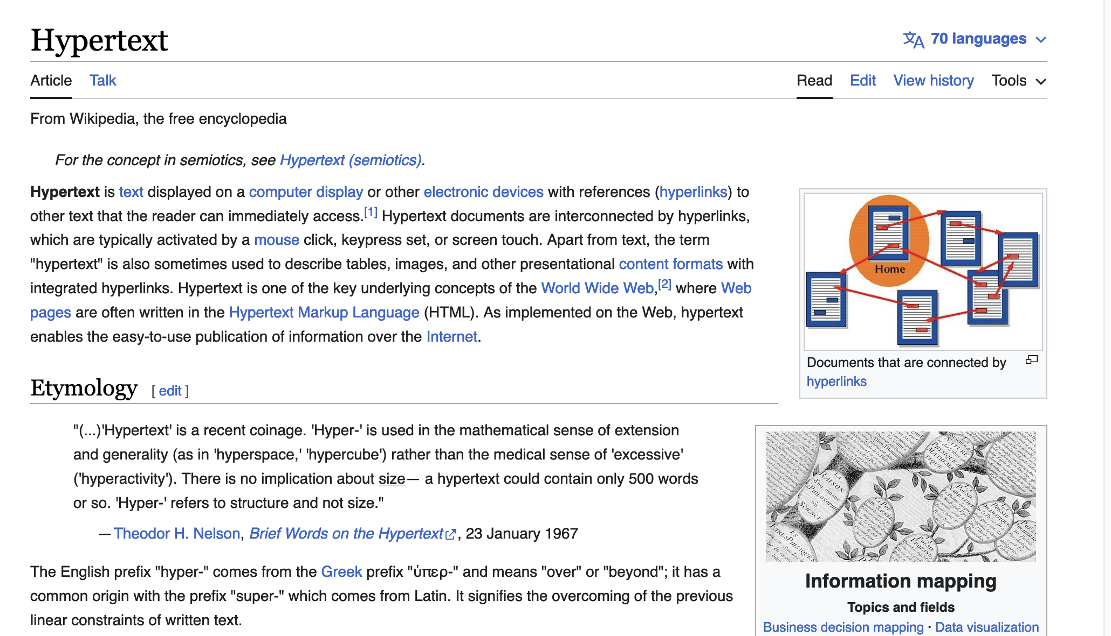

Slide 12
“As we may think”, Vannevar Bush (1945)
“The human mind…operates by association. With one item in its grasp, it snaps instantly to the next … in accordance with some intricate web of trails carried by the cells of the brain”

Slide 13
“As we may think”, Vannevar Bush (1945)
“The human mind…operates by association. With one item in its grasp, it snaps instantly to the next … in accordance with some intricate web of trails carried by the cells of the brain”
Defines the “Memex”: “a device in which an individual stores all his books, records, and communications, and which is mechanized so that it may be consulted with exceeding speed and flexibility”

Slide 14
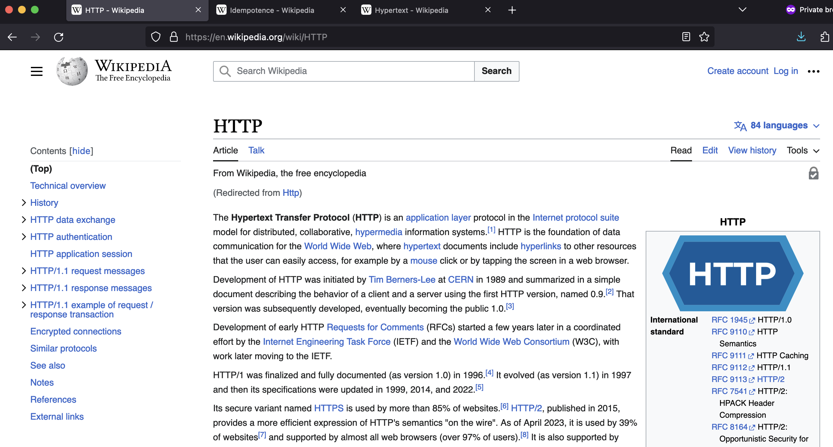

Slide 15
HTTP: a protocol for distributing hypertext media
(*and now so much more)

Slide 16
HTTP: a protocol for distributing hypertext media
(*and now so much more)
Enables the World Wide Web (WWW): a distributed database of pages linked through HTTP

Slide 17
HTTP: a protocol for distributing hypertext media
(*and now so much more)
Enables the World Wide Web (WWW): a distributed database of pages linked through HTTP
… now synonymous with with “The Internet” itself!

Slide 18
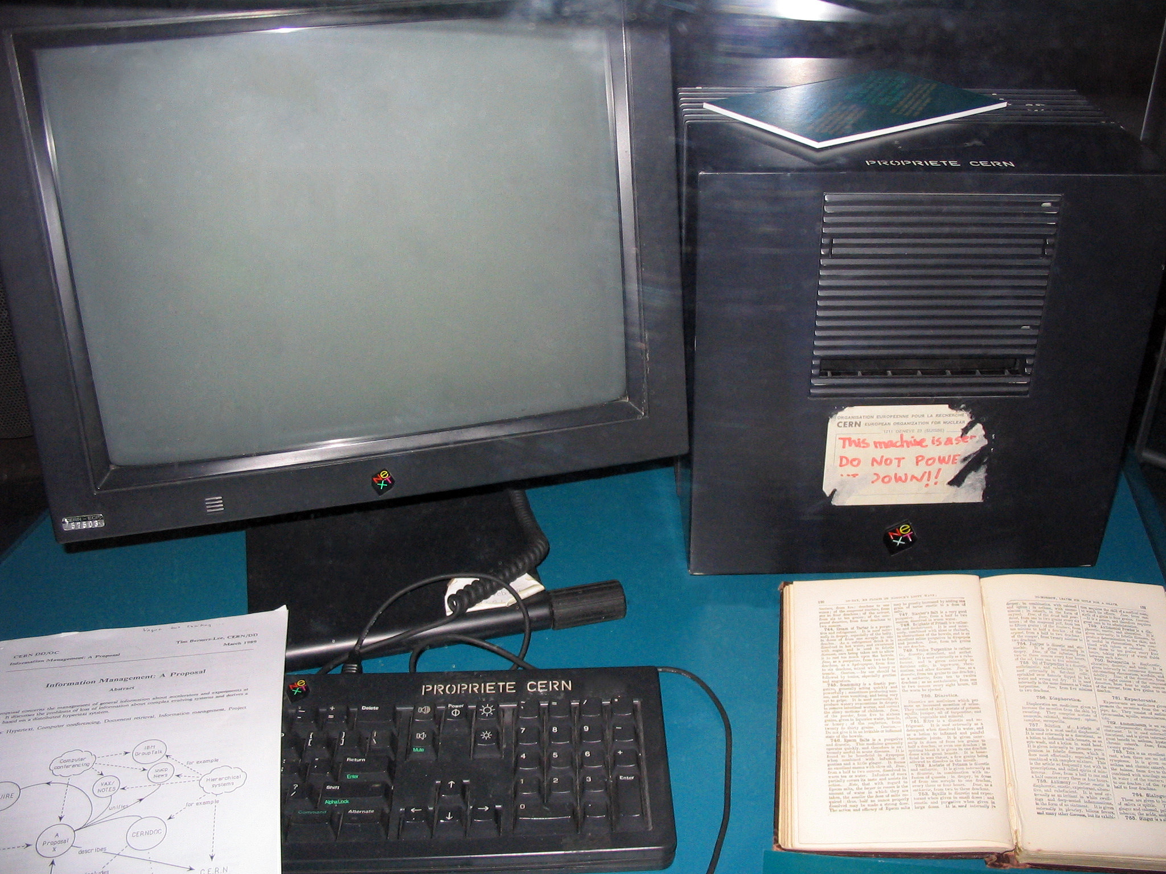
Some history
1990: First HTTP implementation
  Tim Berners-Lee, CERN
1992: HTTP/1.0:
Client/server information, some caching
1996: HTTP/1.1
  Extensive caching
  Some things for performance/scaling…
The first webserver

Slide 19
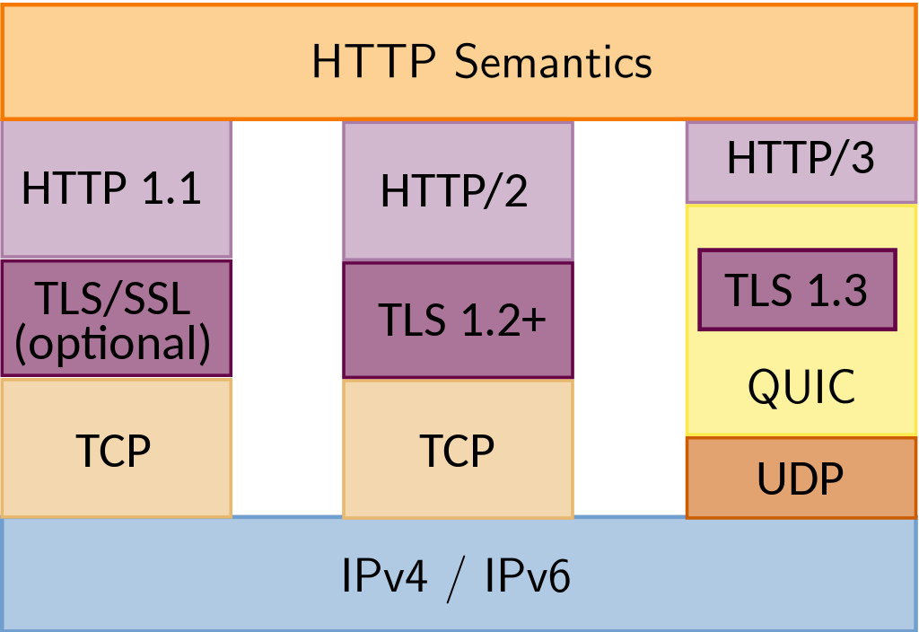
2015: HTTP/2
  Main goal: reduce latency
2022: HTTP/3
  Still: reduce latency
  Integrates security via TLS
  Replace transport layer with QUIC
  Already supported in >94% of browsers
http://httpwg.org/specs/rfc7540.html

Slide 20
How does “the web” work?

Slide 21
Webserver
example.com
page.html
<html>
<title>hi</title>
<h1>Welcome!</h1>
</html>

Slide 22
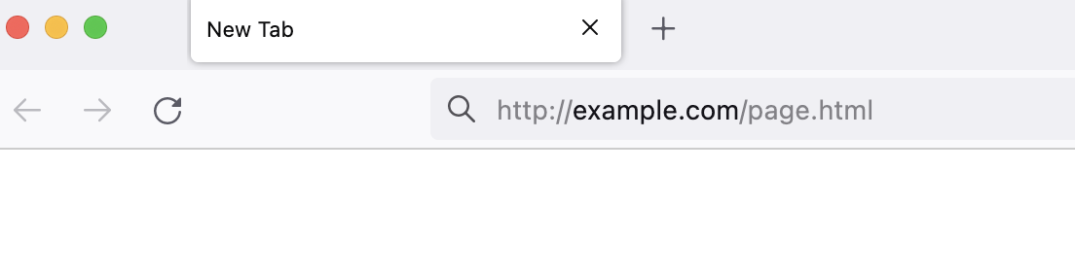
Web browser
Webserver
example.com
page.html
<html>
<title>hi</title>
<h1>Welcome!</h1>
</html>
URL: request what you want to visit

Slide 23
Web browser
Webserver
example.com
page.html
<html>
<title>hi</title>
<h1>Welcome!</h1>
</html>
URL: request what you want to visit

Slide 24
Web browser
Webserver
example.com
page.html
<html>
<title>hi</title>
<h1>Welcome!</h1>
</html>
Recap: What are all the steps we need to do before we get page.html?

Slide 26
Web browser
DNS
Webserver
example.com
example.com?
page.html
<html>
<title>hi</title>
<h1>Welcome!</h1>
</html>
First step: look up where server is on Internet
=> Usually, via DNS

Slide 27
Web browser
DNS
Webserver
example.com
example.com?
page.html
<html>
<title>hi</title>
<h1>Welcome!</h1>
</html>
GET /page.html
Connect to server’s IP, Initiate a request for page
=> Via TCP (usually)

Slide 28
Web browser
DNS
Webserver
example.com
example.com?
page.html
<html>
<title>hi</title>
<h1>Welcome!</h1>
</html>
GET /page.html
200 OK + (Content of page.html)
Welcome!
Server returns response (in this case, with HTML)

Slide 30
Why so successful?
Anyone can host a website!
… just need a domain and a server

Slide 31
Why so successful?
Anyone can host a website!
… just need a domain and a server
Clients can easily find arbitrary pages, pages can easily link to others => content can grow very quickly

Slide 32
HTTP components
Content: objects (HTML, images, JSON, …)
Clients: send requests, receive response
Servers: store content, or generate it

Slide 33
HTTP components
Content: objects (HTML, images, JSON, …)
Clients: send requests, receive response
Servers: store content, or generate it
Proxies/Middleboxes
  Placed between clients and servers
  Do extra stuff: caching, anonymization, logging, transcoding, filtering access
=> Important for scaling, modern browsing…
more on this later

Slide 34
How to find stuff?
So far: DNS: names for one or more hosts
  eg. cs.brown.edu
How do we ask for a specific resource from this host?
URL: Uniform Resource Locator

Slide 35
How to find stuff?
So far: DNS: names for one or more hosts
  eg. cs.brown.edu
How do we ask for a specific resource from this host?
URL: Uniform Resource Locator

Slide 36
URLs: how we find stuff
https://brown-csci1680.github.io/policies/index.html#late-policy

Slide 37
How to find stuff: URLs
protocol://[name@]hostname[:port]/directory/resource?k1=v1&k2=v2#tag
Name: can identify a client
Hostname: FQDN or IP address
Port number: defaults to common protocol port (eg. 80, 22)
Directory: path to the resource
Resource: name of the object
After that, various delimiters to specify further, common examples:
  ?parameters are passed to the server for execution
  #tag allows jumps to named tags within document

Slide 38
HTTP: the protocol
Client-server protocol
Protocol (but not data) in ASCII (before HTTP/2)
Stateless
Server typically listens on port 80 (or 443, with TLS)
Server sends response, may close connection (client may ask it to say open)

Slide 39
Steps in HTTP^{(1.0)} Request
Open TCP connection to server
Send request
Receive response
TCP connection terminates
  How many RTTs for a single request?
You may also need to do a DNS lookup first!

Slide 40
> nc cs.brown.edu 80
GET / HTTP/1.0
Host: cs.brown.edu
Content-Type: text/html
Accept-Language: en
HTTP/1.1 200 OK
Date: Thu, 24 Mar 2011 12:58:46 GMT
Server: Apache/2.2.9 (Debian) mod_ssl/2.2.9 OpenSSL/0.9.8g
Last-Modified: Thu, 24 Mar 2011 12:25:27 GMT
ETag: "840a88b-236c-49f3992853bc0"
Accept-Ranges: bytes
Content-Length: 9068
Vary: Accept-Encoding
Connection: close
Content-Type: text/html
<!DOCTYPE html PUBLIC "-//W3C//DTD XHTML 1.0 Strict//EN"
"http://www.w3.org/TR/xhtml1/DTD/xhtml1-strict.dtd">
<html xmlns="http://www.w3.org/1999/xhtml" xml:lang="en" lang="en”>
...

Slide 41
HTTP Request
Method:
  GET: current value of resource, run program
  POST: update a resource, provide input for a program. . .
Headers: useful info about request
  E.g., desired language, text encoding

Slide 42
Sample Browser Request
GET / HTTP/1.1
Host: localhost:8000
User-Agent: Mozilla/5.0 (Macinto ...
Accept: text/xml,application/xm ...
Accept-Language: en-us,en;q=0.5
Accept-Encoding: gzip,deflate
Accept-Charset: ISO-8859-1,utf-8;q=0.7,*;q=0.7
(empty line)
In your browser: right click => Inspect element => Network

Slide 43
HTTP Responses
Status codes to indicate something about the result
1xx: Information e.g, 100 Continue
2xx: Success e.g., 200 OK
3xx: Redirection e.g., 302 Found (elsewhere),
4xx: Client Error e.g., 403 Forbidden, 404 Not Found
5xx: Server Error e.g, 503 Service Unavailable

Slide 44
HTTP is Stateless
Each request/response treated independently
Servers not required to maintain state

Slide 45
HTTP is Stateless
Each request/response treated independently
Servers not required to maintain state
But…
  Most applications need persistent state
  E.g., shopping cart, web-mail, usage tracking, (most sites today!)

Slide 46
HTTP Cookies
Client-side state maintenance
  Client stores small state on behalf of server
  Sends request in future requests to the server
  Cookie value is meaningful to the server (e.g., session id)
Can provide authentication
1. Request
Client
2. Response
Set-Cookie: XYZ
Server
3. Request
Cookie: XYZ

Slide 47
Anatomy of a Web Page
HTML content
A number of additional resources
  Images
  Scripts
  Frames
Browser makes one HTTP request for each object
  Course web page: 14 objects
  Modern web pages: hundreds of objects

Slide 48
How do web sites work?
(at least, in terms of HTTP)

Slide 49
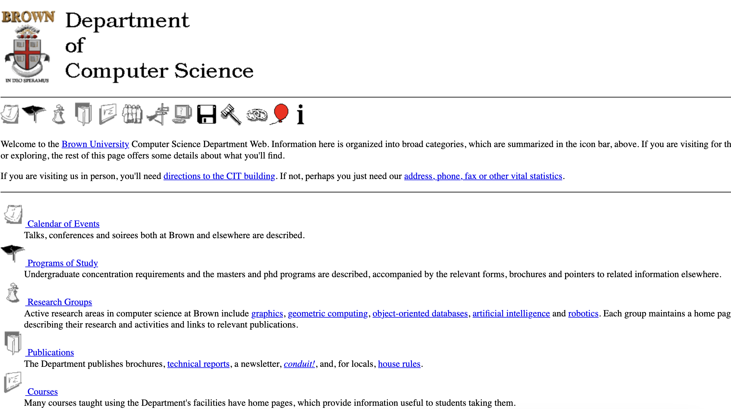

Slide 50
Fetching a website
Visit some initial URL: http://cs.brown.edu
=> Browser fetches some initial page (often completes to index.html)
=> Initial page tells browser about other resources to fetch (eg. images, fonts, videos, …)
=> Page contains links that lead elsewhere => repeat proces

Slide 51
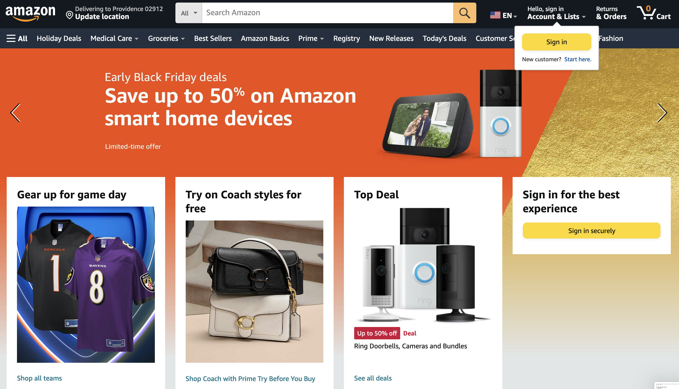

Slide 52
Modern web pages and HTTP
Web APIs: HTTP response/requests are a standard way to ask for anything
Modern web pages: use Javascript to make lots of requests without reloading page
  And can use APIs for all kinds of other stuff

Slide 53
What does a webserver look like?
Webservers can…
Serve static content
Generate/serve dynamic content
Host lots of things at once
Lots of possibilities!!!!!!

Slide 54
What does a webserver look like?
Webservers can…

Slide 56
Example: Github public API
$ curl https://api.github.com/users/ndemarinis
{
"login": "ndemarinis",
"id": 1191319,
"node_id": "MDQ6VXNlcjExOTEzMTk=",
"avatar_url": "https://avatars.githubusercontent.com/u/1191319?v=4",
"gravatar_id": "",
"url": "https://api.github.com/users/ndemarinis",
"type": "User",
"site_admin": false,
"name": "Nick DeMarinis",
"blog": "https://vty.sh",
"twitter_username": null,
"public_repos": 10,
. . .
}

Slide 57
HTTP
> telnet www.cs.brown.edu 80
Trying 128.148.32.110...
Connected to www.cs.brown.edu.
Escape character is '^]'.
GET / HTTP/1.0
HTTP/1.1 200 OK
Date: Thu, 24 Mar 2011 12:58:46 GMT
Server: Apache/2.2.9 (Debian) mod_ssl/2.2.9 OpenSSL/0.9.8g
Last-Modified: Thu, 24 Mar 2011 12:25:27 GMT
ETag: "840a88b-236c-49f3992853bc0"
Accept-Ranges: bytes
Content-Length: 9068
Vary: Accept-Encoding
Connection: close
Content-Type: text/html
<!DOCTYPE html PUBLIC "-//W3C//DTD XHTML 1.0 Strict//EN"
"http://www.w3.org/TR/xhtml1/DTD/xhtml1-strict.dtd">
<html xmlns="http://www.w3.org/1999/xhtml" xml:lang="en" lang="en”>
...

Slide 58
HTTP: What matters for performance?
Depends on type of request
  Lots of small requests (objects in a page)
  Some big requests (large download or video)

Slide 59
Small Requests
Latency matters
RTT dominates
Major steps:
  DNS lookup (if not cached)
  Opening a TCP connection
  Setting up TLS (optional, but now common)
  Actually sending the request and receiving response

Slide 60
How can we reduce the number of connection setups?
Keep the connection open and request all objects serially
  Works for all objects coming from the same server
  Which also means you don’t have to “open” the window each time
Persistent connections (HTTP/1.1)

Slide 61
Browser Request
GET / HTTP/1.1
Host: localhost:8000
User-Agent: Mozilla/5.0 (Macinto ...
Accept: text/xml,application/xm ...
Accept-Language: en-us,en;q=0.5
Accept-Encoding: gzip,deflate
Accept-Charset: ISO-8859-1,utf-8;q=0.7,*;q=0.7
Keep-Alive: 300
Connection: keep-alive

Slide 62
Small Requests (cont)
Second problem is that requests are serialized
  Similar to stop-and-wait protocols!
Two solutions
  Pipelined requests (similar to sliding windows)
  Parallel Connections
    Browsers implement this differently—see “Inspect element”
  How are these two approaches different?
Notes:
Transport layer is different

Slide 63
HTTP/2
Adds more options to trade off:
Multiplexed streams on same connection
  Plus stream weights, dependencies
No head of line blocking!
  But what happens if there is packet loss?
https://www.twilio.com/blog/2017/10/http2-issues.html
Notes:
Head of line blocking!

Slide 64
HTTP/3
Mapping of HTTP semantics onto QUIC
  E.g., QUIC already implements multiple streams, and HTTP doesn’t need to do it
QUIC: Another transport-layer protocol, intended to replace TCP
  RFC9000
  Same goals as TCP, but…
  Integrates security by default (TLS, next class)
  Supports multiple streams at once
  Various tricks to reduce message size and latency
By moving multiplexing into the transport layer, can do so in a way that benefits HTTP (no head of line blocking!)
Notes:
Removing abstractions is good sometimes

Slide 65
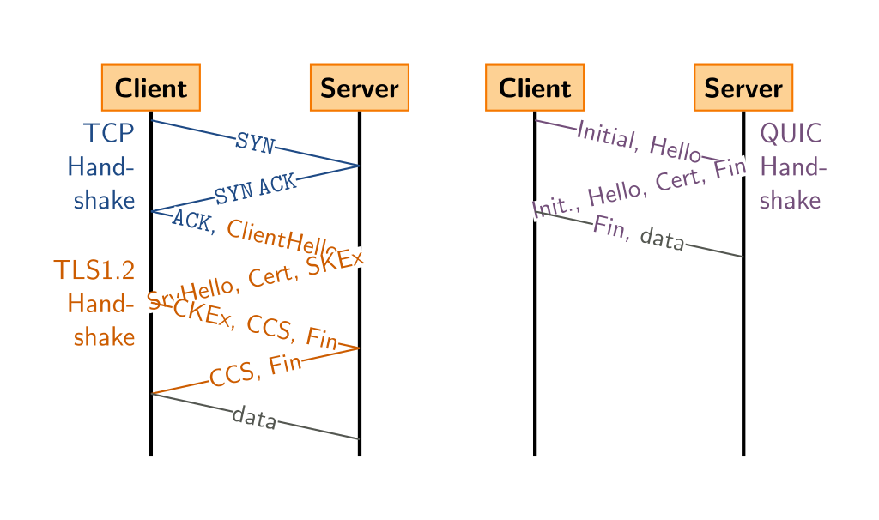
Comparison: QUIC’s handshake

Slide 66
Larger Objects
Problem is throughput in bottleneck link
Solution: HTTP Proxy Caching
  Also improves latency, and reduces server load

Slide 67
How to Control Caching?
Server sets options
  Expires header
  No-Cache header
Client can do a conditional request:
  Header option: if-modified-since
  Server can reply with 304 NOT MODIFIED

Slide 68
Caching
Where to cache content?
  Client (browser): avoid extra network transfers
  Server: reduce load on the server
  Service Provider: reduce external traffic
Server
Backbone ISP
ISP-1
ISP-2
Clients

Slide 69
Caching
Why caching works?
  Locality of reference:
    Users tend to request the same object in succession
    Some objects are popular: requested by many users
Server
Backbone ISP
ISP-1
ISP-2
Clients

Slide 70
How well does caching work?
Very well, up to a point
  Large overlap in requested objects
  Objects with one access place upper bound on hit ratio
  Dynamic objects not cacheable*
Example: Wikipedia
  About 400 servers, 100 are HTTP Caches (Squid)
  85% Hit ratio for text, 98% for media
* But can cache portions and run special code on edges to reconstruct

Slide 71
HTTP Cache Control
Cache-Control = "Cache-Control" ":" 1#cache-directive
cache-directive = cache-request-directive
| cache-response-directive
cache-request-directive =
"no-cache" ; Section 14.9.1
| "no-store" ; Section 14.9.2
| "max-age" "=" delta-seconds ; Section 14.9.3, 14.9.4
| "max-stale" [ "=" delta-seconds ] ; Section 14.9.3
| "min-fresh" "=" delta-seconds ; Section 14.9.3
| "no-transform" ; Section 14.9.5
| "only-if-cached" ; Section 14.9.4
| cache-extension ; Section 14.9.6
cache-response-directive =
"public" ; Section 14.9.1
| "private" [ "=" <"> 1#field-name <"> ] ; Section 14.9.1
| "no-cache" [ "=" <"> 1#field-name <"> ]; Section 14.9.1
| "no-store" ; Section 14.9.2
| "no-transform" ; Section 14.9.5
| "must-revalidate" ; Section 14.9.4
| "proxy-revalidate" ; Section 14.9.4
| "max-age" "=" delta-seconds ; Section 14.9.3
| "s-maxage" "=" delta-seconds ; Section 14.9.3
| cache-extension ; Section 14.9.6
cache-extension = token [ "=" ( token | quoted-string ) ]

Slide 72
Reverse Proxies
Close to the server
  Also called Accelerators
  Only work for static content
Server
Reverse proxies
Backbone ISP
ISP-1
ISP-2
Clients

Slide 73
Forward Proxies
Typically done by ISPs or Enterprises
  Reduce network traffic and decrease latency
  May be transparent or configured
Server
Reverse proxies
Backbone ISP
ISP-1
ISP-2
Forward proxies
Clients

Slide 74
Content Distribution Networks
Integrate forward and reverse caching
  One network generally administered by one entity
  E.g. Akamai
Provide document caching
  Pull: result from client requests
  Push: expectation of high access rates to some objects
Can also do some processing
  Deploy code to handle some dynamic requests
  Can do other things, such as transcoding

Slide 75
Example CDN
Server
CDN
Backbone ISP
ISP-1
ISP-2
Forward proxies
Clients

Slide 76
How Akamai works
Akamai has cache servers deployed close to clients
  Co-located with many ISPs
Challenge: make same domain name resolve to a proxy close to the client
Lots of DNS tricks. BestBuy is a customer
  Delegate name resolution to Akamai (via a CNAME)

Slide 77
DNS Resolution
dig www.bestbuy.com
;; ANSWER SECTION:
www.bestbuy.com. 3600 IN CNAME www.bestbuy.com.edgesuite.net.
www.bestbuy.com.edgesuite.net. 21600 IN CNAME a1105.b.akamai.net.
a1105.b.akamai.net. 20 IN A 198.7.236.235
a1105.b.akamai.net. 20 IN A 198.7.236.240
;; AUTHORITY SECTION:
b.akamai.net. 1101 IN NS n1b.akamai.net.
b.akamai.net. 1101 IN NS n0b.akamai.net.
;; ADDITIONAL SECTION:
n0b.akamai.net. 1267 IN A 24.143.194.45
n1b.akamai.net. 2196 IN A 198.7.236.236
n1b.akamai.net finds an edge server close to the client’s local resolver
  Uses knowledge of network: BGP feeds, traceroutes. Their secret sauce…

Slide 78
Example
From Brown
dig www.bestbuy.com
;; ANSWER SECTION:
www.bestbuy.com. 3600 IN CNAME www.bestbuy.com.edgesuite.net.
www.bestbuy.com.edgesuite.net. 21600 IN CNAME a1105.b.akamai.net.
a1105.b.akamai.net. 20 IN A 198.7.236.235
a1105.b.akamai.net. 20 IN A 198.7.236.240
  Ping time: 2.53ms
From Berkeley, CA
a1105.b.akamai.net. 20 IN A 198.189.255.200
a1105.b.akamai.net. 20 IN A 198.189.255.207
  Ping time: 3.20ms

Slide 79
Example
dig www.bestbuy.com
;; QUESTION SECTION:
;www.bestbuy.com. IN A
;; ANSWER SECTION:
www.bestbuy.com. 2530 IN CNAME www.bestbuy.com.edgekey.net.
www.bestbuy.com.edgekey.net. 85 IN CNAME e1382.x.akamaiedge.net.
e1382.x.akamaiedge.net. 16 IN A 104.88.86.223
;; Query time: 6 msec
;; SERVER: 192.168.1.1#53(192.168.1.1)
;; WHEN: Thu Nov 16 09:43:11 2017
;; MSG SIZE rcvd: 123
traceroute to 104.88.86.223 (104.88.86.223), 64 hops max, 52 byte packets
1 router (192.168.1.1) 2.461 ms 1.647 ms 1.178 ms
2 138.16.160.253 (138.16.160.253) 1.854 ms 1.509 ms 1.462 ms
3 10.1.18.5 (10.1.18.5) 1.886 ms 1.705 ms 1.707 ms
4 10.1.80.5 (10.1.80.5) 4.276 ms 6.444 ms 2.307 ms
5 lsb-inet-r-230.net.brown.edu (128.148.230.6) 1.804 ms 1.870 ms 1.727 ms
6 131.109.200.1 (131.109.200.1) 2.841 ms 2.587 ms 2.530 ms
7 host-198-7-224-105.oshean.org (198.7.224.105) 4.421 ms 4.523 ms 4.496 ms
8 5-1-4.bear1.boston1.level3.net (4.53.54.21) 4.099 ms 3.974 ms 4.290 ms
9 * ae-4.r00.bstnma07.us.bb.gin.ntt.net (129.250.66.93) 4.689 ms 4.109 ms
10 ae-6.r24.nycmny01.us.bb.gin.ntt.net (129.250.4.114) 8.863 ms 10.205 ms 10.477 ms
11 ae-1.r08.nycmny01.us.bb.gin.ntt.net (129.250.5.62) 9.298 ms
ae-1.r07.nycmny01.us.bb.gin.ntt.net (129.250.3.181) 10.008 ms 8.677 ms
12 ae-0.a00.nycmny01.us.bb.gin.ntt.net (129.250.3.94) 8.543 ms 7.935 ms
ae-1.a00.nycmny01.us.bb.gin.ntt.net (129.250.6.55) 9.836 ms
13 a104-88-86-223.deploy.static.akamaitechnologies.com (104.88.86.223) 9.470 ms 8.483 ms 8.738 ms
dig www.bestbuy.com @109.69.8.51
e1382.x.akamaiedge.net. 12 IN A 23.60.221.144
traceroute to 23.60.221.144 (23.60.221.144), 64 hops max, 52 byte packets
1 router (192.168.1.1) 44.072 ms 1.572 ms 1.154 ms
2 138.16.160.253 (138.16.160.253) 2.460 ms 1.736 ms 2.722 ms
3 10.1.18.5 (10.1.18.5) 1.841 ms 1.649 ms 3.348 ms
4 10.1.80.5 (10.1.80.5) 2.304 ms 15.208 ms 2.895 ms
5 lsb-inet-r-230.net.brown.edu (128.148.230.6) 1.784 ms 4.744 ms 1.566 ms
6 131.109.200.1 (131.109.200.1) 3.581 ms 5.866 ms 3.238 ms
7 host-198-7-224-105.oshean.org (198.7.224.105) 4.288 ms 6.218 ms 8.332 ms
8 5-1-4.bear1.boston1.level3.net (4.53.54.21) 4.209 ms 6.103 ms 5.031 ms
9 ae-4.r00.bstnma07.us.bb.gin.ntt.net (129.250.66.93) 3.982 ms 5.824 ms 4.514 ms
10 ae-6.r24.nycmny01.us.bb.gin.ntt.net (129.250.4.114) 9.735 ms 12.442 ms 8.689 ms
11 ae-9.r24.londen12.uk.bb.gin.ntt.net (129.250.2.19) 81.098 ms 81.343 ms 81.120 ms
12 ae-6.r01.mdrdsp03.es.bb.gin.ntt.net (129.250.4.138) 102.009 ms 110.595 ms 103.010 ms
13 81.19.109.166 (81.19.109.166) 99.426 ms 93.236 ms 101.168 ms
14 a23-60-221-144.deploy.static.akamaitechnologies.com (23.60.221.144) 94.884 ms 92.779 ms 93.281 ms
Notes:
Other DNS servers to try:
77.88.8.8 (St Petersburg),
89.233.43.71 (Copenhagen),
202.46.32.22(Beijing)

Slide 80
Other CDNs
Akamai, Limelight, Cloudflare
Amazon, Facebook, Google, Microsoft
Netflix
Where to place content?
Which content to place? Pre-fetch or cache?

