Slide 1
CSCI-1680 DNS
Nick DeMarinis
Based partly on lecture notes by Rodrigo Fonseca, Scott Shenker and John Jannotti

Slide 2
Administrivia
TCP due this Friday (11/22)
See Ed for latest on bugs with reference
Look for an update on testing resources, SRC component (due after Thanksgiving)
It’s going to be okay.
Grading update, final project info out later this week

Slide 3
Breathe

Slide 4
Warmup
If a client A makes two separate HTTP requests to example.com, does the server know both requests came from A?
Explain why/why not.
A’s browser
example.com

Slide 6
Reverse proxy: proxy server that lives somewhere in the network, transparent to the client

Slide 7
A simple reverse proxy
<VirtualHost *:443>
ServerName test.cs1680.systems
ErrorLog "/var/log/httpd/test-error_log"
CustomLog "/var/log/httpd/test-access_log" combined
ProxyPass "/" "http://127.0.0.1:9999/"
ProxyPassReverse "/" "http://127.0.0.1:9999/"
SSLCertificateFile /etc/letsencrypt/live/test.cs1680.systems/fullchain.pem
SSLCertificateKeyFile /etc/letsencrypt/live/test.cs1680.systems/privkey.pem
Include /etc/letsencrypt/options-ssl-apache.conf
</VirtualHost>

Slide 8
Content Distribution Networks (CDNs)
Companies that specialize in providing caching services (among other things)
=> Akamai, Cloudflare, …

Slide 9
Content Distribution Networks (CDNs)
Companies that specialize in providing caching services (among other things)
Akamai, Cloudflare, …
Provides caching throughout network
Can also do some processing
Useful for security

Slide 10
Application servers
Backbone ISP
ISP-1
ISP-2
Clients

Slide 11
CDNs for securing traffic
DDoS attacks: overwhelm a target host/network with packets, denying resources for legitimate traffic

Slide 12
DDoS attacks: overwhelm a target host/network with packets, denying resources for legitimate traffic
=> Often performed by ”botnets” of compromised devices
=> Attack traffic can take many forms: lots of SYNs, DNS requests, exploiting bugs in protocols, …
Want to learn more? CS 1660.

Slide 13
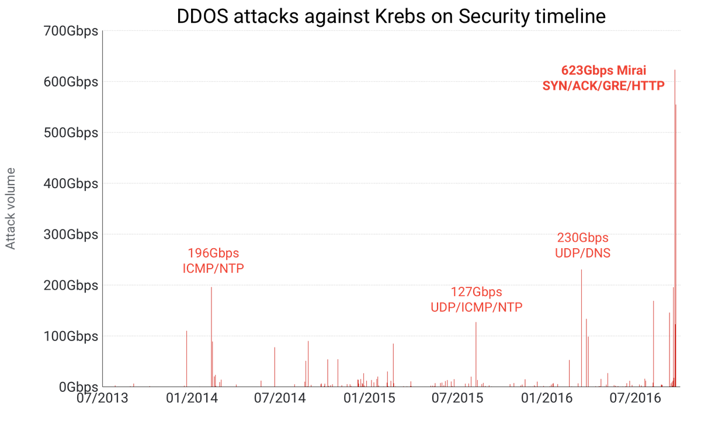

Slide 14
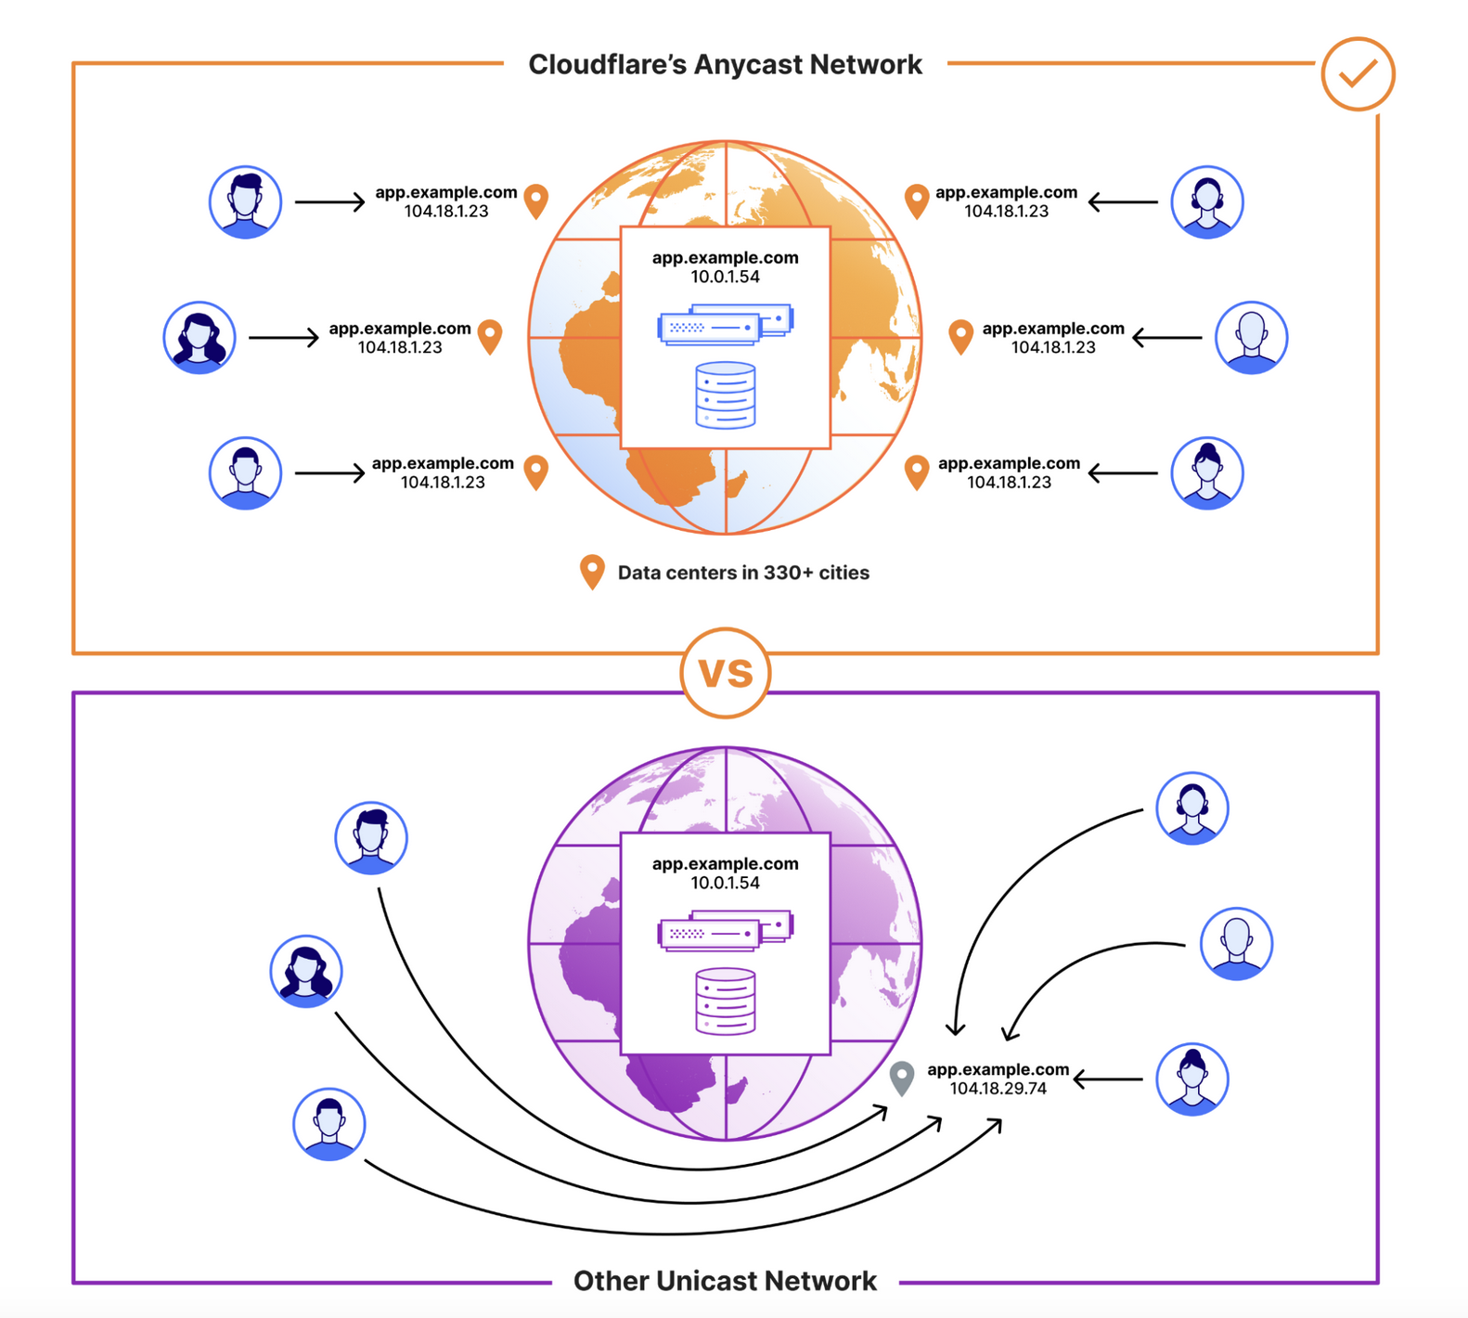
DDoS mitigation via CDN
Link

Slide 16
HTTP: what more do we need?

Slide 17
Welcome!
Web browser
Webserver
example.com
page.html
<html>
<title>hi</title>
<h1>Welcome!</h1>
</html>

Slide 18
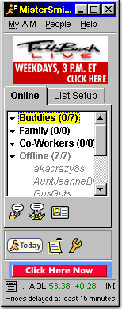
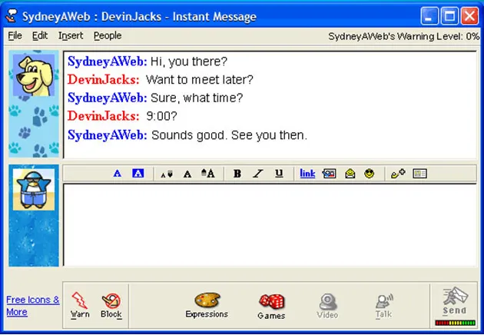
Example: Instant Messaging (~2005)

Slide 19
Example: Instant Messaging (~2005)
Old chat/IM applications: one TCP connection
=> Can we still do that?

Slide 20
Can we do this with HTTP?

Slide 21
Welcome!
Web browser
Webserver
example.com
page.html
<html>
<title>hi</title>
<h1>Welcome!</h1>
</html>
GET /page.html
200 OK + (Content of page.html)

Slide 22
Client
HTTP server
Request: GET /thing

Slide 23
Client
HTTP server
Request: GET /thing
Response: 200 OK + thing

Slide 24
Client
HTTP server
Request: GET /thing
Response: 200 OK + thing
HTTP request: a way to fetch (GET) or send (POST) some object
Doesn’t need to be a web page
Doesn’t need to be from a browser

Slide 25
When does this not work?

Slide 26
Browser
HTTP server
Request: GET /thing
Response: 200 OK + thing
Request, response model doesn’t always fit…
=> Server may need to send data asynchronously!

Slide 27
But it’s TCP right?
Browser
HTTP server
Request: GET /thing
Response: 200 OK + thing

Slide 28
But it’s TCP right?
Browser
HTTP server
Request: GET /thing
Response: 200 OK + thing
TCP is bidirectional, but the HTTP protocol is not.

Slide 29
What can be done?
Browser
Webserver
Can the server connect to the client?

Slide 30
What can be done?
Browser
Webserver
Can the server connect to the client?
Almost always no.
NAT, Firewalls, security policies are in the way
Don’t want to allow browser to open a listen port => security risk!

Slide 31
How to wait for the server’s response?
One way: Polling
for {
resp, err := doRequest(“http://example.com/do-you-have-my-data”)
if resp != nil {.
doThing(resp)
}
time.Sleep(1 * time.Second)
}

Slide 32
How to wait for the server’s response?
Another way: long polling
for {
resp, err := doRequest(“http://example.com/do-you-have-my-data”)
// ^ Assume this will block for very long time
doThing(resp)
}

Slide 33
How to wait for the server’s response?
Another way: long polling
Require server to hold connection open with long timeout,
respond when data is ready
for {
resp, err := doRequest(“http://example.com/do-you-have-my-data”)
// ^ Assume this will block for very long time
doThing(resp)
}
Problems?

Slide 34
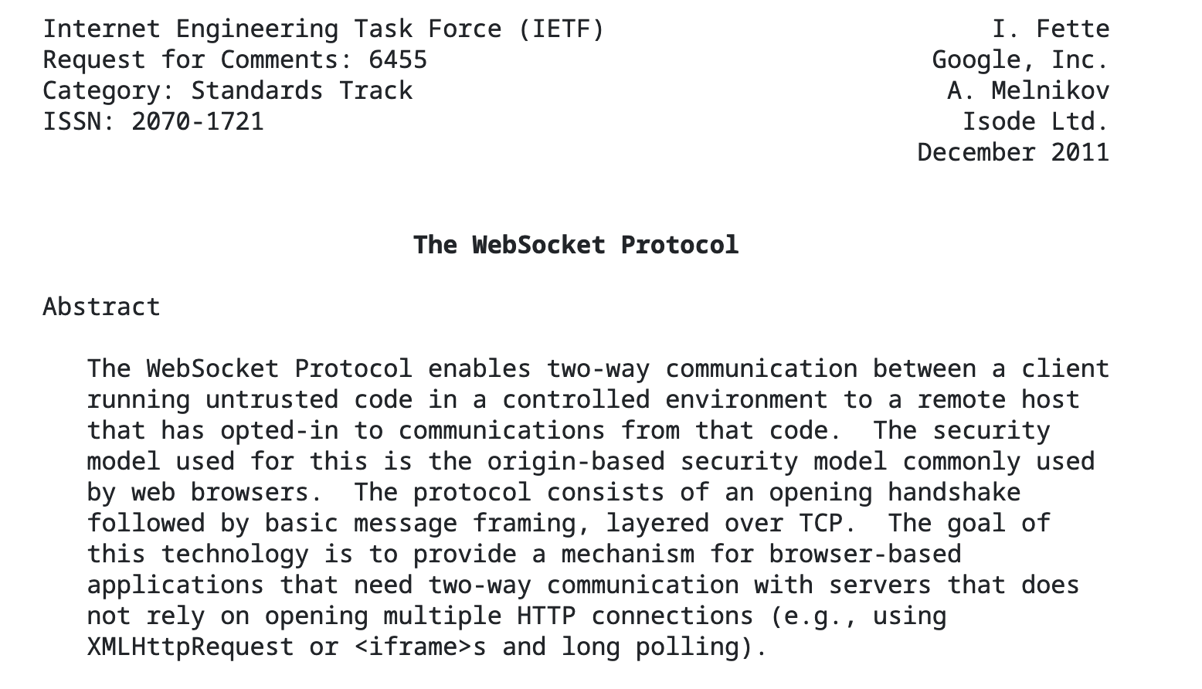
Another way: Websockets (RFC6455, 2011)

Slide 35
Another way: Websockets (RFC6455, 2011)
Persistent, bidirectional transport layer between browser and server
=> Can start with an HTTP request!
GET /chat
Host: javascript.info
Origin: https://javascript.info
Connection: Upgrade
Upgrade: websocket
Sec-WebSocket-Key: Iv8io/9s+lYFgZWcXczP8Q==
Sec-WebSocket-Version: 13

Slide 36
Push notifications

Slide 38
Client
HTTP server
Request: GET /thing
Response: 200 OK + thing
HTTP request: a way to fetch (GET) or send (POST) some object
Doesn’t need to be a web page
Doesn’t need to be from a browser
Generic way to ask the server to do something => an API over the network!

Slide 39
Modern websites don’t just load pages when you click links:
Every modern webpage is filled with arbitrary code, usually Javascript, which can make more requests:
async function doRequest() {
const response = await fetch("http://example.com/thing.json");
const data = await response.json();
console.log(data);
}
Can make requests when….
User does something (click button, scroll, ...)
Periodic events, timers, etc
…

Slide 40
Modern websites don’t just load pages when you click links:
Every modern webpage is filled with arbitrary code, usually Javascript, which can make more requests:
async function doRequest() {
const response = await fetch("http://example.com/thing.json");
const data = await response.json();
console.log(data);
}

Slide 41
Modern websites don’t just load pages when you click links:
Every modern webpage is filled with arbitrary code, usually Javascript, which can make more requests:
async function doRequest() {
const response = await fetch("http://example.com/thing.json");
const data = await response.json();
console.log(data);
}
Can make requests when….
User does certain action
Periodic events, timers, etc
…

Slide 42
Modern websites don’t just load pages when you click links:
Every modern webpage is filled with arbitrary code, usually Javascript, which can make more requests:
async function doRequest() {
const response = await fetch("http://example.com/thing.json");
const data = await response.json();
console.log(data);
}
Can make requests when….
User does certain action
Periodic events, timers, etc
…
“Arbitrary code”… from a web page? Sound sketchy? It can be. Take CS1660.

Slide 44
HTTP
> telnet www.cs.brown.edu 80
Trying 128.148.32.110...
Connected to www.cs.brown.edu.
Escape character is '^]'.
GET / HTTP/1.0
HTTP/1.1 200 OK
Date: Thu, 24 Mar 2011 12:58:46 GMT
Server: Apache/2.2.9 (Debian) mod_ssl/2.2.9 OpenSSL/0.9.8g
Last-Modified: Thu, 24 Mar 2011 12:25:27 GMT
ETag: "840a88b-236c-49f3992853bc0"
Accept-Ranges: bytes
Content-Length: 9068
Vary: Accept-Encoding
Connection: close
Content-Type: text/html
<!DOCTYPE html PUBLIC "-//W3C//DTD XHTML 1.0 Strict//EN"
"http://www.w3.org/TR/xhtml1/DTD/xhtml1-strict.dtd">
<html xmlns="http://www.w3.org/1999/xhtml" xml:lang="en" lang="en”>
...

Slide 45
Example: Github public API
$ curl https://api.github.com/users/ndemarinis
{
"login": "ndemarinis",
"id": 1191319,
"node_id": "MDQ6VXNlcjExOTEzMTk=",
"avatar_url": "https://avatars.githubusercontent.com/u/1191319?v=4",
"gravatar_id": "",
"url": "https://api.github.com/users/ndemarinis",
"type": "User",
"site_admin": false,
"name": "Nick DeMarinis",
"blog": "https://vty.sh",
"twitter_username": null,
"public_repos": 10,
. . .
}

Slide 46
Web browser
DNS
Webserver
example.com
example.com?
page.html
<html>
<title>hi</title>
<h1>Welcome!</h1>
</html>
GET /page.html
200 OK + (Content of page.html)
Welcome!
Server returns response (in this case, with HTML)

