Slide 1
CSCI-1680
TLS
Nick DeMarinis
Based partly on lecture notes by Rodrigo Fonseca, Scott Shenker and John Jannotti

Slide 2
Administrivia
Thanksgiving break!
  No hours/Ed support Wed-Fri
TCP grading: after break, signups on Mon, Dec 2
  You can work on your readme, fix small bugs before meeting without using late days

Slide 3
Administrivia
TCP was due Friday, Nov 22
  Like with IP: you can continue to make small bugfixes after the deadline
    OK: Fixing small bugs, README, capture files, code cleanup
    Not OK: eg. implementing sendfile/recvfile, teardown, submitting untested code
  Grading meetings: after break
After break: HW5, small SRC component, final project

Slide 4
Administrivia
TCP was due Friday, Nov 22
  Like with IP: you can continue to make small bugfixes after the deadline
    OK: Fixing small bugs, README, capture files, code cleanup
    Not OK: eg. implementing sendfile/recvfile, teardown, submitting untested code
  Grading meetings: after break

Slide 5
The final project
Out after break, handout online after class
  …maybe skim it before break?

Slide 6
The final project
Out after break, handout online after class
  …maybe skim it before break?
What it is
Open-ended: build something new related to class topics
List of ideas in document… or propose your own!

Slide 7
Project examples
Make your own iterative DNS resolver
Make your own web API / responsive website
Implement something (eg. Snowcast), etc. using RPCs (more next week)
Build your own traffic analyzer
Extend your IP/TCP in some way…

Slide 8
Project examples
Make your own iterative DNS resolver
Make your own web API / responsive website
Implement something (eg. Snowcast), etc. using RPCs (more next week)
Build your own traffic analyzer
Extend your IP/TCP in some way…
These are only a few ideas!

Slide 9
Final project Logistics
Out after break, document online after class
  …maybe skim it before break?
Deadlines
  Team assignment form: Due Monday, 12/2
    Keep your current groups, or form new ones, or work solo
  Project proposal: Due Friday, 12/6
  Final submission: Due Thursday, 12/16

Slide 10
Version 1
  func VWrite(toSend) {
  snd.add(toSend)
  }
  func SendThread() {
  for {
  if canSend() && snd.hasBytes() {
  doSend()
  }
  }
  }

Slide 11
Version 1
  func VWrite(toSend) {
  snd.add(toSend)
  }
  func SendThread() {
  for {
  if canSend() && snd.hasBytes() {
  doSend()
  }
  }
  }
  func VWrite(toSend) {
  snd.add(toSend)
  sendChan <- true
  }
  func SendThread() {
  for {
  <- sendChan
  if canSend() && snd.hasBytes() {
  doSend()
  }
  }
  }

Slide 12
Warmup: what’s the functional difference between these?
(And why did we prefer version 2?)
Version 1
Version 2: signal channel when writing
  func VWrite(toSend) {
  snd.add(toSend)
  }
  func SendThread() {
  for {
  if canSend() && snd.hasBytes() {
  doSend()
  }
  }
  }
  func VWrite(toSend) {
  snd.add(toSend)
  sendChan <- true
  }
  func SendThread() {
  for {
  <- sendChan
  if canSend() && snd.hasBytes() {
  doSend()
  }
  }
  }

Slide 13
The good
  func VWrite(toSend) {
  snd.add(toSend)
  sendChan <- true
  }
  func SendThread() {
  for {
  <- sendChan
  if canSend() && snd.hasBytes() {
  doSend()
  }
  }
  }

Slide 14
The bad
  func VWrite(toSend) {
  snd.add(toSend)
  sendChan <- true
  }
  func SendThread() {
  for {
  <- sendChan
  if canSend() && snd.hasBytes() {
  doSend()
  }
  }
  }

Slide 15
”I thought using threads was good?!” 😱
  func VWrite(toSend) {
  snd.add(toSend)
  sendChan <- true
  }
  func SendThread() {
  for {
  <- sendChan
  if canSend() && snd.hasBytes() {
  doSend()
  }
  }
  }
Up to the kernel to decide how to schedule threads
How long before next thread wakes up????
=> Depends on how long the kernel takes to get around to it!

Slide 16
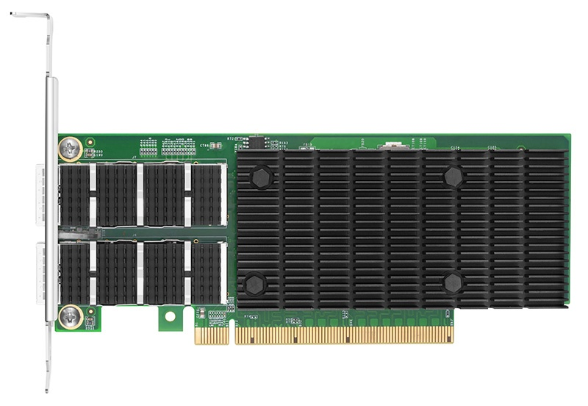

vs.
Modern enterprise network cards
40-100+ Gbps
Linux kernel

Slide 17
Lot of ongoing work in this area
Work to improve kernel performance
Kernel bypass: circumvent kernel entirely
Help from hardware: offload things like checksum, batching of segments, even more…
I am absolutely not an expert on this…

Slide 18
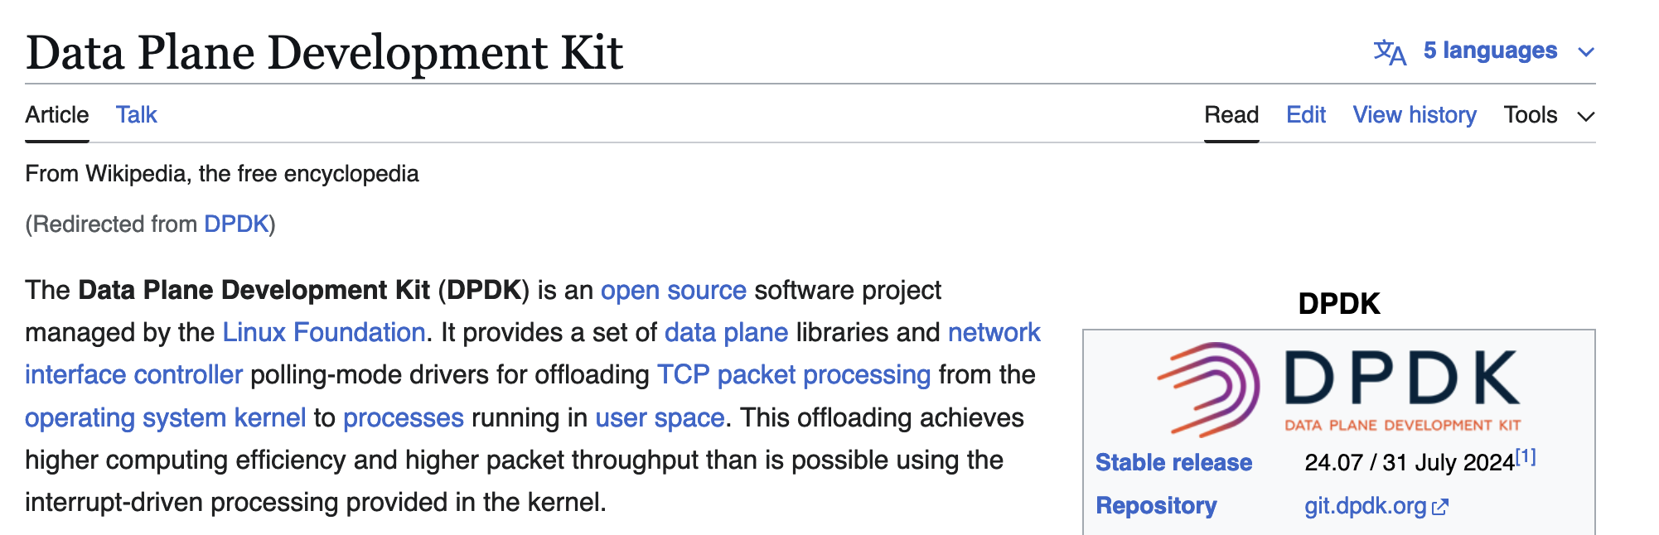
Example: kernel bypass

Slide 19
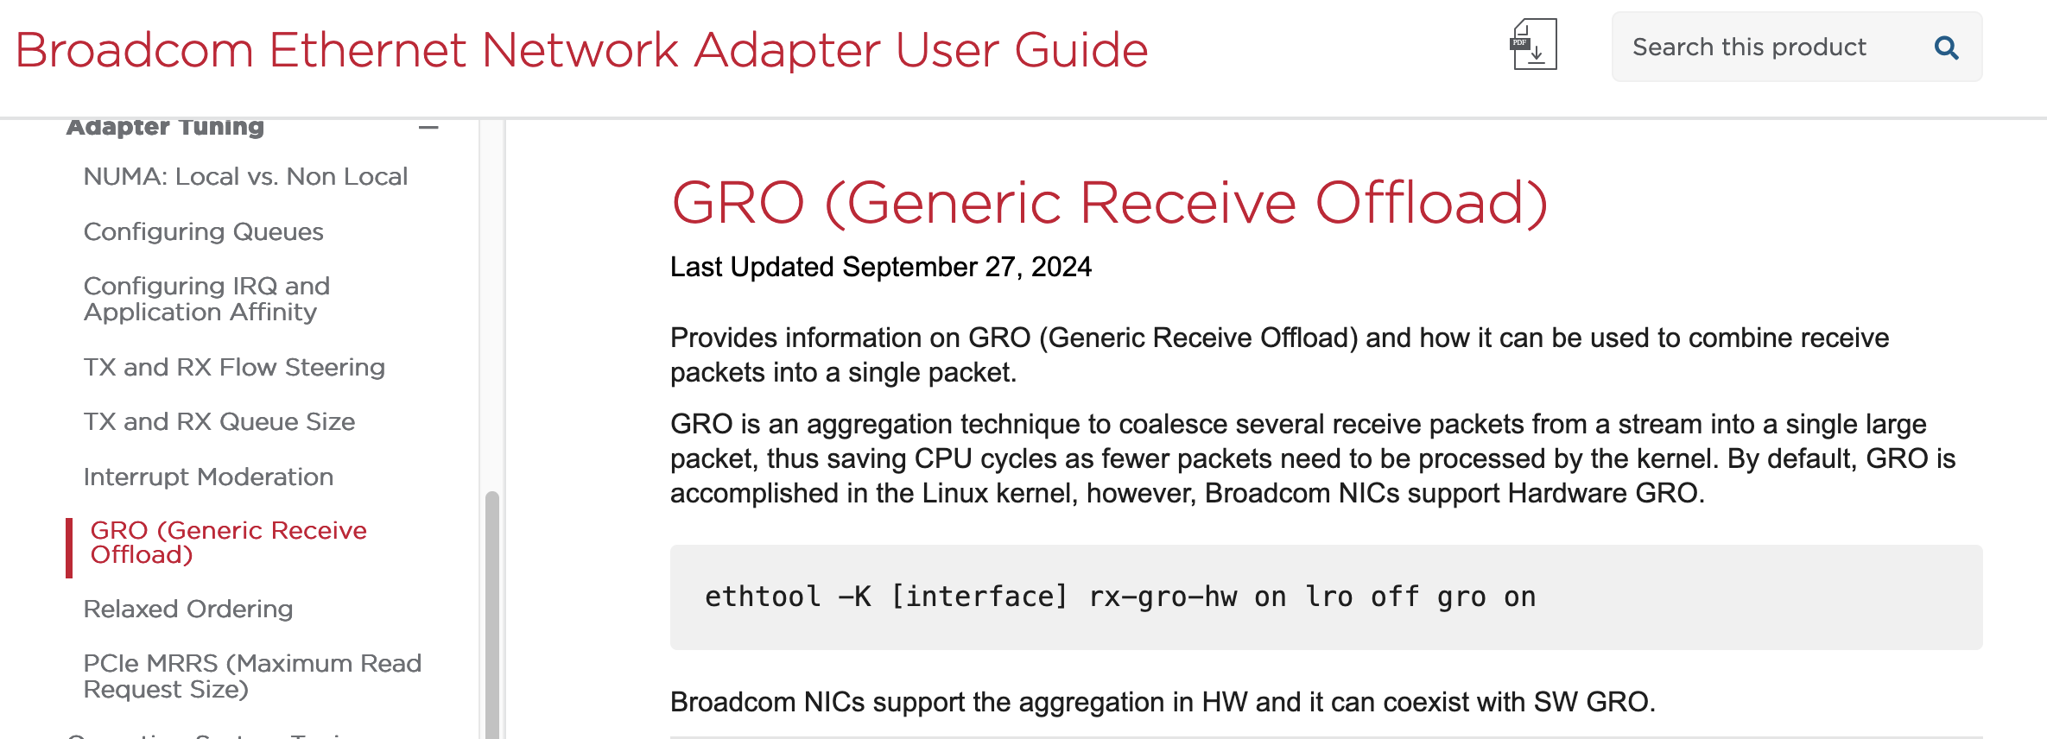
Example: help from hardware

Slide 20
IPoAC

Slide 21
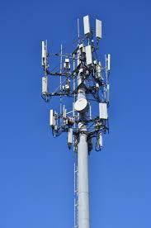
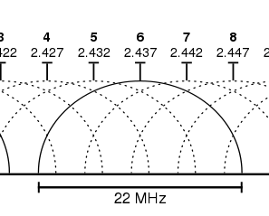
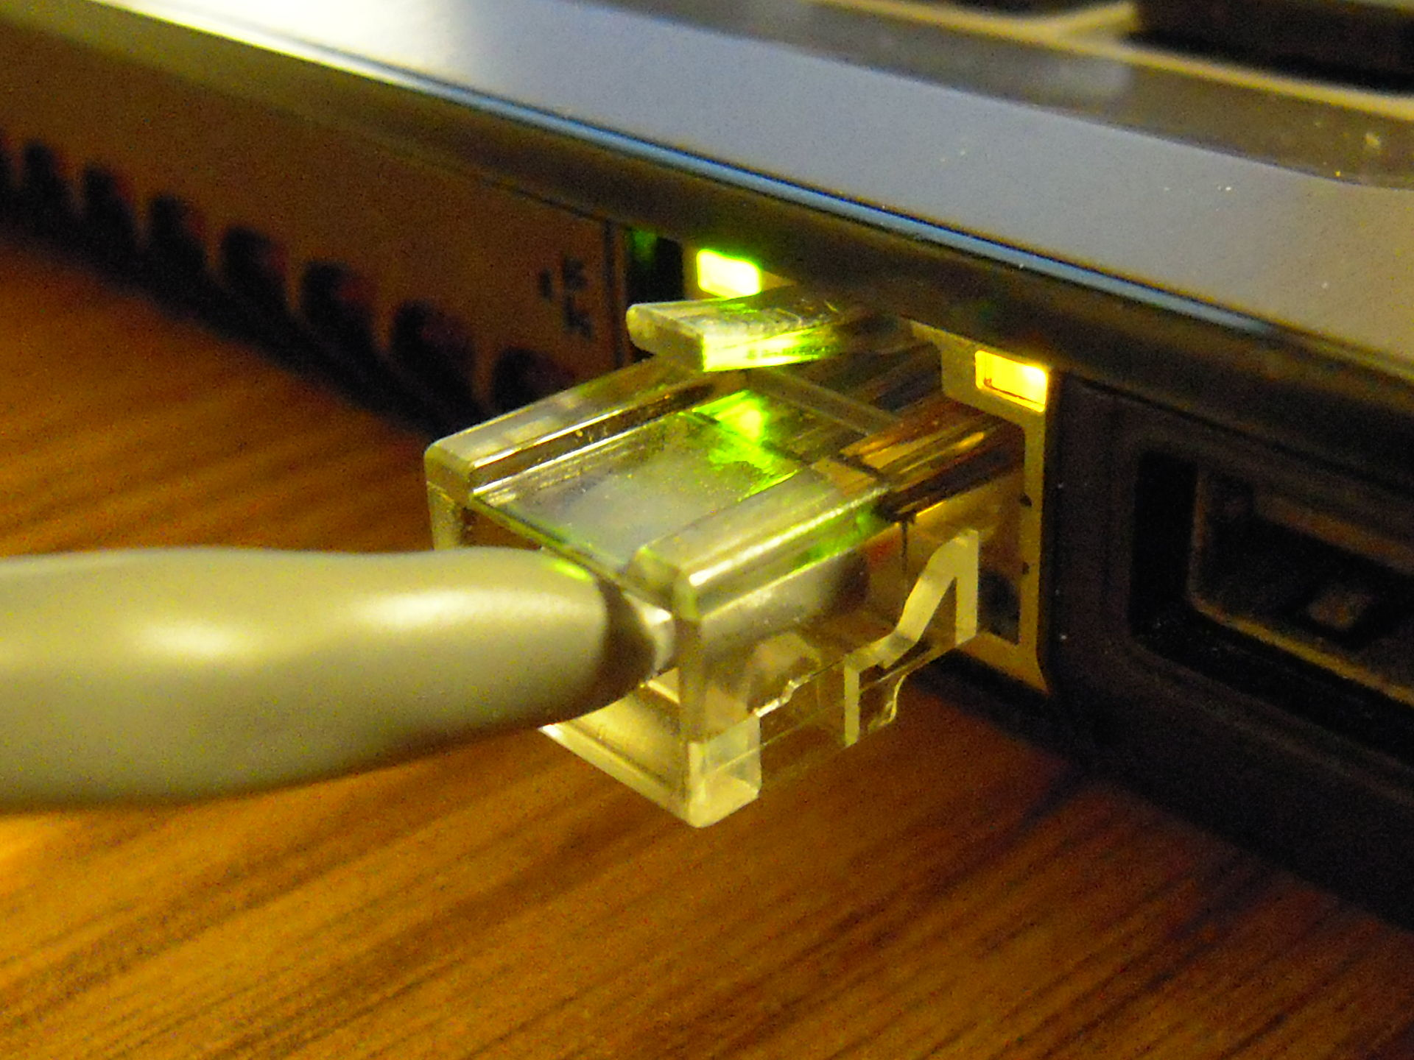
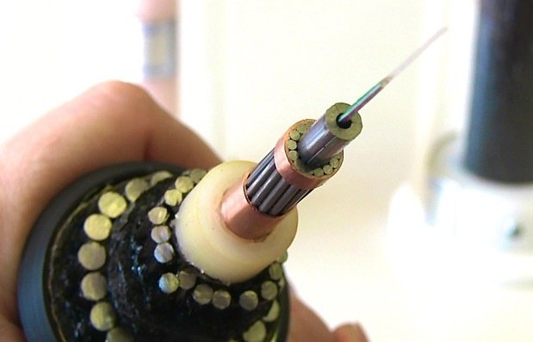
How can we improve the physical layer?
Traditional links have fixed bandwidth
Media limits what frequencies can be used for signal
Places upper bound on channel capacity

Slide 22
What if we weren’t constrained by the EM spectrum?
How else can we transmit data?

Slide 23


Slide 24
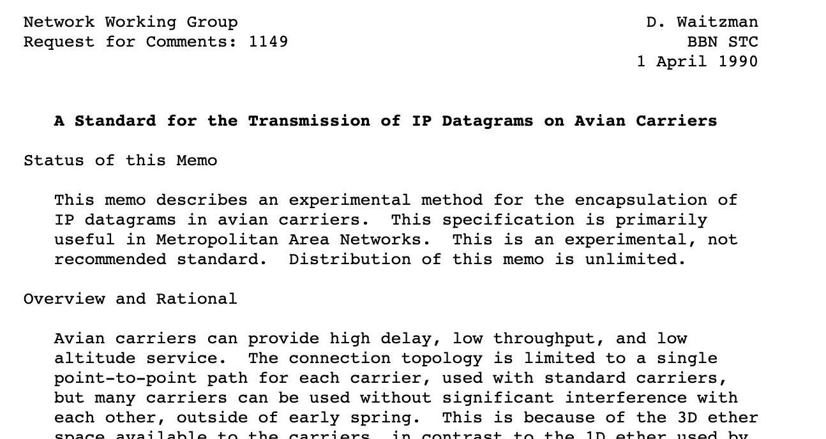

Slide 25
RFC1149: IPoAC
IP over Avian Carriers (1 April 1990)
High delay, low throughput, low altitude datagram service
Nearly unlimited movement in 3D etherspace
Intrinsic collision avoidance
Typical MTU: 256 milligrams

Slide 26
IPoAC: Design

Slide 27
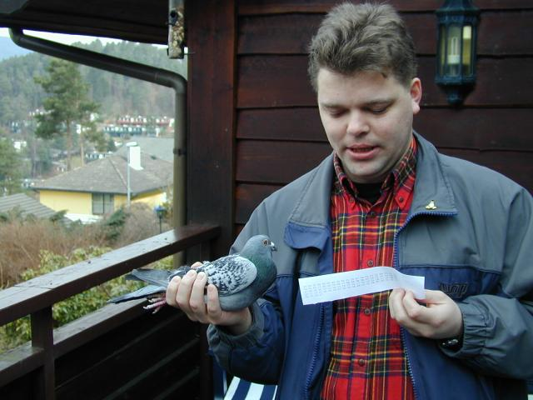
IPoAC: Implementation
Proof of concept: 28 April 2001
Bergen, Norway
https://web.archive.org/web/20140215072548/http://www.blug.linux.no/rfc1149/

Slide 28
IPoAC in practice
$ ping -c 9 -i 900 10.0.3.1
PING 10.0.3.1 (10.0.3.1): 56 data bytes
64 bytes from 10.0.3.1: icmp_seq=0 ttl=255 time=6165731.1 ms
64 bytes from 10.0.3.1: icmp_seq=4 ttl=255 time=3211900.8 ms
64 bytes from 10.0.3.1: icmp_seq=2 ttl=255 time=5124922.8 ms
64 bytes from 10.0.3.1: icmp_seq=1 ttl=255 time=6388671.9 ms
--- 10.0.3.1 ping statistics ---
9 packets transmitted, 4 packets received, 55% packet loss round-trip min/avg/max = 3211900.8/5222806.6/6388671.9 ms
Notes:
Responses called Resource Records (RRs)

Slide 29
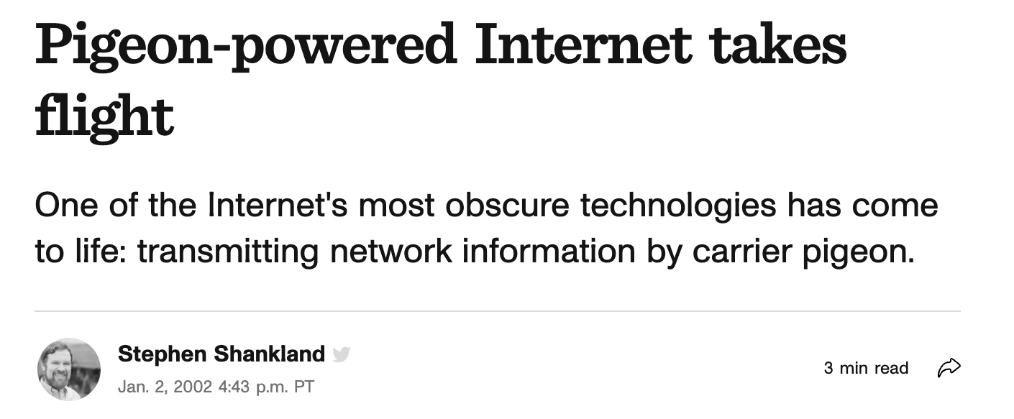

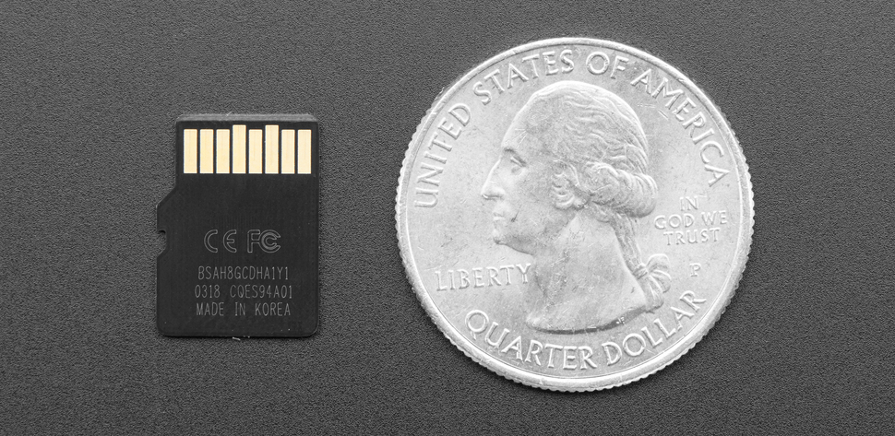
IPoAC: (more) Modern implementations
Today: microSD card: ~250mg, 1TB
+
= ???

Slide 30
But actually
What happens if you have a LOT of data to move into the cloud?

Slide 31
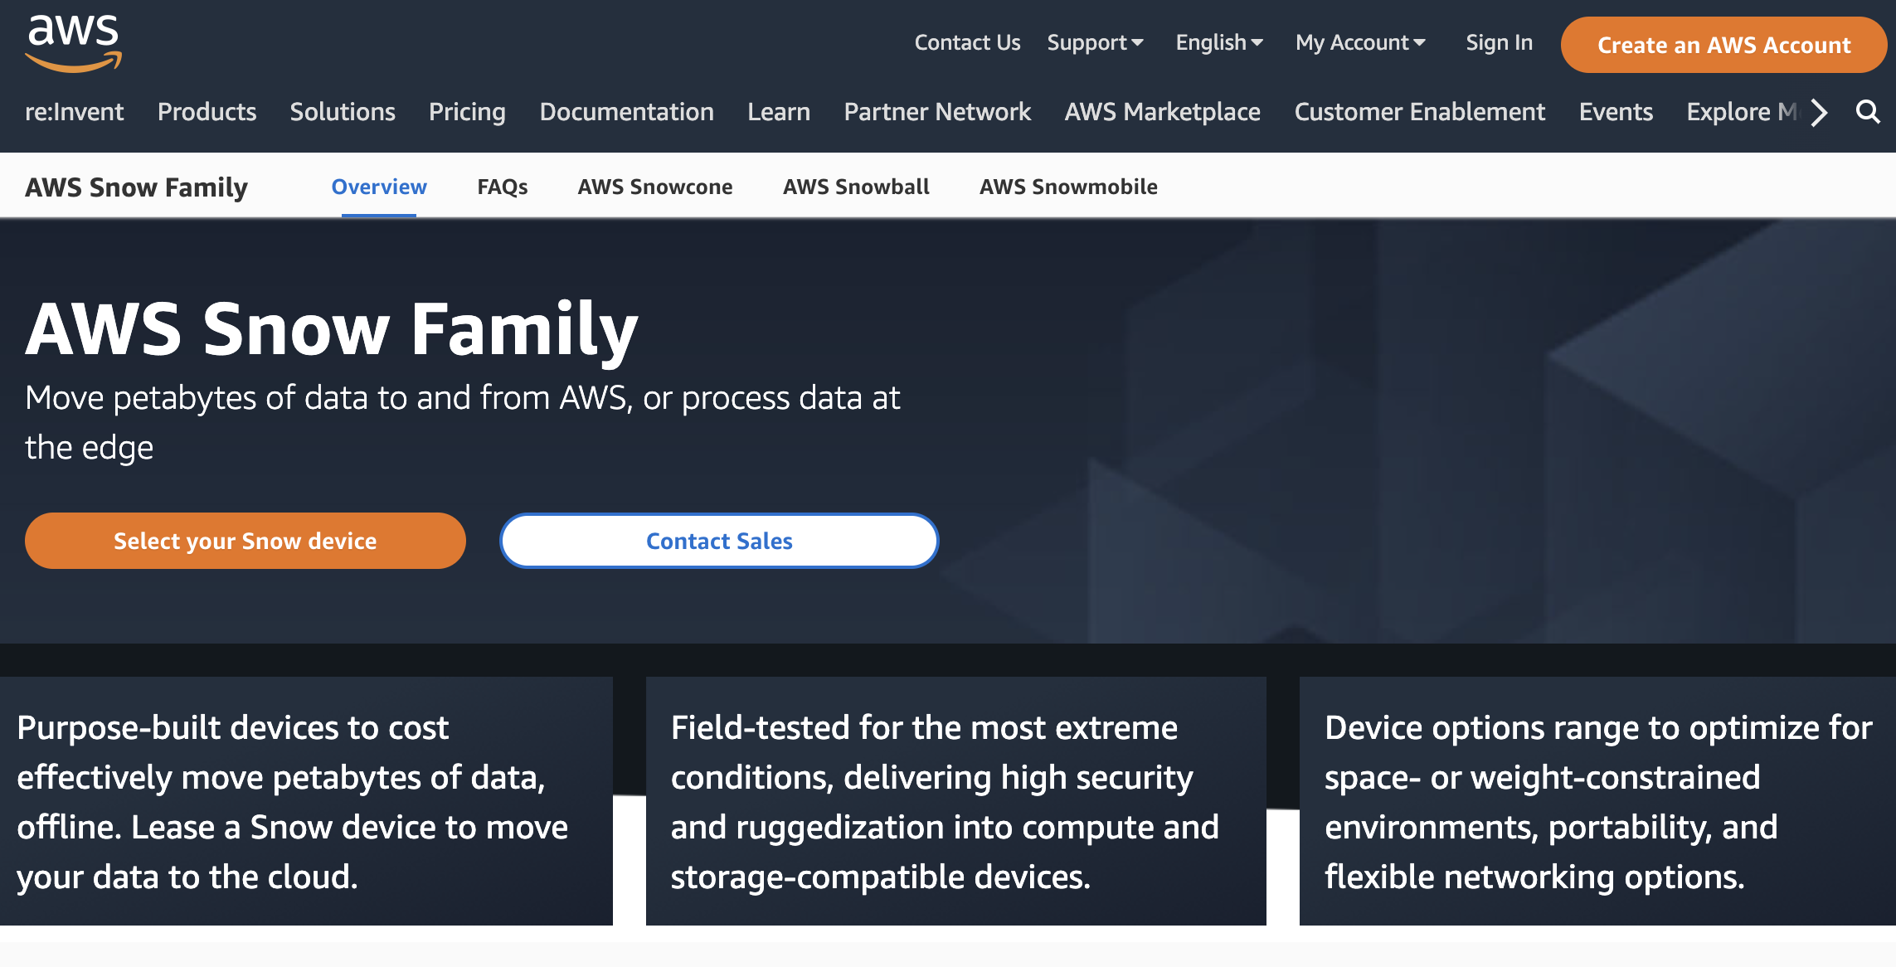
But actually
What happens if you have a LOT of data to move into the cloud?
Example: AWS

Slide 32
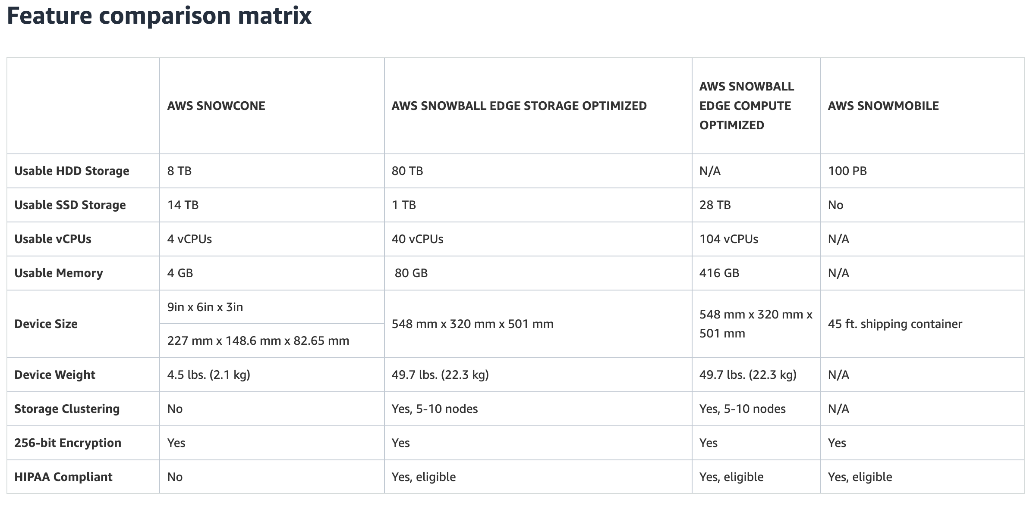

Slide 33
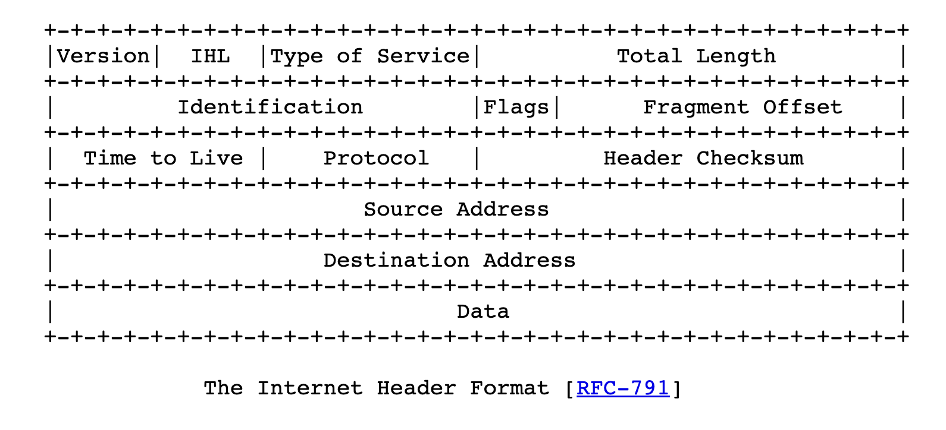
RFC791: IPv4 Header

Slide 34
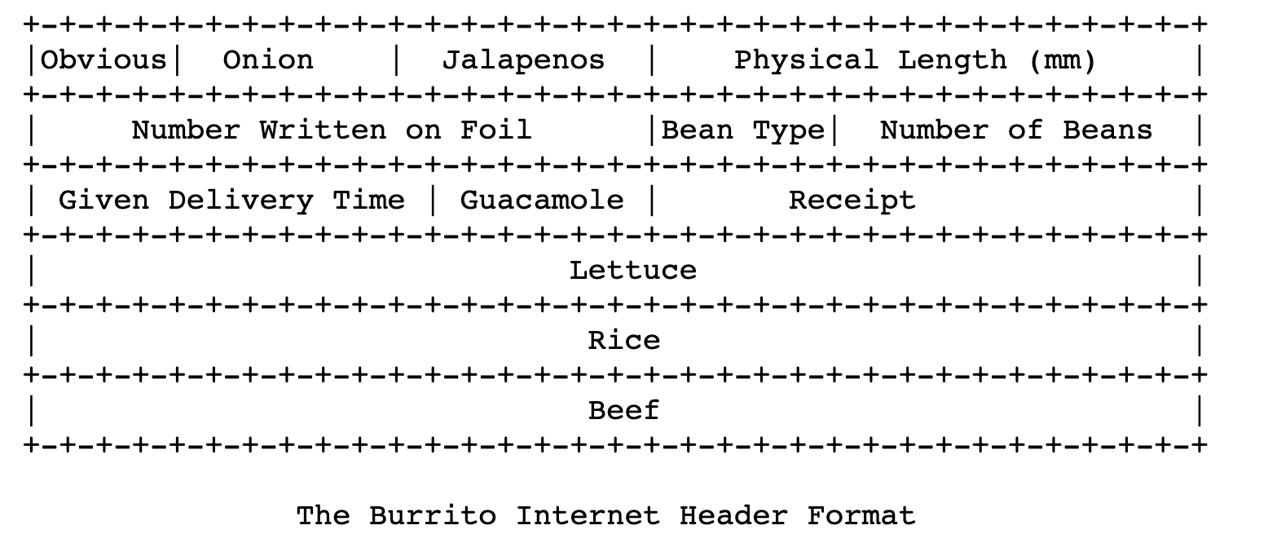
IP over Burrito Carriers

Slide 35
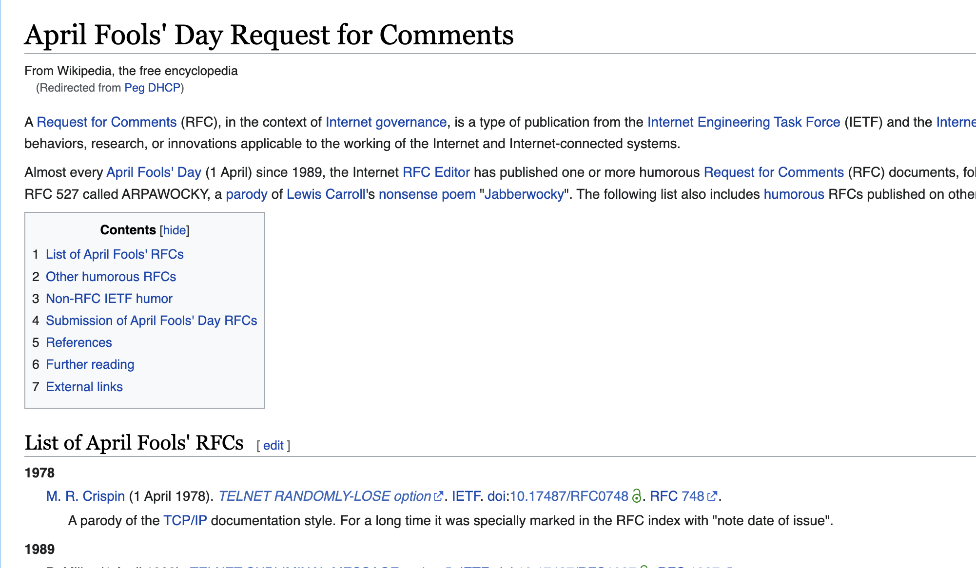
April Fool’s Day RFCs
https://en.wikipedia.org/wiki/April_Fools%27_Day_Request_for_Comments Enjoy!

Slide 38
This is not a security class
(as much as I would like it to be…)
This isn’t intended to be a lecture on all crypto
I want you to appreciate the important principles, understand what’s important for TLS (and other protocols like it)
Want to know more?

Slide 39
This is not a security class
(as much as I would like it to be…)
This isn’t intended to be a lecture on all crypto
I want you to appreciate the important principles, understand what’s important for TLS (and other protocols like it)
Want to know more?
CS1660 (Spring): Intro to Computer Systems Security
CS1515 (Spring): Applied cryptography
CS1510 (Fall): Intro to Cryptography and Computer Security

Slide 40
Internet’s Design: Insecure
Designed for simplicity in a naïve era
Lots of insecure systems that can be compromised
No central administration => hard to diagnose, coordinate fixes

Slide 41
What can go wrong?
yourbank.com
You
Attacker

Slide 42
(some) Key security properties
Confidentiality
Authentication
Integrity

Slide 43
(some) Key security properties
Confidentiality: prevent adversary from reading the data
  => Protect against eavesdropping, sniffing
Authentication: verifying the identity of a message or actor
=> Protect against spoofing, impersonation
Integrity: make sure messages arrive in original form
  => Protect against tampering

Slide 44
(some) Key security properties
Confidentiality: prevent adversary from reading the data
  => Protect against eavesdropping, sniffing
Authentication: verifying the identity of a message or actor
=> Protect against spoofing, impersonation
Integrity: make sure messages arrive in original form
  => Protect against tampering
There are more security properties, but we’ll stick to these => Focus of TLS

Slide 45
Other important security properties
Availability: Will the network deliver data?
  Protect against infrastructure compromise, DDoS
Provenance: Who is responsible for this data?
  Prevent forging responses, denying responsibility; prove who created the data
Authorization: is actor allowed to do this action?
Appropriate use: is action consistent with policy? (spam, copyright, …)
Anonymity: can someone tell what packets I am sending?

Slide 46
TLS: Transport layer security
TLS 1.0 (1999) => TLS 1.3 (2018)
Bidirectional pipe between two parties providing:
  Confidentiality
  Integrity
  Authentication

Slide 47
TLS: Transport layer security
Bidirectional pipe between two parties providing:
  Confidentiality
  Integrity
  Authentication
You
yourbank.com
Are these all the security properties we might want? No!

Slide 48
Where does TLS go?
Service: user-facing application.
Application-defined messages
Application
Transport
How to support multiple applications?
Network
Moving data between hosts (nodes)
Link
Move data across individual links
Physical
Service: move bits to other node across link

Slide 49
Throwback: The OSI model
Application Protocol
Transport Protocol
Network Protocol
Link-Layer Protocol
Notes:
Open Systems Interconnect, ISO
We no longer care about paths

Slide 51
Fundamental crypto properties we need

Slide 52
Symmetric cryptography
A, B share secret key k
Examples: AES, Serpent, Whirlpool, DES (old, insecure), …
Provides: confidentiality (encrypt/decrypt), integrity (MAC)
Symmetric crypto: strong, fast, but parties need to have shared key k
=> Key distribution is hard, why?

Slide 53
Confidentiality: Symmetric encryption
Plaintext
Plaintext
Internet
Encrypt with
secret key
Decrypt with
secret key
Ciphertext

Slide 54
Confidentiality: Asymmetric encryption
Everyone has two keys: k_pub, k_priv

Slide 55
Confidentiality: Asymmetric encryption
Everyone has two keys: k_pub, k_priv
  k_pub: Public key, widely-known
  k_priv: Private key, kept secret
Used for: authentication, signing (and confidentiality, integrity)

Slide 56
Public Key / Asymmetric Encryption
Sender uses receiver’s public key
  Advertised to everyone
Receiver uses complementary private key
  Must be kept secret
Plaintext
Plaintext
Internet
Encrypt with
public key
Decrypt with
private key
Ciphertext

Slide 57
What can we do with this?

Slide 58
Public Key Authentication
Each side need only to know the other side’s public key
  No secret key need be shared
A encrypts a nonce (random number) x using B’s public key
B proves it can recover x
A can authenticate itself to B in the same way
A
B
E(x, Public_{B})
x

Slide 59
How it works in TLS
Type in your browser: https://www.amazon.com
https = “Use HTTP over TLS”
  TLS = Transport Layer Security
  SSL = Secure Socket Layer (older version)
  RFC 4346, and many others
Goal: provide security layer (authentication, encryption) on top of transport layer
=> Fairly transparent to the app (once set up)

Slide 60
TLS: setup
Browser
Amazon
First: TCP handshake
SYN
SYN ACK
ACK

Slide 61
TLS: setup
Browser
Amazon
First: TCP handshake
Client sends over list of crypto protocols it supports
Server picks crypto protocols to use for this session
SYN
SYN ACK
ACK
Hello. I support
(TLS+RSA+AES128+SHA1) or
(SSL+RSA+3DES+MD5) or …
Let’s use
TLS+RSA+AES128+SHA1
Here’s my cert
~1 KB of data

Slide 62
TLS: setup
Browser
Amazon
First: TCP handshake
Client sends over list of crypto protocols it supports
Server picks crypto protocols to use for this session
Use this to do two things:
  Create shared session key
  Verify server’s identity
SYN
SYN ACK
ACK
Hello. I support
(TLS+RSA+AES128+SHA1) or
(SSL+RSA+3DES+MD5) or …
Let’s use
TLS+RSA+AES128+SHA1
Here’s my cert
~1 KB of data

Slide 63
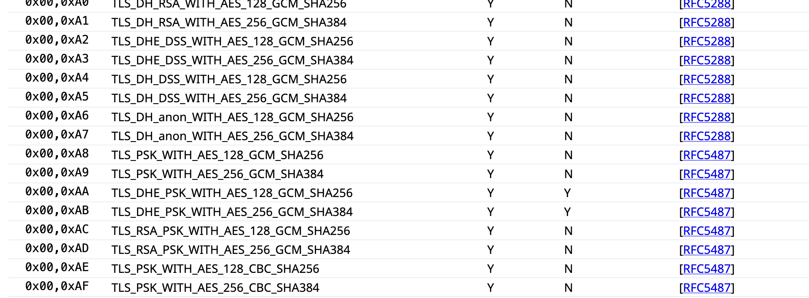

Slide 64
TLS + Authentication

Slide 65
TLS Goals
Authentication: verifying that the entity on the other end of the connection is who they claim to be

Slide 66
TLS Goals
Authentication: verifying that the entity on the other end of the connection is who they claim to be
Technical aspects: crypto
Social aspects
  How to distribute keys to entities
  What to do when things go wrong
TLS: relies on Public Key Infrastructure (PKI) via certificates

Slide 67
The Challenge
You
bank.com

Slide 68
The Challenge
You
bank.com
(...part of handshake...)
Kpub,bank.com

Slide 69
The Challenge
You
bank.com
(...part of handshake...)
Kpub,bank.com
Pick challenge x
Enc(Kpub,bank.com, x)

Slide 70
The Challenge
You
bank.com
(...part of handshake...)
Kpub,bank.com
Pick challenge x
Enc(Kpub,bank.com, x)
x' = Dec(Kpriv, x)
x'
x ?= x'
What does this prove?

Slide 71
Authentication challenges
Challenge proves that the server at bank.com holds K_priv
Does NOT prove belong to the server belongs to your bank, the real-life bank with your money

Slide 72
Authentication challenges
Challenge proves that the server at yourbank.com holds K_priv
Does NOT prove the server belongs to YourBank, the real-life bank that holds your money
"But I'm visiting yourbank.com!"

Slide 73
Authentication challenges
Challenge proves that the server at yourbank.com holds K_priv
Does NOT prove the server belongs to YourBank, the real-life bank that holds your money
"But I'm visiting yourbank.com!"
DNS can be spoofed
Possible active network attacker (redirecting your IP traffic to malicious server)
Domain names can expire and be re-registered...

Slide 74
Problem: How can we trust K_pub is
Your Bank's public key?

Slide 75
Problem: distributing trust
How can we trust Kpub is Your Bank's public key?
Problem: Trust distribution
Hard to verify real-world identities
Hard to scale to the whole Internet
Different protocols have different mechanisms
=> TLS (and others): Public Key Infrastructure (PKI) with certificates

Slide 76
PKI: The main idea
Public keys managed by Certificate Authorities (CAs)
Everyone knows public key for some root CAs
  Pre-installed into browser/OS
CA

Slide 77
PKI: The main idea
X
K_{pub,X}
Public keys managed by Certificate Authorities (CAs)
Everyone knows public key for some root CAs
  Pre-installed into browser/OS
If X wants a public key, request from CA
  CA validates X's identity, then signs X's public key
$$$ (maybe)
CA

Slide 78
PKI: The main idea
X
✅
K_{pub,X}
Public keys managed by Certificate Authorities (CAs)
Everyone knows public key for some root CAs
  Pre-installed into browser/OS
If X wants a public key, request from CA
  CA supposed to validate X’s identity…
$$$ (maybe)
CA

Slide 79
PKI: The main idea
X
Public keys managed by Certificate Authorities (CAs)
Everyone knows public key for some root CAs
  Pre-installed into browser/OS
If X wants a public key, request from CA
  CA validates X's identity => if OK, signs X's public key
  Generates certificate
K_{pub,X}
$$$ (maybe)
CA

Slide 80
PKI: The main idea
X
K_{pub,X}
Public keys managed by Certificate Authorities (CAs)
Everyone knows public key for some root CAs
  Pre-installed into browser/OS
If X wants a public key, request from CA
  CA validates X's identity, then signs X's public key
  Generates certificate
$$$ (usually)
CA
s = Sign(K_{priv,CA}, {K_{pub,X}, ... })
Cert = {K_{pub,X}, metadata, s}

Slide 81
PKI: The main idea
X
K_{pub,X}
Public keys managed by Certificate Authorities (CAs)
Everyone knows public key for some root CAs
  Pre-installed into browser/OS
If X wants a public key, request from CA
  CA validates X's identity => if OK, signs X’s public key
  Generates certificate
Client can verify K_{pub,X} from CA's signature:
  Verify(K_{pub,CA} Cert) => True/False
$$$ (maybe)
CA
s = Sign(K_{priv,CA}, {K_{pub,X}, ... })
Cert = {K_{pub,X}, metadata, s}

Slide 82
PKI: The main idea
X
K_{pub,X}
Public keys managed by Certificate Authorities (CAs)
Everyone knows public key for some root CAs
  Pre-installed into browser/OS
If X wants a public key, request from CA
  CA validates X's identity => if OK signs X's public key
  Generates certificate
Client can verify K_{pub,X} from CA's signature:
  Verify(K_{pub,CA} Cert) => True/False
$$$ (maybe)
CA
s = Sign(K_{priv,CA}, {K_{pub,X}, ... })
Cert = {K_{pub,X}, metadata, s}
=> Delegates trust for individual entity to a more trusted authority

Slide 83
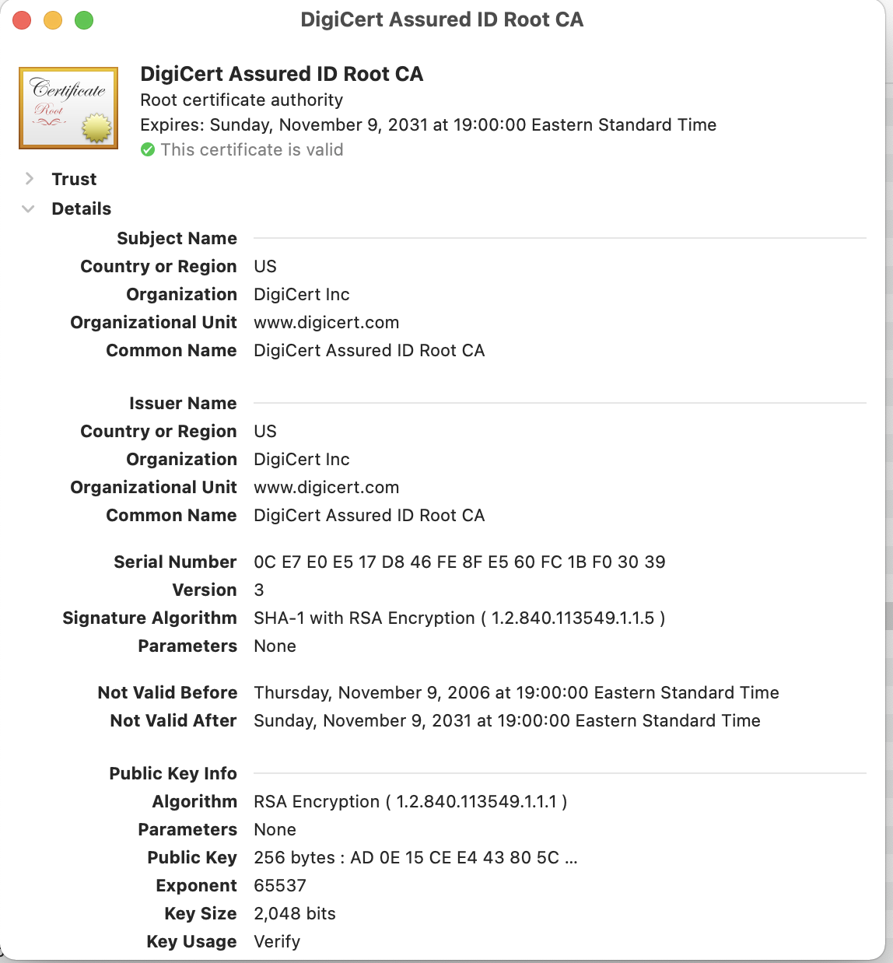

Slide 84
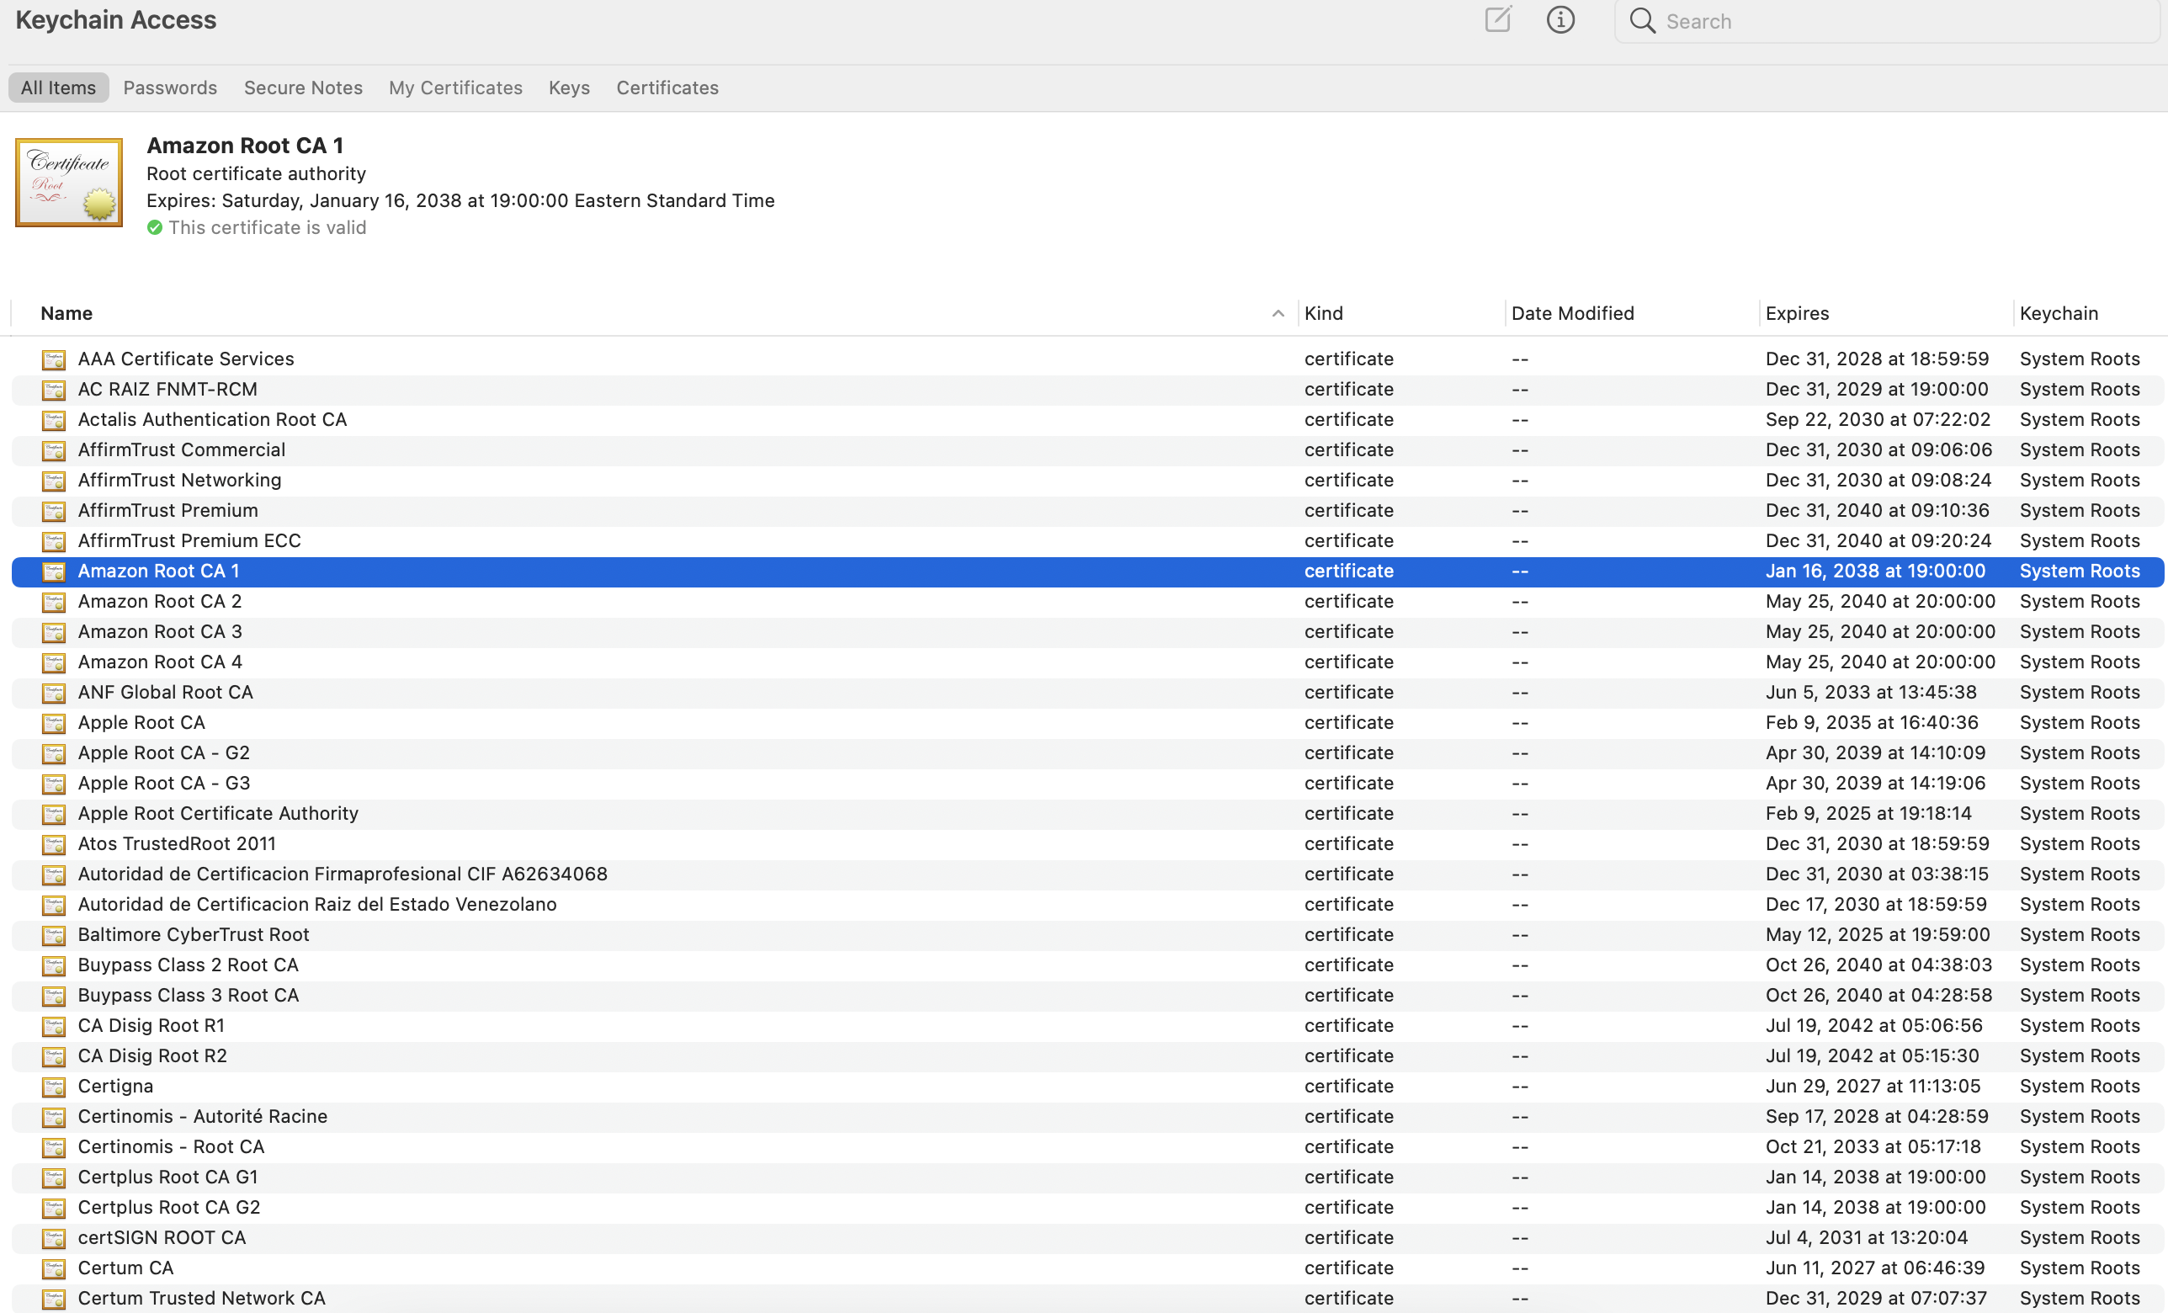

Slide 85
What's in a certificate?
Public key of entity (eg. yourbank.com)
Common name: DNS name of server (yourbank.com)
Contact info for organization

Slide 86
What's in a certificate?
Public key of entity (eg. yourbank.com)
Common name: DNS name of server (yourbank.com)
Contact info for organization
Validity dates (start date, expire date)
URL of revocation center to check if key has been revoked
All of this is part of the data signed by the CA
=> Critical to check all parts during TLS startup!

Slide 87
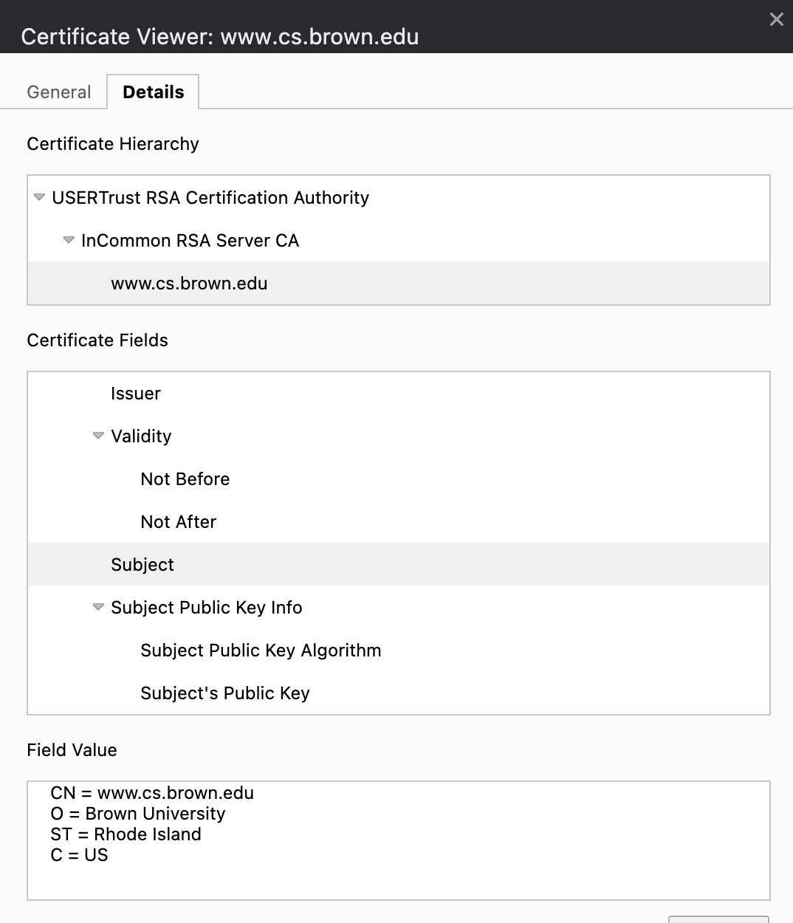

Slide 88
What’s in a certificate?

Slide 90
PKI hierarchy
In reality, PKI creates a hierarchy of trust:
Root CAs: k_{pub} stored in virtually every browser, OS
  Private keys protected by most stringent security measures (software, hardware, physical)

Slide 91
PKI hierarchy
In reality, PKI creates a hierarchy of trust:
Root CAs: k_{pub} stored in virtually every browser, OS
  Private keys protected by most stringent security measures (software, hardware, physical)
Intermediate CAs: k_{pub} signed by root CA
  Sign certificates for general use (ie, regular websites)
  Doesn't require same protections as root

Slide 92
PKI hierarchy
In reality, PKI creates a hierarchy of trust:
Root CAs: k_{pub} stored in virtually every browser, OS
  Private keys protected by most stringent security measures (software, hardware, physical)
Intermediate CAs: k_{pub} signed by root CA
  Sign certificates for general use (ie, regular websites)
  Doesn't require same protections as root
General-use certificates: for a specific webserver

Slide 93
PKI hierarchy
In reality, PKI creates a hierarchy of trust:
Root CAs: k_{pub} stored in virtually every browser, OS
  Private keys protected by most stringent security measures (software, hardware, physical)
Intermediate CAs: k_{pub} signed by root CA
  Sign certificates for general use (ie, regular websites)
  Doesn't require same protections as root
General-use certificates: for a specific webserver
What happens if a root is compromised?

Slide 94
How the hierarchy works
Ex. Server has certificate from Intermediate CA_{Int}
Client
B
(yourbank.com)
Kpub,Root
B has:
Kpriv,B
CertB = { K_{pub,B}, Sign(K_{pub,B}, K_{priv,Int}), ... }

Slide 95
How the hierarchy works
Ex. Server has certificate from Intermediate CA_{Int}
Client
B
(yourbank.com)
(TLS handshake)
B has:
Kpriv,B
CertB = { K_{pub,B}, Sign(K_{pub,B}, K_{priv,Int}), ... }
Kpub,Root
{Cert_{B}, Cert_{Int}}

Slide 96
How the hierarchy works
Ex. Server has certificate from Intermediate CA_{Int}
Client
B
(yourbank.com)
(TLS handshake)
B has:
Kpriv,B
CertB = { K_{pub,B}, Sign(K_{pub,B}, K_{priv,Int}), ... }
Kpub,Root
{Cert_{B}, Cert_{Int}}
Client's workflow:
Checks metadata ✅
Verify(Cert_{B}, K_{pub,Int}) ✅
Verify(Cert_{Int}, K_{pub,Root}) ✅

Slide 97
How the hierarchy works
Ex. Server has certificate from Intermediate CA_{Int}
Client
B
(yourbank.com)
(TLS handshake)
B has:
Kpriv,B
CertB = { K_{pub,B}, Sign(K_{pub,B}, K_{priv,Int}), ... }
Kpub,Root
{Cert_{B}, Cert_{Int}}
Client's workflow:
Checks metadata ✅
Verify(Cert_{B}, K_{pub,Int}) ✅
Verify(Cert_{Int}, K_{pub,Root}) ✅
=> To verify integrity, need to verify certificates back to (trusted) root certificate
=> OK if verification passes and metadata correct: 🔒

Slide 98
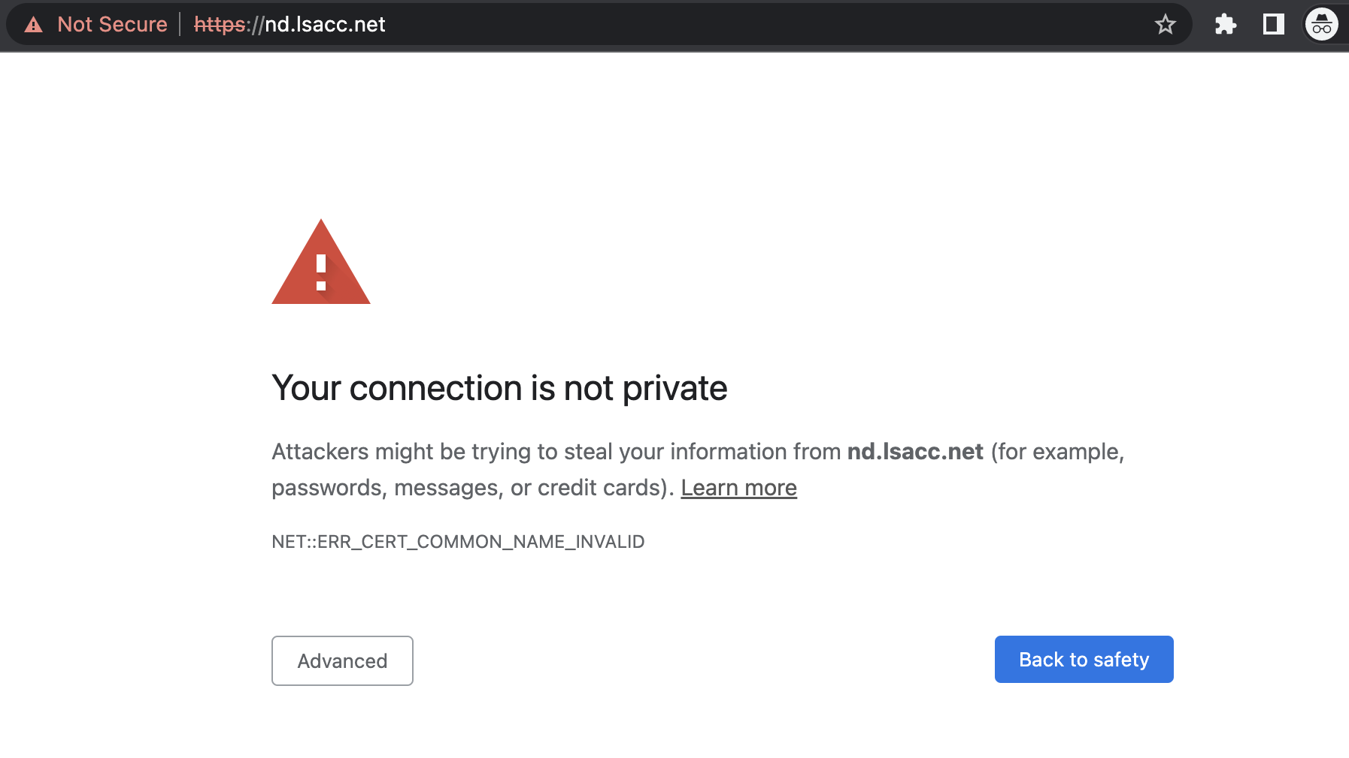

Slide 99
Most common TLS errors you might see
Common name (eg. yourbank.com) invalid
Self-signed
Certificate expired
When is it okay to click "proceed"? What happens if you do?

Slide 100
Most common TLS errors you might see
Common name invalid
Self-signed
Certificate expired
When is it okay to click "proceed"? What happens if you do?
=> Might occur if webserver configured improperly, or if you're setting up a system

Slide 101
Rogue Certificates?
In 2011, DigiNotar, a Dutch root certificate authority, was compromised
The attacker created rogue certificates for popular domains like google.com and yahoo.com
DigiNotar was distrusted by browsers and filed for bankruptcy
See the incident investigation report by Fox-IT

Slide 102
In 2017, Google questioned the certificate issuance policies and practices of Symantec
Google’s Chrome would start distrusting Symantec’s certificates unless certain remediation steps were taken
See back and forth between Ryan Sleevi (Chromium team) and Symantec
The matter was settled with DigiCert acquiring Symantec’s certificate business

Slide 103
TLS decryption
What happens when an organization wants to view TLS traffic on its network?

Slide 104
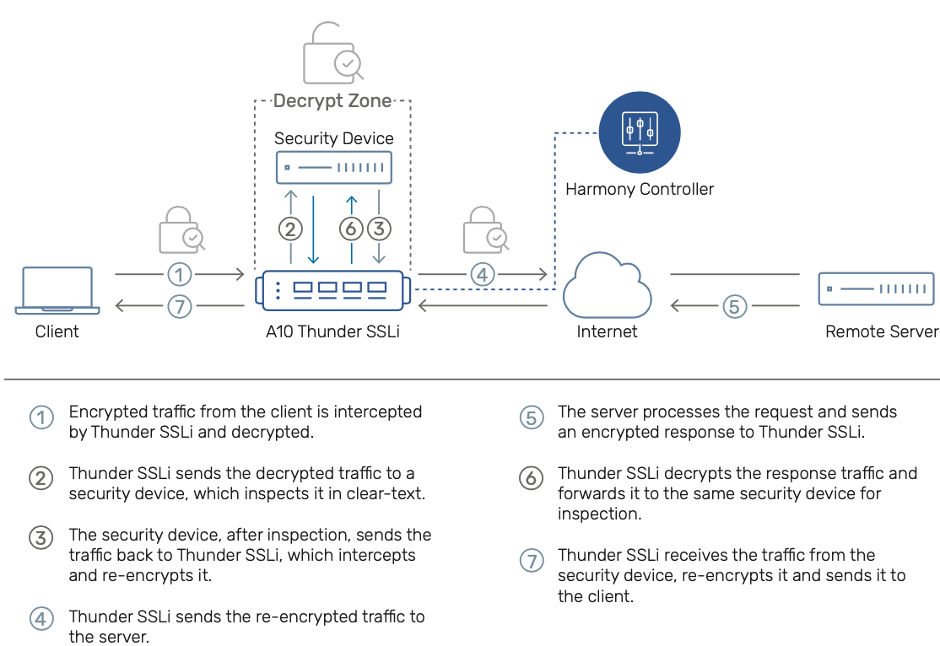
Example: https://www.a10networks.com/products/thunder-ssli/

Slide 105
PKIs, TLS, and HTTPS

Slide 106
The story so far
Asymmetric crypto: each entity gets a key in two parts
  K_{priv}: Private key, kept secret
  K_{pub}: Public key, shared with everyone
Can provide important security properties
  Authentication/Integrity: A signs message with K_{priv,A}, anyone with K_{pub,A} can verify message came from A
  Confidentiality: A encrypts message to B with K_{pub,B}, B can decrypt with K_{priv,B}
But: how do we know if we can trust a public key?

Slide 107
Public Key Infrastructure (PKI)
Public key crypto is very powerful …
… but the realities of tying public keys to real world identities turn out to be quite hard
PKI: Trust distribution mechanism
  Authentication via Digital Certificates
Note: Trust doesn’t mean someone is honest, just that they are who they say they are…

Slide 108
Managing Trust
The most solid level of trust is rooted in our direct personal experience
  E.g., Alice’s trust that Bob is who they say they are
  Clearly doesn’t scale to a global network!
In its absence, we rely on delegation
  Alice trusts Bob’s identity because Charlie attests to it ….
  …. and Alice trusts Charlie

Slide 109
Managing Trust, con’t
Trust is not particularly transitive
  Should Alice trust Bob because she trusts Charlie …
  … and Charlie vouches for Donna …
  … and Donna says Eve is trustworthy …
  … and Eve vouches for Bob’s identity?
Two models of delegating trust
  Rely on your set of friends and their friends
    “Web of trust” -- e.g., PGP
  Rely on trusted, well-known authorities (and those they trust…)
    “Trusted root” -- e.g., HTTPS

Slide 110
PKI Conceptual framework
Public keys managed by Certificate Authorities (CAs)
Everyone knows public key for some root CAs
To publish a public key for entity X, root CA R signs X’s public key
  What this means: CA agrees that this is X’s public key
  Creates a Certificate: {K_{pub,X}, signature, metadata}
Given signature, anyone who knows the root can verify
  Delegates trust of Kpub,X to CA
  If you trust the CA, you now trust X
Root CAs: pre-installed in your system/browser

Slide 111
What’s in a certificate?

Slide 113
PKI hierarchy
In reality, hierarchy of trust
Root CAs sign certificates for Intermediate CAs
Intermediate CAs sign certificates for general users/sites
The further up the hierarchy, the more protections it needs
CA’s often use Hardware Security Modules (HSMs), other physical protections…
What happens if a CA is compromised?

Slide 114
PKI Example

Slide 115
Inside the Server’s Certificate
Common name: Domain name for cert (e.g., amazon.com)
Amazon’s public key
A bunch of auxiliary info (physical address, type of cert, expiration time)
URL to revocation center to check for revoked keys
Name of certificate’s signatory (who signed it)
A public-key signature of a hash of all this
  Constructed using the signatory’s private RSA key

Slide 116
PKI Conceptual Framework
Trusted-Root PKI:
  Basis: well-known public key serves as root of a hierarchy
  Managed by a Certificate Authority (CA)
To publish a public key, ask the CA to digitally sign a statement indicating that they agree (“certify”) that it is indeed your key
  This is a certificate for your key (certificate = bunch of bits)
    Includes both your public key and the signed statement
  Anyone can verify the signature
Delegation of trust to the CA
  They’d better not screw up (duped into signing bogus key)
  They’d better have procedures for dealing with stolen keys
  Note: can build up a hierarchy of signing

Slide 117
Validating Amazon’s Identity
Browser retrieves cert belonging to the signatory
If it can’t find the cert, then warns the user that site has not been verified
  And may ask whether to continue
  Could still proceed, just without authentication
Browser uses public key in signatory’s cert to decrypt signature
  Compares with its own hash of Amazon’s cert
Assuming signature matches, now have high confidence it’s indeed Amazon
  … assuming signatory is trustworthy

Slide 118
HTTPS Connection (SSL/TLS), con’t
Browser
Amazon
Browser constructs a random session key K
Browser encrypts K using Amazon’s public key
Browser sends E(K, KA_{public}) to server
Browser displays 🔒
All subsequent communication encrypted w/ symmetric cipher using key K
  E.g., client can authenticate using a password
Here’s my cert
~1 KB of data
K
E(K, KA_{public})
Agreed
K
E(password …, K)
E(response …, K)

Slide 119
When does this break down?
TLS is hard to implement
Need to trust the CAs
Users need to understand warnings

Slide 120
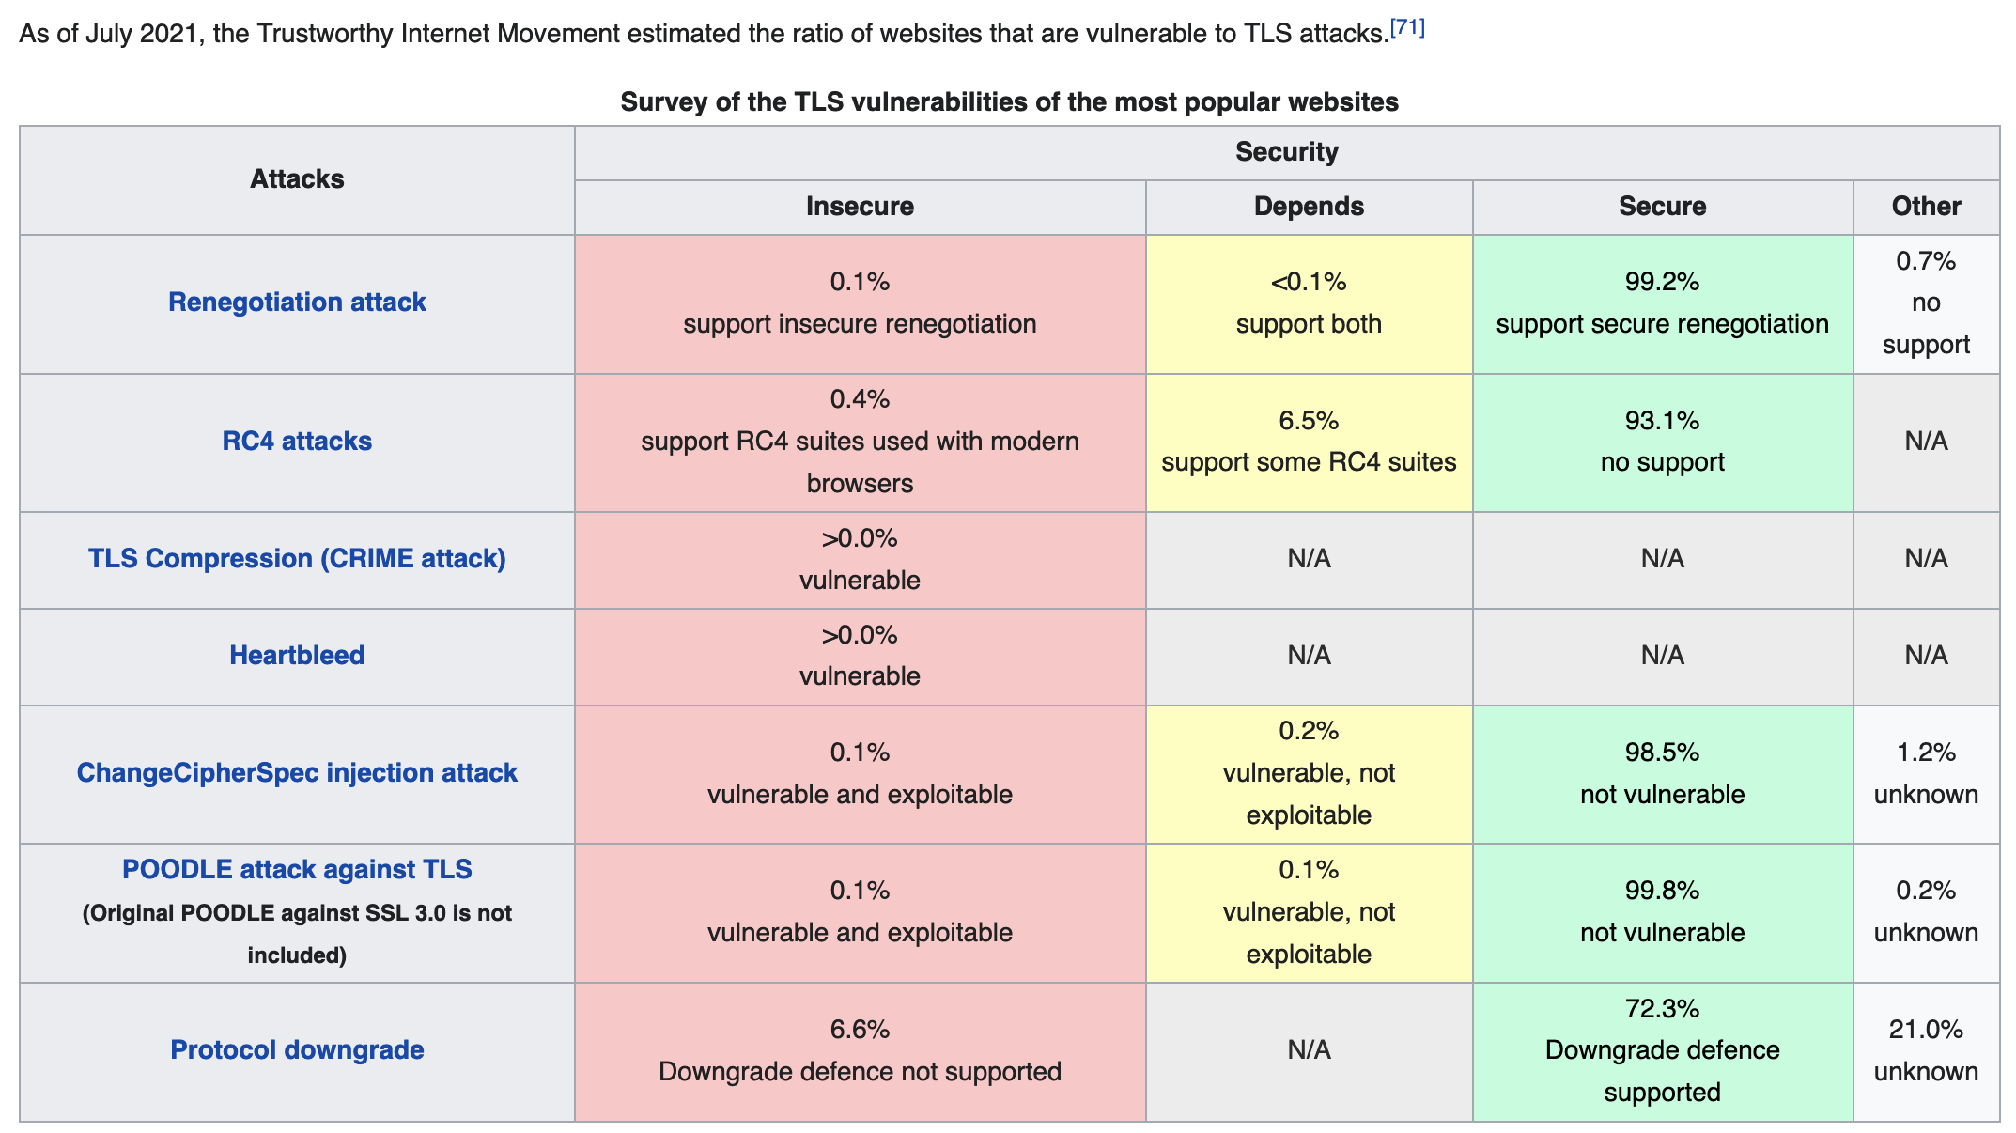
Server
Wikipedia table, source: https://www.ssllabs.com/ssl-pulse/

Slide 122
Digital Signatures
Suppose Alice has published public key K_{E}
If she wishes to prove who she is, she can send a message x encrypted with her private key K_{D}
  Therefore: anyone w/ public key K_{E} can recover x, verify that Alice must have sent the message
  It provides a digital signature
  Alice can’t deny later deny it ⇒ non-repudiation

Slide 123
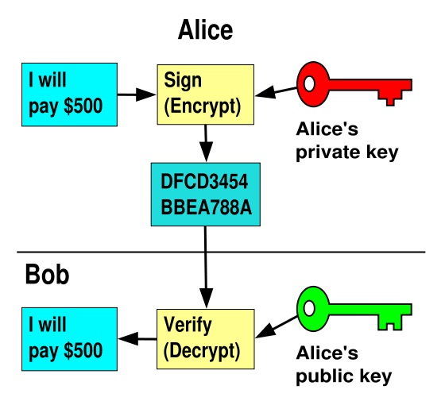
RSA Crypto & Signatures, con’t

Slide 124
Summary of Our Crypto Toolkit
If we can securely distribute a key, then
  Symmetric ciphers (e.g., AES) offer fast, presumably strong confidentiality
Public key cryptography can make this easier (can share public keys anywhere)
  But not as computationally efficient
  Use public key crypto to exchange session key, which is used for symmetric encryption
  And not guaranteed secure
    but major result if not
Notes:
No efficient algorithm to factor large numbers.

Slide 125
Summary of Our Crypto Toolkit, con’t
Cryptographically strong hash functions provide major building block for integrity (e.g., SHA-256)
  As well as providing concise digests
  And providing a way to prove you know something (e.g., passwords) without revealing it (non-invertibility)
  But: worrisome recent results regarding their strength (MD5, SHA1)
Public key also gives us signatures
  Including sender non-repudiation
Turns out there’s a crypto trick based on similar algorithms that allows two parties who don’t know each other’s public key to securely negotiate a secret key even in the presence of eavesdroppers
  Look up: Diffie-Hellman Key Exchange

