Slide 1
CSCI-1680
How to (try) to be anonymous
Wrapup
Nick DeMarinis
Based partly on lecture notes by Rodrigo Fonseca, Scott Shenker and John Jannotti

Slide 2
Administrivia
HW5: Due Monday, 12/9
Final project: Due 12/16
SRC problem: Due 12/16 (will be some form of extra credit)
Office hours: see the calendar
Course feedback
  University feedback
  Critical Review
  I will send you a form

Slide 3
My (major) TODOs
I owe you grades on Snowcast, TCP
I owe you a bunch of lecture notes
I will be watching Ed for final project questions

Slide 4
yourbank.com
You
Attacker

Slide 5
Warmup
With TLS we get this:
You
yourbank.com
Are we good? Have we solved web security?

Slide 6
Warmup
bank.com
Kpriv,B, Kpriv,B

Slide 7
Warmup
K_{pub,B}
CA
bank.com
Kpriv,B, Kpriv,B
s = Sign(K_{priv,CA}, {K_{pub,B}, ... })
Cert_{B} = {K_{pub,B}, metadata, s}

Slide 8
Warmup
K_{pub,B}
CA
You
bank.com
Kpriv,B, Kpriv,B
s = Sign(K_{priv,CA}, {K_{pub,B}, ... })
Cert_{B} = {K_{pub,B}, metadata, s}
{CertB, …}
Attacker

Slide 9
Warmup
K_{pub,B}
What happens if attacker obtains Kpriv,B?
What about Kpriv,CA?
CA
You
bank.com
Kpriv,B, Kpriv,B
s = Sign(K_{priv,CA}, {K_{pub,B}, ... })
Cert_{B} = {K_{pub,B}, metadata, s}
{CertB, …}

Slide 10
Today’s Lecture
More about Tor
Wrapup

Slide 11
Q: If private key is compromised, can attacker decrypt data?

Slide 12
Q: If private key is compromised, can attacker decrypt data?
Not if TLS connection uses forward secrecy
Cannot recover session key if server private key leaked
Once optional, now required by TLS 1.3 (2018)

Slide 13
Q: If private key is compromised, can attacker decrypt data?
Not if TLS connection uses forward secrecy
Cannot recover session key if server private key leaked
Once optional, now required by TLS 1.3 (2018)

Slide 14
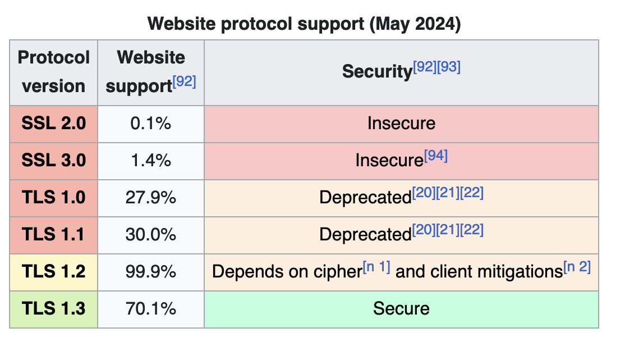
In practice, TLS 1.3 rollout delayed by many broken TLS implementations
(eg. in-network middleboxes/proxies) …

Slide 15
In practice, TLS 1.3 rollout delayed by many broken TLS implementations
(eg. in-network middleboxes/proxies) …

Slide 16
In practice, TLS 1.3 rollout delayed by many broken TLS implementations
(eg. in-network middleboxes/proxies) …
Remember how we said don’t propagate buggy behavior in TCP?

Slide 17
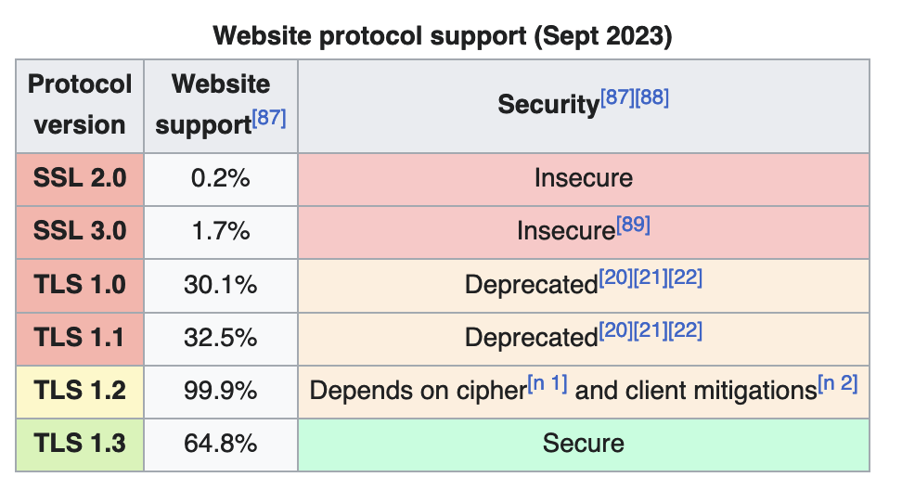

Slide 18
In general, implementing security protocols is hard to get right

Slide 19
In general, implementing security protocols is hard to get right
=> TLS libraries are very critical and need lots of oversight/auditing
=> Servers (and clients) need to be updated with latest standards/fixes

Slide 20
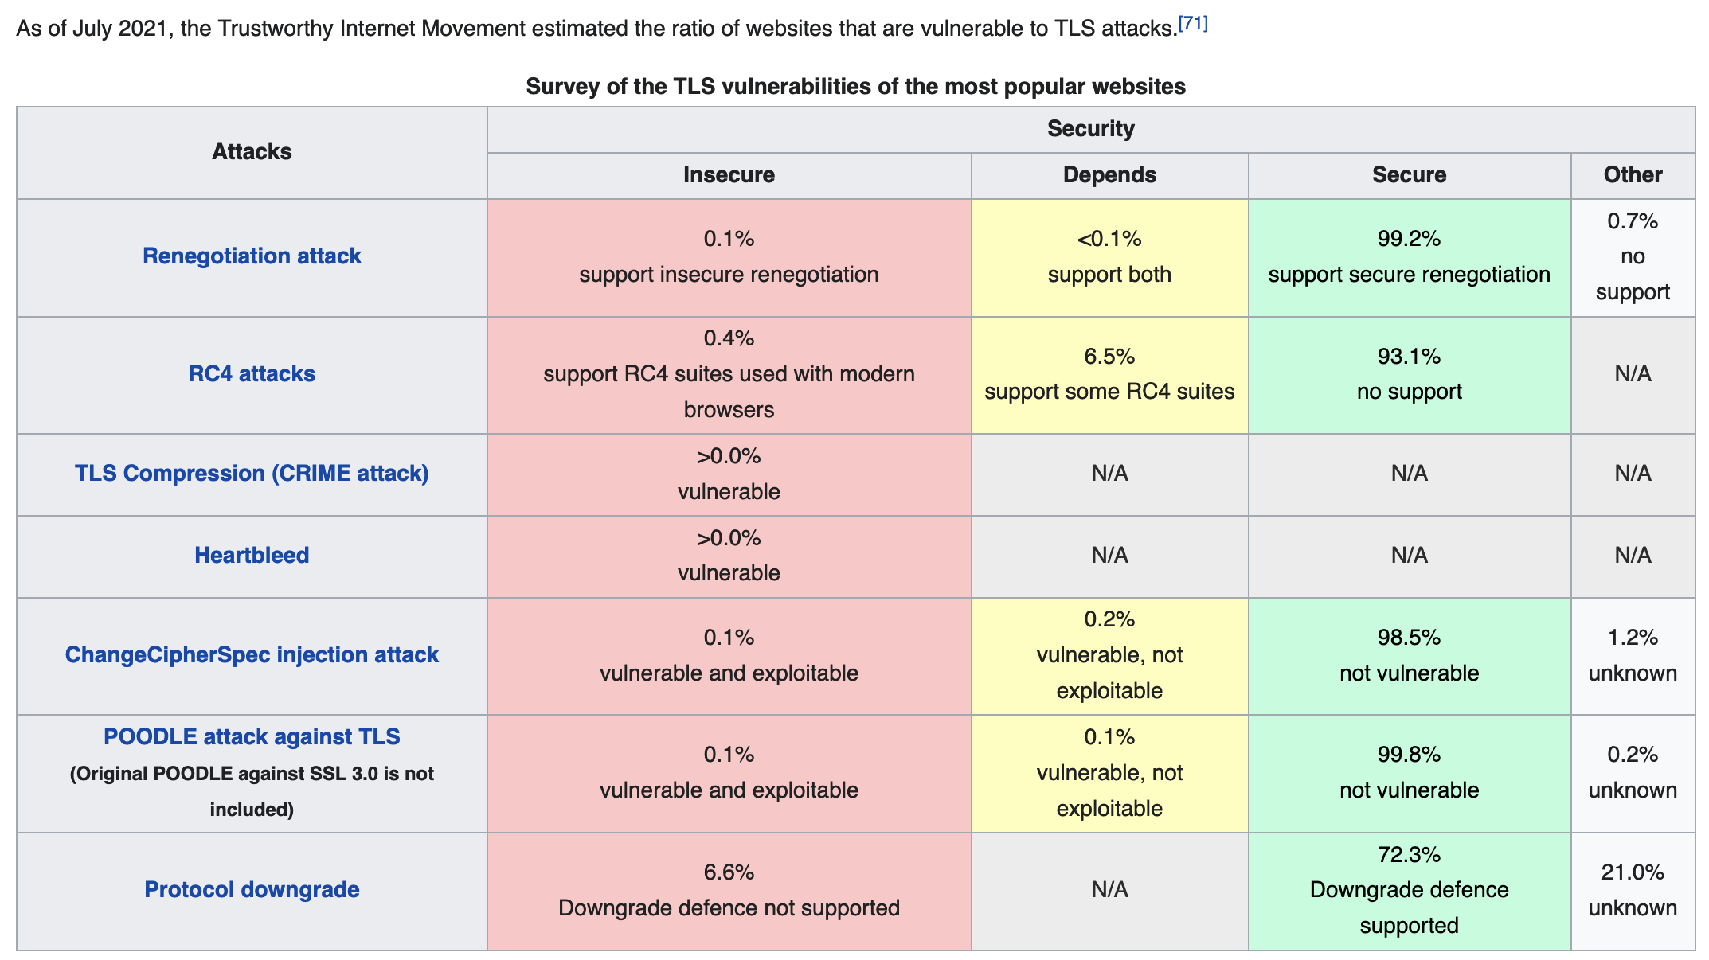
Server
Wikipedia table, source: https://www.ssllabs.com/ssl-pulse/

Slide 22
So, are we good?
If we use TLS, is it enough?

Slide 23
Overall, depends on your threat model…
Server still knows who you are, even if connection is encrypted
Even encrypted traffic leaks information!

Slide 24
Overall, depends on your threat model…
Server still knows who you are, even if connection is encrypted
=> IPs can be traced to location (to varying levels of precision)
=> Your browser may leak info (cookies, mouse usage, etc.)
Even encrypted traffic leaks information!
=> Name of server: DNS, Server Name Indicator (SNI)
=> Traffic patterns (timing of packets, protocols, …)
Securing the transport layer not enough => info leaks based on other layers

Slide 25
Why?
Avoiding censorship
Avoiding surveillance (by person, or an organization)
Anonymous reporting (journalists, whistleblowers)

Slide 26
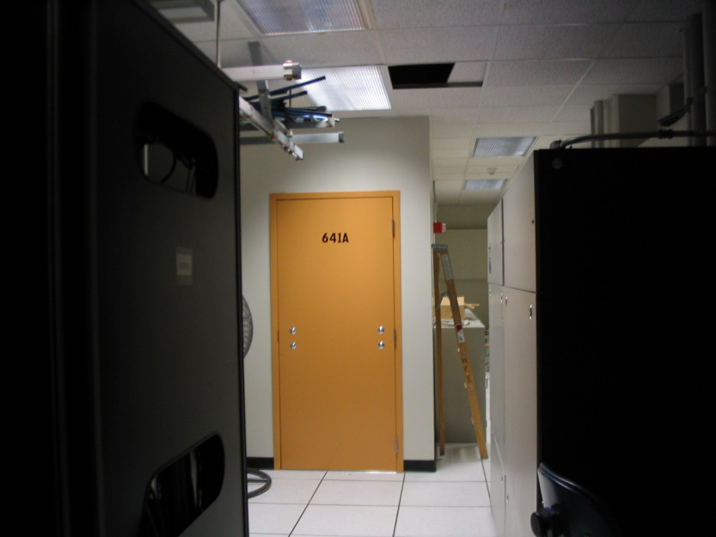
Why?
Avoiding censorship
Avoiding surveillance (by person, or an organization)
Anonymous reporting (journalists, whistleblowers)
Room 641A: alleged wiretapping room in a
datacenter for an Internet backbone…
https://en.wikipedia.org/wiki/Room_641A

Slide 27
How can we deal with this?
Mechanisms to provide more security at the network layer

Slide 28
How can we deal with this?
Mechanisms to provide more security at the network layer
Security for all your network traffic => not just one 5-tuple
Can (try to) provide more anonymity

Slide 29
VPN: secure tunnel for network traffic
=> Connect a host to a private network

Slide 30
Virtual Private Network (VPN)
Secure tunnel for arbitrary network traffic (any IP packets)
Use for
=> Accessing a private network (remote access internal network)
=> Secure proxy for your traffic: traffic appears to originate from VPN server

Slide 31
Problems?
Server
You

Slide 32
VPN: secure tunnel for network traffic
=> Connect a host to a private network
Server
You

Slide 33
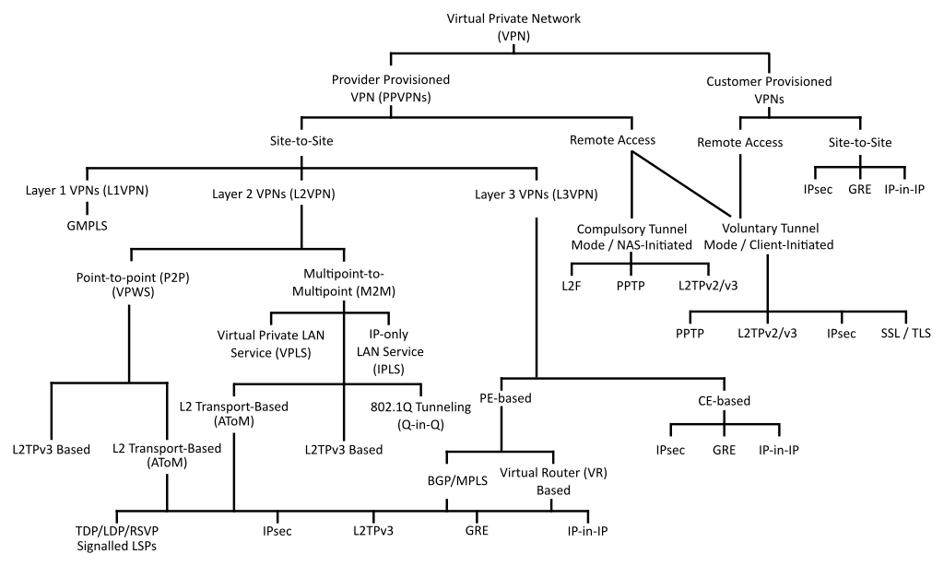
Lots of VPN protocols…

Slide 34
Can we do better?

Slide 35

Tor
Onion routing service: build encrypted circuit on tor relay network
Network of relays, mainly operated by volunteers
Started in 1990s from Naval Research Lab, now maintained by The Tor Project (a non-profit)

Slide 36
Onion Routing
Layered encryption
  Build onion inside out
Routing
  Peel onion outside in
Each router knows only previous and next
A
R₂
B
R₃
R₁
E_{K1}
R₂ E_{K2}
R₃ E_{K3}
B E_{KB}(M)

Slide 37
What if the server wants to help?
Onion services: server connects to tor directly => no need for an exit node!

Slide 38
What if the server wants to help?
Onion services: server connects to tor directly => no need for an exit node!
Accessible via .onion domain: special DNS TLD not in root zone
Site addresses based on public key of server, client looks up using distributed hash table (DHT)

Slide 39
What if the server wants to help?
Onion services: server connects to tor directly => no need for an exit node!
Accessible via .onion domain: special DNS TLD not in root zone
Site addresses based on public key of server, client looks up using distributed hash table (DHT)
Examples
New York Times: https://www.nytimesn7cgmftshazwhfgzm37qxb44r64ytbb2dj3x62d2lljsciiyd.onion
Facebook
https://facebookwkhpilnemxj7asaniu7vnjjbiltxjqhye3mhbshg7kx5tfyd.onion
Cloudflare public DNS
dns4torpnlfs2ifuz2s2yf3fc7rdmsbhm6rw75euj35pac6ap25zgqad.onion

Slide 40
Wrapping up
This is our last formal lecture
From here: work on final project

Slide 41
What I hope you have learned

Slide 42
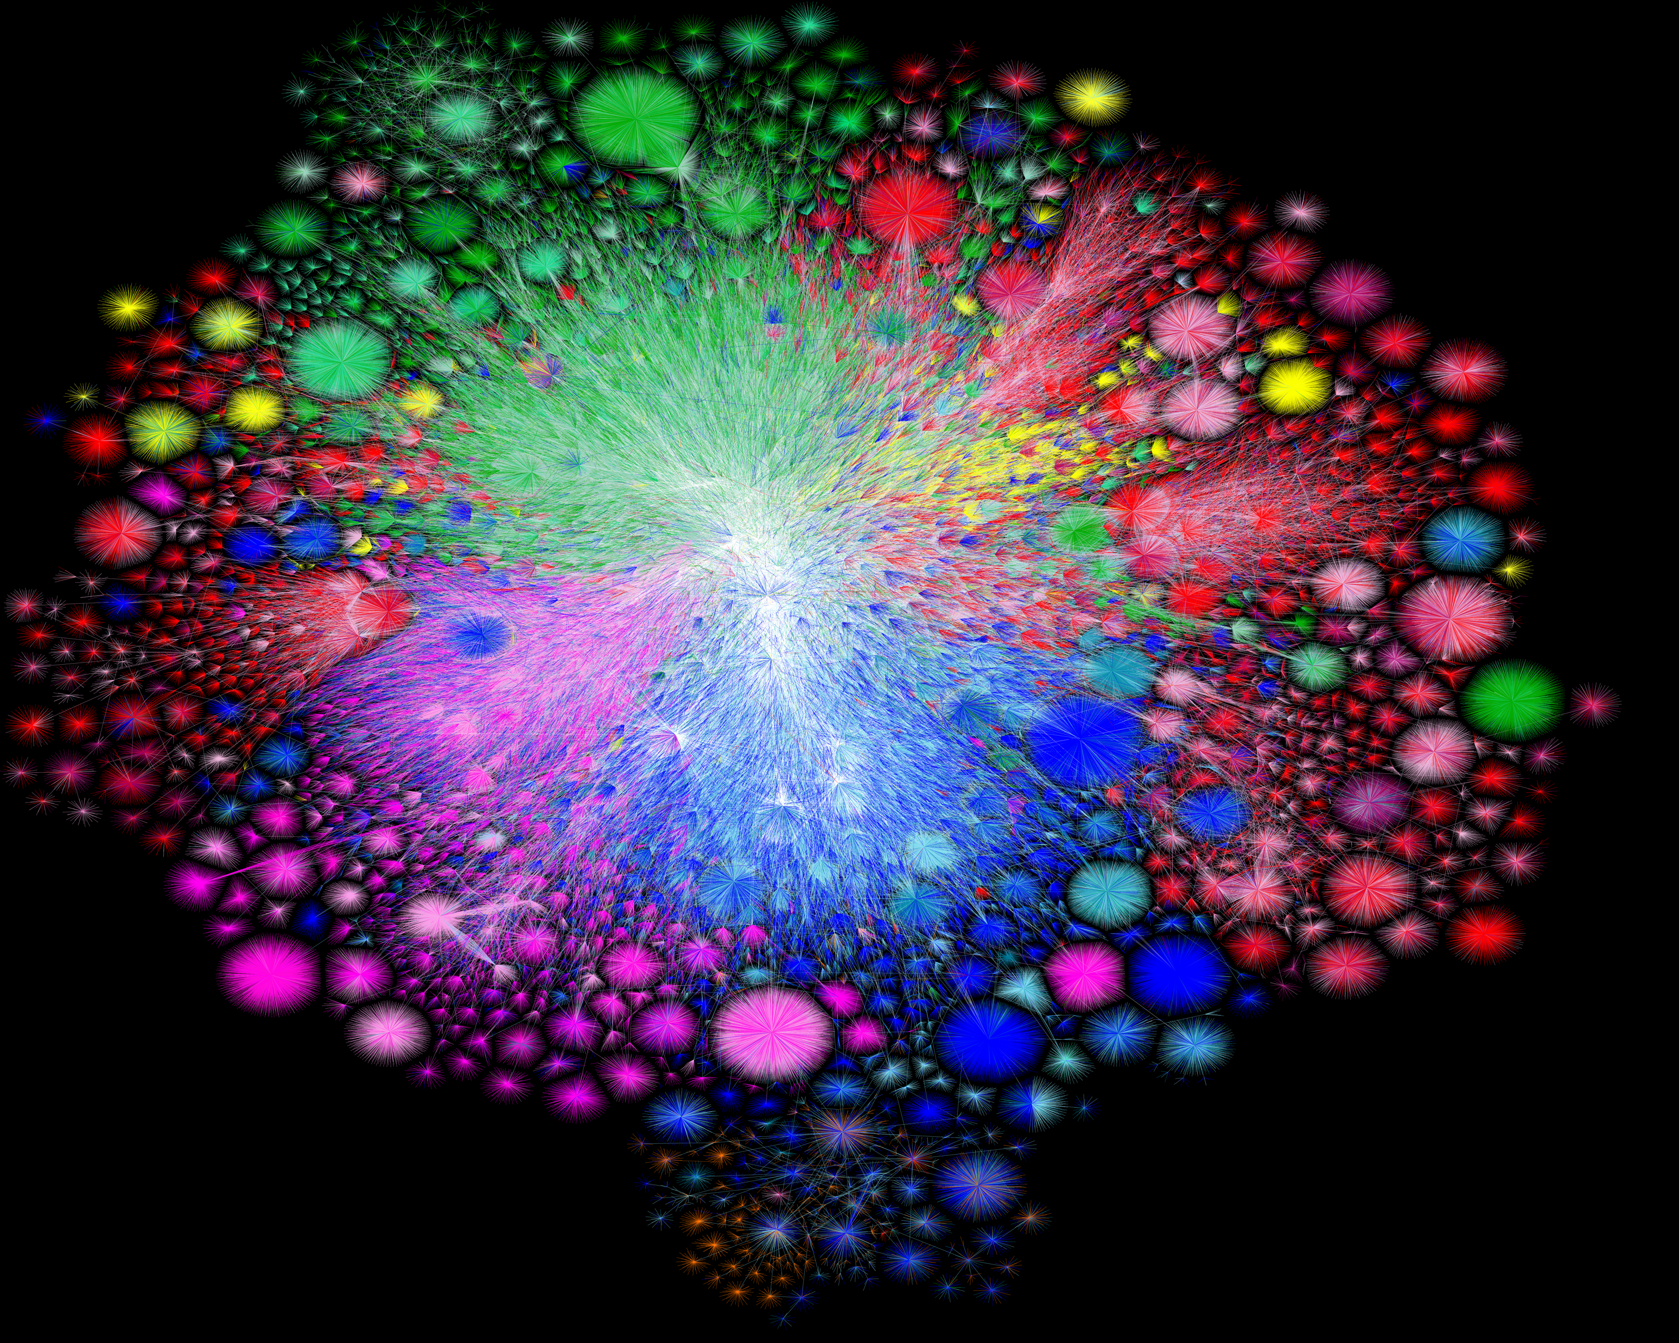

Slide 43
We can’t cover (or remember) everything
Hope you learn important tools/principles to
understand networking challenges you encounter

Slide 44
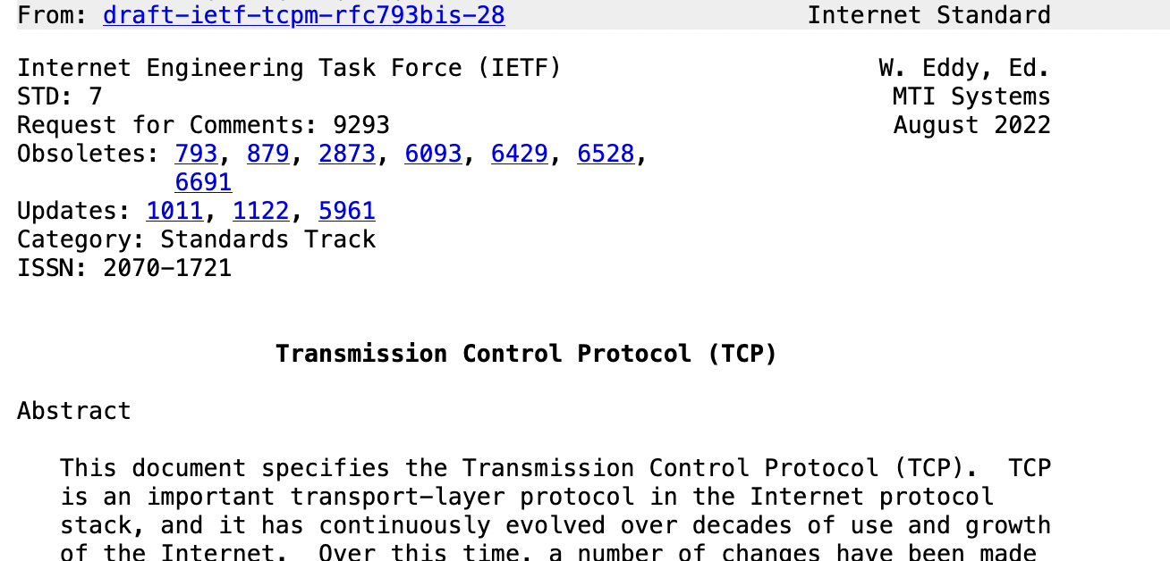
Protocols
Ways to communicate between heterogeneous systems
Network programming
conn, err := net.Dial(“tcp”, “10.0.0.1:80”)
. . .
someBuf := make([]byte, . . .)
conn.Write(someBuf)

Slide 45
Layering / Encapsulation
Building abstractions and interfaces to hide lower-level details from “higher” layers
Ethernet Frame
IP Packet
TCP Segment
Application data
Abstractions are great!
Can support huge variety of devices, protocols
Allows independent evolution => new protocols!

Slide 46
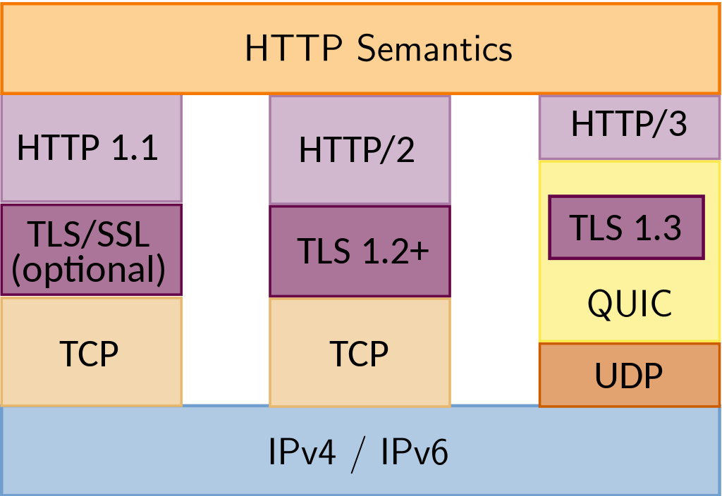
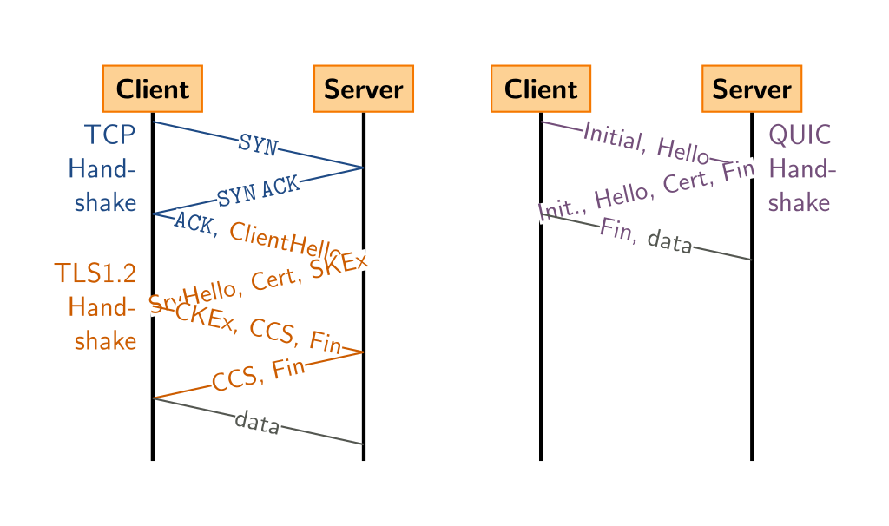
… until they aren’t
Sometimes, need to break them

Slide 47
Naming
Indirection: abstract low-level info with a higher-level name
=> Human-readable DNS names
=> Scalability: redundancy, proxies, load balancing
Can leverage hierarchy of naming => scalability (IP, DNS, …)

Slide 48
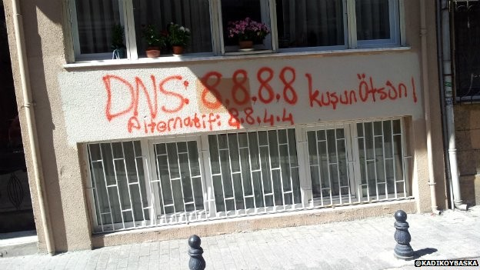
How naming, etc. can be controlled…
Changing DNS servers in response to blocking of Twitter in Turkey (2014)
Writeup, with more links: https://www.thousandeyes.com/blog/internet-censorship-around-the-world

Slide 49
Lots of challenges out there
Our Internet architecture was designed in the 1980s, where modern scale and complexity was unimaginable

Slide 50
Lots of challenges out there
Our Internet architecture was designed in the 1980s, where modern scale and complexity was unimaginable
Now…
No one knows how big the Internet is
No one is in charge
Anyone can add any application
Packets traverse many paths, countries, regulatory domains

Slide 51
Thank you!
Please stay in touch!

